Slide 1
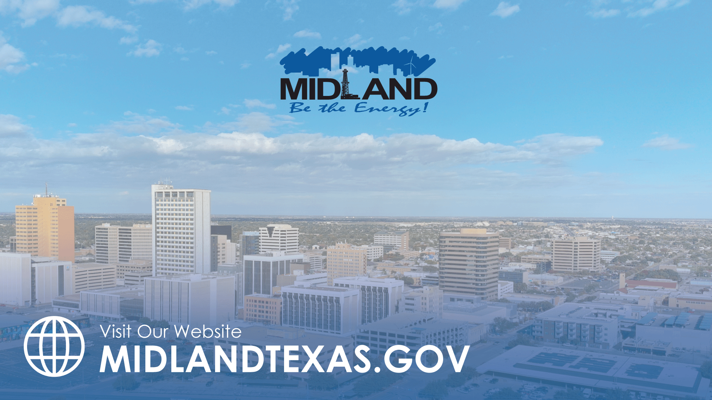
CITY DEBT SUMMARY
MAY 13, 2025
TITLE HERE
TITLE HERE

Slide 2

ALIGNMENT WITH STRATEGIC PLAN
Goal 5: Provide Sound Governance & Fiscal Management
5.7 Ensure Continued Financial Stability and Accountability: Maintain Financial Transparency
Goal 6: Strengthen and Sustain our Infrastructure
2

Slide 3

MIDLAND DEBT OVERVIEW
Total Community Debt: $2,420,995,000
$597.68 Million
$1,823,315,000
Community Includes:
School District
County
Hospital District
College
3

Slide 4

WHAT THE BONDS PAY FOR
TOTAL MUNICIPAL DEBT $597,680,000
4

Slide 5

TAX SUPPORTED DEBT – PER CAPITA
5

Slide 6

TAX VS. FEE SUPPORTED DEBT
Revenue (Fee) Supported
$398,620,000
Tax Supported
$199,060,000
6
Notes:
Increase in Net Position
Governmental Funds $65.5 million
Business-type Funds $51.2 million

Slide 7

TAX VS. FEE SUPPORTED DEBT
REVENUE (FEE) SUPPORTED MUNICIPAL DEBT | TAX SUPPORTED MUNICIPAL DEBT
Debt repaid using income generated by a specific project or service, NOT general taxes. | A debt that a city (or other local government) repays using general tax revenues such as property or sales tax.
Does NOT rely on tax revenue. Commonly used for things like water, sewer, or airport projects. | Example: A bond issued to build a new park or a road bond.
7

Slide 8

MISSION
Deliver exceptional services and promote a high quality of life and place for ALL our citizens.

Slide 9
TAX SUPPORTED DEBT
$199.1 Million
$1.7 Billion
Community Includes:
School District
County
Hospital District
College
9

