Slide 1

TITLE HERE
TITLE HERE
CYBERSECURITY BRIEFING

Slide 2

CYBERSECURITY BRIEFING
Presented by:
Gorgees Eskander
Chief Information Officer
City of Midland, Texas
May 27, 2025
2

Slide 3

WHAT WE’LL COVER TODAY
What’s happening across Texas
Why cybersecurity matters to Midland
Why do we ask you to use Multifactor Authentication (MFA)
What we’re doing to protect the city
What’s next
3

Slide 4

CYBER ATTACKS ARE HAPPENING ACROSS TEXAS
City of Dallas was hit by ransomware in 2023
Since then, attacks have affected:
Dallas County, Fort Worth, Killeen, Richardson, Coppell, McKinney, Odessa, Lubbock, and recently the City of Abilene
It’s not a matter of if, but when
4

Slide 5

WHEN CITIES GET ATTACKED
Downtime: City services may go offline for days
Data Risk: Sensitive data can be exposed
Cost: Recovery can cost $500K-$1.8M per event
Reputation: It hurts public trust
5

Slide 6

HOW WE PROTECT THE CITY
We use layers of protection, like:
Firewalls, Antimalware, Virtual Private Network (VPN)
Monitoring and Alerts
Password and Multifactor Authentication
Data Backups and Replications
User Awareness Training
6

Slide 7
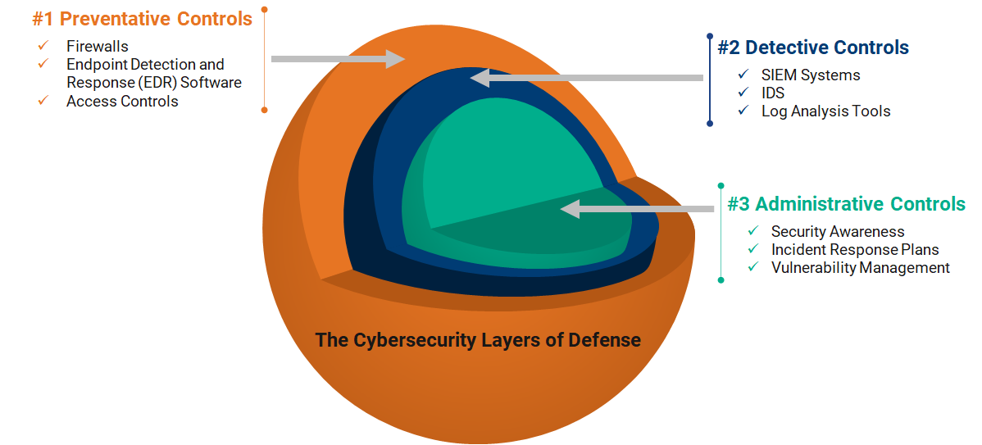
LAYERS OF DEFENSE
7

Slide 8
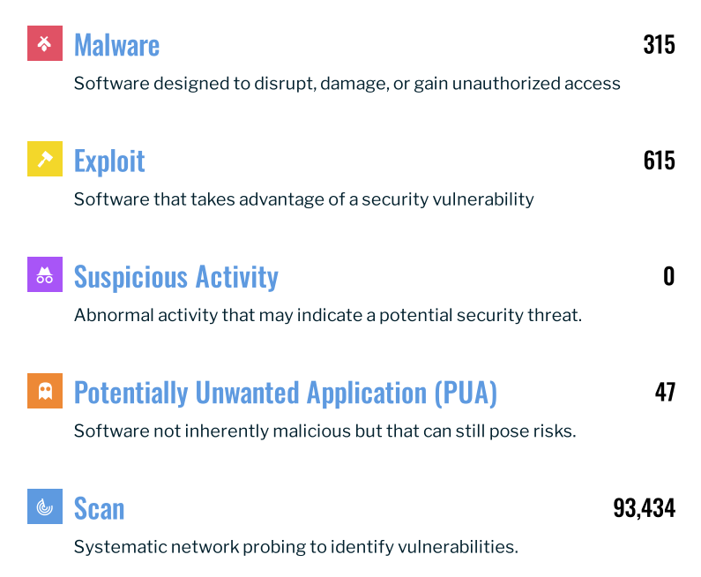
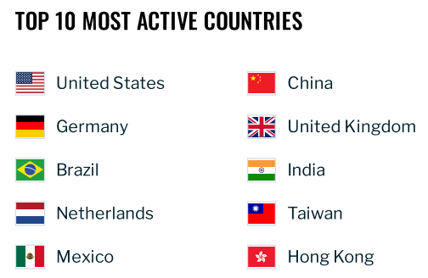
CYBER ATTACKS - YTD
A cyber attacker needs only a single success. We, as defenders, must prevent every attempt, every time.
8

Slide 9
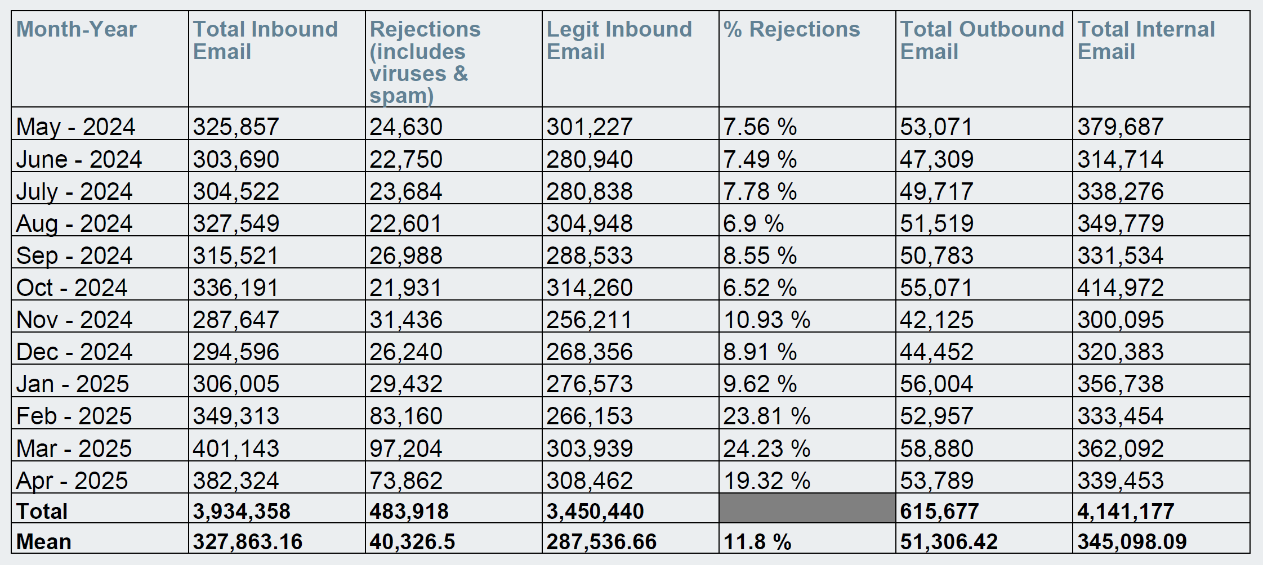
EMAIL STATISTICS – LAST 12 MONTHS
9

Slide 10

WE USE MULTIFACTOR AUTHENTICATION (MFA)
We know it feels like a hassle. But:
Hackers use tools that guess passwords in seconds
MFA (the code from your phone) stops most attacks
One extra step now can prevent a major disaster late
Think of it like locking both the door and the deadbolt.
10

Slide 11
WE ENFORCE COMPLEX PASSWORDS
Long, unique passwords are safer
We limit who gets admin or “superuser” access
Vendors and support teams get access only when needed—and it’s recorded
11

Slide 12
HOW LONG DOES IT TAKE FOR A HACKER TO CRACK A PASSWORD?
No. of Characters | Numbers Only | Lowercase Letters | Upper and Lowercase Letters | Numbers, Upper and Lowercase Letters | Numbers, Upper and Lowercase Letters, Symbols
11 | Instantly | 32 mins | 1 month | 10 months | 3 years
12 | 1 sec | 14 hours | 6 years | 53 years | 226 years
12

Slide 13


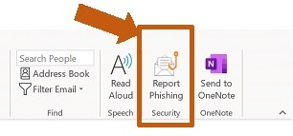
WE TRAIN EVERYONE, EVERY YEAR
Cybersecurity training is required by Texas law
All employees, officials, and appointees take it annually
We also test staff with fake phishing emails
→ fewer people are clicking each time (good sign!)
13

Slide 14

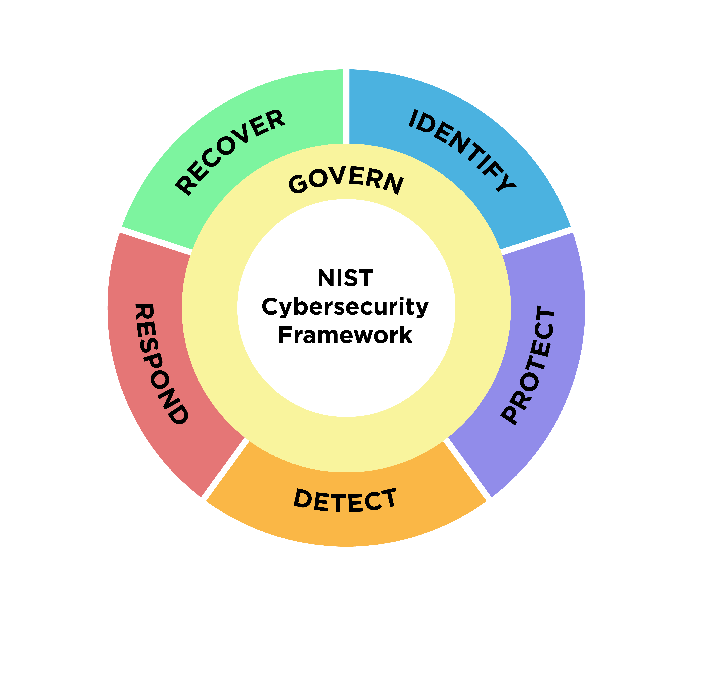
UPDATING OUR POLICIES
Many of our old security policies are outdated
We’re rewriting them based on national best practices
National Institute of Standards and Technology (NIST)
(NIST Cybersecurity Framework 2.0)
New policies will be easier to follow and apply to everyone
14

Slide 15

NEW BACKUP SYSTEM APPROVED 05/13/2025
Ransomware can lock or delete our backups
We’re working on a safer system with:
Backups that can’t be changed or deleted
Faster recovery if something goes wrong This helps restore services faster when we’re attacked.
15

Slide 16

WHAT’S NEXT
Deploy the new backup system approved on 05/13/2025
Refreshing the data center and adding new servers to support high availability, replication, and disaster recovery capabilities, which will help us restore services quickly during outages or cyber incidents.
Continue improving our policies, procedures, and training

Slide 17
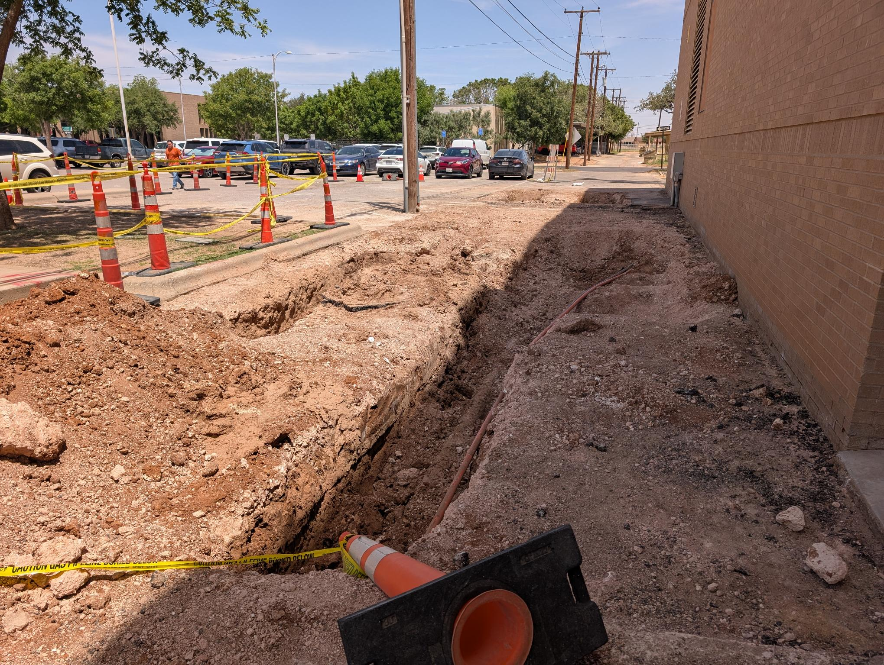
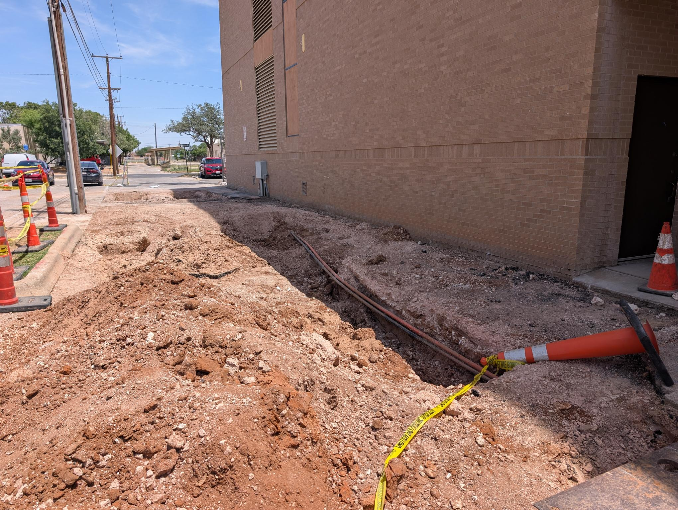
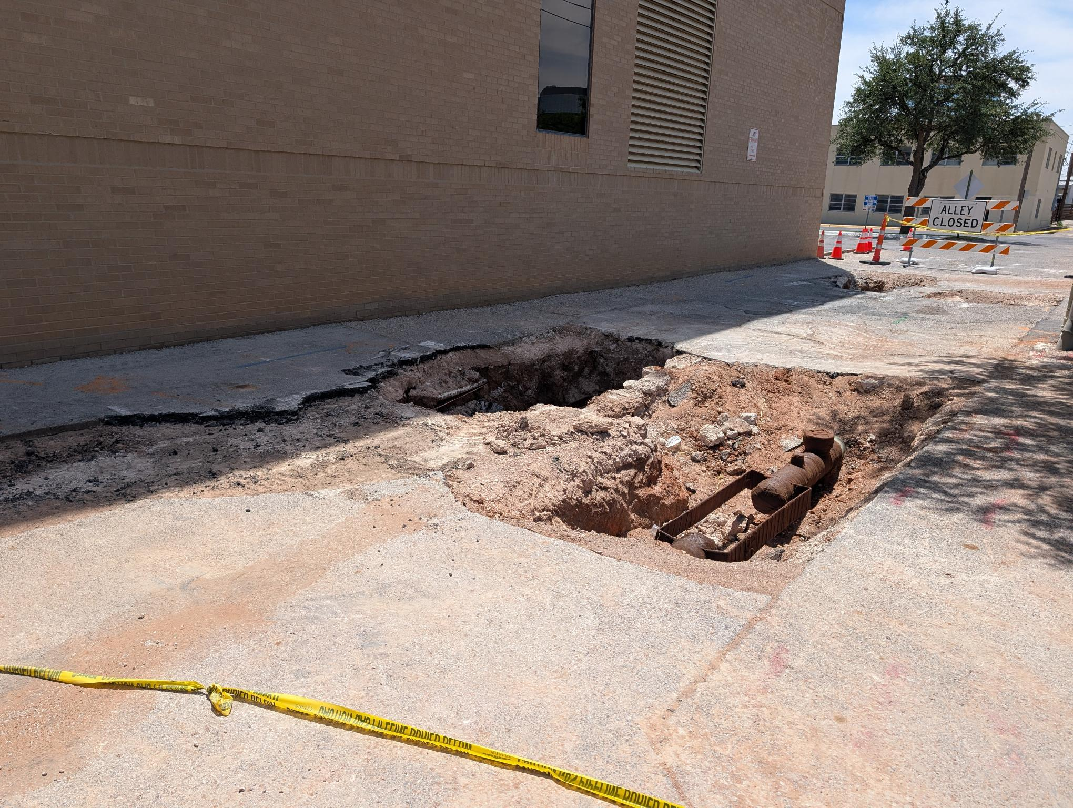
WHAT HAPPENED ON FRIDAY, MAY 9TH, 2025?
On May 9, 2025, a gas leak detected by ATMOS at the Midland Police/ITSD building required an immediate evacuation. Actions taken by ATMOS and Oncor to mitigate explosive risk created a cascade of service disruptions, including power cutoffs, generator failures, and the depletion of backup batteries. This caused a 12-hour outage of critical city services.

Slide 18

QUESTIONS?
Thank you for your time. I’m happy to answer any questions.
Cybersecurity isn’t just an IT issue — it’s about protecting services you rely on, data you’ve entrusted us with, and the confidence you have in your local government.

Slide 19

MISSION
Deliver exceptional services and promote a high quality of life and place for ALL our citizens.

