Slide 1

OPERATIONAL OVERVIEW
MAY 27, 2025
TITLE HERE
TITLE HERE
Notes:
We had some questions raised at the last council meeting. And this presentation speaks to the facts regarding those questions but in particular, city operations.

Slide 2

WHERE WE WERE
Lack of:
Strategic Plan/Execution
Alignment with Council and Citizen Centric Priorities
Continuous Process & Organization Improvement Culture
Purpose Driven Technological Enhancements
Institutional-Wide Training Programs
Effective Standard Operational Procedures and Policies
Financial Alignments/Cost Recovery/Efficiencies/Innovation
Sustainable Firefighter Pension Fund
Effective Inter and Intra Departmental Communication
Consistent Code Enforcement and Effective Ordinances
2
Notes:
We lacked a cohesive plan that reflected the priorities of both the Council and our residents—yet everyone expected disciplined execution. To meet that expectation we had to break down silos, embed a culture of continuous improvement, and deploy technology that drives efficiency while freeing resources for stronger training programs.
Sound finances are CRITICAL in working toward changing a culture. By recovering the true cost of services instead of subsidizing them with property-tax dollars—and by fully funding the firefighter retirement plan, saving taxpayers roughly $60 million in avoided interest—we create the fiscal headroom to invest in what matters.
Standard operating procedures were missing or outdated in several critical areas, and even where procedures existed, training lagged behind industry best practice. The consequences are visible in our water operations and, more recently, in code compliance: Special Use Designations had not been updated since 2017, and Certificates of Occupancy were out-of-date for nearly every illicit massage parlor—conditions that likely allowed those businesses to slip through the cracks.
In short, aligning strategy, cost recovery, SOPs, and training is not a option; it is the foundation for delivering the efficient, accountable city government our community expects.

Slide 3

WHERE WE ARE
New recurring revenue delivering approximately $11 million in revenue each year. (Utility dept. overhauls & Airport enplanement fee reform)
Permanent budget savings of $2.4 million per year. (Pre-employment medical testing overhaul, Enterprise IT optimization, Hogan golf course and Airport subsidy elimination)
One-time grants, cash, and cost avoidance of $26.31 million in external funds and capital cost offsets. (Airport Enterprise fund reconciliation, Hotel occupancy tax, Garfield St. Bid savings, and Vision Zero)
3
Notes:
Today we have examples of cost recovery at our airport and in our water department that help those departments pay for their operations and capital improvements.
In particular, the airport where the city was subsidizing $1M dollars annually with taxpayer dollars. We also no longer subsidize the golf course annually at $700K. in 10 years that saves taxpayers $17M. These kind of savings helps us pay for priorities in the plan – like the Firefighter retirement fund.
We now also conduct hotel tax audits. Our audit this year, recovered $500K. Enough to cover the first year of Midland Merry Lights.
All important examples of why a plan is important – why training is critical – and where execution is vital. MORE importantly, we are sharing with you how it takes a great deal of maneuvering to turn an organization in a direction of adherence to a plan – a plan that can yield these kind of positive changes.
These examples do not include Todd Road being moved up by 6 years thanks to a $1 million MDC funded design study that got us $26 million in state funding or the other project on the West side - 158 & 2 intersections – one of which is the Wadley intersection – $1 million of MDC funding toward a study got us $7 million in TxDOT funds, and it moved up the projects 4 years from 2029 to 2025—moving up these improvements works perfectly as the new Costco traffic is literally a month away.
Our track record NOW demonstrates outcomes associated with a strategic vision – alignment to fiscal responsibility, staff training, standardizing our processes (SOP's), and innovation through technology and first of its kind actions for our city.

Slide 4
FISCAL RESPONSIBLITY
MAY 27, 2025
TITLE HERE
TITLE HERE

Slide 5

RESULTS
Eliminated Subsidies (Airport / Golf) – Cost Recovery From Airport of $5.5M; Golf $700K
Optimization of State and Federal Funding - $8.6M Grant for Road Safety Improvements
Process Improvement Leads to $10M in Additional Revenue
5

Slide 6
DEBT ADDED LAST 22 MONTHS
2024 | 2025
$56,000,000 | $56,800,000
WATER, SOLID WASTE and GOLF COURSE | ROADS AND PARKS
TOTAL DEBT ADDED $112.8M
6

Slide 7
DEBT ADDED SINCE AUGUST 2023
$56M Water, Sanitation and Golf Course
Fee Supported
Does not affect the Tax Rate
Needed Infrastructure (NE Utility Expansion)
$56.8M Roads and Parks
In lieu of Pension Obligation Bond – Saving the City $60M in Taxes, Fees, Interest
Needed Infrastructure – Keep Up with Growth
62 Soccer Fields Added
Private Funds Activated – Over $18 Million
7

Slide 8

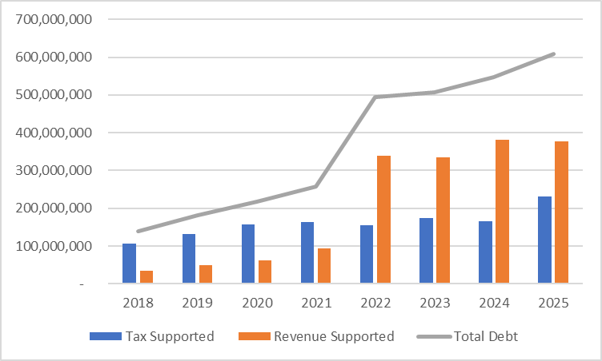
TAX VS REVENUE SUPPORTED
TBAR INFRASTRUCTURE PURCHASE 2022
8

Slide 9
MIDLAND DEBT OVERVIEW
Total Community Debt: $2,420,995,000
$597.68 Million
$1,823,315,000
Community Includes:
School District
County
Hospital District
College
9

Slide 10

WHAT THE BONDS PAY FOR
TOTAL MUNICIPAL DEBT $597,680,000
10

Slide 11

TAX SUPPORTED DEBT – PER CAPITA
11

Slide 12

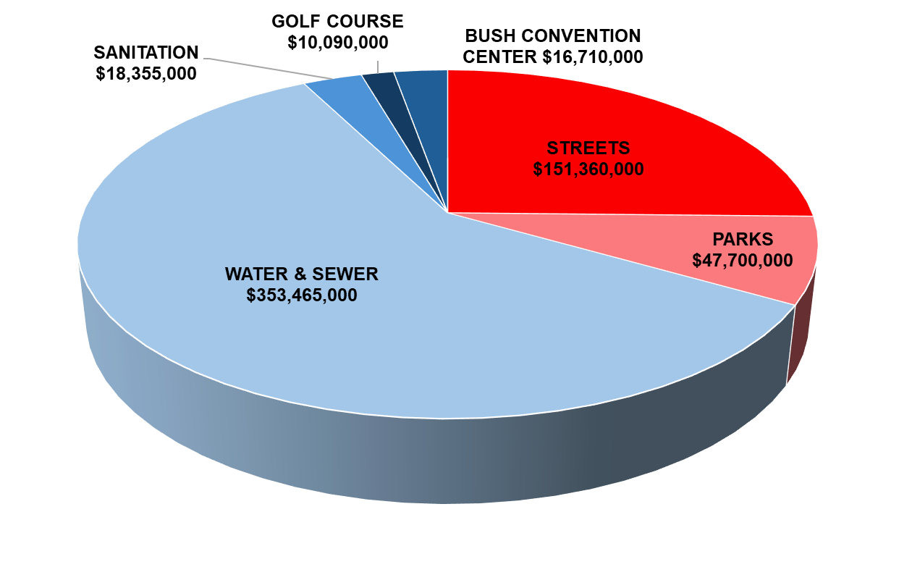
TAX VS. FEE SUPPORTED DEBT
Revenue (Fee) Supported
$398,620,000
Tax Supported
$199,060,000
12
Notes:
Increase in Net Position
Governmental Funds $65.5 million
Business-type Funds $51.2 million

Slide 13
TAX VS. FEE SUPPORTED DEBT
REVENUE (FEE) SUPPORTED MUNICIPAL DEBT | TAX SUPPORTED MUNICIPAL DEBT
Debt repaid using income generated by a specific project or service, NOT general taxes. | A debt that a city (or other local government) repays using general tax revenues such as property or sales tax.
Does NOT rely on tax revenue. Commonly used for things like water, sewer, or airport projects. | Example: A bond issued to build a new park or a road bond.
13

Slide 14
TAX SUPPORTED DEBT
Total Tax-Supported Community Debt: $1,933,700,000
$199.1 Million
$1.7 Billion
Community Includes:
School District
County
Hospital District
College
14

Slide 15
INVESTING IN MIDLAND’S ROADS
TITLE HERE
TITLE HERE

Slide 16

CITY OF MIDLAND - POTHOLES
Year | Number of potholes filled
2017 | 17,048
2018 | 12,944
2019 | 12,226
2020 | 13,389
2021 | 16,273
2022 | 13,146
2023 | 13,790
2024 | 25,637
2025 (as of May 1) | 11,164
SH158- widening and repaving project
16
Notes:
Mention SCF

Slide 17
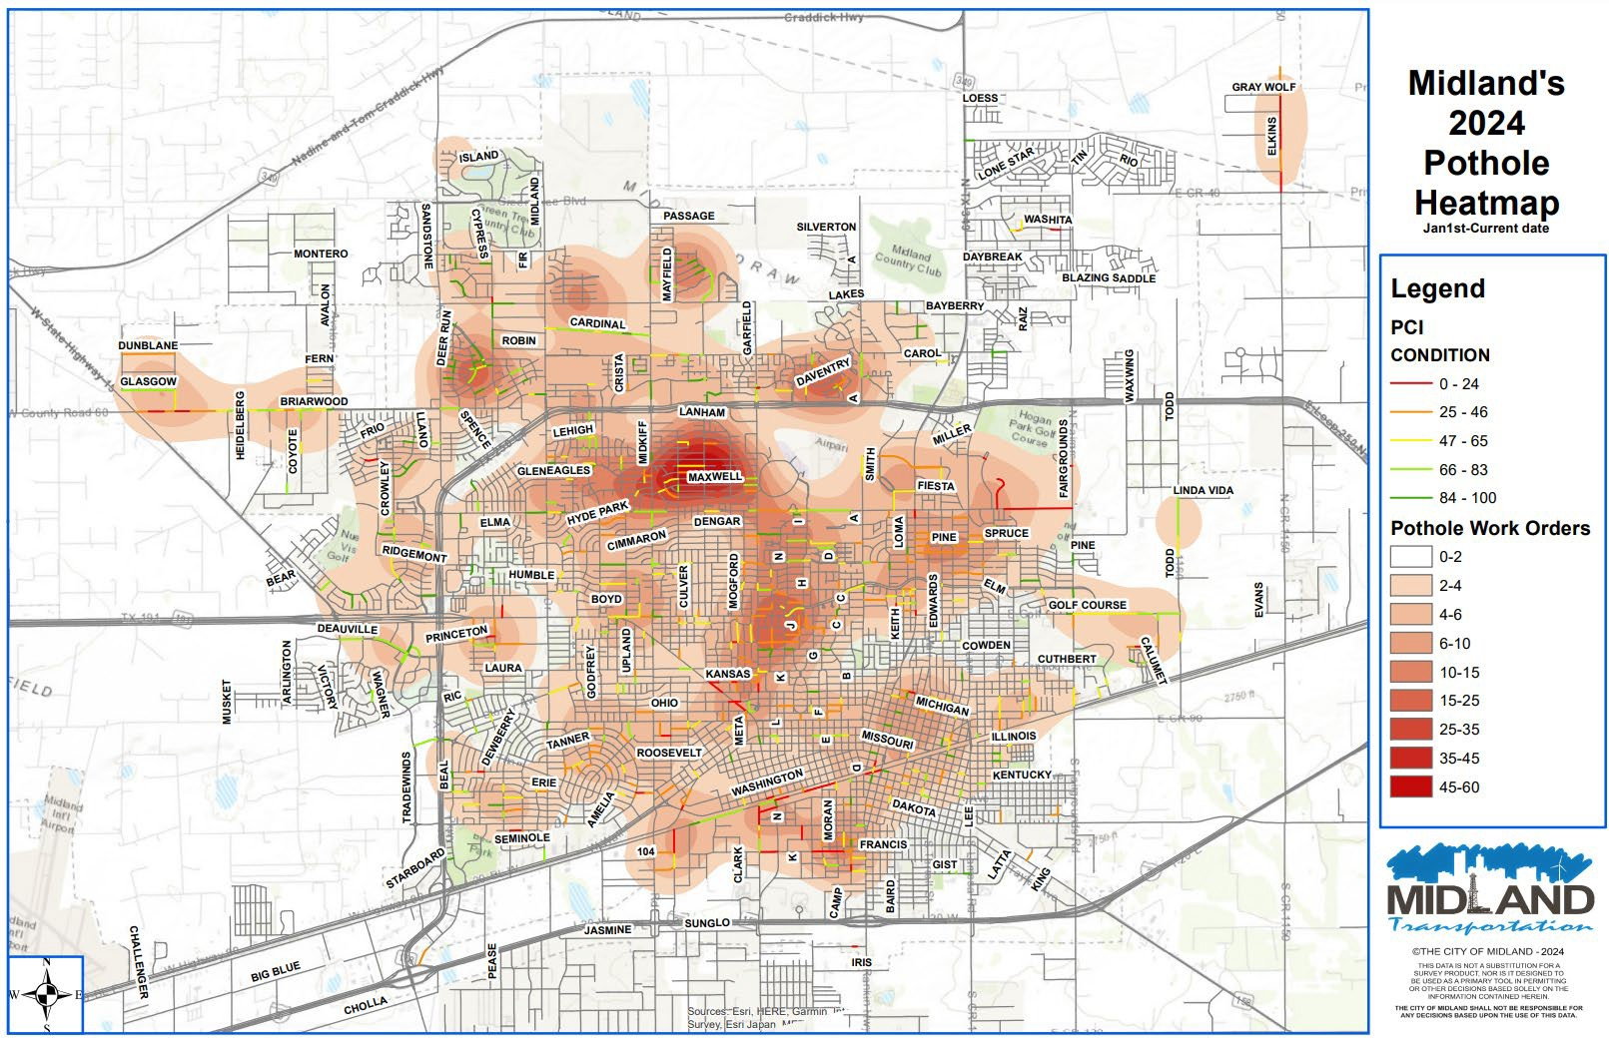

POTHOLE REPAIR & SERVICE
REQUESTS
The average number of Service requests entered for Pothole for pothole repair weekly: 20-25 requests
These requests come to our department in a variety of ways including:
Calls to the Pothole Hotline:
Contact from Council district members
Info provided by City employees in the field
Input from SeeClickFix
432-685-7293
Heat map showing service requests for pothole repair.
Notes:
Mention SCF

Slide 18

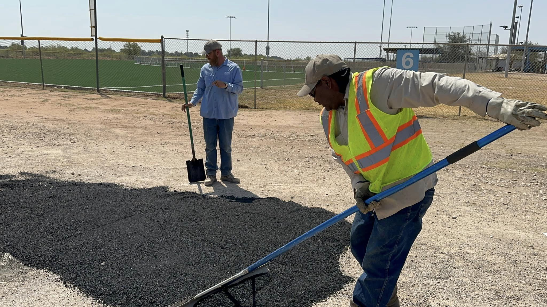
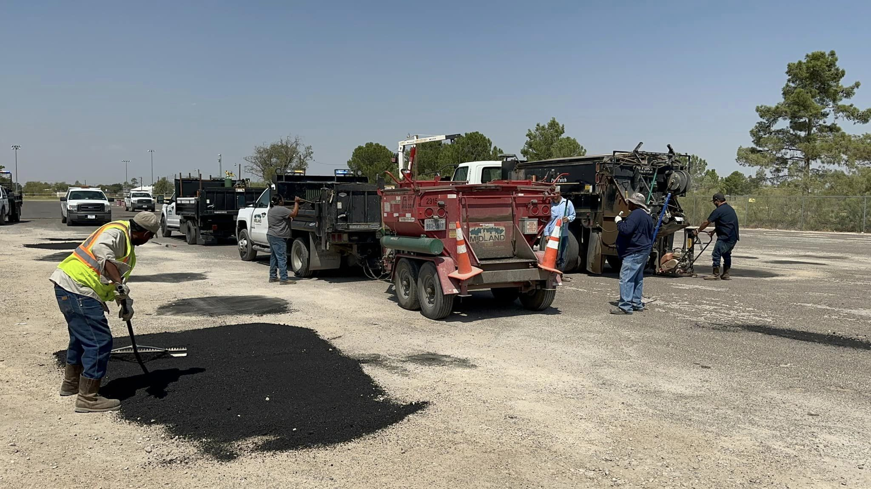
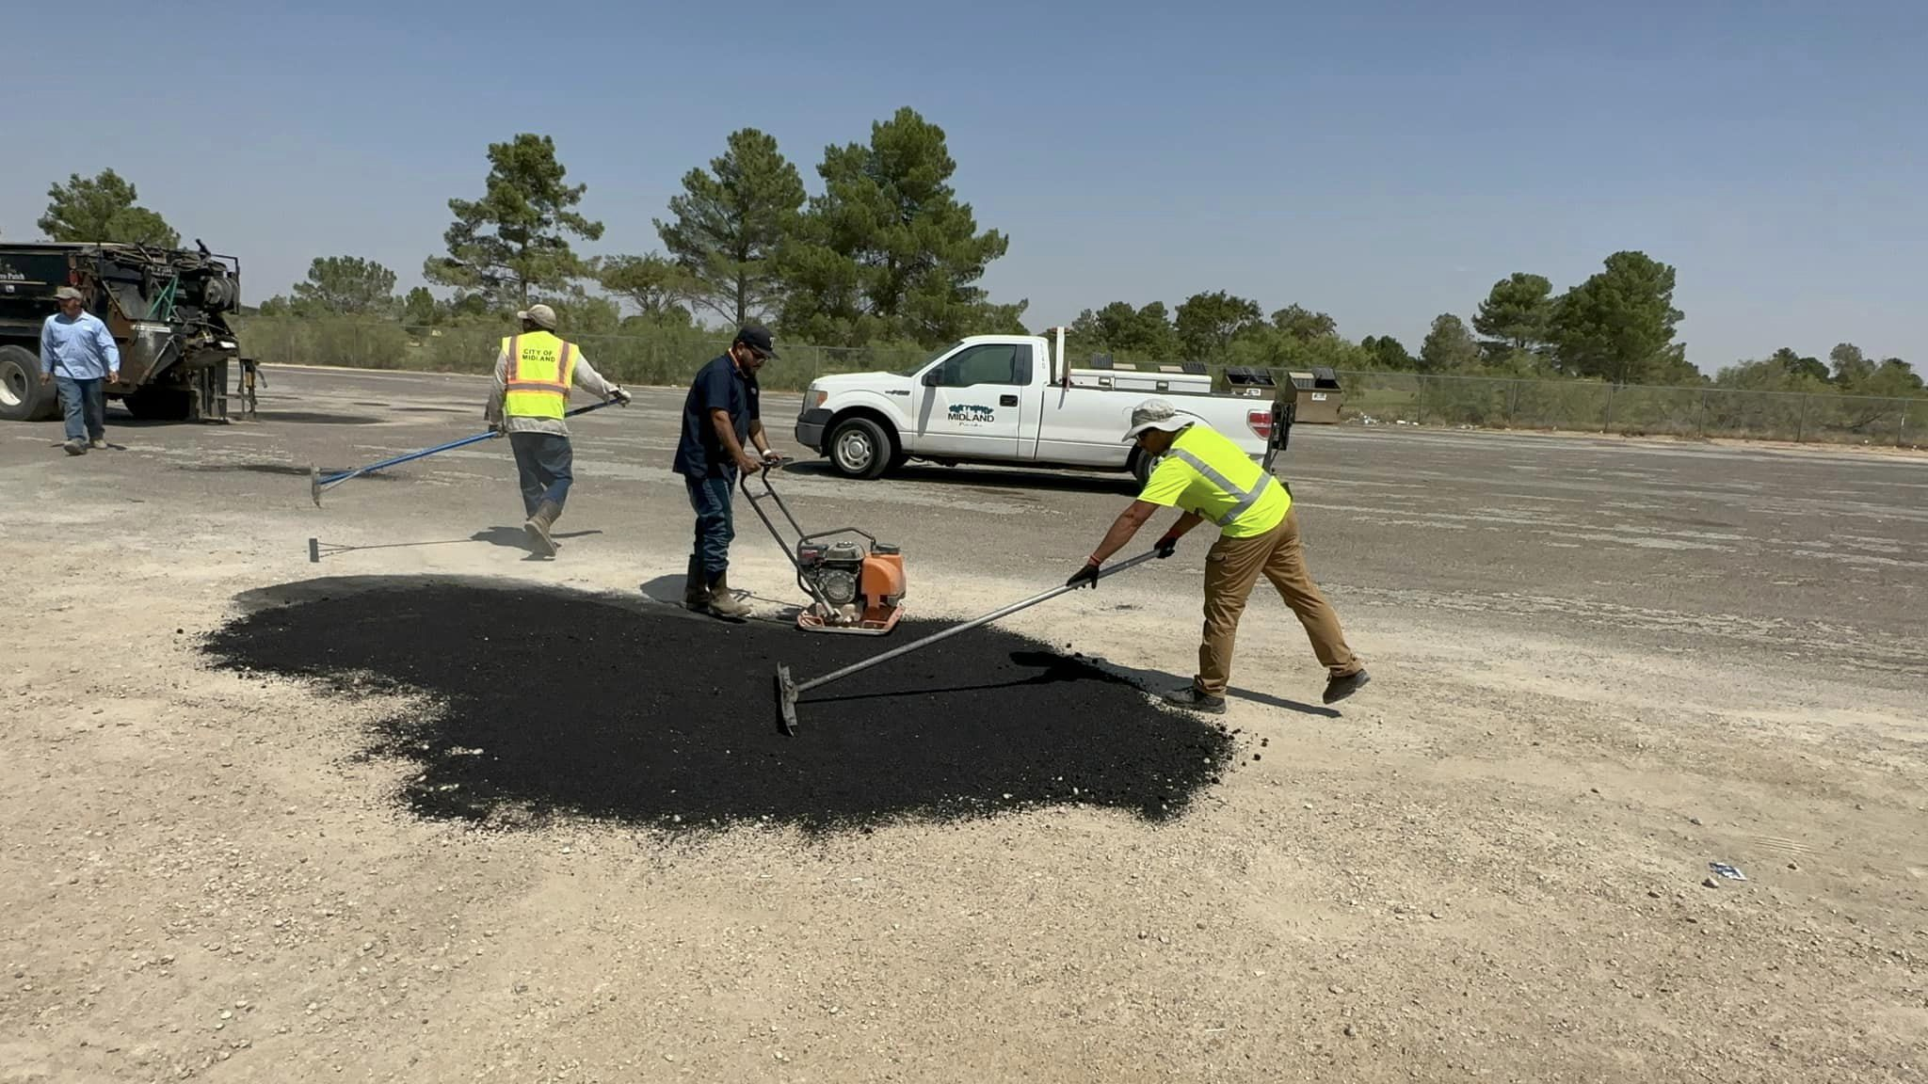
POTHOLES AT PARKS
Strategy:
6.2 Enhance infrastructure for economic growth: Boost competitiveness through infrastructure investments that encourage collaboration with neighboring jurisdictions and high-performing peer agencies.
Action:
The Engineering and Parks Department collaborated on the “Potholes in Parks” Project to in-house fill 2,386 potholes in park parking lots.
18
Notes:
Cross-functional effort

Slide 19
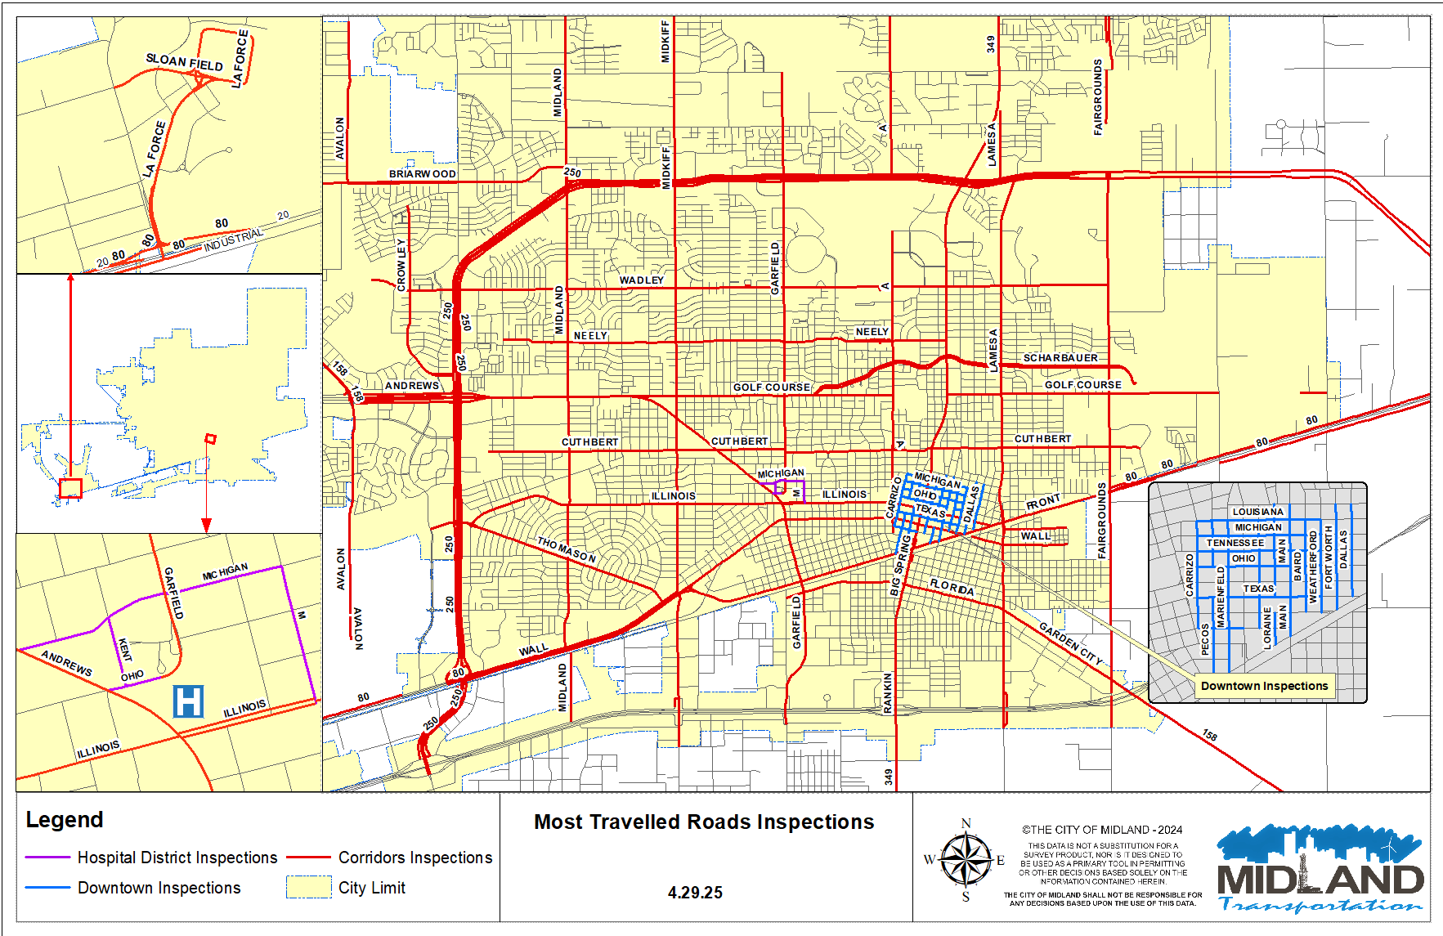
MOST VISIBLE ROADS
19

Slide 20

644 Service Requests COMPLETED Maintaining Integrity of Most Visible Roads
Service Request Distribution
Litter Abatement | 486.5 CY | Pedestrian Enhancement | 13
Pothole Repair | 97 | Signage/Striping | 43
Landscape/Vegetation | 183 | ADA Compliance | 16
Road Improvements | 29 | Buckled Curb/Sidewalks | 118
Drainage Repair/Cleaning | 25 | Street Sweeping | 64
20

Slide 21
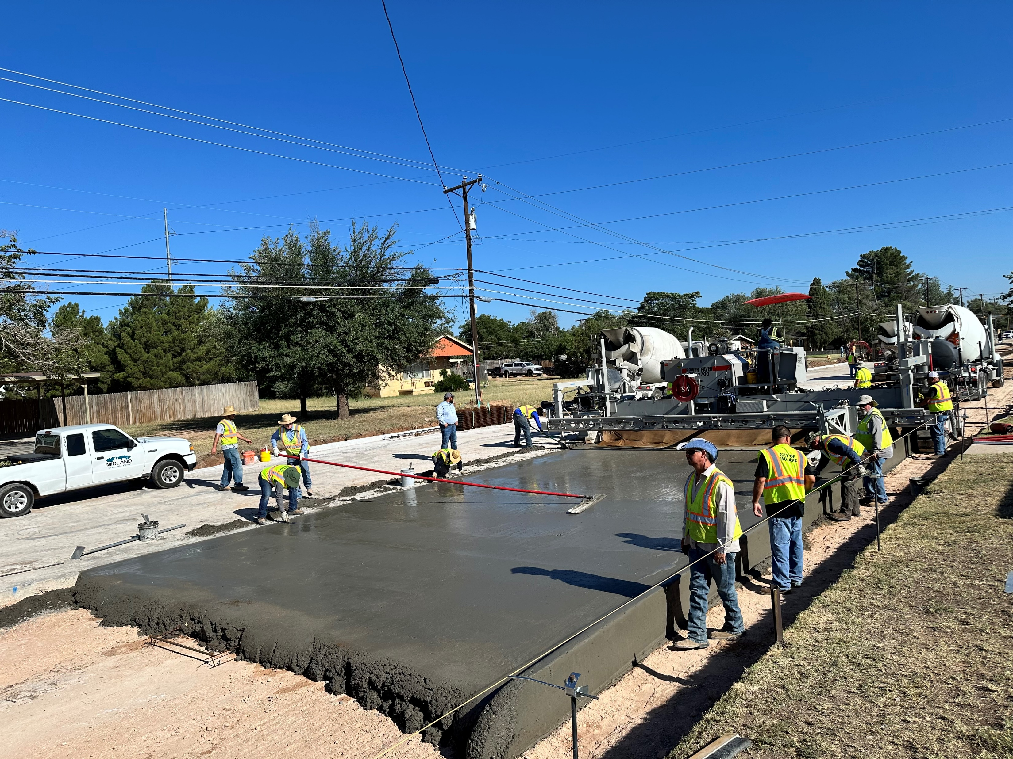

ROAD BOND UPDATE
Bond Program
Main Street
Utilities Completed
Paving Project Ongoing
Garfield Street
Utilities Completed
Paving and Roundabout Ongoing
21
Notes:
24 of the 26 selected roadways are complete

Slide 22
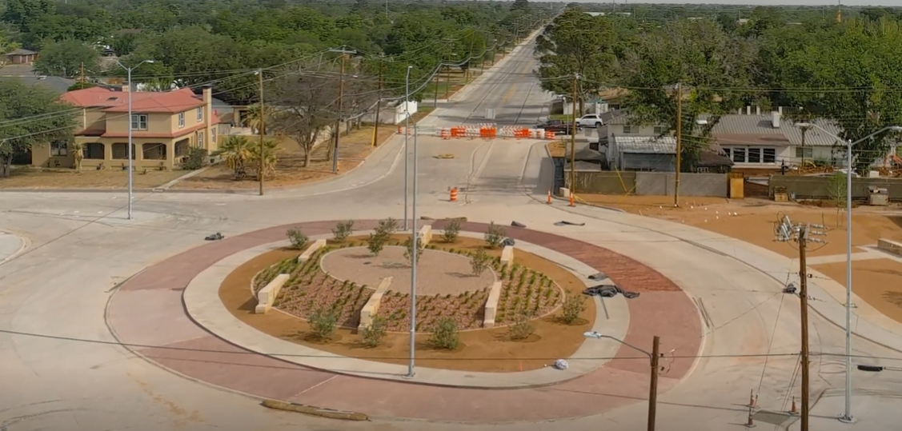
GARFIELD STREET
Timeline
Comprehensive bid package in 2022 resulted in sole bid of $25 million
With Council approval, sole bid was rejected
Phase I: Michigan to Louisiana
Phase II: Utilities from Golf Course to Louisiana
Phase III: Paving from Golf Course to Louisiana (City crews and Contractor)
22
Notes:
Currently on track to complete project this summer.
Phasing of project added to overall length of construction but led to Cost savings of $10 million or more
Includes continuous sidewalk and curb and new curb and gutter, not part of the original bid
Utility contractor completed their portion in 23 months
In-house concrete paving crews completed their portion in 12 months
Paving contractor currently working at the project for an estimated duration of 10 months
Total estimated duration is 27 months

Slide 23



PARTNERSHIPS
Enhance Resource Sharing
Improve Infrastructure Through Joint Efforts
Promote Synergistic Development
Fast-track Project Timelines
Shared Goals (Vision Zero)
Keeping Up With Growth
23
Notes:
Not many years ago, there was not much funding for roadways. This includes funding for O & M and new roadways. Between 2010 and 2017, addressing the poor condition of our streets was a Council priority. This emphasis led to increased funding for maintenance and eventually led to the $100 million Road Bond.
During this time, Tx. D.O.T. also did not have much funding for projects. The State was focused on other areas, especially the I-35 corridor between Austin and the Dallas-area. Things have changed, and the state has allocated funds to Tx. D.O.T.’s Odessa District for many much-needed projects.
In recent years Midland County added a Public Works Department. Throughout the years, the County’s Road and Bridge Department completed primarily maintenance projects, but not much was done to expand or grow the County’s infrastructure.
We can’t do it alone
Need to be resourceful to keep up with growth
$100 million bond program addresses deferred maintenance or neglect on existing roadways, does not help us keep up with growth.
Mutual benefit and mutual interest
Combine our resources to keep up with growth
Eventual goal is to stay ahead of growth

Slide 24

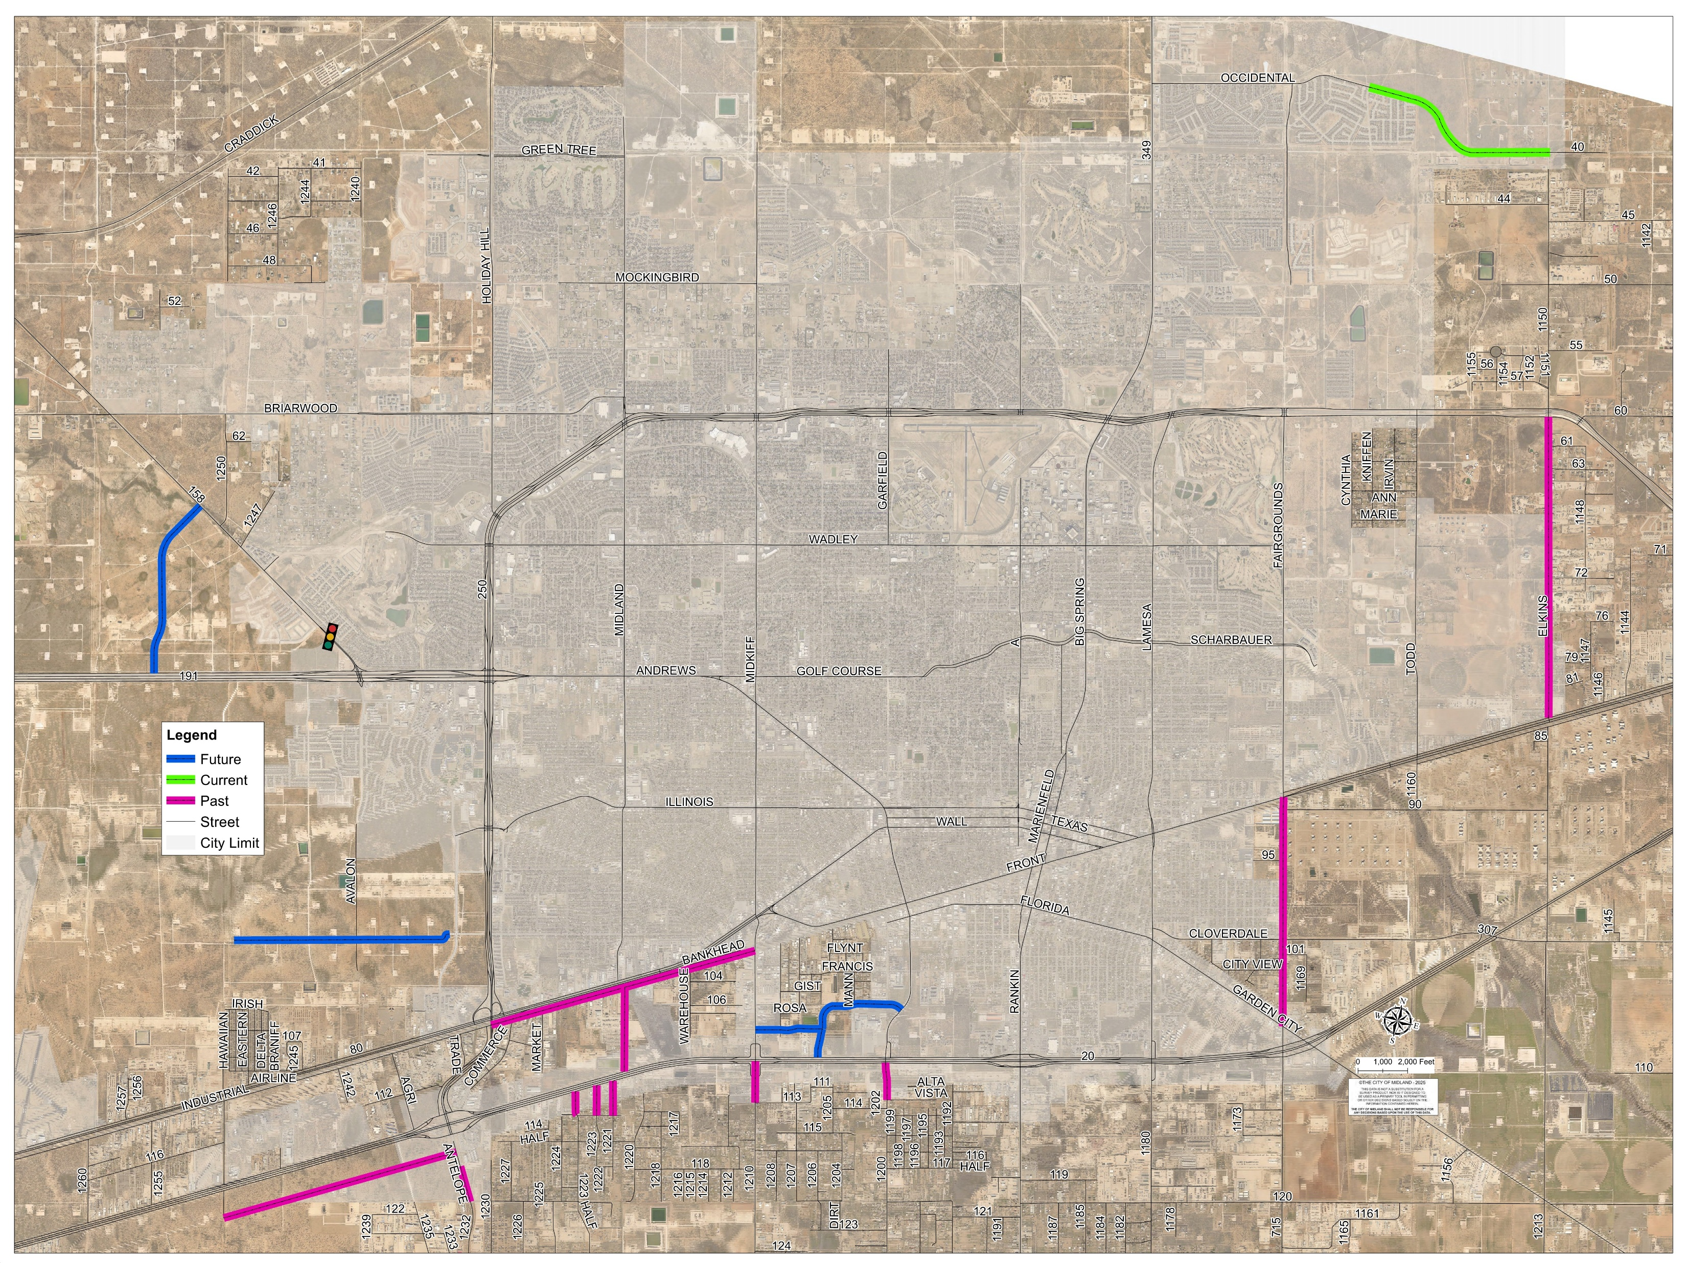
PARTNERSHIPS – MIDLAND COUNTY
16 Projects since 2018
Total Value: $19 Million
24

Slide 25
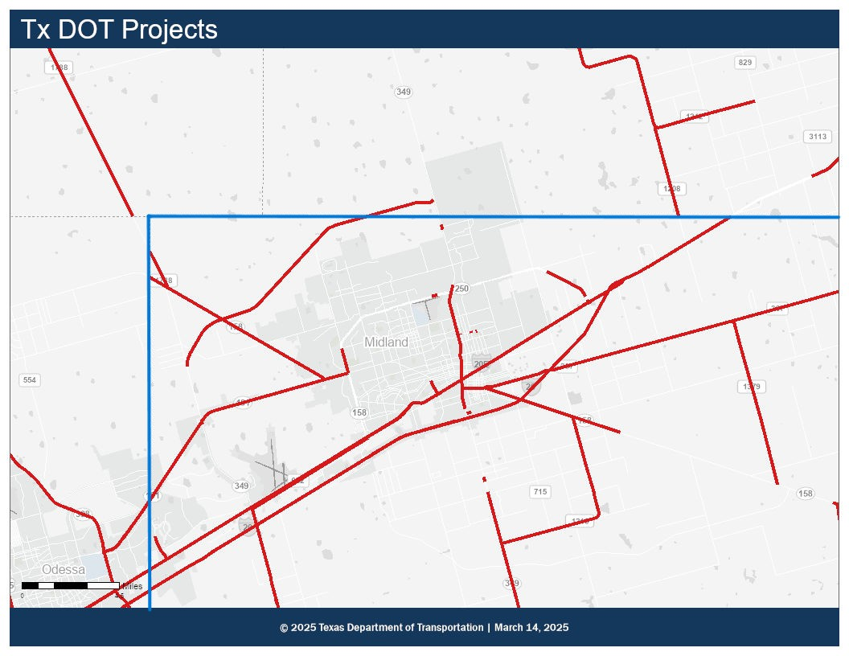
PARTNERSHIPS – TXDOT
$40 million in projects designed by the City and constructed by TXDOT
Assisted with moving timelines forward for critical projects
All projects are in the PBMPO Boundary
TXDOT total project value is $698,076,777, including maintenance
25
Notes:
$4,000,000.00 in design for $40 million

Slide 26
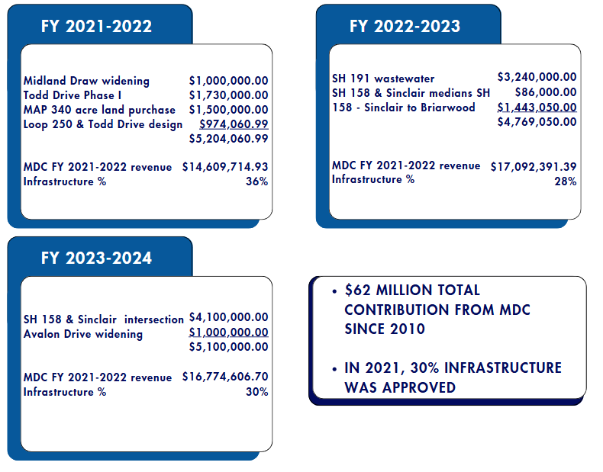

PARTNERSHIPS - MDC
26
Notes:
MDC decided to contribute 30% of revenue with City Council support
$62 million total contribution since 2010
About $9.8 million for design

Slide 27
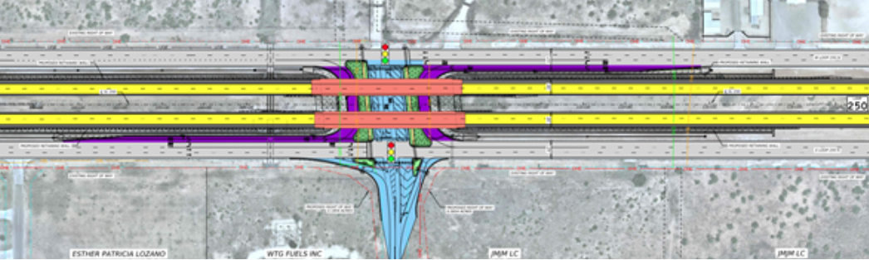
LOOP 250 AT TODD DRIVE
$974,060.99 for Design Produces $25,969,208.00 Project MOVED UP BY 6 YEARS from 2031 to 2025
27
Notes:
Gabe

Slide 28
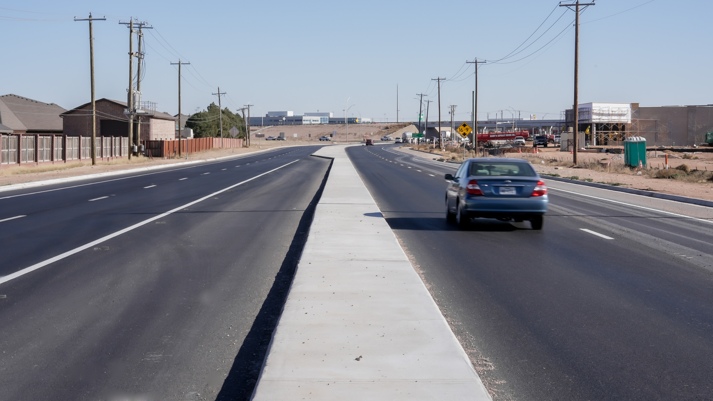
CITY OF MIDLAND
FY 2022 to 2024 Awarded Average of $25 million in Construction Projects Annually
SH158- widening and repaving project
28

Slide 29
CURRENT CIP PROJECTS
Wadley Extension
Fairgrounds Extension
SH 158 and Sinclair
Sinclair west of SH 158
Briarwood Utility
Various Traffic Signal Projects
NE Sewer Main Extension
Garfield and Main St Bond Projects
COMPASS
Utility Extension Projects
Waste Water Rehab Projects
County Project Partnerships
TxDOT Project Partnerships
SH158- widening and repaving project
29

Slide 30
PROJECTS IN DESIGN FOR FUTURE GROWTH
Avalon Projects
Garfield Extension
Mockingbird Projects
I-20 Backage Road
COMPASS Projects
Thomason Extension
TxDOT Projects (Overpass at Loop 250 and Todd, SH158 Widening, Wildcatter Trail, and Overpass at 191 and 1250)
County Projects (CR1250, Anetta)
30

Slide 31
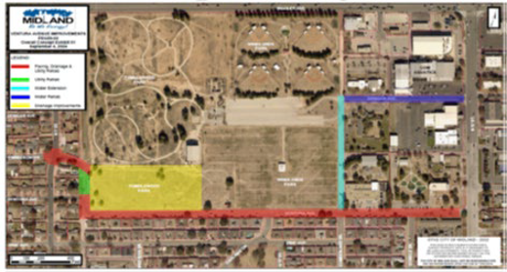
PROJECTS IN DESIGN FOR DRAINAGE IMPROVEMENTS
Wadley Ave Reconstruction
Golf Course Rd
Ventura Ave
Channel Improvements (Jal Draw, Midland Draw, Mulberry Channel, and Industrial Channel)
California Ave
31

Slide 32

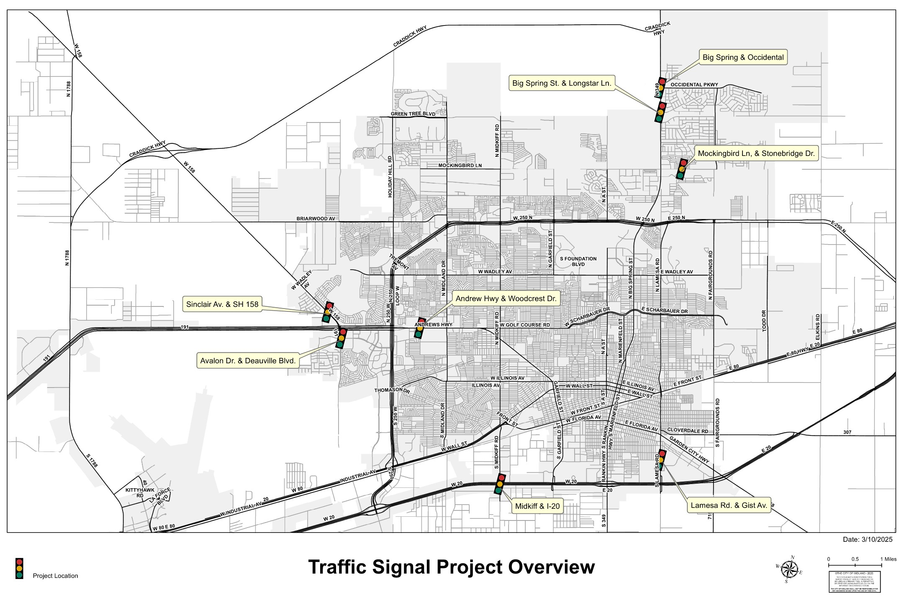
TRAFFIC SIGNAL PROJECTS
Notes:
Gabe

Slide 33
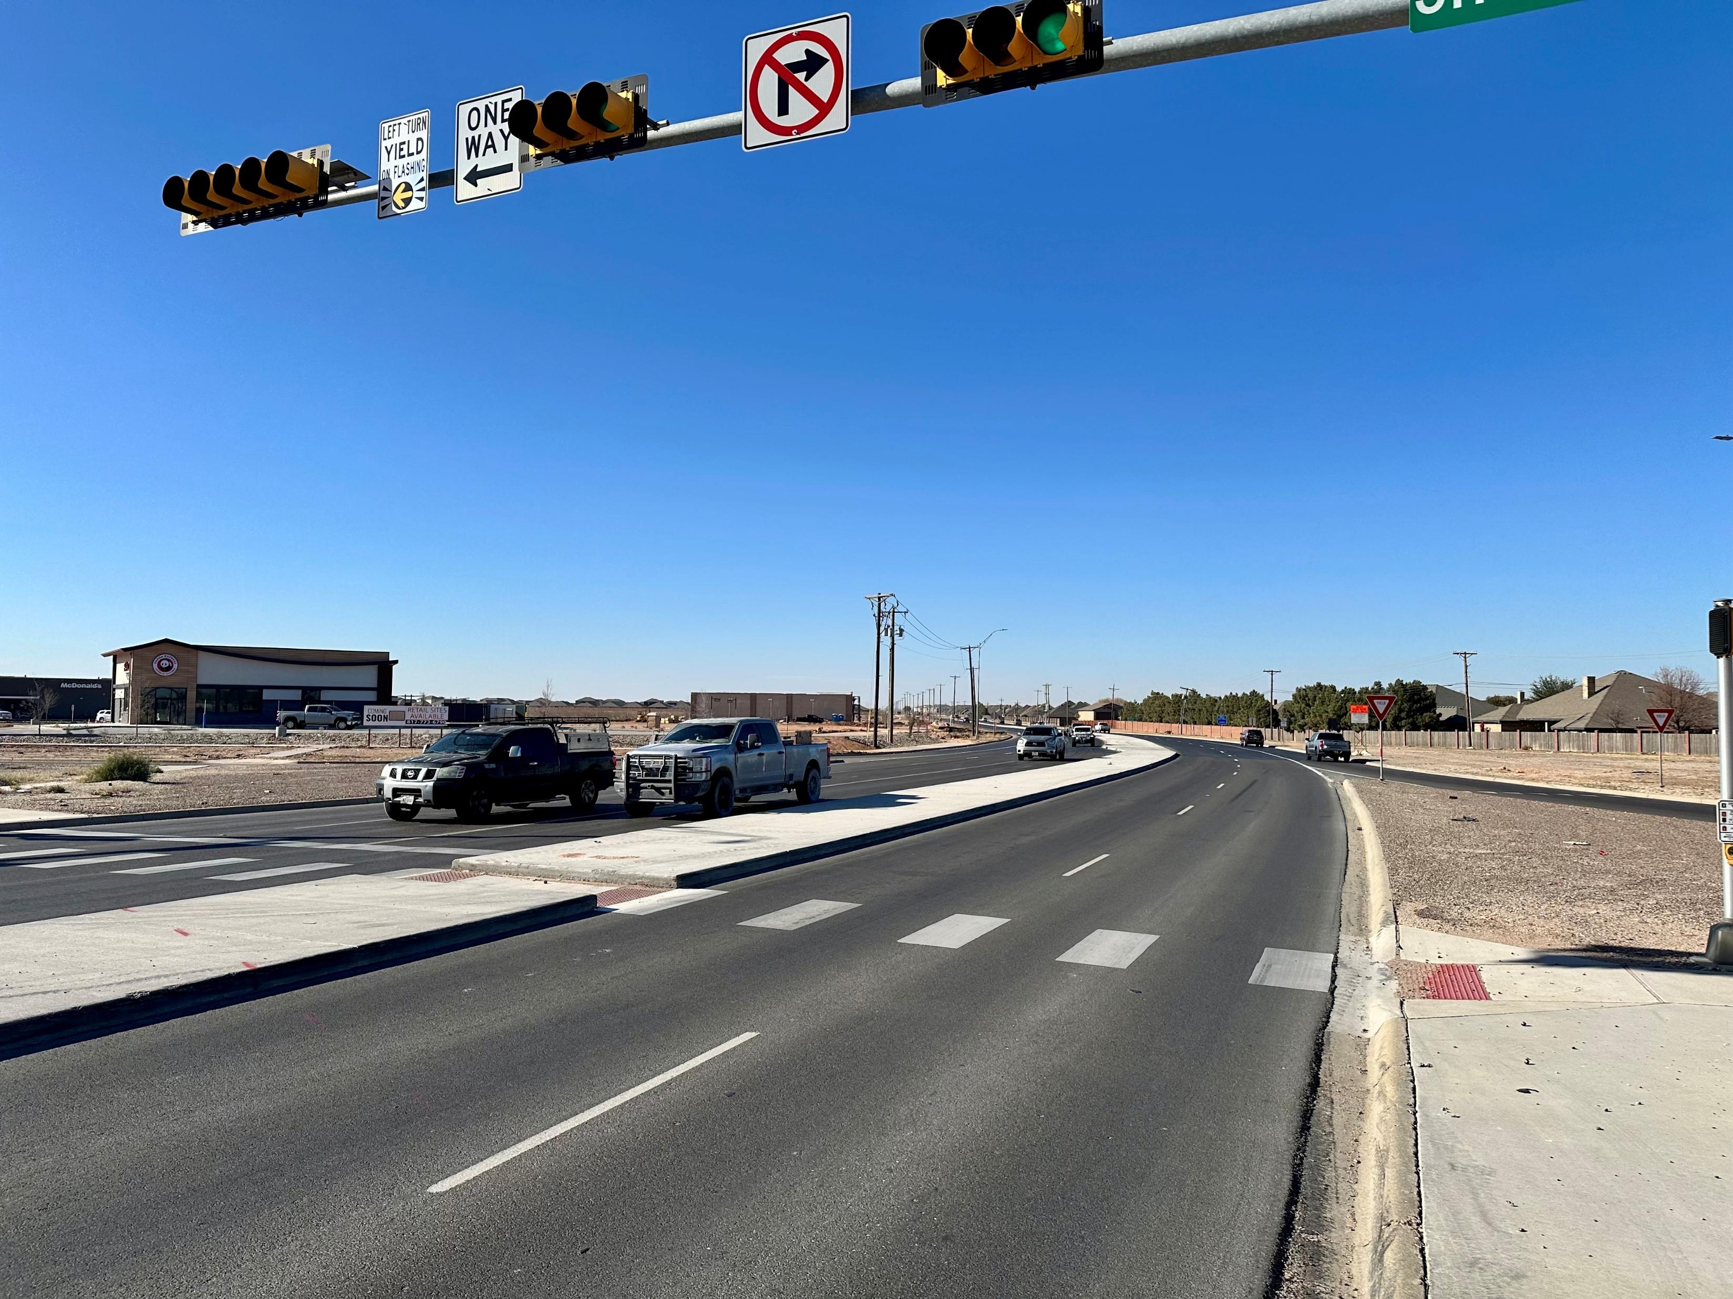
CITY OF MIDLAND LOOK AHEAD
The City of Midland is investing $52 million to improve roads across Midland over next 2 years.
Includes Operations dollars and Bonds.
Does not include MDC pledges.
Notes:
Gabe

Slide 34
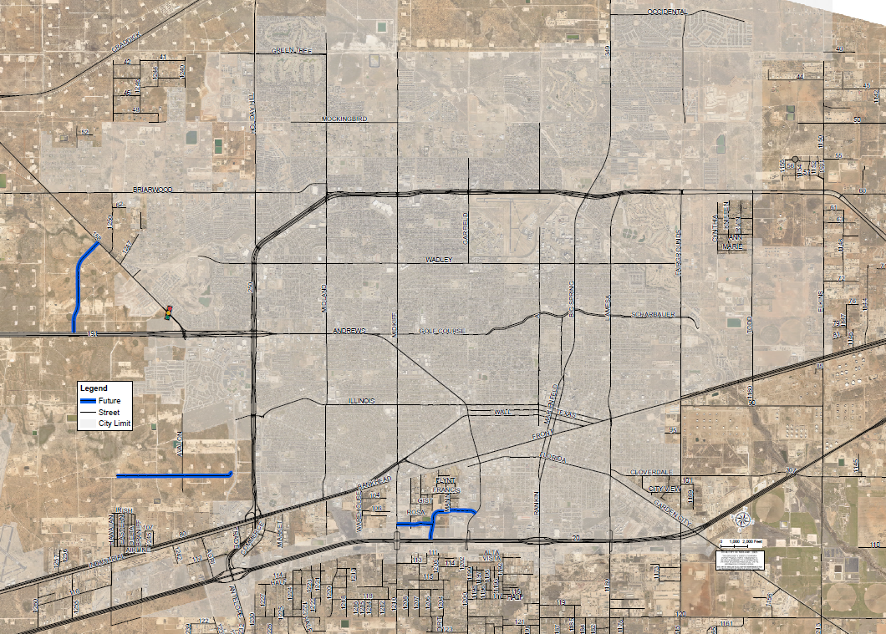
MIDLAND COUNTY INVESTMENT
Midland County invests approximately $34–$40 million annually in construction and design on their ROW, a consistent trend since 2020.
34

Slide 35
VISION ZERO RESOLUTION
1
ZERO traffic deaths and serious injuries by 2050.
Memorializes the Task Force & long-term responsibilities.
Oversee the completion of the CSAP within 12 months of the resolution
Report progress on Vision Zero goals and Action Plan recommendations within 12 months of finalizing Action Plan, and annually thereafter
Required for the SS4A grant
Same goal as TxDOT’s Road to Zero Campaign
Council Vote on Resolution April 9, 2024
Draft of Plan Publicly Available April 2024
Plan adopted by Council
April 23, 2024
Notes:
Movement aiming to eliminate all traffic fatalities and serious injuries by 2050.
Eliminating deaths on Midland’s roads by
BUILDING complete streets, ENGAGING
the community, and INNOVATING safer solutions to protect all users.”
City Council officially adopted the goal of
Vision Zero, meaning Zero roadway
fatalities by 2050 in April of 2024. The
Comprehensive Safety Action Plan was
adopted in June of 2024, and allows us to
compete nationwide for the SS4A Grant program.

Slide 36
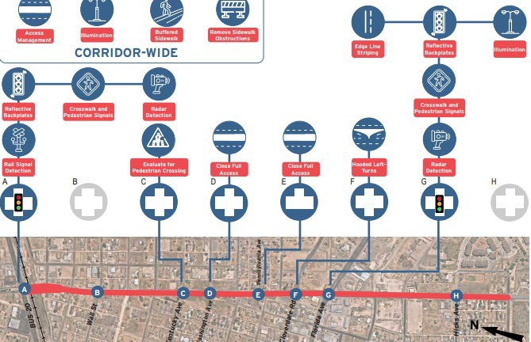

LAMESA CORRIDOR IMPROVEMENTS AND CITYWIDE SIGNAL RETIMING
Awarded Funding | Required Match | Total Project Cost
$8,664,368 | $2,166,092 (20%) | $10,830,460
Utilizing recommendations from Midland’s Vision Zero- Comprehensive Safety Action Plan, the City was awarded funding from FHWA Safe Streets and Roads for All (SS4A) program, to complete systematic infrastructure improvements along Lamesa Road and citywide signal retiming to increase roadway safety.
36
Notes:
Lindsey

Slide 37
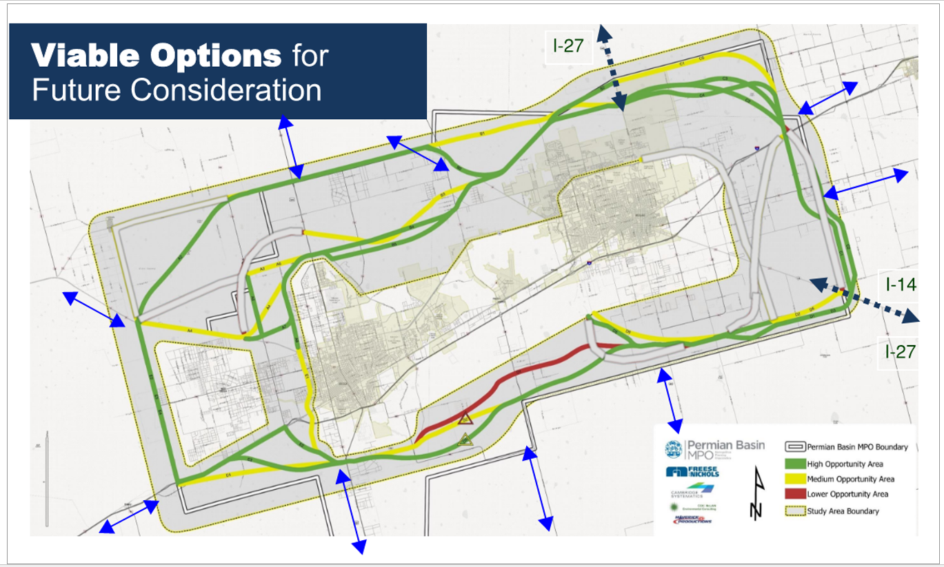
Notes:
Who: Permian Basin MPO, City of Midland, City of Odessa, Midland County, Ector County, and Martin County
What: Identification of need for “Outer Loop” or connectivity corridor encircling Midland & Odessa through Planning and Environmental Linkages (PEL) Study
Goals: Enhance Safety, redirect freight traffic, provide comprehensive travel corridors
PBMPO adopted the results of the study in November 2024
Illustrative map added to TXDOT MTP in Fall 2024

Slide 38
UTILITIES: BUILDING A PREPARED UTILITY FOR MIDLAND'S FUTURE
TITLE HERE
TITLE HERE

Slide 39
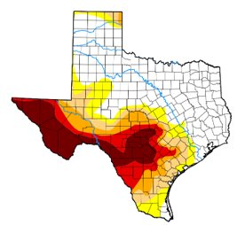
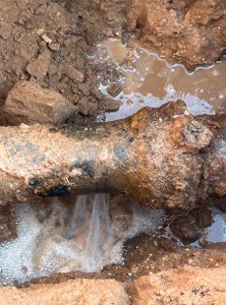
STAYING READY FOR GROWTH AND RISK
Aging infrastructure, drought, and population growth create operational risks.
Goal: Ensure long-term, sustainable, and reliable water and sewer services.
Alignment with Strategic Plan: Reinforced Infrastructure and Resource Stewardship.
39
SH158- widening and repaving project
Notes:
Mention SCF

Slide 40

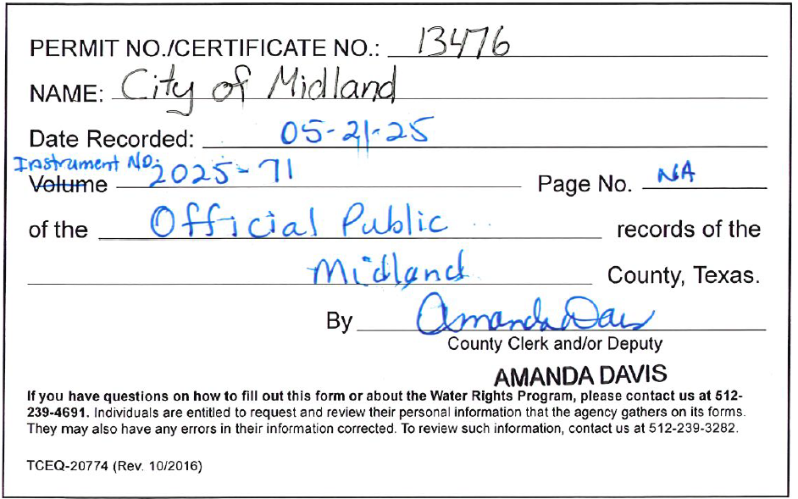
WATER SUPPLY REDUNDANCY
Bed & Banks Permit: Retains ownership of treated effluent for reuse or recharge.
Advanced Groundwater Treatment: Implementing scalable solutions.
Fort Stockton Partnership: Securing future water through long-term groundwater supply.
Reservoir Monitoring: Tracking rainfall and lake inflows for supply forecasting.
Paul Davis Well Field Upgrades: Improving performance of existing groundwater assets.
40
Notes:
Gabe

Slide 41
EMERGENCY & OPERATIONAL READINESS
Valve Isolation Testing and Repair: Ensures operability for planned and emergency shutoffs.
Sewer Overflow Response: Rapid response protocols, avg. < 1 hour resolution.
Drought Mitigation (HMAP): Groundwater development and targeted conservation.
Pipeline Failure Preparedness: System mapping, SCADA upgrades, alternate routing.
T-Bar System Redundancy: Planning for rare events near key infrastructure.
41

Slide 42
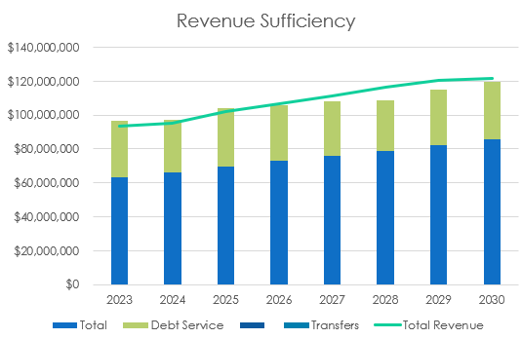
FINANCIAL & STRATEGIC EFFICIENCY
Revenue Process Improvements: $8.2M increase in billing through process strategies.
Funding Tech Upgrades Internally: Pressure monitors and smart meters from savings.
Strategic Use of Unallocated Funds: Proactive, self-funded system investments.
42

Slide 43
INFRASTRUCTURE & DISTRIBUTION MODERNIZATION
Water Main Replacement Program: Prioritizing deteriorated and undersized lines.
Satellite Leak Detection – Key Highlight:
Semi-annual aerial surveys identify leaks before they surface.
Allows for proactive repairs, significantly reducing water loss.
Supports strategic pipe replacement planning based on real-world data.
Reduces unaccounted-for water, improving overall system efficiency.
Real-Time Pressure Monitoring – Key Highlight:
Sensors deployed citywide detect sudden drops indicating breaks or major leaks.
Enables near-instant alerts to operators, reducing response time.
Decreases customer downtime and service disruptions.
Minimizes loss volume by isolating and correcting failures faster.
Design-Build Water Main Expansion: 5.5-mile project to enhance transmission capacity.
43

Slide 44
SATELLITE PROGRAM OVERVIEW
Asterra
The Asterra satellite leak detection program provides biannual flyovers of the City’s water infrastructure. It identifies potential underground leaks based on moisture anomalies in the soil. It is not a real-time monitoring system and does not provide alerts during or immediately before events.
Asterra's lower detection limit is generally estimated to detect leaks with a flow as low as 1 gallon per minute, though actual performance varies based on soil type, depth of pipe, and surface cover.
Asterra Contract Details
The Asterra contract began in May 2025 with annual contract renewals every may and includes two flyovers per year and related data analysis. The $930,000 figure represents the entire contract value, yearly cost $232,500, with the annual renewal determined by the City
We are aligning its use with internal benchmarks to reduce 10 % reduction in water loss over the 4 years and a 10% reduction in water main breaks.
59%
MISD
23%
CITY OF MIDLAND
5% 5% 8%
44

Slide 45
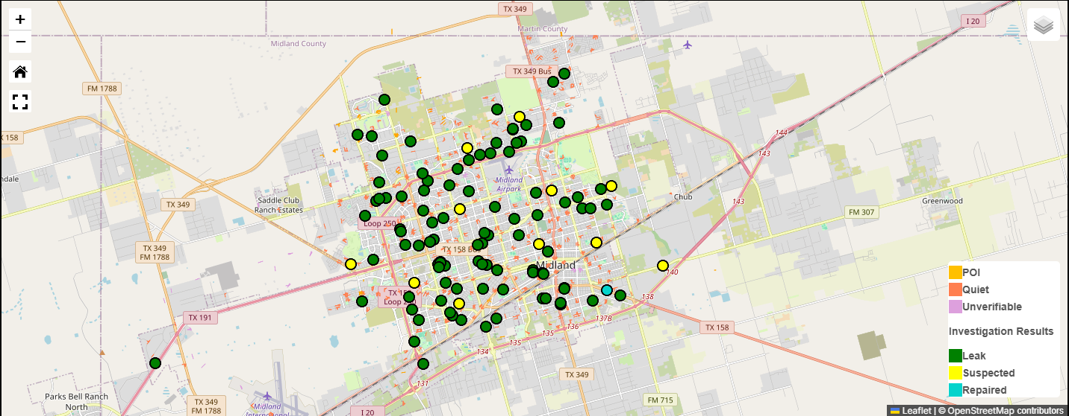
LEAK DETECTION
45

Slide 46
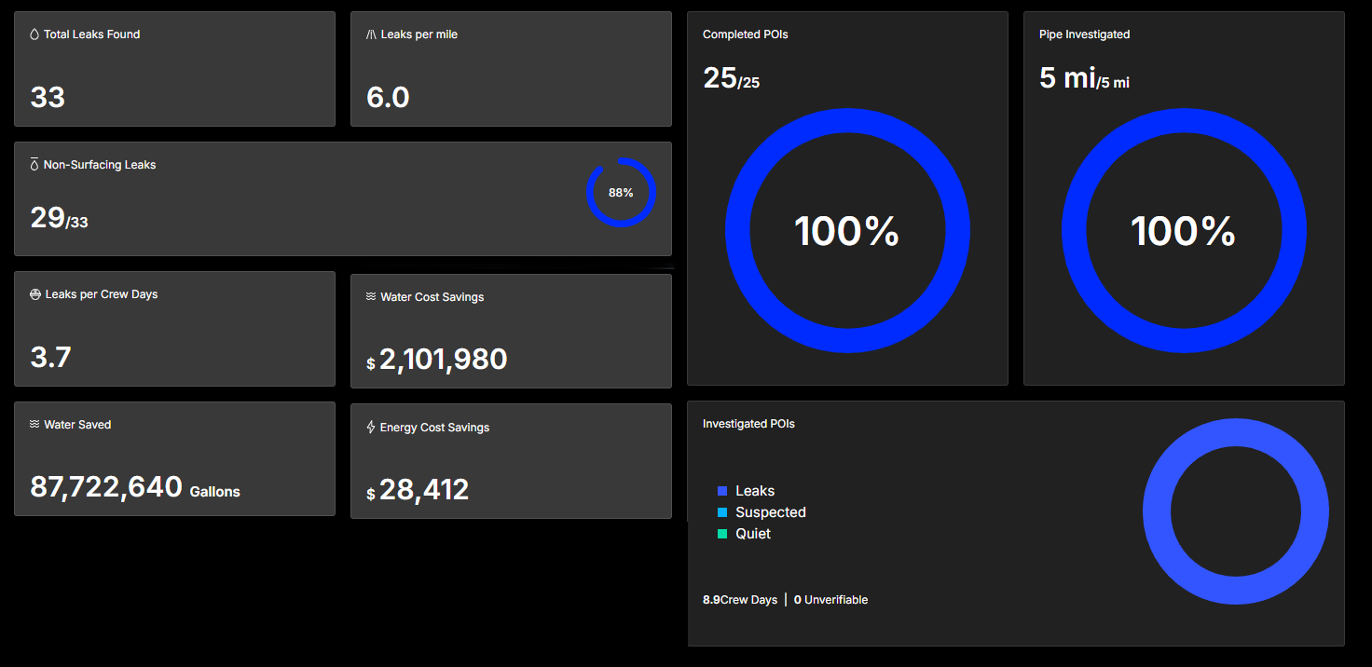
FIRST PROGRAMS OUTCOMES:
46

Slide 47
MONITOR PROGRAM OVERVIEW
30 Pressure Monitors (Pressure Rangers) being installed throughout the City
The monitors are being installed at the City’s sampling stations
Project will be expanded to 64 locations after initial testing phase
The monitors are actively tracked in signal-fire cloud and sends multiple City personnel texts if the station gets out of set ranges.
47

Slide 48
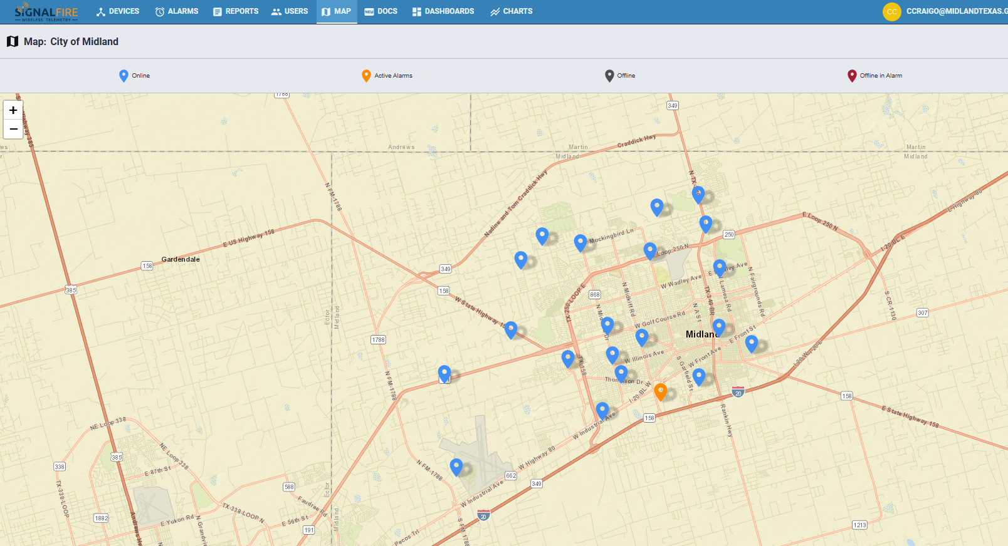
ACTIVE PRESSURE MONITORING
48

Slide 49
NEXT STEPS
Finalize deployment of pressure monitoring across the city.
Piloting groundwater treatment systems.
Develop effluent reuse roadmap tied to Bed & Banks permit.
Continue water main replacements and pursue funding options.
49

Slide 50
CODE ENFORCEMENT UPDATE
TITLE HERE
TITLE HERE

Slide 51
MISSION & PURPOSE
The purpose of Code Enforcement is to be proactive and responsive to the needs of the citizens of Midland while obtaining compliance with the City’s codes and ordinances.
Ordinances are intended to improve quality of life by ensuring a cleaner, safer, and more attractive community.
Compliance with ordinances reduces vandalism, deters crime, and maintains property values.
51

Slide 52
KEY RESPONSIBILITIES
Respond to citizen reports and proactively patrol for health, safety, and aesthetic compliance
Investigate and address land use & zoning, building code, property maintenance, and nuisance violations
Work with property owners to achieve compliance
Team: 11 Code Officers (7 licensed, including 2 Supervisors), 2 Admin Assistants, 4 Maintenance Specialists (1 licensed), 1 Assistant Director
52

Slide 53
CHALLENGES (2024 BASELINE)
Severely Understaffed
6 officers for a population of 138k (1 per 23k)
Industry standard: 1 officer per 10k
No Formal Training or Strategic Direction
No required training or certification program
No clear priorities – everything is urgent
Lack of internal policies and procedures
Inefficient Processes
No streamlined abatement procedures
Affidavit process required even for minor issues like weeds or trash
53

Slide 54
CHALLENGES (2024 BASELINE)
Outdated and Incomplete Codes
No property maintenance code
Reliance on construction codes makes it difficult to address substandard buildings
Codes are complex and difficult to enforce
Limited Enforcement Tools
No authority to issue citations
No fast-track board and secure process for dangerous and vacant buildings
Lack of Building Standards Commission
54

Slide 55
CHALLENGES (2024 BASELINE)
Impact of Past Decisions
Certificates of Occupancy and Specific Use Designation (SUD) renewals have not been consistently enforced
Legacy (past) subdivision approvals allowed development with inadequate infrastructure
Example: In 2016, a waiver allowing for development in Vista del Pueblo was approved without requiring the developer to connect to City water/wastewater
55

Slide 56
IDENTIFYING PRIORITIES
Aligning Code Enforcement with the Strategic Plan:
Most Visible Streets Program
See, Click, Fix
Substandard Buildings
Special Projects (e.g., Illicit Massage Businesses)
Focus on:
Proactivity + Responsiveness
Efficiency + Effectiveness
56
Notes:
Proactivity + Responsiveness (volume, SCF closure rate, average response time to new violations)​
Efficiency (closure rate, average time to close, percent closed within 30 days)​
Effectiveness (voluntary compliance rate, repeat violation rate, abatement cost recovery rate)​

Slide 57
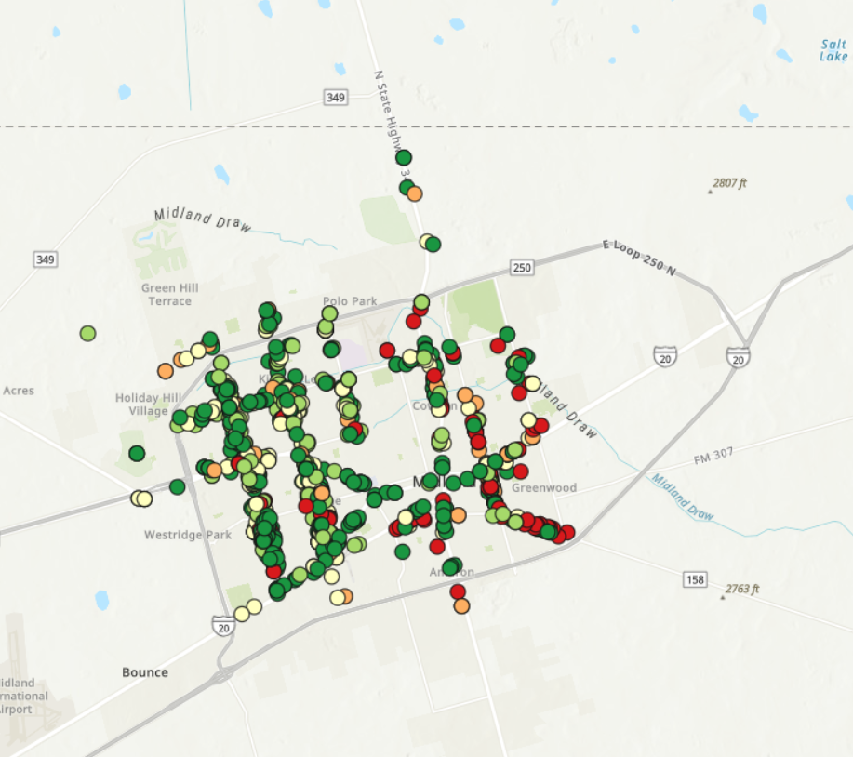
RESULTS: MOST VISIBLE STREETS
FY25 YTD: 1,276 cases opened along corridors – 23% of all cases citywide (up from 15% in FY24)
April 2025: 48% of all citywide cases were on the corridors
Case Resolution: 85% of corridor cases have been closed
Top Violations: weeds or debris (46%); temporary signs (10%)
57

Slide 58

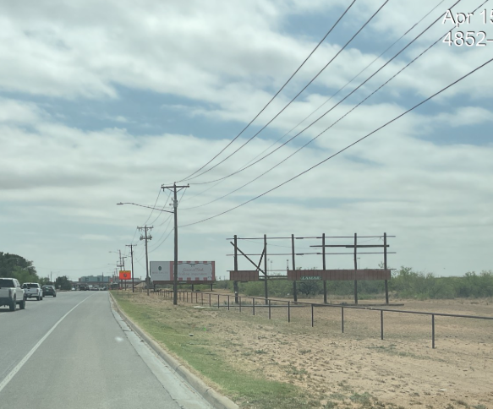
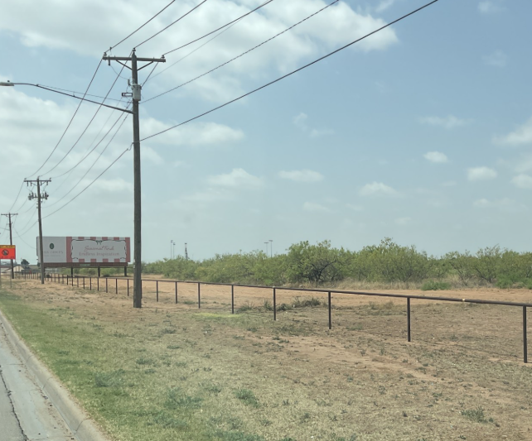
RESULTS: MOST VISIBLE STREETS
Broken sign on Big Spring was voluntarily removed by the property owner after Code Enforcement contact
Before: April 15, 2024
After: April 24, 2024
58

Slide 59
RESULTS: SUBSTANDARD BUILDINGS
Board & Secure Ordinance Approved
(March 2024)
1st Floor of Vaughn Building Secured
(April 2024)
2nd Floor of Vaughn Building Secured
(April 2025)
*Boarded within two weeks of report
59

Slide 60
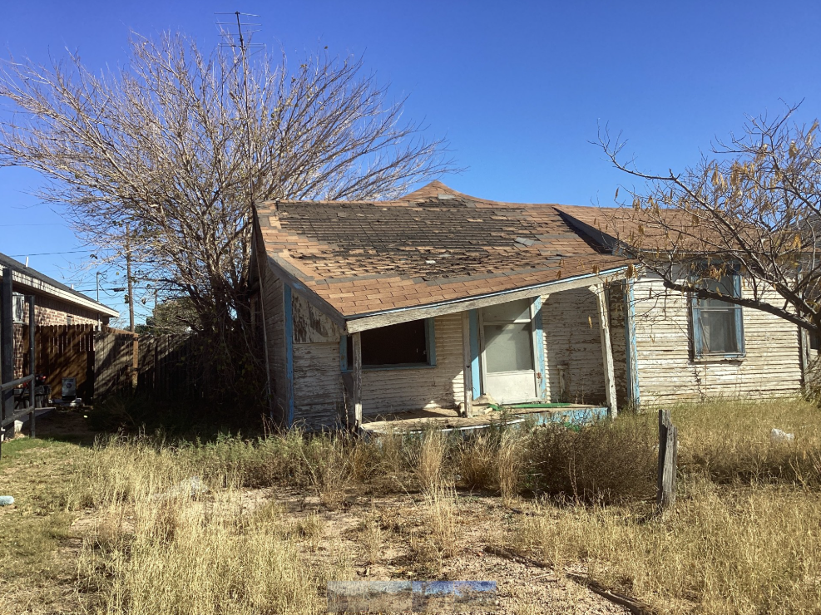
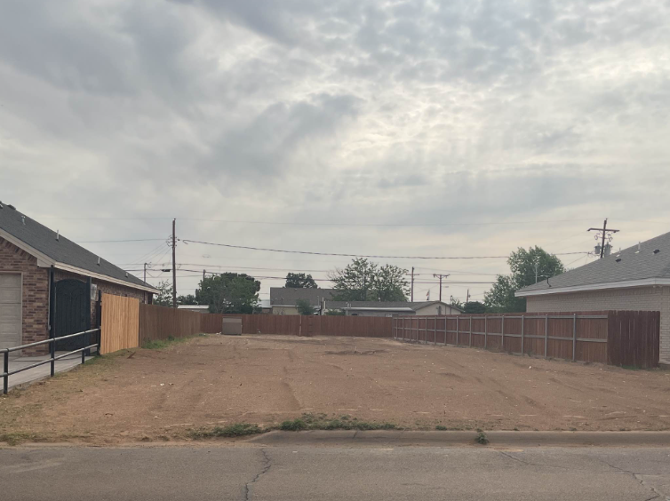
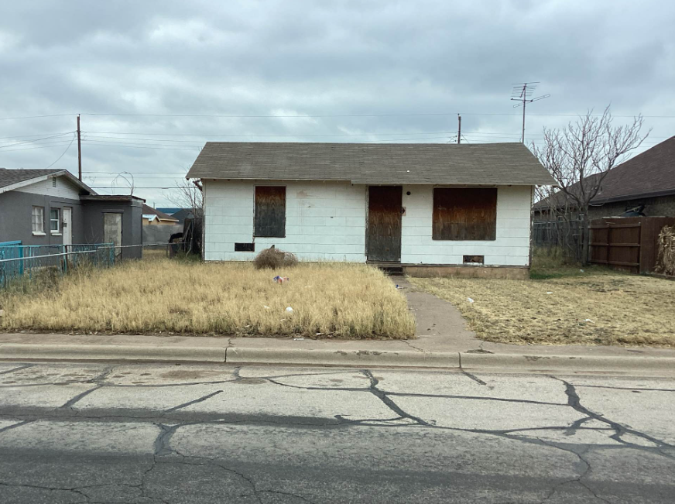
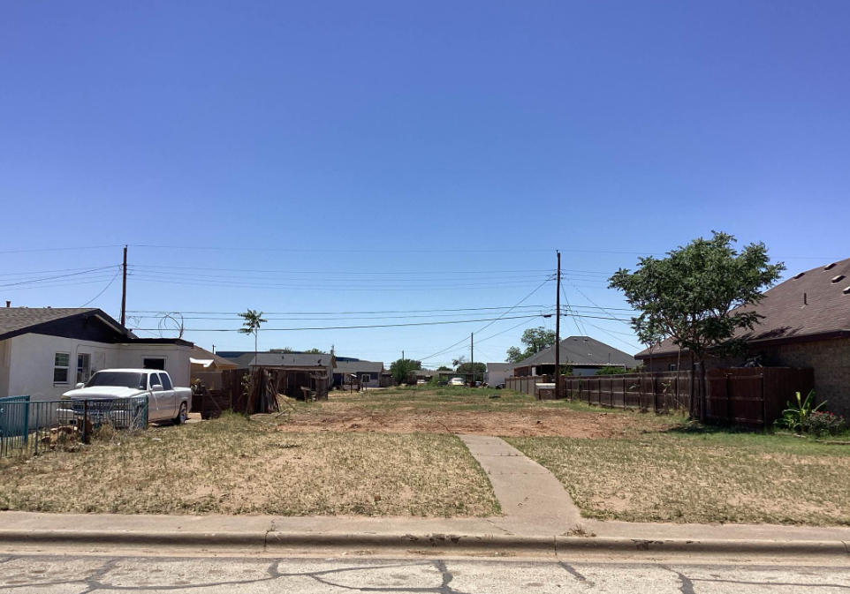
RESULTS: SUBSTANDARD BUILDINGS
Two substandard homes voluntarily demolished after Code Enforcement initiated contact, saving the City $45,000 each, removing neighborhood blight, improving public safety, and increasing chances of redevelopment.
602 N Lee St
Before: Dec 9, 2024
After: Apr 28, 2025
702 S Tilden St
Before: Jan 9, 2025
After: May 20, 2025
60

Slide 61
RESULTS: ILLICIT MASSAGE BUSINESSES
Stricter Ordinance Adopted: April 8, 2025
New licensing and operations standards for massage businesses with prior illicit activity approved
Joint Task Force: April 29 – May 1, 2025
Agencies: TDLR, Homeland Security Investigations, MPD, Code Enforcement
25 inspections conducted
61

Slide 62
RESULTS: ILLICIT MASSAGE BUSINESSES
Inspection Outcomes
1 emergency shutdown: Sunny Spa, 2814 W Wall
24 non-compliant businesses began CO process
5 obtained COs
19 pending further review (Permitting, Inspections, Fire)
13 had additional violations
3 have resolved them
62

Slide 63
RESULTS: KEY PERFORMANCE METRICS
 | Indicator | Annual Goal | FY24 | FY25 YTD
Proactive + Responsive | Case Volume (# of cases initiated) | 8,000 | 7,901 | 5,518
 | See Click Fix Closure Rate (% of SCF cases closed) | 95% | 98.4% | 98.7%
Efficient | Closure Rate (% of initiated cases closed) | 95% | 95.7% | 89.6%
 | Average Time to Close (average days to close a case) | 30 | 31.3 | 23.6
 | % Closed within 30 days (% of closed cases closed within 30 days) | 75% | 74.3% | 71.3%
VAD Program | Buildings Demolished | 5 | 2 | 2
 | Buildings Boarded & Secured | 5 | 1 | 3
63
Notes:
SCF
596 COMPLAINTS YTD
98.7% CLOSURE RATE
93% SLA COMPLIANCE RATE

Slide 64
CONTINUOUS IMPROVEMENT
Encouraging Compliance Through Citations Tailgate Case Study
2+ years without enforcement
47 citations since 2024; $90K+ in fines
Now in compliance
Optimizing Resources
MPD handled initial citations despite limited capacity
As of May 14, 2025, licensed Code Enforcement Officers are trained and authorized to issue citations
64

Slide 65
CONTINUOUS IMPROVEMENT: SIGN ENFORCEMENT AAR
On April 22nd, staff directed to remove all illegal signs from ROW along: 12 Most Traveled Corridors, Loop 250 Service Road, CJ Kelly Park
Aligned with Most Visible Streets Program goals
Applied uniformly – political signs in ROW are prohibited by City Code
Several political signs mistakenly removed from private property
65
Notes:
What Happened:
Code Enforcement was directed to remove all signs in the public right-of-way (ROW) along 12 high-traffic corridors, Loop 250 Service Road, and CJ Kelly Park, as part of the City’s corridor clean-up program.
Signs—including political signs—are prohibited in ROW under City Code §§ 11-7a-3(G) and 11-7a-10.
Four political signs were mistakenly removed from private property due to a misunderstanding of ROW boundaries.
Immediate Response:
All signs were returned to their original locations by April 23.
Affected residents were contacted and apologized to.
Operations were paused and internal corrective actions initiated.

Slide 66
RESPONSE
Operation suspended same day (April 22nd, PM)
All signs, including those unlawfully placed, were returned the following day (April 23rd by end of day)
Internal review and corrective actions initiated
66

Slide 67
RESULTS OF INTERNAL REVIEW
Inexperienced Workforce: Nearly half of the Code Enforcement team has less than two years of experience
Lack of Structured Training: Absence of formal training programs led to misunderstandings regarding ROW boundaries
Corrective Actions:
Verbal and written counseling for involved staff
Scheduled mandatory division-wide training
67

Slide 68
TRAINING & POLICY UPDATES
Quarterly training implemented to include:
Right-of-Way Boundaries
Proper Sign Retrieval Procedures
Code Enforcement Priorities
Commercial Maintenance Along Corridors
See, Click, Fix Response Protocols
Dilapidated and Dangerous Structures
New Policy: TDLR licensure required within 18 months of hire
68

Slide 69
SIGN ENFORCEMENT AAR: CONCLUSION
Incident was an unintentional enforcement error by a relatively new team
Staff involved received verbal + written counseling per City policy
Prompted meaningful policy, training + staffing improvements to ensure consistent, fair enforcement going forward
69

Slide 70
TITLE HERE
TITLE HERE
EMPLOYEE ACTION

Slide 71
INTERNAL RESPONSE
A thorough review of the situation was conducted, including an internal investigation into the employees' actions.
Appropriate disciplinary actions, both verbal and written, were taken in accordance with the City of Midland’s personnel policies.
Additional training needs were identified, assigned, and successfully completed by all Code Enforcement Officers.
71

Slide 72
CRIMINAL CONCERN
Under the Texas Penal Code, Chapter 6, a crime is only committed when there is intent to commit a criminal act.
While a mistake was made, the employees were acting in the course of their duties and had no criminal intent.
Therefore, no further action, including criminal charges or termination, is required or mandated.
72

Slide 73
TRANSPARENCY IN ACTION
TITLE HERE
TITLE HERE

Slide 74
TRANSPARENCY IN ACTION
Strategic Plan Brochure
2024 Annual Report
Vision Midland
Parks
CIP
Transportation
Popular Annual Financial Report
SeeClickFix - AskJacky
Operational Dashboard
Meetings and Agendas
Live Council Meetings
Council Meetings Presentations
74

Slide 75
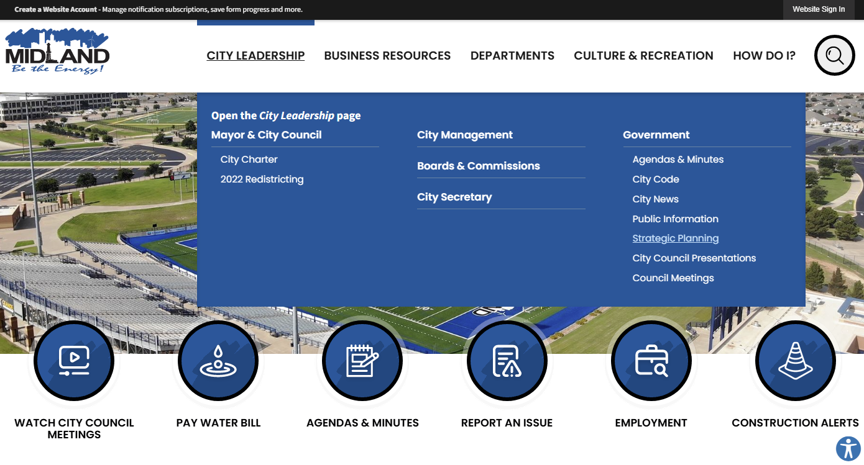

WWW.MIDLANDTEXAS.GOV
75

Slide 76
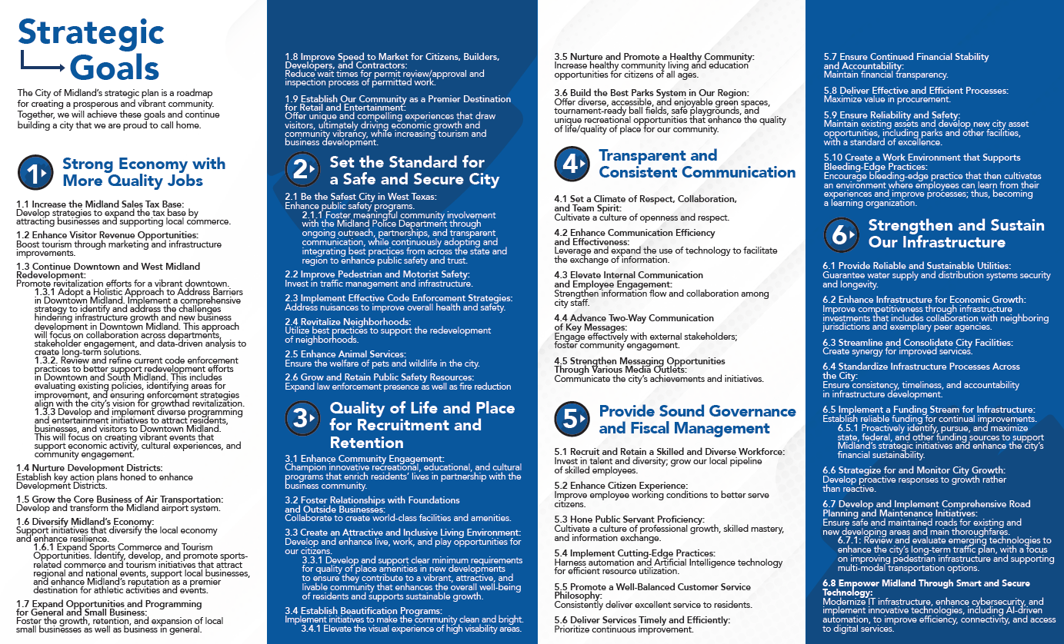

STRATEGIC PLAN BROCHURE
76

Slide 77
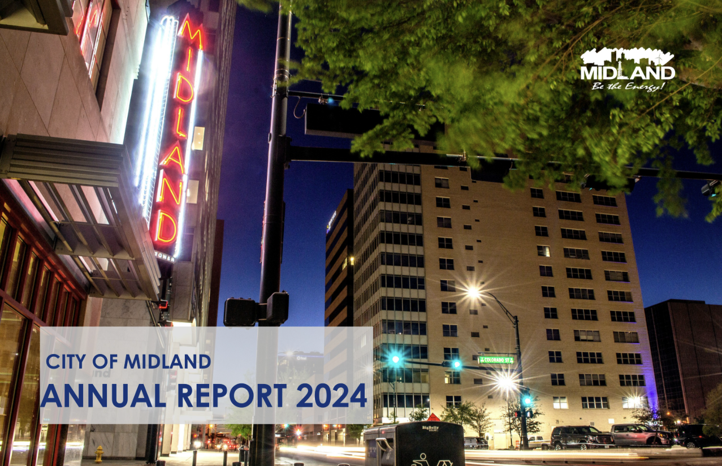
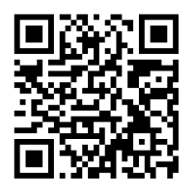
2024 ANNUAL REPORT
77

Slide 78
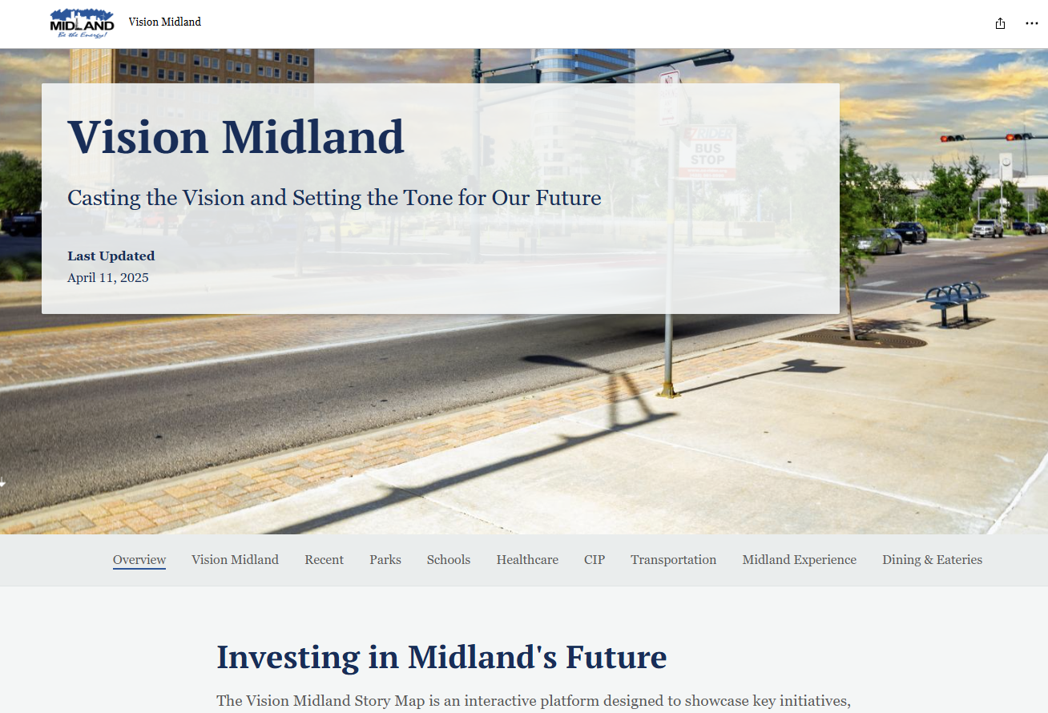

VISION MIDLAND
78

Slide 79
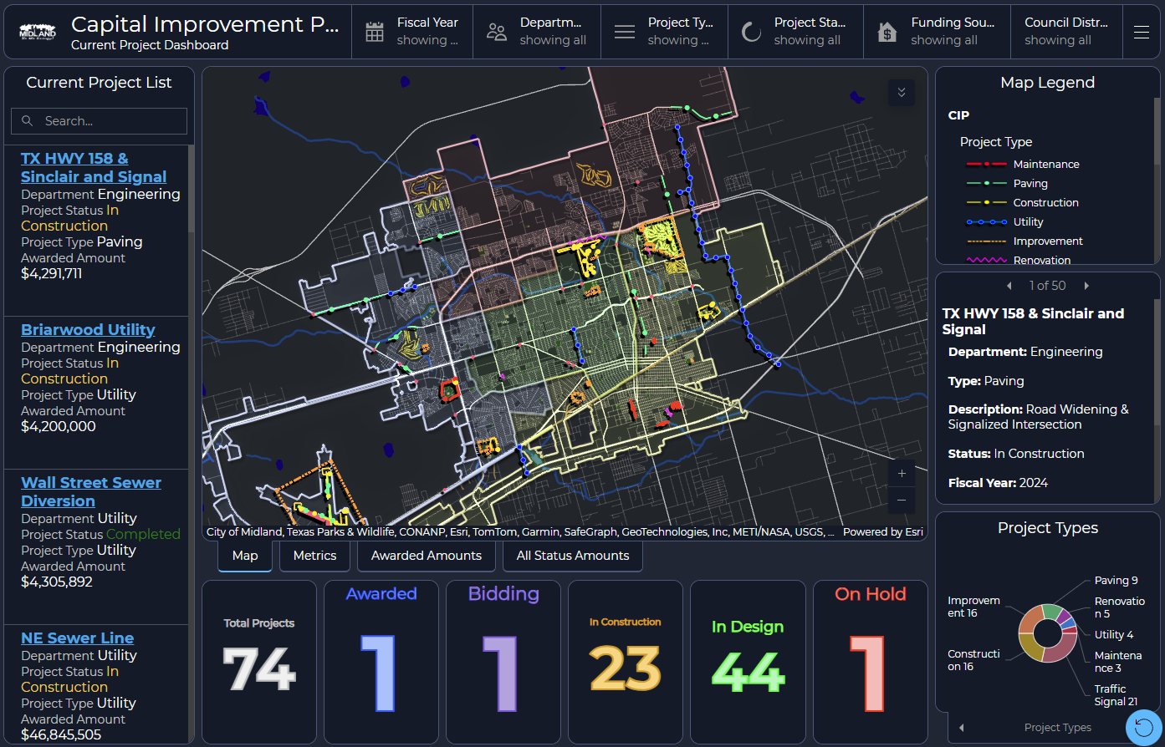

CAPITAL IMPROVEMENT PROJECTS
79

Slide 80
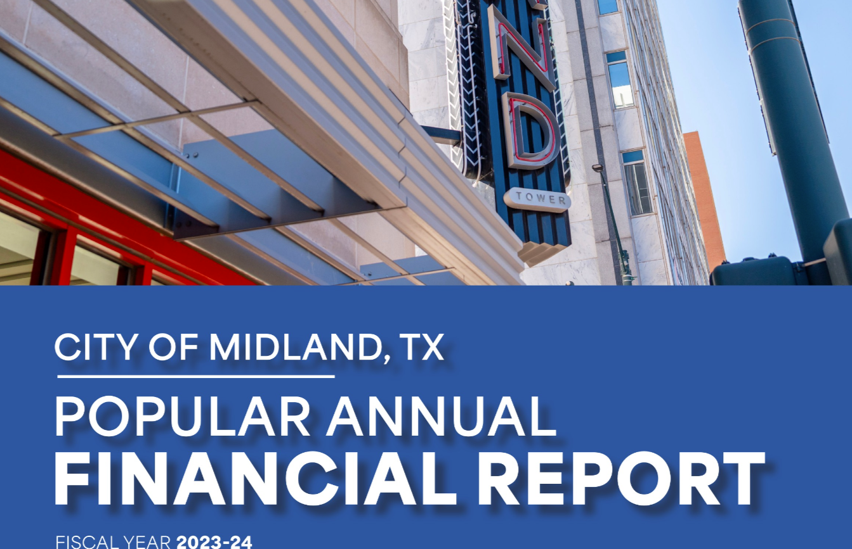

POPULAR ANNUAL FINANCIAL REPORT
80

Slide 81
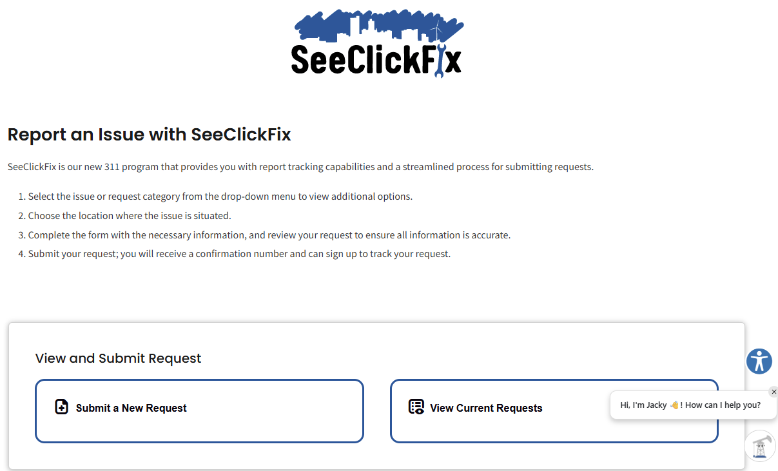

SEECLICKFIX & ASKJACKY
81

Slide 82
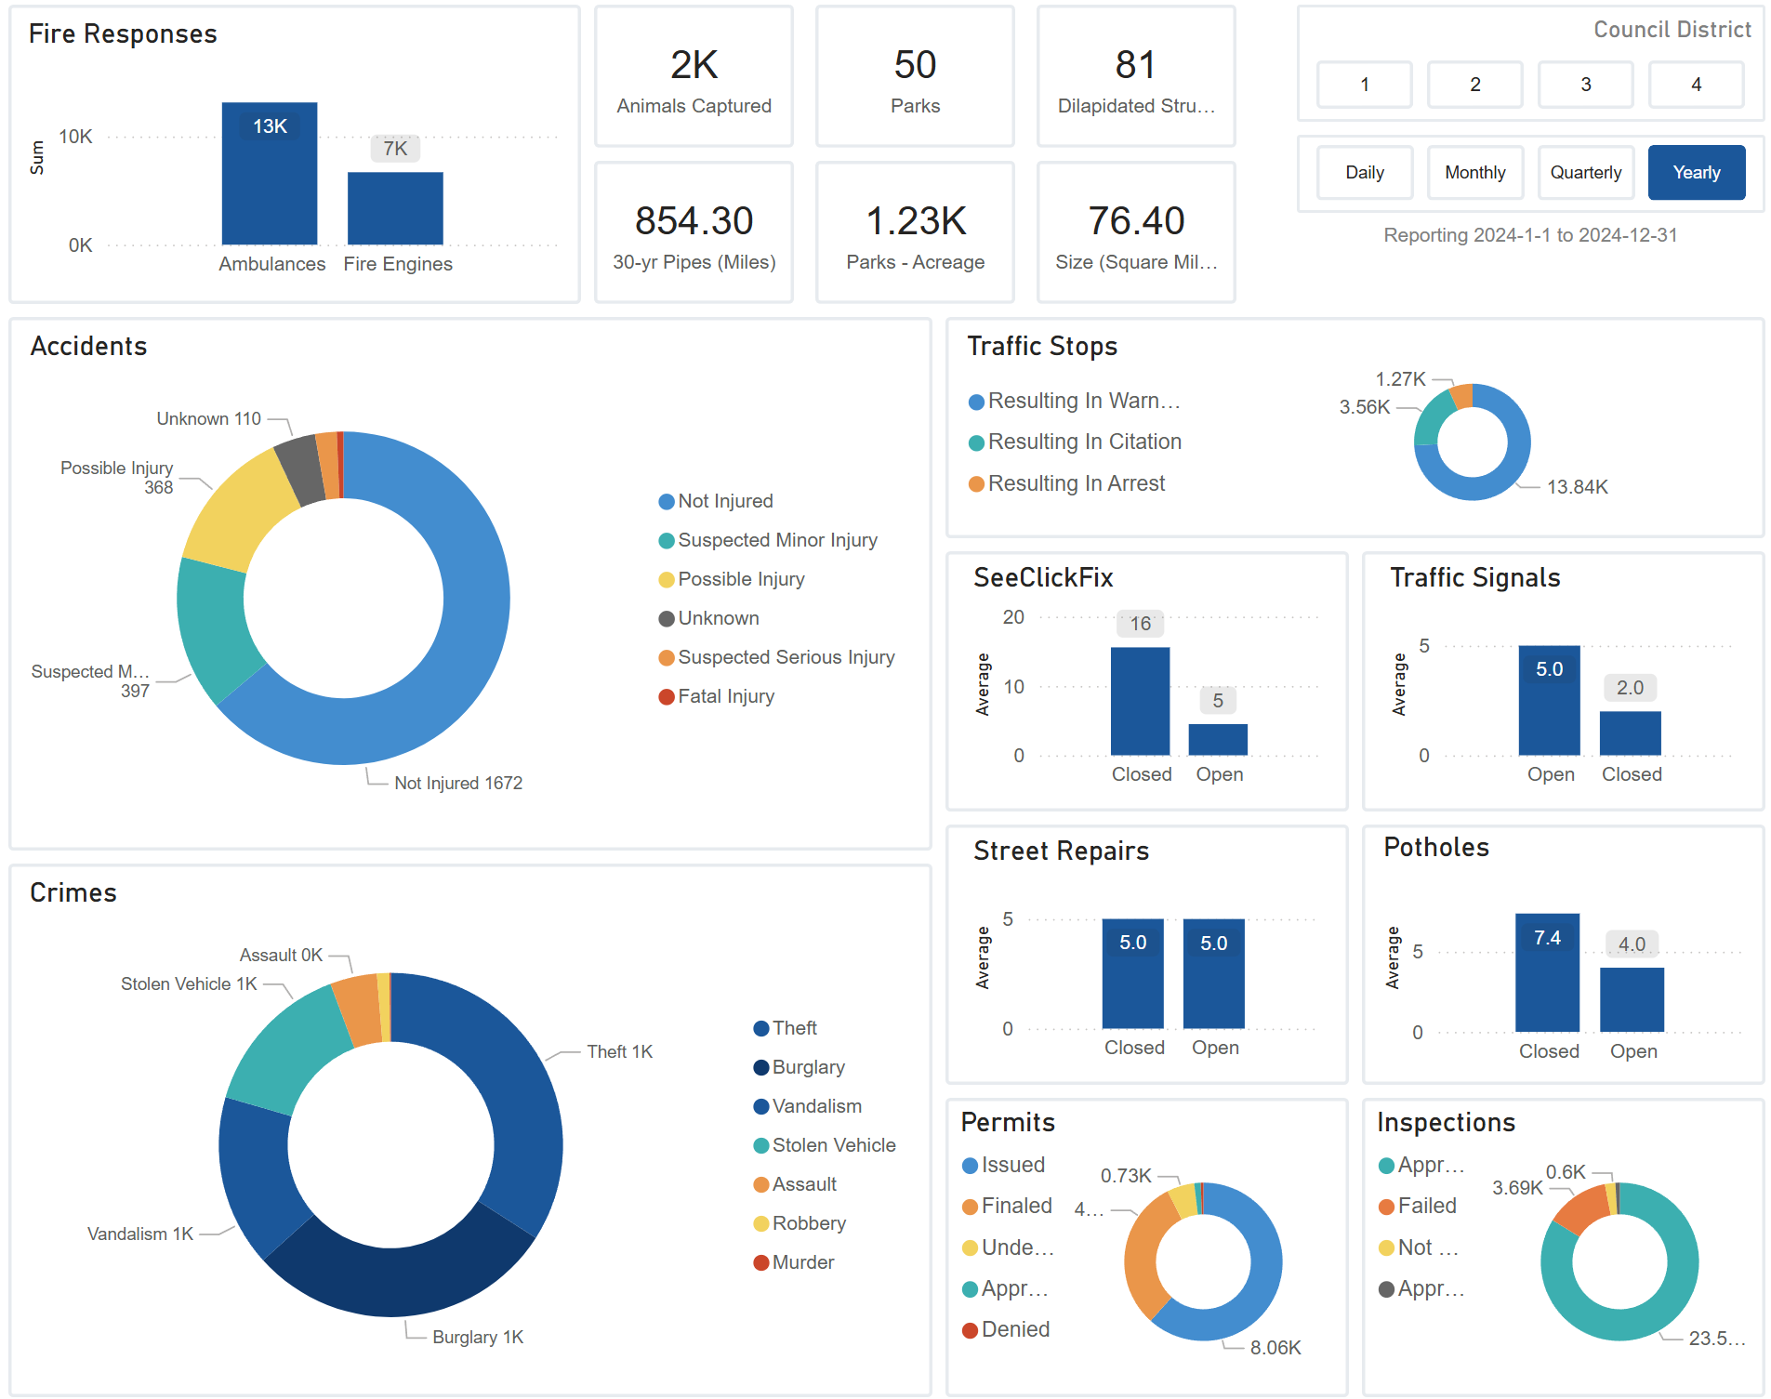
OPERATIONAL DASHBOARD
82

Slide 83
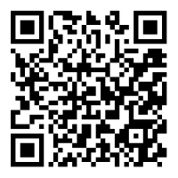
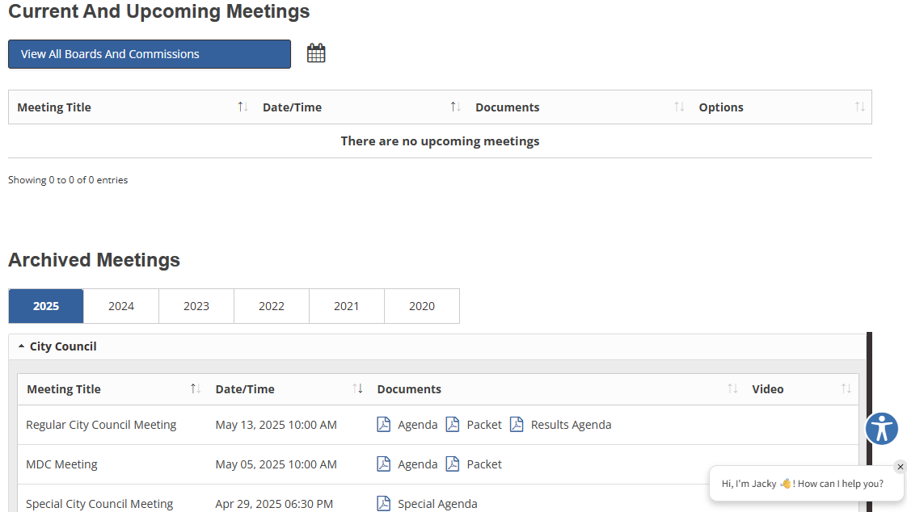
MEETINGS AND AGENDAS
83

Slide 84
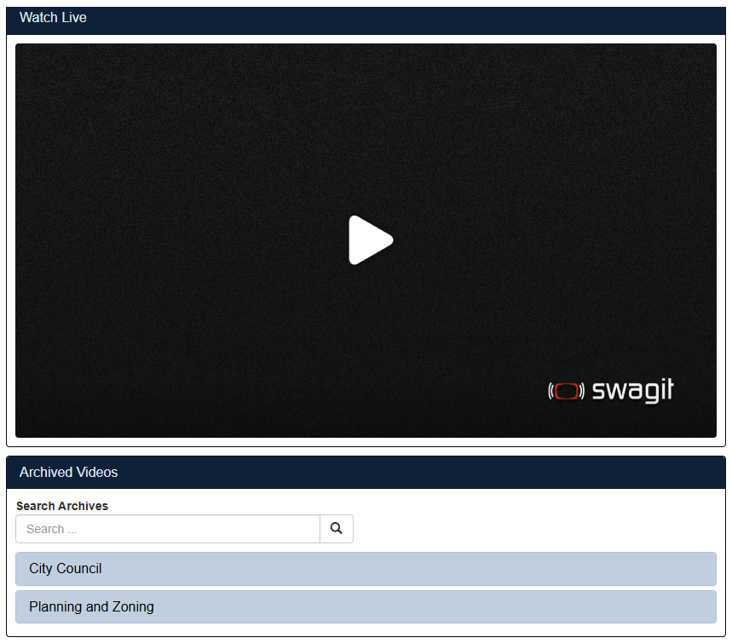
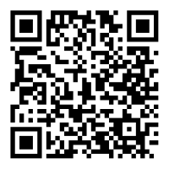
LIVE COUNCIL MEETINGS
84

Slide 85
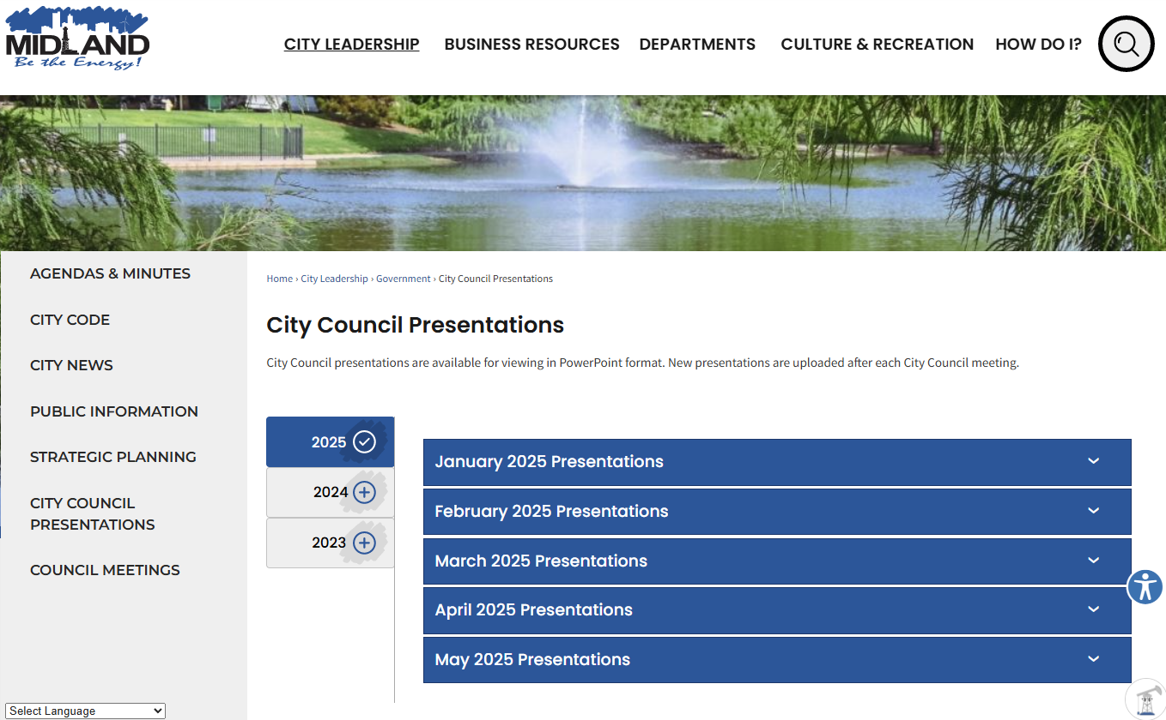

COUNCIL MEETING PRESENTATIONS
85

Slide 86

MISSION
Deliver exceptional services and promote a high quality of life and place for ALL our citizens.

