Slide 1

BUDGET UPDATE
TITLE HERE
TITLE HERE
JUNE 10, 2025

Slide 2

ALIGNMENT WITH STRATEGIC PLAN
Goal 5: Provide Sound Governance & Fiscal Management
5.7 Ensure Continued Financial Stability and Accountability: Maintain Financial Transparency.
2
Notes:
We have worked hard to be very transparent and will continue to demonstrate that with our upcoming budget presentations.

Slide 3

WHAT WE WILL COVER
5-Year Forecast
Best Practices Implemented
Funding Our Priorities
3
Notes:
We will go over our projected 5 year FORECAST. As well as going over some of the practices we have implemented over the last two years, streamlining our processes, and doing more with limited resources.

Slide 4

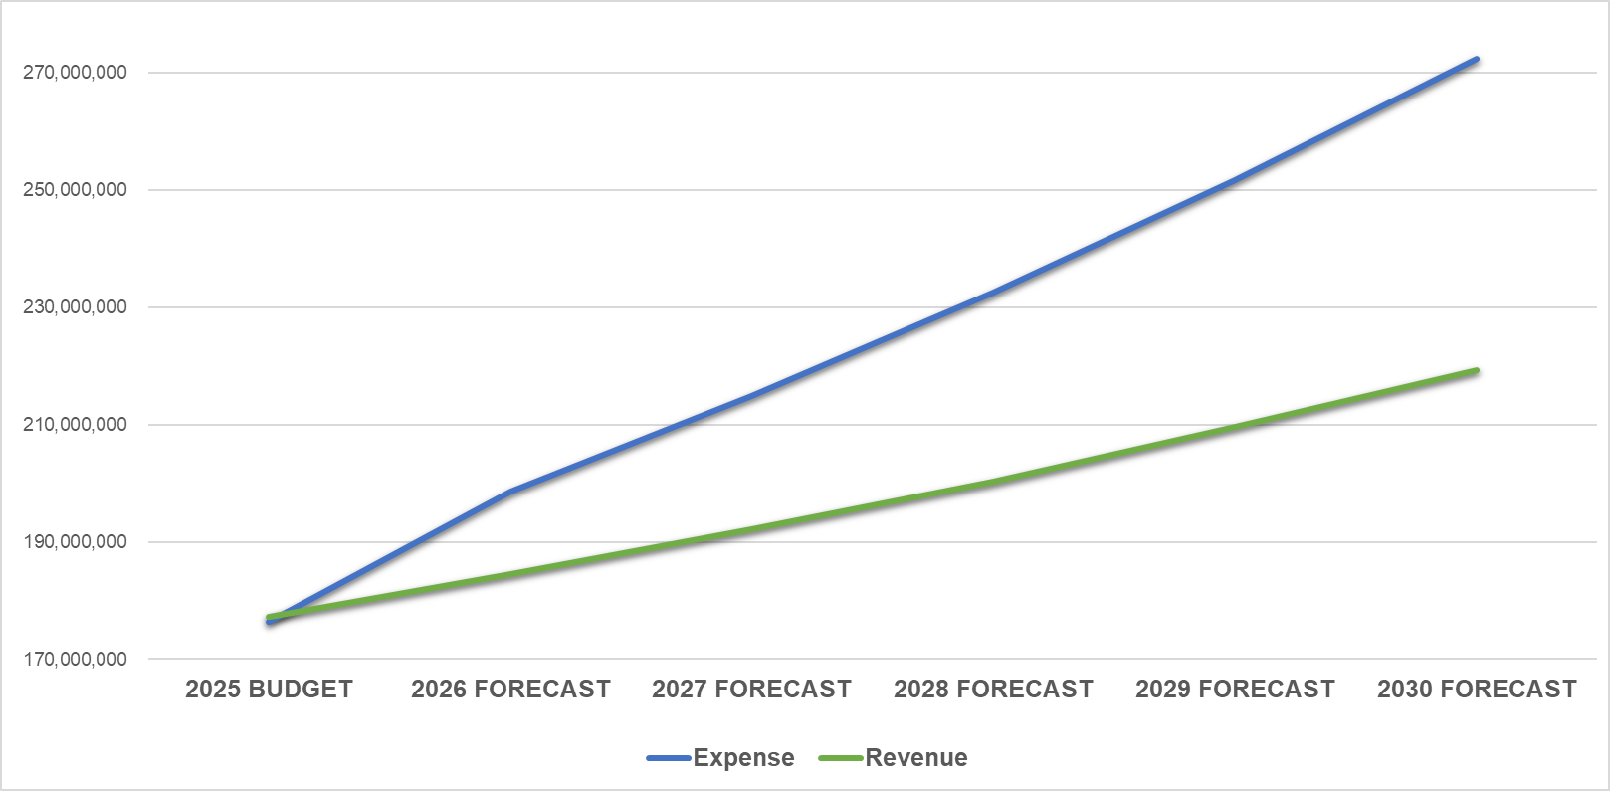
5-YEAR FORECAST
Average Annual Expense Increase, +8.1%
Average Annual Revenue Increase, +4.2%
Forecast for expenditures outpace revenue by 3.9%.
4

Slide 5

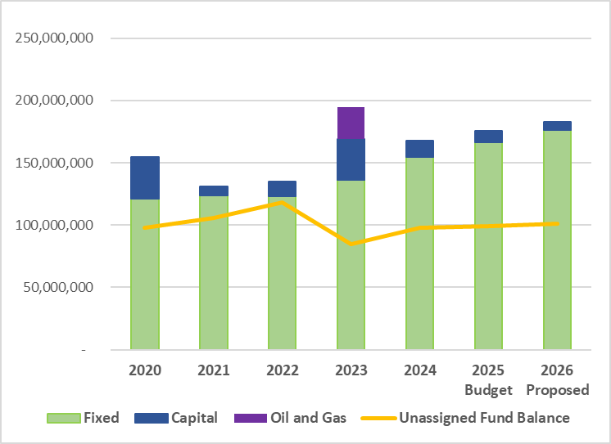
FIXED COST VS CAPITAL COSTS
5

Slide 6
FIXED COSTS INCREASES
EXPENSE | INCREASE
Chemicals | 30% - 100% and higher
Software renewals | 35% and higher
Heavy trucks and equipment | 35%-50%
Construction Materials and Labor | 35% - 100% and higher
Health Insurance | 21%
6
Notes:
We have worked hard to be very transparent and will continue to demonstrate that with our upcoming budget presentations.

Slide 7

SOUND GOVERNANCE:
BEST PRACTICES IMPLEMENTED
Audits
Hotels and Motels = $500K
Sales Taxes – in process
Franchise Fees – in process
Internal Process Improvements
Water $10M
Collections $300K
Results: Cost Savings and Revenue Increases
EMS Item on Council – Best Practice
7

Slide 8

FINANCIAL DISCIPLINE
Eliminated Subsidies
Airport ~$1M a Year Benefit
Golf Course ~$700K a Year Benefit
Health Insurance Fund
Reviewed with Consultant
Build Rate Stabilization Fund (3 Years)
Protects Against Downturns in Tax Revenue
Self Supporting Funds
Enterprise Funds Can Pay for Themselves
Internal Service Funds are Structured to Replace Equipment when Needed
8

Slide 9

FINANCIAL ACCOUNTABILITY
Zero Audit Findings
Highlights Strong Internal Controls
Extends to Critical Cybersecurity Controls
Sets Tone for Excellence and Continuous Improvement
Reinforces Credibility with the Public
Demonstrates Financial Stewardship
Not an Accident – Result of Intentional Effort, Consistent Policy and Culture of Accountability
9
Notes:
“Zero findings don’t happen by accident. They’re the result of intentional effort, consistent policy, and a culture of accountability. It’s not just a finance win—it’s a win for the entire city organization and our residents

Slide 10

NEW COSTS ABSORBED
Street CO $2.1M Debt Service
$2.2M Cost Increases for Health Insurance
$500,000 per Year for Fire Fighter Retirement Fund
10

Slide 11
EXAMPLES OF FUTURE NEEDS
MISD Infrastrucure
True Cost of Road Maintenance
Park Maintenance Increases
Dwindling Sports Complex Fund
11

Slide 12

FY2025 TAX RATES – PEER CITIES
Municipal Tax Bill on a $300,000 Valuation Property
12

Slide 13

PUBLIC SAFETY VS PROPERTY TAX REVENUE
13

Slide 14
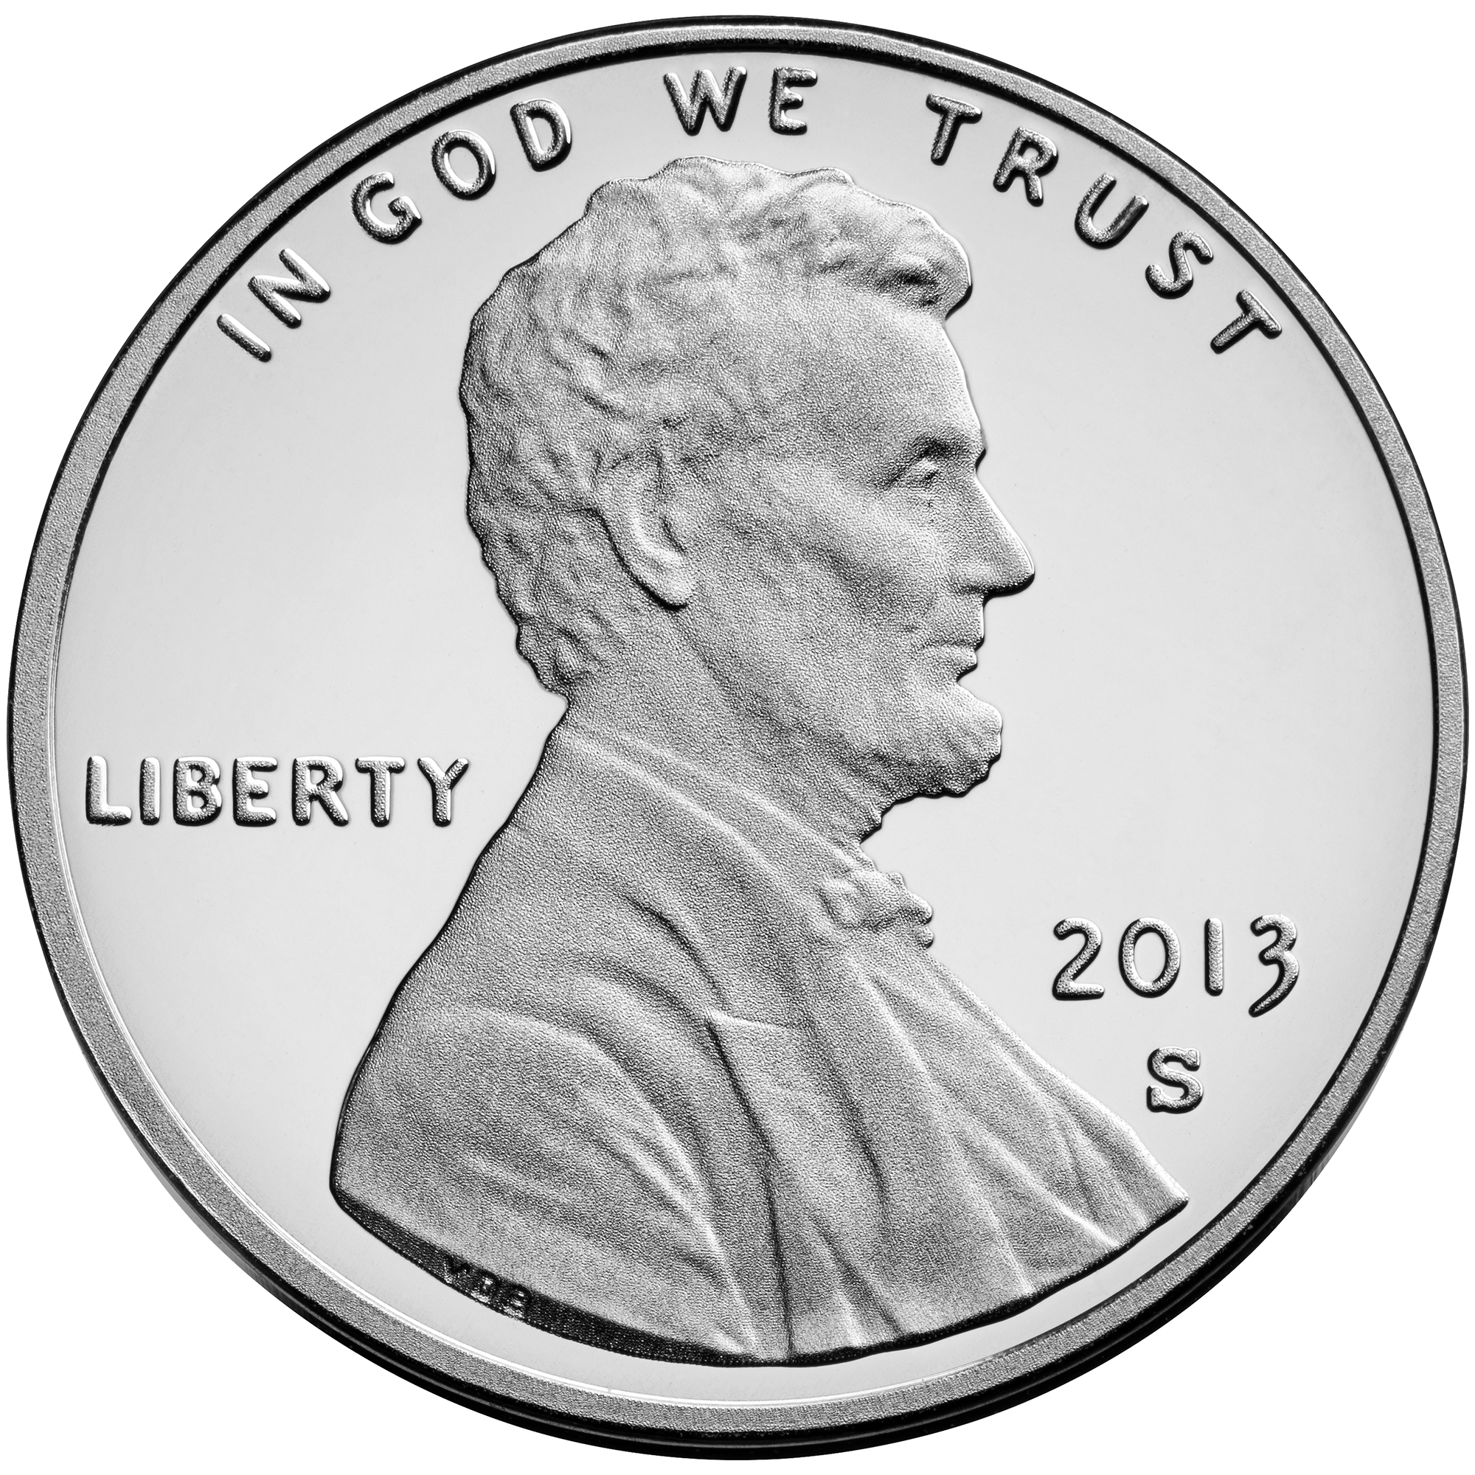
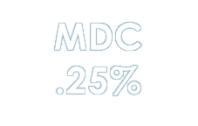
SALES TAXES BY ENTITY
City of Midland Revenue Streams
Property Taxes
Sales Tax
Fines and Fees for Services
City of Midland Sales Tax Rate is 1.00% -
Many Texas Cities Enjoy the Full 2.0%
Midland County, .50%
Midland Memorial Hospital, .25%
Midland Development Corporation, .25%
This loss amounts to $66.5M Annually
City
1.00%
County
.50%
Hospital
.25%
14

Slide 15
SALES TAX RATES BY CITY
1.00%
15

Slide 16
Historical Tax Levy fy2005 to fy2025 (Represented In Cents PER $100 VALUATION)
16

Slide 17
PROPERTY TAX RATES: FY2023 – FY2025
Reduction of 64 Tax Basis Points
17

Slide 18
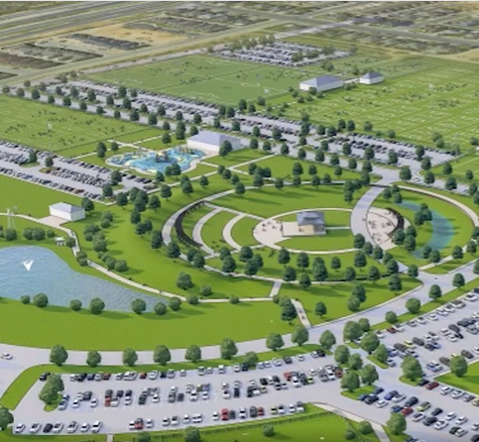
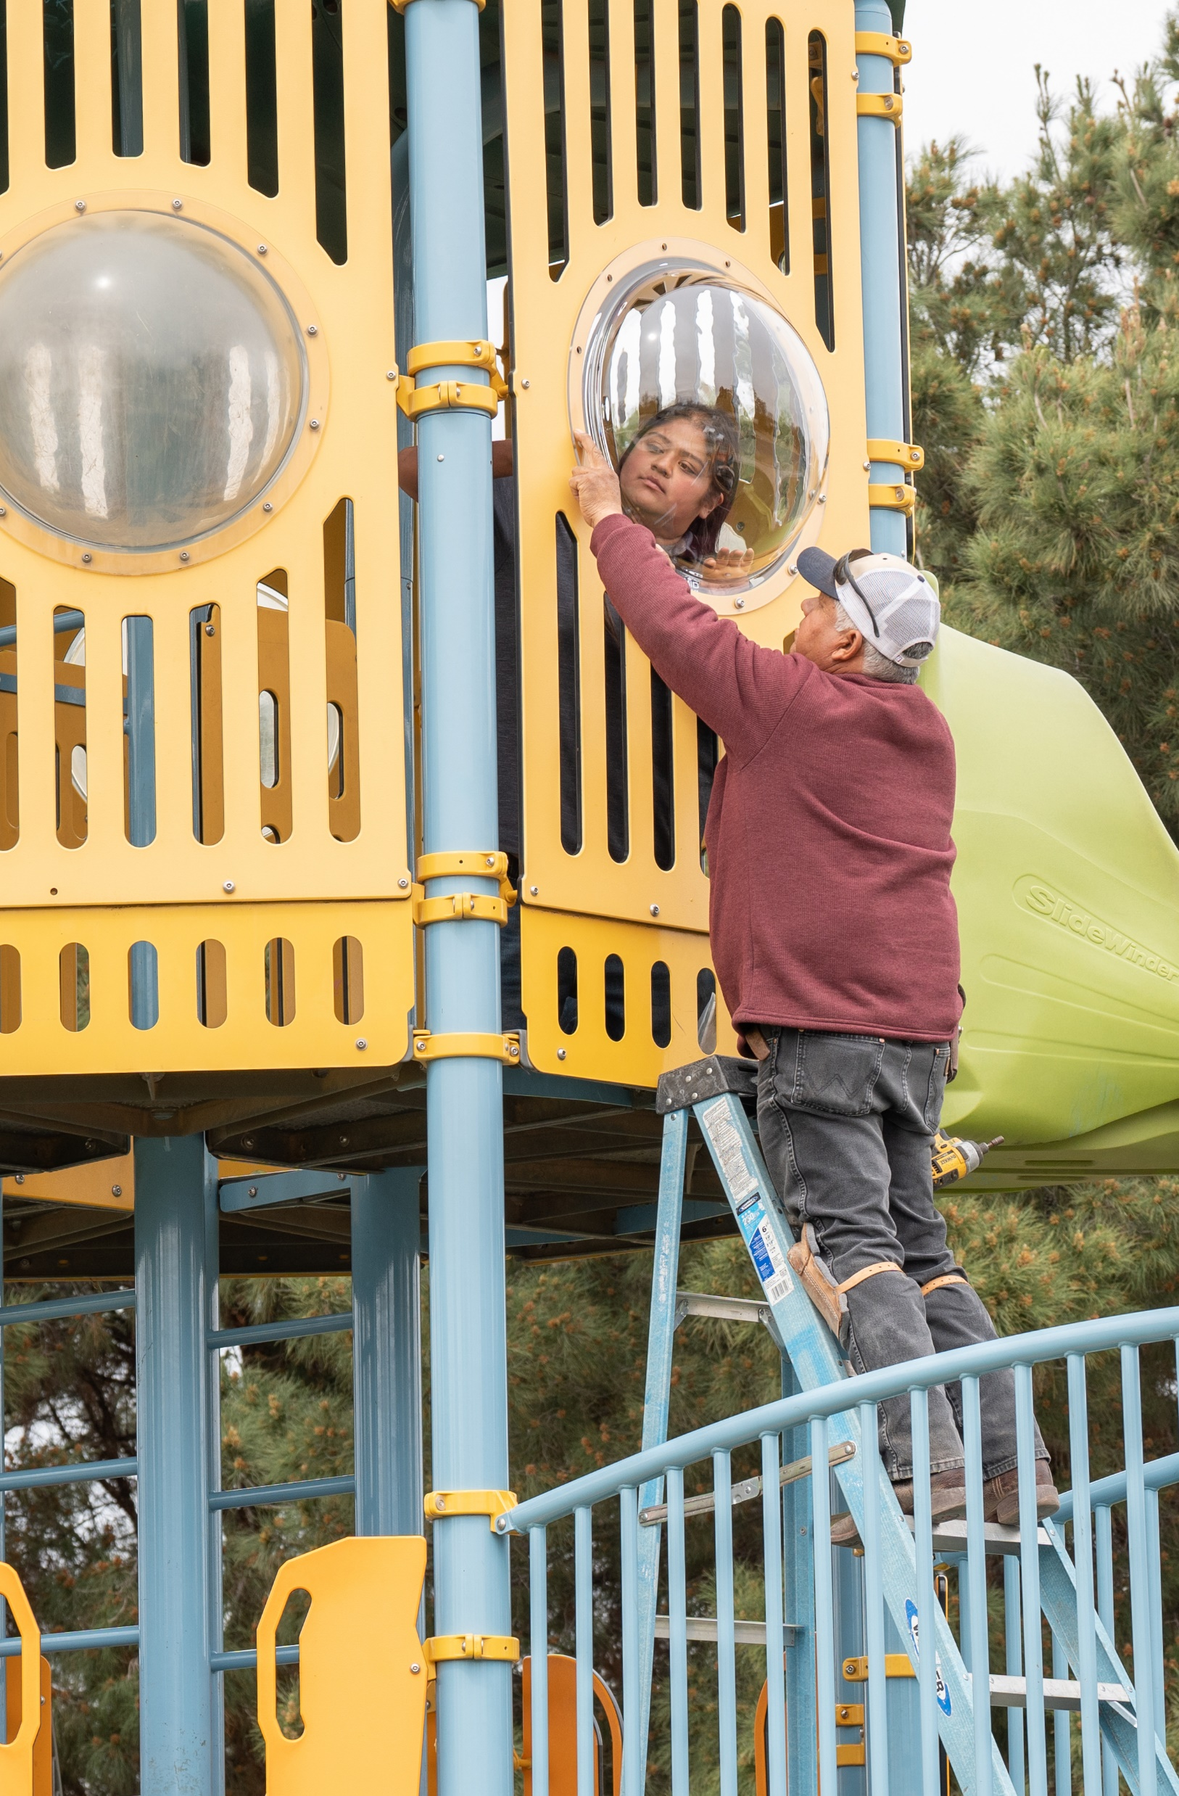

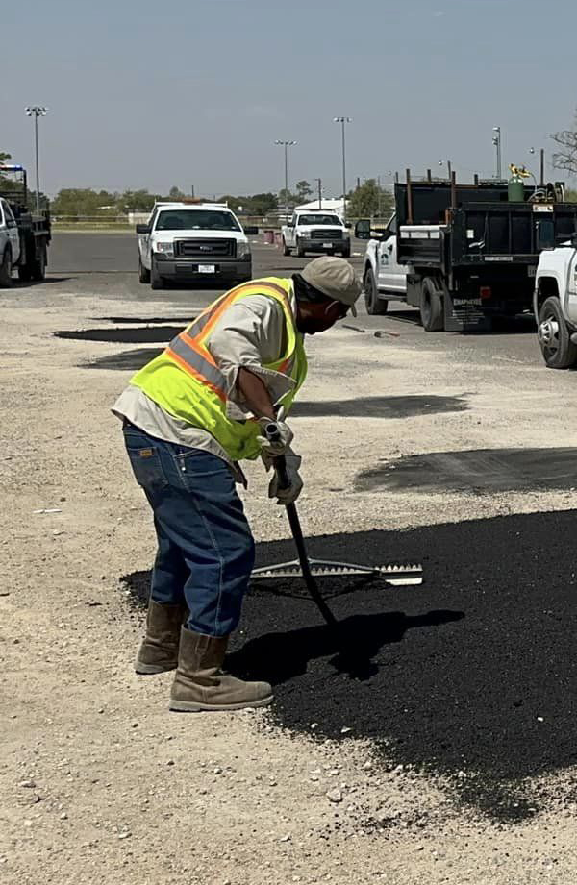
SOUND GOVERNANCE
Plan
People
Process
Performance
18
Notes:
We have demonstrated SOUND GOVERNANCE by Implementing our Plan, Activating our People, Improving our Processes, and Driving Excellence in Performance

Slide 19

MISSION
Deliver exceptional services and promote a high quality of life and place for ALL our citizens.

Slide 20
FY2025 TAX – PEER CITIES
*PER $100 VALUATION
20

Slide 21
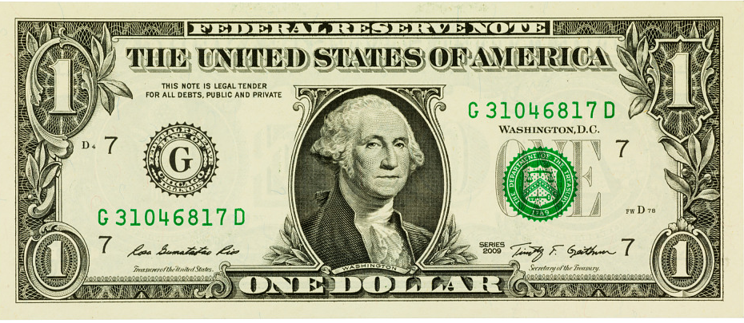
FY2025 PROPERTY TAX BY ENTITY
Hospital
$.05
$.23
City of Midland
College
$.05
$.58
MISD
County
$.09
21

