Slide 1

Weeds & Grass Ordinance Amendment

Slide 2

STRATEGIC PLAN ALIGNMENT
Goal 2. Set the Standard for a Safe and Secure City
2.3 Implement Effective Code Enforcement Strategies
2.4 Revitalize Neighborhoods
Goal 3. Quality of Life and Place for Recruitment and Retention
3.3 Create an Attractive and Inclusive Living Environment
3.4 Establish Beautification Programs
3.4.1 Elevate the visual experience of high visibility areas

Slide 3
PROPOSED CHANGE
Current code allows:
Weeds or tall grass less than 18 inches
Brush less than 2 feet
Proposed revision:
Set maximum height for weeds and grass to less than 12 inches
No other changes, including to maximum brush regulations or exceptions for weeds and grass 18 inches or greater on certain types of properties, including agricultural properties

Slide 4
PROPOSED CHANGE
§8-6-18 Accumulation of stagnant water, filth, weeds, brush, and debris on lots.
Prohibited accumulations:
4. It shall be unlawful for any person or entity who shall own, occupy, or possess any lot, lots, or premises in the City to allow weeds, tall grass, rubbish, brush, animal refuse, industrial or commercial waste, spoiled foodstuffs, construction or remodeling wastes, or unsanitary matter to accumulate or grow on that property.

Slide 5
PROPOSED CHANGE
§8-6-18 Accumulation of stagnant water, filth, weeds, brush, and debris on lots.
(B) Affirmative defense: It is an affirmative defense to prosecution if any of the following apply:
1. The weeds or tall grass are less than eighteen inches (18”) twelve inches (12”) tall, and the brush is less than two feet tall.

Slide 6
BEST PRACTICES
City | Maximum Weed Height
Midland | < 18”
Odessa | < 12”
Lubbock | < 8”
Amarillo | < 8”
Abilene | < 12”
San Angelo | < 12”
El Paso | < 12”
Fort Worth | < 12”
Dallas | < 12”
Austin | < 12”
San Antonio | < 12”
Houston | < 8”
These maximums apply to residential properties—and often all properties to support public health and neighborhood appearance.

Slide 7
BENEFITS
Public Safety: Reduces fire hazards, deters pests and improves visibility along roads and sidewalks.
Aesthetics: Keeps neighborhoods looking neat and cared for, which makes a better impression on residents and visitors.
Property Values: Maintained lots contribute to higher property values and attract potential buyers or investors.
Staff Time & Resources: Lowers the need for repeated inspections, enforcement, and abatements—allowing staff to focus on other community priorities.

Slide 8



MISSION
Deliver exceptional services and promote a high quality of life and place for ALL our citizens.

Slide 9

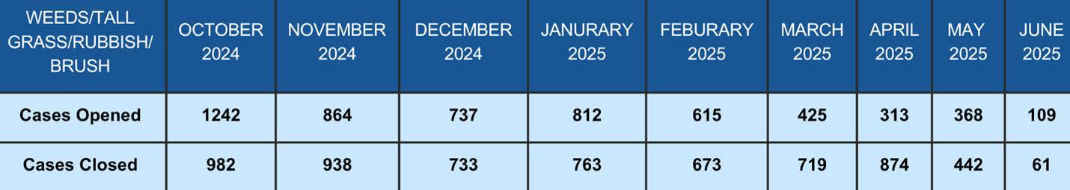
Weeds/Tall/Grass/Rubbish/Brush
The chart above shows the number of weed- related cases tracked monthly from October 2024 through June 2025.

Slide 10
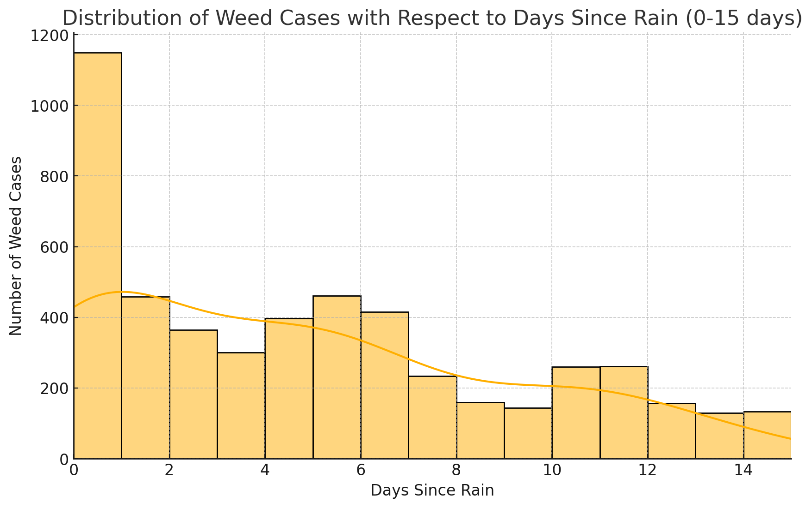
Benefits of Lowering Weed Height

Slide 11
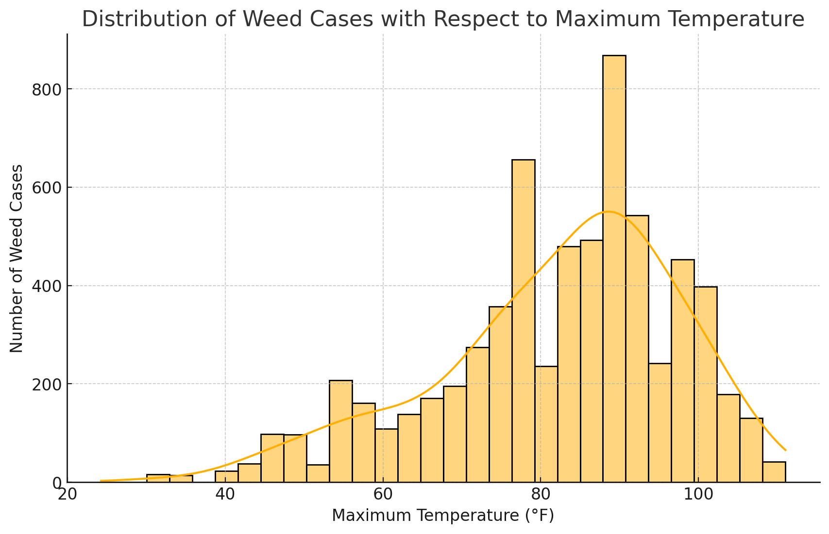
Benefits of Lowering Weed Height

Slide 12
Benefits of Lowering weed Height
Rainfall Effects
Because rainfall is sporadic growth occurs more in a spurt pattern
Takes longer to get to 18 inches meaning yards sit longer unkempt
Weed height change means yards don’t sit as long unkempt before being actionable
Temperature Effects
Weeds become dormant in temperatures above or below optimal growth
If they are less than maximum height Code Enforcement can’t abate
Adds to prolonging the problem

