Slide 1

DELIVERING RESULTS THROUGH EFFICIENCY
JUNE 24, 2025
TITLE HERE
TITLE HERE
Notes:
Good Morning/Afternoon Mayor and Council. Taylor Novak, Chief Of Staff
Thank you for the opportunity to share an update on the progress we’re making across our organization. This presentation isn’t just about financial numbers or savings — it’s about the intentional, strategic shift we’ve made as a city government to become more efficient, more innovative, and more accountable.
What you’ll see today reflects how far we’ve come. We’re:
Closing financial gaps without raising taxes. In fact, under your leadership we’ve lowered the tax rate two years in a row-with plans for a third in the upcoming budget.
Recovering millions that would’ve been left on the table
Eliminating inefficiencies that cost time and money
And ensuring enterprise funds, like the Airport and Golf Course, are operating like businesses — standing on their own
None of this means we’re perfect. But what it does mean is that we are a learning organization. We’re committed to improving every single day — across every department. That includes owning our mistakes, correcting them, and using them as fuel to get better. That’s the culture we’re building. That’s the Midland we’re delivering.

Slide 2

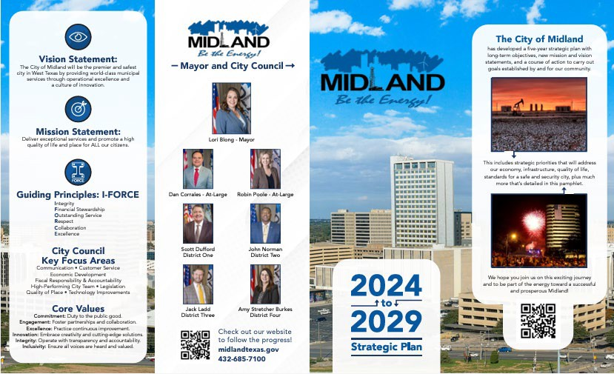
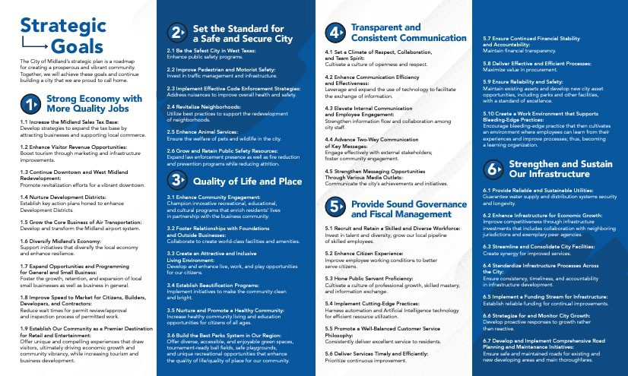
A STRATEGIC START: COUNCIL’S VISION
Council asked for a forward-looking strategic plan; a living document, not one that was just sitting on a shelf.
We delivered with clear priorities, long-term forecasts, and strong fiscal planning.
The result: Foundation set for a resilient, high-performing government.
2
Notes:
Your leadership as a Council has been clear: build a stronger, smarter city. This began with your support for a strategic plan that doesn’t just meet today’s needs — but establishes a solid, forward-looking foundation for the future.
That means:
Clear priorities
Long-term forecasting
Responsible budgeting
And an expectation that we operate like a high-performing organization.
The success we’re reporting today began with your vision. This Council made it clear: Midland needed a strategic plan — not just for today’s needs, but to build a stronger foundation for the future.
You asked for forward-looking planning, data-driven decision-making, and sound fiscal discipline. And as a team, we are delivering that together.

Slide 3

FACING THE FUTURE: 5 YEAR FORECASTS
🟦Why It Matters:
Forecasting is a Best Practice among high performing cities and organizations.
Helps us Plan ahead and anticipate future needs.
📊What it Tells Us:
Our 5-Year forecast identifies a future financial gap.
This gap is not due to overspending but the Result of:
Rising Costs
A Growing Population
A limited tax base
💡What it Reinforces:
the need for long-term discipline
Importance of innovative financial Strategies
That we must continue to find way to close the gap year by year
3
Notes:
A major part of our strategic approach — and a hallmark of high-performing organizations — is planning ahead, not just managing year to year. This Council made it clear from the beginning: you wanted a forward-looking financial forecast to help guide decisions.
You asked for a clear picture of where we’re headed — and we delivered that through the 5-Year Financial Forecast.
This forecast isn’t just an internal tool — it’s a shared accountability mechanism. And we’ve been honest about what it tells us:
We have a structural financial gap.
This is because the cost of doing business keeps rising, while our core revenues — property and sales taxes — are limited.
Everything from salaries to asphalt, costs more than it did just a few years ago. Meanwhile, our community’s expectations continue to rise — and rightly so. Midland is growing. But our resources are not keeping pace at the same rate.
Here’s the key: we’re not waiting for that gap to force tough decisions. We’re acting now — because that’s what you as a Council asked us to do.
We’re closing that gap through:
Efficiencies
Revenue recovery, both recurring and one time
Better processes
And a more disciplined, accountable culture across departments
The 5-Year Forecast you asked for is doing its job — it’s showing us where we need to go, and today’s presentation shows how far we’ve already come in moving toward that goal.

Slide 4

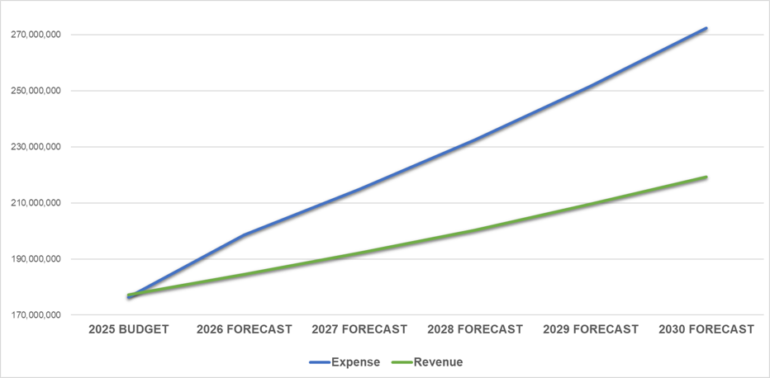
FACING THE FUTURE: 5 YEAR FORECASTS
Average Annual Expense Increase, +8.1%
Projected Funding Gap We Must Close
Average Annual Revenue Increase, +4.2%
Forecast for expenditures outpace revenue by 3.9%.
Notes:
You've seen this slide before (and you will see it again), and I know it may feel repetitive — but it’s critical that we keep bringing it back.
This is the reality we’re preparing for. The gap shown here is not a theoretical "what if" — it's the projected result of rising costs, limited revenue growth, and the increasing service demands of a growing community.

Slide 5
FACING THE FUTURE: 5 YEAR FORECASTS
Notes:
Think of this gap like an accordion — it expands and contracts depending on what’s happening with inflation, capital needs, debt obligations, and economic cycles. But no matter how it shifts, we must have a plan to address it.
We continue to highlight it because it’s the driving force behind everything we’re doing: our innovation, our efficiency strategies, and the financial discipline we're embedding across the organization.
Closing this gap will require ongoing creativity, strong financial planning, and a willingness to challenge the status quo — year after year.

Slide 6

THE MANDATE: GOVERNMENT THAT WORKS LIKE A BUSINESS
TRADITIONAL GOVERNMENT | MODERN GOVERNMENT
Reactive | Proactive
Budget-Heavy | Lean & Strategic
Tax-Dependent | Diversified Revenue
Process-Driven | Outcome-Focused
Manual Workflows | Automated & Digital Solutions
Short-Term Focus | Long-Term, Strategic Planning
Minimal Transparency | Open Data & Communication
One-Size-Fits-All Services | Customer-Centered Service Design
Static Budgets | Rolling Forecasts & Adaptability
6
Notes:
Let me take a moment to step back and explain why this shift matters.
When you think of a traditional government, it often operated with a reactive mindset: budgets were heavy, systems were slow, and too often, the approach was to just do things “the way they’ve always been done.” Revenue came mostly from property or sales taxes, and customer service was more of an afterthought than a goal.
But this Council set a different expectation — and we are hearing you.
We’re embracing the mindset that a city government should operate more like a high-performing business:
We’re cost-conscious in every department.
We’re revenue-smart, identifying creative and new streams beyond property and sales tax.
We’re customer-focused, treating residents not just as users of services, but as people whose experience matters.
And we’re accountability-driven, measuring outcomes, not just effort.
This isn’t about buzzwords. It’s about making decisions rooted in data, strategy, and value.
We’ve moved beyond managing line items. Now we manage results:
We renegotiate contracts instead of renewing them automatically.
We optimize software licenses instead of overpaying for what we don’t use.
We recover dollars that would’ve previously gone uncollected — like the $500K from hotel audits.
And we’re realigning enterprise funds like the Airport and Golf Course so they stand on their own — just like private-sector entities would.
So when we say we’re acting like a business, it’s not a slogan — it’s a shift. And it’s one that’s helping us serve more people, more effectively, with the same limited dollars.
But how do we know it’s working?
We’re measuring outcomes through two key methods:
1. Key Performance Indicators (KPIs): Every department is tracking what matters — from service turnaround times to maintenance response rates to permit processing, as you just heard. These aren’t vanity metrics. They’re practical, operational signals that help us identify gaps, spot inefficiencies, and make better decisions — faster.
2. Survey Data: We’re listening. Whether it’s internal staff surveys or resident feedback from SeeClickFix and citywide outreach, we’re using that input to adjust and improve — in real time. These insights shape hiring, budgeting, and customer experience — not just process improvement on paper.
Together, these tools are building a feedback loop. One that helps every department learn, adapt, and grow stronger every quarter.
So yes — we’re acting like a business. But more importantly, we’re acting like a learning organization. One that values progress over perfection and performance over paperwork. And that shift is starting to take root — across teams, service lines, and interactions.

Slide 7

REAL RESULTS FROM A STRATEGIC APPROACH
RECURRING EFFICIENCIES
Department/Area |  | Type | Amount
Utilities | Strategic Policy Changes & Process Improvements | Revenue | $10,000,000
ITSD | Enterprise IT Optimization | Savings/Cost Avoidance | $870,000
Utilities | Asterra Annual Leak Detection - Water Savings | Savings/Cost Avoidance | $2,101,980
Human Relations | Pre-employment Medical Testing Overhaul | Savings/Cost Avoidance | $500,000
Parks & Recreation | Hogan Golf Course YEARLY Subsidy Elimination | Savings/Cost Avoidance | $700,000
Airport | Airport YEARLY Subsidy Elimination | Savings/Cost Avoidance | $1,000,000
Utilities | Asterra Annual Leak Detection - Energy Savings | Savings/Cost Avoidance | $28,412
Total |  |  | $15,200,392.00
7
Notes:
Let’s zoom in on what this really looks like in action — because strategy without execution is just a plan on paper.
This slide is the proof point of what happens when strategy turns into action.
Across departments — from Utilities to Human Resources to IT — we’ve challenged ourselves to rethink how we operate. Not just to do things more cheaply, but to do them smarter, with more intention, more measurement, and more accountability.
And the result? $15.2 million in recurring, annual efficiencies — dollars that strengthen our base budget every single year going forward. That includes $10 million (and growing) just from billing reforms and policy changes in Utilities — getting our house in order and making sure we bill fairly and accurately.
It includes nearly $900,000 in IT savings — simply by eliminating software we don’t need or no longer use, calling vendors, renegotiating licenses, and tightening what we pay for.
We’ve reduced pre-employment medical testing costs, eliminated unnecessary subsidies, and even saved more than $2 million just by finding and fixing leaks in the water system, and saving water.
These aren’t one-time wins — they’re structural improvements. That means they benefit us year after year. They help to close the gap in the general fund outlook, reduce future budget pressure, and give us breathing room to invest in what matters. In five years time, that is $76 Million, just from these savings and revenue increases alone.
And again, this is just the beginning.
Last Council Meeting, you approved an EMS billing and collections contract to better collect on EMS and Ambulance services, largely from insurance companies— and that’s just one of several initiatives already underway that will grow these savings even further. There are additional efforts in motion — some early-stage, some pending validation — and while we’re not ready to report all of them just yet, we’re confident they’ll push these numbers even higher.
So when we say this is working, it’s not just anecdotal. It’s measurable. It’s repeatable.

Slide 8

STRATEGIC WINS THAT FUND THE FUTURE
ONE-TIME EFFICIENCIES
Department/Area |  | Type | Amount
Multiple | Fire Fighter Pension Obligation Bond Avoidance | Savings/Cost Avoidance | $60,000,000
Engineering | FHWA Safe Streets and Roads for All | Grant | $8,664,368
Airport | Airport Pay Back | Cost Recovery | $5,400,000
Finance | Hotel Occupancy Tax Audit | Cost Recovery | $530,000
Parks & Recreation | Beal Park | Private/Public Partnerships | $16,800,000
Parks & Recreation | Grasslands Park | Grant | $150,000
Parks & Recreation | Wildcatter Trail | Grants | $6,667,495
Utilities | Collection of Delinquent Accounts Receivable | Cost Recovery | $298,043
Airport | Federal ATP Grant for terminal modernization | Grant | $2,800,000
Total |  |  | $101,309,906
Notes:
Following the recurring efficiencies, this slide tells the rest of the story — the one-time wins. These aren’t about trimming fat; they’re about being bold, strategic, and proactive.
This is $101 million in financial impact — made possible through intentional efforts across departments and through Council direction.
Starting at the top:
The $60 million in pension obligation bond interest avoidance was a joint effort between City Council and the Midland Fire Department. It avoided locking taxpayers into decades of interest payments that would’ve gone straight to Wall Street.
This decision kept $60 million off the backs of residents — and kept those dollars local. That’s meaningful, long-term impact.
Looking at the Airport Payback:
This wasn’t new revenue — it was the Airport refunding the General Fund for a prior subsidy.
But what made that possible is even more important: we corrected our enplanement fee structure for the airlines, which means that going forward, the Airport can sustain itself — and we don’t have to keep backfilling with general fund dollars.
Across the board, we’ve taken steps to make one-time dollars do more:
$15 million in infrastructure and mobility grants to reduce local burden.
$530,000 recovered from hotel and motel audits — dollars that belonged to taxpayers, now back in the City’s hands. And enough, may I remind you, to pay for Midland’s Merry Lights in the first year.
$16.8 million in public-private leverage at Beal Park, which would’ve never been possible without the strategy in place.
And even more, with trail and park grants, utility collections, and capital reimbursements — all adding up. Little by little.
Altogether, these one-time wins total more than $101 million. But even more importantly, these types of wins weren’t happening before — not at this scale, and not with this level of coordination.
These outcomes are the direct result of a plan. A financial forecast. A strategy. All of which have only been in place for the last 18 months. That’s the difference leadership makes.
This is what happens when you stop waiting for opportunities — and start building systems to find them.

Slide 9

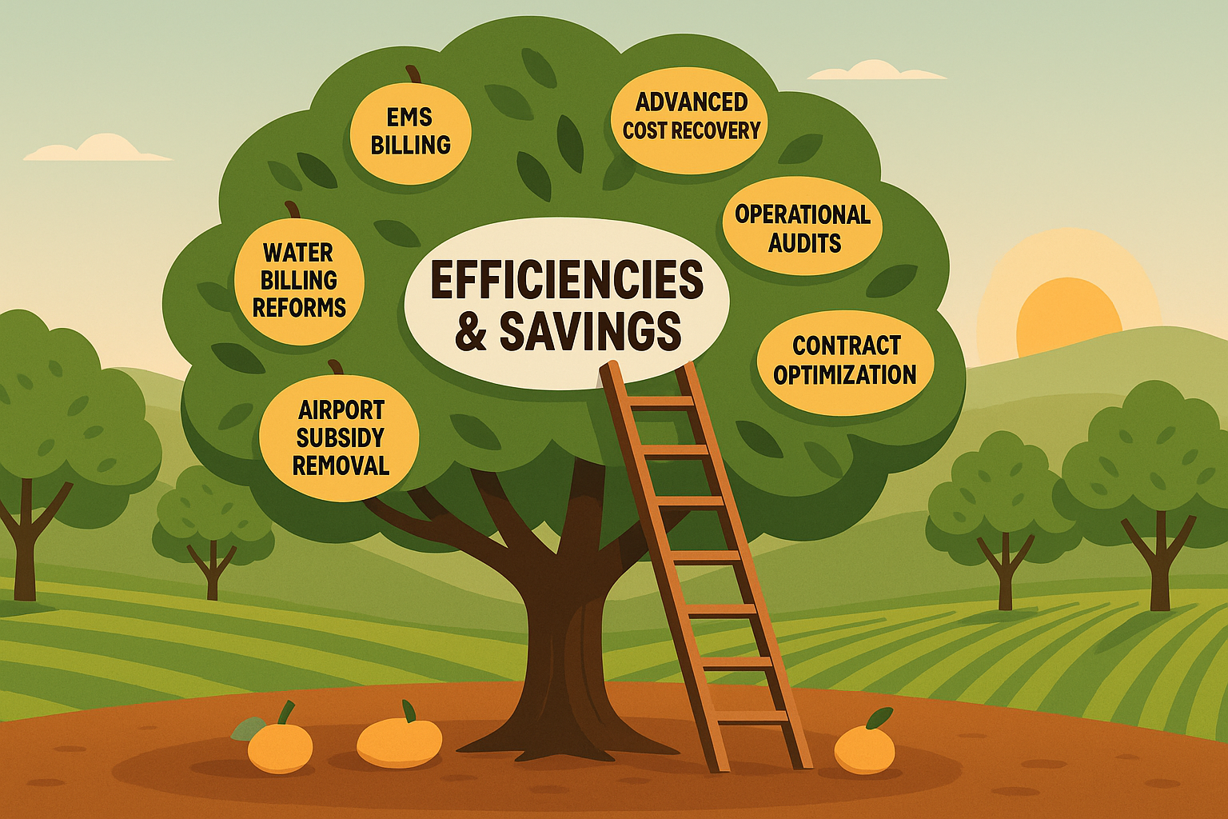
WHERE WE GO FROM HERE
Strategic Progress and the Climb Ahead
9
Notes:
This presentation is just a snapshot — a high-level look at the work underway across the City of Midland to deliver more with what we have. We’ve tried to capture as much as possible without overwhelming anyone, but this is far from the full story.
We’ll continue to report on efficiencies and savings — both recurring gains that build our base budget and one-time wins that create capacity to reinvest.
And it’s worth saying clearly: much of what you’ve seen today would not have happened without this Council’s vision. These wins — whether through grants, cost recovery, or smarter management — have been made possible because we now have a strategic plan and five-year financial forecast in place. Most of these results have come in just the last 18 months.
At this stage, we’ve gathered much of the low-hanging fruit. The obvious fixes. The foundational changes. Now, like an orchard that’s been well-tended, the next fruit is higher up — still there, still valuable, but harder to reach. That means grabbing the ladder.
It will take more creativity, more coordination, and yes — more risk. But with that risk comes greater reward. The most forward-thinking governments — like the most successful companies — push past routine. They think differently, act decisively, and stay committed to improvement.

Slide 10

MISSION
Deliver exceptional services and promote a high quality of life and place for ALL our citizens.
Notes:
Thank you! As a reminder all of our presentations are made available online after the council meetings, I’m happy to take any questions or feedback.

