Slide 1

ENTERPRISE FUNDS UPDATE
TITLE HERE
TITLE HERE
June 24, 2025

Slide 2

ALIGNMENT WITH STRATEGIC PLAN
Goal 5: Provide Sound Governance & Fiscal Management
5.7 Ensure Continued Financial Stability and Accountability: Maintain Financial Transparency.
2
Notes:
We have worked hard to be very transparent and will continue to demonstrate that with our upcoming budget presentations.

Slide 3

TYPES OF FUNDS
General Fund – Parent Fund
Enterprise Funds – Self Supportive
Internal Service Funds
Special Revenue Funds
3
Notes:
We will go over our projected 5 year FORECAST. As well as going over some of the practices we have implemented over the last two years, streamlining our processes, and doing more with limited resources.

Slide 4

GENERAL FUND
Limited Revenue Raising Ability – Property Tax
Sales Tax – Volatile
Fees for Services
Police, Fire, Streets, Parks and Recreation, and Animal Services
Parent Fund – subsidizes funds if necessary
Maintains strategic reserves to shield against economic uncertainty – 120 days
4

Slide 5

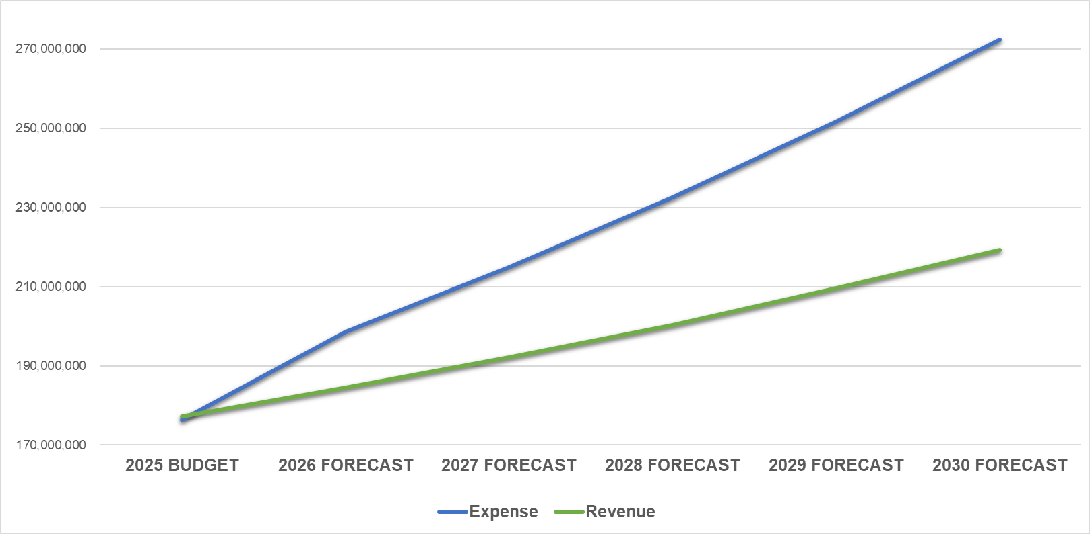
5-YEAR FORECAST – GENERAL FUND
Average Annual Expense Increase, +8.1%
Average Annual Revenue Increase, +4.2%
Forecast for expenditures outpace revenue by 3.9%.
5

Slide 6

FIXED COST VS CAPITAL COSTS
6

Slide 7

FIXED COSTS INCREASES
EXPENSE | INCREASE
Chemicals | 30% - 100% and higher
Software Renewals | 35% and higher
Heavy Trucks and Equipment | 35%-50%
Construction Materials and Labor | 35% - 100% and higher
Health Insurance | 21%
7
Notes:
We have worked hard to be very transparent and will continue to demonstrate that with our upcoming budget presentations.

Slide 8

AIRPORT
8

Slide 9

AIRPORT
9

Slide 10

WATER AND SEWER FUND
Responsible for Safe and Efficient Water Sourcing
Historically Sound
2021-2022 shifted to Expenses Outpacing Revenue
Inflation has affected the costs of Labor, Materials and Construction
Revenue Restructured in 2024 to provide for growth
10

Slide 11

WATER AND SEWER FUND
11
Notes:
We have demonstrated SOUND GOVERNANCE by Implementing our Plan, Activating our People, Improving our Processes, and Driving Excellence in Performance

Slide 12
WATER AND SEWER
12
Notes:
We have worked hard to be very transparent and will continue to demonstrate that with our upcoming budget presentations.

Slide 13
SANITATION
Responsible for Clean and Efficient Waste Collection and Disposal
Historically Sound
Raised rates July 1, 2024 with Revenue Restructure with 2.5% increases needed in future years
13

Slide 14
SANITATION
14

Slide 15

GOLF COURSE HISTORICAL
15
Notes:
“Zero findings don’t happen by accident. They’re the result of intentional effort, consistent policy, and a culture of accountability. It’s not just a finance win—it’s a win for the entire city organization and our residents

Slide 16
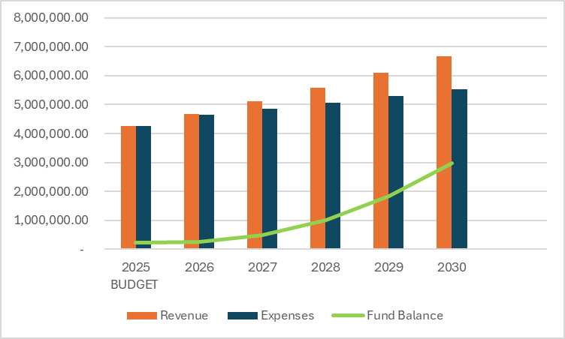

GOLF COURSE RESTRUCTURED
16
Notes:
Total Capital Needs Solid Waste 40,000,00
18 Million 2024 Certificates of Obligation will fund Needs = $40 Million
Includes state mandates
2024 CO ISSUANCE OF $18 Million
Landfill Gas Flare System:
Federal emission guidelines require existing landfills to calculate the annual non-methane organic compounds (NMOC) emission rate. The NMOC emission rate is required until emissions surpass 34 Mg/Yr. Once the emission rate surpasses 34 Mg/Yr. The landfill must construct a gas control system to manage the landfill gas. The City of Midland Landfill is expected to exceed 34 Mg/yr. in 2025. Unfunded Mandate
Estimated Engineering and Gas Flare System Construction Costs: $5,500,000

Slide 17
SPORTS COMPLEX
Citizens Voted to cease 4B Sales Tax - 2017
Fund Balance is decreasing
25-yr old facility – maintenance costs heavy
17

Slide 18
SPORTS COMPLEX – REV vs EXP
18

Slide 19
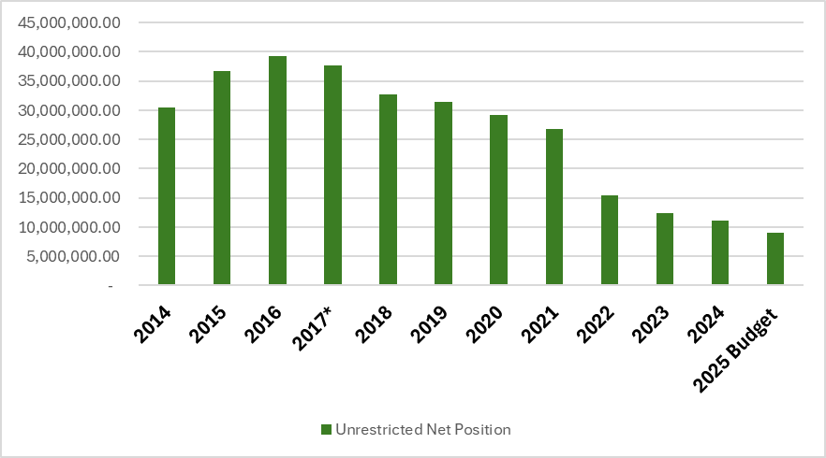
SPORTS COMPLEX – FUND BALANCE
19

Slide 20
INTERNAL SERVICE FUNDS
20
Notes:
Charge Backs
Revenue Sources Come from the external serving departments

Slide 21
HOTEL MOTEL FUND
Promotes Tourism and the Convention and Hotel Industry
Revenue tied to economy
Maintains a Healthy Fund Balance - $19M
21

Slide 22
OIL AND GAS FUND
Revenue is volatile
$54.5M toward Fire Retirement Fund
$2M set aside for Park Maintenance each year
22

Slide 23
CONCLUSION
General Fund – Parent Fund
Enterprise Funds – Self Supportive
Sustainable Rate Structures and Financial Discipline are essential
23
Notes:
We will go over our projected 5 year FORECAST. As well as going over some of the practices we have implemented over the last two years, streamlining our processes, and doing more with limited resources.

Slide 24

MISSION
Deliver exceptional services and promote a high quality of life and place for ALL our citizens.

