Slide 1

PERMITTING & INSPECTIONS UPDATE
JUNE 24, 2025
TITLE HERE
TITLE HERE
Notes:
Good afternoon. Today’s update focuses on the progress we’ve made in permitting and inspections, with a focus on continuous improvement.
We’ll highlight how we’ve responded to increasing volume, introduced new tools, and prioritized transparency, speed, and service.

Slide 2

STRATEGIC GOAL ALIGNMENT
Goal 1: Strong Economy with More Quality Jobs
1.8 Improve speed to market for citizens, builders, developers, and contractors: Reduce wait times for permit review/approval and inspection processes of permitted work
Goal 2. Set the Standard for a Safe & Secure City
2.1 Be the safest city in West Texas: Enhance public safety programs
2
Notes:
Everything we’re doing in permitting and inspections connects back to the broader goals set by Council.
For example, when we talk about reducing review times and speeding up inspections, that’s directly tied to helping builders and developers get to market faster — which supports economic growth and job creation.
Likewise, inspections are not just about checking boxes — they play a critical role in ensuring the safety of our buildings and neighborhoods.

Slide 3

STRATEGIC GOAL ALIGNMENT
Goal 4: Transparent & Consistent Communication
4.2 Enhance Communication Efficiency and Effectiveness: Leverage and expand the use of technology to facilitate the exchange of information
Goal 5: Provide Sound Governance & Fiscal Management
5.6 Deliver services timely and efficiently: Prioritize continuous improvement
3
Notes:
We're also placing a strong emphasis on communication and transparency — both with the public and internally.
By using dashboards and digital tools, we’re making it easier to share accurate, timely information and keep everyone aligned.
And finally, all of these improvements help us deliver services more efficiently and effectively, which supports sound governance and good stewardship of public resources.

Slide 4

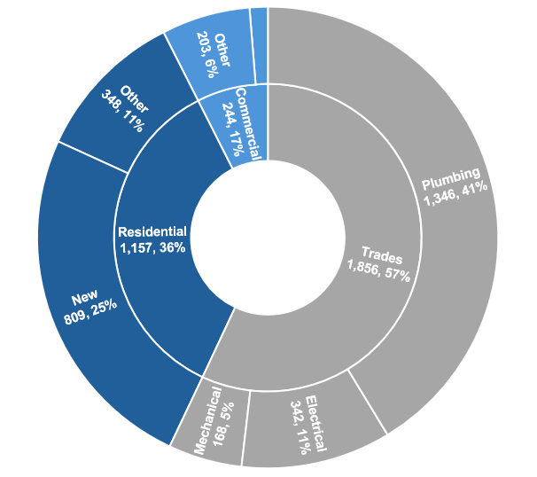
ISSUED PERMIT SUMMARY – FY25 YTD
New
41, 1%
3,257 permits have been issued FY25 to date; 57% are trade permits, mostly over-the-counter
Residential permits make up 36%, including 25% for new single-family homes
Commercial permits make up 7% of all permits issued
Notes:
To date, we’ve issued 3,257 permits in FY25.
57% are trade permits, most handled over the counter.
We focus our review timelines on residential and commercial permits, which require more detailed coordination and technical review.
Residential permits account for 36%, including 25% for new single-family homes.
Commercial permits make up 7%, typically more complex projects.

Slide 5
NEW SINGLE-FAMILY PERMITTING
Single-family volume up 27% this year, 41% over three years (projected)
Average review time cut from 7.2 to 1.6 days since FY23
Average issue time down to 7.3 days from 11.9 in FY23
FY23
FY24
FY25
Notes:
Single-family demand is surging: We’re on track for 1,164 permits this year, a 27% increase from last year’s 915.
That’s a 41% increase in total workload over three years — from 826 in FY23 to 1,164 projected this year.
Despite the growth:
Average review time dropped from 7.2 to 1.6 days
Average issue time decreased from 11.9 to 7.3 days
Our internal goal is ≤ 3-day review time, and we’re consistently meeting or approaching that, even with rising volume.
Occasional spikes are almost always due to incomplete submittals or applicant delays, not City performance.
Why this matters: Fast, consistent reviews reduce delays, support timely construction starts, and build trust with developers.

Slide 6
NEW COMMERCIAL PERMITTING
Average review time cut from 16.1 to 3.5 days (FY24 – FY25)
Average issue time down from 53 to 29 days since FY23
Lower volume ≠ less complexity; refining processes remains critical
FY23
FY24
FY25
Notes:
New commercial permit volume is down from 85 in FY24 to a projected 49.5 in FY25.
Still, we’ve made major efficiency gains:
Review time dropped from 16.1 to 3.5 days
Issue time fell from 53 to 29 days
We’re consistently staying below our 3-day review goal.
Longer issue times often stem from applicant delays or multiple rounds of revisions, not internal bottlenecks.
Commercial projects often involve extensive coordination, so continued process refinement is key to reducing uncertainty and maintaining momentum.

Slide 7
BUILDING INSPECTIONS
Inspection volume up 27% since FY23, with no increase in staffing
On-time completion within 1 business day of inspection request improved from 94% in FY23 to 96% in FY25, despite higher demand
FY23
FY24
FY25
Notes:
Inspection volume has grown by 27% since FY23 — from 22,049 to a projected 27,969 in FY25.
That’s an increase from 1,837 to 2,331 average monthly inspections.
Despite no increase in staffing, we’ve maintained 96% on-time completion, up from 94% in FY23.
A recent dip below the 95% goal was temporary:
No added staffing means one person out can ripple across performance.
In April, technical issues with Energov delayed syncing, which affected how quickly inspections were logged.
Even with these challenges, our team is meeting high service expectations — and we’re actively monitoring and adjusting to keep pace with growth.

Slide 8

DASHBOARDS FOR IMPROVED COMMUNICATION
Dashboards pull automatically from multiple platforms to ensure current, reliable information
Strengthen transparent and consistent communication with Council, staff, and the public
Vision Midland Dashboard: Showcases key initiatives, projects, developments across the City
Operational Dashboard for Council: Real-time data supports informed decision-making
8
Notes:
To better manage operations and improve transparency, we’ve expanded the use of dashboards.
These dashboards pull real-time data from multiple City platforms, giving staff, Council, and the public reliable, up-to-date information.
The Vision Midland Dashboard shows progress on strategic goals and citywide initiatives.
The Operational Dashboard for Council supports real-time decision-making and visibility into department performance.

Slide 9

DASHBOARDS AS TOOLS FOR PROCESS IMPROVEMENT
Internal Operational Permitting Dashboards
Shared across departments to track timelines and ensure coordination on permit reviews
Promotes cross-disciplinary accountability
Public-Facing Permit & Inspections Dashboards
Displays activity over the past 30 days
Demonstrates performance and responsiveness to both the public and City leadership
9
Notes:
Internally, dashboards help us track timelines and coordinate across departments.
They support cross-disciplinary accountability, ensuring departments stay aligned and responsive.
Externally, our public-facing permitting and inspections dashboard shows 30-day activity trends to inform the public and City leadership.
These tools help monitor service levels and provide real-time insight into how we’re doing.

Slide 10

DASHBOARDS AS TOOLS FOR IMPROVED COMMUNICATION
Public-Facing Development Dashboard
Highlights recent development activity across the city, including permits under review
Offers a real-time look at growth in Midland
Dashboards are displayed in the One-Stop-Shop and 4th floor to keep staff and the public informed
Publicly-facing dashboards are also available online
10
Notes:
The Public-Facing Development Dashboard shares current permits under review and active development across the city.
It offers a real-time look at growth, reinforcing our commitment to open communication.
Dashboards are prominently displayed at the One-Stop-Shop and 4th floor, and also available online for broader access.

Slide 11
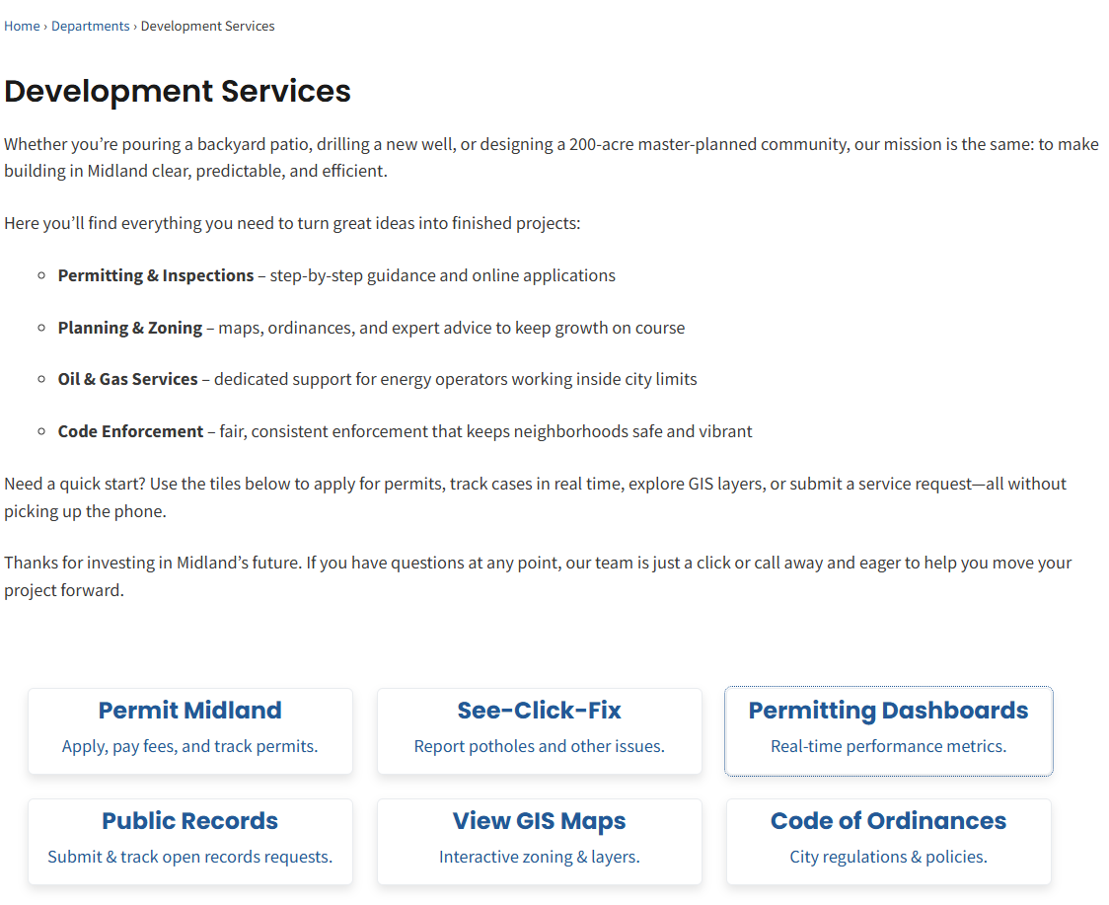
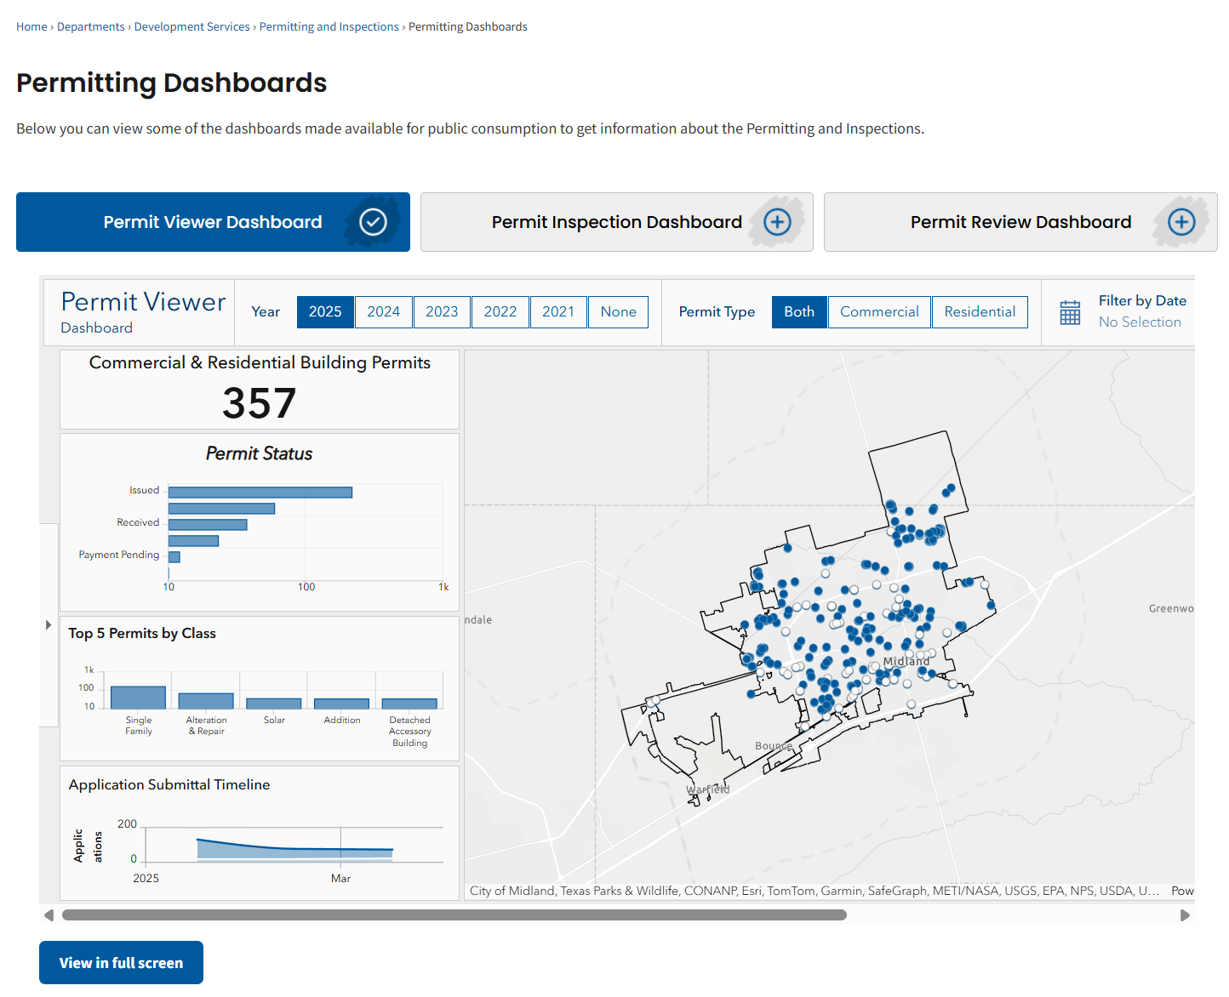
PUBLIC-FACING PERMITTING & INSPECTIONS DASHBOARDS
11
Notes:
The three public-facing permitting and inspections dashboards which show permitting and inspections performance over the last 30 days and provide an interactive look at recent and ongoing development across the city can be accessed via our website, by clicking on the Development Services Department webpage.

Slide 12




TECHNOLOGY ENHANCEMENTS DRIVING BETTER SERVICE
SeeClickFix – More engagement, faster response, and greater accountability through issue reporting
“Ask Jacky” AI Chatbot – 24/7 access, faster service, and consistent communication via automated responses
RingCentral – Reliable, scalable phone system that lowered costs, saving $100k annually by consolidating vendors
12
Notes:
These dashboards are part of a broader effort to modernize City services through technology.
We’ve implemented:
SeeClickFix for citizen-reported issues and faster response
“Ask Jacky”, our AI chatbot, for 24/7 access to common questions
RingCentral, our internet-based phone system, improving reliability and saving $100,000 annually

Slide 13


INTRODUCING PERMIT MIDLAND
Midland’s new customer facing online permitting and inspection portal – launched June 16, 2025
Provides applicants online access to submit applications for building and trade permits and to schedule inspections
Designed for transparency — applicants can track permit and inspection status in real time
Residents can also search properties to view past and ongoing permit history
13
Notes:
Our biggest recent step: Permit Midland, which launched on June 16, 2025.
This online portal allows users to:
Submit applications for building and trade permits
Schedule inspections
Track real-time permit status
Search property history for past and current permits
This supports greater transparency, more convenience, and better tracking for both staff and applicants.

Slide 14

PERMIT MIDLAND – CAPABILITIES & FUTURE EXPANSION
Now Available (as of June 2025)
Commercial & residential permitting for building, electrical, plumbing, mechanical, and solar needs
All building and trade inspection requests
Coming Soon:
Special Event, Engineering, and Fire Permits
Planning Applications
Inspections App accessible from mobile devices
14
Notes:
Permit Midland currently supports:
Residential and commercial permits for building, electrical, plumbing, mechanical, and solar
All building and trade inspection requests
Coming soon:
Engineering permits, including ROW and taps
Planning applications like plats and special exceptions
Fire Marshal permits and after-hours permits
A mobile inspection app to allow contractors to schedule inspections directly from their mobile devices in the field

Slide 15

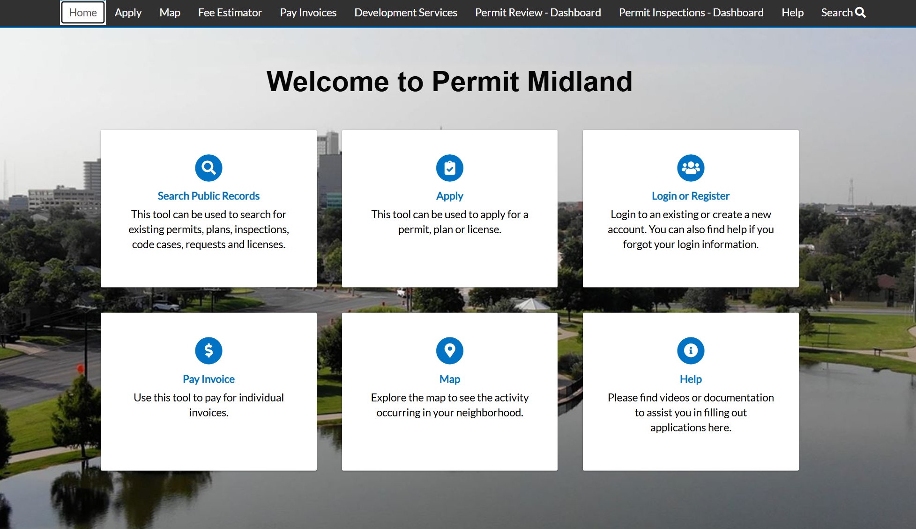
PERMIT MIDLAND – TOUR
15
Notes:
We’re happy to provide a quick look at the portal and highlight how it’s improving the user experience.

Slide 16

MISSION
Deliver exceptional services and promote a high quality of life and place for ALL our citizens.

