Slide 1

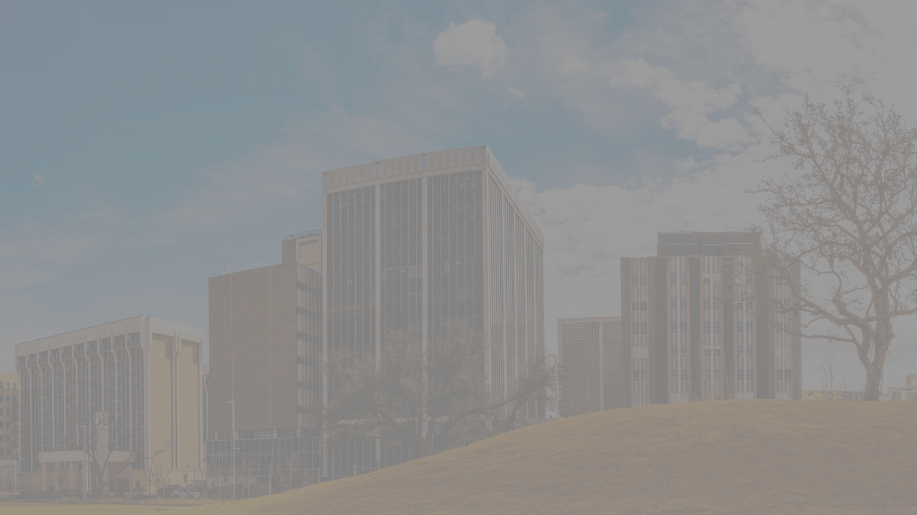



Annual Vision Zero Comprehensive Safety Action Plan Update
July 22, 2025
Notes:
Lindsey

Slide 2
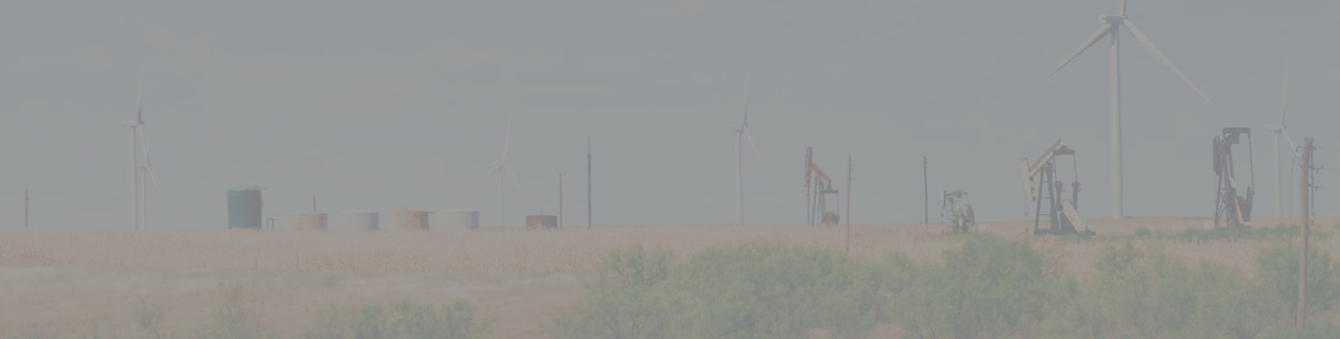




VISION ZERO MIDLAND
1
Vision Zero Midland Goals
2
City of Midland Updates
3
CSAP Amendment & Future Plans
Notes:
Lindsey

Slide 3
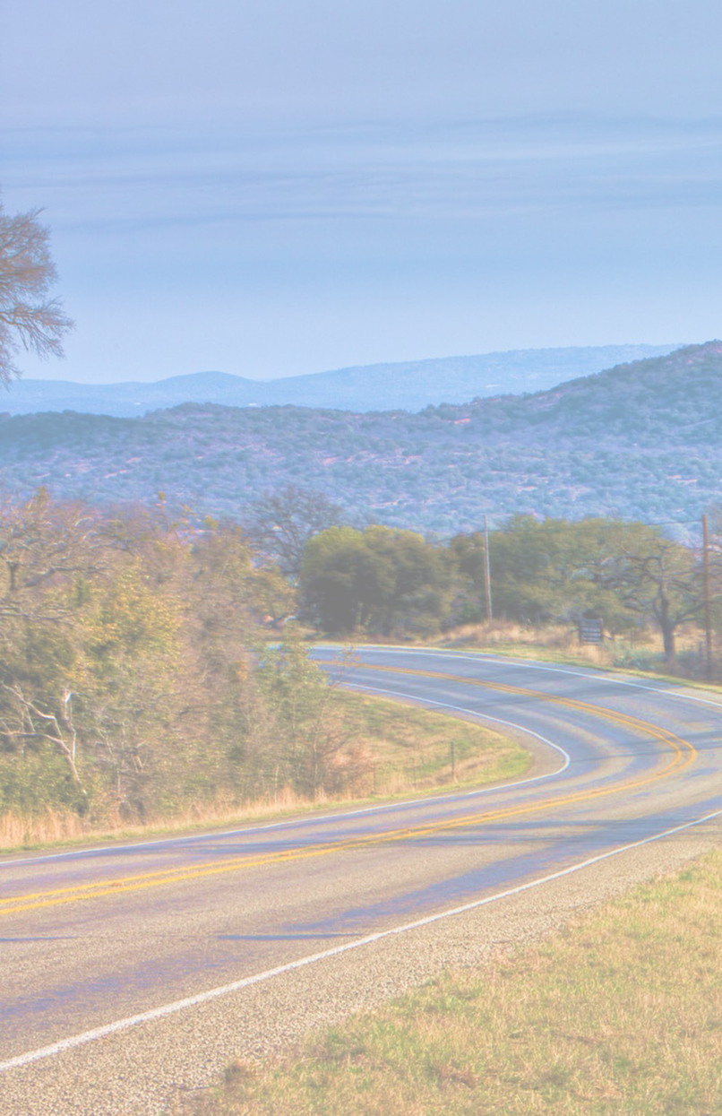







Mission Statement
“Eliminating deaths on Midland’s roads by BUILDING complete streets, ENGAGING the community, and
INNOVATING safer solutions to protect all users.”
Notes:
Lindsey

Slide 4
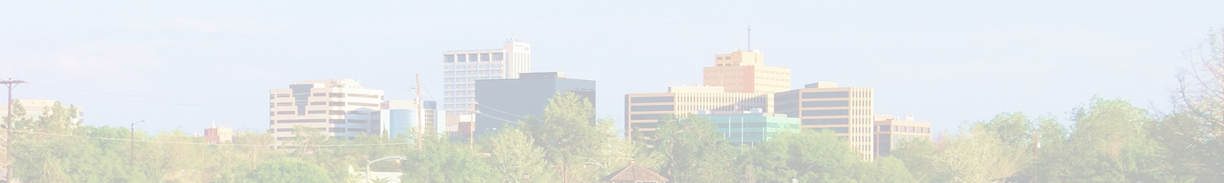
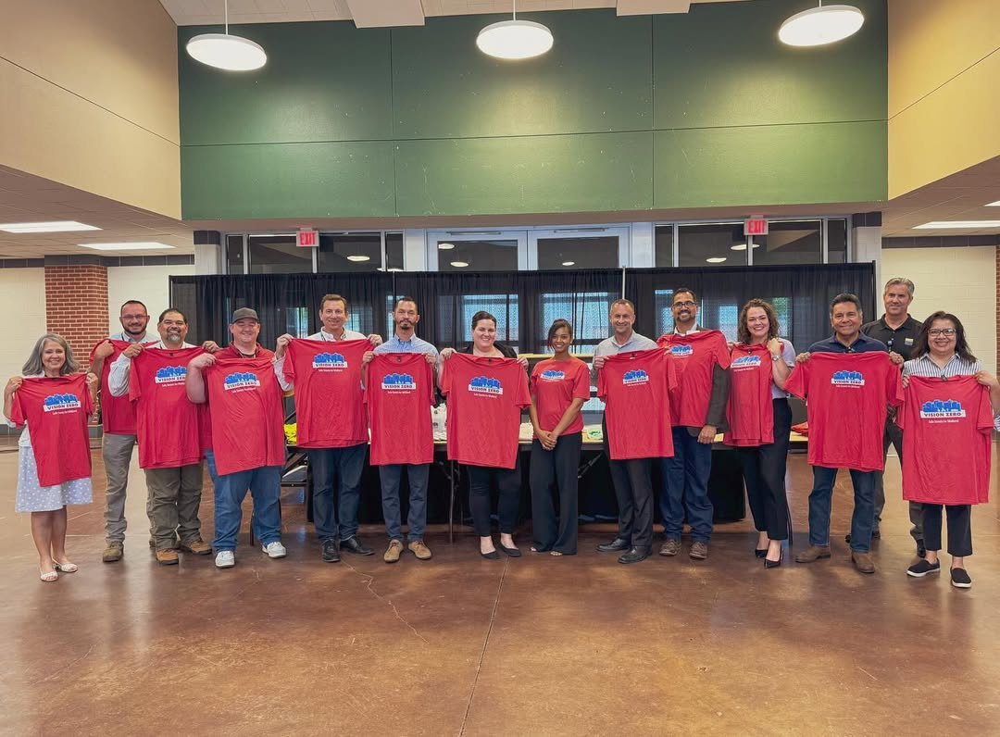
JOINT ADOPTION EVENT
Midland City Council and Midland County officially adopted the goal of​
Vision Zero, meaning Zero roadway​
fatalities by 2050 in a dual Comprehensive Safety Action Plan adoption ceremony​ August of 2024.​
Notes:
Lindsey

Slide 5
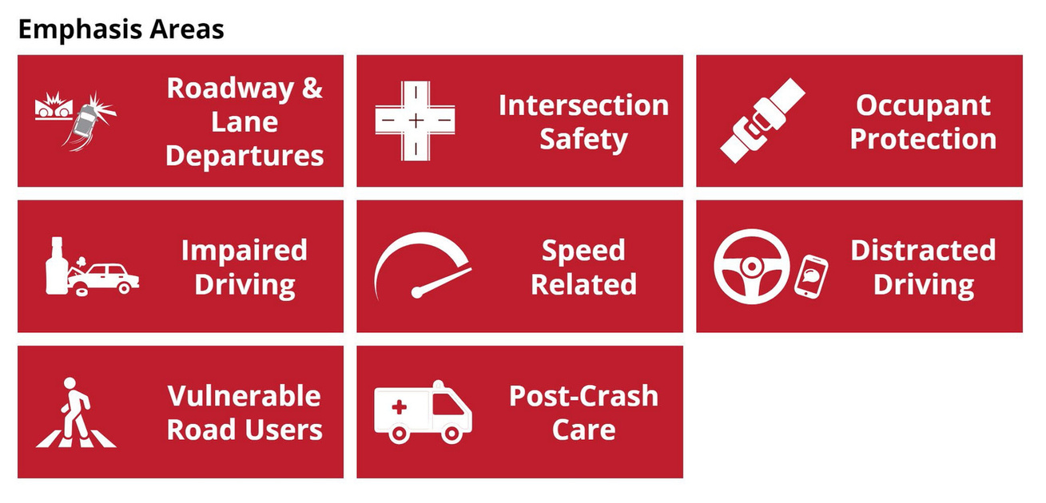
2025 CSAP UPDATE
For this initial update, data from calendar year 2024 is compared to baseline data from the current CSAPs (2022 data). To gain more insight on community needs, this specific update includes data from 2023 as well. This allows entities to identify areas of success and areas needing improvement using data driven results in the seven emphasis areas.

Slide 6
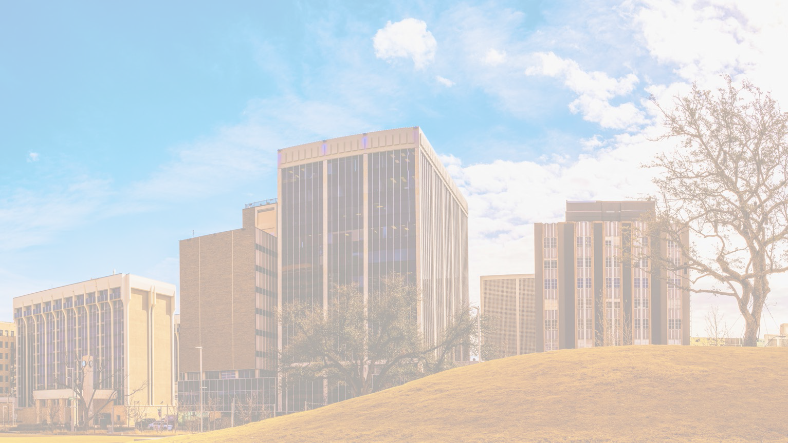


CITY OF MIDLAND
DATA
SUCCESSFUL EFFORTS
NEXT STEPS
Notes:
Michele

Slide 7

TRAFFIC VOLUME IN MIDLAND
To best interpret CSAP data comparisons, we must take changes in general traffic volume into account.
Based on the available data, Midland has seen a 3% annual increase since 2022

Slide 8
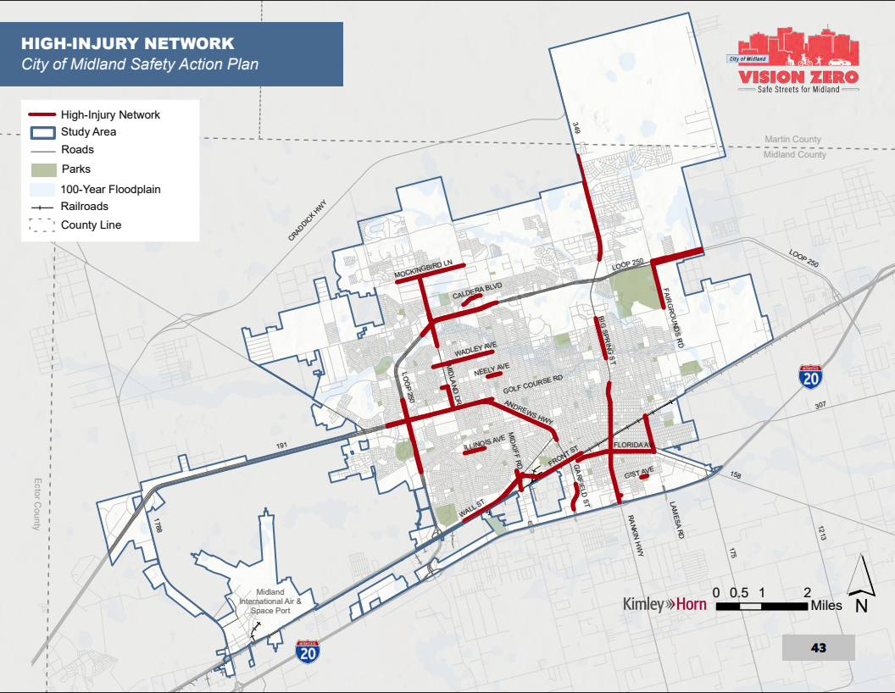

Slide 9
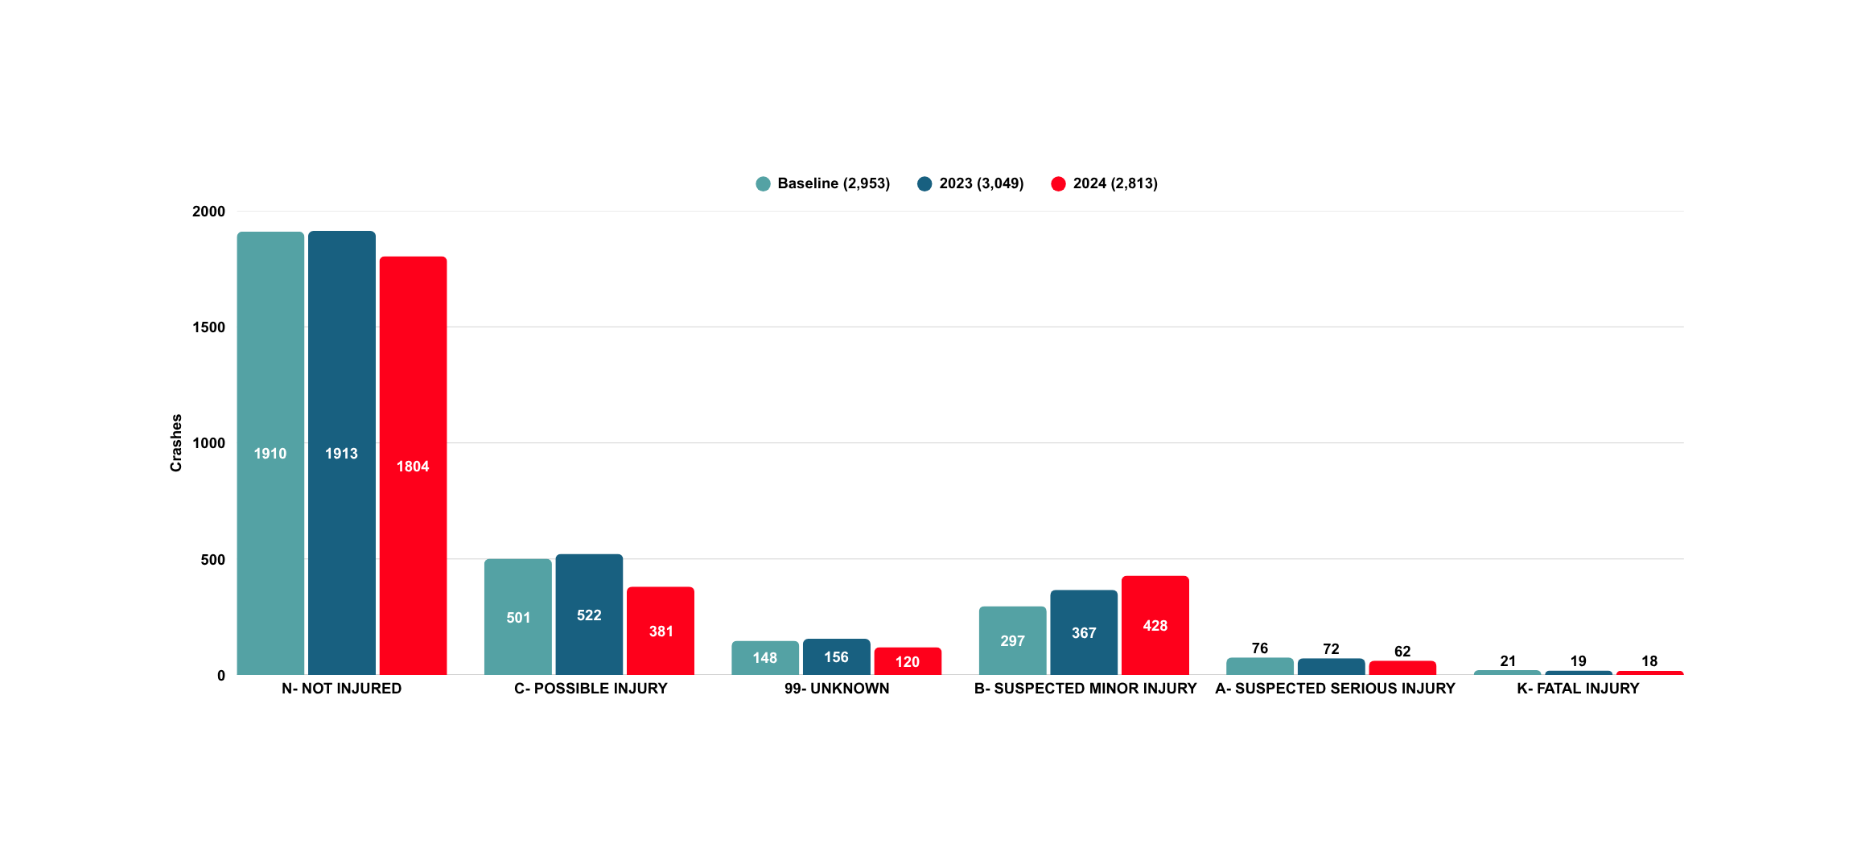
TOTAL CRASH DATA COMPARISON
BASED ON INJURY SEVERITY

Slide 10
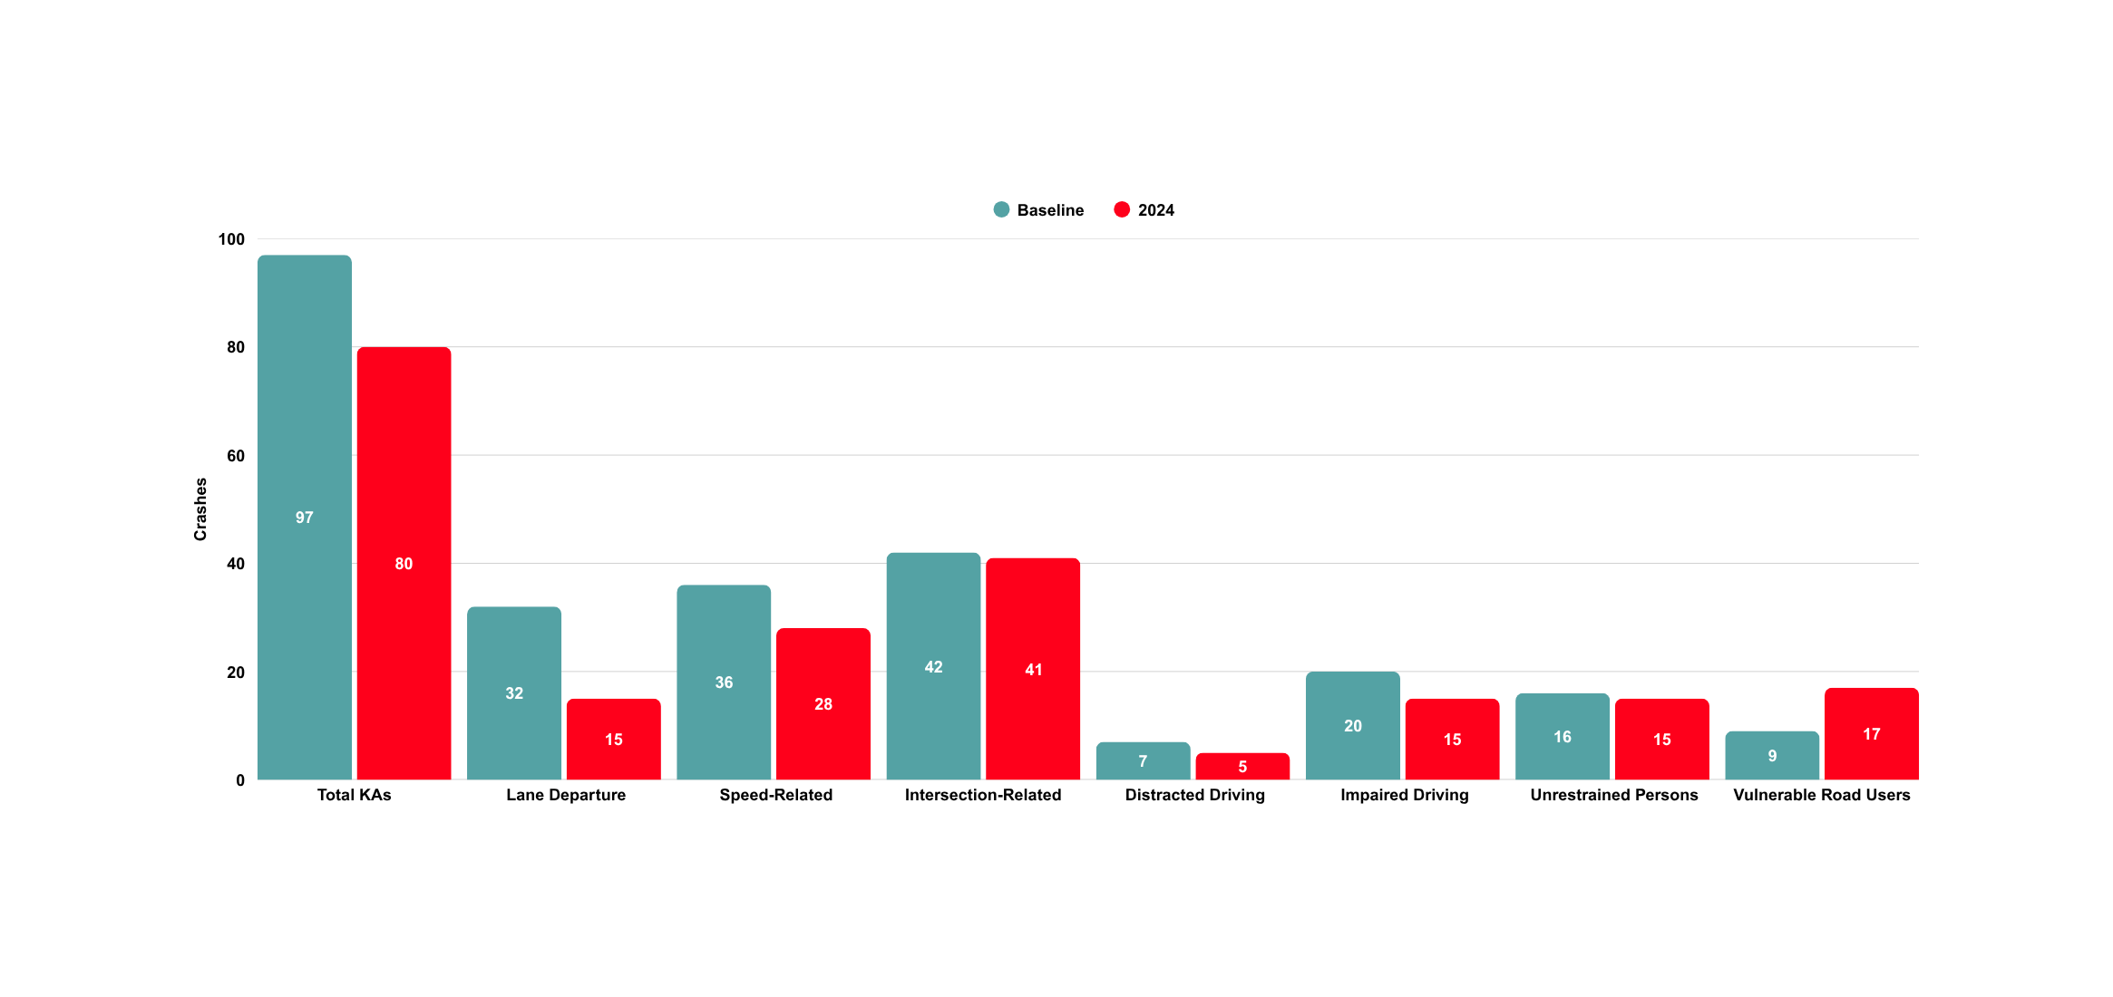
SEVERE AND FATAL (KA) CRASH COMPARISON
BASED ON EMPHASIS AREA
19% Reduction in Total KAs

Slide 11
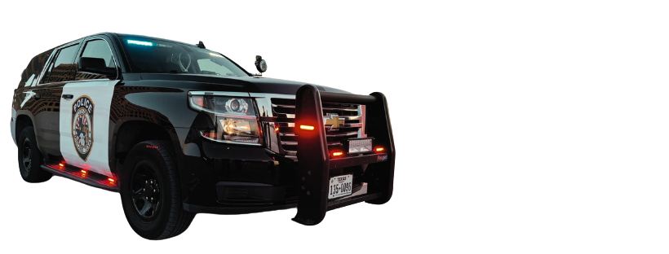

ENFORCEMENT EFFORTS
Traffic Enforcement- Lt. Pete Dehlinger
Intersection Intervention Program
Operation Cruise Control
Crime Prevention & Community Relations- Sgt. Michael Wilson
Citizens on Patrol
Coffee with Cops
Youth Athlete Programs
Seeking to improve teen/young driver education and exposure program

Slide 12
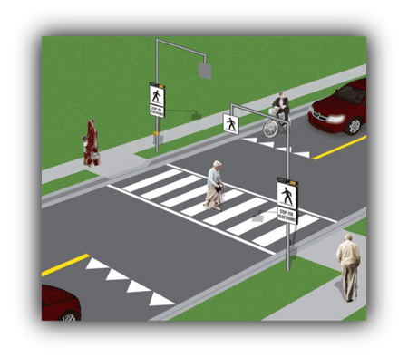
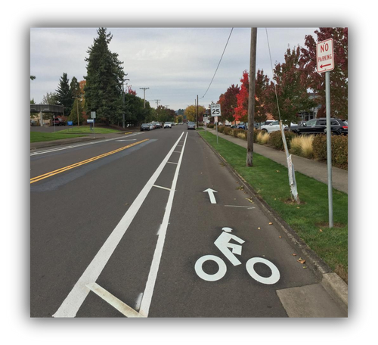
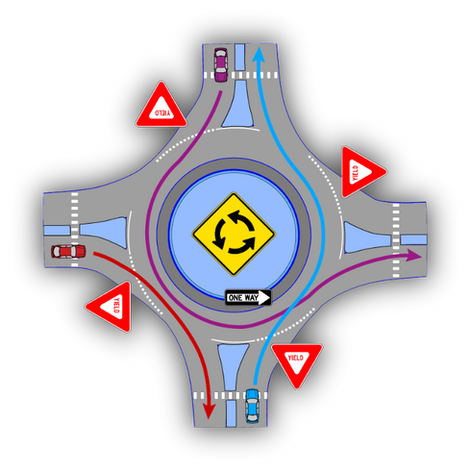
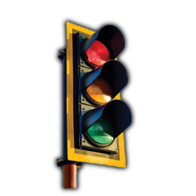
INFRASTRUCTURE IMPROVEMENTS
The City of Midland has focused on intersection enhancements, improved visibility, and additional roadway studies to determine best practices that enhance safety.
Added the Longview & Belmont roundabout (with more planned) to increase safety and reduce congestion. This new installation reduced crashes from 8 in 2023 (Jan- Apr), to 1 in 2025 - an 87.5% reduction.
Retrofitted 20 existing intersections with Reflective Backplates.
Bike lanes added along several roadways and around schools such as Legacy High.
Updated pedestrian facilities at various locations.

Slide 13
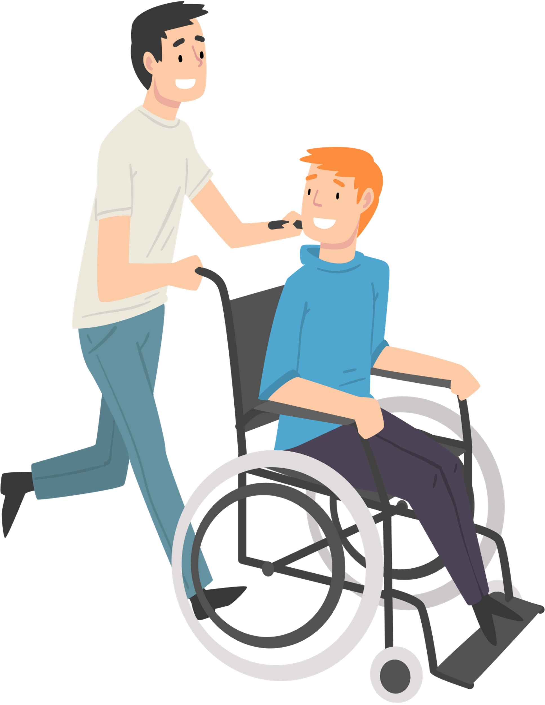

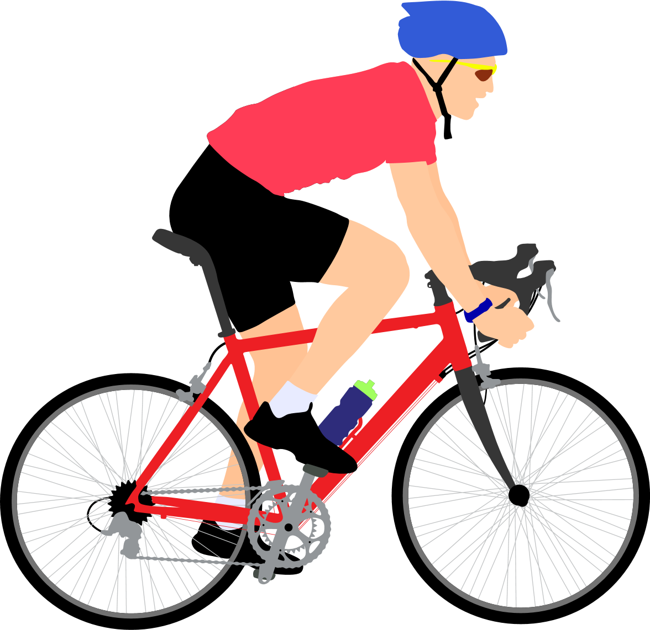

NEW CSAP STRATEGY
Vulnerable Road Users (bicyclists, pedestrians, etc.)
Strategy VRU5: Create and implement policies and procedures to enhance enforcement and promote safety
Action VR5.1- Create and establish ordinances that encourage safe transportation practices and enforceable protective measures
Action VR5.2- Create policies and procedures that establish and enhance ADA features in public areas

Slide 14
NEXT STEPS FOR THE CITY OF MIDLAND
Continue retrofitting all intersections
ADA enhancements (MPO ADA transition plan)
Reflective back plates on Midland’s most traveled roads
“tattle-tale” lights
Update pedestrian facilities
Increase enforcement and education efforts
Strategic evaluation of roadways for possible speed reduction
Using advanced technology to address needs and collect data
NoTraffic AI Autonomized Signal Timing
MioVision AI traffic counters
Notes:
Reflective back plates: Wadley from Loop 250 to Fairgrounds
Next would be Midland Dr.
Tech: Similarly used in larger cities around stadiums and such

Slide 15
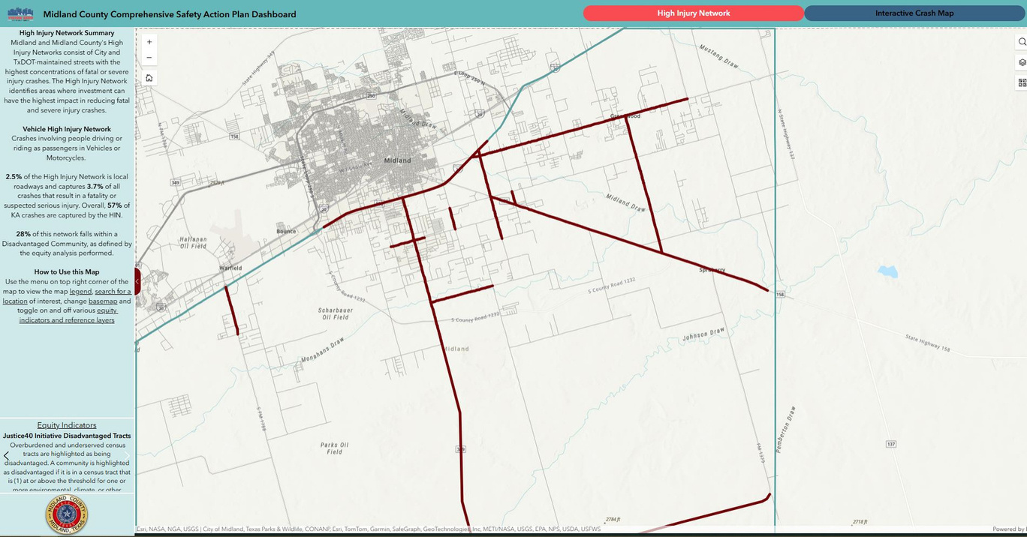

CONTINUED COLLABORATION
The City of Midland and Midland County are working together to manage and update a joint Vision Zero GIS interactive map. As progress is made in projects to help Midland reach Vision Zero by 2050, the GIS map will be updated quarterly for public viewing to increase transparency.
Both the City and the County also work together to address growth and congestion in coordination with the PBMPO and TXDOT Odessa District.

Slide 16
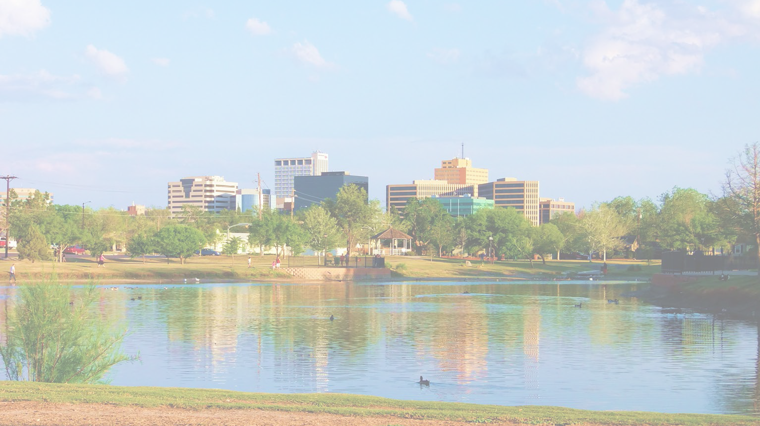


THANK YOU FOR YOUR COMMITEMENT TO VISION ZERO MIDLAND
Questions or ideas?
Reach out to:
Lindsey Adams
ladams@midlandtexas.gov
or
Michele Hagemann
mhagemann@midlandtexas.gov
Notes:
**Timeline has shifted due to administration, waiting for the Federal green light.

