Slide 1

STRATEGIC WATER UPDATE
JULY 2025
TITLE HERE
TITLE HERE

Slide 2

STRATEGIC CONNECTIONS
Goal 4: Transparent + Consistent Communication
• Strategies 4.1, 4.2, 4.3 • Clear internal and external communication strengthened collaboration during the emergency response and built public confidence in Utilities operations.
Goal 5: Provide Sound Governance + Fiscal Management
• Strategies 5.2, 5.6, 5.10 • Timely repairs, targeted capital reinvestment, and proactive maintenance demonstrate effective service delivery and a learning organization approach.
Goal 6: Strengthen and Sustain Our Infrastructure
• Strategies 6.1, 6.5 • Long-term supply secured through CRMWD contract; critical system improvements (valves, sensors, flow meters) ensure reliable water delivery.
2

Slide 3

COLLABORATIVE ALIGNMENT LED TO REAL RESULTS
The comprehensive After-Action Review (AAR) process—developed in close coordination with City Council and Management—marked a new standard for how we reflect, plan, and act following operational challenges.
This collaborative approach ensured alignment across departments, empowered timely decision-making, and helped prioritize critical infrastructure investments.
Unlike past incidents, where follow-up was often fragmented or completely missing, the structured AAR in this case created a shared roadmap that has directly informed our progress—from treatment plant restoration to strategic system upgrades.
The outcome: unified momentum that turned short-term fixes into sustainable, long-term improvements.
3

Slide 4

CURRENT WATER SUPPLY
Full 32 MGD Treatment Capacity (an increase from 8 MGD at it's low) Restored at the Water Treatment Plant
Restored the ability to provide a max 20 MGD from T-bar (increased from 7 MGD at it's low)
Increase in lake levels over the last year:
O H Ivie from 27.8% to 54.7%
J B Thomas from 18.7% to 38.6%
E V Spence from 14.1% to 15.4%
4

Slide 5
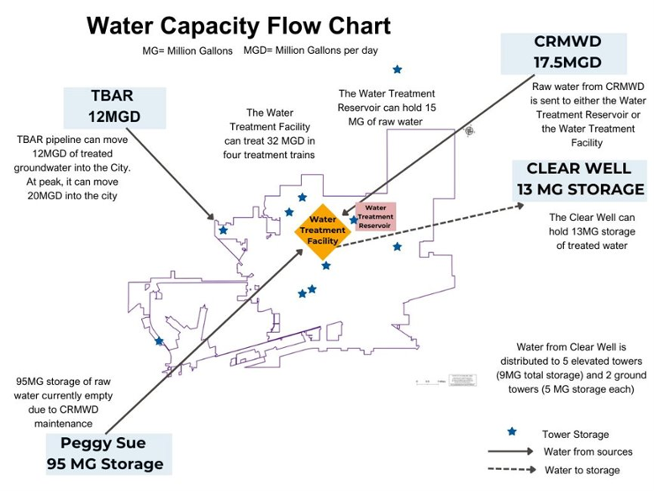
5

Slide 6

FUTURE WATER SUPPLY
2030 Raw Water Supply Contract with CRMWD
Advanced treatment of Paul Davis and Tbar Groundwater Supplies
Development of Phase 1 of the Fort Stockton Groundwater Supply
Evaluating feasibility of Direct and Indirect Potable Reuse
6

Slide 7

REDUNDANCY IN THE SYSTEM
Professional Services agreement for consultant to be the City’s owner's rep for design build of a new water line from T-bar line to the Water Treatment Plant
Professional Service agreement for the modeling and design for back-up groundwater supply at the Edgewood Ground Storage tanks
7

Slide 8

ACTIVE SYSTEM IMPROVEMENTS
Initiated a 4-year satellite leak detection program (previous program reduced winter breaks from 22 to 4 during two freezes)
Initiated a multiyear valve exercise and repair contract
Installed 30 actively monitored pressure gauges (34 more on order)
Upgrading Zebra mussel treatment
Replaced two critical valves at the water purification plant
Installed new flow meter at the HWY 158 valve
8

Slide 9

IN SUMMARY: ADVANCING THROUGH PROCESS IMPROVEMENT
Focused support from City Council and Management enabled Utilities to prioritize long-term process improvements—not just one-time fixes.
Collaborative AAR development helped set a new standard for structured response and follow-through.
Dedicated leak detection paired with active pressure monitoring is now a system-wide tool for proactive risk management.
A multi-year valve maintenance program is underway to address system vulnerabilities before they become failures.
Redundancy planning is now built into key infrastructure decisions—from backup supply lines to monitoring capabilities.
9

Slide 10

MISSION
Deliver exceptional services and promote a high quality of life and place for ALL our citizens.

