Slide 1

BUDGET UPDATE
TITLE HERE
TITLE HERE
August 13, 2025

Slide 2

STRATEGIC PLAN ALIGNMENT
Goal 5: Provide Sound Governance & Fiscal Management
5.7 Ensure Continued Financial Stability and Accountability: Maintain Financial Transparency
2

Slide 3

YEAR-ROUND BUDGET PRESENTATIONS
Nov 12th Inflation and the Midland Factor
Dec 17th Budget Update
Feb 11th Investing in Infrastructure and
Public Safety
Mar 18th Fixed Cost Drivers
April 8th Sound Governance and Fiscal Mgmt
May 13th Debt Summary
June 12th Budget Update
June 24th Enterprise Funds Update
3

Slide 4


BUDGET PROCESS
HERE
Department Requests and
Forecasting
Prelim. Property Values
City
Management Review
Certified Valuation
City Council briefings
Budget Workshop
Set Tax Ceiling
Public Hearings
Adoption of 2026 Budget and Tax Rate
Finance Review
Fee Ordinance
Spring
Summer
Late Summer
PLANNING
COMMUNICATING
PASSING

Slide 5

UPCOMING DATES
August 13 – Council Budget Workshop and Set Tax Rate Ceiling – Action Required
September 9 – Public Hearing of Budget and Tax Rate – First Reading
September 16 – Public Hearing of Budget and Tax Rate – Adoption
5

Slide 6

BUDGETING OUR CORE VALUES
Strategic Long-Term Planning
Fiscal Discipline and Efficiency
Limited Government
Transparency and Accountability
Strategic Use of Debt
6

Slide 7
TRANSFORMING THE BUDGET PROCESS
Strategic Long-Term Planning
Responsible Budgeting
Proactive rather than Reactive
Staying Ahead of Economic Growth
Structural Financial Balance
Prioritizing the Basics like Water, Roads, Safety & Parks
Streamlining Operations
Values in Action – Fiscal Discipline and Limited Government
Citizen First Focus – Small Things That Matter
7

Slide 8
SOUND FISCAL PRACTICES
Prudent Spending
Cost Recovery
No Subsidies
Collection Practices
Strategic New and Additional Revenue Sources
Strong Internal Controls
Strategic use of Debt to Counteract Inflation
Doing more with Less – Lowered Taxes
Expense Reduction Across the City
8

Slide 9

WHAT IS IN THE BUDGET –
THE BASICS:
$98M Water Infrastructure and Maintenance
$28M Roads and Signals
$99M Public Safety
$22M Park Maintenance
Rate Stabilization Fund Implementation
9

Slide 10

PERSONNEL: VACANCY LEVELS
45.4% Reduction in Budget Vacancies from FY 2024 to FY 2026
10

Slide 11

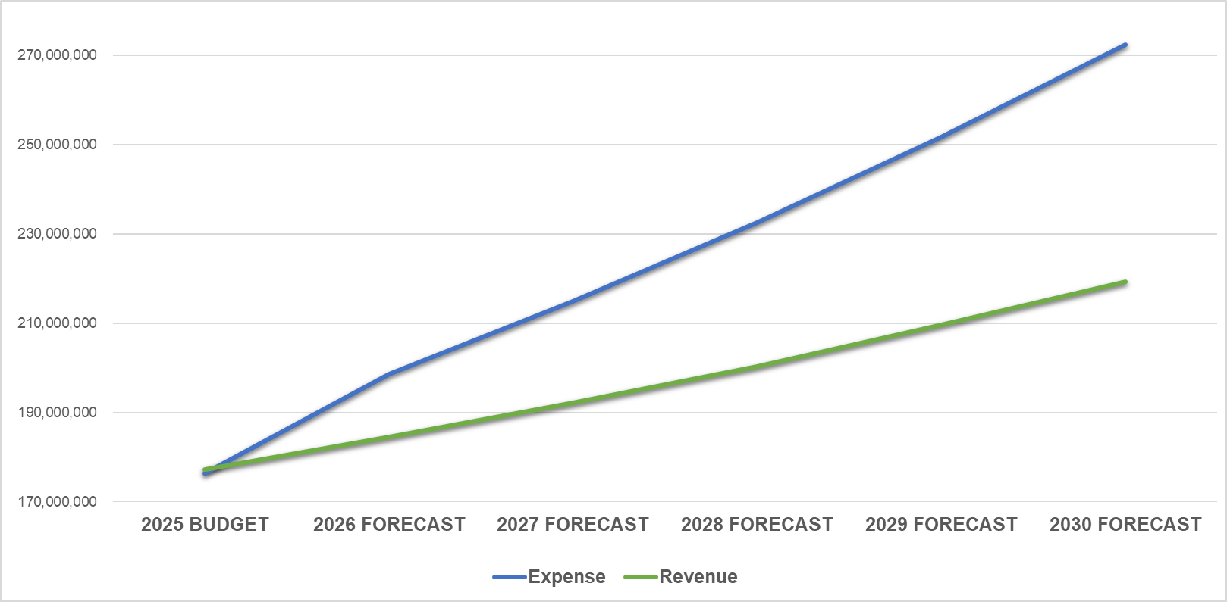
GENERAL FUND: 5-YEAR FORECAST
Average Annual Expense Increase, +8.1%
Average Annual Revenue Increase, +4.2%
Forecast for expenditures outpace revenue by 3.9%.
11

Slide 12
GENERAL FUND: 5-YEAR FORECAST
Natural Small Revenue Growth
State & Federal Funding
Partnerships
(Public & Private)
Remove Subsidies
User Fees
12

Slide 13
GENERAL FUND: 5-YEAR FORECAST
13

Slide 14
CLOSING THE GAP – GENERAL FUND
Budgets reduced to close the gap | Amount
Personnel, equipment and facilities requests | $5 M
Vacant positions | $1 M
Vehicle and equipment, due to slow delivery | $2 M
Technology Charge/Recovery | $500K
Conservative salary increases* | $2 M
TOTAL REDUCED | $10.5 M
*Following a 20% cumulative increase over the last three years
14

Slide 15

STRATEGIC PLAN FUNDING
ALL CITY FUNDS
Strategic Goal | FY2025 Budget | FY2026 Proposed | Difference | Variance
Goal 1: Strong Economy & More Quality Jobs | 29,469,375 | 42,826,782 | 13,357,407 | 45.3%
Goal 2: Set Standard for a Safe & Secure City | 99,318,761 | 106,565,608 | 7,294,912 | 7.3%
Goal 3: Quality of Life & Place | 40,738,077 | 29,189,422 | (11,548,655) | -28.3%
Goal 4: Transparent & Consistent Communication | 22,007,920 | 24,140,569 | 2,132,649 | 9.7%
Goal 5: Sound Governance & Fiscal Management | 76,894,812 | 79,525,716 | 2,630,903 | 3.4%
Goal 6: Strengthen and Sustain Infrastructure | 185,882,229 | 178,611,524 | (7,270,705) | -3.9%
Grand Total | 454,311,174 | 460,859,620 | 6,548,446 | 1.4%
15

Slide 16
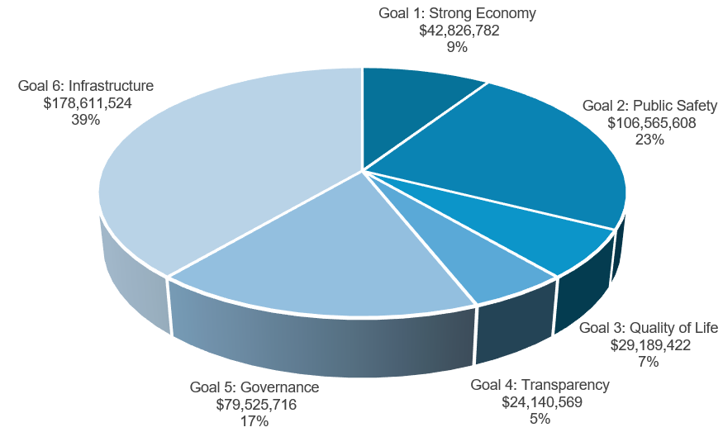
ALL CITY FUNDS
16

Slide 17
STRATEGIC PLAN FUNDING
GENERAL FUND
Strategic Goal | FY2025 Budget | FY2026 Proposed | Difference | Variance
Goal 1: Strong Economy & More Quality Jobs | 6,797,835 | 7,471,603 | 673,768 | 9.9%
Goal 2: Set Standard for a Safe & Secure City | 98,625,111 | 105,909,864 | 7,284,753 | 7.4%
Goal 3: Quality of Life & Place | 11,292,024 | 12,349,686 | 1,057,662 | 9.4%
Goal 4: Transparent & Consistent Communication | 12,790,742 | 13,350,965 | 560,223 | 4.4%
Goal 5: Sound Governance & Fiscal Management | 21,811,768 | 22,140,796 | 329,028 | 1.5%
Goal 6: Strengthen and Sustain Infrastructure | 25,022,222 | 26,235,446 | 1,213,224 | 4.8%
Grand Total | 176,339,702 | 187,458,359 | 11,118,658 | 6.3%
17

Slide 18
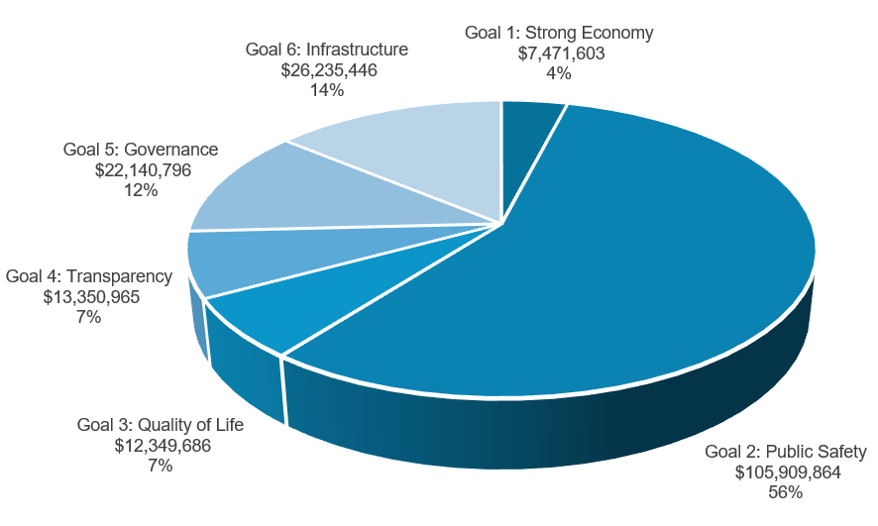
GENERAL FUND
18

Slide 19

GENERAL FUND HIGHLIGHTS
$6.5M Cost of Living and Merit Increases
$500K Police COLA
$1M Fire pay increase and COLA
$500K Fire Retirement Increased Contribution
$2.6M Park Maintenance Budget
$200K traffic calming and pavement marking
$2.1M CO for roads paid out of General Fund
19

Slide 20
GENERAL FUND INCREASE BREAKDOWN
$16.1 M Increase
$2.1 M – 2025 CO bond payment absorbed into GF
$6.5 M –Cost of Living Adjustment (2%) and Merit Pay (2%), Including:
$500K– Increase Police Compensation (2%)
$1.0 M – Increase to Firefighter Compensation (4%)
$2.0 M – Increased Health Insurance cost to the City (approx. additional 2% value to the employee)
$2.0 M – Software & Liability Coverage Increases
$3.0M – Increase in Vehicle and Equipment cost
$500K – City Increase to Midland Firemen's Relief and Retirement Fund Contribution; 22.2% to 24.2%
+6.3%
FY 2025
$176.3M
FY 2026
$187.4M
20

Slide 21
ALL FUNDS SUPPLEMENTAL REQUEST HIGHLIGHTS
$8.4M Total Requests vs. $3.3M Total Funded
Of $3.3M, $1.3M Funded for General Fund
Approved:
$140K Parks Security Cameras and Fiber
New positions for Engineering, Parks, ITSD, Sports Complex, Drainage Fund, Sanitation
$600K in Facilities Maintenance
21

Slide 22
DEFERRED GENERAL FUND SUPPLEMENTAL REQUESTS
$1.2M Engineering equipment deferred
$1.9M Animal, Health, and Fire personnel and software deferred
$1.3M Fire Alerting System deferred
$300K ITSD software deferred
$355K Parks personnel and equipment deferred
$5.1M Total deferred FY2026 requests
22
$14M deferred requests for All Funds – FY2025

Slide 23
WHAT WE HAVE ABSORBED
$100M 2017 Road Bond – did not raise taxes for the road bond referendum
$10M annual cost of Road Bond
$56.8M CO for Infrastructure and Quality of Life
$2M annually for Beal and RMN Parks
$2.1M annually for roads, paid out of General Fund
$2.5M additional costs of employee health and risk insurance
$500K Increase in Fire Retirement Contributions
*$35M in Public Safety Costs not covered by Property Taxes (Absorbed Annually)
23

Slide 24
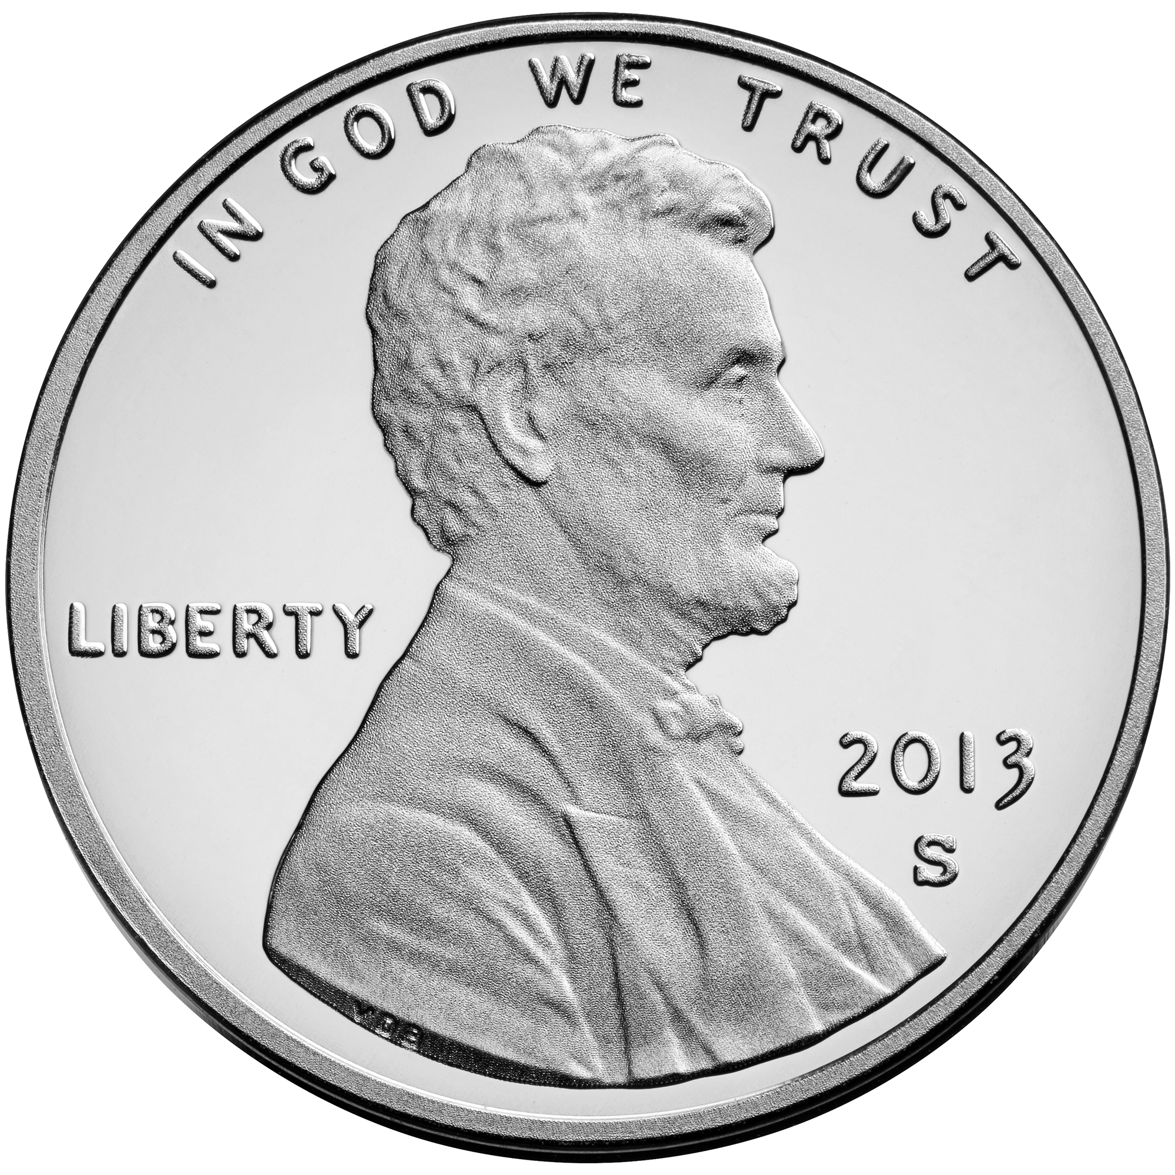
GENERAL FUND
City of Midland Revenue Streams
Property Taxes
Sales Tax
Fines and Fees for Services
City of Midland Sales Tax Rate is 1.25% - Most Texas Cities Enjoy the Full 2%
Midland County, .50%
Midland Memorial Hospital, .25%
This loss amounts to $48M Annually
City
1.25%
County
.50%
Hospital
.25%
24

Slide 25
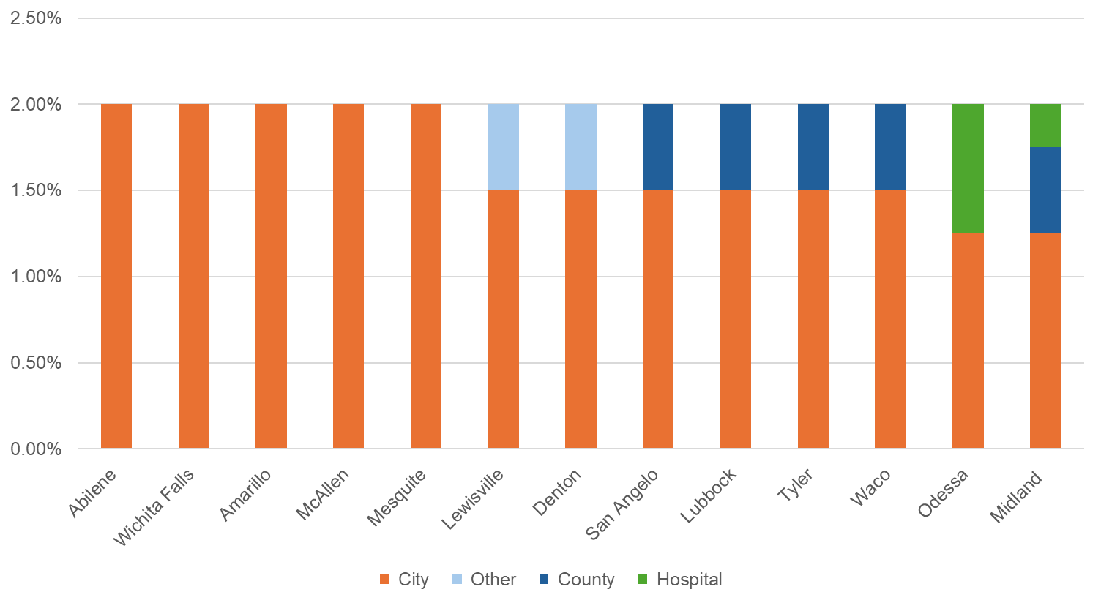
SALES TAX RATES BY CITY
1.25%
25

Slide 26
PROPERTY TAX
Where do your property taxes go?
26

Slide 27



PROPERTY TAX
What do you get for your taxes?
$300,000
Valuation
$4,500
Total Tax Bill
$1,000
City Portion
27
Notes:
79.07 M Ad Valorem Revenue
To
49.628 M Fire (Public Safety)
45.816 M Police (Public Safety)
26.235 M Engineering (Infrastructure)
121.679 M (not including Debt)
153.888% back to Tax Payer

Slide 28






PROPERTY TAX
What do you get for your taxes?
Reduced Crime Rates
Increased Public Safety - ISO 1 Rated Fire Department
New and Upgraded Parks and Recreation
Road Expansions and Maintenance
New Sports Facility – Public Private Partnership
Downtown Activities and Events for the Family
28
Notes:
79.07 M Ad Valorem Revenue
To
49.628 M Fire (Public Safety)
45.816 M Police (Public Safety)
26.235 M Engineering (Infrastructure)
121.679 M (not including Debt)
153.888% back to Tax Payer

Slide 29
PUBLIC SAFETY VS PROPERTY TAX REVENUE
FY2017 to FY2026
$35 Million Deficit between Public Safety Expenses and Property Tax Revenue
29

Slide 30
PUBLIC SAFETY VS PROPERTY TAX REVENUE
FY2017 to FY2026
Had the City the increased the rate to the Voter Approval every year during this time frame, there would still be a $14 M deficit
30

Slide 31
FY2025 TAX BILLS-PEER CITIES
31

Slide 32
FY2025 TAX RATES-PEER CITIES
32

Slide 33
Historical Tax Levy fy2006 to fy2026 (Represented In Cents PER $100 VALUATION)
Reduction in overall tax burden to the Citizens even after $100M Bond Referendum in 2017
33

Slide 34
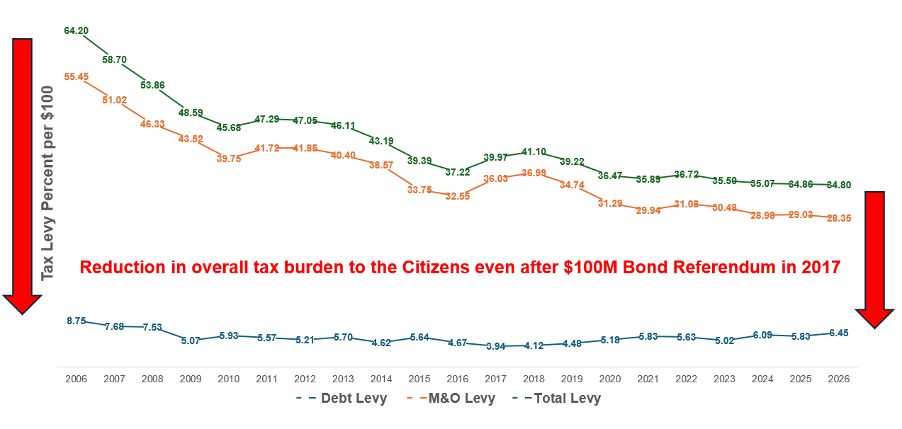
PROPERTY TAX STRATEGY
Total tax rate not increased to
account for $100M Road Bond –
absorbed by the General Fund
Strategically used Oil and Gas funds on hand to take care of 20-year fire retirement fund issue - $54M cash solution saving $60M in fees, interests and taxes associated with a Pension Obligation Bond
34

Slide 35

PROPERTY TAX RATES:
FY2022 to FY2025
Reduction of 185 Tax Basis Points
35

Slide 36

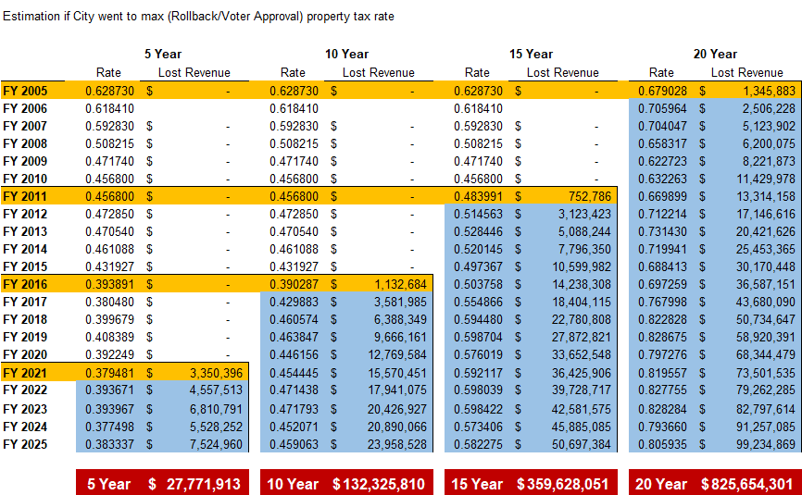
36

Slide 37


MIDLAND CITIZEN “FUND”:
GIVING BACK TO OUR CITIZENS
FY2026 VAR w/ Increment
FY2025
.348662
FY2026 VAR
$2.2 Million Left in the hands of Citizens
FY2026
NNR
FY2026 Proposed
Instead of adopting the maximum tax rate allowed by law, the City chose a lower rate - prioritizing our residents’ financial well-being
37

Slide 38
2026 PROPOSED TAX RATES*
Tax Rate | Adopted 2024-25 | Proposed 2025-26 | Revenue Inc/(Dec)
Proposed Tax Rate (Adopted for 2024-25) | .348662 | .347999 | $2.1M
No-New-Revenue Rate (NNR) | .344044 | .336458 | ($550K)
Voter-Approval Tax Rate (VAR) | .353200 | .354787 | $3.6M
Voter-Approval w/Increments | .361054 | .366483 | $6.3M
Interest & Sinking (Debt Service) | .058342 | .064451 | $2.1M
38

Slide 39
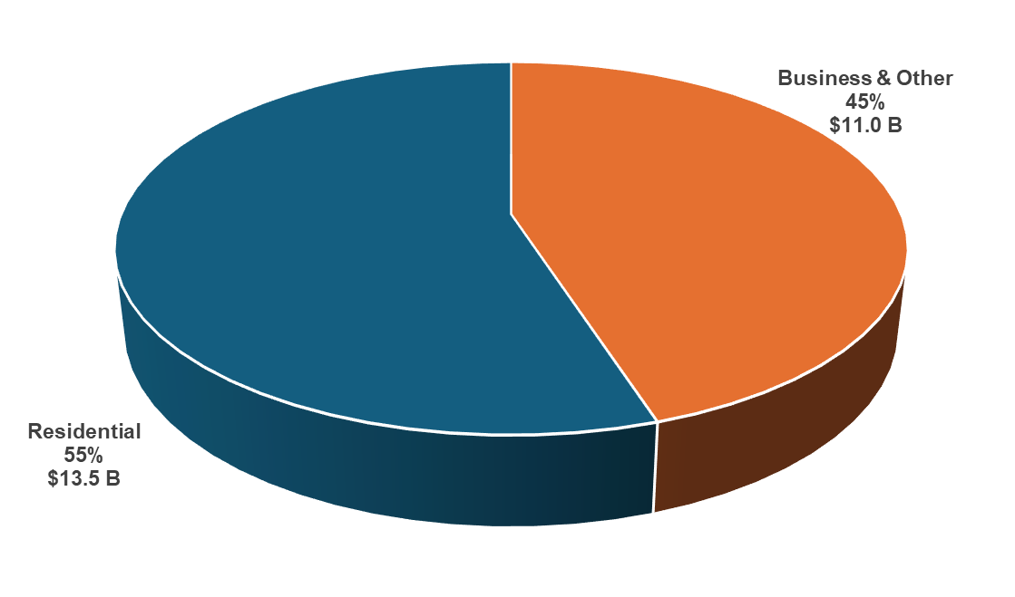
PROPERTY TAX REVENUE FY2026
$29.0M Revenue
$35.5M
Revenue
39

Slide 40

BUDGET FOCUS
WATER
ROADS
PARKS
PUBLIC SAFETY
40

Slide 41
WATER
$26M total Investment in Infrastructure (5.4%of total city budget)
Replacement of 4” water line, manhole rehab, UEP Program
Innovative maintenance like the Satellite Leak Detection service and Proactive Valve Replacement program
*A Total of $95M is set aside in the budget for Water & Sewer Services
41

Slide 42
ROADS
$9.2M Road Maintenance - Includes $600K
In-House Maintenance
$28M in Road and Signal Bond Projects underway
$2.6M Drainage Improvements – out of $75M in Drainage Needs
*A Total of $28M is set aside in the budget for Roads and Engineering
42

Slide 43
PUBLIC SAFETY
$200K Set Aside to Provide for Police Bullet Proof Vest Replacements (over 5 years) and other Equipment (Not budgeted for previously)
$2.3M increase in Replacement Vehicles for Police & Fire
$1M COLA increase for Police & Fire
$500k increase for all FF staff
$500k Contribution added to Fire Retirement Fund
*A Total of $99M is set aside in the budget for Public Safety
43
Notes:
Hire of Equipment for Orgs 001105 through 001125 (Police and Fire)
FY2025 – $9.5 M
FY2026 - $11.8 M

Slide 44
PARKS
$4M Upgrades and Replacements
$12.3M General Fund Park Budget – 18% Increase over last 2 years
$2M Set Aside for Future Park Updates and Replacement Needs
Ongoing Bond Projects for Parks
Public Private Partnership Projects - Over $20M invested
*A Total of $22M is set aside in the budget for Parks
44

Slide 45
INCREASED SERVICE LEVELS
“Thank you so very much for your assistance. I appreciate the many individuals that make our city work and their time and dedication. Thank you for your service.”
– Citizen after using SeeClickFix
“Thank you again for your concern and for your continued commitment to the city. We truly value being a part of this community and are committed to contributing in a meaningful and respectful way”
– Code Enforcement Requestor
“The Dallas builder submitted plans and let me know that in record time and in the smoothest process yet he was able to secure the permit! I just wanted to say thank you for the work you all are doing to continuing to refine this process! It is getting noticed!”
– Permitting Customer
45

Slide 46
BUDGETING BOTTOM LINE
Lower Tax Rate: 3rd Consecutive Year
Strong Investment in Water, Roads, Public Safety and Parks
Long-term Strategy to keep taxes low
Financial Discipline and Conservative Practices
46

Slide 47

MISSION
Deliver exceptional services and promote a high quality of life and place for ALL our citizens.

