Slide 1
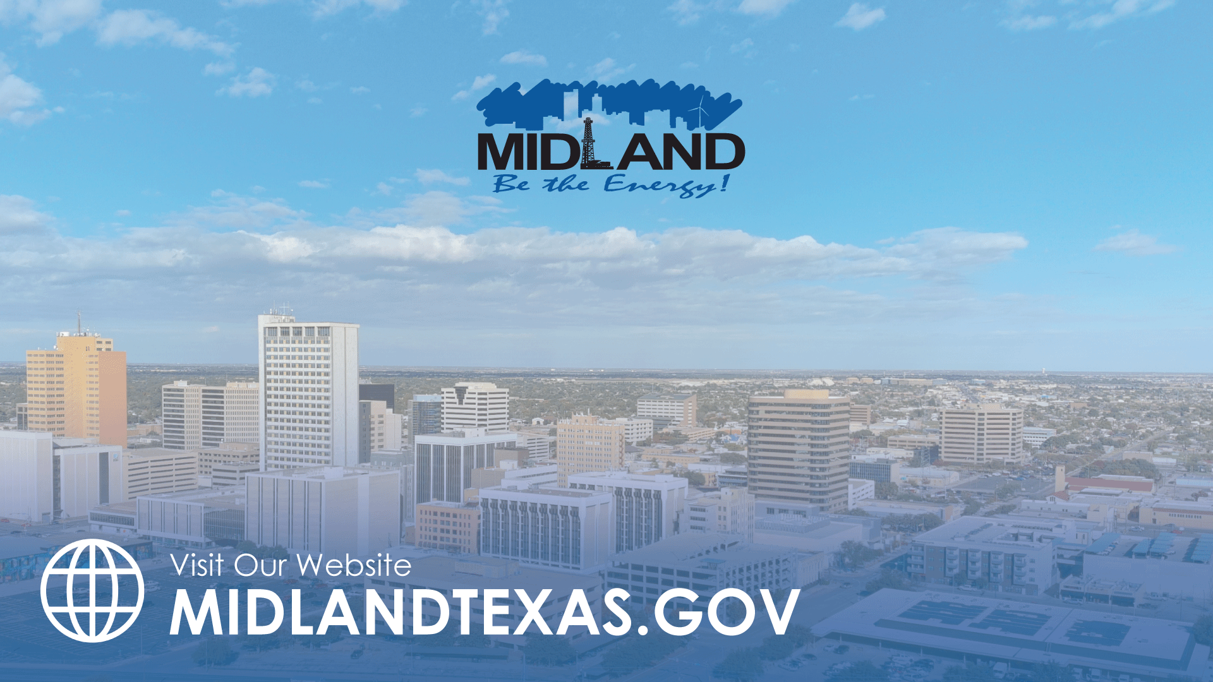
GOAL ONE
STRONG ECONOMY WITH MORE QUALITY JOBS
FY 2026 BUDGET PRESENTATION
AUGUST 2025
TITLE HERE
TITLE HERE
Notes:
This presentation covers Goal 1 of the FY 2026 budget — Strong Economy with More Quality Jobs.
These initiatives directly impact our long-term ability to grow the sales tax base and diversify revenue sources, which is essential in supporting our tax rate and funding core services.

Slide 2

TABLE OF CONTENTS
Vision Block Connections + Strategic Alignment
Priorities Focus
Budget Highlights
FY 2025 Key Accomplishments
FY 2026 Key Deliverables
2
Notes:
DO NOT CHANGE TABLE OF CONTENTS, YOUR PRESENTATION SHOULD FOLLOW THIS TEMPLATE (FOR EVERY GOAL!)

Slide 3

VISION BLOCK CONNECTIONS
“The City of Midland will be the Premier and Safest City in West Texas by Providing World Class Municipal Services through Operational Excellence and a Culture of Innovation”
Premier City (Goals 1, 3)
3
Notes:
ADD YOUR VISION BLOCK CONNECTIONS HERE. IT WILL NOT BE THE SAME AS GOAL 4!

Slide 4

STRATEGIC ALIGNMENT
Goal 1: Strong Economy with More Quality Jobs
1.1 Increase the Midland Sales Tax Base
1.2 Enhance Visitor Revenue Opportunities
1.3 Continue Downtown + West Midland Redevelopment
  1.3.1 Adopt a holistic approach to address development barriers in Downtown Midland
  1.3.2 Review + refine current code enforcement practices to better support redevelopment efforts in Downtown + South Midland
  1.3.3 Develop + implement diverse programming + entertainment initiatives to attract residents, businesses, and visitors to Downtown Midland
4
Notes:
1.3.1 Adopt a holistic approach to address barriers in downtown Midland
1.3.2 Review and refine current code enforcement practices to better support redevelopment efforts in downtown and south Midland
1.3.3 Develop and implement diverse programming and entertainment initiatives to attract residents, businesses, and visitors to downtown Midland

Slide 5

STRATEGIC ALIGNMENT
Goal 1: Strong Economy with More Quality Jobs
1.4 Nurture Development Districts
1.5 Grow the Core Business of Air Transportation
1.6 Diversify Midland’s Economy
  1.6.1 Expand sports commerce + tourism opportunities
1.7 Expand Opportunities + Programming for General + Small Business
1.8 Improve Speed to Market for Citizens, Builders, Developers + Contractors
1.9 Establish Our Community as a Premier Destination for Retail + Entertainment
5
Notes:
1.3.1 Adopt a holistic approach to address barriers in downtown Midland
1.3.2 Review and refine current code enforcement practices to better support redevelopment efforts in downtown and south Midland
1.3.3 Develop and implement diverse programming and entertainment initiatives to attract residents, businesses, and visitors to downtown Midland

Slide 6

DEPARTMENTS
Organizational Alignment
Airport
  Midland International Air & Space Port
  Midland Airpark
Development Services
  Planning
  Oil & Gas Coordination
  Building Permits & Inspections
6
Notes:
LIST YOUR DEPARTMENTS THAT ARE INCLUDED IN YOUR GOAL HERE

Slide 7


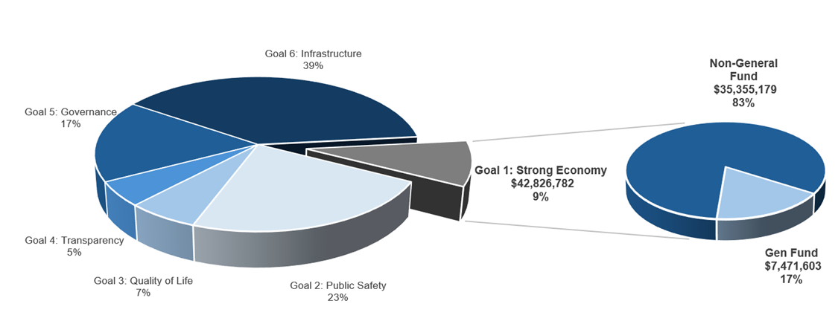
STRONG ECONOMY WITH MORE QUALITY JOBS
FY 2026 ALL FUNDS BUDGET: $460,749,550
Notes:
CALL OUT YOUR SPECIFIC GOAL BUDGET HERE WITH PIE GRAPH BREAKDOWN (PROVIDED BY FINANCE)

Slide 8
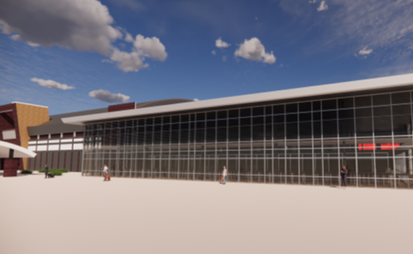
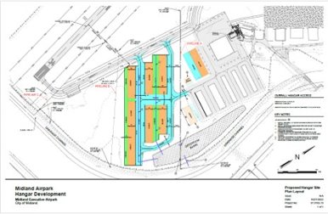
GOAL ONE: STRONG ECONOMY WITH MORE QUALITY JOBS
Airports:
FY 2026 Priorities
Advance and Complete Capital Improvements
  Midland International Air & Spaceport: Terminal Expansion, Airport Entrance Road Enhancements, Parking Improvements
  Midland Airpark: Hangar Infrastructure Expansion, Airfield Rehabilitation, Self-Serve Fueling Improvements
8
Notes:
THIS IS THE PRIORITIES SLIDE. LIST YOUR DEPARTMENTS FY2026 PRIORITIES. THESE ARE THINGS THAT YOU SHOULD BE WORKING TOWARDS BASED ON THE STRATEGIC PLAN.

Slide 9
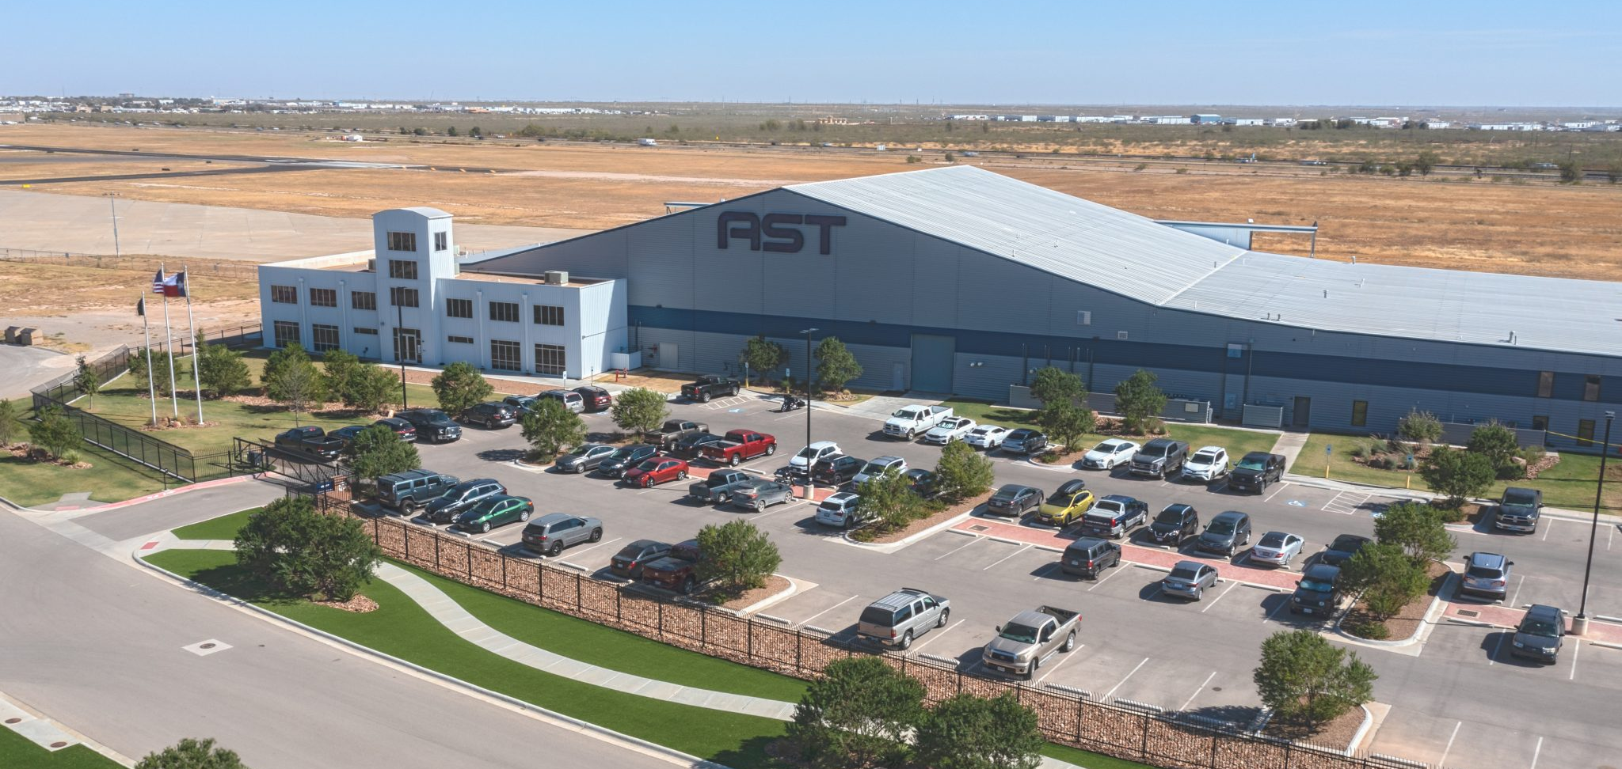
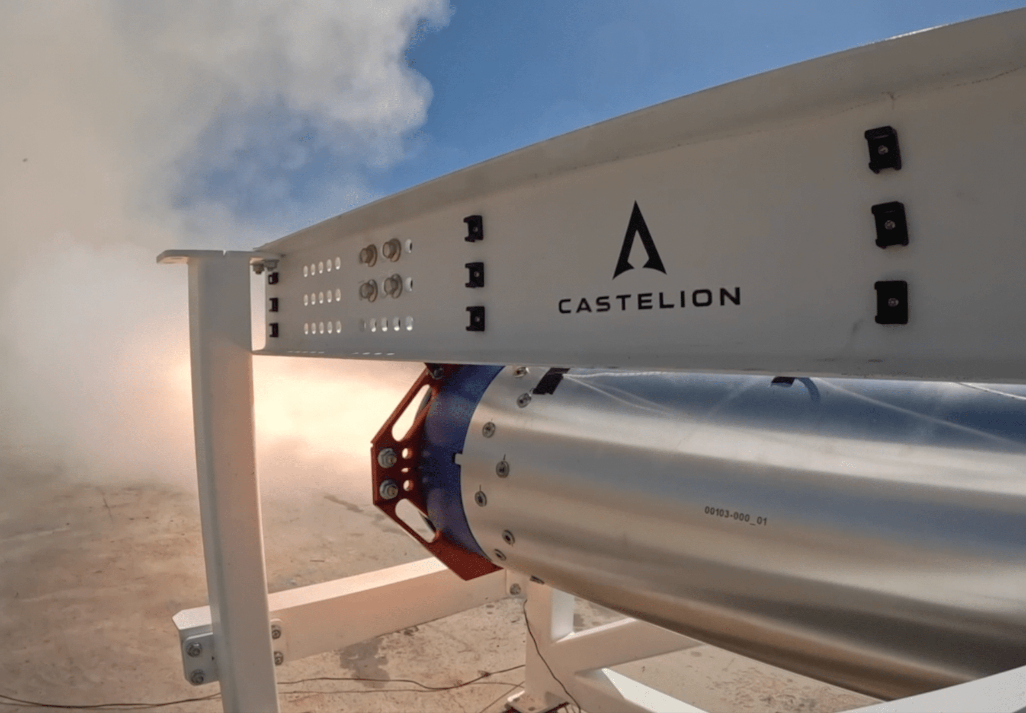
GOAL ONE: STRONG ECONOMY WITH MORE QUALITY JOBS
Airports:
FY 2026 Priorities
Advance Airport-Owned Real Estate Development
  Continue aerospace development with MDC
  Update Midland International Air & Spaceport and begin NE Midland Master Plans
Continue Air Service Development
9
Notes:
THIS IS THE PRIORITIES SLIDE. LIST YOUR DEPARTMENTS FY2026 PRIORITIES. THESE ARE THINGS THAT YOU SHOULD BE WORKING TOWARDS BASED ON THE STRATEGIC PLAN.

Slide 10


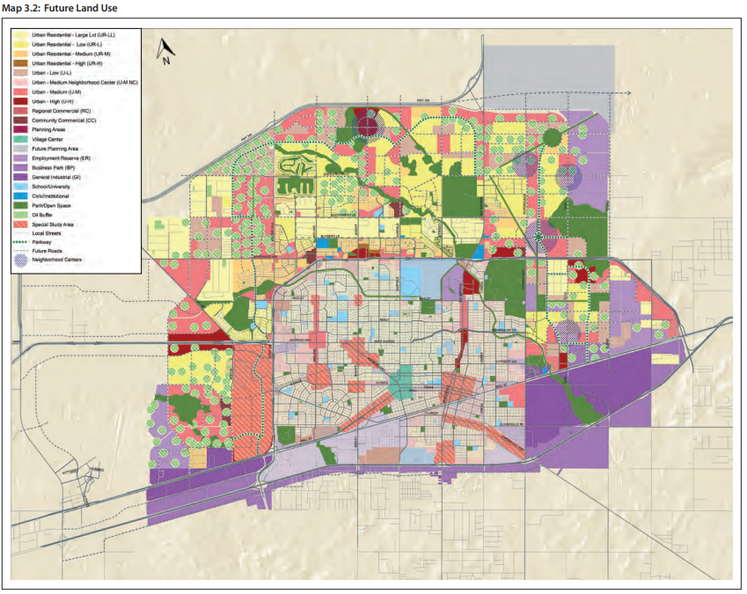

GOAL ONE: STRONG ECONOMY WITH MORE QUALITY JOBS
Development Services:
FY 2026 Priorities
Proactively Plan For + Facilitate Future Growth
  Tall City Tomorrow Update
    Housing & Neighborhoods
    Future Land Use Map
    Major Thoroughfare Plan
  Key Development Districts action plans
10
Notes:
THIS IS THE PRIORITIES SLIDE. LIST YOUR DEPARTMENTS FY2026 PRIORITIES. THESE ARE THINGS THAT YOU SHOULD BE WORKING TOWARDS BASED ON THE STRATEGIC PLAN.

Slide 11

GOAL ONE: STRONG ECONOMY WITH MORE QUALITY JOBS
Development Services:
FY 2026 Priorities
Improve Development Speed to Market
  Streamline entitlement, permitting, and inspection processes with a focus on technology
Encourage Strategic Economic Development
  Key industries, small business, destination retail + entertainment, redevelopment of key districts
11
Notes:
Targeted industries should leverage existing strengths – especially the technical, logistical, and engineering expertise cultivated through oil and gas. Key industries should meet the following criteria:
Align with local and regional workforce skillsets
Build economic resilience beyond the oil cycle
Offer high wage, high-growth job opportunities
Take advantage of Midland’s energy infrastructure, land availability, and logistics position
🔋 1. Energy Tech & Advanced Energy Services
Why: Midland already leads in energy. There's an opportunity to expand from traditional oil and gas into next-gen energy applications and services.
Subsectors:
Carbon capture, utilization, and storage (CCUS)
Hydrogen production and distribution
Grid-scale battery storage
Enhanced geothermal systems
Artificial lift and downhole tech innovation
Workforce fit: Petroleum engineers, field techs, electricians, fluid dynamics experts, welders, machinists
💻 2. Data Centers & Digital Infrastructure
Why: Energy-intensive facilities like data centers pair well with local abundant power and land. The reliability and security concerns in the tech sector align with Midland's isolated but stable infrastructure.
Workforce fit: Electricians, mechanical/HVAC technicians, IT systems support, engineers with SCADA experience
🚚 3. Advanced Logistics & Regional Distribution
Why: Midland’s location and highway/rail access make it a hub for oilfield logistics—this base can support broader regional distribution, especially for industrial and energy-related goods.
Subsectors:
Warehousing and automated fulfillment
Cold chain distribution
Specialized energy-related logistics
Workforce fit: CDL drivers, operations managers, dispatchers, warehouse techs
🏭 4. Advanced Manufacturing
Why: Precision manufacturing for energy, aerospace, defense, or industrial equipment can grow here by tapping Midland’s mechanical and fabrication skills.
Subsectors:
Industrial automation and sensors
Turbines and power systems
Aerospace components
Modular housing/building systems
Workforce fit: Machinists, welders, fabricators, quality control, industrial engineers
🧪 5. Applied Research, Testing & Engineering Services
Why: Midland has technical talent capable of supporting prototyping and field testing for energy and industrial systems in real-world conditions.
Subsectors:
Materials testing and inspection
Field R&D for energy technologies
Remote monitoring & automation
Workforce fit: Engineers, techs, instrumentation specialists, chemists
🏥 6. Specialized Healthcare & Life Sciences (Energy-Adjacent)
Why: Occupational health, injury recovery, and telemedicine are vital for energy workforce support—and can be expanded into broader specialties.
Subsectors:
Occupational medicine
Behavioral health (especially telehealth)
Medical device testing and logistics
Workforce fit: Nurses, PTs, radiology techs, clinical admin, EMTs
🎯 Summary of Recommended Target Industries
IndustryWhy It Fits MidlandLeverages Oil & Gas Skills?Energy Tech & Carbon SolutionsBuilds on leadership in energy✅ YesData CentersNeeds power, land, stability✅ YesAdvanced LogisticsExpands oilfield supply chain capacity✅ YesAdvanced ManufacturingTaps local mechanical/fabrication talent✅ YesField Testing & Engineering R&DUses real-world energy conditions✅ YesOccupational & Telehealth CareSupports workforce and regional demand⚠️ Partial

Slide 12
EXPENSES BY DEPARTMENT
Variance Highlights: ​
Airport: Revenue increase from higher rates and enplanements; most new revenue allocated to capital (see next slide).
Development Services: Increase reflects full-year budgeting for prior-year staffing added to advance Strategic Plan goals – code enforcement (2.3) and permitting services (1.8) – with fewer vacancies expected in FY26.
Notes:
Airport
Renegotiated Contracts with Airlines and the restructured all rates/fees to bring rates into a comparative range of other similar entities.
Rates for the terminal building, parking lot, landing fees, and oil and gas all increase, some by 50%.
Landing fees renegotiated from $500,000 per year to $3.1 million
Expenditures must balance the budget, and includes $8.3 million for capital improvements to expand the facility and services to provided to the growing population
2 New FTE’s from FY2025: Account Clerk and Equipment Operator
Development Services
FY2025 vacancies from the previous year are now shown to be fully staffed, increasing the salary and FTE’s projection for FY2026. 8-10 vacancies were shown last year during the budget development, compared to present day at 0 vacancies.
Assistant Director of Code Enforcement added
Code Enforcement Officer added
Added $105k for special postage and shipping
Hotel/Motel
Midland Convention Center CO 2016 refunded at a lower rate, reducing the annual debt service payment
Increase funding to subgrantees.
Chamber contract decreased, transferring funding to increase Visit Midland Sports and Entertainment budget
Revenue accumulated to $8,657,119 in FY24, which is 33% above budgeted revenue.

Slide 13
EXPENSES BY TYPE
Variance Highlights: ​
Airport: Capital increase reflects higher revenue from rate adjustments and increased enplanements.
Development Services: Personnel increase tied to prior-year staffing investments now fully budgeted.
Notes:
PLEASE INCLUDE TABLE THAT IS EXPENSES BY TYPE THAT WILL BE PROVDIED BY FINANCE FOR YOUR GOAL.

Slide 14

STAFFING
Variance Highlights: ​
Airport: Addition of 2 FTEs to support operational growth, including an account clerk position added per audit recommendation.
Development Services: Net reduction of 1 FTE due to position transfers to/from Engineering and Parks, aligning with Strategic Plan priorities for infrastructure funding and improved code enforcement.
Notes:
THIS IS THE TABLE THAT WILL BE PROVIDED BY FINANCE THAT WILL SHOW YOUR VARIANCES IN STAFFING LEVELS FOR EACH DEPARTMENT IN YOUR GOAL. PLEASE INCLUDE HIGHLGHTS FOR VARIANCES AS SHOWN AS AN EXAMPLE ABOVE.

Slide 15

FY2025 RESULTS
Airport: FY 2025
Infrastructure Investments
Completed $6.3M+ in airfield upgrades at MAF:
  $2.7M NW Drainage Basin Wildlife Project
  $3.6M MAF Taxiway E Reconstruction
Secured $10.7M for MAF Terminal Expansion + Modernization Project
Completed Airpark Fence Project
15
Notes:
Completed $6.3 million in airfield upgrades at MAF, including a $2.7 million drainage and wildlife mitigation project and a $3.6 million reconstruction of Taxiway E to improve safety and reliability.
Secured $10.7 million in funding for the design of a Terminal Expansion and Modernization project to enhance the passenger experience and operational resilience.
Finalized the Airpark Fence Project, improving security and enhancing the appearance of the airport campus—recognizing that a first impression matters when attracting new businesses and investment.
These strategic infrastructure investments boost safety, expand capacity, attract new airlines and aerospace activity, and support Midland’s long-term economic growth and diversification.

Slide 16
FY2025 RESULTS
Airport: FY 2025
Midland Air & Space Port
FY25 on track for record enplanements; 3rd TSA line added to handle demand
Parking revenue reached $6.6M in June, up 9% year-to-date
Partnered with MDC to support space industry growth via AST expansion + Starfighters lease
756
BETTER
16
Notes:
FY 25 is on track for record-breaking enplanements, with 567,067 through June—a nearly 4% increase year-over-date and set to surpass last year's high by over 2%
Parking revenue has surged—June net intake reached $820,800 (up 10%), and fiscal-year total hit $6.6 million, a 9% increase Midland Reporter-Telegram.
Roaring passenger and parking revenues are lifting overall airport revenue to new highs, fortifying MAF’s financial footing and capacity to reinvest in infrastructure and services.
AST & Science expanded its operations with a second facility at MAF, investing $30 million and creating 50 new jobs—building on its original commitment of $21 million and more than 200 jobs.
Starfighters Space executed a lease for a long-vacant hangar and began operations, bringing in supersonic jets for testing, defense research, and satellite launches.
These accomplishments strengthen Midland’s position as a regional aerospace and innovation hub, attract high-wage jobs and private investment, and support long-term economic diversification beyond oil and gas.

Slide 17
FY2025 RESULTS
Development Services: FY 2025
Permitting + Inspections
Residential permit volume up 27% this year, with avg review + issue times cut to 1.6 and 7.3 business days, respectively.
Commercial average review time down to 3.5 business days; average issue time cut nearly in half since FY23.
BETTER
17
Notes:
Development speed matters—delays cost time and money. By cutting permit review times and inspection backlogs, we help projects move faster, getting homes and businesses to market sooner.
Residential permit volume is up 27% this year, yet we’ve cut average review and issue times to just 1.6 and 7.3 business days, helping housing reach the market faster to meet demand.
Commercial development moves faster too—Average review time is down to 3.5 days, with total permit turnaround nearly cut in half since FY23, allowing businesses to open sooner and start contributing to the local economy.

Slide 18
FY2025 RESULTS
Development Services: FY 2025
Permitting + Inspections
Inspections up 27% since FY23 with on-time completion rising to 96%
Launched Permit Midland, an online permitting and inspection request portal
Rolled out public dashboards to track real-time permitting and development activity
BETTER
18
Notes:
Development speed matters—delays cost time and money. By cutting permit review times and inspection backlogs, we help projects move faster, getting homes and businesses to market sooner.
Stronger inspection performance—a 27% increase in inspections with no added staff shows we’re doing more with what we have, keeping pace with growth without sacrificing service.
Technology is essential to scale—we can’t sustainably grow by adding staff alone. Tools like Permit Midland and public dashboards increase transparency, streamline processes, and expand our capacity without expanding our headcount.
Public access builds confidence—real-time dashboards give developers, investors, and residents clear visibility into growth activity, reinforcing trust and reducing uncertainty.
A more responsive system fuels growth—faster, smarter permitting and inspections reduce friction, making Midland a more competitive place to build and invest.

Slide 19
FY 2025 RESULTS
Development Services: FY2025
Downtown Revitalization
Omni Midland announced; design underway
Re-established Downtown TIRZ and completed 2024 Master Plan to fund and guide growth
New events like Chalk the Block and Midland's Merry Lights boost foot traffic and support small businesses
19
Notes:
Downtown is central to Midland’s economic future—as the historic core and a major employment center, a vibrant downtown attracts private investment, supports small businesses, and helps retain talent by offering a unique, experience-driven environment.
The Omni Midland and Tapestry Hilton projects mark a turning point—they bring high-quality lodging, conference space, and dining that help position Midland to host more visitors, events, and business travel, directly supporting Strategic Plan goals for economic diversification and destination development.
Securing state legislation to capture sales tax from nearby businesses was a game-changer—this tool helps fund public infrastructure around the Omni without burdening local taxpayers and creates a sustainable path to reinvest in downtown.
Re-establishing the Downtown TIRZ with strong regional partners—including the County, College, and Hospital District—aligns with our strategic priority to invest collaboratively in transformational projects that benefit the entire community.
The 2024 Downtown Master Plan provides a clear roadmap—it reflects our community’s vision and will guide future investments in housing, streetscapes, public spaces, and connectivity in support of economic vibrancy.
Events like Chalk the Block and Midland Merry Lights are more than just fun—they drive foot traffic, support small business growth, and increase downtown visibility, advancing our strategic focus on placemaking and small business vitality.

Slide 20
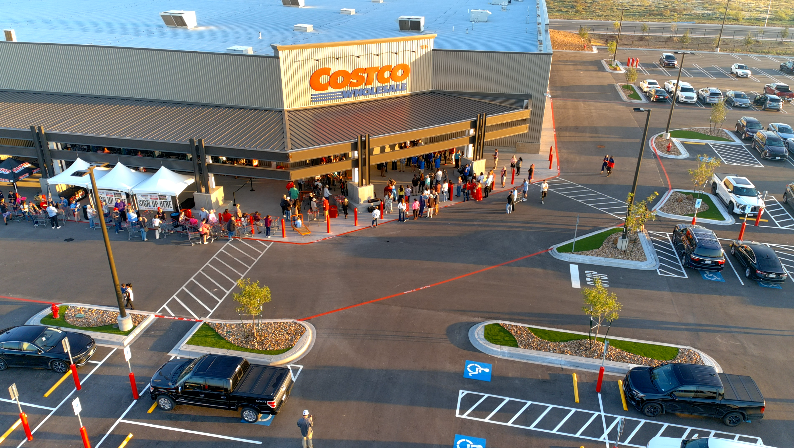
FY 2025 RESULTS
Development Services: FY 2025
West Midland Development
Texas’ largest Costco opened in Midland
Broke ground on Diamondback Energy Athletic Complex, ExxonMobil Soccer Complex at Beal Park, and Cinergy Tall City
Approved two new TIRZs with City and County:
  TIRZ 3 – Funds infrastructure to proactively support growth
  TIRZ 4 – Supports Sports Complex and boosts visitor spending through youth sports
20
Notes:
West Midland is where the city is expanding fastest, and investing here ensures we grow in a smart, sustainable way.
The opening of Texas’ largest Costco signals strong market demand and helps anchor additional retail and service development in the area.
Breaking ground on the Diamondback sports facility, Beal Park Soccer Complex, and Tall City Cinergy adds vital quality-of-life amenities that attract families and enhance livability.
TIRZ 3 funds infrastructure in advance of development, preventing strain on City services and ensuring growth pays for itself.
TIRZ 4 supports the sports complex and related amenities, boosting youth sports tourism and visitor spending to diversify our economy.
Together, these projects position West Midland as a well-planned, high-opportunity growth area critical to Midland’s long-term economic success.

Slide 21
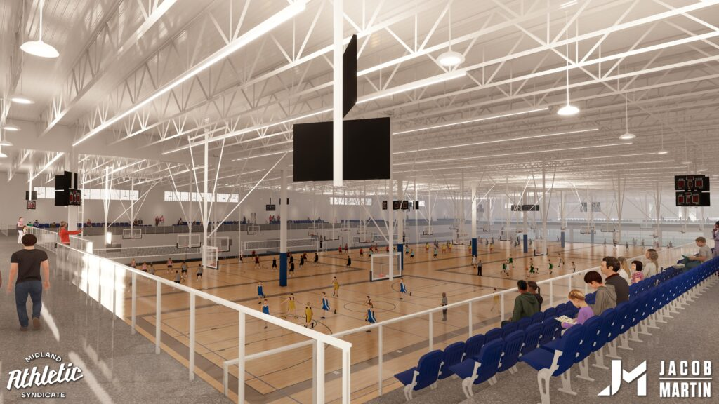
FY 2026 DELIVERABLES
Strategy: Increase the Midland Sales Tax Base
Improve shovel-readiness for destination retail and/or entertainment opportunities
Begin master plan for Airport-owned land in Northeast Midland
Strategy: Enhance Visitor Revenue Opportunities
Increase hotel uses in Downtown Midland
Continue park facilities’ improvements and partner to attract youth sports tournaments
21
Notes:
INSTRUCTIONS FOR THESE SLIDES. CREATE AS MANY SLIDES NEEDED FOR AS MANY STRATEGIES THAT YOU WANT TO SPECIFICALLY CALL OUT.
📋 How to Create Key Deliverables for Budget Goal Team Updates
Step 1: Start with the Strategy
Look at the exact wording of the Strategic Plan strategy assigned to your team. For example:
➡️ Strategy: Enhance Communication Efficiency and Effectiveness
This is the "what"—the high-level direction or goal. Your job is to define "how" your team will help achieve it.
Step 2: Identify Actionable Deliverables
Think about the specific, tangible actions, programs, or projects your team will complete in the fiscal year to advance the strategy. These are your Key Deliverables.
Ask:
✔️ What can we implement, launch, improve, or expand?
✔️ How will this action directly support the strategy?
✔️ Can this be tracked or measured by year-end?
Examples for the strategy above:
✅ Maximize the use of reverse 9-1-1 & citizen notification systems to improve emergency communication.
✅ Expand the use of Virtual Agent via RingCX to provide 24/7 phone system access for residents.
✅ Target messaging to specific populations using tools like geo-fencing or Spanish-language content on social media.
Step 3: Keep Deliverables Focused, Measurable, and Budget-Relevant
Key Deliverables should:
✔️ Be specific—not vague or general.
✔️ Be measurable—you should know when it’s done or if it’s working.
✔️ Tie back to budget decisions—does this require funding, staffing, or technology?
✅ Quick Tips for Writing Deliverables:
Start with an action verb: Implement, Expand, Launch, Complete, Deploy.
Be clear on the outcome: What will this change, improve, or deliver?
Think one fiscal year at a time—keep deliverables achievable within the FY.
👉 If your strategy is citywide (like communication), your department’s deliverables should reflect what you specifically control or influence—while working toward the larger goal.

Slide 22
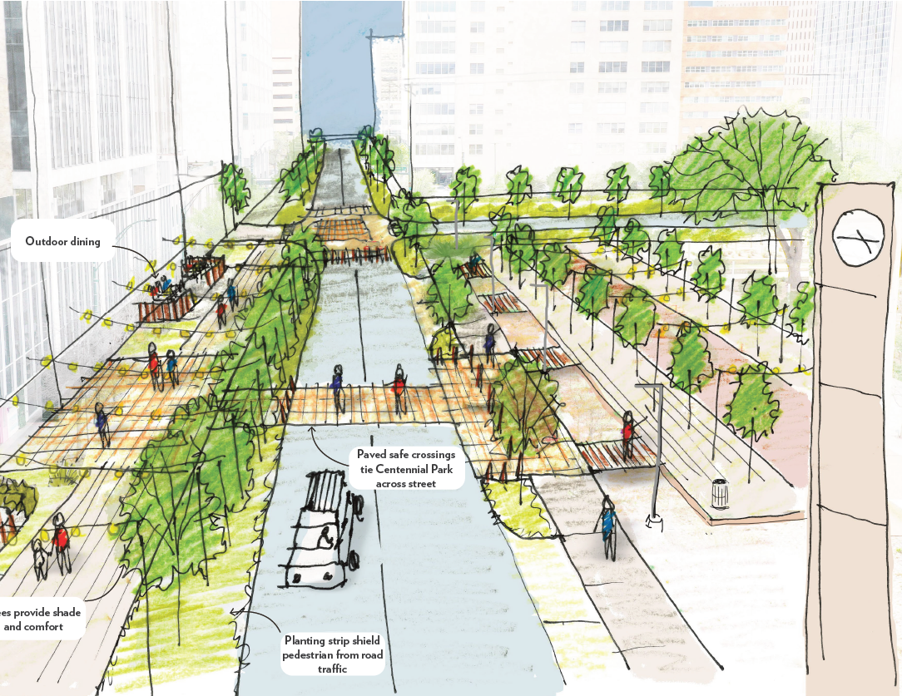
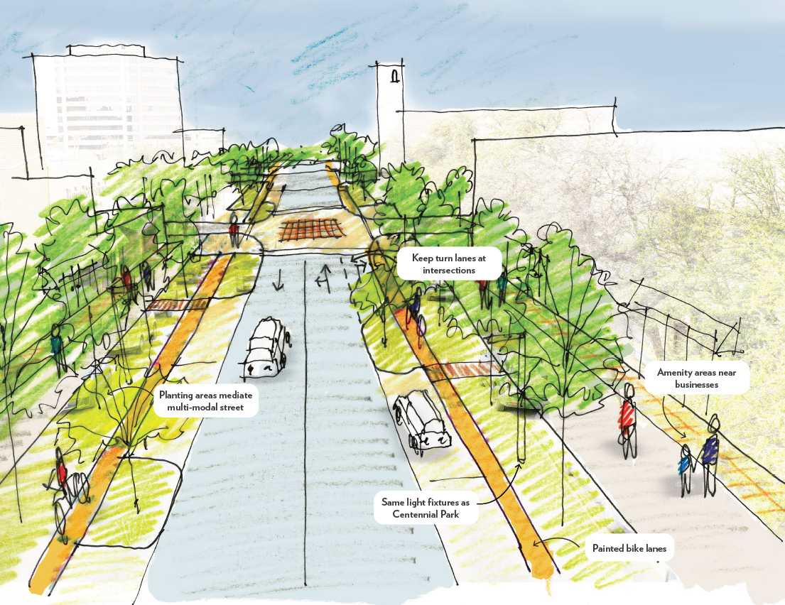
FY 2026 DELIVERABLES
Strategy: Continue Downtown and West Midland Redevelopment
Activate, deploy, and enforce downtown parking strategy
Expand downtown programming (outdoor dining, Midland Merry Lights, Chalk the Block)
Deploy placemaking strategies (entryway signage, lighting, alley activation, public art)
Partner with developers on retail, entertainment, and master-planned communities
22
Notes:
INSTRUCTIONS FOR THESE SLIDES. CREATE AS MANY SLIDES NEEDED FOR AS MANY STRATEGIES THAT YOU WANT TO SPECIFICALLY CALL OUT.
📋 How to Create Key Deliverables for Budget Goal Team Updates
Step 1: Start with the Strategy
Look at the exact wording of the Strategic Plan strategy assigned to your team. For example:
➡️ Strategy: Enhance Communication Efficiency and Effectiveness
This is the "what"—the high-level direction or goal. Your job is to define "how" your team will help achieve it.
Step 2: Identify Actionable Deliverables
Think about the specific, tangible actions, programs, or projects your team will complete in the fiscal year to advance the strategy. These are your Key Deliverables.
Ask:
✔️ What can we implement, launch, improve, or expand?
✔️ How will this action directly support the strategy?
✔️ Can this be tracked or measured by year-end?
Examples for the strategy above:
✅ Maximize the use of reverse 9-1-1 & citizen notification systems to improve emergency communication.
✅ Expand the use of Virtual Agent via RingCX to provide 24/7 phone system access for residents.
✅ Target messaging to specific populations using tools like geo-fencing or Spanish-language content on social media.
Step 3: Keep Deliverables Focused, Measurable, and Budget-Relevant
Key Deliverables should:
✔️ Be specific—not vague or general.
✔️ Be measurable—you should know when it’s done or if it’s working.
✔️ Tie back to budget decisions—does this require funding, staffing, or technology?
✅ Quick Tips for Writing Deliverables:
Start with an action verb: Implement, Expand, Launch, Complete, Deploy.
Be clear on the outcome: What will this change, improve, or deliver?
Think one fiscal year at a time—keep deliverables achievable within the FY.
👉 If your strategy is citywide (like communication), your department’s deliverables should reflect what you specifically control or influence—while working toward the larger goal.

Slide 23
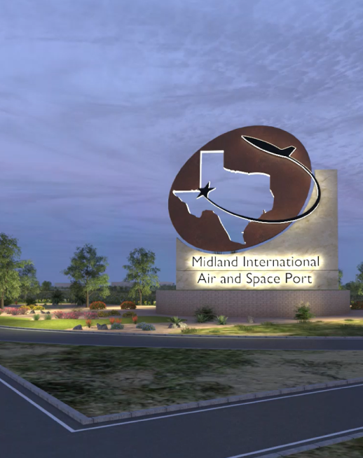
FY 2026 DELIVERABLES
Strategy: Nurture Development Districts
Launch master plans for key development areas in the city
Secure + deploy municipal financial instruments to drive targeted development
Strategy: Grow the Core Business of Air Transportation
Complete design + secure funding for MAF terminal + Airpark hangar infrastructure project
23
Notes:
INSTRUCTIONS FOR THESE SLIDES. CREATE AS MANY SLIDES NEEDED FOR AS MANY STRATEGIES THAT YOU WANT TO SPECIFICALLY CALL OUT.
📋 How to Create Key Deliverables for Budget Goal Team Updates
Step 1: Start with the Strategy
Look at the exact wording of the Strategic Plan strategy assigned to your team. For example:
➡️ Strategy: Enhance Communication Efficiency and Effectiveness
This is the "what"—the high-level direction or goal. Your job is to define "how" your team will help achieve it.
Step 2: Identify Actionable Deliverables
Think about the specific, tangible actions, programs, or projects your team will complete in the fiscal year to advance the strategy. These are your Key Deliverables.
Ask:
✔️ What can we implement, launch, improve, or expand?
✔️ How will this action directly support the strategy?
✔️ Can this be tracked or measured by year-end?
Examples for the strategy above:
✅ Maximize the use of reverse 9-1-1 & citizen notification systems to improve emergency communication.
✅ Expand the use of Virtual Agent via RingCX to provide 24/7 phone system access for residents.
✅ Target messaging to specific populations using tools like geo-fencing or Spanish-language content on social media.
Step 3: Keep Deliverables Focused, Measurable, and Budget-Relevant
Key Deliverables should:
✔️ Be specific—not vague or general.
✔️ Be measurable—you should know when it’s done or if it’s working.
✔️ Tie back to budget decisions—does this require funding, staffing, or technology?
✅ Quick Tips for Writing Deliverables:
Start with an action verb: Implement, Expand, Launch, Complete, Deploy.
Be clear on the outcome: What will this change, improve, or deliver?
Think one fiscal year at a time—keep deliverables achievable within the FY.
👉 If your strategy is citywide (like communication), your department’s deliverables should reflect what you specifically control or influence—while working toward the larger goal.

Slide 24
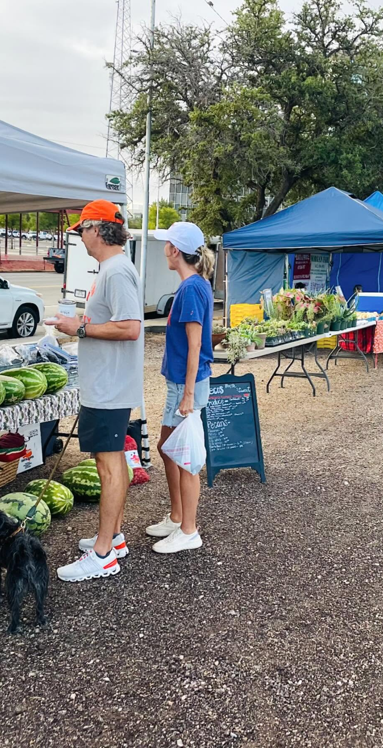
FY 2026 DELIVERABLES
Strategy: Expand Opportunities + Programming for General + Small Business
Leverage downtown programming to support small businesses
Support the Midland Entrepreneurial Challenge to grow local startups
Explore additional tools to strengthen small business development (e.g., access to capital, City procurement)
24
Notes:
INSTRUCTIONS FOR THESE SLIDES. CREATE AS MANY SLIDES NEEDED FOR AS MANY STRATEGIES THAT YOU WANT TO SPECIFICALLY CALL OUT.
📋 How to Create Key Deliverables for Budget Goal Team Updates
Step 1: Start with the Strategy
Look at the exact wording of the Strategic Plan strategy assigned to your team. For example:
➡️ Strategy: Enhance Communication Efficiency and Effectiveness
This is the "what"—the high-level direction or goal. Your job is to define "how" your team will help achieve it.
Step 2: Identify Actionable Deliverables
Think about the specific, tangible actions, programs, or projects your team will complete in the fiscal year to advance the strategy. These are your Key Deliverables.
Ask:
✔️ What can we implement, launch, improve, or expand?
✔️ How will this action directly support the strategy?
✔️ Can this be tracked or measured by year-end?
Examples for the strategy above:
✅ Maximize the use of reverse 9-1-1 & citizen notification systems to improve emergency communication.
✅ Expand the use of Virtual Agent via RingCX to provide 24/7 phone system access for residents.
✅ Target messaging to specific populations using tools like geo-fencing or Spanish-language content on social media.
Step 3: Keep Deliverables Focused, Measurable, and Budget-Relevant
Key Deliverables should:
✔️ Be specific—not vague or general.
✔️ Be measurable—you should know when it’s done or if it’s working.
✔️ Tie back to budget decisions—does this require funding, staffing, or technology?
✅ Quick Tips for Writing Deliverables:
Start with an action verb: Implement, Expand, Launch, Complete, Deploy.
Be clear on the outcome: What will this change, improve, or deliver?
Think one fiscal year at a time—keep deliverables achievable within the FY.
👉 If your strategy is citywide (like communication), your department’s deliverables should reflect what you specifically control or influence—while working toward the larger goal.

Slide 25
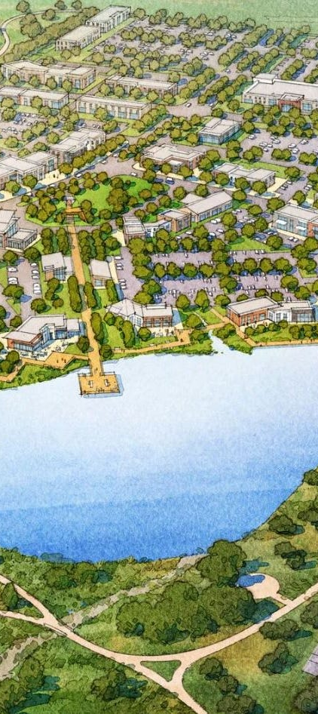
FY 2026 DELIVERABLES
Strategy: Improve Speed to Market for Citizens, Builders, Developers, and Contractors
Continue to accelerate permit and certificate of occupancy issuance through process improvements and leveraging technology
Facilitate development and permitting for major quality of life projects including the Zoo
Strategy: Establish Our Community as a Premier Destination for Retail + Entertainment
Recruit destination retail + entertainment
25
Notes:
INSTRUCTIONS FOR THESE SLIDES. CREATE AS MANY SLIDES NEEDED FOR AS MANY STRATEGIES THAT YOU WANT TO SPECIFICALLY CALL OUT.
📋 How to Create Key Deliverables for Budget Goal Team Updates
Step 1: Start with the Strategy
Look at the exact wording of the Strategic Plan strategy assigned to your team. For example:
➡️ Strategy: Enhance Communication Efficiency and Effectiveness
This is the "what"—the high-level direction or goal. Your job is to define "how" your team will help achieve it.
Step 2: Identify Actionable Deliverables
Think about the specific, tangible actions, programs, or projects your team will complete in the fiscal year to advance the strategy. These are your Key Deliverables.
Ask:
✔️ What can we implement, launch, improve, or expand?
✔️ How will this action directly support the strategy?
✔️ Can this be tracked or measured by year-end?
Examples for the strategy above:
✅ Maximize the use of reverse 9-1-1 & citizen notification systems to improve emergency communication.
✅ Expand the use of Virtual Agent via RingCX to provide 24/7 phone system access for residents.
✅ Target messaging to specific populations using tools like geo-fencing or Spanish-language content on social media.
Step 3: Keep Deliverables Focused, Measurable, and Budget-Relevant
Key Deliverables should:
✔️ Be specific—not vague or general.
✔️ Be measurable—you should know when it’s done or if it’s working.
✔️ Tie back to budget decisions—does this require funding, staffing, or technology?
✅ Quick Tips for Writing Deliverables:
Start with an action verb: Implement, Expand, Launch, Complete, Deploy.
Be clear on the outcome: What will this change, improve, or deliver?
Think one fiscal year at a time—keep deliverables achievable within the FY.
👉 If your strategy is citywide (like communication), your department’s deliverables should reflect what you specifically control or influence—while working toward the larger goal.

Slide 26

MISSION
Deliver exceptional services and promote a high quality of life and place for ALL our citizens.

