Slide 1

GOAL THREE
QUALITY OF LIFE AND PLACE FOR RECRUITMENT AND RETENTION
FY 2026 BUDGET PRESENTATION
AUGUST 2025
TITLE HERE
TITLE HERE
Notes:
PUT YOUR GOAL NUMBER AND WRITE OUT YOUR GOAL NAME. NOTHING ELES SHOULD CHANGE!

Slide 2

TABLE OF CONTENTS
Vision Block Connections & Strategic Alignment
Priorities Focus
Budget Highlights
FY 2025 Results
FY 2026 Deliverables
2
Notes:
DO NOT CHANGE TABLE OF CONTENTS, YOUR PRESENTATION SHOULD FOLLOW THIS TEMPLATE (FOR EVERY GOAL!)

Slide 3

VISION BLOCK CONNECTIONS
“The City of Midland will be the Premier and Safest City in West Texas by Providing World Class Municipal Services through Operational Excellence and a Culture of Innovation”
Premier City (Goals 1, 3)
3
Notes:
ADD YOUR VISION BLOCK CONNECTIONS HERE. IT WILL NOT BE THE SAME AS GOAL 4!

Slide 4

STRATEGIC ALIGNMENT
Goal 3: Quality of Life and Place for Recruitment and Retention
3.1 Enhance Community Engagement
3.2 Foster Relationships with Foundations and Outside Businesses
3.3 Create an Attractive and Inclusive Living Environment
  3.3.1 Develop and support clear minimum requirements for quality of place amenities in new developments
4
Notes:
LIST OUT YOUR STRATEGIC SUB GOALS HERE

Slide 5

STRATEGIC ALIGNMENT
Goal 3: Quality of Life and Place for Recruitment and Retention
3.4 Establish Beautification Programs
  3.4.1 Elevate the visual experience of high visibility areas
3.5 Nurture + Promote a Healthy Community
3.6 Build the Best Parks System in Our Region
5
Notes:
1.3.1 Adopt a holistic approach to address barriers in downtown Midland
1.3.2 Review and refine current code enforcement practices to better support redevelopment efforts in downtown and south Midland
1.3.3 Develop and implement diverse programming and entertainment initiatives to attract residents, businesses, and visitors to downtown Midland

Slide 6

DEPARTMENTS
Organizational Alignment
Parks
Recreation
The Courses at Hogan Park
Scharbauer Sports Complex
Senior Services
6
Notes:
LIST YOUR DEPARTMENTS THAT ARE INCLUDED IN YOUR GOAL HERE

Slide 7


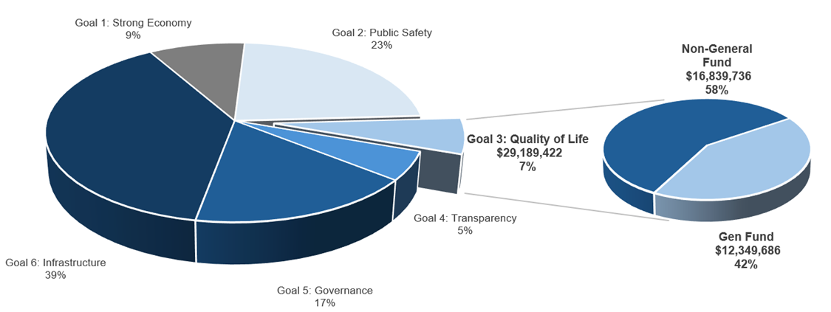
QUALITY OF LIFE AND PLACE FOR RECRUITMENT AND RETENTION
FY 2026 ALL FUNDS BUDGET: $460,749,550
Notes:
CALL OUT YOUR SPECIFIC GOAL BUDGET HERE WITH PIE GRAPH BREAKDOWN (PROVIDED BY FINANCE)

Slide 8

GOAL THREE: QUALITY OF LIFE AND PLACE
Parks and Recreation
FY 2026 Priorities
Build and maintain quality sports facilities to attract tournaments and visitor spending
Foster existing + develop new partnerships to enhance quality of life for Midland
Provide residents world-class public golf facilities
Identify and develop plans for new recreational opportunities for Midlanders of all ages
8
Notes:
We’re investing in quality sports facilities to attract tournaments and boost visitor spending—with new baseball fields at Reyes-Mashburn-Nelms, new auxiliary fields at Scharbauer, expanded soccer fields at Beal Park, and a new indoor volleyball/basketball facility led by the Midland Athletic Syndicate.
Strong partnerships are key to enhancing quality of life—we’re building on relationships with groups like Keep Midland Beautiful, Diamondback Energy, and the Texas Forest Service to support tree planting and beautification, and exploring new amenities at Grasslands, Beal, and Hogan Parks.
We’re focused on elevating Hogan Park Golf Course—beginning master planning and capital improvements, improving course management and maintenance, and making it easier for residents to access the only public course in Midland.
We’re creating more recreational opportunities for all ages—expanding popular programming like Chalk the Block and Holiday Lights, exploring a new multi-generational facility and indoor playground, and kicking off work on an updated Parks Master Plan.
The Wildcatters Trail continues to move forward, expanding connectivity and outdoor access as a long-term community asset.

Slide 9

EXPENSES BY DEPARTMENT
Variance Highlights: ​
Parks & Recreation: Increase due to maintenance costs and fiber upgrades for security
Golf Course: revenue growth from new rates; budget includes Hogan debt service
Sports Complex: General Fund support reduced by 50% due to cost allocation study
Oil & Gas: Budget matches projected revenues
Notes:
PLEASE INCLUDE YOUR TABLE FOR EXPENSES BY DEPARMENT FOR EACH OF THE DEPARTMENTS INCLUDED IN YOUR GOAL

Slide 10
EXPENSES BY TYPE
Variance Highlights: ​
Higher ongoing maintenance needs associated with existing and upcoming park improvements, including completion of Beal Phase I
Capital reflects projected oil and gas revenue
Notes:
PLEASE INCLUDE TABLE THAT IS EXPENSES BY TYPE THAT WILL BE PROVDIED BY FINANCE FOR YOUR GOAL.

Slide 11
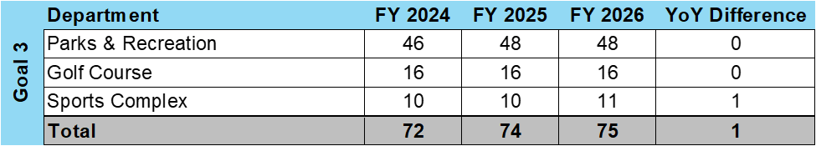
STAFFING
Variance Highlights: ​
Parks and Recreation: Adds one net new FTE – an irrigation specialist for the Sports Complex – allowing existing staff to focus on expanding assets.
Notes:
THIS IS THE TABLE THAT WILL BE PROVIDED BY FINANCE THAT WILL SHOW YOUR VARIANCES IN STAFFING LEVELS FOR EACH DEPARTMENT IN YOUR GOAL. PLEASE INCLUDE HIGHLGHTS FOR VARIANCES AS SHOWN AS AN EXAMPLE ABOVE.

Slide 12
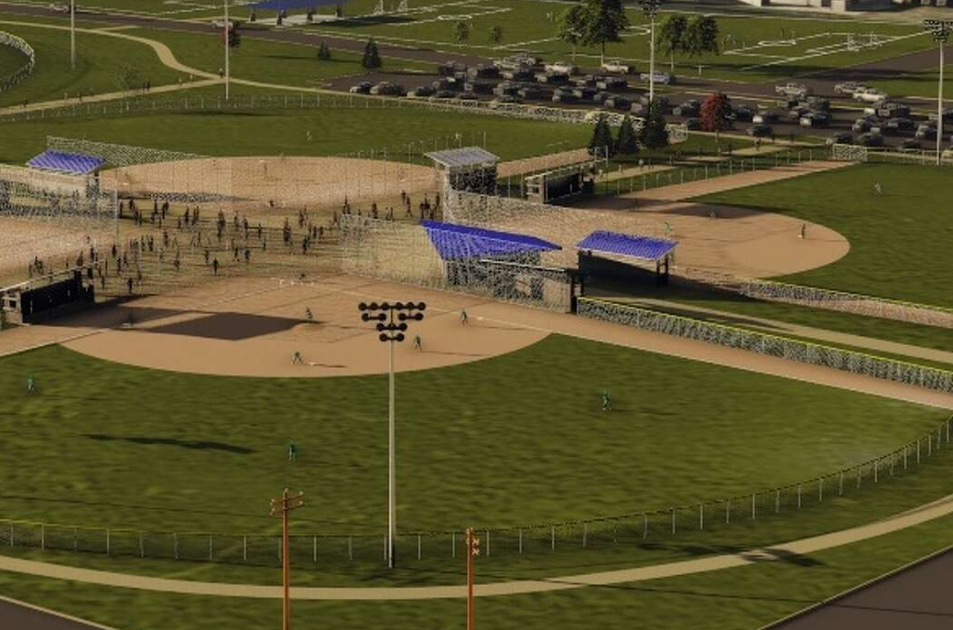
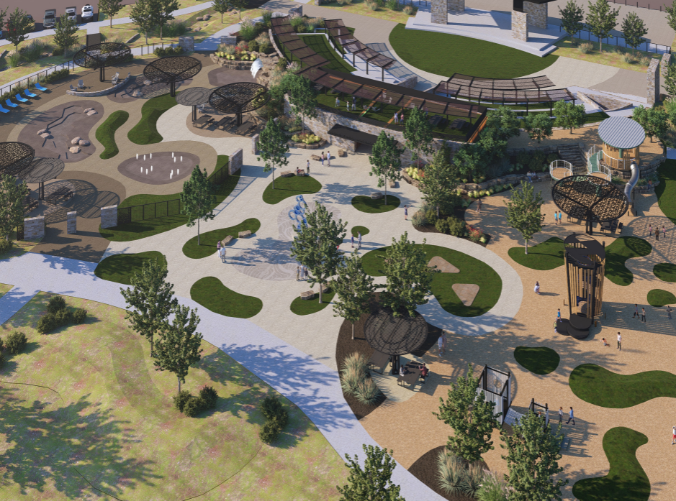

FY 2025 RESULTS
Parks and Recreation: FY 2025
Sports Facility Improvements
Completed $16M RMN Baseball Complex Phase 1
Broke ground on the $46M+ Beal Park Soccer Complex
  Secured $8.2M in additional donations and naming rights bringing total to $18.2M
  Started Phases 2 and 3 design
12
Notes:
Other improvements: New D Cell Lights throughout Scharbauer Sports Complex
New Fire Suppression System at Scharbauer Sports Complex
Fiber installed at Astound Broadband Stadium
New Fitness Court at Dennis the Menace Park
Renovated Ulmer Sand Volleyball Courts

Slide 13
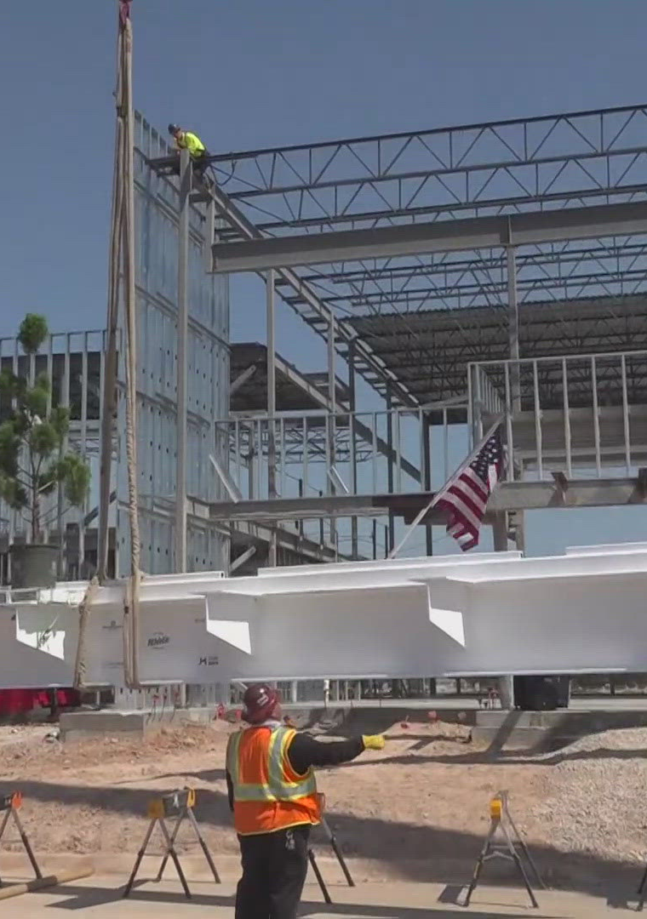
FY 2025 RESULTS
Parks and Recreation: FY 2025
Sports Facility Improvements
Completed Windlands Soccer and MUGS Softball field, irrigation, and lighting improvements
Diamondback Energy Athletic Complex broke ground and held topping out ceremony
Completed plans for two Scharbauer Sports Complex auxiliary fields
13
Notes:
Other improvements: New D Cell Lights throughout Scharbauer Sports Complex
New Fire Suppression System at Scharbauer Sports Complex
Fiber installed at Astound Broadband Stadium
New Fitness Court at Dennis the Menace Park
Renovated Ulmer Sand Volleyball Courts

Slide 14
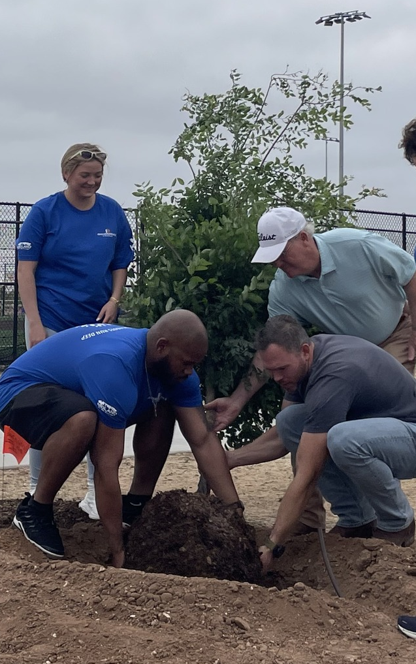

FY 2025 RESULTS
Parks & Recreation: FY 2025
Other Facility Improvements
Key Partnerships:
  100 trees planted at RMN Park with Diamondback Energy and Keep Midland Beautiful
  Grasslands Park Solar pathway lighting funded with donation
14
Notes:
LIST OUT KEY ACCOMPLISHMENTS MADE IN FY2025. THESE SHOULD CLOSELY REFLECT THE PRIORITIES & KEY DELIVERABLES SET IN LAST YEARS PRESENTATION. ALSO INCLUDE ANY BIG HIGHLIGHTS OR WINS THAT WERE NOT CALLED OUT IN PREVIOUS PRESENTATIONS. CAN INCLUDE METRICS, GRAPHICS, ETC. BUT STILL KEEP THESE AT A HIGH LEVEL. ONLY THE MOST IMPACTFUL ACCOMPLISHMENTS SHOULD BE LISTED! USE AS MANY SLIDES AS YOU NEED, BUT DON'T GO OVER BOARD!
EACH DEPARTMENT WILL NEED A KEY ACCOMPLISHMENTS SLIDE(S).

Slide 15
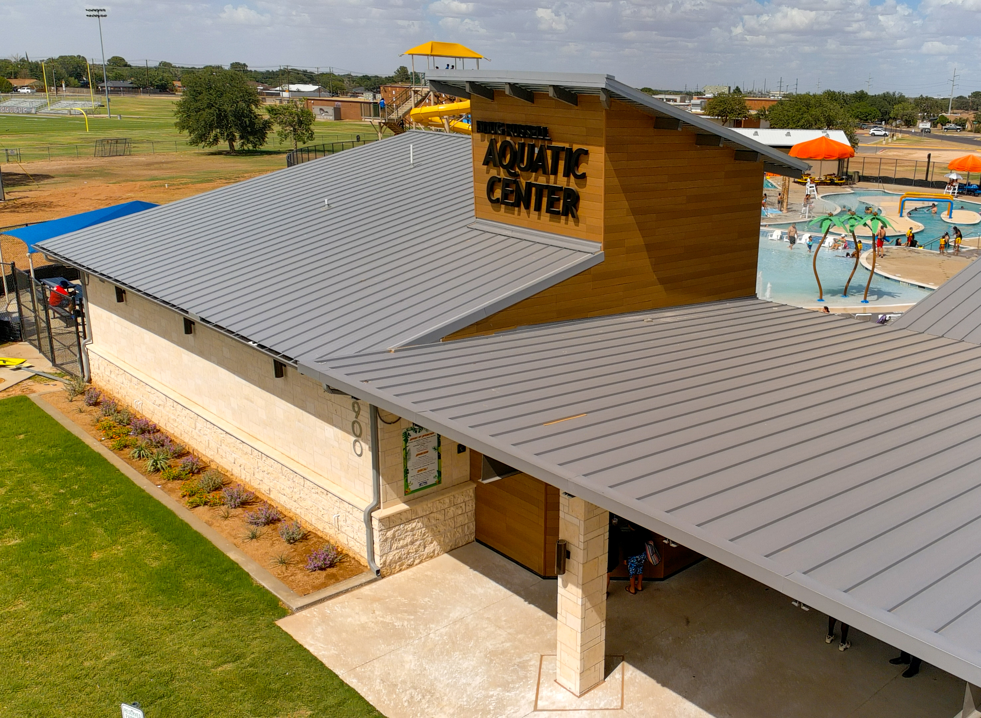
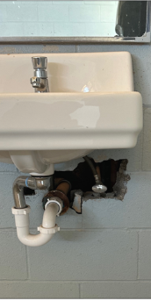
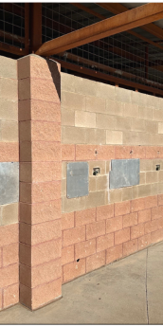
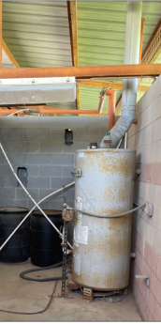
FY 2025 RESULTS
Parks & Recreation: FY 2025
Other Facility Improvements
Doug Russell Aquatic Center completed on-time and under budget
AFTER
BEFORE
15
Notes:
LIST OUT KEY ACCOMPLISHMENTS MADE IN FY2025. THESE SHOULD CLOSELY REFLECT THE PRIORITIES & KEY DELIVERABLES SET IN LAST YEARS PRESENTATION. ALSO INCLUDE ANY BIG HIGHLIGHTS OR WINS THAT WERE NOT CALLED OUT IN PREVIOUS PRESENTATIONS. CAN INCLUDE METRICS, GRAPHICS, ETC. BUT STILL KEEP THESE AT A HIGH LEVEL. ONLY THE MOST IMPACTFUL ACCOMPLISHMENTS SHOULD BE LISTED! USE AS MANY SLIDES AS YOU NEED, BUT DON'T GO OVER BOARD!
EACH DEPARTMENT WILL NEED A KEY ACCOMPLISHMENTS SLIDE(S).

Slide 16
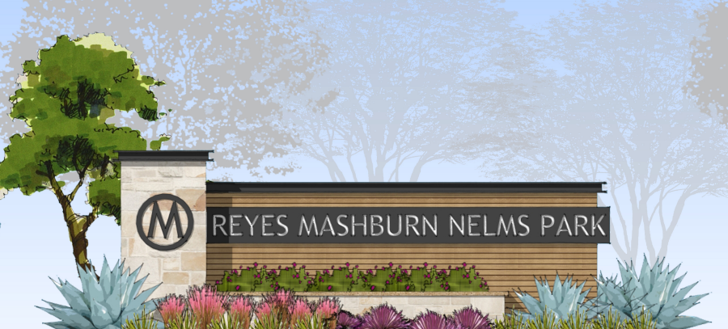
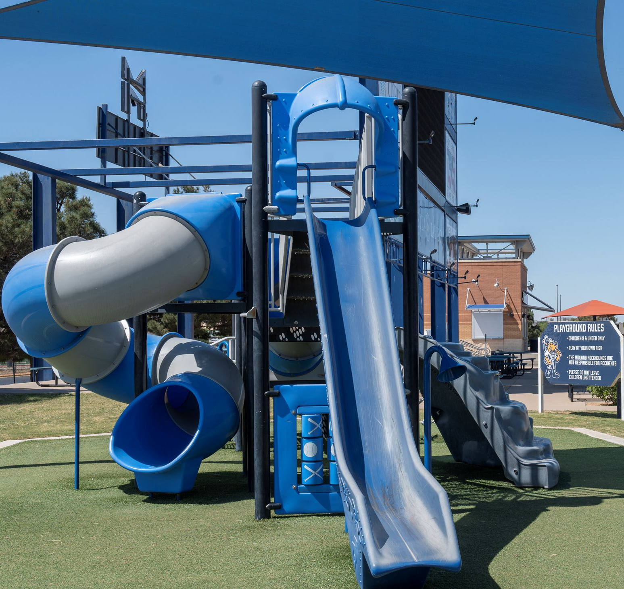
FY 2025 RESULTS
Parks & Recreation: FY 2025
Other Facility Improvements
Three play structures replaced at Tumbleweed Park, Bill Williams Softball Complex, Momentum Bank Ballpark
New restroom facility for Dunagan Park ordered
Completed new branding/signage for parks system
16
Notes:
LIST OUT KEY ACCOMPLISHMENTS MADE IN FY2025. THESE SHOULD CLOSELY REFLECT THE PRIORITIES & KEY DELIVERABLES SET IN LAST YEARS PRESENTATION. ALSO INCLUDE ANY BIG HIGHLIGHTS OR WINS THAT WERE NOT CALLED OUT IN PREVIOUS PRESENTATIONS. CAN INCLUDE METRICS, GRAPHICS, ETC. BUT STILL KEEP THESE AT A HIGH LEVEL. ONLY THE MOST IMPACTFUL ACCOMPLISHMENTS SHOULD BE LISTED! USE AS MANY SLIDES AS YOU NEED, BUT DON'T GO OVER BOARD!
EACH DEPARTMENT WILL NEED A KEY ACCOMPLISHMENTS SLIDE(S).

Slide 17
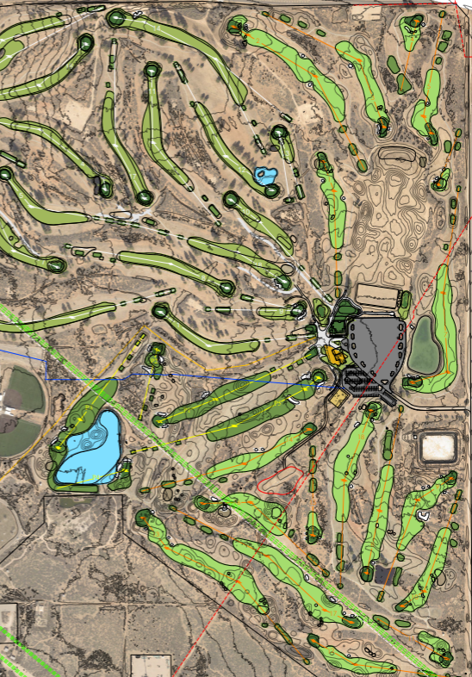

FY 2025 RESULTS
Parks & Recreation: FY 2025
The Courses at Hogan Park
Broke ground on cart barn
Launched Master Plan development
Released new branding + logo
Implemented new tee time booking system allowing golfers to book tee times online
17
Notes:
LIST OUT KEY ACCOMPLISHMENTS MADE IN FY2025. THESE SHOULD CLOSELY REFLECT THE PRIORITIES & KEY DELIVERABLES SET IN LAST YEARS PRESENTATION. ALSO INCLUDE ANY BIG HIGHLIGHTS OR WINS THAT WERE NOT CALLED OUT IN PREVIOUS PRESENTATIONS. CAN INCLUDE METRICS, GRAPHICS, ETC. BUT STILL KEEP THESE AT A HIGH LEVEL. ONLY THE MOST IMPACTFUL ACCOMPLISHMENTS SHOULD BE LISTED! USE AS MANY SLIDES AS YOU NEED, BUT DON'T GO OVER BOARD!
EACH DEPARTMENT WILL NEED A KEY ACCOMPLISHMENTS SLIDE(S).

Slide 18
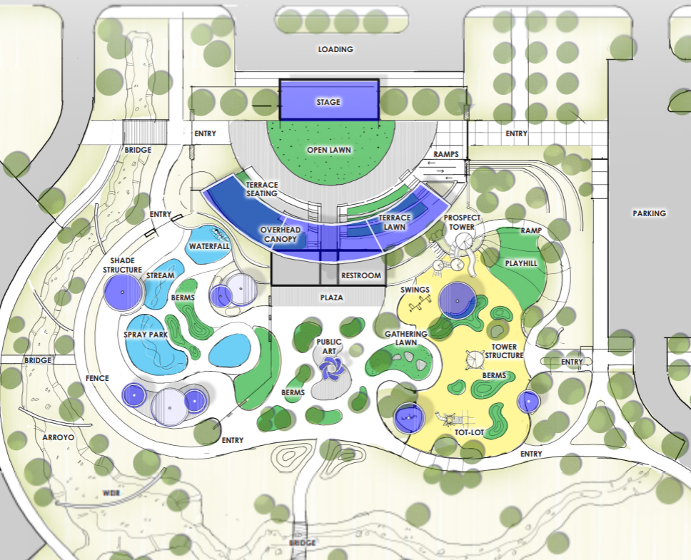
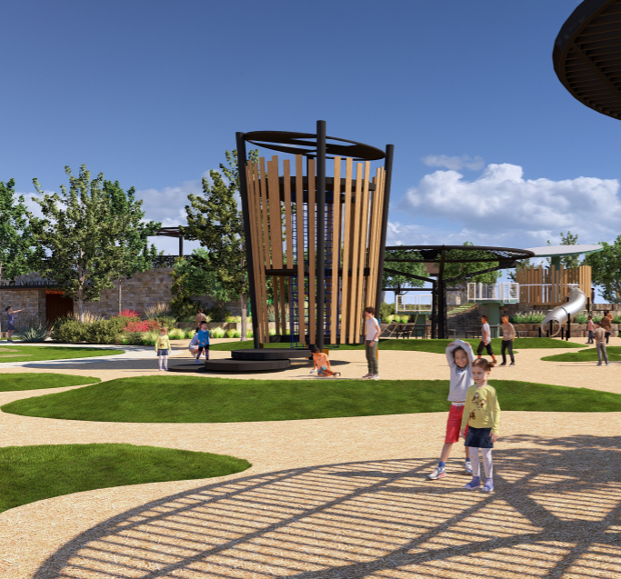
FY 2026 DELIVERABLES
Strategy: Enhance Community Engagement
Maximize youth sports field use
Grow tournament play
Expand community programming like Movies in the Park and downtown events
Strategy: Foster Relationships with Foundations and Outside Businesses
Grow partnerships to enhance park amenities with an emphasis on Beal Park
18
Notes:
INSTRUCTIONS FOR THESE SLIDES. CREATE AS MANY SLIDES NEEDED FOR AS MANY STRATEGIES THAT YOU WANT TO SPECIFICALLY CALL OUT.
📋 How to Create Key Deliverables for Budget Goal Team Updates
Step 1: Start with the Strategy
Look at the exact wording of the Strategic Plan strategy assigned to your team. For example:
➡️ Strategy: Enhance Communication Efficiency and Effectiveness
This is the "what"—the high-level direction or goal. Your job is to define "how" your team will help achieve it.
Step 2: Identify Actionable Deliverables
Think about the specific, tangible actions, programs, or projects your team will complete in the fiscal year to advance the strategy. These are your Key Deliverables.
Ask:
✔️ What can we implement, launch, improve, or expand?
✔️ How will this action directly support the strategy?
✔️ Can this be tracked or measured by year-end?
Examples for the strategy above:
✅ Maximize the use of reverse 9-1-1 & citizen notification systems to improve emergency communication.
✅ Expand the use of Virtual Agent via RingCX to provide 24/7 phone system access for residents.
✅ Target messaging to specific populations using tools like geo-fencing or Spanish-language content on social media.
Step 3: Keep Deliverables Focused, Measurable, and Budget-Relevant
Key Deliverables should:
✔️ Be specific—not vague or general.
✔️ Be measurable—you should know when it’s done or if it’s working.
✔️ Tie back to budget decisions—does this require funding, staffing, or technology?
✅ Quick Tips for Writing Deliverables:
Start with an action verb: Implement, Expand, Launch, Complete, Deploy.
Be clear on the outcome: What will this change, improve, or deliver?
Think one fiscal year at a time—keep deliverables achievable within the FY.
👉 If your strategy is citywide (like communication), your department’s deliverables should reflect what you specifically control or influence—while working toward the larger goal.

Slide 19
FY 2026 DELIVERABLES
Strategy: Create an Attractive and Inclusive Living Environment
In alignment with the Parks & Recreation Master Plan, begin development of a parkland ordinance
Strategy: Establish beautification programs
Grow tree planting program
Develop funding plan for park signage replacement
Strategy: Nurture and Promote a Healthy Community
Complete Wildcatter Trail Phase 1 design
Update Hike + Bike Trails & Parks + Rec Masterplans
19
Notes:
INSTRUCTIONS FOR THESE SLIDES. CREATE AS MANY SLIDES NEEDED FOR AS MANY STRATEGIES THAT YOU WANT TO SPECIFICALLY CALL OUT.
📋 How to Create Key Deliverables for Budget Goal Team Updates
Step 1: Start with the Strategy
Look at the exact wording of the Strategic Plan strategy assigned to your team. For example:
➡️ Strategy: Enhance Communication Efficiency and Effectiveness
This is the "what"—the high-level direction or goal. Your job is to define "how" your team will help achieve it.
Step 2: Identify Actionable Deliverables
Think about the specific, tangible actions, programs, or projects your team will complete in the fiscal year to advance the strategy. These are your Key Deliverables.
Ask:
✔️ What can we implement, launch, improve, or expand?
✔️ How will this action directly support the strategy?
✔️ Can this be tracked or measured by year-end?
Examples for the strategy above:
✅ Maximize the use of reverse 9-1-1 & citizen notification systems to improve emergency communication.
✅ Expand the use of Virtual Agent via RingCX to provide 24/7 phone system access for residents.
✅ Target messaging to specific populations using tools like geo-fencing or Spanish-language content on social media.
Step 3: Keep Deliverables Focused, Measurable, and Budget-Relevant
Key Deliverables should:
✔️ Be specific—not vague or general.
✔️ Be measurable—you should know when it’s done or if it’s working.
✔️ Tie back to budget decisions—does this require funding, staffing, or technology?
✅ Quick Tips for Writing Deliverables:
Start with an action verb: Implement, Expand, Launch, Complete, Deploy.
Be clear on the outcome: What will this change, improve, or deliver?
Think one fiscal year at a time—keep deliverables achievable within the FY.
👉 If your strategy is citywide (like communication), your department’s deliverables should reflect what you specifically control or influence—while working toward the larger goal.

Slide 20
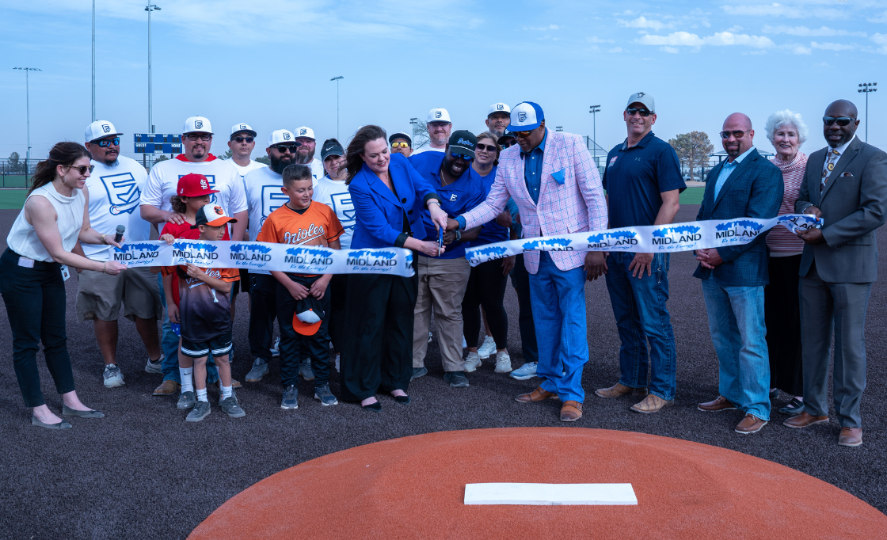
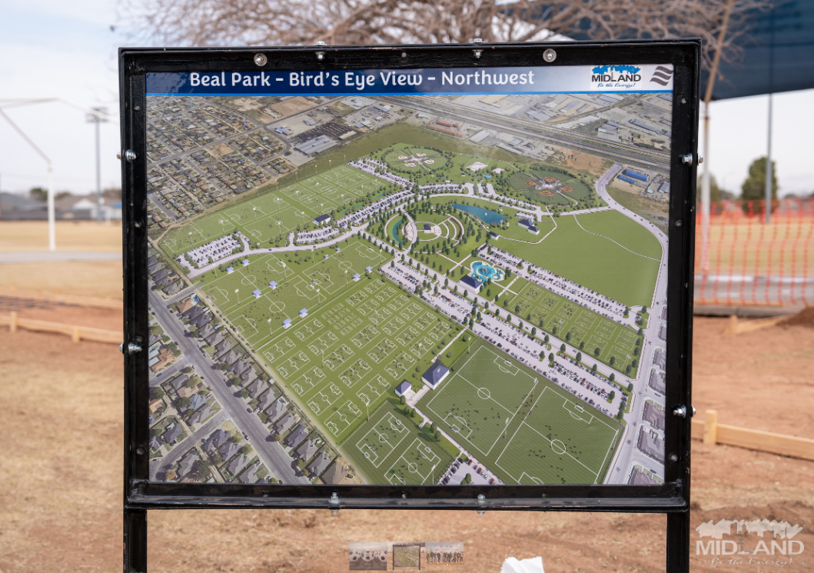
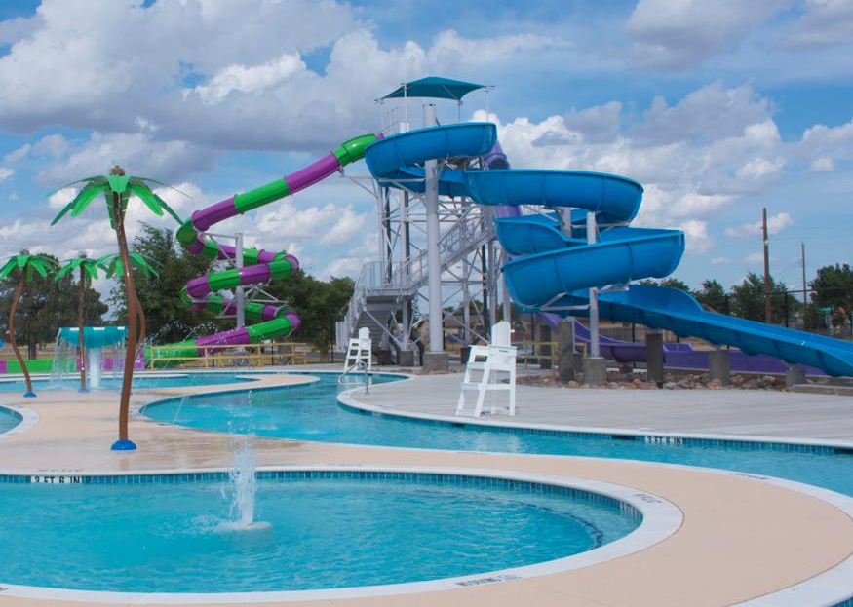
FY 2026DELIVERABLES
Strategy: Build the Best Parks System in Our Region
Begin RMN Phase 2 design for 2 baseball fields
Complete Beal Park Phase 1 construction, and Phase 2 and 3 design
Improve playgrounds, fields + facilities
  Begin Grasslands design and construction
  Complete CDBG-funded projects: Washington Park slide repair + Dunagan Park restroom replacement
20
Notes:
INSTRUCTIONS FOR THESE SLIDES. CREATE AS MANY SLIDES NEEDED FOR AS MANY STRATEGIES THAT YOU WANT TO SPECIFICALLY CALL OUT.
📋 How to Create Key Deliverables for Budget Goal Team Updates
Step 1: Start with the Strategy
Look at the exact wording of the Strategic Plan strategy assigned to your team. For example:
➡️ Strategy: Enhance Communication Efficiency and Effectiveness
This is the "what"—the high-level direction or goal. Your job is to define "how" your team will help achieve it.
Step 2: Identify Actionable Deliverables
Think about the specific, tangible actions, programs, or projects your team will complete in the fiscal year to advance the strategy. These are your Key Deliverables.
Ask:
✔️ What can we implement, launch, improve, or expand?
✔️ How will this action directly support the strategy?
✔️ Can this be tracked or measured by year-end?
Examples for the strategy above:
✅ Maximize the use of reverse 9-1-1 & citizen notification systems to improve emergency communication.
✅ Expand the use of Virtual Agent via RingCX to provide 24/7 phone system access for residents.
✅ Target messaging to specific populations using tools like geo-fencing or Spanish-language content on social media.
Step 3: Keep Deliverables Focused, Measurable, and Budget-Relevant
Key Deliverables should:
✔️ Be specific—not vague or general.
✔️ Be measurable—you should know when it’s done or if it’s working.
✔️ Tie back to budget decisions—does this require funding, staffing, or technology?
✅ Quick Tips for Writing Deliverables:
Start with an action verb: Implement, Expand, Launch, Complete, Deploy.
Be clear on the outcome: What will this change, improve, or deliver?
Think one fiscal year at a time—keep deliverables achievable within the FY.
👉 If your strategy is citywide (like communication), your department’s deliverables should reflect what you specifically control or influence—while working toward the larger goal.

Slide 21
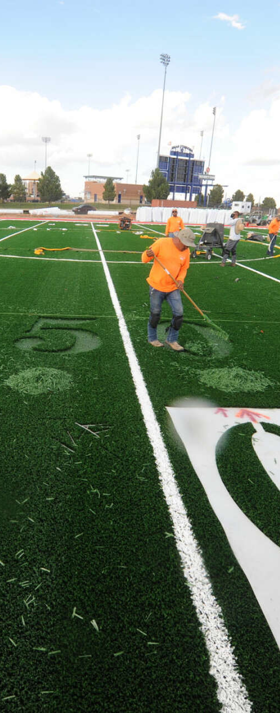
FY 2026 DELIVERABLES
Strategy: Build the Best Park System in Our Region
Continue the Courses at Hogan Park improvements
  Complete Master Plan
  Complete new Cart Barn
  Begin Quail Golf Course renovation and install RO system to serve both courses
Grow and maintain the Scharbauer Sports Complex
  Begin construction of 2 new auxiliary fields
  Replace baseball video board
  Diversify and expand stadium usage
21
Notes:
INSTRUCTIONS FOR THESE SLIDES. CREATE AS MANY SLIDES NEEDED FOR AS MANY STRATEGIES THAT YOU WANT TO SPECIFICALLY CALL OUT.
📋 How to Create Key Deliverables for Budget Goal Team Updates
Step 1: Start with the Strategy
Look at the exact wording of the Strategic Plan strategy assigned to your team. For example:
➡️ Strategy: Enhance Communication Efficiency and Effectiveness
This is the "what"—the high-level direction or goal. Your job is to define "how" your team will help achieve it.
Step 2: Identify Actionable Deliverables
Think about the specific, tangible actions, programs, or projects your team will complete in the fiscal year to advance the strategy. These are your Key Deliverables.
Ask:
✔️ What can we implement, launch, improve, or expand?
✔️ How will this action directly support the strategy?
✔️ Can this be tracked or measured by year-end?
Examples for the strategy above:
✅ Maximize the use of reverse 9-1-1 & citizen notification systems to improve emergency communication.
✅ Expand the use of Virtual Agent via RingCX to provide 24/7 phone system access for residents.
✅ Target messaging to specific populations using tools like geo-fencing or Spanish-language content on social media.
Step 3: Keep Deliverables Focused, Measurable, and Budget-Relevant
Key Deliverables should:
✔️ Be specific—not vague or general.
✔️ Be measurable—you should know when it’s done or if it’s working.
✔️ Tie back to budget decisions—does this require funding, staffing, or technology?
✅ Quick Tips for Writing Deliverables:
Start with an action verb: Implement, Expand, Launch, Complete, Deploy.
Be clear on the outcome: What will this change, improve, or deliver?
Think one fiscal year at a time—keep deliverables achievable within the FY.
👉 If your strategy is citywide (like communication), your department’s deliverables should reflect what you specifically control or influence—while working toward the larger goal.

Slide 22

MISSION
Deliver exceptional services and promote a high quality of life and place for ALL our citizens.

Slide 23

GOAL FOUR: TRANSPARENT & CONSISTENT COMMUNICATION
Strategic Communications
FY 2026 Priorities
Priority #1
Priority #2
Priority #3
Etc.
23
Notes:
THIS IS THE PRIORITIES SLIDE. LIST YOUR DEPARTMENTS FY2026 PRIORITIES. THESE ARE THINGS THAT YOU SHOULD BE WORKING TOWARDS BASED ON THE STRATEGIC PLAN. USE AS MANY SLIDES AS YOU NEED FOR YOUR DEPARTMENT(S)

Slide 24
MAJOR VARIANCES
Strategic Communications
Increase Reason #1
Increase Reason #2
Increase Reason #3
So on....
24
Notes:
LIST YOUR DEPARTMENTS CAUSES FOR INCREASES (IF APPLICABLE) HERE. GIVE REASON TO WHY THINGS ARE INCREASING. LIST FOR ALL DEPARTMENTS APPLICABLE. USE AS MANY SLIDES AS NEEDED FOR ALL DEPARTMENTS.

