Slide 1

GOAL FOUR
TRANSPARENT & CONSISTENT COMMUNICATION
FY 2026 BUDGET PRESENTATION
AUGUST 2025
TITLE HERE
TITLE HERE
Notes:
In Goal Four—Transparent and Consistent Communication—we focus on how the City connects with residents and employees, and how technology supports that connection. Technology isn’t the goal—better service is, and technology is how we get there. Our work in this area is about giving residents faster service, better access to information, and more visibility into how their city is performing—all while improving efficiency, enhancing the customer experience, and adding transparency to everything we do.
While it’s the smallest budget of our six goals, it’s the backbone of how we share information, build trust, and keep Midland informed and engaged. George Eskander and I serve as the goal team leaders for this area

Slide 2

TABLE OF CONTENTS
Vision Block Connections & Strategic Alignment
Priorities Focus
Budget Highlights
FY 2025 Results
FY 2026 Deliverables
2
Notes:
You’ve seen this format in the earlier goals—here’s our roadmap for Goal Four. We’ll walk through how our priorities connect to the strategic plan, our budget highlights, what we achieved in FY 2025, and the deliverables we’re focused on for FY 2026

Slide 3

VISION BLOCK CONNECTIONS
“The City of Midland will be the Premier and Safest City in West Texas by Providing World Class Municipal Services through Operational Excellence and a Culture of Innovation”
World Class Service (Goals 4, 5, 6)
Operational Excellence (Goals 4, 5, 6)
Innovation (Goals 4, 5, 6)
3
Notes:
For Goal Four, Transparent & Consistent Communication supports our vision by delivering world-class service through clear, accessible, and timely information backed by reliable, secure technology. Together, these functions drive operational excellence with coordinated messaging, modern systems, and infrastructure, and foster innovation through new tools, platforms, and digital solutions that make it easier for residents to engage with their city.

Slide 4

STRATEGIC ALIGNMENT
Goal 4: Transparent and Consistent Communication
4.1 Set a Climate of Respect, Collaboration and Team Spirit
4.2 Enhance Communication Efficiency and Effectiveness
4.3 Elevate Internal Communication and Employee Engagement
4.4 Advance the Two-Way Communication of Key Messages
4.5 Strengthen Messaging Opportunities through Various Media Outlets
4
Notes:
Goal Four ties directly to the strategic plan by combining communications and technology to deliver world-class service, improve efficiency, and create innovative ways for residents to connect with their city.

Slide 5

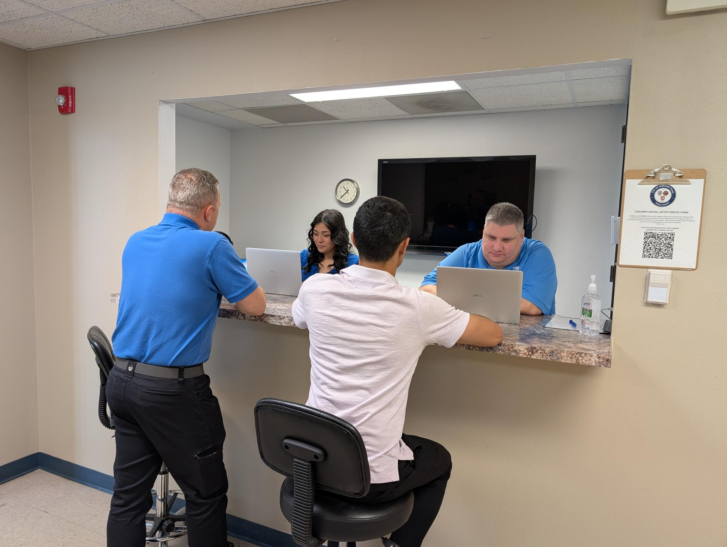
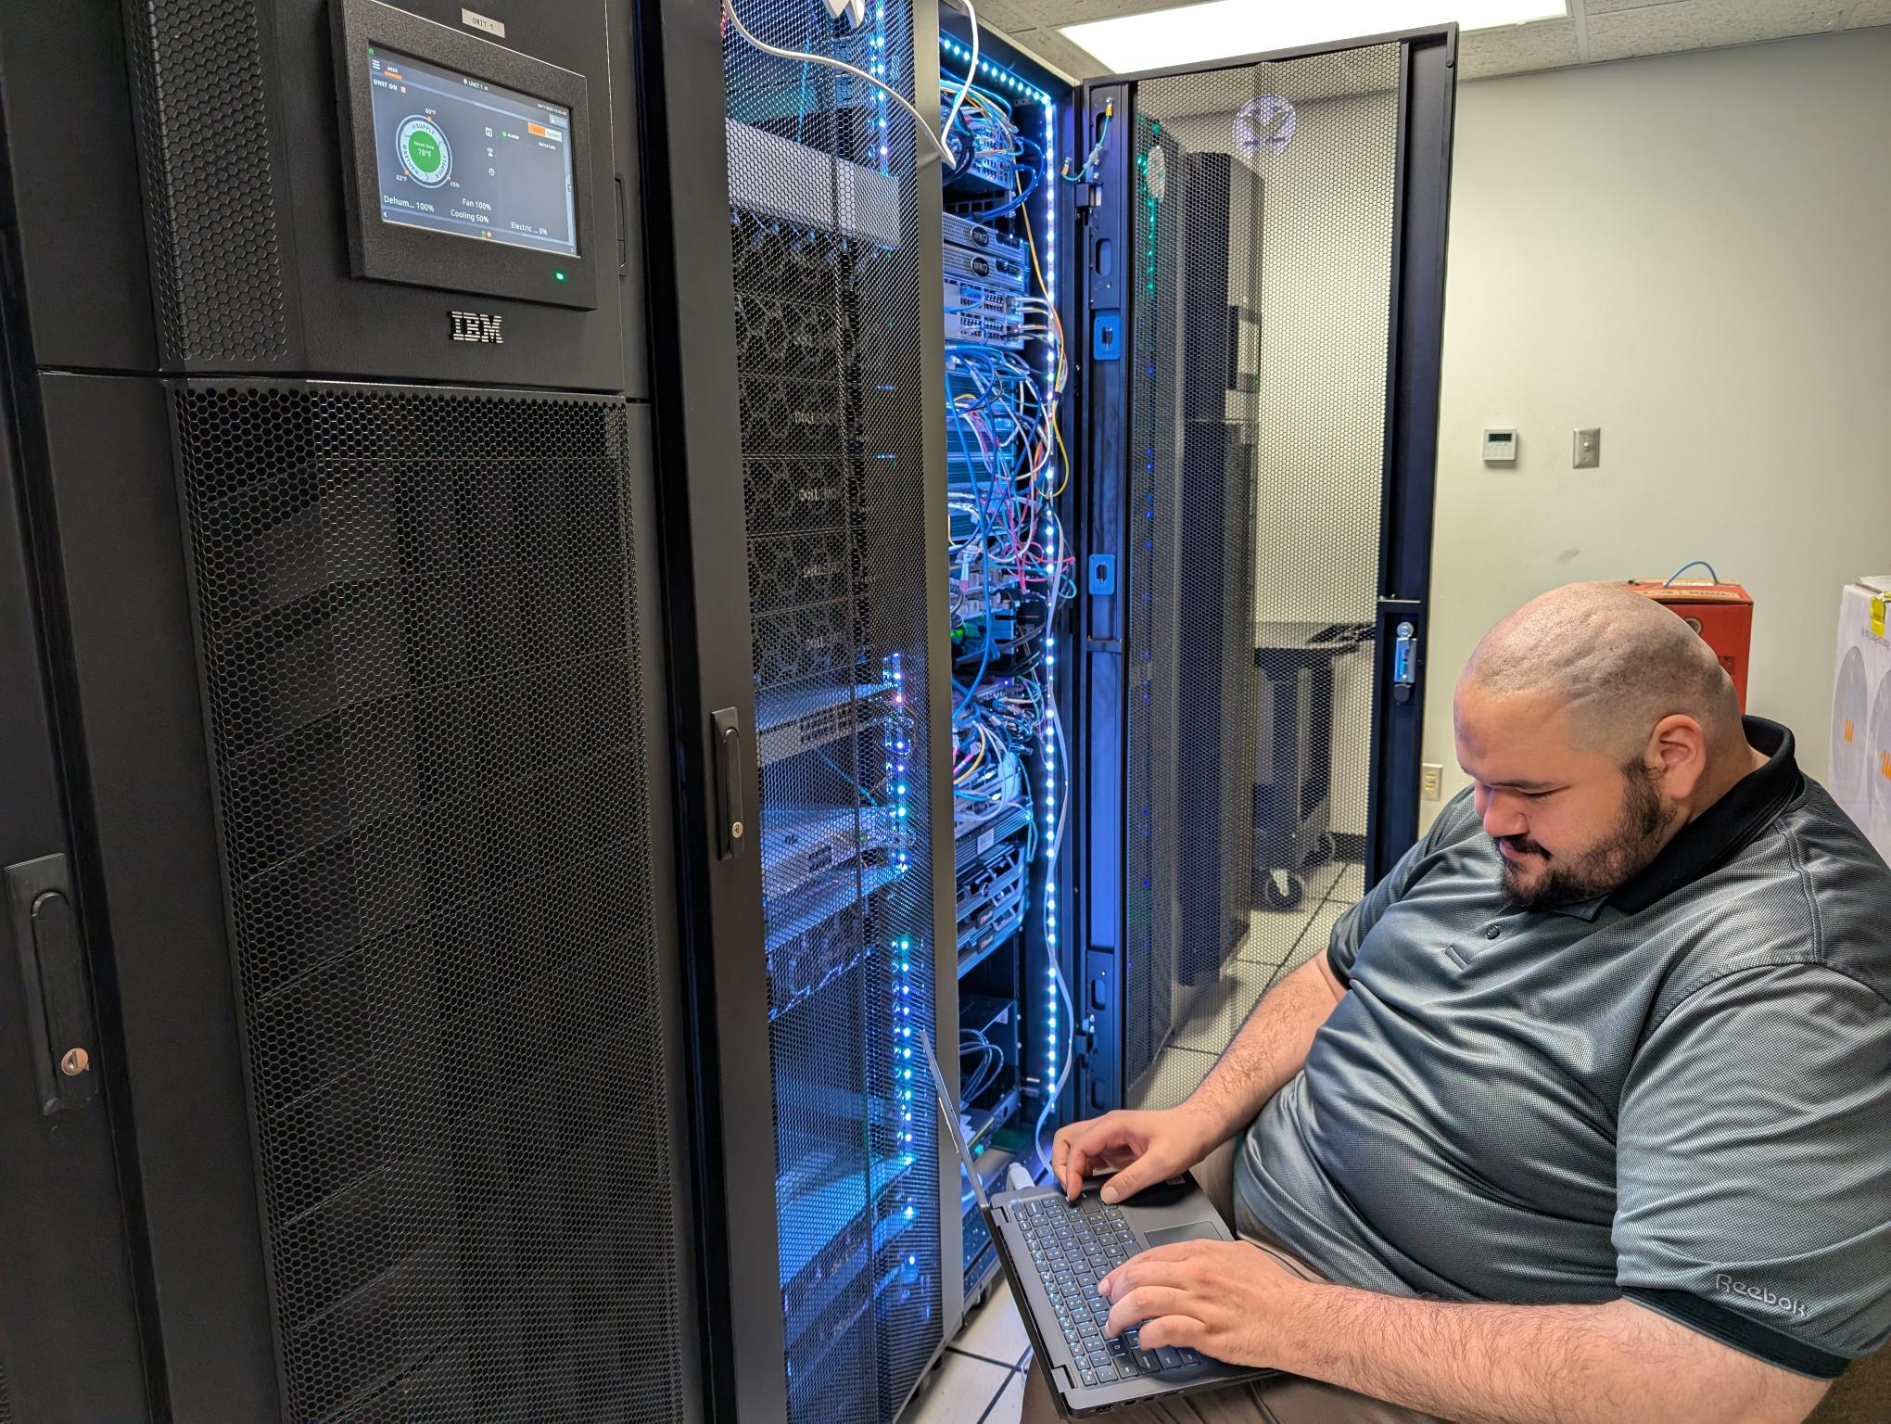
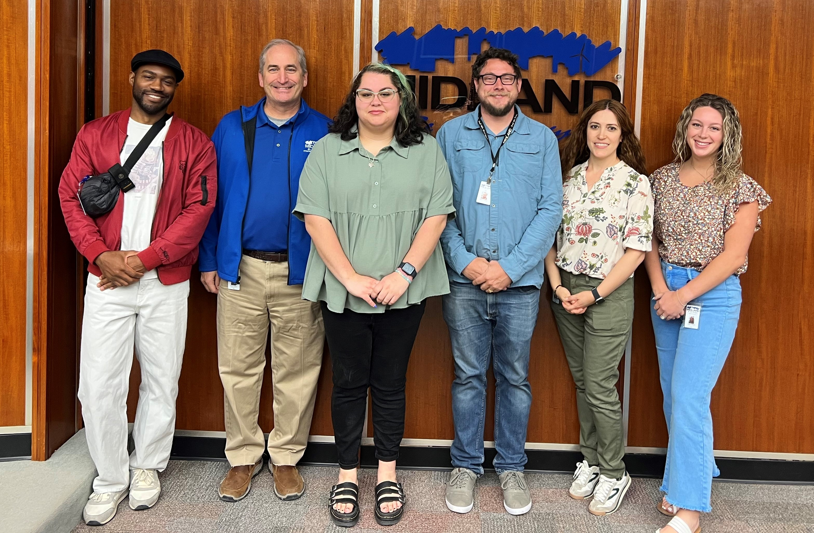
DEPARTMENTS
Organizational Alignment
Information Technology Services
911 Dispatch
Strategic Communications
5
Notes:
Goal Four brings together Information Technology Services, 911 Dispatch, and Strategic Communications—three teams working in sync to ensure the city delivers accurate, timely information and reliable technology to support residents and staff.

Slide 6


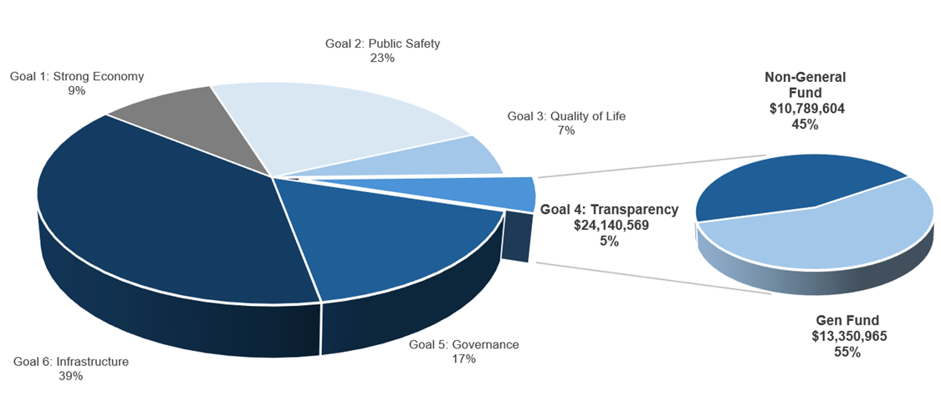
TRANSPARENT & CONSISTENT COMMUNICATION
FY 2026 ALL FUNDS BUDGET: $460,859,620
Notes:
Goal Four represents about 5% of the city’s total FY 2026 budget, making it the smallest of the six strategic goals. Even with a smaller share, this goal is critical—combining communications and technology to keep residents informed, connected, and confident in their city services.

Slide 7

GOAL FOUR: TRANSPARENT & CONSISTENT COMMUNICATION
Information Technology Services
FY 2026 Priorities:
Launch Jacky 2.0
An enhanced Digital Assistant with voice capabilities. Jacky will guide users through applications, answer questions, and complete submissions over the phone or online.
Expand the digital transformation city-wide
We will continue digitizing services that currently rely on paper or in-person.
Centralized Online Payment Processing System
A unified payment system will simplify how residents and businesses pay for city services.
7

Slide 8
GOAL FOUR: TRANSPARENT & CONSISTENT COMMUNICATION
Information Technology Services
FY 2026 Priorities:
Public-Facing Dashboards
We’ll expand public-facing dashboards and launch an open data portal where residents and organizations can view and download non-sensitive data.
Use AI to Support Long-Term Urban Planning
AI will support the creation of Midland’s next 10-year comprehensive plan by analyzing trends in population growth, zoning, infrastructure stress, and economic activity.
8

Slide 9
GOAL FOUR: TRANSPARENT & CONSISTENT COMMUNICATION
Information Technology Services
FY 2026 Priorities:
Leverage AI to Streamline Internal City Operations
AI tools will assist with writing RFPs, reviewing bids, forecasting workloads, and automating repetitive tasks.
Apply AI to Infrastructure and Field Services
AI capabilities will be expanded to evaluate pavement conditions, detect damaged or missing street signs, and automatically identify code violations through analysis of dashcam and video footage.
9

Slide 10
GOAL FOUR: TRANSPARENT & CONSISTENT COMMUNICATION
Information Technology Services
FY 2026 Priorities:
Create a Digital Twin of Midland
A virtual model of the city will simulate population growth, traffic, and infrastructure impact to improve planning decisions.
Upgrade the Fire Dispatch Alerting System
Modernizing fire dispatch technology will improve how quickly crews are notified and arrive on scene - increasing safety and reducing response times.
Update IT Policies
New policies will ensure safe, responsible use of AI, automation, and data tools citywide.
10

Slide 11

GOAL FOUR: TRANSPARENT & CONSISTENT COMMUNICATION
Strategic Communications
FY 2026 Priorities:
Social Media Growth and Reach
Aim for 20% Growth over FY26 on Instagram; 10% Growth over FY26 on Facebook
Alert Midland
Continue to send notices in advance to the public, use of Geofencing Capabilities
Grow subscribers on platform
Explore more ways to communicate items to the public in a timely and relevant manner
11
Notes:
Now, shifting from George’s IT focus to Strategic Communications—our work is about making sure residents get the right information, at the right time, in the right way.
Expanding our social media reach is one way we do that. In FY 2026, we’re aiming for 20% growth on Instagram and 10% growth on Facebook. This isn’t just about followers—it’s about getting important updates, city news, and community initiatives in front of more residents, faster.
You also heard Chuck talk about IPAWS earlier, which is designed for true emergencies. Alert Midland plays a different but equally important role—it’s how we keep residents informed about planned or unplanned water outages, trash schedule changes, and road closures affecting specific neighborhoods. This year, we’ll continue sending notices in advance, using geofencing so the right people get the right updates, and we’ll work to grow our subscriber base so more residents stay in the know.
We’ll also be exploring new delivery methods so our messages reach people in ways that work best for them—whether that’s online, on their phone, or through other channels.
These initiatives strengthen public trust, improve two-way communication, and make sure essential information gets to the community quickly, clearly, and through the channels they use most—fulfilling the heart of Goal Four and keeping Midland connected.

Slide 12
GOAL FOUR: TRANSPARENT & CONSISTENT COMMUNICATION
Strategic Communications
FY 2026 Priorities:
Improve Ratings on External Platforms (Google, LinkedIn, Indeed, Glassdoor, etc.) for various Facilities and Services through outreach to citizens and users with favorable experiences.
More proactive, deliberate messaging
Continue Professional Custom Publications & Increase Engagement
Water Report
Budget Books and Reports
Year End Reports, Quarterly Reports
12
Notes:
Next year, we’re adding a few more priorities in Strategic Communications.
First, Improving Ratings on External Platforms — sites like Google, LinkedIn, Indeed, and Glassdoor play a big role in shaping the City’s public image. Good ratings help us attract top talent, build trust, and show pride in our services. We’ll be more proactive about reaching out to citizens and service users who’ve had positive experiences, encouraging them to share their feedback and help boost Midland’s reputation. And for those who’ve had less favorable experiences, we’ll also reach out to understand where we can improve and make their next experience better.
We’re also focusing on Proactive, Deliberate Messaging — making sure our communications are intentional, timely, and aligned with what matters most to our community. That means working with other departments to create professional, tailored publications that highlight City achievements and progress.
We’ll keep producing high-quality, data-driven reports like the Water Report, Budget Books, Year-End Reports, and Quarterly Reports so both council and the public stay well-informed.
The big picture here is about building trust, being transparent, and reinforcing the City as a dependable, credible source of information — all of which move us closer to fulfilling Goal Four and keeping Midland a learning, responsive organization.

Slide 13
GOAL FOUR: TRANSPARENT & CONSISTENT COMMUNICATION
Strategic Communications
FY 2026 Priorities:
Continued Focus on Video Productions and PSA's
Short Format Video (>60 Seconds)
Expand Proactive Communication Around Infrastructure and Capital Projects
Develop outreach strategies for traditionally underserved or offline communities, including door-to-door, HOA partnerships, and print mailers.
Elevate City Identity and Civic Pride
13
Notes:
In 2026, we’re focusing on a few key priorities to make our communication even stronger.
First, Video Production & PSA Expansion — we’ll keep creating short, engaging videos under 60 seconds so we can grab attention quickly and share important updates in a way that’s easy to watch and share.
We’re also stepping up our Proactive Infrastructure Communication — making sure residents know what’s happening, when it’s happening, and why. This will go hand-in-hand with the CIP dashboard so people can see the progress for themselves.
Next, we’re working on Reaching Underserved Audiences — that means connecting with communities who are traditionally harder to reach, whether that’s through direct contact, HOA partnerships, or even mailed updates for those who aren’t online.
And finally, City Identity & Civic Pride — highlighting Midland’s story, celebrating our wins, and building that sense of pride and connection across the community.
All of these efforts are about making our communication more accessible, more inclusive, and more proactive — so no matter who you are or where you get your information, you can stay connected and engaged with your city.

Slide 14

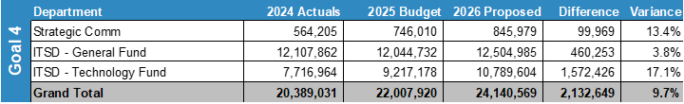
EXPENSES BY DEPARTMENT
Major Variances:
Information Technology Services
Transferring the cost of existing software solutions, previously paid by individual departments outside the IT budget ($1.4 million)
Cost of Living and Pay Progression increases for IT and 911 Dispatch ($460K)
Adding one position in FY26 – Project Manager ($92K)
Strategic Communications ​
Staffing Needs, Fully Hired Department, Cost of Living and Pay Progression Increases ​
Increased needs for advanced equipment and software.​
Training and Certifications Needs​
Notes:
Staffing Needs: Fully staffed department; includes cost-of-living and pay progression increases.
Equipment & Software: Increased investment in advanced tools to meet growing production and outreach needs.
Training & Certifications: Funding to maintain industry best practices and enhance professional skills, enabling a high performing city team.

Slide 15
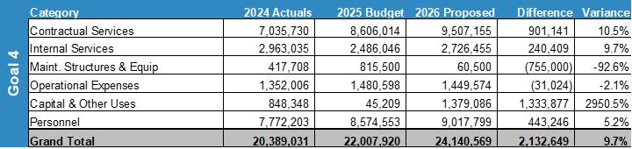
EXPENSES BY TYPE
$1,333,877 represents the transfer of existing software costs, previously paid by individual departments, into the IT fund. This amount will be maintained as a contingency reserve.
Notes:
The largest increase is in Contractual Services (+$901K / 10.5%), reflecting expanded technology licensing, support agreements, and communication service contracts.
Internal Services (+$240K / 9.7%) reflects increased costs for shared city services and support allocations.
Capital & Other Uses shows a significant change (+$1.33M) due to the centralization of existing software costs from other departments into the IT fund, creating a contingency reserve.
Personnel (+$443K / 5.2%) covers cost-of-living and pay progression adjustments, as well as the addition of a Project Manager in IT and maintaining full staffing in Strategic Communications.
Other categories are relatively stable, with Operational Expenses down slightly and Maintenance reduced due to the completion of prior-year projects.
Key Takeaway: These changes align with Goal Four’s priorities by ensuring Strategic Communications and IT have the tools, contracts, and staffing needed to deliver timely, transparent, and reliable communication and technology services to the community.

Slide 16

STAFFING
Variance Highlights: ​
ITSD: Addition of one position - Project Manager
Strategic Communications: N/A
Notes:
Strategic Communications: No staffing changes planned for FY 2026; the department remains fully staffed at six positions.
ITSD: Adding one new position—Project Manager—to oversee major technology initiatives, ensure timely project delivery, and support cross-departmental coordination.
Overall Impact: Total staffing for Goal Four increases by one position, bringing the combined headcount to 79 employees in FY 2026.
Key Takeaway: Staffing levels for Strategic Communications remain stable, while the targeted ITSD addition supports the capacity needed to deliver on the growing demands of technology and communication infrastructure.

Slide 17

FY 2025 RESULTS
Information Technology Services
FY 2025
PermitMidland
Now supports online submission of trade permits, digital uploads of required documentation, inspection scheduling, and secure fee payments - all in one place. This platform enhances the customer experience by making the permitting process simpler, faster, and more transparent, directly supporting the City Council’s goals for efficiency and improved digital access.
Vision Midland StoryMap
An interactive, public-facing roadmap of Midland’s Capital Improvement Plan. The platform showcases key projects and strategic initiatives across categories like parks, schools, transportation, healthcare, and downtown revitalization. This digital platform serves as more than a plan: it's a living blueprint that helps community members, developers, and policymakers visualize Midland’s future growth and infrastructure strategy.
17
Notes:
LIST OUT KEY ACCOMPLISHMENTS MADE IN FY2025. THESE SHOULD CLOSELY REFLECT THE PRIORITIES SET IN LAST YEARS PRESENTATION. ALSO INCLUDE ANY BIG HIGHLIGHTS OR WINS THAT WERE NOT CALLED OUT IN PREVIOUS PRESENTATIONS. CAN INCLUDE METRICS, GRAPHICS, ETC. BUT STILL KEEP THESE AT A HIGH LEVEL. ONLY THE MOST IMPACTFUL ACCOMPLISHMENTS SHOULD BE LISTED! USE AS MANY SLIDES AS YOU NEED, BUT DON'T GO OVER BOARD!
EACH DEPARTMENT WILL NEED A KEY ACCOMPLISHMENTS SLIDE(S).

Slide 18
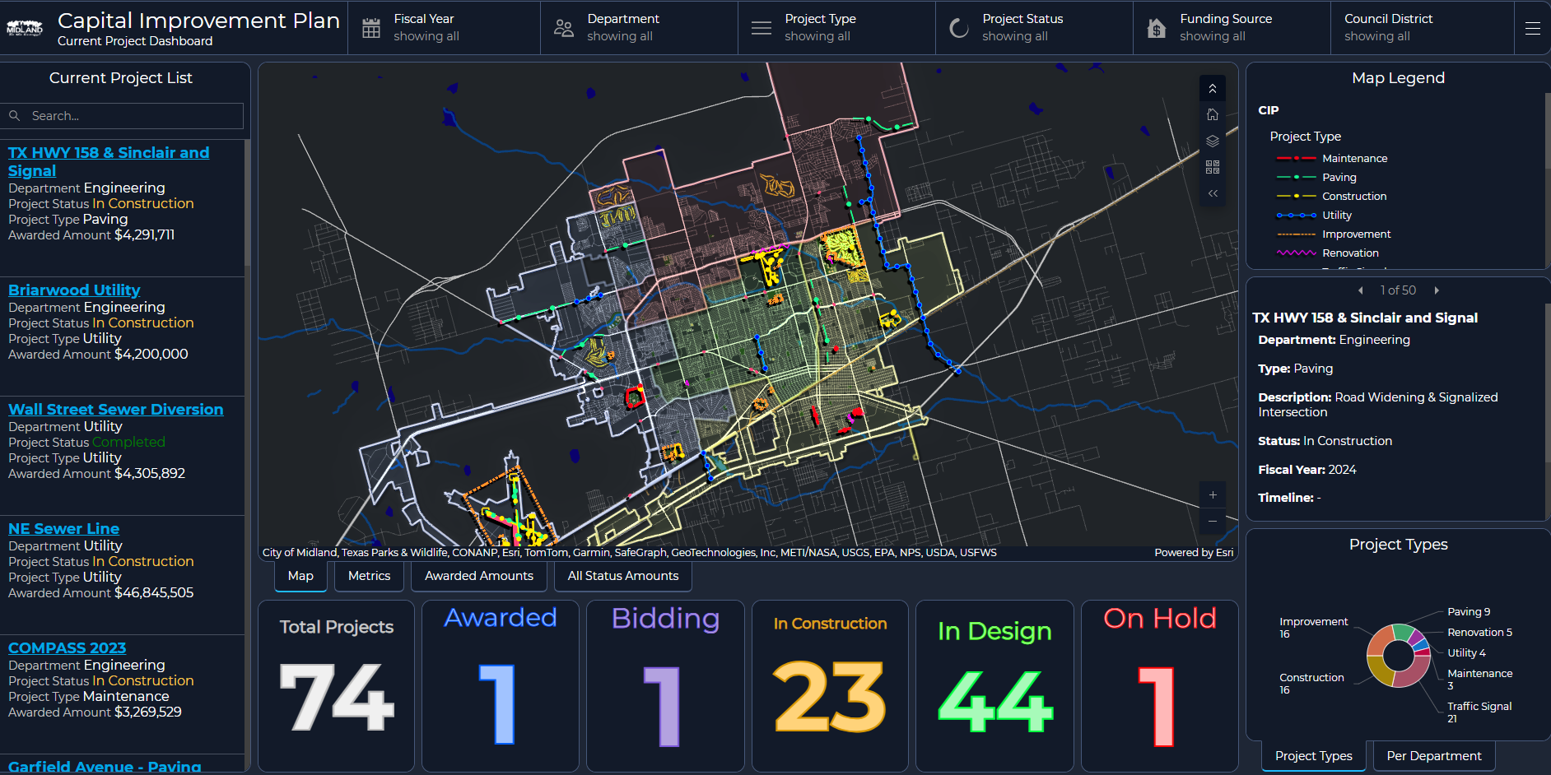
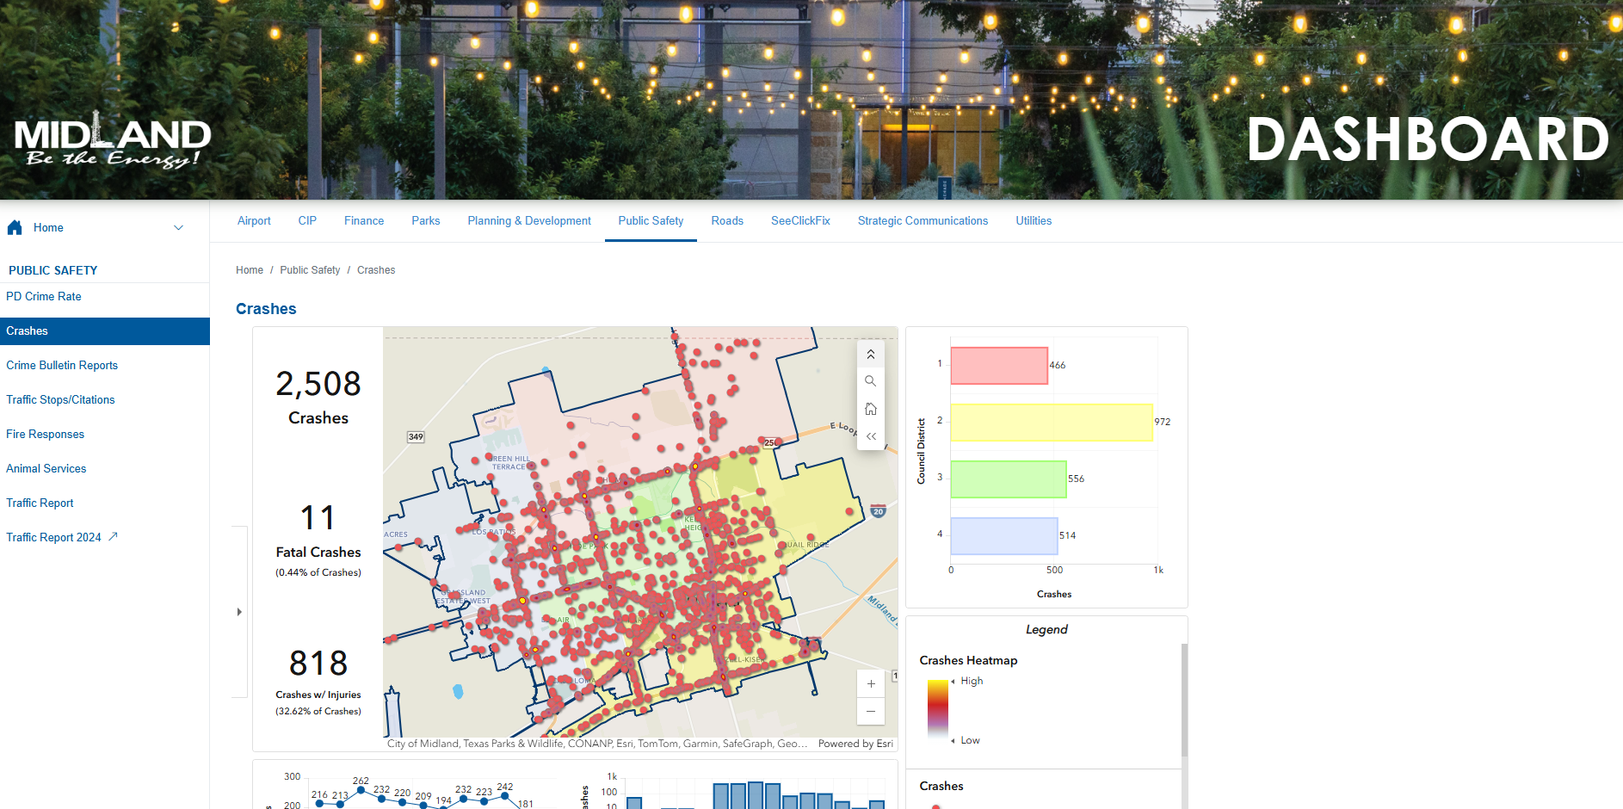
FY 2025 RESULTS
Information Technology Services
FY 2025
CIP Dashboard: was created to give residents and council a clear, visual way to track progress on major city projects and improve transparency.
Council Dashboard: is an internal tool that gives City Council near real-time updates on key projects and performance metrics. A public version will be developed in FY26 to share this information more broadly with residents.
Developed and launched the redesign of the City of Midland Website for a cleaner, design in-line, and customer friendly interface.
18
Notes:
LIST OUT KEY ACCOMPLISHMENTS MADE IN FY2025. THESE SHOULD CLOSELY REFLECT THE PRIORITIES SET IN LAST YEARS PRESENTATION. ALSO INCLUDE ANY BIG HIGHLIGHTS OR WINS THAT WERE NOT CALLED OUT IN PREVIOUS PRESENTATIONS. CAN INCLUDE METRICS, GRAPHICS, ETC. BUT STILL KEEP THESE AT A HIGH LEVEL. ONLY THE MOST IMPACTFUL ACCOMPLISHMENTS SHOULD BE LISTED! USE AS MANY SLIDES AS YOU NEED, BUT DON'T GO OVER BOARD!
EACH DEPARTMENT WILL NEED A KEY ACCOMPLISHMENTS SLIDE(S).

Slide 19
FY 2025 RESULTS
Information Technology Services
FY 2025
Created in coordination with Strategic Communications – AI Generated Digital Reports Including
Popular Annual Financial Report
Mid-Year and Annual Reports
$1 Million in recurring ITSD Savings Through software consolidation and vendor negotiations.
Interoperability Radio Project is formally completed to include all local agencies, including the City of Odessa, Midland, and Ector Counties.
Redesigned Employee Intranet Page 'Midland Connect' to provide better employee access to organization resources.
Implemented ForeUp Online Golf Tee Time Booking for The Courses at Hogan Park.
19
Notes:
LIST OUT KEY ACCOMPLISHMENTS MADE IN FY2025. THESE SHOULD CLOSELY REFLECT THE PRIORITIES SET IN LAST YEARS PRESENTATION. ALSO INCLUDE ANY BIG HIGHLIGHTS OR WINS THAT WERE NOT CALLED OUT IN PREVIOUS PRESENTATIONS. CAN INCLUDE METRICS, GRAPHICS, ETC. BUT STILL KEEP THESE AT A HIGH LEVEL. ONLY THE MOST IMPACTFUL ACCOMPLISHMENTS SHOULD BE LISTED! USE AS MANY SLIDES AS YOU NEED, BUT DON'T GO OVER BOARD!
EACH DEPARTMENT WILL NEED A KEY ACCOMPLISHMENTS SLIDE(S).

Slide 20
FY 2025 RESULTS
Strategic Communications
FY 2025
Social Media Growth and Engagement
9.7k additional Followers on Facebook
2.7k Additional Follower on Instagram
Produced City Annual Report with Accompanying Video
Updated and streamlined city branding and design
Midland's Merry Lights
Chalk the Block
Overall City Branding & Branding Guidelines
The Courses at Hogan Park Updated Branding
Designed PermitMidland, Midland Connect and other department logos
20
Notes:
Thanks, George. Now, on the Strategic Communications side, our focus has been on making sure the technology and systems you just heard about translate into clear, engaging, and accessible information for our residents.
This past year, we grew our reach significantly—adding 9,700 new Facebook followers and 2,700 new Instagram followers, helping us connect with more residents than ever before.
We delivered the City’s Annual Report and companion video, giving residents and council a clear, transparent view of city performance and progress.
We also streamlined branding across major city events, facilities, and initiatives—from Merry Lights and Fly into Fall to Chalk the Block, The Courses at Hogan Park, PermitMidland, and Midland Connect—so our communication is more consistent, recognizable, and professional.
And to make sure that consistency lasts, we developed city-wide branding guidelines and department logos, setting a standard for how Midland presents itself both internally and to the public.

Slide 21
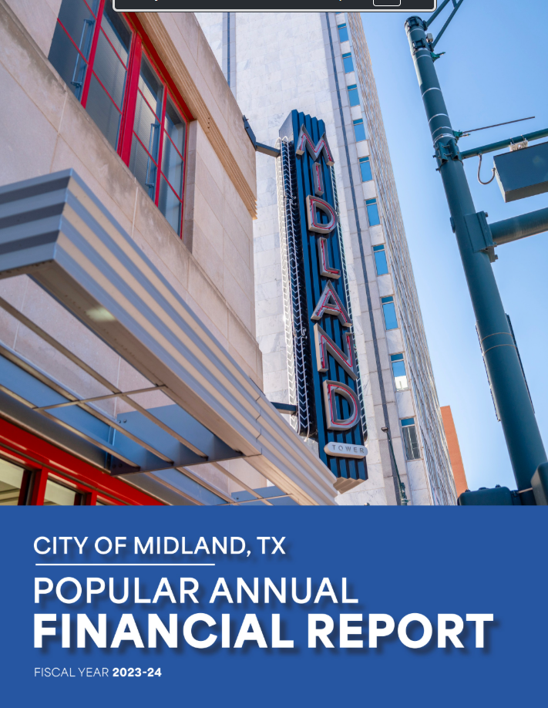

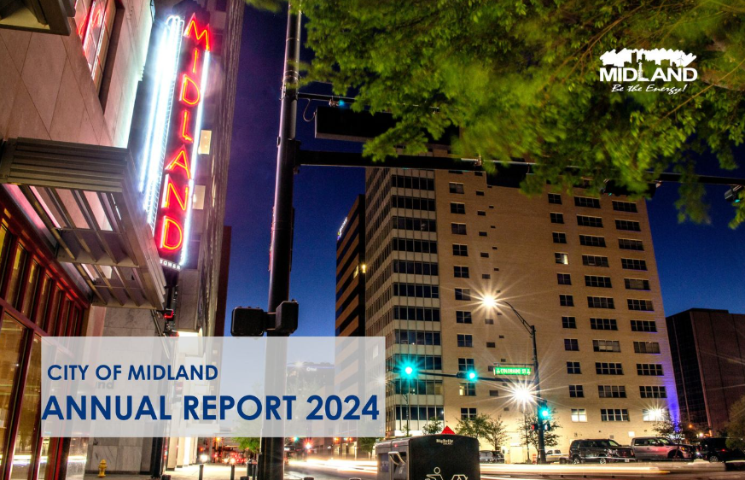
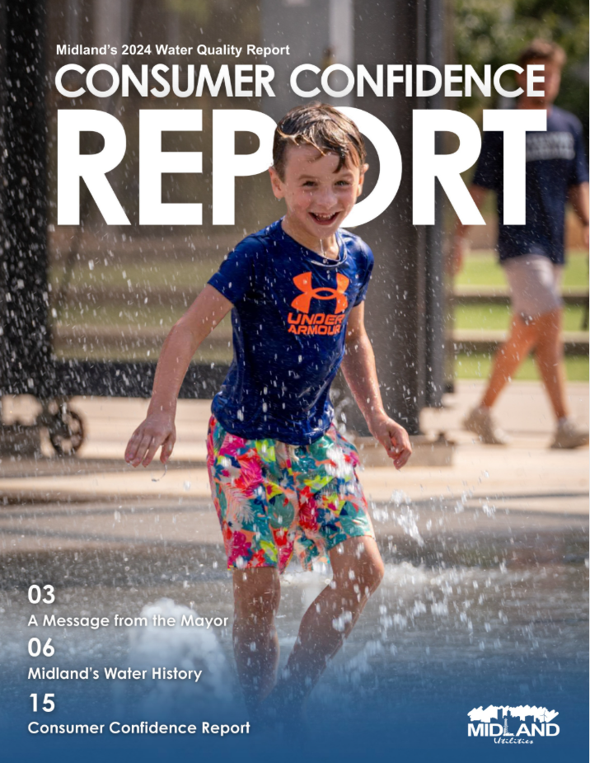

FY 2025 RESULTS
21
Notes:
This slide is a visual representation of some of the projects and publications our team delivered in FY 2025, highlighting the range of communication, branding, and reporting efforts that advance Goal Four.

Slide 22
FY 2025 RESULTS
Strategic Communications
FY 2025
Enhanced communication with neighborhood level alerts through geo-fencing tailored messaging
Largest Midland101 (Citizen Education Program) Class in History, 25 Participants
Reached a higher level of high-quality video productions with a focus on local community and small business
Created a Spanish Language Facebook Page with steady growth
Engaging the ~30% of the population who are Spanish speakers
22
Notes:
Additional results from FY 2025 show how we’ve expanded our reach and improved how we connect with residents.
We introduced more targeted communication through geo-fenced messaging—sending thousands of road closure and water outage notices directly to the neighborhoods affected, using the Everbridge system.
We hosted the largest Midland 101 Citizen Education Program class ever, with 25 participants learning firsthand how their city works.
Our video production reached new heights this year, with more high-quality, community-focused stories and spotlights on local small businesses.
And we launched a Spanish-language Facebook page that’s steadily growing—helping us better connect with the nearly 30% of our population who are Spanish speakers.

Slide 23
FY 2026 DELIVERABLES
4.2 Enhance Communication Efficiency and Effectiveness
Public Dashboards – Launch expanded dashboards covering projects, KPIs, and council initiatives.
Jacky 2.0 Deployment – AI assistant live on phone and web platforms with voice and chat support.
23
Notes:
INSTRUCTIONS FOR THESE SLIDES. CREATE AS MANY SLIDES NEEDED FOR AS MANY STRATEGIES THAT YOU WANT TO SPECIFICALLY CALL OUT.
📋 How to Create Key Deliverables for Budget Goal Team Updates
Step 1: Start with the Strategy Look at the exact wording of the Strategic Plan strategy assigned to your team. For example: ➡️ Strategy: Enhance Communication Efficiency and Effectiveness
This is the "what"—the high-level direction or goal. Your job is to define "how" your team will help achieve it.
Step 2: Identify Actionable Deliverables Think about the specific, tangible actions, programs, or projects your team will complete in the fiscal year to advance the strategy. These are your Key Deliverables.
Ask: ✔️ What can we implement, launch, improve, or expand? ✔️ How will this action directly support the strategy? ✔️ Can this be tracked or measured by year-end?
Examples for the strategy above:
✅ Maximize the use of reverse 9-1-1 & citizen notification systems to improve emergency communication.
✅ Expand the use of Virtual Agent via RingCX to provide 24/7 phone system access for residents.
✅ Target messaging to specific populations using tools like geo-fencing or Spanish-language content on social media.
Step 3: Keep Deliverables Focused, Measurable, and Budget-Relevant Key Deliverables should: ✔️ Be specific—not vague or general. ✔️ Be measurable—you should know when it’s done or if it’s working. ✔️ Tie back to budget decisions—does this require funding, staffing, or technology?
✅ Quick Tips for Writing Deliverables:
Start with an action verb: Implement, Expand, Launch, Complete, Deploy.
Be clear on the outcome: What will this change, improve, or deliver?
Think one fiscal year at a time—keep deliverables achievable within the FY.
👉 If your strategy is citywide (like communication), your department’s deliverables should reflect what you specifically control or influence—while working toward the larger goal.

Slide 24
FY 2026 DELIVERABLES
4.2 Enhance Communication Efficiency and Effectiveness
Launch the Online submission of Health Related (including restaurant) Permits (ITSD)
This will allow easier access to applications and inspections for Restaurants and other facilities, providing better customer service.
Develop a Strategic Plan Scorecard to track and display performance for each strategic goal and its related strategies, using key performance indicators (KPIs) to measure progress and outcomes.
24
Notes:
INSTRUCTIONS FOR THESE SLIDES. CREATE AS MANY SLIDES NEEDED FOR AS MANY STRATEGIES THAT YOU WANT TO SPECIFICALLY CALL OUT.
📋 How to Create Key Deliverables for Budget Goal Team Updates
Step 1: Start with the Strategy Look at the exact wording of the Strategic Plan strategy assigned to your team. For example: ➡️ Strategy: Enhance Communication Efficiency and Effectiveness
This is the "what"—the high-level direction or goal. Your job is to define "how" your team will help achieve it.
Step 2: Identify Actionable Deliverables Think about the specific, tangible actions, programs, or projects your team will complete in the fiscal year to advance the strategy. These are your Key Deliverables.
Ask: ✔️ What can we implement, launch, improve, or expand? ✔️ How will this action directly support the strategy? ✔️ Can this be tracked or measured by year-end?
Examples for the strategy above:
✅ Maximize the use of reverse 9-1-1 & citizen notification systems to improve emergency communication.
✅ Expand the use of Virtual Agent via RingCX to provide 24/7 phone system access for residents.
✅ Target messaging to specific populations using tools like geo-fencing or Spanish-language content on social media.
Step 3: Keep Deliverables Focused, Measurable, and Budget-Relevant Key Deliverables should: ✔️ Be specific—not vague or general. ✔️ Be measurable—you should know when it’s done or if it’s working. ✔️ Tie back to budget decisions—does this require funding, staffing, or technology?
✅ Quick Tips for Writing Deliverables:
Start with an action verb: Implement, Expand, Launch, Complete, Deploy.
Be clear on the outcome: What will this change, improve, or deliver?
Think one fiscal year at a time—keep deliverables achievable within the FY.
👉 If your strategy is citywide (like communication), your department’s deliverables should reflect what you specifically control or influence—while working toward the larger goal.

Slide 25
FY 2026 DELIVERABLES
4.4 Advance the Two-Way Communication of Key Messages
Improve feedback from citizens using city services
Qualtrics Survey Software (ITSD): Post-closure feedback surveys for improved service response analysis for various citizen-facing services including but not limited to:
The Courses at Hogan Park
Animal Adoptions
Police Interactions
Inspections and Permitting
SeeClickFix
25
Notes:
In FY 2026, our focus for Strategy 4.4—Advancing the Two-Way Communication of Key Messages—is expanding how residents can share real-time feedback.
We’ve already begun by linking surveys to tee times booked and completed through our ForeUp golf course software—and automatically sending those surveys via API integration. We’re also sending SeeClickFix surveys automatically after ticket closure through Qualtrics and API integrations, delivering real-time data we can act on immediately.
Over the next year, we plan to expand this approach to virtually every customer interaction—covering services like Park Field and Facility rentals, post animal adoptions, building inspections, and police interactions.
Through Qualtrics surveys, we’ll track satisfaction, identify areas for improvement, and respond quickly. The goal is simple: give citizens a direct voice, show them their feedback matters, and use it to drive visible, meaningful improvements—building trust and enhancing the customer experience across the City.

Slide 26
FY 2026 DELIVERABLES
4.5 Strengthen Messaging Opportunities through Various Media Outlets
“Midland Forward” series spotlighting progress in public safety, infrastructure, and economic development.
Re-introduce the monthly city newsletter to highlight activities and important information regarding city projects and initiatives.
Enhance City messaging and announcements through video boards at various facilities including:
MLK Center
Sports Complex
Health Department
Senior Centers
Airport
26
Notes:
As we move into 2026, we’re also looking at how we can tell Midland’s story in more places, and in more ways.
We’ll keep building out the “Midland Forward” video series, spotlighting progress in safety, infrastructure, and economic growth. Our newsletter relaunch will give residents a regular, easy way to stay updated—whether it’s monthly or bi-monthly, it will focus on the projects, events, and City news that matter most. And by using video boards at key locations—like the MLK Center, Sports Complex, Health Department, Senior Centers, and the Airport—we can share timely updates right where people are.
All of this is about meeting residents where they are, expanding our communication channels, and making sure important information is both easy to find and hard to miss—which brings us right into our next focus area.

Slide 27
FY 2026 DELIVERABLES
4.3 Elevate Internal Communication and Employee Engagement
Performance Dashboards for Department Heads: Develop internal dashboards showing performance metrics (budget, work orders, service KPIs).
27
Notes:
INSTRUCTIONS FOR THESE SLIDES. CREATE AS MANY SLIDES NEEDED FOR AS MANY STRATEGIES THAT YOU WANT TO SPECIFICALLY CALL OUT.
📋 How to Create Key Deliverables for Budget Goal Team Updates
Step 1: Start with the Strategy Look at the exact wording of the Strategic Plan strategy assigned to your team. For example: ➡️ Strategy: Enhance Communication Efficiency and Effectiveness
This is the "what"—the high-level direction or goal. Your job is to define "how" your team will help achieve it.
Step 2: Identify Actionable Deliverables Think about the specific, tangible actions, programs, or projects your team will complete in the fiscal year to advance the strategy. These are your Key Deliverables.
Ask: ✔️ What can we implement, launch, improve, or expand? ✔️ How will this action directly support the strategy? ✔️ Can this be tracked or measured by year-end?
Examples for the strategy above:
✅ Maximize the use of reverse 9-1-1 & citizen notification systems to improve emergency communication.
✅ Expand the use of Virtual Agent via RingCX to provide 24/7 phone system access for residents.
✅ Target messaging to specific populations using tools like geo-fencing or Spanish-language content on social media.
Step 3: Keep Deliverables Focused, Measurable, and Budget-Relevant Key Deliverables should: ✔️ Be specific—not vague or general. ✔️ Be measurable—you should know when it’s done or if it’s working. ✔️ Tie back to budget decisions—does this require funding, staffing, or technology?
✅ Quick Tips for Writing Deliverables:
Start with an action verb: Implement, Expand, Launch, Complete, Deploy.
Be clear on the outcome: What will this change, improve, or deliver?
Think one fiscal year at a time—keep deliverables achievable within the FY.
👉 If your strategy is citywide (like communication), your department’s deliverables should reflect what you specifically control or influence—while working toward the larger goal.

Slide 28

MISSION
Deliver exceptional services and promote a high quality of life and place for ALL our citizens.

Slide 29

MAJOR VARIANCES
Strategic Communications
Staffing Increases, Fully Hired Department
Increased needs for advanced equipment and software.
Training Needs
Certifications
29
Notes:
LIST YOUR DEPARTMENTS CAUSES FOR INCREASES (IF APPLICABLE) HERE. GIVE REASON TO WHY THINGS ARE INCREASING. LIST FOR ALL DEPARTMENTS APPLICABLE. USE AS MANY SLIDES AS NEEDED FOR ALL DEPARTMENTS.

Slide 30
FY 2026 DELIVERABLES
4.4 Advance the Two-Way Communication of Key Messages
Surveying different services helps the City serve citizens better by:
Listening directly to residents – capturing real, unfiltered input on their experiences so we understand their priorities, frustrations, and ideas.
Improving responsiveness – spotting issues early and addressing them before they become bigger problems.
Customizing solutions – tailoring programs, communication, and services based on what specific neighborhoods or groups actually need.
Allocating resources wisely – directing time, funding, and staff where they’ll have the most visible and positive impact for the community.
Measuring trust and satisfaction – tracking how residents feel about the City’s performance and making adjustments to strengthen confidence.
Showing accountability – demonstrating to citizens that we’re using their feedback to make tangible changes.
30
Notes:
INSTRUCTIONS FOR THESE SLIDES. CREATE AS MANY SLIDES NEEDED FOR AS MANY STRATEGIES THAT YOU WANT TO SPECIFICALLY CALL OUT.
📋 How to Create Key Deliverables for Budget Goal Team Updates
Step 1: Start with the Strategy Look at the exact wording of the Strategic Plan strategy assigned to your team. For example: ➡️ Strategy: Enhance Communication Efficiency and Effectiveness
This is the "what"—the high-level direction or goal. Your job is to define "how" your team will help achieve it.
Step 2: Identify Actionable Deliverables Think about the specific, tangible actions, programs, or projects your team will complete in the fiscal year to advance the strategy. These are your Key Deliverables.
Ask: ✔️ What can we implement, launch, improve, or expand? ✔️ How will this action directly support the strategy? ✔️ Can this be tracked or measured by year-end?
Examples for the strategy above:
✅ Maximize the use of reverse 9-1-1 & citizen notification systems to improve emergency communication.
✅ Expand the use of Virtual Agent via RingCX to provide 24/7 phone system access for residents.
✅ Target messaging to specific populations using tools like geo-fencing or Spanish-language content on social media.
Step 3: Keep Deliverables Focused, Measurable, and Budget-Relevant Key Deliverables should: ✔️ Be specific—not vague or general. ✔️ Be measurable—you should know when it’s done or if it’s working. ✔️ Tie back to budget decisions—does this require funding, staffing, or technology?
✅ Quick Tips for Writing Deliverables:
Start with an action verb: Implement, Expand, Launch, Complete, Deploy.
Be clear on the outcome: What will this change, improve, or deliver?
Think one fiscal year at a time—keep deliverables achievable within the FY.
👉 If your strategy is citywide (like communication), your department’s deliverables should reflect what you specifically control or influence—while working toward the larger goal.

Slide 31
FY 2025 RESULTS
Strategic Communications
FY 2025
Enhanced communication with neighborhood level alerts through geo-fencing tailored messaging
Largest Midland101 (Citizen Education Program) Class in History, 25 Participants
Reached a higher level of high-quality video productions with a focus on local community and small business
Created a Spanish Language Facebook Page with steady growth
Engaging the ~30% of the population who are Spanish speakers
31
Notes:
LIST OUT KEY ACCOMPLISHMENTS MADE IN FY2025. THESE SHOULD CLOSELY REFLECT THE PRIORITIES & KEY DELIVERABLES SET IN LAST YEARS PRESENTATION. ALSO INCLUDE ANY BIG HIGHLIGHTS OR WINS THAT WERE NOT CALLED OUT IN PREVIOUS PRESENTATIONS. CAN INCLUDE METRICS, GRAPHICS, ETC. BUT STILL KEEP THESE AT A HIGH LEVEL. ONLY THE MOST IMPACTFUL ACCOMPLISHMENTS SHOULD BE LISTED! USE AS MANY SLIDES AS YOU NEED, BUT DON'T GO OVER BOARD!
EACH DEPARTMENT WILL NEED A KEY ACCOMPLISHMENTS SLIDE(S).

