Slide 1

GOAL FIVE
PROVIDE SOUND GOVERNANCE AND FISCAL MANAGEMENT
FY 2026 BUDGET PRESENTATION
AUGUST 2025
TITLE HERE
TITLE HERE
Notes:
PUT YOUR GOAL NUMBER AND WRITE OUT YOUR GOAL NAME. NOTHING ELES SHOULD CHANGE!

Slide 2

TABLE OF CONTENTS
Vision Block Connections & Strategic Alignment
Priorities Focus
Budget Highlights
FY 2025 Results
FY 2026 Deliverables
2
Notes:
DO NOT CHANGE TABLE OF CONTENTS, YOUR PRESENTATION SHOULD FOLLOW THIS TEMPLATE (FOR EVERY GOAL!)

Slide 3

VISION BLOCK CONNECTIONS
“The City of Midland will be the Premier and Safest City in West Texas by Providing World Class Municipal Services through Operational Excellence and a Culture of Innovation”
World Class Service (Goals 4, 5, 6)
Operational Excellence (Goals 4, 5, 6)
Innovation (Goals 4, 5, 6)
3
Notes:
ADD YOUR VISION BLOCK CONNECTIONS HERE. IT WILL NOT BE THE SAME AS GOAL 4!

Slide 4

STRATEGIC ALIGNMENT
Goal 5: Provide Sound Governance and Fiscal Management
5.1 Recruit and Retain a Skilled and Diverse Workforce
5.2 Enhance Citizen Experience
5.3 Hone Public Servant Proficiency
5.4 Implement Cutting-Edge Practices
5.5 Promote a Well-Balanced Customer Service Philosophy
5.6 Deliver Services Timely and Efficiently
4
Notes:
LIST OUT YOUR STRATEGIC SUB GOALS HERE

Slide 5
STRATEGIC ALIGNMENT
Goal 5: Provide Sound Governance and Fiscal Management
5.7 Ensure Continued Financial Stability and Accountability
5.8 Deliver Effective and Efficient Processes
5.9 Ensure Reliability and Safety
5.10 Create a Work Environment that Supports Bleeding-Edge Practices
5
Notes:
LIST OUT YOUR STRATEGIC SUB GOALS HERE

Slide 6

DEPARTMENTS
Organizational Alignment
City Governance
City Management​
Finance​ Department
General Services​
Human Relations & Development
Legal Department
6
Notes:
LIST YOUR DEPARTMENTS THAT ARE INCLUDED IN YOUR GOAL HERE

Slide 7

GOAL FIVE: PROVIDE SOUND GOVERNANCE & FISCAL MANAGEMENT
Finance Department
FY 2026 Priorities
External Fees Audit and Increase Revenue Streams
Fiscal Transparency Reporting Continued
Zero Findings on Audit – 3rd Year In a Row
Apply and be Awarded the Texas Comptroller Transparency Stars Award
Increased Transparency for the public
Online publications and document availability
7
Notes:
THIS IS THE PRIORITIES SLIDE. LIST YOUR DEPARTMENTS FY2026 PRIORITIES. THESE ARE THINGS THAT YOU SHOULD BE WORKING TOWARDS BASED ON THE STRATEGIC PLAN.

Slide 8

GOAL FIVE: PROVIDE SOUND GOVERNANCE & FISCAL MANAGEMENT
Human Relations and Development
FY 2026 Priorities
Complete Human Resources Information System (NeoGov) Implementation & Training
Employee Benefit Road-Mapping with Cost-Savings
Create and Deploy Comprehensive City-Wide Training Program including strong emphasis on LSS & PMP
Increased Employee Communications
Best Place to Work Designation Awarded
Increase Proactive Recruitment & Retention Processes
8
Notes:
THIS IS THE PRIORITIES SLIDE. LIST YOUR DEPARTMENTS FY2026 PRIORITIES. THESE ARE THINGS THAT YOU SHOULD BE WORKING TOWARDS BASED ON THE STRATEGIC PLAN. USE AS MANY SLIDES AS YOU NEED FOR YOUR DEPARTMENT(S)

Slide 9
GOAL FIVE: PROVIDE SOUND GOVERNANCE & FISCAL MANAGEMENT
General Services Priorities
FY 2026 Priorities
Streamlining and Standardizing Commodity Codes
Implementing Enhanced SOP's for Purchasing and Bidding; Attracting more vendors and bidders. Bringing down cycle times for efficiencies on purchasing.
Achieving ASE Certifications for Most Garage and Vehicle Services Staff
Expanding Field-Based Work Order Execution in Facilities
9
Notes:
THIS IS THE PRIORITIES SLIDE. LIST YOUR DEPARTMENTS FY2026 PRIORITIES. THESE ARE THINGS THAT YOU SHOULD BE WORKING TOWARDS BASED ON THE STRATEGIC PLAN. USE AS MANY SLIDES AS YOU NEED FOR YOUR DEPARTMENT(S)

Slide 10
GOAL FIVE: PROVIDE SOUND GOVERNANCE & FISCAL MANAGEMENT
City Manager’s Office
FY 2026 Priorities
Continue to Build an Agile, Responsive Executive Team
Support Strategic Staffing and Leadership Development
Drive Alignment on Quality-of-Life Capital Projects throughout City Department Coordination and Economic Development Partners
10
Notes:
DO NOT CHANGE TABLE OF CONTENTS, YOUR PRESENTATION SHOULD FOLLOW THIS TEMPLATE (FOR EVERY GOAL!)

Slide 11
GOAL FIVE: PROVIDE SOUND GOVERNANCE & FISCAL MANAGEMENT
City Manager’s Office
FY 2026 Priorities
Deliver on Road Bond & CIP Commitments
Launch Public Facing CIP Dashboard
Accelerate Utility Infrastructure Planning
Formalize Capital Project Management
Expand Public Private Partnerships for Development
Elevate Midland’s Profile on State & Federal Level
Enhance Executive Communication Protocols
11
Notes:
DO NOT CHANGE TABLE OF CONTENTS, YOUR PRESENTATION SHOULD FOLLOW THIS TEMPLATE (FOR EVERY GOAL!)

Slide 12


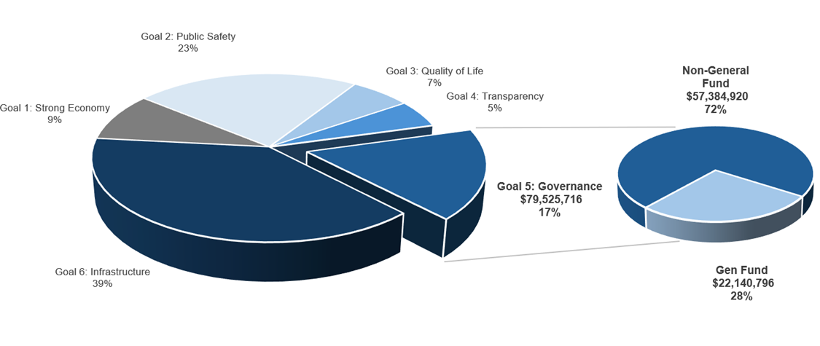
PROVIDE SOUND GOVERNANCE & FISCAL MANAGEMENT
ALL FUNDS BUDGET: $460,749,550
Notes:
CALL OUT YOUR SPECIFIC GOAL BUDGET HERE WITH PIE GRAPH BREAKDOWN (PROVIDED BY FINANCE)

Slide 13
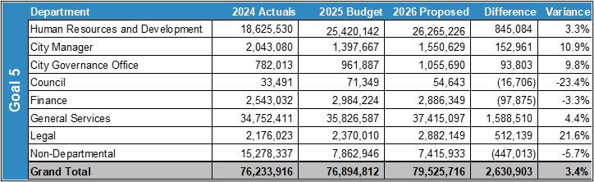
EXPENSES BY DEPARTMENT
Variances:
Overall Increases Driven by Administrative and Personnel Changes
General Services Increase Reflects Greater Availability of Vehicles
Notes:
CALL OUT YOUR SPECIFIC GOAL BUDGET HERE WITH PIE GRAPH BREAKDOWN (PROVIDED BY FINANCE)

Slide 14
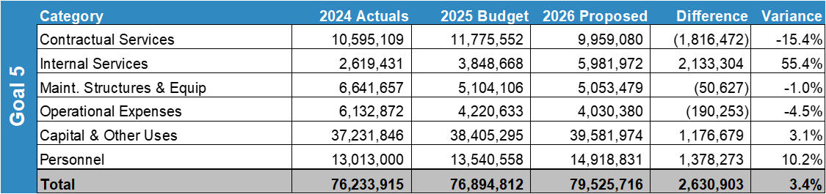
EXPENSES BY TYPE
4 additional FTE's added
Capital increase due to vehicle replacements
Notes:
CALL OUT YOUR SPECIFIC GOAL BUDGET HERE WITH PIE GRAPH BREAKDOWN (PROVIDED BY FINANCE)

Slide 15
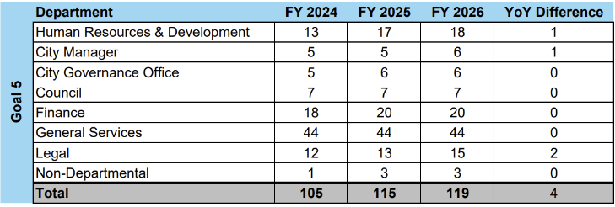
STAFFING
HR & Development – 1 New Benefits Assistant
Legal Department – 2 New Assistant City Attorney's
General Services – 1 New Assistant Director
Non-Departmental – Customer Care Specialist (City Hall Receptionist) moved to this Dept. For better alignment
Notes:
CALL OUT YOUR SPECIFIC GOAL BUDGET HERE WITH PIE GRAPH BREAKDOWN (PROVIDED BY FINANCE)

Slide 16
FY 2025 RESULTS
General Service Department
National Procurement Institute’s Achievement in Excellence in Procurement Award – 2 Year in a Row
Garage Honorable Mention in Top 100 Fleets in 2025 Best Fleets List
Created Specialized ASE Certification for Fleet Staff
Finance Department
Firefighter Pension Resolution
Zero Findings on Audit for 2nd Year in a Row
PAFR Published for the First Time
5-Year Forecasting Models Developed
GFOA Awards for Budget and ACFR
16
Notes:
LIST OUT KEY ACCOMPLISHMENTS MADE IN FY2025. THESE SHOULD CLOSELY REFLECT THE PRIORITIES SET IN LAST YEARS PRESENTATION. ALSO INCLUDE ANY BIG HIGHLIGHTS OR WINS THAT WERE NOT CALLED OUT IN PREVIOUS PRESENTATIONS. CAN INCLUDE METRICS, GRAPHICS, ETC. BUT STILL KEEP THESE AT A HIGH LEVEL. ONLY THE MOST IMPACTFUL ACCOMPLISHMENTS SHOULD BE LISTED! USE AS MANY SLIDES AS YOU NEED, BUT DON'T GO OVER BOARD!
EACH DEPARTMENT WILL NEED A KEY ACCOMPLISHMENTS SLIDE(S).

Slide 17
FY 2025 RESULTS
Human Relations & Development
Community Partnerships Established with Greenwood ISD, Skillpoint Alliance, Texas Tech, and Midland College
Created In-House CDL Program
Retain Skilled Workforce with Cost-Savings
Launched Digital Performance Evaluations
Internship Program Expanded
Creating Strong Candidate Pool
Reinforce Choice Employer Branding
Wellness Initiative Launched with Let’s Move Midland
Increasing Healthiness of Employees
Reducing Cost of Health Insurance Claims
17
Notes:
LIST OUT KEY ACCOMPLISHMENTS MADE IN FY2025. THESE SHOULD CLOSELY REFLECT THE PRIORITIES & KEY DELIVERABLES SET IN LAST YEARS PRESENTATION. ALSO INCLUDE ANY BIG HIGHLIGHTS OR WINS THAT WERE NOT CALLED OUT IN PREVIOUS PRESENTATIONS. CAN INCLUDE METRICS, GRAPHICS, ETC. BUT STILL KEEP THESE AT A HIGH LEVEL. ONLY THE MOST IMPACTFUL ACCOMPLISHMENTS SHOULD BE LISTED! USE AS MANY SLIDES AS YOU NEED, BUT DON'T GO OVER BOARD!
EACH DEPARTMENT WILL NEED A KEY ACCOMPLISHMENTS SLIDE(S).

Slide 18
FY 2025 RESULTS
Human Relations & Development
Trained 734 attendees on Customer Service skills since 2023
Reduced Pre-Employment Annual Cost by 40%
Position Leveling – Increased Retention
Lowest Vacancy Count in Many Years – Especially in Public Safety
45.4% Reduction in Budget Vacancies from FY 2024 to FY 2026
18
Notes:
LIST OUT KEY ACCOMPLISHMENTS MADE IN FY2025. THESE SHOULD CLOSELY REFLECT THE PRIORITIES & KEY DELIVERABLES SET IN LAST YEARS PRESENTATION. ALSO INCLUDE ANY BIG HIGHLIGHTS OR WINS THAT WERE NOT CALLED OUT IN PREVIOUS PRESENTATIONS. CAN INCLUDE METRICS, GRAPHICS, ETC. BUT STILL KEEP THESE AT A HIGH LEVEL. ONLY THE MOST IMPACTFUL ACCOMPLISHMENTS SHOULD BE LISTED! USE AS MANY SLIDES AS YOU NEED, BUT DON'T GO OVER BOARD!
EACH DEPARTMENT WILL NEED A KEY ACCOMPLISHMENTS SLIDE(S).

Slide 19
FY 2025 RESULTS
City Manager’s Office
Costco Development
CRMWD Contract Renegotiation
Saving $100M over 30 years, starting in 2030
Midland's Merry Lights Development & Oversight
Council Dashboard and Vision Midland Story Map Development
Coordination of Major CIP Project Delivery
Led Cost-Saving Initiatives including LSS projects
$10M to date in increased revenue in utilities
Support Strategic Planning for Spaceport and Aerospace Partnerships
Championed Regional Infrastructure Initiatives: I-27 & I-14
19
Notes:
THIS IS THE PRIORITIES SLIDE. LIST YOUR DEPARTMENTS FY2026 PRIORITIES. THESE ARE THINGS THAT YOU SHOULD BE WORKING TOWARDS BASED ON THE STRATEGIC PLAN.

Slide 20
FY 2025 RESULTS
City Manager’s Office
Continuous Feedback and Improvement with immediate adjustments
Council
Employees
Community
Strategic Plan Implementation
Implemented Budget Annually
Bigger Focus on Internal and External Audits
Employee and Leadership Development Training Program
Heightened Level of Communication
Council Dashboard & GIS Dashboard Launched
20
Notes:
THIS IS THE PRIORITIES SLIDE. LIST YOUR DEPARTMENTS FY2026 PRIORITIES. THESE ARE THINGS THAT YOU SHOULD BE WORKING TOWARDS BASED ON THE STRATEGIC PLAN.

Slide 21
FY 2025 RESULTS
City-Wide Awards and Recognitions
Government Finance Officers Association "Certificate of Achievement for Excellence in Financial Reporting" (Finance)
Government Finance Officers Association "Distinguished Budget Award" (Finance)
Adult Protective Service Conference's "Partnering to Protect Award" – First Nomination and Award (Fire)
Honorable Mention in Top 100 Fleets in 2025 Best Fleets List (Garage)
"2024 Civic Experience Award" – Silver (Information Technology)
Lexipol Excellence in Training – Silver Award (Fire)
21
Notes:
THIS IS THE PRIORITIES SLIDE. LIST YOUR DEPARTMENTS FY2026 PRIORITIES. THESE ARE THINGS THAT YOU SHOULD BE WORKING TOWARDS BASED ON THE STRATEGIC PLAN.

Slide 22
FY 2025 RESULTS
City-Wide Awards and Recognitions
"2025 ESIG Enterprise Systems Award" Distinguished System (Information Technology)
Texas Municipal Courts Education Center "Model Traffic Court – Medium Volume" – 4th Year in a Row (Municipal Court)
National Procurement Institute’s "Achievement in Excellence in Procurement Award" – 2nd Year in a Row (Purchasing)
American Planning Association "Silver Award for Transportation Planning" for Vision Zero (Strategic Partnership/ Engineering)
TXDOT Texas Innovation Alliance "STAR Award" – 2nd Year in a Row (Strategic Partnerships/ Engineering)
22
Notes:
THIS IS THE PRIORITIES SLIDE. LIST YOUR DEPARTMENTS FY2026 PRIORITIES. THESE ARE THINGS THAT YOU SHOULD BE WORKING TOWARDS BASED ON THE STRATEGIC PLAN.

Slide 23
FY 2026 DELIVERABLES
Strategy: Ensure Continued Financial Stability and Accountability
Deliver on City Project Promises While Continuing to Be Fiscally Responsible and Accountable with Zero Findings
Work with Partners in Economic Development to Expand Revenue Streams Into the City
Develop Stronger and Transparent Financial Reporting through Financial Statement Presentations
Improve Purchasing Processes to ensure that we include local bidders and get the best price and value
23
Notes:
INSTRUCTIONS FOR THESE SLIDES. CREATE AS MANY SLIDES NEEDED FOR AS MANY STRATEGIES THAT YOU WANT TO SPECIFICALLY CALL OUT.
📋 How to Create Key Deliverables for Budget Goal Team Updates
Step 1: Start with the Strategy Look at the exact wording of the Strategic Plan strategy assigned to your team. For example: ➡️ Strategy: Enhance Communication Efficiency and Effectiveness
This is the "what"—the high-level direction or goal. Your job is to define "how" your team will help achieve it.
Step 2: Identify Actionable Deliverables Think about the specific, tangible actions, programs, or projects your team will complete in the fiscal year to advance the strategy. These are your Key Deliverables.
Ask: ✔️ What can we implement, launch, improve, or expand? ✔️ How will this action directly support the strategy? ✔️ Can this be tracked or measured by year-end?
Examples for the strategy above:
✅ Maximize the use of reverse 9-1-1 & citizen notification systems to improve emergency communication.
✅ Expand the use of Virtual Agent via RingCX to provide 24/7 phone system access for residents.
✅ Target messaging to specific populations using tools like geo-fencing or Spanish-language content on social media.
Step 3: Keep Deliverables Focused, Measurable, and Budget-Relevant Key Deliverables should: ✔️ Be specific—not vague or general. ✔️ Be measurable—you should know when it’s done or if it’s working. ✔️ Tie back to budget decisions—does this require funding, staffing, or technology?
✅ Quick Tips for Writing Deliverables:
Start with an action verb: Implement, Expand, Launch, Complete, Deploy.
Be clear on the outcome: What will this change, improve, or deliver?
Think one fiscal year at a time—keep deliverables achievable within the FY.
👉 If your strategy is citywide (like communication), your department’s deliverables should reflect what you specifically control or influence—while working toward the larger goal.

Slide 24
FY 2026 DELIVERABLES
Strategy: Recruit and Retain a Skilled and Diverse Workforce
Develop and implement a citywide training program focused on Lean Six Sigma, leadership for new and current managers, customer service, and department-specific skills to better equip staff.
All Assistant Directors and above will be Green Belt Certified in Lean Six Sigma, coupled with a validation project.
All employees to be White Belt trained (free training) in LSS
Project Management Trainees will take and pass Project Management Professional (PMP) Exam
Creating Pipelines of Talent for Historically Hard to Fill Positions with Local and State-Wide Partnerships
Enhancing City Culture Through Employee-Driven Feedback
Enhance retention through strategic benefit offerings
24
Notes:
ADD YOUR VISION BLOCK CONNECTIONS HERE. IT WILL NOT BE THE SAME AS GOAL 4!

Slide 25
FY 2026 DELIVERABLES
Strategy: Ensure Reliability and Safety
Deliver reliable infrastructure through improved project execution and utility planning
Promote transparency and coordination with cross-department alignment.
Strengthen leadership and partnerships to enhance long-term city resilience and safety
Elevate Midland’s presence at the state and federal level to support strategic initiatives
25
Notes:
INSTRUCTIONS FOR THESE SLIDES. CREATE AS MANY SLIDES NEEDED FOR AS MANY STRATEGIES THAT YOU WANT TO SPECIFICALLY CALL OUT.
📋 How to Create Key Deliverables for Budget Goal Team Updates
Step 1: Start with the Strategy Look at the exact wording of the Strategic Plan strategy assigned to your team. For example: ➡️ Strategy: Enhance Communication Efficiency and Effectiveness
This is the "what"—the high-level direction or goal. Your job is to define "how" your team will help achieve it.
Step 2: Identify Actionable Deliverables Think about the specific, tangible actions, programs, or projects your team will complete in the fiscal year to advance the strategy. These are your Key Deliverables.
Ask: ✔️ What can we implement, launch, improve, or expand? ✔️ How will this action directly support the strategy? ✔️ Can this be tracked or measured by year-end?
Examples for the strategy above:
✅ Maximize the use of reverse 9-1-1 & citizen notification systems to improve emergency communication.
✅ Expand the use of Virtual Agent via RingCX to provide 24/7 phone system access for residents.
✅ Target messaging to specific populations using tools like geo-fencing or Spanish-language content on social media.
Step 3: Keep Deliverables Focused, Measurable, and Budget-Relevant Key Deliverables should: ✔️ Be specific—not vague or general. ✔️ Be measurable—you should know when it’s done or if it’s working. ✔️ Tie back to budget decisions—does this require funding, staffing, or technology?
✅ Quick Tips for Writing Deliverables:
Start with an action verb: Implement, Expand, Launch, Complete, Deploy.
Be clear on the outcome: What will this change, improve, or deliver?
Think one fiscal year at a time—keep deliverables achievable within the FY.
👉 If your strategy is citywide (like communication), your department’s deliverables should reflect what you specifically control or influence—while working toward the larger goal.

Slide 26
FY 2026 DELIVERABLES
Strategy: Promote a Well-Balanced Customer Service Philosophy
Deliver annual, citywide customer service training that emphasizes problem-solving, ownership, and accountability to at least 250 employees
Provide real-time, on-the-spot coaching from experienced staff to address service gaps and reinforce best practices
Empower employees to take initiative, anticipate needs, and follow through to resolve issues effectively
Promote a service culture that values action, responsiveness, and continuous improvement – not just politeness
26
Notes:
INSTRUCTIONS FOR THESE SLIDES. CREATE AS MANY SLIDES NEEDED FOR AS MANY STRATEGIES THAT YOU WANT TO SPECIFICALLY CALL OUT.
📋 How to Create Key Deliverables for Budget Goal Team Updates
Step 1: Start with the Strategy Look at the exact wording of the Strategic Plan strategy assigned to your team. For example: ➡️ Strategy: Enhance Communication Efficiency and Effectiveness
This is the "what"—the high-level direction or goal. Your job is to define "how" your team will help achieve it.
Step 2: Identify Actionable Deliverables Think about the specific, tangible actions, programs, or projects your team will complete in the fiscal year to advance the strategy. These are your Key Deliverables.
Ask: ✔️ What can we implement, launch, improve, or expand? ✔️ How will this action directly support the strategy? ✔️ Can this be tracked or measured by year-end?
Examples for the strategy above:
✅ Maximize the use of reverse 9-1-1 & citizen notification systems to improve emergency communication.
✅ Expand the use of Virtual Agent via RingCX to provide 24/7 phone system access for residents.
✅ Target messaging to specific populations using tools like geo-fencing or Spanish-language content on social media.
Step 3: Keep Deliverables Focused, Measurable, and Budget-Relevant Key Deliverables should: ✔️ Be specific—not vague or general. ✔️ Be measurable—you should know when it’s done or if it’s working. ✔️ Tie back to budget decisions—does this require funding, staffing, or technology?
✅ Quick Tips for Writing Deliverables:
Start with an action verb: Implement, Expand, Launch, Complete, Deploy.
Be clear on the outcome: What will this change, improve, or deliver?
Think one fiscal year at a time—keep deliverables achievable within the FY.
👉 If your strategy is citywide (like communication), your department’s deliverables should reflect what you specifically control or influence—while working toward the larger goal.

Slide 27

MISSION
Deliver exceptional services and promote a high quality of life and place for ALL our citizens.

