Slide 1

GOAL SIX
STRENGTHEN & SUSTAIN OUR INFRASTRUCTURE
FY 2026 BUDGET PRESENTATION
AUGUST 2025
TITLE HERE
TITLE HERE

Slide 2

TABLE OF CONTENTS
Vision Block Connections & Strategic Alignment
Priorities Focus
Budget Highlights
FY 2025 Results
FY 2026 Deliverables
2

Slide 3

VISION BLOCK CONNECTIONS
“The City of Midland will be the Premier and Safest City in West Texas by Providing World Class Municipal Services through Operational Excellence and a Culture of Innovation”
World Class Service (Goals 4, 5, 6)
Operational Excellence (Goals 4, 5, 6)
Innovation (Goals 4, 5, 6)
3

Slide 4

STRATEGIC ALIGNMENT
Goal 6: Strengthen and Sustain Our Infrastructure
  6.1 Provide Reliable and Sustainable Utilities
  Ensure the reliability and sustainability of water and wastewater systems.
  6.2 Enhance Infrastructure for Economic Growth
  Invest in infrastructure improvements to support economic development and growth.
  6.3 Streamline and Consolidate City Facilities
  Improve efficiency and cost-effectiveness through streamlined facility operations.
Goal 3: Quality of Life and Place
  3.1 Enhance Community Engagement
  Promote active community involvement and enhance communication with residents.
  3.2 Foster Relationships with Foundations and Outside Businesses
  Build partnerships to leverage resources and expertise for community benefit.
Goal 1: Strong Economy with More Quality Jobs
  1.1 Increase the Midland Sales Tax Base
  Support commercial and residential development to boost economic growth and job creation.
4
Notes:
LIST OUT YOUR STRATEGIC SUB GOALS HERE

Slide 5

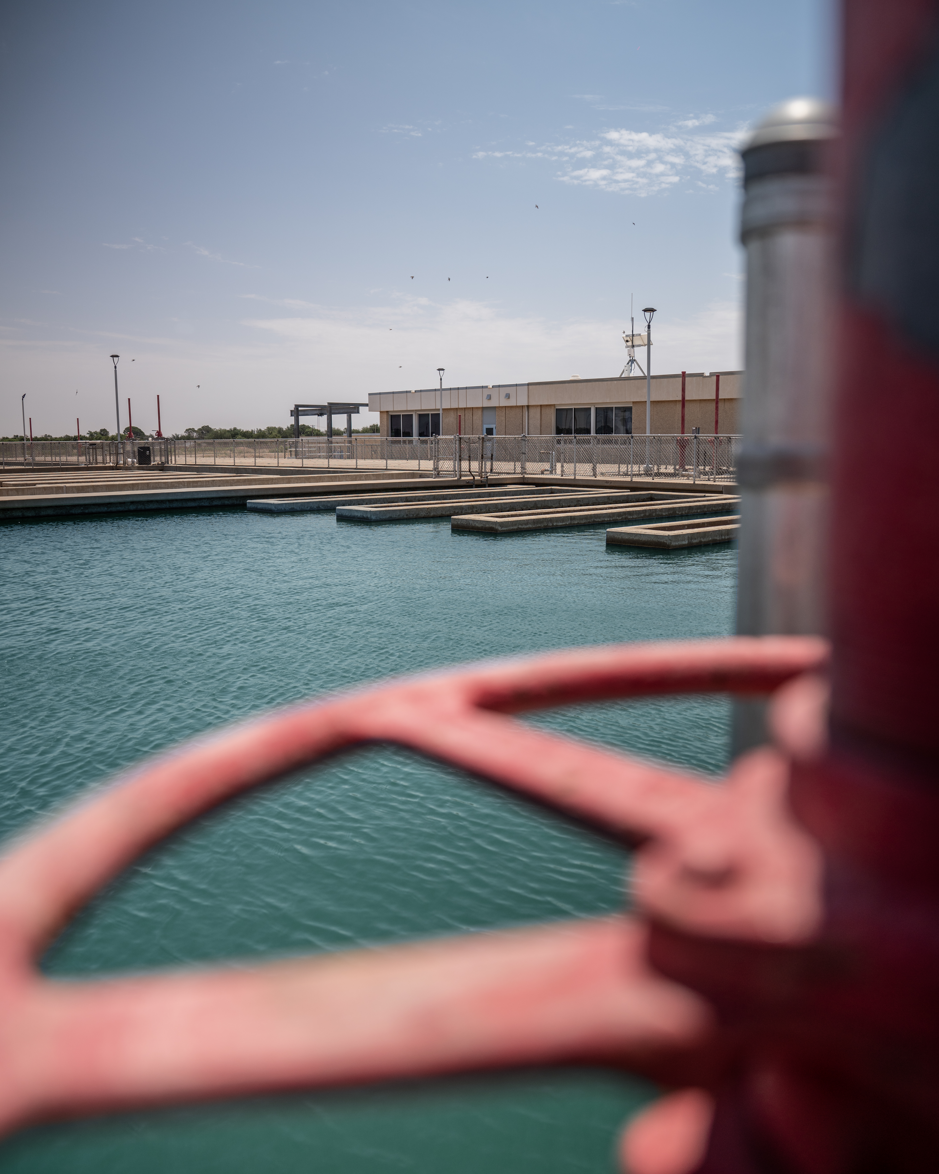
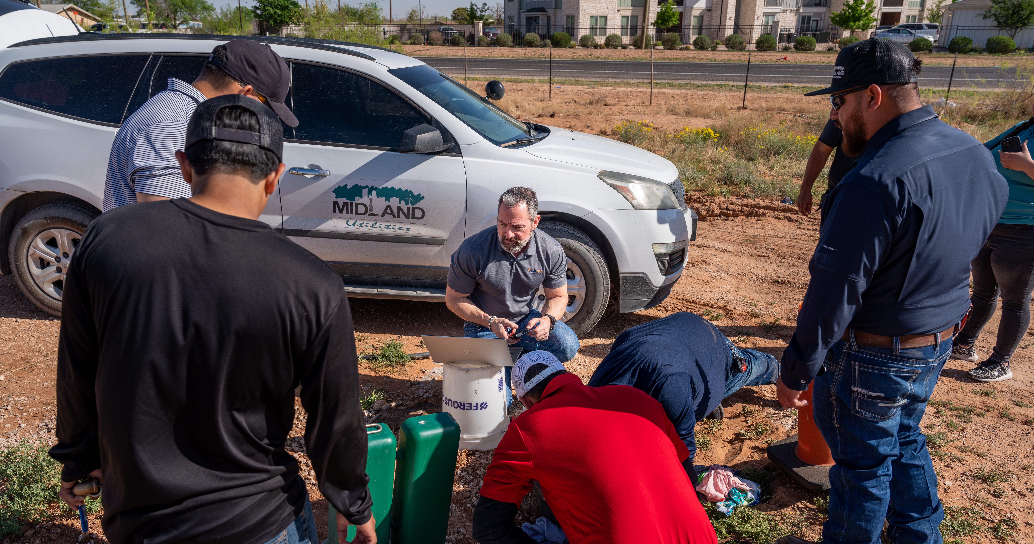
DEPARTMENTS
Utilities
Engineering Services
  Stormwater
  Streets
  Traffic Operations
Solid Waste
5
Notes:
LIST YOUR DEPARTMENTS THAT ARE INCLUDED IN YOUR GOAL HERE

Slide 6


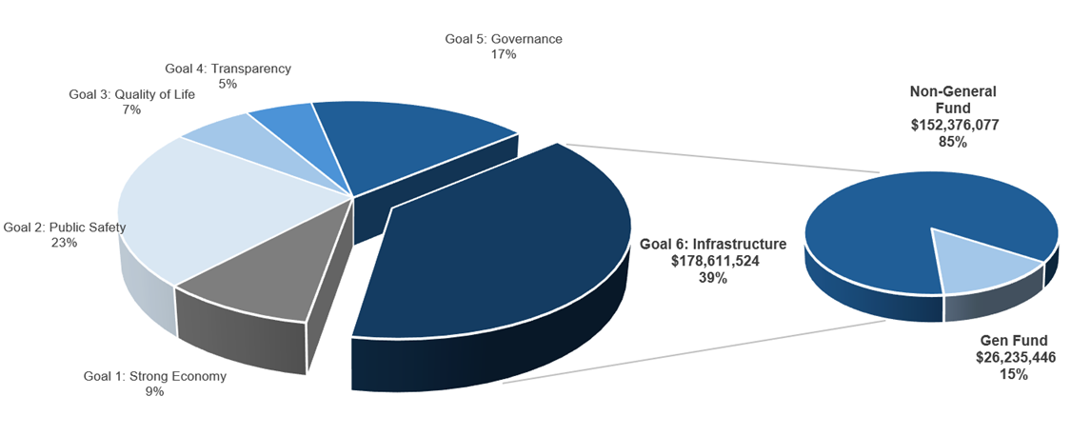
STRENGTHEN & SUSTAIN OUR INFRASTRUCTURE
FY 2026 ALL FUNDS BUDGET: $460,859,620
Notes:
CALL OUT YOUR SPECIFIC GOAL BUDGET HERE WITH PIE GRAPH BREAKDOWN (PROVIDED BY FINANCE)

Slide 7

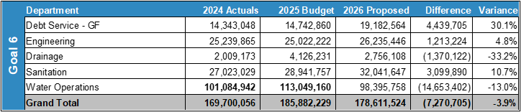
EXPENSES BY DEPARTMENT
Variance Highlights:
Increase in debt service
Increase in staffing and new sanitation routes
Implementing sound financial practices
Notes:
PLEASE INCLUDE YOUR TABLE FOR EXPENSES BY DEPARMENT FOR EACH OF THE DEPARTMENTS INCLUDED IN YOUR GOAL

Slide 8
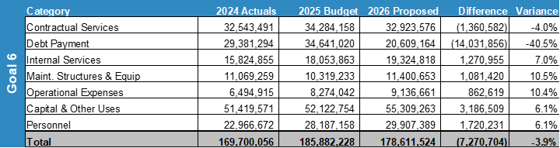
EXPENSES BY TYPE
Variance Highlights:
Utilites and GF debt services increase
Increase in staffing & compensation
Notes:
PLEASE INCLUDE TABLE THAT IS EXPENSES BY TYPE THAT WILL BE PROVDIED BY FINANCE FOR YOUR GOAL.

Slide 9
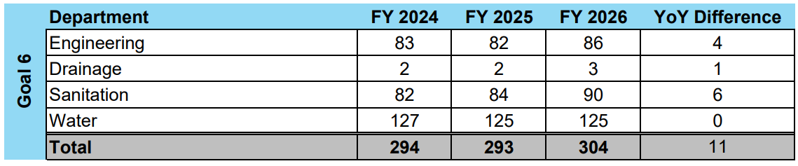
STAFFING
Variance Highlights: ​
Engineering: Transfer of positions from Development Services
Drainage: Added staff for enterprise fund
Sanitation: New routes and litter collection crew
Notes:
THIS IS THE TABLE THAT WILL BE PROVIDED BY FINANCE THAT WILL SHOW YOUR VARIANCES IN STAFFING LEVELS FOR EACH DEPARTMENT IN YOUR GOAL. PLEASE INCLUDE HIGHLGHTS FOR VARIANCES AS SHOWN AS AN EXAMPLE ABOVE.

Slide 10

FY 2026 PRIORITIES
Aligned with Strategic Plan Goals 6.1, 6.4, 6.7 and 5.1, 5.2
Strengthen Water & Sewer Infrastructure
Complete Airport Lift Station & expand system redundancy
Advance clearwell storage planning via dewatering system
Secure & Expand Water Supply
Permit Fort Stockton wells
Launch PPP for advanced treatment at Paul Davis well field
Finalize key regulatory permits to support long-term reuse
Improve Operational Efficiency & Revenue
Maintain pressure monitoring and leak detection
Expand billing automation and Lean Six Sigma practices
Invest in a Highly Skilled Workforce
Sustain 100% TCEQ staff certifications
Highlight Class A-certified operators and internal training gains
Advance Compliance & Innovation
Implement accredited TECTA lab testing
Expand manhole rehab to avoid costly replacements
10
Notes:
LIST YOUR DEPARTMENTS CAUSES FOR INCREASES (IF APPLICABLE) HERE. GIVE REASON TO WHY THINGS ARE INCREASING. LIST FOR ALL DEPARTMENTS APPLICABLE. USE AS MANY SLIDES AS NEEDED FOR ALL DEPARTMENTS.

Slide 11
FY 2025 RESULTS
Utilities
Strategic Goal 6.1: Provide Reliable and Sustainable Utilities
Secured Long-Term Water Supply Flexibility & Cost Savings
Finalized the 2030 Raw Water Contract with CRMWD, enabling dynamic source management—this strategic flexibility is projected to net between $90 million to $140 million in cost savings over the life of the 30-year contract (with potential extension to 40 years).
Launched Leak Detection Program for System Longevity
Initiated a 4-year Satellite Leak Detection Program with two annual scans and third-party investigations—ensuring proactive maintenance and long-term system reliability.
Pressure Monitoring Network Expanded
Deployed 30 pressure monitors throughout the system, advancing our ability to actively detect and respond to leaks before failures occur.
Strategic Goal 5.6: Deliver Services Timely and Efficiently
Utility Billing Revenue Up $10.8 Million Through Process Optimization
Implemented Lean Six Sigma-driven process enhancements in billing and integration workflows, resulting in a $10.8 million year-over-year increase, with projections exceeding $12 million by fiscal year-end—a major win for operational efficiency.
11
Notes:
LIST OUT KEY ACCOMPLISHMENTS MADE IN FY2025. THESE SHOULD CLOSELY REFLECT THE PRIORITIES SET IN LAST YEARS PRESENTATION. ALSO INCLUDE ANY BIG HIGHLIGHTS OR WINS THAT WERE NOT CALLED OUT IN PREVIOUS PRESENTATIONS. CAN INCLUDE METRICS, GRAPHICS, ETC. BUT STILL KEEP THESE AT A HIGH LEVEL. ONLY THE MOST IMPACTFUL ACCOMPLISHMENTS SHOULD BE LISTED! USE AS MANY SLIDES AS YOU NEED, BUT DON'T GO OVER BOARD!
EACH DEPARTMENT WILL NEED A KEY ACCOMPLISHMENTS SLIDE(S).

Slide 12
FY 2025 RESULTS
Water and Sewer Infrastructure
Strategic Goal 6.1: Provide Reliable and Sustainable Utilities
Completed NE 42" Sewer Main – Enabling East Side Growth
Constructed the Northeast 42-inch sewer trunk line, bringing sewer access to previously undeveloped areas of East Midland. This project enables higher-density development and positions the City to support future residential and commercial growth in this key corridor.
Constructed I-20 Preserve Lift Station – Infrastructure Resiliency
Built in response to a major sanitary sewer overflow (SSO), this lift station provides critical redundancy and backup capacity for South Midland’s sewer system—protecting public health and environmental quality.
Strategic Goal 6.7: Develop and Implement Comprehensive Road Planning and Maintenance Initiatives
Initiated Dewater System – Foundation for Future Clearwell Storage
Construction began on a dewatering system at the Water Purification Plant. This infrastructure is a necessary precursor to constructing new clearwell storage, expanding the City’s treated water capacity to meet growing demand and maintain supply stability.
12
Notes:
LIST YOUR DEPARTMENTS CAUSES FOR INCREASES (IF APPLICABLE) HERE. GIVE REASON TO WHY THINGS ARE INCREASING. LIST FOR ALL DEPARTMENTS APPLICABLE. USE AS MANY SLIDES AS NEEDED FOR ALL DEPARTMENTS.

Slide 13

FY 2025 RESULTS
City Utility Billing
Strategic Goal 5.1: Recruit and Retain a Skilled and Diverse Workforce
Training Investment Increased
Delivered 28.92 avg. training hours per employee in FY 25, up from 24.14 hours in FY24—strengthening staff capacity and cross-departmental knowledge.
Strategic Goal 5.2: Enhance Citizen Experience
Major Reduction in Utility Payment Plans
Reduced active payment arrangements from $2.5M (2023) to $83K (2025) through process engineering—a 97% drop.
Customer Touchpoints Increased
Averaged 9,255 monthly interactions, up from 9,114—streamlining customer engagement.
Billing Automation Enhanced Accuracy
Initiated automation of billing processes, improving efficiency and reducing errors, while supporting faster service and increased revenue collection.
13
Notes:
INSTRUCTIONS FOR THESE SLIDES. CREATE AS MANY SLIDES NEEDED FOR AS MANY STRATEGIES THAT YOU WANT TO SPECIFICALLY CALL OUT.
📋 How to Create Key Deliverables for Budget Goal Team Updates
Step 1: Start with the Strategy
Look at the exact wording of the Strategic Plan strategy assigned to your team. For example:
➡️ Strategy: Enhance Communication Efficiency and Effectiveness
This is the "what"—the high-level direction or goal. Your job is to define "how" your team will help achieve it.
Step 2: Identify Actionable Deliverables
Think about the specific, tangible actions, programs, or projects your team will complete in the fiscal year to advance the strategy. These are your Key Deliverables.
Ask:
✔️ What can we implement, launch, improve, or expand?
✔️ How will this action directly support the strategy?
✔️ Can this be tracked or measured by year-end?
Examples for the strategy above:
✅ Maximize the use of reverse 9-1-1 & citizen notification systems to improve emergency communication.
✅ Expand the use of Virtual Agent via RingCX to provide 24/7 phone system access for residents.
✅ Target messaging to specific populations using tools like geo-fencing or Spanish-language content on social media.
Step 3: Keep Deliverables Focused, Measurable, and Budget-Relevant
Key Deliverables should:
✔️ Be specific—not vague or general.
✔️ Be measurable—you should know when it’s done or if it’s working.
✔️ Tie back to budget decisions—does this require funding, staffing, or technology?
✅ Quick Tips for Writing Deliverables:
Start with an action verb: Implement, Expand, Launch, Complete, Deploy.
Be clear on the outcome: What will this change, improve, or deliver?
Think one fiscal year at a time—keep deliverables achievable within the FY.
👉 If your strategy is citywide (like communication), your department’s deliverables should reflect what you specifically control or influence—while working toward the larger goal.

Slide 14

FY 2025 RESULTS
Water and Wastewater Maintenance
Strategic Goal 6.1: Provide Reliable and Sustainable Utilities
Main Breaks Decreasing
Water service/main repairs down from 206 to 150—a 27% drop. Reflects impact of targeted $4M/year water main replacements and satellite leak detection, both reducing emergency repairs.
Manhole Rehab Program Expanded
Completed 105 manhole rehabs, up from 95 avoiding costly replacements—saving $4.6M. The program was featured in the July issue of Underground Infrastructure Magazine.
Strategic Goal 6.4: Standardize Infrastructure Processes
Utility Crews Supporting Parks Projects
Reduced emergency workload has allowed Utilities to install water and wastewater lines in-house for Parks capital projects, accelerating delivery and saving on contractor costs.
14
Notes:
LIST YOUR DEPARTMENTS CAUSES FOR INCREASES (IF APPLICABLE) HERE. GIVE REASON TO WHY THINGS ARE INCREASING.

Slide 15
FY 2025 RESULTS
Environmental Compliance
Strategic Goal 5.1: Recruit and Retain a Skilled and Diverse Workforce
Highly Trained, Fully Certified Staff
Achieved 100% TCEQ certification for Environmental Compliance personnel, reinforcing Midland’s commitment to staff excellence and regulatory compliance
Strategic Goal 6.1: Provide Reliable and Sustainable Utilities
Completed WRF Bed & Banks Permit
Finalized the long-standing Bed & Banks permit for the Water Reclamation Facility, a regulatory process with TCEQ ongoing since 2017
Infrastructure & Equipment Upgrades
Replaced 6 sampling stations and acquired new TECTA lab equipment, increasing water quality monitoring capabilities. Staff were trained in-house on this advanced system to ensure accurate, timely compliance testing.
High Responsiveness to Community Needs
Resolved 117 SeeClickFix requests, with 79% SLA compliance, 0.6-day average response, and 4-day closure average.
15
Notes:
LIST OUT KEY ACCOMPLISHMENTS MADE IN FY2025. THESE SHOULD CLOSELY REFLECT THE PRIORITIES & KEY DELIVERABLES SET IN LAST YEARS PRESENTATION. ALSO INCLUDE ANY BIG HIGHLIGHTS OR WINS THAT WERE NOT CALLED OUT IN PREVIOUS PRESENTATIONS. CAN INCLUDE METRICS, GRAPHICS, ETC. BUT STILL KEEP THESE AT A HIGH LEVEL. ONLY THE MOST IMPACTFUL ACCOMPLISHMENTS SHOULD BE LISTED! USE AS MANY SLIDES AS YOU NEED, BUT DON'T GO OVER BOARD!
EACH DEPARTMENT WILL NEED A KEY ACCOMPLISHMENTS SLIDE(S).

Slide 16
FY 2025 RESULTS
Water Purification Plant
Strategic Goal 6.1: Provide Reliable and Sustainable Utilities
Expanded Groundwater Supply
Completed installation of 5 groundwater wells and a pump station at the Paul Davis well field, strengthening system capacity and drought resiliency.
Strengthened Infrastructure at WPP
Replaced critical valves at the Plant and on the T-Bar line to improve operational reliability and reduce maintenance risk.
Construction on Solids Dewatering System
Began building the solids dewatering system, a foundational step toward adding future Clearwell storage to meet growing demand and population growth.
Maintained Strong Production Output
Produced over 8 billion gallons of treated water, reliably serving Midland’s growing population.
16
Notes:
INSTRUCTIONS FOR THESE SLIDES. CREATE AS MANY SLIDES NEEDED FOR AS MANY STRATEGIES THAT YOU WANT TO SPECIFICALLY CALL OUT.
📋 How to Create Key Deliverables for Budget Goal Team Updates
Step 1: Start with the Strategy
Look at the exact wording of the Strategic Plan strategy assigned to your team. For example:
➡️ Strategy: Enhance Communication Efficiency and Effectiveness
This is the "what"—the high-level direction or goal. Your job is to define "how" your team will help achieve it.
Step 2: Identify Actionable Deliverables
Think about the specific, tangible actions, programs, or projects your team will complete in the fiscal year to advance the strategy. These are your Key Deliverables.
Ask:
✔️ What can we implement, launch, improve, or expand?
✔️ How will this action directly support the strategy?
✔️ Can this be tracked or measured by year-end?
Examples for the strategy above:
✅ Maximize the use of reverse 9-1-1 & citizen notification systems to improve emergency communication.
✅ Expand the use of Virtual Agent via RingCX to provide 24/7 phone system access for residents.
✅ Target messaging to specific populations using tools like geo-fencing or Spanish-language content on social media.
Step 3: Keep Deliverables Focused, Measurable, and Budget-Relevant
Key Deliverables should:
✔️ Be specific—not vague or general.
✔️ Be measurable—you should know when it’s done or if it’s working.
✔️ Tie back to budget decisions—does this require funding, staffing, or technology?
✅ Quick Tips for Writing Deliverables:
Start with an action verb: Implement, Expand, Launch, Complete, Deploy.
Be clear on the outcome: What will this change, improve, or deliver?
Think one fiscal year at a time—keep deliverables achievable within the FY.
👉 If your strategy is citywide (like communication), your department’s deliverables should reflect what you specifically control or influence—while working toward the larger goal.

Slide 17
FY 2025 RESULTS
Water Reclamation Facility
Strategic Goal 5.1: Recruit and Retain a Skilled and Diverse Workforce
Highly Trained Team Supporting Operations
Increased staffing by 50%, with 10 of 13 employees TCEQ-certified, including 3 Class A Wastewater Operators.
Strategic Goal 6.1: Provide Reliable and Sustainable Utilities
Boosted Treatment Capacity
Cleaned Basin 4 and installed cathodic protection, increasing total WPP plant capacity to 32 MGD.
Restored Full Solids Handling Capacity
Repaired and aligned all 4 screw press baskets, restoring full solids processing functionality—up from just one operational unit.
Extended Pump Life with In-House Innovation
Installed custom-fabricated baskets on Return Activated Sludge (RAS) pumps, improving performance and reducing downtime.
17
Notes:
LIST OUT KEY ACCOMPLISHMENTS MADE IN FY2025. THESE SHOULD CLOSELY REFLECT THE PRIORITIES SET IN LAST YEARS PRESENTATION. ALSO INCLUDE ANY BIG HIGHLIGHTS OR WINS THAT WERE NOT CALLED OUT IN PREVIOUS PRESENTATIONS. CAN INCLUDE METRICS, GRAPHICS, ETC. BUT STILL KEEP THESE AT A HIGH LEVEL. ONLY THE MOST IMPACTFUL ACCOMPLISHMENTS SHOULD BE LISTED! USE AS MANY SLIDES AS YOU NEED, BUT DON'T GO OVER BOARD!
EACH DEPARTMENT WILL NEED A KEY ACCOMPLISHMENTS SLIDE(S).

Slide 18
FY 2026 DELIVERABLES
Strategy: Strengthen and Sustain Our Infrastructure
Strategic Goal 6.1: Provide Reliable and Sustainable Utilities
Establish PPP for Advanced Groundwater Treatment
Begin public-private partnership for advanced treatment at the Paul Davis groundwater ranch, targeting high-quality, low-TDS water.
Permit Fort Stockton Wells
Secure TCEQ permits for two new wells at the Fort Stockton source to increase long-term water supply flexibility.
Lead and Copper Rule Compliance
Complete 5% of required testing at all childcare and school facilities to maintain compliance with revised TCEQ standards.
Implement TECTA Testing with TCEQ Accreditation
Launch use of new TECTA testing method and pursue TCEQ lab accreditation for faster, more accurate water quality results.
18
Notes:
INSTRUCTIONS FOR THESE SLIDES. CREATE AS MANY SLIDES NEEDED FOR AS MANY STRATEGIES THAT YOU WANT TO SPECIFICALLY CALL OUT.
📋 How to Create Key Deliverables for Budget Goal Team Updates
Step 1: Start with the Strategy
Look at the exact wording of the Strategic Plan strategy assigned to your team. For example:
➡️ Strategy: Enhance Communication Efficiency and Effectiveness
This is the "what"—the high-level direction or goal. Your job is to define "how" your team will help achieve it.
Step 2: Identify Actionable Deliverables
Think about the specific, tangible actions, programs, or projects your team will complete in the fiscal year to advance the strategy. These are your Key Deliverables.
Ask:
✔️ What can we implement, launch, improve, or expand?
✔️ How will this action directly support the strategy?
✔️ Can this be tracked or measured by year-end?
Examples for the strategy above:
✅ Maximize the use of reverse 9-1-1 & citizen notification systems to improve emergency communication.
✅ Expand the use of Virtual Agent via RingCX to provide 24/7 phone system access for residents.
✅ Target messaging to specific populations using tools like geo-fencing or Spanish-language content on social media.
Step 3: Keep Deliverables Focused, Measurable, and Budget-Relevant
Key Deliverables should:
✔️ Be specific—not vague or general.
✔️ Be measurable—you should know when it’s done or if it’s working.
✔️ Tie back to budget decisions—does this require funding, staffing, or technology?
✅ Quick Tips for Writing Deliverables:
Start with an action verb: Implement, Expand, Launch, Complete, Deploy.
Be clear on the outcome: What will this change, improve, or deliver?
Think one fiscal year at a time—keep deliverables achievable within the FY.
👉 If your strategy is citywide (like communication), your department’s deliverables should reflect what you specifically control or influence—while working toward the larger goal.

Slide 19
FY 2026 DELIVERABLES
Strategy: Strengthen and Sustain Our Infrastructure
Strategic Goal 6.6: Develop Proactive Responses to Growth Rather than Reactive
Enhance System Redundancy
Design and begin construction of redundant transmission line from T-Bar to the Water Purification Plant and Edgewood Ground Storage Tanks.
Sewer System Modernization
Complete construction of the new Airport Lift Station, increasing sewer reliability in a growing service area.
Ongoing Water Main Replacements
Continue replacing aging water mains citywide to reduce leaks and improve service reliability.
19
Notes:
INSTRUCTIONS FOR THESE SLIDES. CREATE AS MANY SLIDES NEEDED FOR AS MANY STRATEGIES THAT YOU WANT TO SPECIFICALLY CALL OUT.
📋 How to Create Key Deliverables for Budget Goal Team Updates
Step 1: Start with the Strategy
Look at the exact wording of the Strategic Plan strategy assigned to your team. For example:
➡️ Strategy: Enhance Communication Efficiency and Effectiveness
This is the "what"—the high-level direction or goal. Your job is to define "how" your team will help achieve it.
Step 2: Identify Actionable Deliverables
Think about the specific, tangible actions, programs, or projects your team will complete in the fiscal year to advance the strategy. These are your Key Deliverables.
Ask:
✔️ What can we implement, launch, improve, or expand?
✔️ How will this action directly support the strategy?
✔️ Can this be tracked or measured by year-end?
Examples for the strategy above:
✅ Maximize the use of reverse 9-1-1 & citizen notification systems to improve emergency communication.
✅ Expand the use of Virtual Agent via RingCX to provide 24/7 phone system access for residents.
✅ Target messaging to specific populations using tools like geo-fencing or Spanish-language content on social media.
Step 3: Keep Deliverables Focused, Measurable, and Budget-Relevant
Key Deliverables should:
✔️ Be specific—not vague or general.
✔️ Be measurable—you should know when it’s done or if it’s working.
✔️ Tie back to budget decisions—does this require funding, staffing, or technology?
✅ Quick Tips for Writing Deliverables:
Start with an action verb: Implement, Expand, Launch, Complete, Deploy.
Be clear on the outcome: What will this change, improve, or deliver?
Think one fiscal year at a time—keep deliverables achievable within the FY.
👉 If your strategy is citywide (like communication), your department’s deliverables should reflect what you specifically control or influence—while working toward the larger goal.

Slide 20
FY 2026 PRIORITIES
Aligned with Strategic Plan Goals 3.3, 3.4, 5.1, 5.2, 6.2, 6.4, 6.5, 6.6, 6.7
Stay Ahead of Growth
Build/expand partnerships
Secure ROW for future expansion
Improve Existing Infrastructure
Improve pedestrian and motorist safety in alignment with Vision Zero
Add tools to our street maintenance toolbox allowing for proactive maintenance
Establish Programs to improve quality of life (weed and litter abatement)
Improve Operational Efficiency
Work with consultants/contractors for better project delivery
Expand In-house capabilities and implement Lean Six Sigma practices
Identify funding opportunities for important projects
Invest in a Highly Skilled Workforce
Provide the training needed and develop programs that foster growth
Modernize Infrastructure to Improve Efficiency
Implement innovative technologies for traffic improvements
20
Notes:
LIST YOUR DEPARTMENTS CAUSES FOR INCREASES (IF APPLICABLE) HERE. GIVE REASON TO WHY THINGS ARE INCREASING. LIST FOR ALL DEPARTMENTS APPLICABLE. USE AS MANY SLIDES AS NEEDED FOR ALL DEPARTMENTS.

Slide 21
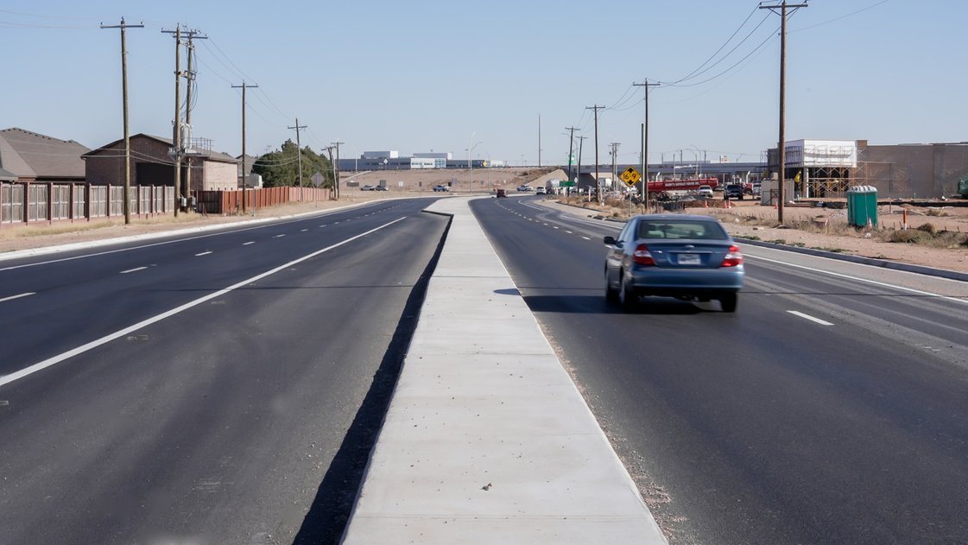
FY 2025 RESULTS
Engineering
SH 158 and Sinclair Avenue (Complete)
Sinclair backage road ​(Complete to Costco)
Wadley Avenue Extension (Complete)
COMPASS 2024 ​(Complete)
Fairgrounds Rd. Extension (Ongoing)
Briarwood utilities (Ongoing)
21
Notes:
LIST OUT KEY ACCOMPLISHMENTS MADE IN FY2025. THESE SHOULD CLOSELY REFLECT THE PRIORITIES & KEY DELIVERABLES SET IN LAST YEARS PRESENTATION. ALSO INCLUDE ANY BIG HIGHLIGHTS OR WINS THAT WERE NOT CALLED OUT IN PREVIOUS PRESENTATIONS. CAN INCLUDE METRICS, GRAPHICS, ETC. BUT STILL KEEP THESE AT A HIGH LEVEL. ONLY THE MOST IMPACTFUL ACCOMPLISHMENTS SHOULD BE LISTED! USE AS MANY SLIDES AS YOU NEED, BUT DON'T GO OVER BOARD!
EACH DEPARTMENT WILL NEED A KEY ACCOMPLISHMENTS SLIDE(S).

Slide 22
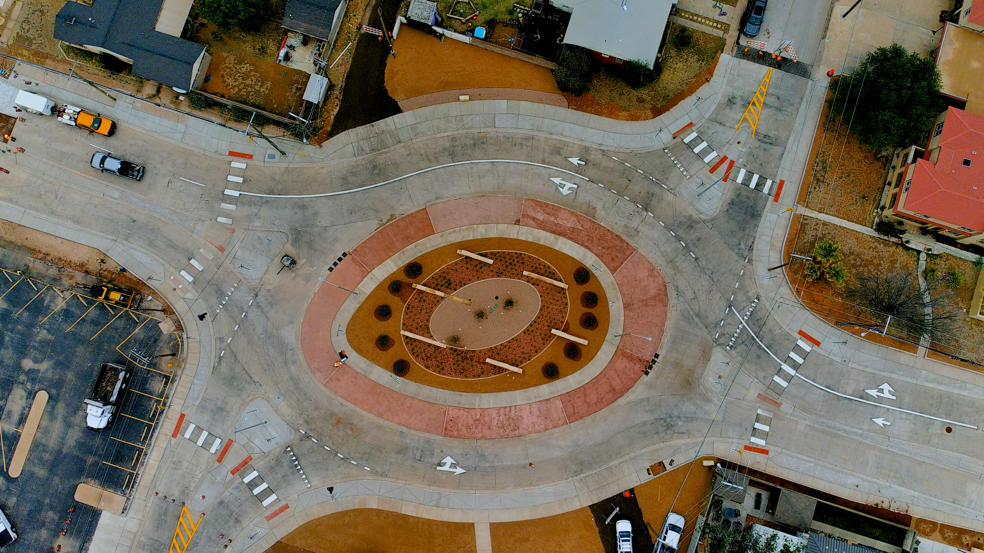
FY 2025 RESULTS
Engineering – Bond Program
Garfield is Complete – Saved $11,984,619.90
Main Street under construction ​
22
Notes:
LIST OUT KEY ACCOMPLISHMENTS MADE IN FY2025. THESE SHOULD CLOSELY REFLECT THE PRIORITIES & KEY DELIVERABLES SET IN LAST YEARS PRESENTATION. ALSO INCLUDE ANY BIG HIGHLIGHTS OR WINS THAT WERE NOT CALLED OUT IN PREVIOUS PRESENTATIONS. CAN INCLUDE METRICS, GRAPHICS, ETC. BUT STILL KEEP THESE AT A HIGH LEVEL. ONLY THE MOST IMPACTFUL ACCOMPLISHMENTS SHOULD BE LISTED! USE AS MANY SLIDES AS YOU NEED, BUT DON'T GO OVER BOARD!
EACH DEPARTMENT WILL NEED A KEY ACCOMPLISHMENTS SLIDE(S).

Slide 23
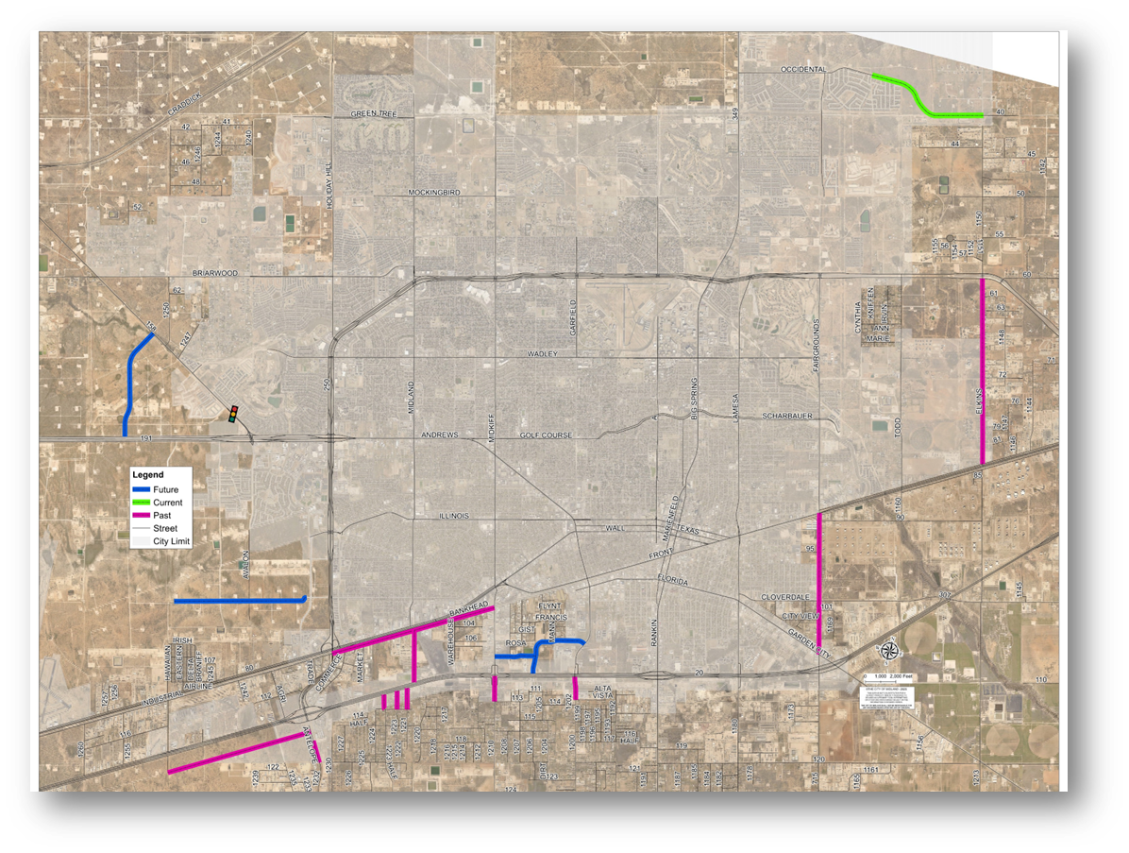
FY 2025 RESULTS
Engineering
  Through Partnerships:
  SH 158 Intersections – City Design $330,055.55 - TXDOT project $15.7 million (Estimated) Project accelerated FOUR (4) years
  Scharbauer bridge reconstruction at Lamesa, Main, and Carver – City Design $455,157.00 - TXDOT project $6,133,440.95
  Occidental Pkwy. - City Design $416,319.48 County project $4.5 million
  SH 158 and Sinclair – County reimbursement $588,900.00
  TXDOT Grant Agreement for Wildcatter Trail Phase I
23
Image: County Partnerships
Notes:
INSTRUCTIONS FOR THESE SLIDES. CREATE AS MANY SLIDES NEEDED FOR AS MANY STRATEGIES THAT YOU WANT TO SPECIFICALLY CALL OUT.
📋 How to Create Key Deliverables for Budget Goal Team Updates
Step 1: Start with the Strategy
Look at the exact wording of the Strategic Plan strategy assigned to your team. For example:
➡️ Strategy: Enhance Communication Efficiency and Effectiveness
This is the "what"—the high-level direction or goal. Your job is to define "how" your team will help achieve it.
Step 2: Identify Actionable Deliverables
Think about the specific, tangible actions, programs, or projects your team will complete in the fiscal year to advance the strategy. These are your Key Deliverables.
Ask:
✔️ What can we implement, launch, improve, or expand?
✔️ How will this action directly support the strategy?
✔️ Can this be tracked or measured by year-end?
Examples for the strategy above:
✅ Maximize the use of reverse 9-1-1 & citizen notification systems to improve emergency communication.
✅ Expand the use of Virtual Agent via RingCX to provide 24/7 phone system access for residents.
✅ Target messaging to specific populations using tools like geo-fencing or Spanish-language content on social media.
Step 3: Keep Deliverables Focused, Measurable, and Budget-Relevant
Key Deliverables should:
✔️ Be specific—not vague or general.
✔️ Be measurable—you should know when it’s done or if it’s working.
✔️ Tie back to budget decisions—does this require funding, staffing, or technology?
✅ Quick Tips for Writing Deliverables:
Start with an action verb: Implement, Expand, Launch, Complete, Deploy.
Be clear on the outcome: What will this change, improve, or deliver?
Think one fiscal year at a time—keep deliverables achievable within the FY.
👉 If your strategy is citywide (like communication), your department’s deliverables should reflect what you specifically control or influence—while working toward the larger goal.

Slide 24
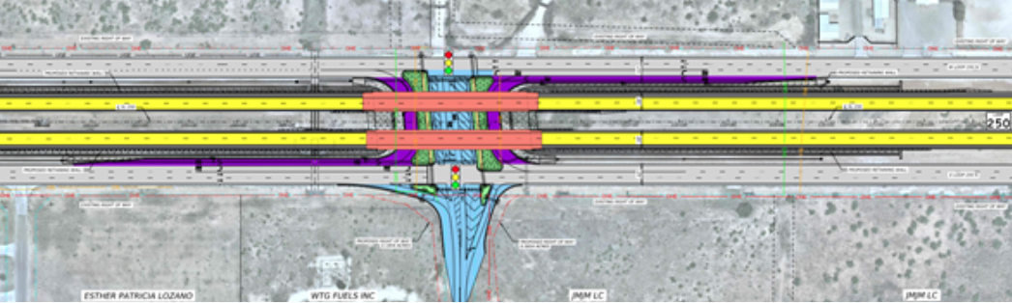
FY 2025 RESULTS
Engineering
  Through Partnerships:
  Todd Drive - MDC $1 Million investment accelerated TXDOT project by SIX (6) years! Led to $26 Million project
Image: Todd Dr. Overpass schematic
24
Notes:
INSTRUCTIONS FOR THESE SLIDES. CREATE AS MANY SLIDES NEEDED FOR AS MANY STRATEGIES THAT YOU WANT TO SPECIFICALLY CALL OUT.
📋 How to Create Key Deliverables for Budget Goal Team Updates
Step 1: Start with the Strategy
Look at the exact wording of the Strategic Plan strategy assigned to your team. For example:
➡️ Strategy: Enhance Communication Efficiency and Effectiveness
This is the "what"—the high-level direction or goal. Your job is to define "how" your team will help achieve it.
Step 2: Identify Actionable Deliverables
Think about the specific, tangible actions, programs, or projects your team will complete in the fiscal year to advance the strategy. These are your Key Deliverables.
Ask:
✔️ What can we implement, launch, improve, or expand?
✔️ How will this action directly support the strategy?
✔️ Can this be tracked or measured by year-end?
Examples for the strategy above:
✅ Maximize the use of reverse 9-1-1 & citizen notification systems to improve emergency communication.
✅ Expand the use of Virtual Agent via RingCX to provide 24/7 phone system access for residents.
✅ Target messaging to specific populations using tools like geo-fencing or Spanish-language content on social media.
Step 3: Keep Deliverables Focused, Measurable, and Budget-Relevant
Key Deliverables should:
✔️ Be specific—not vague or general.
✔️ Be measurable—you should know when it’s done or if it’s working.
✔️ Tie back to budget decisions—does this require funding, staffing, or technology?
✅ Quick Tips for Writing Deliverables:
Start with an action verb: Implement, Expand, Launch, Complete, Deploy.
Be clear on the outcome: What will this change, improve, or deliver?
Think one fiscal year at a time—keep deliverables achievable within the FY.
👉 If your strategy is citywide (like communication), your department’s deliverables should reflect what you specifically control or influence—while working toward the larger goal.

Slide 25
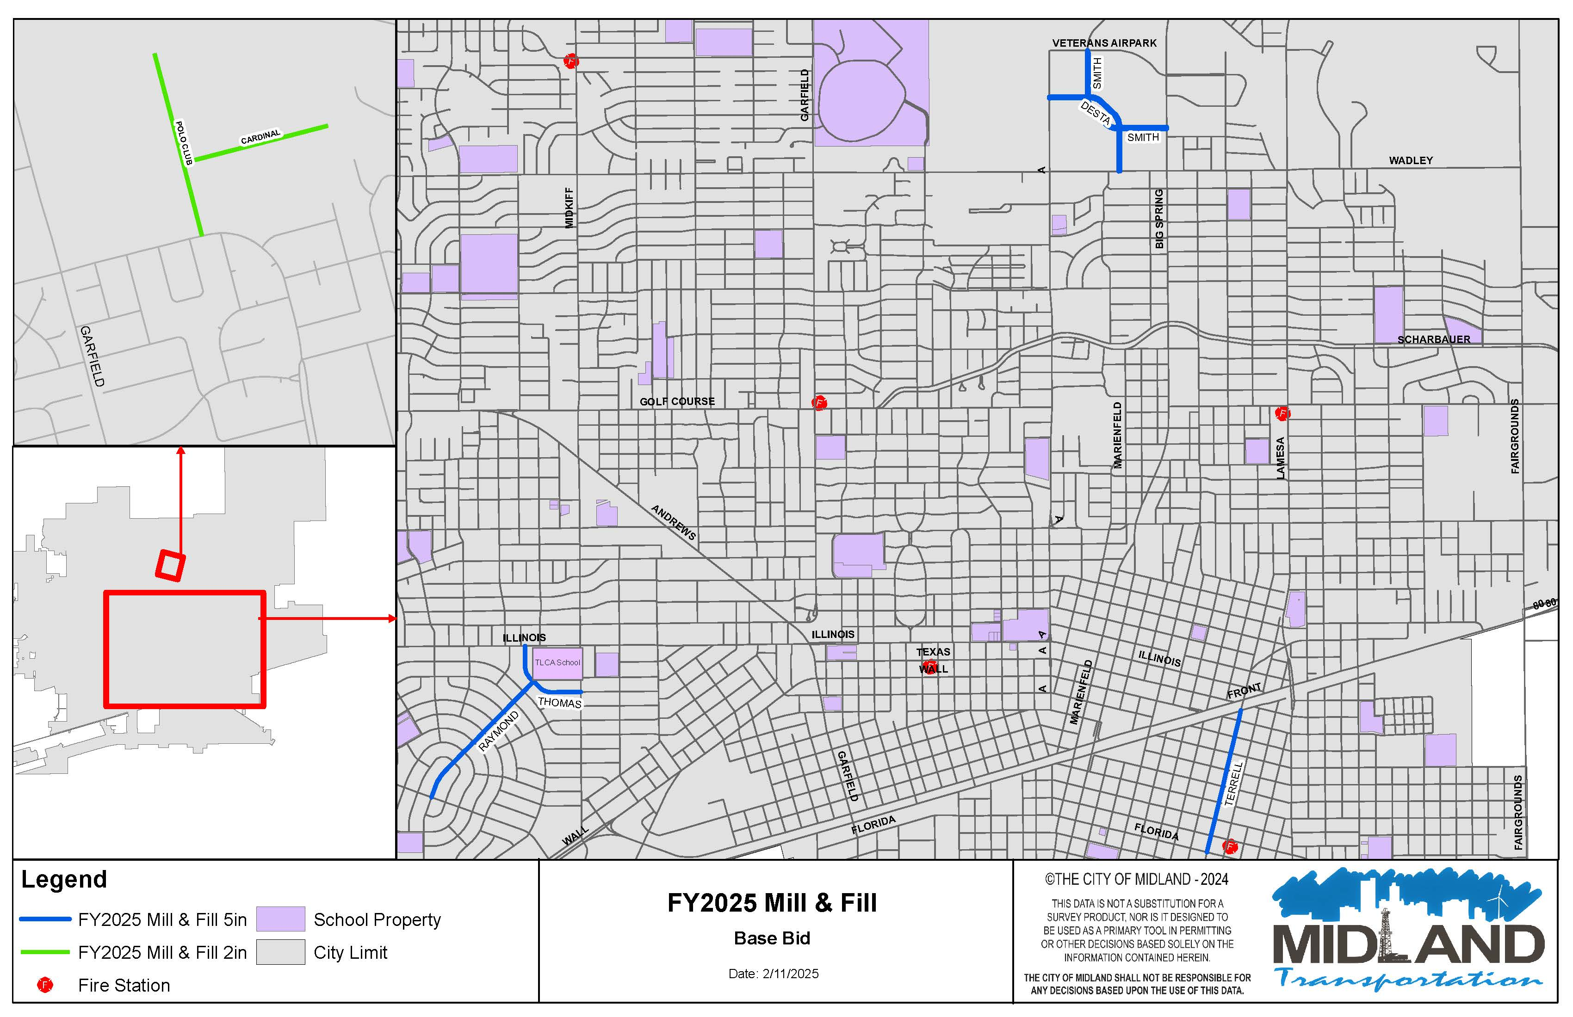
FY 2025 RESULTS
Mill & Inlay FY 2025 – 3.4 Miles
25
Notes:
LIST OUT KEY ACCOMPLISHMENTS MADE IN FY2025. THESE SHOULD CLOSELY REFLECT THE PRIORITIES & KEY DELIVERABLES SET IN LAST YEARS PRESENTATION. ALSO INCLUDE ANY BIG HIGHLIGHTS OR WINS THAT WERE NOT CALLED OUT IN PREVIOUS PRESENTATIONS. CAN INCLUDE METRICS, GRAPHICS, ETC. BUT STILL KEEP THESE AT A HIGH LEVEL. ONLY THE MOST IMPACTFUL ACCOMPLISHMENTS SHOULD BE LISTED! USE AS MANY SLIDES AS YOU NEED, BUT DON'T GO OVER BOARD!
EACH DEPARTMENT WILL NEED A KEY ACCOMPLISHMENTS SLIDE(S).

Slide 26
FY 2025 RESULTS
Most Traveled Roads
This program has resulted in over 374 service requests* thus far in FY25 to maintain the integrity of our Most Traveled Roads. Accomplishments include:​
Service Request Distribution​
Litter Abatement​ | 29 | Enhancements for Pedestrians​ | 3
Pothole Repair​ | 42 | Improved Lighting​ | 2
Landscape Enhancements​ | 10 | ADA Compliance​ | 3
Road & Signage Improvements​ | 33 | Rectifying Buckled Curb & Sidewalks​ | 69
Vegetation Control​/Drainage | 152 | Street Sweeping ​ | 31
*Service requests include notifications made to entities outside City of Midland right of way (e.g. TXDOT, Midland County, Atmos, Oncor)
26
Notes:
LIST OUT KEY ACCOMPLISHMENTS MADE IN FY2025. THESE SHOULD CLOSELY REFLECT THE PRIORITIES & KEY DELIVERABLES SET IN LAST YEARS PRESENTATION. ALSO INCLUDE ANY BIG HIGHLIGHTS OR WINS THAT WERE NOT CALLED OUT IN PREVIOUS PRESENTATIONS. CAN INCLUDE METRICS, GRAPHICS, ETC. BUT STILL KEEP THESE AT A HIGH LEVEL. ONLY THE MOST IMPACTFUL ACCOMPLISHMENTS SHOULD BE LISTED! USE AS MANY SLIDES AS YOU NEED, BUT DON'T GO OVER BOARD!
EACH DEPARTMENT WILL NEED A KEY ACCOMPLISHMENTS SLIDE(S).

Slide 27
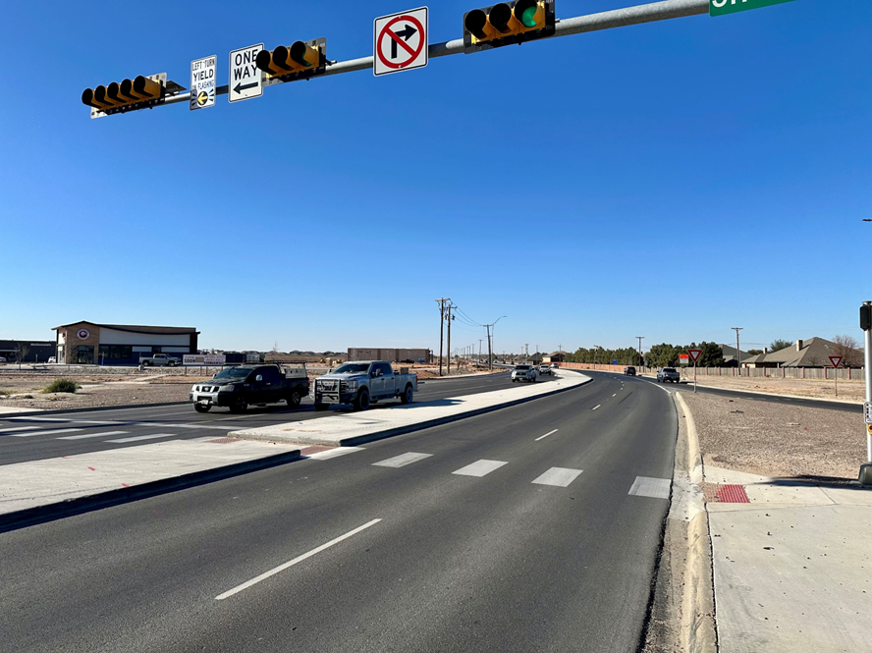
FY 2025 RESULTS
Traffic Operations - FY 2025
Traffic Signals
Mockingbird and Stonebridge (Complete)
Lamesa and Gist (Complete)
Avalon and Deauville (Complete)
SH 158 and Sinclair signal (Complete)
Fairgrounds and Scharbauer (Awarded)
Andrews and Woodcrest (Ongoing)
  $4,020,126.29
Design Traffic Signal
Wadley and Crowley
Big Spring and Sharp lane
Avalon and Briarwood
  $175,143.00
27
Notes:
LIST YOUR DEPARTMENTS CAUSES FOR INCREASES (IF APPLICABLE) HERE. GIVE REASON TO WHY THINGS ARE INCREASING. LIST FOR ALL DEPARTMENTS APPLICABLE. USE AS MANY SLIDES AS NEEDED FOR ALL DEPARTMENTS.

Slide 28
FY 2026 DELIVERABLES
Strategy: Strategize for and Monitor for City Growth
Leverage partnerships with Midland County, TxDOT, MDC and developers
  Begin Construction of Todd Dr. Overpass (TXDOT)
  Todd Dr. From Occidental South (Developer partnership)
  Andrews Highway Utilities at Alpine to Midkiff (City Utilities, TXDOT repaving)
  Corridor planning for Outerloop and Fairgrounds (With the PBMPO)
28
Notes:
INSTRUCTIONS FOR THESE SLIDES. CREATE AS MANY SLIDES NEEDED FOR AS MANY STRATEGIES THAT YOU WANT TO SPECIFICALLY CALL OUT.
📋 How to Create Key Deliverables for Budget Goal Team Updates
Step 1: Start with the Strategy
Look at the exact wording of the Strategic Plan strategy assigned to your team. For example:
➡️ Strategy: Enhance Communication Efficiency and Effectiveness
This is the "what"—the high-level direction or goal. Your job is to define "how" your team will help achieve it.
Step 2: Identify Actionable Deliverables
Think about the specific, tangible actions, programs, or projects your team will complete in the fiscal year to advance the strategy. These are your Key Deliverables.
Ask:
✔️ What can we implement, launch, improve, or expand?
✔️ How will this action directly support the strategy?
✔️ Can this be tracked or measured by year-end?
Examples for the strategy above:
✅ Maximize the use of reverse 9-1-1 & citizen notification systems to improve emergency communication.
✅ Expand the use of Virtual Agent via RingCX to provide 24/7 phone system access for residents.
✅ Target messaging to specific populations using tools like geo-fencing or Spanish-language content on social media.
Step 3: Keep Deliverables Focused, Measurable, and Budget-Relevant
Key Deliverables should:
✔️ Be specific—not vague or general.
✔️ Be measurable—you should know when it’s done or if it’s working.
✔️ Tie back to budget decisions—does this require funding, staffing, or technology?
✅ Quick Tips for Writing Deliverables:
Start with an action verb: Implement, Expand, Launch, Complete, Deploy.
Be clear on the outcome: What will this change, improve, or deliver?
Think one fiscal year at a time—keep deliverables achievable within the FY.
👉 If your strategy is citywide (like communication), your department’s deliverables should reflect what you specifically control or influence—while working toward the larger goal.

Slide 29
FY 2026 DELIVERABLES
Engineering
Briarwood Paving (break ground)
Mockingbird (break ground)
IH-20 Backage Road (Stokes- Complete Phase I)
Arlington Road (Complete in 2026)
Jal Draw and Multi-use trail (break ground)
SH 158/Wadley (City design- TXDOT construct)
SH 158/Briarwood (City design- TXDOT construct)
Wildcatter Trail Phase I Design (Complete Design)
29
Notes:
INSTRUCTIONS FOR THESE SLIDES. CREATE AS MANY SLIDES NEEDED FOR AS MANY STRATEGIES THAT YOU WANT TO SPECIFICALLY CALL OUT.
📋 How to Create Key Deliverables for Budget Goal Team Updates
Step 1: Start with the Strategy
Look at the exact wording of the Strategic Plan strategy assigned to your team. For example:
➡️ Strategy: Enhance Communication Efficiency and Effectiveness
This is the "what"—the high-level direction or goal. Your job is to define "how" your team will help achieve it.
Step 2: Identify Actionable Deliverables
Think about the specific, tangible actions, programs, or projects your team will complete in the fiscal year to advance the strategy. These are your Key Deliverables.
Ask:
✔️ What can we implement, launch, improve, or expand?
✔️ How will this action directly support the strategy?
✔️ Can this be tracked or measured by year-end?
Examples for the strategy above:
✅ Maximize the use of reverse 9-1-1 & citizen notification systems to improve emergency communication.
✅ Expand the use of Virtual Agent via RingCX to provide 24/7 phone system access for residents.
✅ Target messaging to specific populations using tools like geo-fencing or Spanish-language content on social media.
Step 3: Keep Deliverables Focused, Measurable, and Budget-Relevant
Key Deliverables should:
✔️ Be specific—not vague or general.
✔️ Be measurable—you should know when it’s done or if it’s working.
✔️ Tie back to budget decisions—does this require funding, staffing, or technology?
✅ Quick Tips for Writing Deliverables:
Start with an action verb: Implement, Expand, Launch, Complete, Deploy.
Be clear on the outcome: What will this change, improve, or deliver?
Think one fiscal year at a time—keep deliverables achievable within the FY.
👉 If your strategy is citywide (like communication), your department’s deliverables should reflect what you specifically control or influence—while working toward the larger goal.

Slide 30
FY 2026 DELIVERABLES
Engineering
572 Miles of Roadway in 2014
667 Miles of Roadway in 2023
  17% Increase
734 miles in 2028 (10% increase)
30
Notes:
INSTRUCTIONS FOR THESE SLIDES. CREATE AS MANY SLIDES NEEDED FOR AS MANY STRATEGIES THAT YOU WANT TO SPECIFICALLY CALL OUT.
📋 How to Create Key Deliverables for Budget Goal Team Updates
Step 1: Start with the Strategy
Look at the exact wording of the Strategic Plan strategy assigned to your team. For example:
➡️ Strategy: Enhance Communication Efficiency and Effectiveness
This is the "what"—the high-level direction or goal. Your job is to define "how" your team will help achieve it.
Step 2: Identify Actionable Deliverables
Think about the specific, tangible actions, programs, or projects your team will complete in the fiscal year to advance the strategy. These are your Key Deliverables.
Ask:
✔️ What can we implement, launch, improve, or expand?
✔️ How will this action directly support the strategy?
✔️ Can this be tracked or measured by year-end?
Examples for the strategy above:
✅ Maximize the use of reverse 9-1-1 & citizen notification systems to improve emergency communication.
✅ Expand the use of Virtual Agent via RingCX to provide 24/7 phone system access for residents.
✅ Target messaging to specific populations using tools like geo-fencing or Spanish-language content on social media.
Step 3: Keep Deliverables Focused, Measurable, and Budget-Relevant
Key Deliverables should:
✔️ Be specific—not vague or general.
✔️ Be measurable—you should know when it’s done or if it’s working.
✔️ Tie back to budget decisions—does this require funding, staffing, or technology?
✅ Quick Tips for Writing Deliverables:
Start with an action verb: Implement, Expand, Launch, Complete, Deploy.
Be clear on the outcome: What will this change, improve, or deliver?
Think one fiscal year at a time—keep deliverables achievable within the FY.
👉 If your strategy is citywide (like communication), your department’s deliverables should reflect what you specifically control or influence—while working toward the larger goal.

Slide 31
FY 2026 DELIVERABLES
Strategy: Develop and Implement Comprehensive Road Planning and Maintenance Initiatives
Road Maintenance and Operations
Mill & Inlay Bad Roadways
Apply Surface Treatments to Preserve Good Asphalt
Grow In-House Asphalt and Concrete Paving Programs
Maintain Efficient Pothole Response
  Goal of: 30,000 Potholes
Increase Focus on Midland’s Most-Travelled Roads
31
Notes:
INSTRUCTIONS FOR THESE SLIDES. CREATE AS MANY SLIDES NEEDED FOR AS MANY STRATEGIES THAT YOU WANT TO SPECIFICALLY CALL OUT.
📋 How to Create Key Deliverables for Budget Goal Team Updates
Step 1: Start with the Strategy
Look at the exact wording of the Strategic Plan strategy assigned to your team. For example:
➡️ Strategy: Enhance Communication Efficiency and Effectiveness
This is the "what"—the high-level direction or goal. Your job is to define "how" your team will help achieve it.
Step 2: Identify Actionable Deliverables
Think about the specific, tangible actions, programs, or projects your team will complete in the fiscal year to advance the strategy. These are your Key Deliverables.
Ask:
✔️ What can we implement, launch, improve, or expand?
✔️ How will this action directly support the strategy?
✔️ Can this be tracked or measured by year-end?
Examples for the strategy above:
✅ Maximize the use of reverse 9-1-1 & citizen notification systems to improve emergency communication.
✅ Expand the use of Virtual Agent via RingCX to provide 24/7 phone system access for residents.
✅ Target messaging to specific populations using tools like geo-fencing or Spanish-language content on social media.
Step 3: Keep Deliverables Focused, Measurable, and Budget-Relevant
Key Deliverables should:
✔️ Be specific—not vague or general.
✔️ Be measurable—you should know when it’s done or if it’s working.
✔️ Tie back to budget decisions—does this require funding, staffing, or technology?
✅ Quick Tips for Writing Deliverables:
Start with an action verb: Implement, Expand, Launch, Complete, Deploy.
Be clear on the outcome: What will this change, improve, or deliver?
Think one fiscal year at a time—keep deliverables achievable within the FY.
👉 If your strategy is citywide (like communication), your department’s deliverables should reflect what you specifically control or influence—while working toward the larger goal.

Slide 32
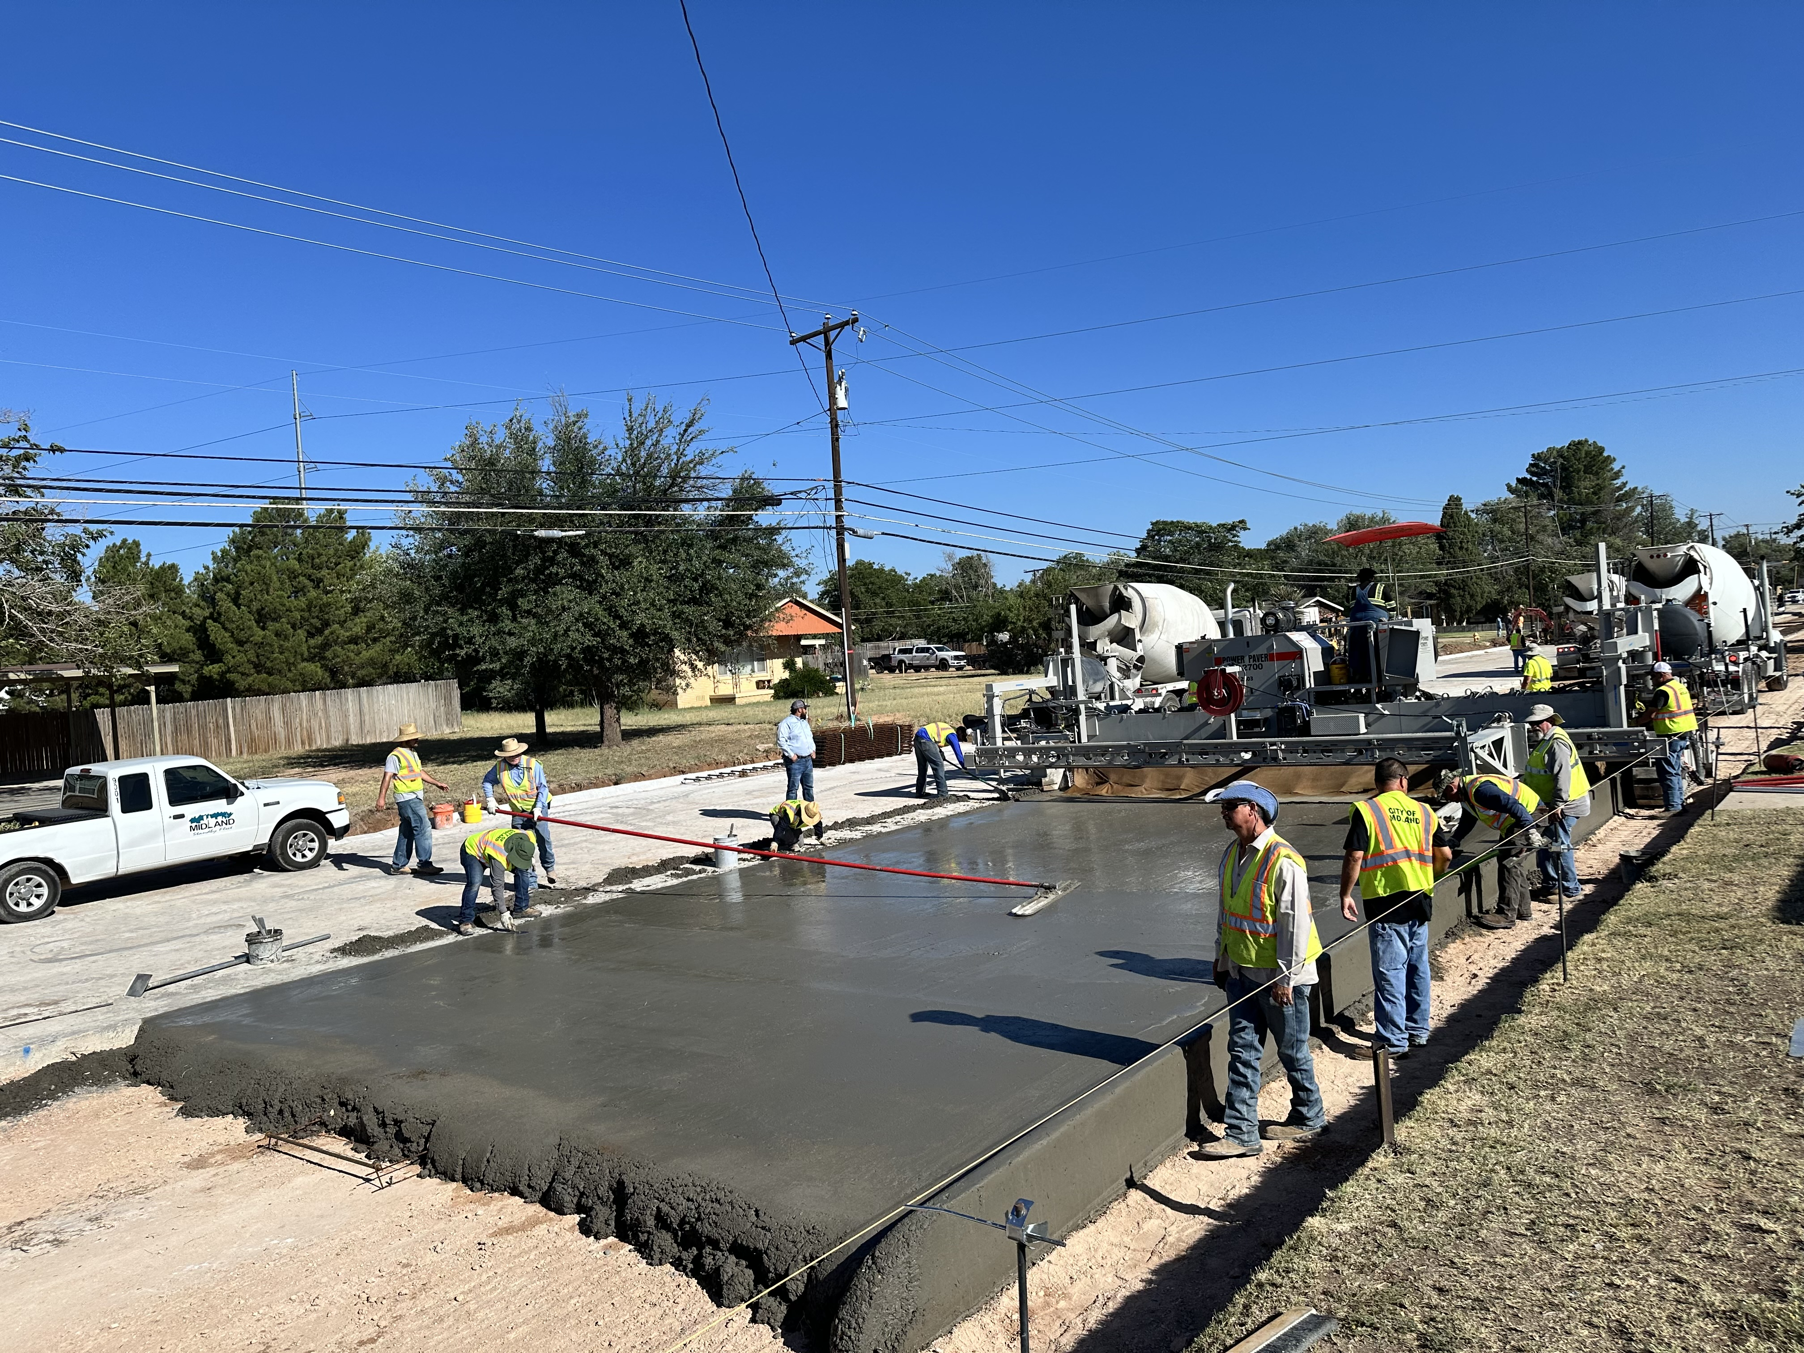
FY 2026 DELIVERABLES
Strategy: Develop and Implement Comprehensive Road Planning and Maintenance Initiatives
In-House Programs
$5 Million in savings
32
Notes:
INSTRUCTIONS FOR THESE SLIDES. CREATE AS MANY SLIDES NEEDED FOR AS MANY STRATEGIES THAT YOU WANT TO SPECIFICALLY CALL OUT.
📋 How to Create Key Deliverables for Budget Goal Team Updates
Step 1: Start with the Strategy
Look at the exact wording of the Strategic Plan strategy assigned to your team. For example:
➡️ Strategy: Enhance Communication Efficiency and Effectiveness
This is the "what"—the high-level direction or goal. Your job is to define "how" your team will help achieve it.
Step 2: Identify Actionable Deliverables
Think about the specific, tangible actions, programs, or projects your team will complete in the fiscal year to advance the strategy. These are your Key Deliverables.
Ask:
✔️ What can we implement, launch, improve, or expand?
✔️ How will this action directly support the strategy?
✔️ Can this be tracked or measured by year-end?
Examples for the strategy above:
✅ Maximize the use of reverse 9-1-1 & citizen notification systems to improve emergency communication.
✅ Expand the use of Virtual Agent via RingCX to provide 24/7 phone system access for residents.
✅ Target messaging to specific populations using tools like geo-fencing or Spanish-language content on social media.
Step 3: Keep Deliverables Focused, Measurable, and Budget-Relevant
Key Deliverables should:
✔️ Be specific—not vague or general.
✔️ Be measurable—you should know when it’s done or if it’s working.
✔️ Tie back to budget decisions—does this require funding, staffing, or technology?
✅ Quick Tips for Writing Deliverables:
Start with an action verb: Implement, Expand, Launch, Complete, Deploy.
Be clear on the outcome: What will this change, improve, or deliver?
Think one fiscal year at a time—keep deliverables achievable within the FY.
👉 If your strategy is citywide (like communication), your department’s deliverables should reflect what you specifically control or influence—while working toward the larger goal.

Slide 33
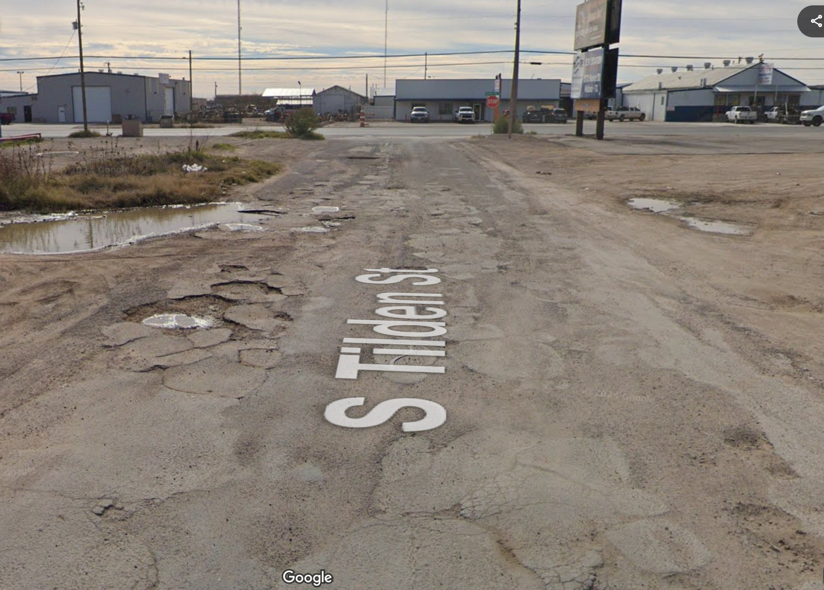
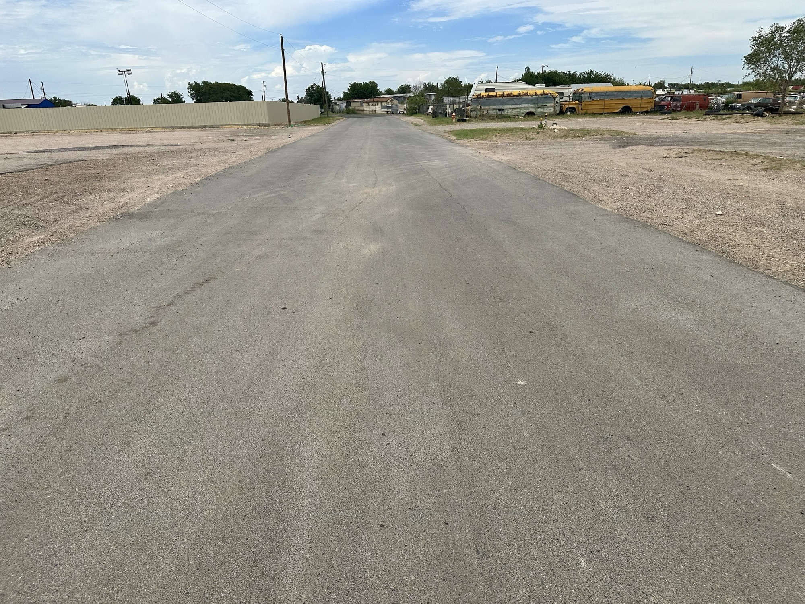
FY 2026 DELIVERABLES
In-House Mill and Inlay
Before
After
33
Notes:
INSTRUCTIONS FOR THESE SLIDES. CREATE AS MANY SLIDES NEEDED FOR AS MANY STRATEGIES THAT YOU WANT TO SPECIFICALLY CALL OUT.
📋 How to Create Key Deliverables for Budget Goal Team Updates
Step 1: Start with the Strategy
Look at the exact wording of the Strategic Plan strategy assigned to your team. For example:
➡️ Strategy: Enhance Communication Efficiency and Effectiveness
This is the "what"—the high-level direction or goal. Your job is to define "how" your team will help achieve it.
Step 2: Identify Actionable Deliverables
Think about the specific, tangible actions, programs, or projects your team will complete in the fiscal year to advance the strategy. These are your Key Deliverables.
Ask:
✔️ What can we implement, launch, improve, or expand?
✔️ How will this action directly support the strategy?
✔️ Can this be tracked or measured by year-end?
Examples for the strategy above:
✅ Maximize the use of reverse 9-1-1 & citizen notification systems to improve emergency communication.
✅ Expand the use of Virtual Agent via RingCX to provide 24/7 phone system access for residents.
✅ Target messaging to specific populations using tools like geo-fencing or Spanish-language content on social media.
Step 3: Keep Deliverables Focused, Measurable, and Budget-Relevant
Key Deliverables should:
✔️ Be specific—not vague or general.
✔️ Be measurable—you should know when it’s done or if it’s working.
✔️ Tie back to budget decisions—does this require funding, staffing, or technology?
✅ Quick Tips for Writing Deliverables:
Start with an action verb: Implement, Expand, Launch, Complete, Deploy.
Be clear on the outcome: What will this change, improve, or deliver?
Think one fiscal year at a time—keep deliverables achievable within the FY.
👉 If your strategy is citywide (like communication), your department’s deliverables should reflect what you specifically control or influence—while working toward the larger goal.

Slide 34
FY 2026 DELIVERABLES
Strategy: Traffic Operations
Install retroreflective backplates on Midland Dr and Midkiff Rd as part of Vision Zero Safety Action Plan
Install new NoTraffic detection along Andrews Hwy and FM 1788, which helps traffic flow move more efficiently
Finish construction and activate signal at Fairgrounds and Scharbauer
Design new signal at Big Spring and Solomon Ln
Install new signal at Avalon and Briarwood
Purchase new striping truck
34
Notes:
INSTRUCTIONS FOR THESE SLIDES. CREATE AS MANY SLIDES NEEDED FOR AS MANY STRATEGIES THAT YOU WANT TO SPECIFICALLY CALL OUT.
📋 How to Create Key Deliverables for Budget Goal Team Updates
Step 1: Start with the Strategy
Look at the exact wording of the Strategic Plan strategy assigned to your team. For example:
➡️ Strategy: Enhance Communication Efficiency and Effectiveness
This is the "what"—the high-level direction or goal. Your job is to define "how" your team will help achieve it.
Step 2: Identify Actionable Deliverables
Think about the specific, tangible actions, programs, or projects your team will complete in the fiscal year to advance the strategy. These are your Key Deliverables.
Ask:
✔️ What can we implement, launch, improve, or expand?
✔️ How will this action directly support the strategy?
✔️ Can this be tracked or measured by year-end?
Examples for the strategy above:
✅ Maximize the use of reverse 9-1-1 & citizen notification systems to improve emergency communication.
✅ Expand the use of Virtual Agent via RingCX to provide 24/7 phone system access for residents.
✅ Target messaging to specific populations using tools like geo-fencing or Spanish-language content on social media.
Step 3: Keep Deliverables Focused, Measurable, and Budget-Relevant
Key Deliverables should:
✔️ Be specific—not vague or general.
✔️ Be measurable—you should know when it’s done or if it’s working.
✔️ Tie back to budget decisions—does this require funding, staffing, or technology?
✅ Quick Tips for Writing Deliverables:
Start with an action verb: Implement, Expand, Launch, Complete, Deploy.
Be clear on the outcome: What will this change, improve, or deliver?
Think one fiscal year at a time—keep deliverables achievable within the FY.
👉 If your strategy is citywide (like communication), your department’s deliverables should reflect what you specifically control or influence—while working toward the larger goal.

Slide 35
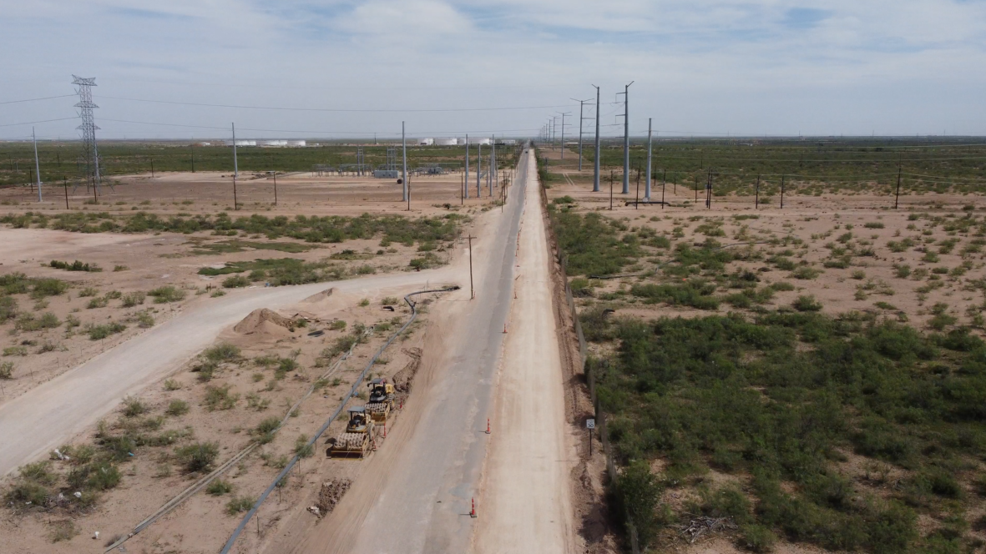
FY 2025 RESULTS
Strategic Goal 6.1: Provide Reliable and Sustainable Utilities
Litter & Large Item Collection Increased
Collected 360 tons of litter (up from 280) and 860 tons of large items (up from 662), reflecting expanded cleanup efforts citywide.
Enhanced Recycling Efforts
Collected 800 tons of recyclables at the Citizens’ Convenience Center, supporting environmental sustainability.
Strategic Goal 6.4: Standardize Infrastructure Processes
Container Replacement & Illegal Dump Cleanup
Replaced 1,900+ dilapidated containers and cleaned up 50+ major illegal dumpsites, improving service reliability and community appearance.
Landfill Operations
Annually process 350,000 tons of waste, averaging 1,100 tons/day at the landfill
35
Notes:
LIST YOUR DEPARTMENTS CAUSES FOR INCREASES (IF APPLICABLE) HERE. GIVE REASON TO WHY THINGS ARE INCREASING. LIST FOR ALL DEPARTMENTS APPLICABLE. USE AS MANY SLIDES AS NEEDED FOR ALL DEPARTMENTS.

Slide 36
FY 2026 DELIVERABLES
Strategy: Solid Waste
Citizen's Convenience Center
Complete the large CCC at 6400 W. Hwy 80, anticipated completion in mid FY 2026
Constructing a small CCC at 1924 E Cuthbert Ave utilizing cross-functional cooperation with departments within the City
Landfill Entrance Road
Complete the new Landfill entrance road, first quarter of FY 2026
Motive Fleet Safety Solution
Completed a demo with Motive for dash and exterior cameras
Finding innovative ways to enhance safety initiatives through AI
Referred Motive to IT for City-wide initiative and savings
36
Notes:
INSTRUCTIONS FOR THESE SLIDES. CREATE AS MANY SLIDES NEEDED FOR AS MANY STRATEGIES THAT YOU WANT TO SPECIFICALLY CALL OUT.
📋 How to Create Key Deliverables for Budget Goal Team Updates
Step 1: Start with the Strategy
Look at the exact wording of the Strategic Plan strategy assigned to your team. For example:
➡️ Strategy: Enhance Communication Efficiency and Effectiveness
This is the "what"—the high-level direction or goal. Your job is to define "how" your team will help achieve it.
Step 2: Identify Actionable Deliverables
Think about the specific, tangible actions, programs, or projects your team will complete in the fiscal year to advance the strategy. These are your Key Deliverables.
Ask:
✔️ What can we implement, launch, improve, or expand?
✔️ How will this action directly support the strategy?
✔️ Can this be tracked or measured by year-end?
Examples for the strategy above:
✅ Maximize the use of reverse 9-1-1 & citizen notification systems to improve emergency communication.
✅ Expand the use of Virtual Agent via RingCX to provide 24/7 phone system access for residents.
✅ Target messaging to specific populations using tools like geo-fencing or Spanish-language content on social media.
Step 3: Keep Deliverables Focused, Measurable, and Budget-Relevant
Key Deliverables should:
✔️ Be specific—not vague or general.
✔️ Be measurable—you should know when it’s done or if it’s working.
✔️ Tie back to budget decisions—does this require funding, staffing, or technology?
✅ Quick Tips for Writing Deliverables:
Start with an action verb: Implement, Expand, Launch, Complete, Deploy.
Be clear on the outcome: What will this change, improve, or deliver?
Think one fiscal year at a time—keep deliverables achievable within the FY.
👉 If your strategy is citywide (like communication), your department’s deliverables should reflect what you specifically control or influence—while working toward the larger goal.

Slide 37

MISSION
Deliver exceptional services and promote a high quality of life and place for ALL our citizens.

