Slide 1

GOAL TWO
SAFE AND SECURE CITY
FY 2026 BUDGET PRESENTATION
AUGUST 2025
TITLE HERE
TITLE HERE
Notes:
PUT YOUR GOAL NUMBER AND WRITE OUT YOUR GOAL NAME. NOTHING ELES SHOULD CHANGE!

Slide 2

TABLE OF CONTENTS
Vision Block Connections & Strategic Alignment
Priorities Focus
Budget Highlights
FY 2025 Results
FY 2026 Deliverables
2
Notes:
DO NOT CHANGE TABLE OF CONTENTS, YOUR PRESENTATION SHOULD FOLLOW THIS TEMPLATE (FOR EVERY GOAL!)

Slide 3

VISION BLOCK CONNECTIONS
“The City of Midland will be the Premier and Safest City in West Texas by Providing World Class Municipal Services through Operational Excellence and a Culture of Innovation”
Safe City (Goal 2)
Provide Sound Governance & Fiscal Management (Goal 5)
3
Notes:
ADD YOUR VISION BLOCK CONNECTIONS HERE. IT WILL NOT BE THE SAME AS GOAL 4!

Slide 4

STRATEGIC ALIGNMENT
2. Set the Standard for a Safe and Secure City
Strategies:
2.1 Be the safest city in West Texas: Enhance public safety programs.
2.2 Improve pedestrian and motorist safety: Invest in traffic management and infrastructure.
2.3 Implement effective code enforcement strategies: Address nuisances to improve overall health and safety.
2.4 Revitalize neighborhoods: Utilize best practices to support the redevelopment of neighborhoods.
2.5 Enhance animal services: Ensure the welfare of pets and wildlife in the city.
2.6 Grow and retain public safety resources: Expand law enforcement presence and fire reduction & prevention programs while reducing attrition.
4
Notes:
LIST OUT YOUR STRATEGIC SUB GOALS HERE

Slide 5

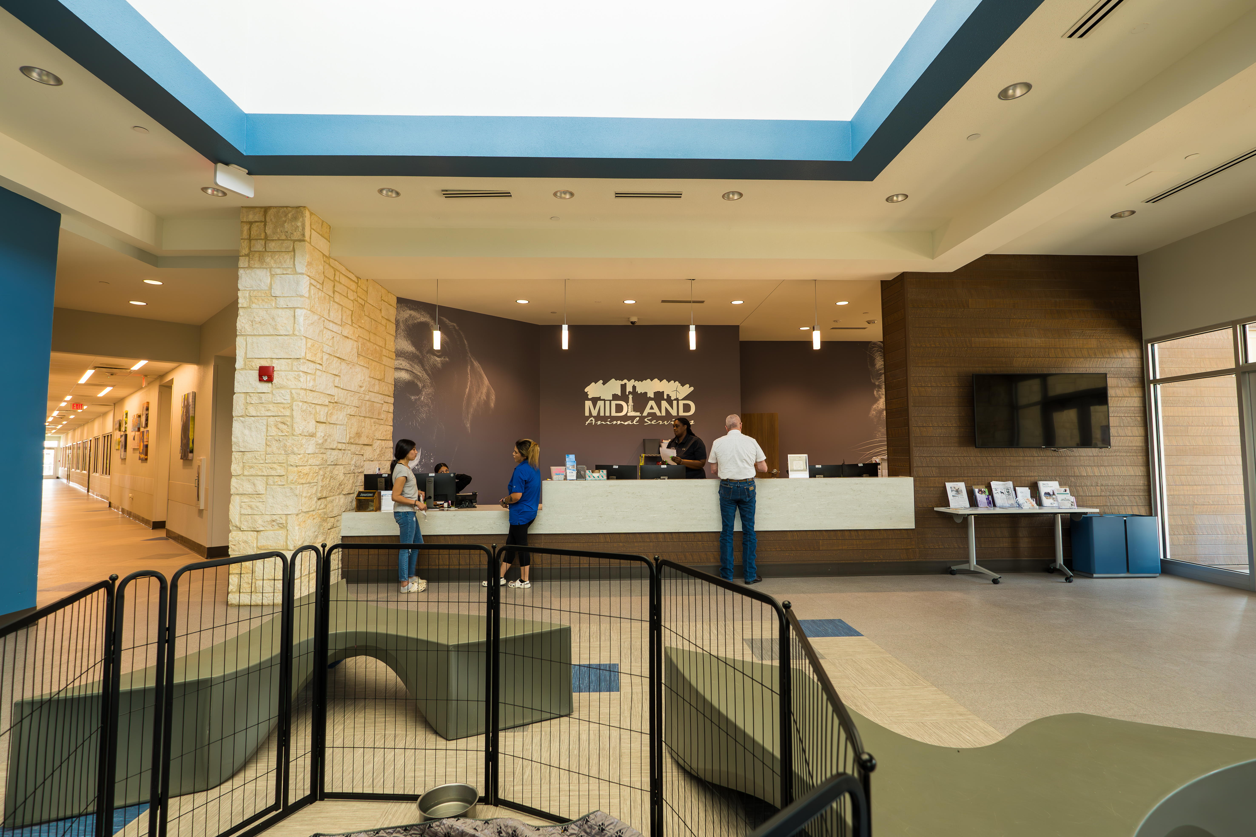
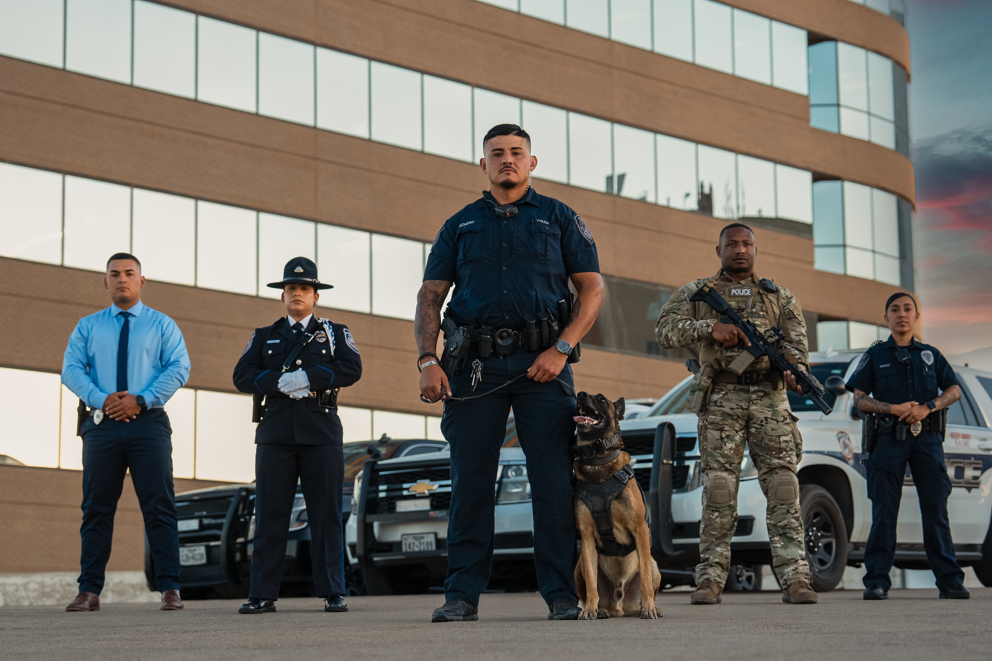
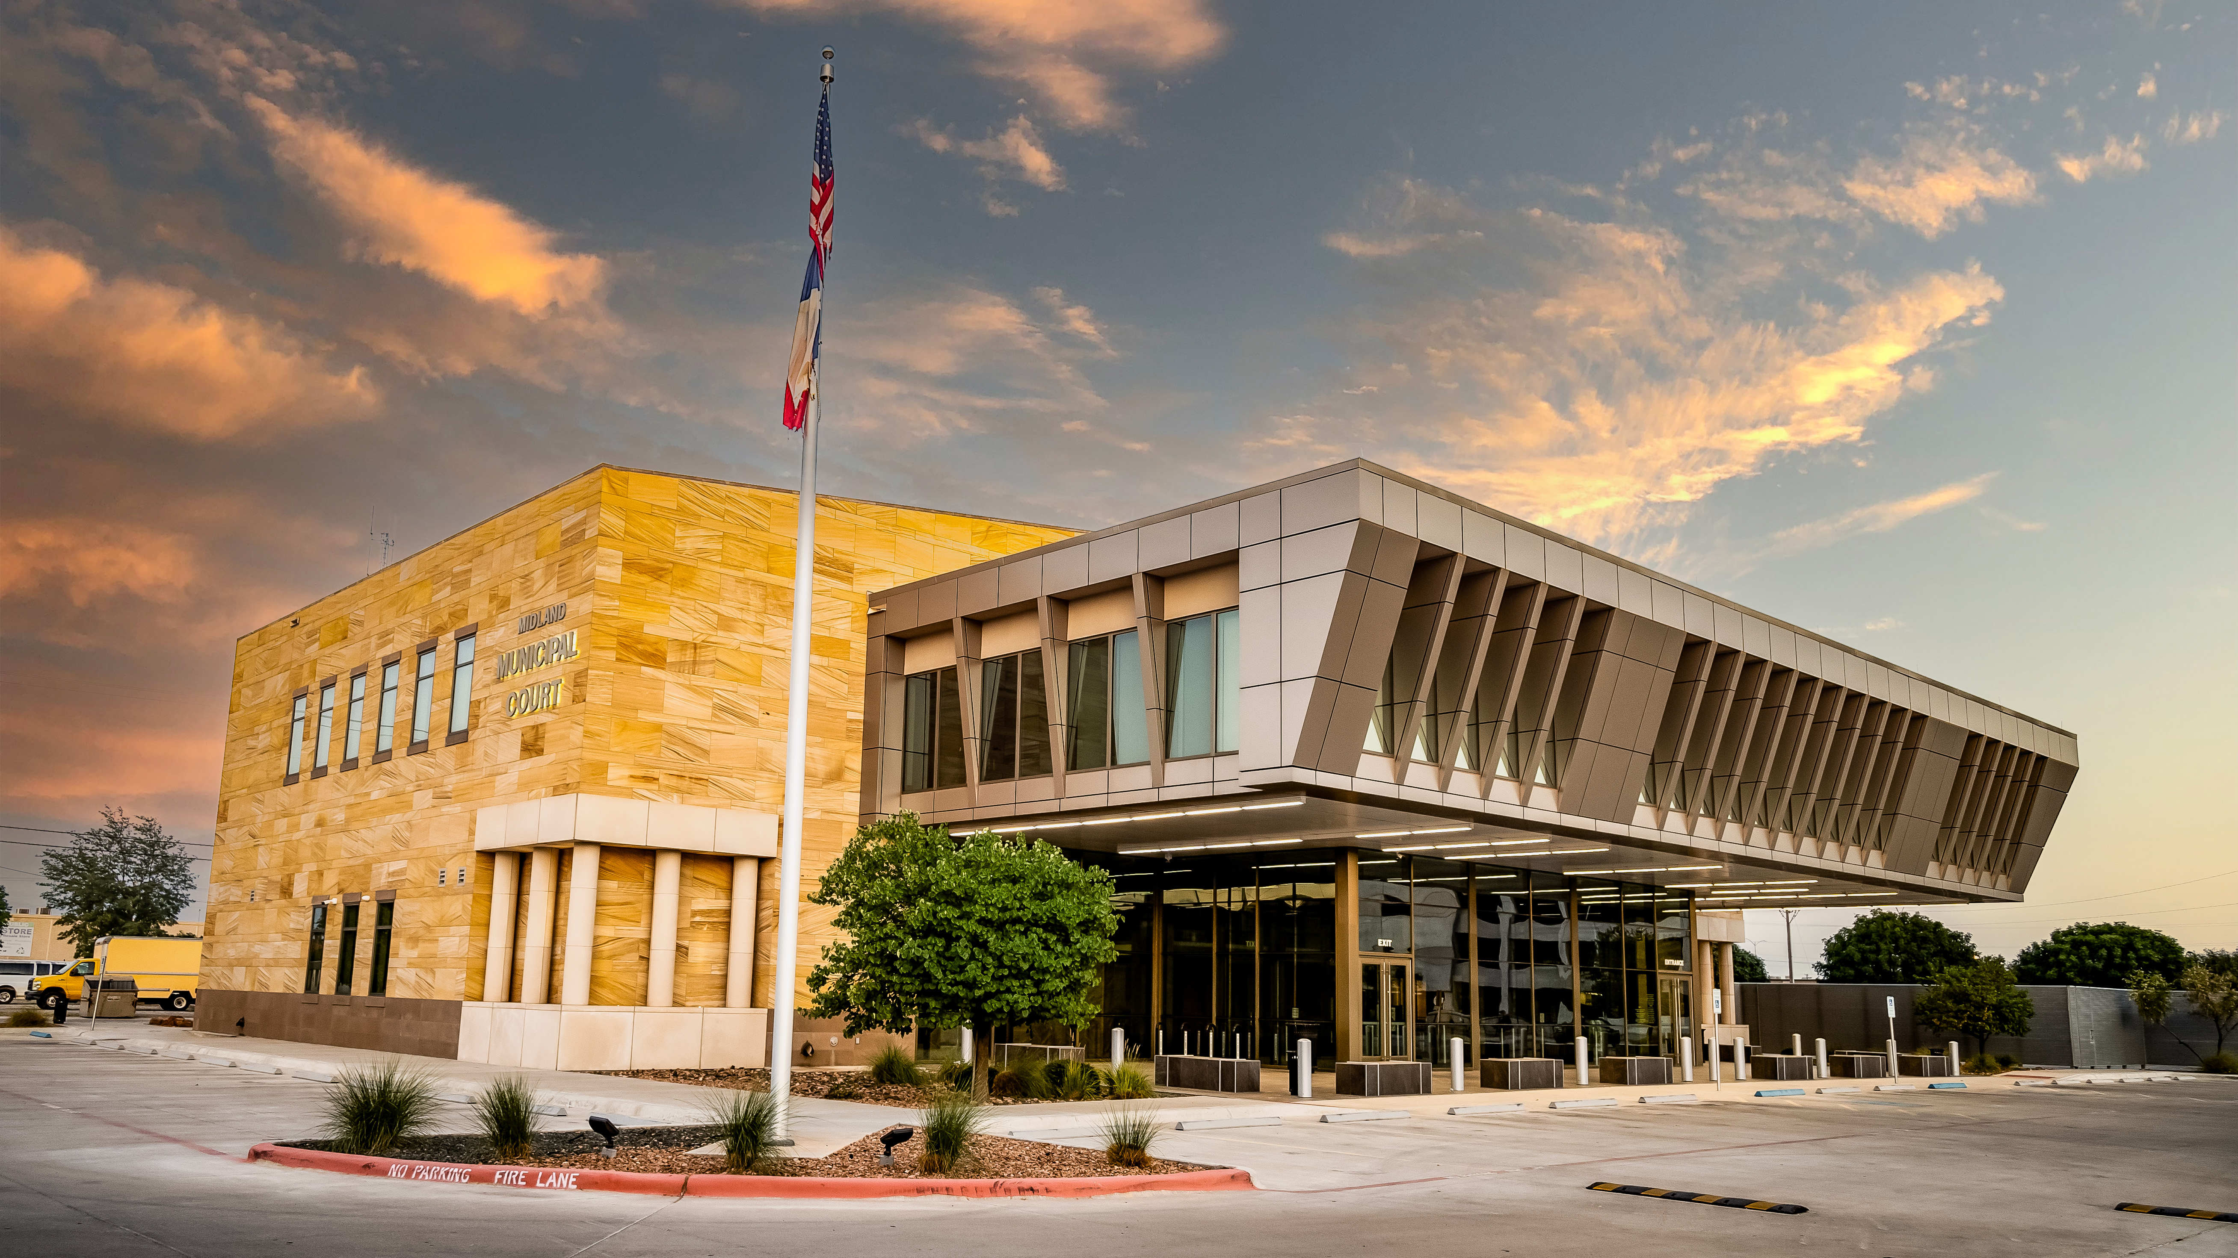
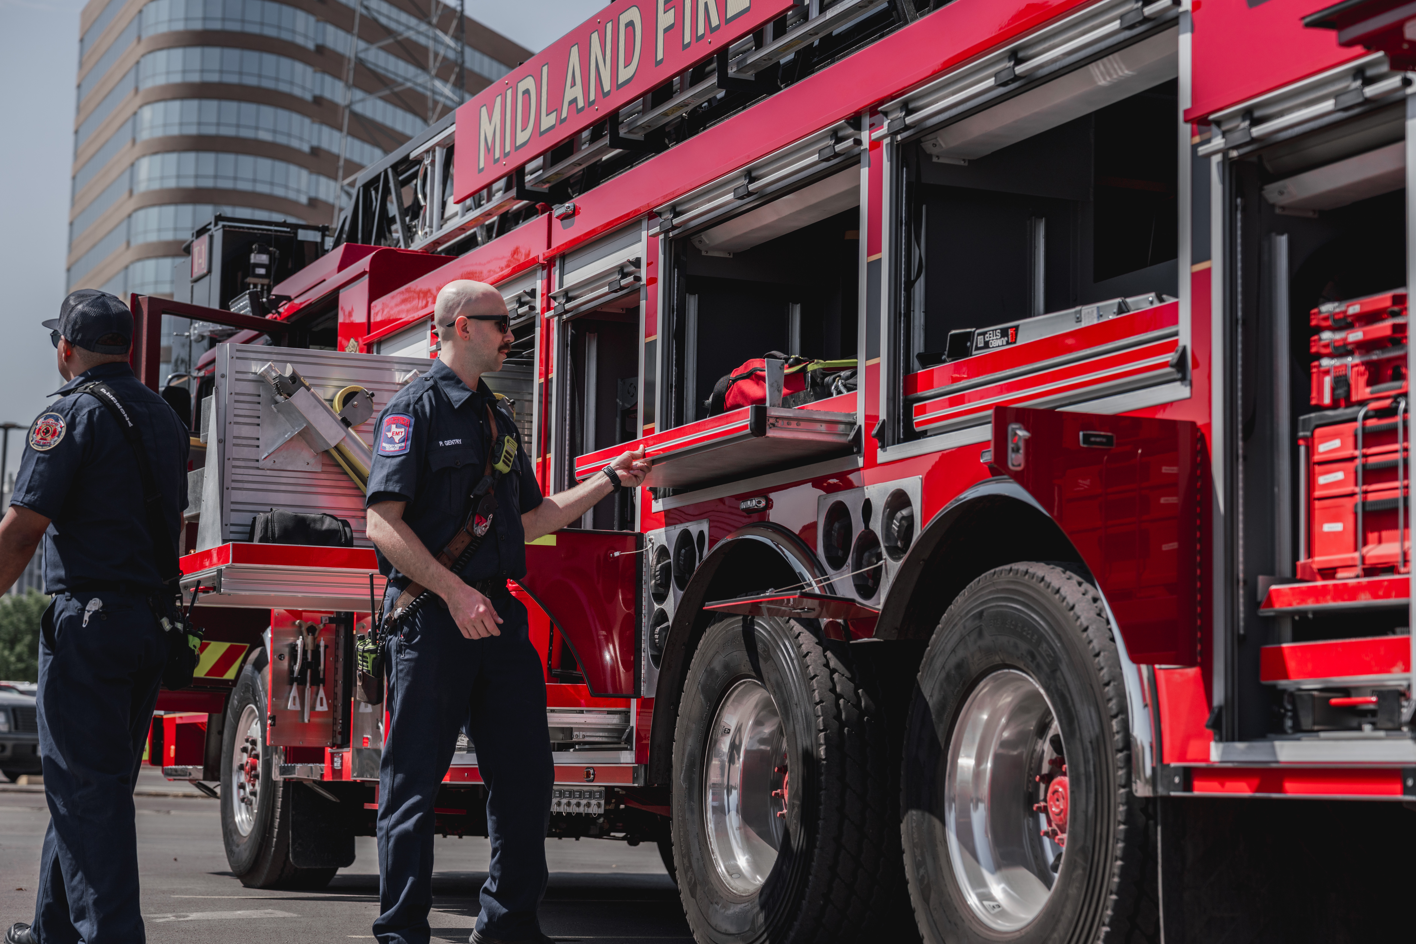
DEPARTMENTS
Organizational Alignment
Police Department
Fire Department
Animal Services
Health Department
Municipal Court
Code Enforcement
5
Notes:
LIST YOUR DEPARTMENTS THAT ARE INCLUDED IN YOUR GOAL HERE

Slide 6

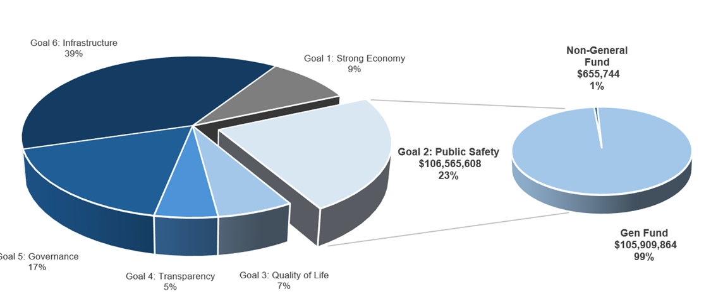
SAFE AND SECURE CITY
FY 2026 ALL FUNDS BUDGET: $460,859,620
Notes:
CALL OUT YOUR SPECIFIC GOAL BUDGET HERE WITH PIE GRAPH BREAKDOWN (PROVIDED BY FINANCE)

Slide 7

GOAL TWO: SAFE AND SECURE CITY
Police Department
FY 2026 Priorities
Strategies:
  Enhance Public Safety Programs to Reduce Crime
    Citizens on Patrol
    Crime Stoppers
  Strengthen Ties Within the Community Through Collaboration and Community Outreach
    Jingle Bell Run
    Coffee with a Cop
7
Notes:
THIS IS THE PRIORITIES SLIDE. LIST YOUR DEPARTMENTS FY2026 PRIORITIES. THESE ARE THINGS THAT YOU SHOULD BE WORKING TOWARDS BASED ON THE STRATEGIC PLAN. USE AS MANY SLIDES AS YOU NEED FOR YOUR DEPARTMENT(S)

Slide 8

GOAL TWO: SAFE AND SECURE CITY
Police Department
FY 2026 Priorities
Strategies:
  Enhance Road Safety Through Targeted Enforcement Campaigns
    Safe Passage Initiative
    School Zone Enforcement
  Strengthen Bonds With Other Agencies Through Collaboration and Joint Operations
    Continued joint operations on IMBs
    Participation in the Midland County TAG
7
Notes:
THIS IS THE PRIORITIES SLIDE. LIST YOUR DEPARTMENTS FY2026 PRIORITIES. THESE ARE THINGS THAT YOU SHOULD BE WORKING TOWARDS BASED ON THE STRATEGIC PLAN. USE AS MANY SLIDES AS YOU NEED FOR YOUR DEPARTMENT(S)

Slide 9
GOAL TWO: SAFE AND SECURE CITY
Fire Department
FY 2026 Priorities
Strategies:
  Maintain ISO Class 1 Excellence
    ISO 1 status saves Midland residents and businesses millions every year
    Training, response model review, hydrant inspection.
Modernize and Sustain Emergency Medical Service
  Implement EMS/MC billing model
  Evaluate need for a 9th frontline EMS unit
8
Notes:
Thanks to our ISO 1 rating, the average homeowner in Midland saves at least $200–$400 per year on their insurance premium, while businesses see even greater reductions. Altogether, this translates to over $20 million in annual insurance savings citywide—real dollars that stay in the pockets of Midland families and help local businesses thrive.
Breakdown:
With the average homeowners insurance premium in Texas around $2,400–$2,500 per year, an ISO 1 rating typically reduces costs by 8–15%. For a Midland home valued at $300,000, this means a savings of approximately $200–$375 per year on insurance premiums.
With the new fee structure and a dedicated EMS billing company, we conservatively project annual revenue gains between $1.5 million and $3 million

Slide 10
GOAL TWO: SAFE AND SECURE CITY
Fire Department
FY 2026 Priorities
Strategies – continued
  Develop and Retain Future Leaders
    Launch Fire Officer Development Program
  Enhance Environmental and Firefighter Safety
    Continue PFAS-free foam conversion discussions and funding efforts
  Strengthen Interagency Partnerships
    Expand coordination with local, state, and federal partners
9

Slide 11

GOAL TWO: SAFE AND SECURE CITY
Animal Services
FY 2026 Priorities
Strategies
Reduce Length of Stay by One Day
  Shorter shelter stays lower stress for animals, improve health outcomes, and help more pets find homes faster.
  Streamline adoption processes, enhance marketing of available animals, and expedite medical and behavioral evaluations to move pets quickly into loving homes.
Enhance Volunteer Program
  Boosts capacity and Community Support
  Improve training, roles, and recruitment
11
Notes:
THIS IS THE PRIORITIES SLIDE. LIST YOUR DEPARTMENTS FY2026 PRIORITIES. THESE ARE THINGS THAT YOU SHOULD BE WORKING TOWARDS BASED ON THE STRATEGIC PLAN.

Slide 12

GOAL TWO: SAFE AND SECURE CITY
Health Department
FY 2026 Priorities
Strategies
Modernize Services to Better Protect and Serve Community Health
  Enhance Technology and Digital Services:
    Environmental: Access vital services faster and easier for residents and business:
      Support local business by competing restaurant inspections and permits in less than 7 days.
    Health: Improve online registrations, record/report requests, and bill payments.
  Develop a Community Health Improvement Plan
    Use data to focus resources on top health priorities.
12
Notes:
THIS IS THE PRIORITIES SLIDE. LIST YOUR DEPARTMENTS FY2026 PRIORITIES. THESE ARE THINGS THAT YOU SHOULD BE WORKING TOWARDS BASED ON THE STRATEGIC PLAN.

Slide 13
GOAL TWO: SAFE AND SECURE CITY
Health Department
FY 2026 Priorities
Strategies - continued
Evaluate Facility and Space Needs
  Assess current and future space to support growth and enhance service delivery.
Expand and Improve Community Outreach
  Increase engagement through more vaccination clinics, health fairs, and education events.
13
Notes:
THIS IS THE PRIORITIES SLIDE. LIST YOUR DEPARTMENTS FY2026 PRIORITIES. THESE ARE THINGS THAT YOU SHOULD BE WORKING TOWARDS BASED ON THE STRATEGIC PLAN.

Slide 14
GOAL TWO: SAFE AND SECURE CITY
Code Enforcement
FY 2026 Priorities
Addressing Substandard Buildings
SeeClickFix Response and Resolution
Property Maintenance along Most Visible Streets
Public Safety Projects (Illicit Massage Businesses)
Focus on: Responsiveness, Efficiency, Effectiveness
14
Notes:
Responsiveness (volume, SCF closure rate, average response time to new violations)​
Efficiency (closure rate, average time to close, percent closed within 30 days)​
Effectiveness (voluntary compliance rate, repeat violation rate, abatement cost recovery rate)​

Slide 15
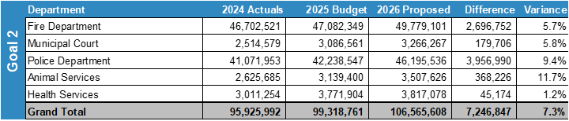
MAJOR VARIANCES
Police
Most sworn officers will receive step increase this year, adding approximately 5% to salaries.
COLA of 2% budgeted for all
Funded half of police scanner for $100,000
Budgeted 250K for bulletproof vest replacement
15
Notes:
LIST YOUR DEPARTMENTS CAUSES FOR INCREASES (IF APPLICABLE) HERE. GIVE REASON TO WHY THINGS ARE INCREASING.

Slide 16
MAJOR VARIANCES
Fire
Adjusting Fire Department pay scale
$500k increase for the Fire Retirement Fund 22% to 24%
16
Notes:
LIST YOUR DEPARTMENTS CAUSES FOR INCREASES (IF APPLICABLE) HERE. GIVE REASON TO WHY THINGS ARE INCREASING.

Slide 17
MAJOR VARIANCES
Animal Services
Primary increases are salary and benefits.
  2024 - 25 FTE and 12 vacancies
  2025 – 27 FTE and 6 vacancies budgeted at 50%
  2026 – 27 FTE and 3 vacancies budgeted at 50%
Increases in Technology Charges and Hire of Equipment
17
Notes:
LIST YOUR DEPARTMENTS CAUSES FOR INCREASES (IF APPLICABLE) HERE. GIVE REASON TO WHY THINGS ARE INCREASING.

Slide 18
MAJOR VARIANCES
Health
2024 - 28 FTE
2025 - 31 FTE
2026 – 31 FTE
Increases in Technology Charges and Hire of Equipment
18
Notes:
LIST YOUR DEPARTMENTS CAUSES FOR INCREASES (IF APPLICABLE) HERE. GIVE REASON TO WHY THINGS ARE INCREASING.

Slide 19
MAJOR VARIANCES
Municipal Court
Increase overtime by $38,000
Personnel and benefit costs increases
19
Notes:
LIST YOUR DEPARTMENTS CAUSES FOR INCREASES (IF APPLICABLE) HERE. GIVE REASON TO WHY THINGS ARE INCREASING.

Slide 20
EXPENSES BY DEPARTMENT
Notes:
PLEASE INCLUDE YOUR TABLE FOR EXPENSES BY DEPARMENT FOR EACH OF THE DEPARTMENTS INCLUDED IN YOUR GOAL

Slide 21
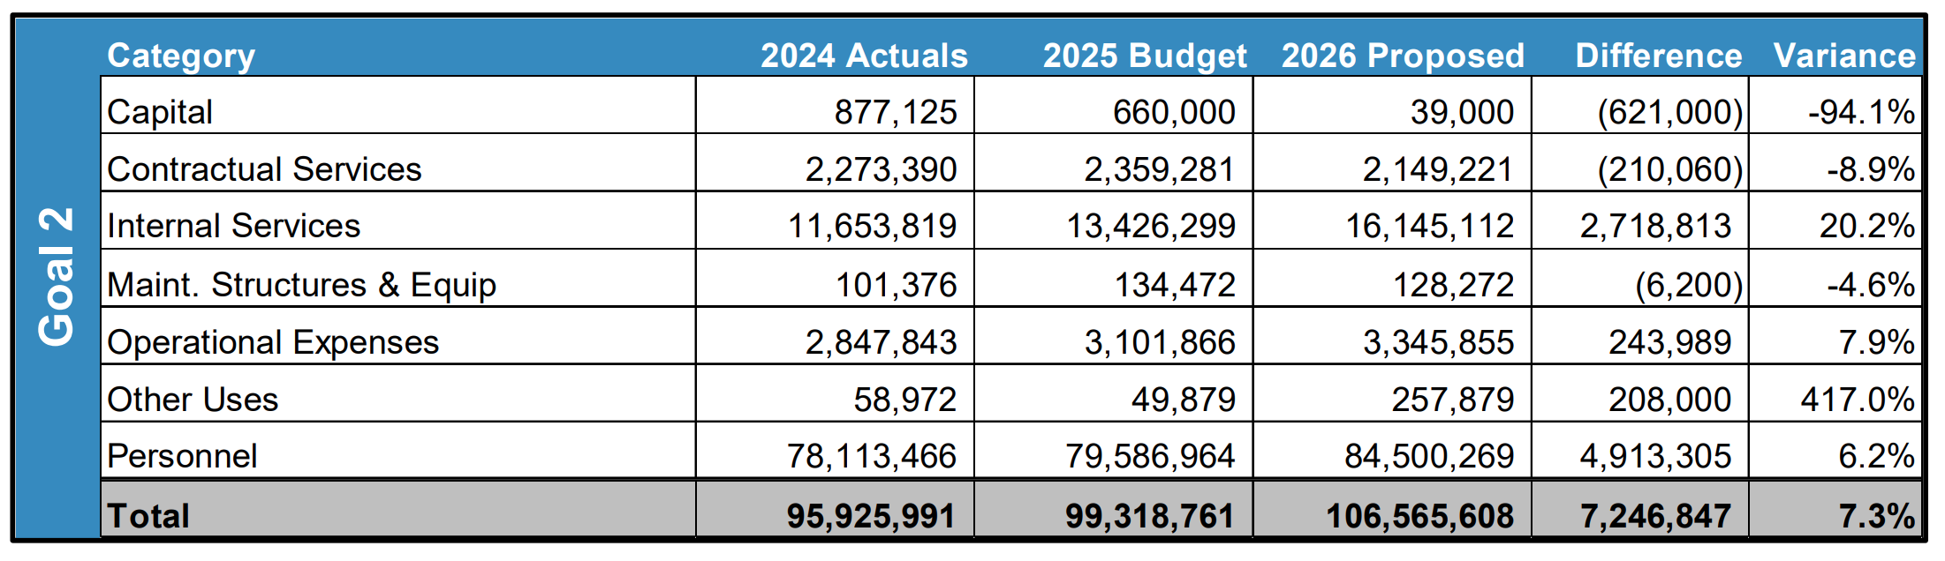
EXPENSES BY TYPE
Police: Internal Services (which includes garage and fleet) is higher in FY26 due to more regular delivery of vehicles, including patrol units. Over the last 5 years, production times have been excessively long due to COVID backlogs.
Notes:
PLEASE INCLUDE TABLE THAT IS EXPENSES BY TYPE THAT WILL BE PROVDIED BY FINANCE FOR YOUR GOAL.

Slide 22
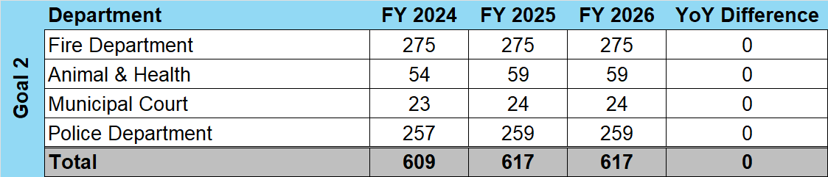
STAFFING
Notes:
THIS IS THE TABLE THAT WILL BE PROVIDED BY FINANCE THAT WILL SHOW YOUR VARIANCES IN STAFFING LEVELS FOR EACH DEPARTMENT IN YOUR GOAL. PLEASE INCLUDE HIGHLGHTS FOR VARIANCES AS SHOWN AS AN EXAMPLE ABOVE.

Slide 23
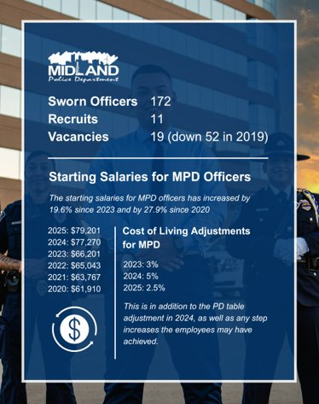
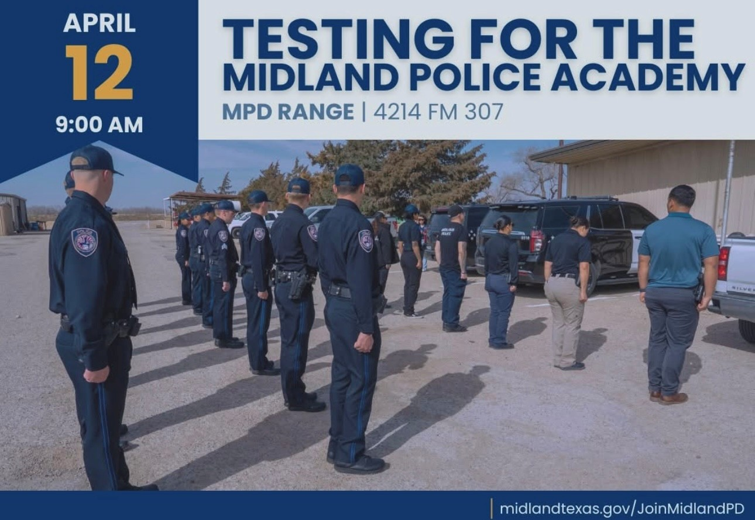
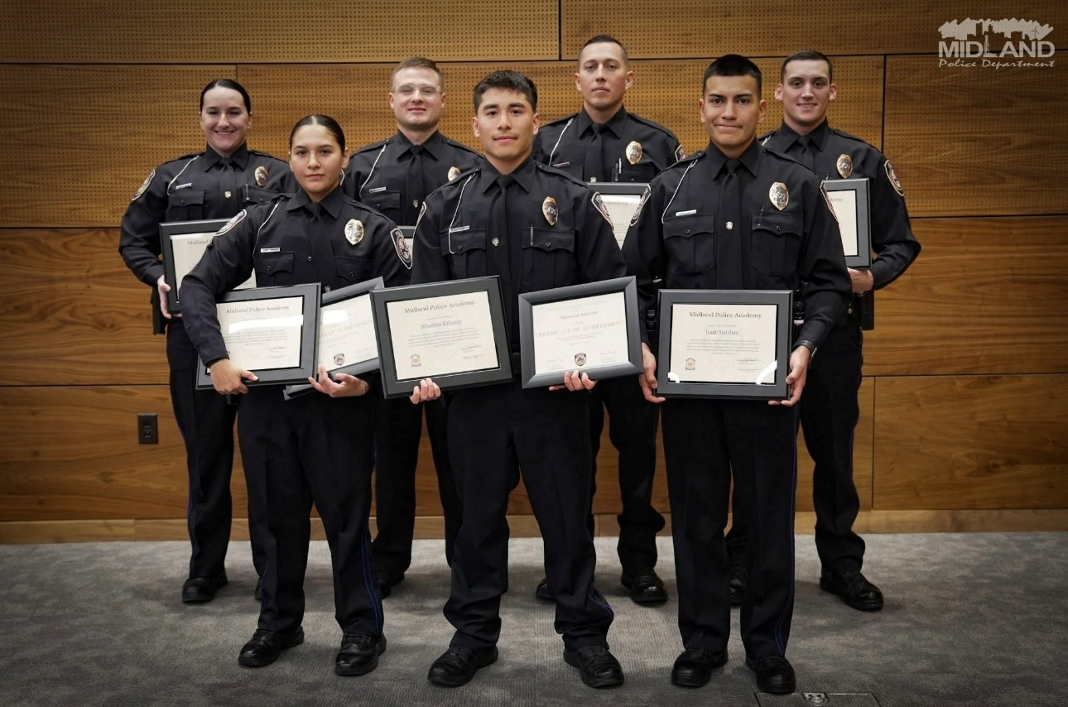
FY 2025 RESULTS
Midland Police Department FY2025
Grow and Retain Public Safety Resources
198 Sworn, permission to over hire to 203.
176 Sworn (including Recruits and Laterals). Lowest number of vacancies since 2018
MPD Academy 06 August 12, 2024-January 22, 2025: 7 Recruits passed.
MPD Academy 07 March 3, 2025-August 14, 2025: 10 Recruits attending.
MPD Academy 08 projected to begin January 2026.
23
Notes:
LIST OUT KEY ACCOMPLISHMENTS MADE IN FY2025. THESE SHOULD CLOSELY REFLECT THE PRIORITIES SET IN LAST YEARS PRESENTATION. ALSO INCLUDE ANY BIG HIGHLIGHTS OR WINS THAT WERE NOT CALLED OUT IN PREVIOUS PRESENTATIONS. CAN INCLUDE METRICS, GRAPHICS, ETC. BUT STILL KEEP THESE AT A HIGH LEVEL. ONLY THE MOST IMPACTFUL ACCOMPLISHMENTS SHOULD BE LISTED! USE AS MANY SLIDES AS YOU NEED, BUT DON'T GO OVER BOARD!
EACH DEPARTMENT WILL NEED A KEY ACCOMPLISHMENTS SLIDE(S).

Slide 24
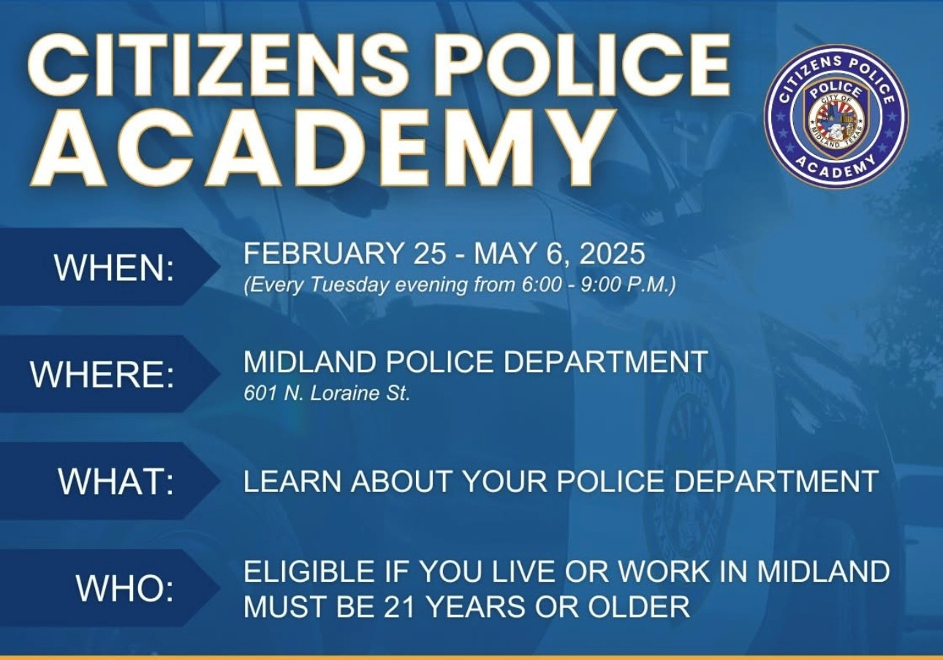
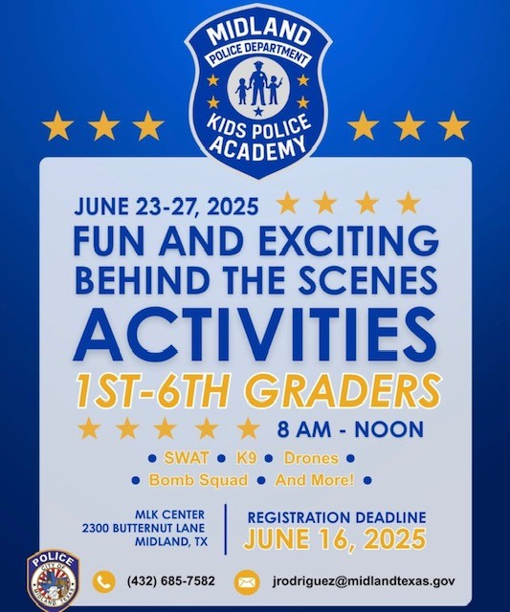
FY 2025 RESULTS
Midland Police Department FY2025
Strengthening Ties with the Community
National Night Out-October 1, 2024: MPD and MFD attended 38 different business and block parties!
President Trump Visit-October 2, 2024: MPD worked in concert with U.S. Secret Service, Texas DPS, MCSO, and OPD to ensure a professional and safe event.
MPD Community Relations re-established the Citizen’s Police Academy. This ten-week program had 6 graduates.
MPD conducted the 2nd Annual Kid’s Police Academy. Available to 1st to 6th graders. Filled up the day registration opened! All 42 kids had an educational and fun time!
24
Notes:
LIST OUT KEY ACCOMPLISHMENTS MADE IN FY2025. THESE SHOULD CLOSELY REFLECT THE PRIORITIES SET IN LAST YEARS PRESENTATION. ALSO INCLUDE ANY BIG HIGHLIGHTS OR WINS THAT WERE NOT CALLED OUT IN PREVIOUS PRESENTATIONS. CAN INCLUDE METRICS, GRAPHICS, ETC. BUT STILL KEEP THESE AT A HIGH LEVEL. ONLY THE MOST IMPACTFUL ACCOMPLISHMENTS SHOULD BE LISTED! USE AS MANY SLIDES AS YOU NEED, BUT DON'T GO OVER BOARD!
EACH DEPARTMENT WILL NEED A KEY ACCOMPLISHMENTS SLIDE(S).

Slide 25


FY 2025 RESULTS
Midland Police Department
Be the Safest City in West Texas
Strengthen Bonds With Other Agencies Through Collaboration and Joint Operations.
The Midland Police Department worked in conjunction with the DEA and the HIDTA Task Force on a two-year investigation that yielded the seizure of 70 kilograms of Cocaine, 216 grams of THC, 67 gallons of liquid methamphetamines, and 18 arrests.
25
Notes:
INSTRUCTIONS FOR THESE SLIDES. CREATE AS MANY SLIDES NEEDED FOR AS MANY STRATEGIES THAT YOU WANT TO SPECIFICALLY CALL OUT.
📋 How to Create Key Deliverables for Budget Goal Team Updates
Step 1: Start with the Strategy
Look at the exact wording of the Strategic Plan strategy assigned to your team. For example:
➡️ Strategy: Enhance Communication Efficiency and Effectiveness
This is the "what"—the high-level direction or goal. Your job is to define "how" your team will help achieve it.
Step 2: Identify Actionable Deliverables
Think about the specific, tangible actions, programs, or projects your team will complete in the fiscal year to advance the strategy. These are your Key Deliverables.
Ask:
✔️ What can we implement, launch, improve, or expand?
✔️ How will this action directly support the strategy?
✔️ Can this be tracked or measured by year-end?
Examples for the strategy above:
✅ Maximize the use of reverse 9-1-1 & citizen notification systems to improve emergency communication.
✅ Expand the use of Virtual Agent via RingCX to provide 24/7 phone system access for residents.
✅ Target messaging to specific populations using tools like geo-fencing or Spanish-language content on social media.
Step 3: Keep Deliverables Focused, Measurable, and Budget-Relevant
Key Deliverables should:
✔️ Be specific—not vague or general.
✔️ Be measurable—you should know when it’s done or if it’s working.
✔️ Tie back to budget decisions—does this require funding, staffing, or technology?
✅ Quick Tips for Writing Deliverables:
Start with an action verb: Implement, Expand, Launch, Complete, Deploy.
Be clear on the outcome: What will this change, improve, or deliver?
Think one fiscal year at a time—keep deliverables achievable within the FY.
👉 If your strategy is citywide (like communication), your department’s deliverables should reflect what you specifically control or influence—while working toward the larger goal.

Slide 26

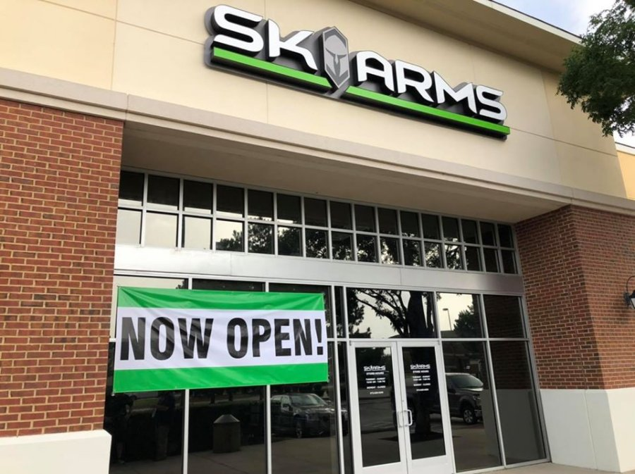
FY 2025 RESULTS
Midland Police Department
Be the Safest City in West Texas
Strengthen Bonds With Other Agencies Through Collaboration and Joint Operations.
October-November 2024: SK Arms was burglarized twice. Approximately 37 guns were stolen. The Midland Police Department worked tirelessly in partnership with the ATF, Texas Rangers, and the Odessa Police Department. By the end of the investigation about 29 of the guns were recovered valued at about $120K, a stolen vehicle was recovered, and multiple arrests were made.
26
Notes:
INSTRUCTIONS FOR THESE SLIDES. CREATE AS MANY SLIDES NEEDED FOR AS MANY STRATEGIES THAT YOU WANT TO SPECIFICALLY CALL OUT.
📋 How to Create Key Deliverables for Budget Goal Team Updates
Step 1: Start with the Strategy
Look at the exact wording of the Strategic Plan strategy assigned to your team. For example:
➡️ Strategy: Enhance Communication Efficiency and Effectiveness
This is the "what"—the high-level direction or goal. Your job is to define "how" your team will help achieve it.
Step 2: Identify Actionable Deliverables
Think about the specific, tangible actions, programs, or projects your team will complete in the fiscal year to advance the strategy. These are your Key Deliverables.
Ask:
✔️ What can we implement, launch, improve, or expand?
✔️ How will this action directly support the strategy?
✔️ Can this be tracked or measured by year-end?
Examples for the strategy above:
✅ Maximize the use of reverse 9-1-1 & citizen notification systems to improve emergency communication.
✅ Expand the use of Virtual Agent via RingCX to provide 24/7 phone system access for residents.
✅ Target messaging to specific populations using tools like geo-fencing or Spanish-language content on social media.
Step 3: Keep Deliverables Focused, Measurable, and Budget-Relevant
Key Deliverables should:
✔️ Be specific—not vague or general.
✔️ Be measurable—you should know when it’s done or if it’s working.
✔️ Tie back to budget decisions—does this require funding, staffing, or technology?
✅ Quick Tips for Writing Deliverables:
Start with an action verb: Implement, Expand, Launch, Complete, Deploy.
Be clear on the outcome: What will this change, improve, or deliver?
Think one fiscal year at a time—keep deliverables achievable within the FY.
👉 If your strategy is citywide (like communication), your department’s deliverables should reflect what you specifically control or influence—while working toward the larger goal.

Slide 27


FY 2025 RESULTS
Midland Police Department
Be the Safest City in West Texas
Strengthen Bonds With Other Agencies Through Collaboration and Joint Operations.
Illicit Massage Businesses (IMB)
The Midland Police Department has formed relationships with several stakeholders including Code Enforcement, the Office of the Attorney General of Texas, the Texas Department of Public Safety, the Texas Department of Licensing and Regulation (TDLR), and Homeland Security.
Multiple successful joint operations have led to many arrests. Enforcement efforts will continue.
27
Notes:
INSTRUCTIONS FOR THESE SLIDES. CREATE AS MANY SLIDES NEEDED FOR AS MANY STRATEGIES THAT YOU WANT TO SPECIFICALLY CALL OUT.
📋 How to Create Key Deliverables for Budget Goal Team Updates
Step 1: Start with the Strategy
Look at the exact wording of the Strategic Plan strategy assigned to your team. For example:
➡️ Strategy: Enhance Communication Efficiency and Effectiveness
This is the "what"—the high-level direction or goal. Your job is to define "how" your team will help achieve it.
Step 2: Identify Actionable Deliverables
Think about the specific, tangible actions, programs, or projects your team will complete in the fiscal year to advance the strategy. These are your Key Deliverables.
Ask:
✔️ What can we implement, launch, improve, or expand?
✔️ How will this action directly support the strategy?
✔️ Can this be tracked or measured by year-end?
Examples for the strategy above:
✅ Maximize the use of reverse 9-1-1 & citizen notification systems to improve emergency communication.
✅ Expand the use of Virtual Agent via RingCX to provide 24/7 phone system access for residents.
✅ Target messaging to specific populations using tools like geo-fencing or Spanish-language content on social media.
Step 3: Keep Deliverables Focused, Measurable, and Budget-Relevant
Key Deliverables should:
✔️ Be specific—not vague or general.
✔️ Be measurable—you should know when it’s done or if it’s working.
✔️ Tie back to budget decisions—does this require funding, staffing, or technology?
✅ Quick Tips for Writing Deliverables:
Start with an action verb: Implement, Expand, Launch, Complete, Deploy.
Be clear on the outcome: What will this change, improve, or deliver?
Think one fiscal year at a time—keep deliverables achievable within the FY.
👉 If your strategy is citywide (like communication), your department’s deliverables should reflect what you specifically control or influence—while working toward the larger goal.

Slide 28

FY 2025 RESULTS
Midland Police Department FY2025
Revitalizing Neighborhoods
MPD participated in operations with Code Enforcement to clear 15 homeless camps around the city. Several persons received Criminal Trespass Warnings or Prohibited Camping Citations.
3306 Cunningham: MPD, Code Enforcement, Solid Waste, and Animal Control teamed up to work complaints about this residence. Multiple persons were criminally trespassed, a dilapidated camper was removed, and the owner advised how to secure the residence.
28
Notes:
LIST OUT KEY ACCOMPLISHMENTS MADE IN FY2025. THESE SHOULD CLOSELY REFLECT THE PRIORITIES SET IN LAST YEARS PRESENTATION. ALSO INCLUDE ANY BIG HIGHLIGHTS OR WINS THAT WERE NOT CALLED OUT IN PREVIOUS PRESENTATIONS. CAN INCLUDE METRICS, GRAPHICS, ETC. BUT STILL KEEP THESE AT A HIGH LEVEL. ONLY THE MOST IMPACTFUL ACCOMPLISHMENTS SHOULD BE LISTED! USE AS MANY SLIDES AS YOU NEED, BUT DON'T GO OVER BOARD!
EACH DEPARTMENT WILL NEED A KEY ACCOMPLISHMENTS SLIDE(S).

Slide 29
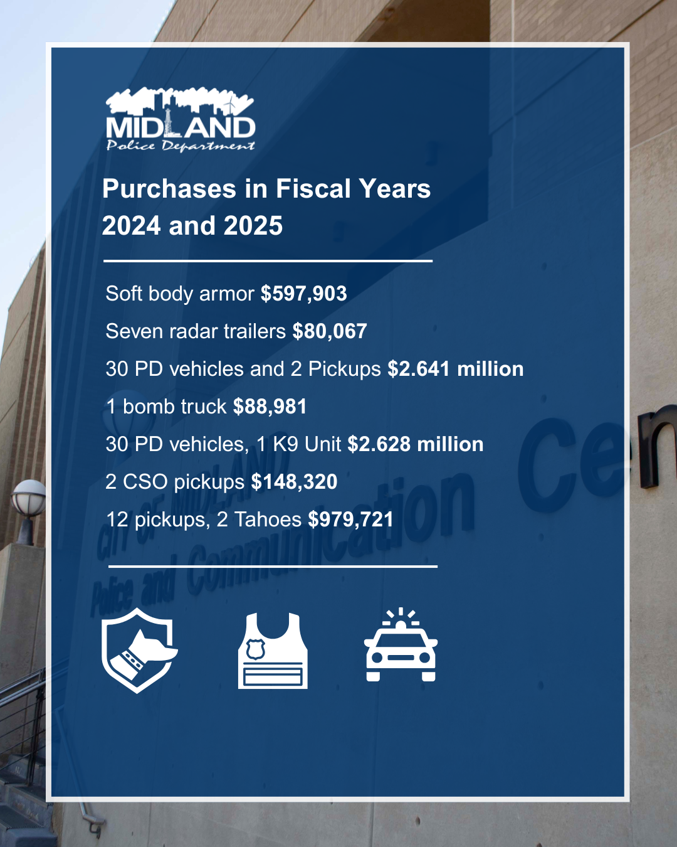
FY 2025 RESULTS
Midland Police Department
Grow and Retain Public Safety Resources
Angel Armor Body Armor
Discovered body armor was set to expire at end of 2024.
Worked diligently with the City to purchase new body armor to replace expired armor for every officer.
Council, City Management, and our private partners were very generous.
Worked with COM Finance to put plan in place to ensure funds are available when current vests expire.
29
Notes:
LIST OUT KEY ACCOMPLISHMENTS MADE IN FY2025. THESE SHOULD CLOSELY REFLECT THE PRIORITIES SET IN LAST YEARS PRESENTATION. ALSO INCLUDE ANY BIG HIGHLIGHTS OR WINS THAT WERE NOT CALLED OUT IN PREVIOUS PRESENTATIONS. CAN INCLUDE METRICS, GRAPHICS, ETC. BUT STILL KEEP THESE AT A HIGH LEVEL. ONLY THE MOST IMPACTFUL ACCOMPLISHMENTS SHOULD BE LISTED! USE AS MANY SLIDES AS YOU NEED, BUT DON'T GO OVER BOARD!
EACH DEPARTMENT WILL NEED A KEY ACCOMPLISHMENTS SLIDE(S).

Slide 30
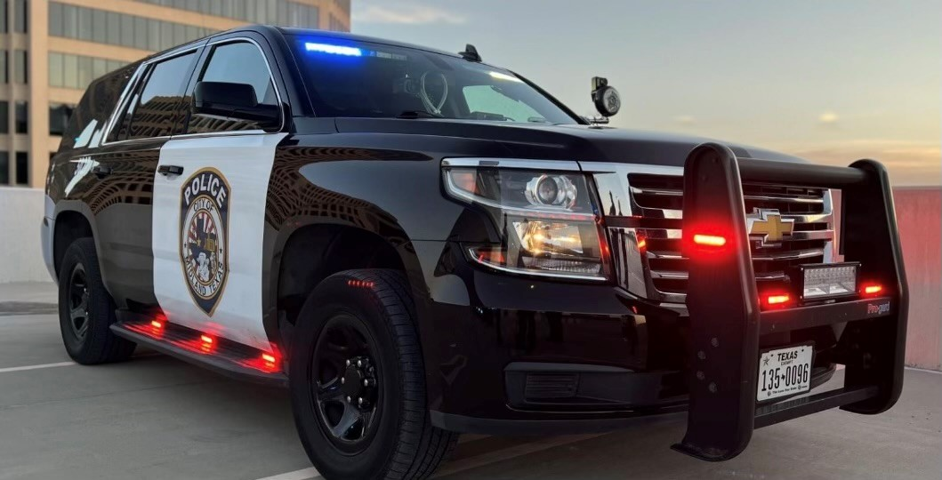
FY 2025 RESULTS
Midland Police Department
Improve Pedestrian and Motorist Safety
Safe Passage Initiative
Operation Intersection Intervention
Traffic Stops: 2,267
Citations: 1,388
Arrests: 54
Operation Cruise Control
Traffic Stops: 1,938
Citations: 716
Arrests: 80
30
Notes:
INSTRUCTIONS FOR THESE SLIDES. CREATE AS MANY SLIDES NEEDED FOR AS MANY STRATEGIES THAT YOU WANT TO SPECIFICALLY CALL OUT.
📋 How to Create Key Deliverables for Budget Goal Team Updates
Step 1: Start with the Strategy
Look at the exact wording of the Strategic Plan strategy assigned to your team. For example:
➡️ Strategy: Enhance Communication Efficiency and Effectiveness
This is the "what"—the high-level direction or goal. Your job is to define "how" your team will help achieve it.
Step 2: Identify Actionable Deliverables
Think about the specific, tangible actions, programs, or projects your team will complete in the fiscal year to advance the strategy. These are your Key Deliverables.
Ask:
✔️ What can we implement, launch, improve, or expand?
✔️ How will this action directly support the strategy?
✔️ Can this be tracked or measured by year-end?
Examples for the strategy above:
✅ Maximize the use of reverse 9-1-1 & citizen notification systems to improve emergency communication.
✅ Expand the use of Virtual Agent via RingCX to provide 24/7 phone system access for residents.
✅ Target messaging to specific populations using tools like geo-fencing or Spanish-language content on social media.
Step 3: Keep Deliverables Focused, Measurable, and Budget-Relevant
Key Deliverables should:
✔️ Be specific—not vague or general.
✔️ Be measurable—you should know when it’s done or if it’s working.
✔️ Tie back to budget decisions—does this require funding, staffing, or technology?
✅ Quick Tips for Writing Deliverables:
Start with an action verb: Implement, Expand, Launch, Complete, Deploy.
Be clear on the outcome: What will this change, improve, or deliver?
Think one fiscal year at a time—keep deliverables achievable within the FY.
👉 If your strategy is citywide (like communication), your department’s deliverables should reflect what you specifically control or influence—while working toward the larger goal.

Slide 31
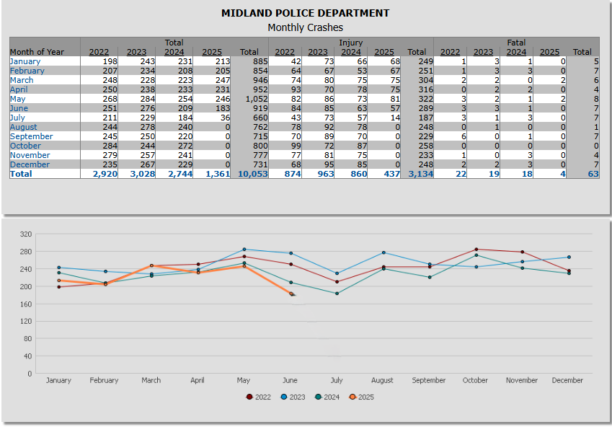
FY 2025 RESULTS
Midland Police Department
Improve Pedestrian and Motorist Safety
Safe Passage enforcement efforts have led to a reduction in Traffic Crashes.
In comparison years 2022-2025, February, April, May, and June 2025 each showed the fewest crashes for that month.
31
Notes:
INSTRUCTIONS FOR THESE SLIDES. CREATE AS MANY SLIDES NEEDED FOR AS MANY STRATEGIES THAT YOU WANT TO SPECIFICALLY CALL OUT.
📋 How to Create Key Deliverables for Budget Goal Team Updates
Step 1: Start with the Strategy
Look at the exact wording of the Strategic Plan strategy assigned to your team. For example:
➡️ Strategy: Enhance Communication Efficiency and Effectiveness
This is the "what"—the high-level direction or goal. Your job is to define "how" your team will help achieve it.
Step 2: Identify Actionable Deliverables
Think about the specific, tangible actions, programs, or projects your team will complete in the fiscal year to advance the strategy. These are your Key Deliverables.
Ask:
✔️ What can we implement, launch, improve, or expand?
✔️ How will this action directly support the strategy?
✔️ Can this be tracked or measured by year-end?
Examples for the strategy above:
✅ Maximize the use of reverse 9-1-1 & citizen notification systems to improve emergency communication.
✅ Expand the use of Virtual Agent via RingCX to provide 24/7 phone system access for residents.
✅ Target messaging to specific populations using tools like geo-fencing or Spanish-language content on social media.
Step 3: Keep Deliverables Focused, Measurable, and Budget-Relevant
Key Deliverables should:
✔️ Be specific—not vague or general.
✔️ Be measurable—you should know when it’s done or if it’s working.
✔️ Tie back to budget decisions—does this require funding, staffing, or technology?
✅ Quick Tips for Writing Deliverables:
Start with an action verb: Implement, Expand, Launch, Complete, Deploy.
Be clear on the outcome: What will this change, improve, or deliver?
Think one fiscal year at a time—keep deliverables achievable within the FY.
👉 If your strategy is citywide (like communication), your department’s deliverables should reflect what you specifically control or influence—while working toward the larger goal.

Slide 32
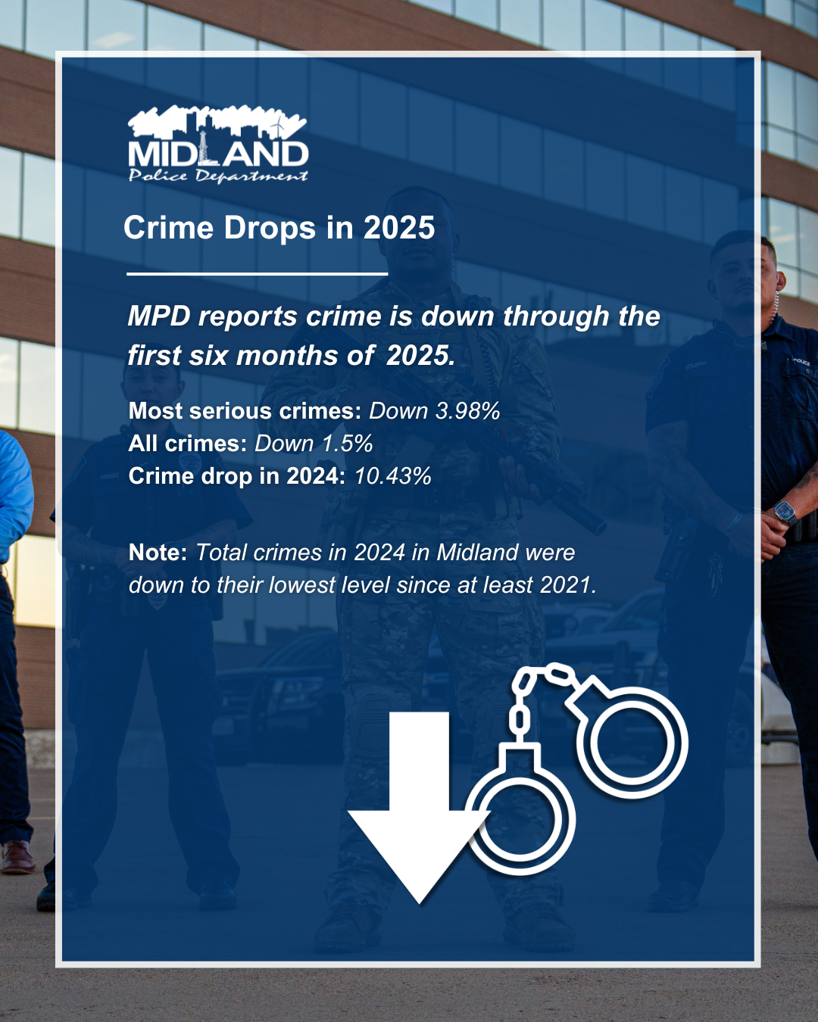
FY 2025 RESULTS
Midland Police Department:
Be the Safest City in West Texas
Reduced Crime Rate
Reduced Traffic Collisions
32
Notes:
LIST OUT KEY ACCOMPLISHMENTS MADE IN FY2025. THESE SHOULD CLOSELY REFLECT THE PRIORITIES SET IN LAST YEARS PRESENTATION. ALSO INCLUDE ANY BIG HIGHLIGHTS OR WINS THAT WERE NOT CALLED OUT IN PREVIOUS PRESENTATIONS. CAN INCLUDE METRICS, GRAPHICS, ETC. BUT STILL KEEP THESE AT A HIGH LEVEL. ONLY THE MOST IMPACTFUL ACCOMPLISHMENTS SHOULD BE LISTED! USE AS MANY SLIDES AS YOU NEED, BUT DON'T GO OVER BOARD!
EACH DEPARTMENT WILL NEED A KEY ACCOMPLISHMENTS SLIDE(S).

Slide 33
FY25 KEY RESULTS
602 N Lee St
Midland Fire Department
Grow and Retain Public Safety Resources
Adjustment of Fire Department Pay
  Increased FF Starting Pay: Raised to $65,000 to better align with other regional departments starting pay.
  Retention Improvements: Reduced pay compression in upper ranks, added new career steps, and increased Engineer certification pay to $1,000/month phased in over three years.
  Fund Stability: Structured funding to keep annual growth inline with the 3% actuarial expectation, ensuring long-term sustainability of the retirement fund.
  Regionally Competitive Pay: New pay scale is competitive with other fire departments in the region, particularly for Firefighters and Engineers, supporting recruitment and retention efforts.
33
Notes:
LIST OUT KEY ACCOMPLISHMENTS MADE IN FY2025. THESE SHOULD CLOSELY REFLECT THE PRIORITIES SET IN LAST YEARS PRESENTATION. ALSO INCLUDE ANY BIG HIGHLIGHTS OR WINS THAT WERE NOT CALLED OUT IN PREVIOUS PRESENTATIONS. CAN INCLUDE METRICS, GRAPHICS, ETC. BUT STILL KEEP THESE AT A HIGH LEVEL. ONLY THE MOST IMPACTFUL ACCOMPLISHMENTS SHOULD BE LISTED! USE AS MANY SLIDES AS YOU NEED, BUT DON'T GO OVER BOARD!
EACH DEPARTMENT WILL NEED A KEY ACCOMPLISHMENTS SLIDE(S).

Slide 34
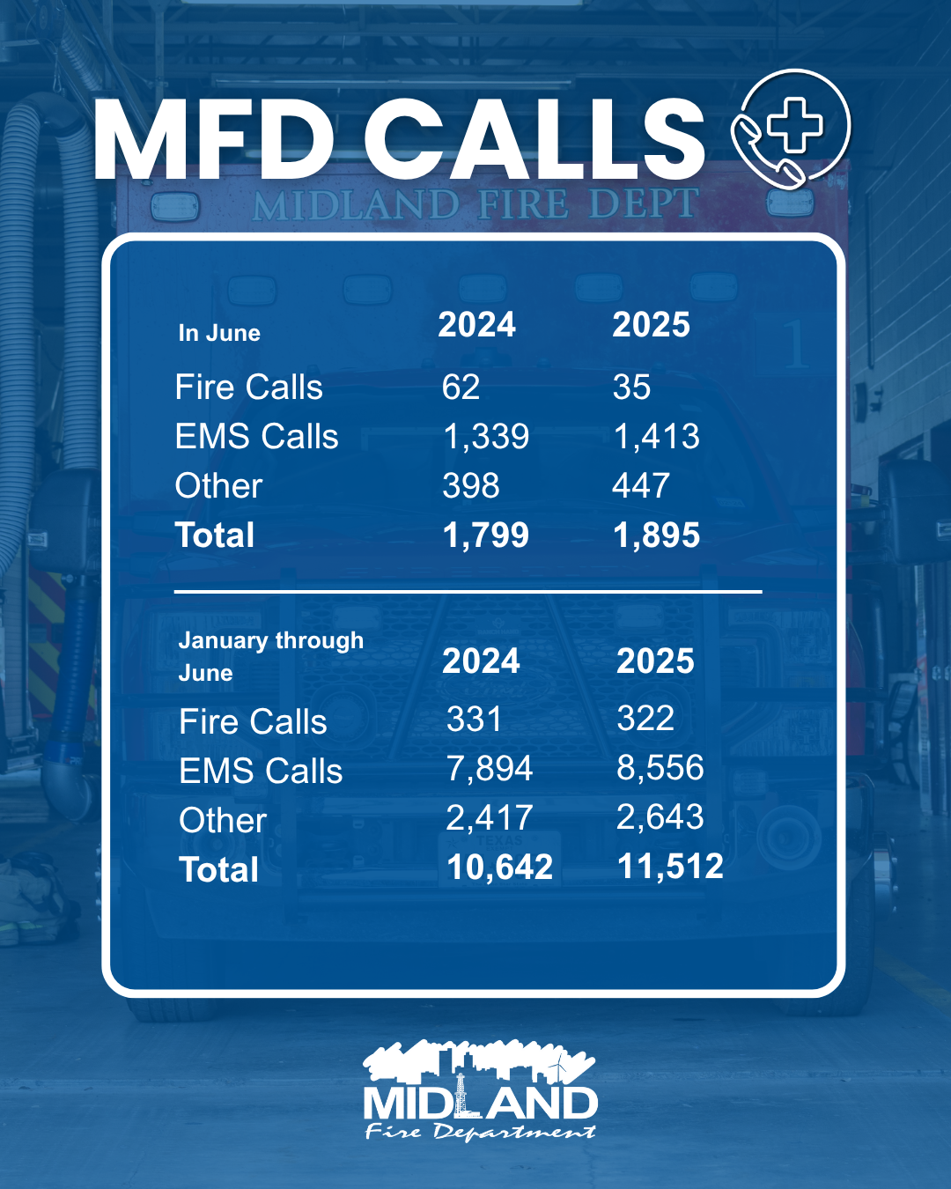
FY 2025 RESULTS
Midland Fire Department
Be the Safest City in West Texas
2024 – City 81% County 19%
2025 – City 81% County 19%
34
Notes:
LIST OUT KEY ACCOMPLISHMENTS MADE IN FY2025. THESE SHOULD CLOSELY REFLECT THE PRIORITIES SET IN LAST YEARS PRESENTATION. ALSO INCLUDE ANY BIG HIGHLIGHTS OR WINS THAT WERE NOT CALLED OUT IN PREVIOUS PRESENTATIONS. CAN INCLUDE METRICS, GRAPHICS, ETC. BUT STILL KEEP THESE AT A HIGH LEVEL. ONLY THE MOST IMPACTFUL ACCOMPLISHMENTS SHOULD BE LISTED! USE AS MANY SLIDES AS YOU NEED, BUT DON'T GO OVER BOARD!
EACH DEPARTMENT WILL NEED A KEY ACCOMPLISHMENTS SLIDE(S).

Slide 35
FY 2025 RESULTS
Midland Fire Department
Grow and Retain Public Safety Resources
Technology Improvements
  Motorola Implementation
    Improved communication and interoperability with Midland & Odessa for faster emergency response.
  IPAWS Notification System
    Enabled effective public alerts for critical events.
Efficiency & Staffing
  Key Hire - Fire Plans Reviewer
    Accelerated plan review process, increased speed to market, and improved service delivery.
35
Notes:
LIST OUT KEY ACCOMPLISHMENTS MADE IN FY2025. THESE SHOULD CLOSELY REFLECT THE PRIORITIES SET IN LAST YEARS PRESENTATION. ALSO INCLUDE ANY BIG HIGHLIGHTS OR WINS THAT WERE NOT CALLED OUT IN PREVIOUS PRESENTATIONS. CAN INCLUDE METRICS, GRAPHICS, ETC. BUT STILL KEEP THESE AT A HIGH LEVEL. ONLY THE MOST IMPACTFUL ACCOMPLISHMENTS SHOULD BE LISTED! USE AS MANY SLIDES AS YOU NEED, BUT DON'T GO OVER BOARD!
EACH DEPARTMENT WILL NEED A KEY ACCOMPLISHMENTS SLIDE(S).

Slide 36
FY 2025 RESULTS
Midland Fire Department
Be the Safest city in West Texas
Public Outreach
  Casa de Amigos food pantry & Senior Link Meals on Wheels: Expanded community support and engagement.
  Oil and Gas industry drills: Supported local industry safety and compliance.
  Firefighter Friday photos with Animal Services: Boosted public awareness and pet adoptions.
36
Notes:
LIST OUT KEY ACCOMPLISHMENTS MADE IN FY2025. THESE SHOULD CLOSELY REFLECT THE PRIORITIES SET IN LAST YEARS PRESENTATION. ALSO INCLUDE ANY BIG HIGHLIGHTS OR WINS THAT WERE NOT CALLED OUT IN PREVIOUS PRESENTATIONS. CAN INCLUDE METRICS, GRAPHICS, ETC. BUT STILL KEEP THESE AT A HIGH LEVEL. ONLY THE MOST IMPACTFUL ACCOMPLISHMENTS SHOULD BE LISTED! USE AS MANY SLIDES AS YOU NEED, BUT DON'T GO OVER BOARD!
EACH DEPARTMENT WILL NEED A KEY ACCOMPLISHMENTS SLIDE(S).

Slide 37
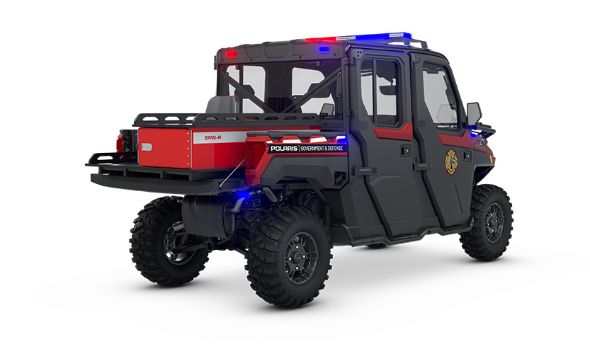
FY 2025 RESULTS
Midland Fire Department
Be the Safest city in West Texas
Partnerships & Collaboration
  Hydrant inspections: Over 4,000 hydrants checked with Utilities (ISO metric)
    180+ reported for repair in 2024.
  State resource partnerships:
    EMTF (DSHS): Enhanced Midland emergency response capacity.
    TIFMAS deployments & new wildland paramedic unit (donated by Phillips66): Increased wildfire and EMS support with state reimbursement when deployed.
    Deployed to: Kerrville (Winter Weather), Merkel, Lubbock, McGregor, Alice, Fredericksburg, Childress, San Antonio, and Kerrville (Flooding).
37
Notes:
LIST OUT KEY ACCOMPLISHMENTS MADE IN FY2025. THESE SHOULD CLOSELY REFLECT THE PRIORITIES SET IN LAST YEARS PRESENTATION. ALSO INCLUDE ANY BIG HIGHLIGHTS OR WINS THAT WERE NOT CALLED OUT IN PREVIOUS PRESENTATIONS. CAN INCLUDE METRICS, GRAPHICS, ETC. BUT STILL KEEP THESE AT A HIGH LEVEL. ONLY THE MOST IMPACTFUL ACCOMPLISHMENTS SHOULD BE LISTED! USE AS MANY SLIDES AS YOU NEED, BUT DON'T GO OVER BOARD!
EACH DEPARTMENT WILL NEED A KEY ACCOMPLISHMENTS SLIDE(S).

Slide 38
FY 2025 RESULTS
Midland Fire Department
Leadership & Quality
  Key leadership transitions: New Fire Chief, Asst. Chiefs of Administration & Operations for strategic direction.
  DSHS-EMS license inspection: Passed with no findings—demonstrates high compliance.
  EMS FTO program: Internally certified mentors ensure new EMS staff readiness and protocol adherence.
38
Notes:
LIST OUT KEY ACCOMPLISHMENTS MADE IN FY2025. THESE SHOULD CLOSELY REFLECT THE PRIORITIES SET IN LAST YEARS PRESENTATION. ALSO INCLUDE ANY BIG HIGHLIGHTS OR WINS THAT WERE NOT CALLED OUT IN PREVIOUS PRESENTATIONS. CAN INCLUDE METRICS, GRAPHICS, ETC. BUT STILL KEEP THESE AT A HIGH LEVEL. ONLY THE MOST IMPACTFUL ACCOMPLISHMENTS SHOULD BE LISTED! USE AS MANY SLIDES AS YOU NEED, BUT DON'T GO OVER BOARD!
EACH DEPARTMENT WILL NEED A KEY ACCOMPLISHMENTS SLIDE(S).

Slide 39
FY 2025 RESULTS
Animal Services
Live Release & Field Response
  Increased Return-to-Owner (RTO) rates through proactive field officer engagement and free microchipping.
  Enhanced intake coordination and reunification efforts, streamlining the process for lost pets to return home.
  Targeted patrols and community follow-up addressed rising stray animal reports, improving public safety and animal outcomes.
Community Engagement
  Relaunched Rescue Runners: Provided shelter dogs with increased public visibility, supporting higher adoption rates.
  Firefighter Friday partnership with MFD: Featured adoptable pets, boosting awareness and community involvement.
  Active participation in citywide events (e.g., Truck or Treat, Fall Resource Fair) to strengthen public outreach and education.
39
Notes:
LIST OUT KEY ACCOMPLISHMENTS MADE IN FY2025. THESE SHOULD CLOSELY REFLECT THE PRIORITIES SET IN LAST YEARS PRESENTATION. ALSO INCLUDE ANY BIG HIGHLIGHTS OR WINS THAT WERE NOT CALLED OUT IN PREVIOUS PRESENTATIONS. CAN INCLUDE METRICS, GRAPHICS, ETC. BUT STILL KEEP THESE AT A HIGH LEVEL. ONLY THE MOST IMPACTFUL ACCOMPLISHMENTS SHOULD BE LISTED! USE AS MANY SLIDES AS YOU NEED, BUT DON'T GO OVER BOARD!
EACH DEPARTMENT WILL NEED A KEY ACCOMPLISHMENTS SLIDE(S).

Slide 40
FY 2025 RESULTS
Animal Services
Leadership Transition
  Recruited New Animal Services Manager (effective August 11), ensuring stable leadership and a foundation for future program improvements.
  Maintained shelter stability during this transition and initiated planning for enhanced services.
40
Notes:
LIST OUT KEY ACCOMPLISHMENTS MADE IN FY2025. THESE SHOULD CLOSELY REFLECT THE PRIORITIES SET IN LAST YEARS PRESENTATION. ALSO INCLUDE ANY BIG HIGHLIGHTS OR WINS THAT WERE NOT CALLED OUT IN PREVIOUS PRESENTATIONS. CAN INCLUDE METRICS, GRAPHICS, ETC. BUT STILL KEEP THESE AT A HIGH LEVEL. ONLY THE MOST IMPACTFUL ACCOMPLISHMENTS SHOULD BE LISTED! USE AS MANY SLIDES AS YOU NEED, BUT DON'T GO OVER BOARD!
EACH DEPARTMENT WILL NEED A KEY ACCOMPLISHMENTS SLIDE(S).

Slide 41
FY 2025 RESULTS
Health Department
Metric | 2024 Final | 2025 YTD (6/30) | % Change (Est)
Appointments Scheduled | 14,278 | 6,000 | -16%
Vaccines Given | 19,795 | 6,300 | -36%
Patients 18 and Under (Vaccines) | 5,121 | 2,140 | -16%
Health Inspections Completed | 1,308 | 758 | 16%
Illegal Food Vendors Encountered | 21 | 9 | -14%
Complaints Investigated | 204 | 102 | 0%
Large Scale Events Worked | 14 | 8 | 14%
Patient Referrals\* | 48 | 216 | 800%
Texas Notifiable Condition Investigations | 414 | 287 | 39%
Outbreaks Investigated | 1 | 2 | 300%
*2024 Patient Referrals only tracked from October onward.
41
Notes:
LIST OUT KEY ACCOMPLISHMENTS MADE IN FY2025. THESE SHOULD CLOSELY REFLECT THE PRIORITIES SET IN LAST YEARS PRESENTATION. ALSO INCLUDE ANY BIG HIGHLIGHTS OR WINS THAT WERE NOT CALLED OUT IN PREVIOUS PRESENTATIONS. CAN INCLUDE METRICS, GRAPHICS, ETC. BUT STILL KEEP THESE AT A HIGH LEVEL. ONLY THE MOST IMPACTFUL ACCOMPLISHMENTS SHOULD BE LISTED! USE AS MANY SLIDES AS YOU NEED, BUT DON'T GO OVER BOARD!
EACH DEPARTMENT WILL NEED A KEY ACCOMPLISHMENTS SLIDE(S).

Slide 42
FY 2025 RESULTS
Health Department
Environmental Services Streamlined Process
Combined operations at the County Building with Fire Marshal staff.
Food truck inspections now held every Monday at one location for greater convenience and coordination.
  Internal and External customers are both pleased with this process.
42
Notes:
LIST OUT KEY ACCOMPLISHMENTS MADE IN FY2025. THESE SHOULD CLOSELY REFLECT THE PRIORITIES SET IN LAST YEARS PRESENTATION. ALSO INCLUDE ANY BIG HIGHLIGHTS OR WINS THAT WERE NOT CALLED OUT IN PREVIOUS PRESENTATIONS. CAN INCLUDE METRICS, GRAPHICS, ETC. BUT STILL KEEP THESE AT A HIGH LEVEL. ONLY THE MOST IMPACTFUL ACCOMPLISHMENTS SHOULD BE LISTED! USE AS MANY SLIDES AS YOU NEED, BUT DON'T GO OVER BOARD!
EACH DEPARTMENT WILL NEED A KEY ACCOMPLISHMENTS SLIDE(S).

Slide 43
FY 2025 RESULTS
Health Department
Patient Registration Platform Launched
  Implemented InteliChart
  Supports digital pre-registration, secure communication, appointment notifications, and patient portal access
  Improves patient convenience, reduces staff time on paperwork, and ensures more accurate records
  Frees up staff time to focus on other needed tasks and assignments instead of working with paper registration forms and inputting them manually into a system, duplicating work.
43
Notes:
LIST OUT KEY ACCOMPLISHMENTS MADE IN FY2025. THESE SHOULD CLOSELY REFLECT THE PRIORITIES SET IN LAST YEARS PRESENTATION. ALSO INCLUDE ANY BIG HIGHLIGHTS OR WINS THAT WERE NOT CALLED OUT IN PREVIOUS PRESENTATIONS. CAN INCLUDE METRICS, GRAPHICS, ETC. BUT STILL KEEP THESE AT A HIGH LEVEL. ONLY THE MOST IMPACTFUL ACCOMPLISHMENTS SHOULD BE LISTED! USE AS MANY SLIDES AS YOU NEED, BUT DON'T GO OVER BOARD!
EACH DEPARTMENT WILL NEED A KEY ACCOMPLISHMENTS SLIDE(S).

Slide 44
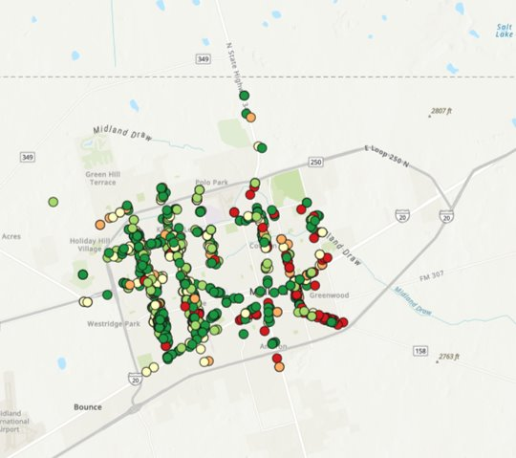
FY 2025 RESULTS
Code Enforcement: FY 2025
Most Visible Streets Focus
FY25 YTD (July 1): 1,512 cases opened along corridors – 22% of all cases citywide (up from 15% in FY24)​
June 2025: 35% of all citywide cases were on main corridors​
Case Resolution: 90% of corridor cases have been closed​
Top Violations: weeds or debris (56%)
44
Notes:
LIST OUT KEY ACCOMPLISHMENTS MADE IN FY2025. THESE SHOULD CLOSELY REFLECT THE PRIORITIES SET IN LAST YEARS PRESENTATION. ALSO INCLUDE ANY BIG HIGHLIGHTS OR WINS THAT WERE NOT CALLED OUT IN PREVIOUS PRESENTATIONS. CAN INCLUDE METRICS, GRAPHICS, ETC. BUT STILL KEEP THESE AT A HIGH LEVEL. ONLY THE MOST IMPACTFUL ACCOMPLISHMENTS SHOULD BE LISTED! USE AS MANY SLIDES AS YOU NEED, BUT DON'T GO OVER BOARD!
EACH DEPARTMENT WILL NEED A KEY ACCOMPLISHMENTS SLIDE(S).

Slide 45

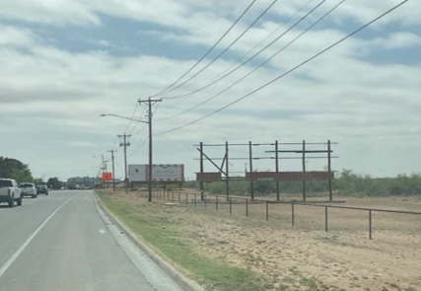
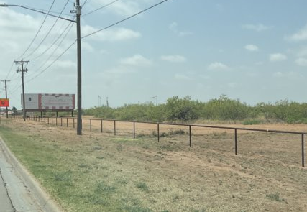
FY 2025 RESULTS
Code Enforcement: FY 2025
Most Visible Streets Focus
Broken sign on Big Spring voluntarily removed by property owner after Code Enforcement initiated contact.​
Before: April 15, 2024​
After: April 24, 2024​
45
Notes:
LIST OUT KEY ACCOMPLISHMENTS MADE IN FY2025. THESE SHOULD CLOSELY REFLECT THE PRIORITIES SET IN LAST YEARS PRESENTATION. ALSO INCLUDE ANY BIG HIGHLIGHTS OR WINS THAT WERE NOT CALLED OUT IN PREVIOUS PRESENTATIONS. CAN INCLUDE METRICS, GRAPHICS, ETC. BUT STILL KEEP THESE AT A HIGH LEVEL. ONLY THE MOST IMPACTFUL ACCOMPLISHMENTS SHOULD BE LISTED! USE AS MANY SLIDES AS YOU NEED, BUT DON'T GO OVER BOARD!
EACH DEPARTMENT WILL NEED A KEY ACCOMPLISHMENTS SLIDE(S).

Slide 46
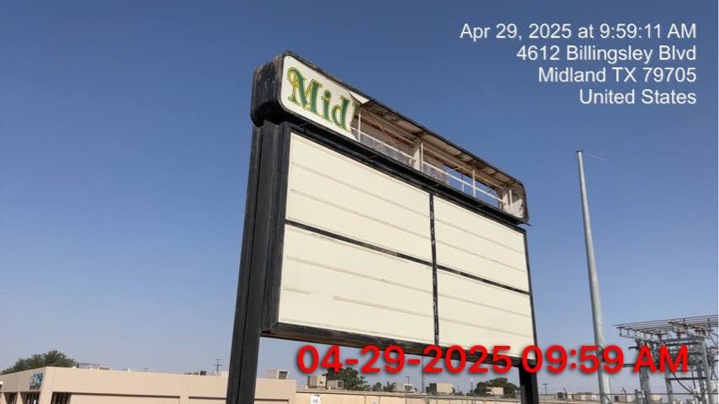
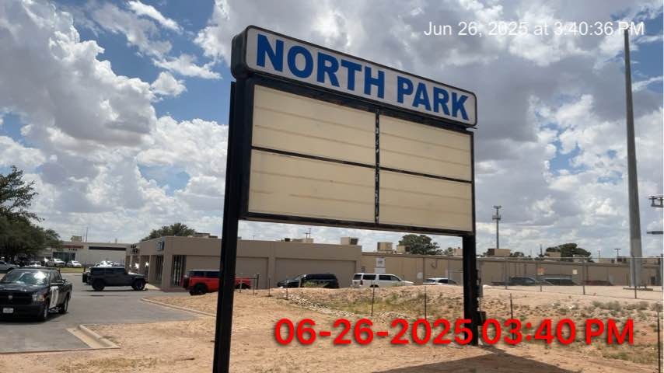
FY 2025 RESULTS
Code Enforcement: FY 2025
Most Visible Streets Focus
Broken commercial sign on Loop 250 voluntarily repaired by property owner after Code Enforcement initiated contact.​
46
Notes:
LIST OUT KEY ACCOMPLISHMENTS MADE IN FY2025. THESE SHOULD CLOSELY REFLECT THE PRIORITIES SET IN LAST YEARS PRESENTATION. ALSO INCLUDE ANY BIG HIGHLIGHTS OR WINS THAT WERE NOT CALLED OUT IN PREVIOUS PRESENTATIONS. CAN INCLUDE METRICS, GRAPHICS, ETC. BUT STILL KEEP THESE AT A HIGH LEVEL. ONLY THE MOST IMPACTFUL ACCOMPLISHMENTS SHOULD BE LISTED! USE AS MANY SLIDES AS YOU NEED, BUT DON'T GO OVER BOARD!
EACH DEPARTMENT WILL NEED A KEY ACCOMPLISHMENTS SLIDE(S).

Slide 47
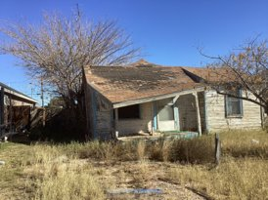
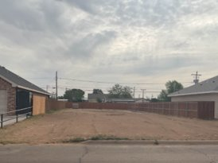
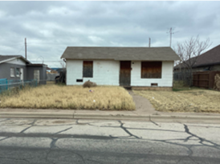
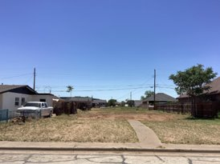
FY 2025 RESULTS
Code Enforcement: FY 2025
Substandard Buildings Focus
602 N Lee St
Two substandard homes voluntarily demolished after Code Enforcement initiated contact, saving the City $45,000 each, removing neighborhood blight, improving public safety, and increasing chances of redevelopment.
Before: Dec 9, 2024​
After: Apr 28, 2025​
702 S Tilden St
Before: Jan 9, 2025​
After: May 20, 2025​
47
Notes:
LIST OUT KEY ACCOMPLISHMENTS MADE IN FY2025. THESE SHOULD CLOSELY REFLECT THE PRIORITIES SET IN LAST YEARS PRESENTATION. ALSO INCLUDE ANY BIG HIGHLIGHTS OR WINS THAT WERE NOT CALLED OUT IN PREVIOUS PRESENTATIONS. CAN INCLUDE METRICS, GRAPHICS, ETC. BUT STILL KEEP THESE AT A HIGH LEVEL. ONLY THE MOST IMPACTFUL ACCOMPLISHMENTS SHOULD BE LISTED! USE AS MANY SLIDES AS YOU NEED, BUT DON'T GO OVER BOARD!
EACH DEPARTMENT WILL NEED A KEY ACCOMPLISHMENTS SLIDE(S).

Slide 48
FY 2025 RESULTS
Code Enforcement: FY 2025
Illicit Massage Businesses
Stricter Ordinance Adopted: April 8, 2025
New licensing and operations standards for massage businesses with prior illicit activity approved
Joint Task Force: April 29 – May 1, 2025
Agencies: TDLR, Homeland Security Investigations, Midland Police Department, Code Enforcement
25 inspections conducted
2 emergency shutdowns: Sunny Spa, 2814 W Wall
Massage A+, 3211 W Wadley
602 N Lee St
48
Notes:
LIST OUT KEY ACCOMPLISHMENTS MADE IN FY2025. THESE SHOULD CLOSELY REFLECT THE PRIORITIES SET IN LAST YEARS PRESENTATION. ALSO INCLUDE ANY BIG HIGHLIGHTS OR WINS THAT WERE NOT CALLED OUT IN PREVIOUS PRESENTATIONS. CAN INCLUDE METRICS, GRAPHICS, ETC. BUT STILL KEEP THESE AT A HIGH LEVEL. ONLY THE MOST IMPACTFUL ACCOMPLISHMENTS SHOULD BE LISTED! USE AS MANY SLIDES AS YOU NEED, BUT DON'T GO OVER BOARD!
EACH DEPARTMENT WILL NEED A KEY ACCOMPLISHMENTS SLIDE(S).

Slide 49
FY 2025 RESULTS
Code Enforcement: FY 2025
Key Performance Metrics
 | Indicator | Annual Goal | FY24 | FY25 YTD
Proactive + Responsive | Case Volume (# of cases initiated) | 8,000 | 7,901 | 6,108
 | See Click Fix Closure Rate (% of SCF cases closed) | 95% | 98.4% | 98.7%
Efficient | Closure Rate (% of initiated cases closed) | 95% | 95.7% | 90.1%
 | Average Time to Close (average days to close a case) | 30 | 31.3 | 23.8
 | % Closed within 30 days (% of closed cases closed within 30 days) | 75% | 74.3% | 71.3%
49
Notes:
LIST OUT KEY ACCOMPLISHMENTS MADE IN FY2025. THESE SHOULD CLOSELY REFLECT THE PRIORITIES SET IN LAST YEARS PRESENTATION. ALSO INCLUDE ANY BIG HIGHLIGHTS OR WINS THAT WERE NOT CALLED OUT IN PREVIOUS PRESENTATIONS. CAN INCLUDE METRICS, GRAPHICS, ETC. BUT STILL KEEP THESE AT A HIGH LEVEL. ONLY THE MOST IMPACTFUL ACCOMPLISHMENTS SHOULD BE LISTED! USE AS MANY SLIDES AS YOU NEED, BUT DON'T GO OVER BOARD!
EACH DEPARTMENT WILL NEED A KEY ACCOMPLISHMENTS SLIDE(S).

Slide 50
FY 2026 DELIVERABLES
Midland Police Department
Improve Pedestrian and Motorist Safety
Enhance Road Safety Through Targeted Enforcement Campaigns.
Safe Passage Initiative
Operation Safe Return (In Development)
Patrol, the Traffic Division, and the Community Relations Unit will work with schools to help ensure a safe return to school for students.
Will include a social media component, messaging, and enforcement.
50
Notes:
INSTRUCTIONS FOR THESE SLIDES. CREATE AS MANY SLIDES NEEDED FOR AS MANY STRATEGIES THAT YOU WANT TO SPECIFICALLY CALL OUT.
📋 How to Create Key Deliverables for Budget Goal Team Updates
Step 1: Start with the Strategy
Look at the exact wording of the Strategic Plan strategy assigned to your team. For example:
➡️ Strategy: Enhance Communication Efficiency and Effectiveness
This is the "what"—the high-level direction or goal. Your job is to define "how" your team will help achieve it.
Step 2: Identify Actionable Deliverables
Think about the specific, tangible actions, programs, or projects your team will complete in the fiscal year to advance the strategy. These are your Key Deliverables.
Ask:
✔️ What can we implement, launch, improve, or expand?
✔️ How will this action directly support the strategy?
✔️ Can this be tracked or measured by year-end?
Examples for the strategy above:
✅ Maximize the use of reverse 9-1-1 & citizen notification systems to improve emergency communication.
✅ Expand the use of Virtual Agent via RingCX to provide 24/7 phone system access for residents.
✅ Target messaging to specific populations using tools like geo-fencing or Spanish-language content on social media.
Step 3: Keep Deliverables Focused, Measurable, and Budget-Relevant
Key Deliverables should:
✔️ Be specific—not vague or general.
✔️ Be measurable—you should know when it’s done or if it’s working.
✔️ Tie back to budget decisions—does this require funding, staffing, or technology?
✅ Quick Tips for Writing Deliverables:
Start with an action verb: Implement, Expand, Launch, Complete, Deploy.
Be clear on the outcome: What will this change, improve, or deliver?
Think one fiscal year at a time—keep deliverables achievable within the FY.
👉 If your strategy is citywide (like communication), your department’s deliverables should reflect what you specifically control or influence—while working toward the larger goal.

Slide 51


FY 2026 DELIVERABLES
Midland Police Department
Be the Safest City in West Texas
Strengthen Bonds With Other Agencies Through Collaboration and Joint Operations
  The Midland Police Department spearheaded and continues to support the High Intensity Drug Trafficking Areas (HIDTA) in our region, a multi-agency collaboration that includes MPD, OPD, ECSO, and DEA.
  The Midland Police Department maintains Task Force Officers (TFOs) with many Federal Agencies including the FBI, DEA, and HSI.
51

Slide 52
FY 2026 DELIVERABLES
Midland Police Department
Be the Safest City in West Texas
Strengthen Bonds With Other Agencies Through Collaboration and Joint Operations.
Texas Anti-Gang (TAG) Center
Awarded to Sheriff Criner and funded by the Governor’s Public Safety Office, TAG Centers bring together local, state, and federal law enforcement and prosecutor offices through strategic partnerships and targeted investigative efforts that act as a force multiplier in joint operations.
The Midland Police Department will be participating alongside other stakeholders in our local TAG Center.
52
Notes:
INSTRUCTIONS FOR THESE SLIDES. CREATE AS MANY SLIDES NEEDED FOR AS MANY STRATEGIES THAT YOU WANT TO SPECIFICALLY CALL OUT.
📋 How to Create Key Deliverables for Budget Goal Team Updates
Step 1: Start with the Strategy
Look at the exact wording of the Strategic Plan strategy assigned to your team. For example:
➡️ Strategy: Enhance Communication Efficiency and Effectiveness
This is the "what"—the high-level direction or goal. Your job is to define "how" your team will help achieve it.
Step 2: Identify Actionable Deliverables
Think about the specific, tangible actions, programs, or projects your team will complete in the fiscal year to advance the strategy. These are your Key Deliverables.
Ask:
✔️ What can we implement, launch, improve, or expand?
✔️ How will this action directly support the strategy?
✔️ Can this be tracked or measured by year-end?
Examples for the strategy above:
✅ Maximize the use of reverse 9-1-1 & citizen notification systems to improve emergency communication.
✅ Expand the use of Virtual Agent via RingCX to provide 24/7 phone system access for residents.
✅ Target messaging to specific populations using tools like geo-fencing or Spanish-language content on social media.
Step 3: Keep Deliverables Focused, Measurable, and Budget-Relevant
Key Deliverables should:
✔️ Be specific—not vague or general.
✔️ Be measurable—you should know when it’s done or if it’s working.
✔️ Tie back to budget decisions—does this require funding, staffing, or technology?
✅ Quick Tips for Writing Deliverables:
Start with an action verb: Implement, Expand, Launch, Complete, Deploy.
Be clear on the outcome: What will this change, improve, or deliver?
Think one fiscal year at a time—keep deliverables achievable within the FY.
👉 If your strategy is citywide (like communication), your department’s deliverables should reflect what you specifically control or influence—while working toward the larger goal.

Slide 53




FY 2026 DELIVERABLES
Midland Police Department
Strengthen Ties Within the Community Through Collaboration and Community Outreach
The Midland Police Department will continue to support popular and valuable community outreach programs.
Texas National Night Out
Trunk-or-Treat
Blue Santa
Coffee with a Cop/Donuts with a Cop
Rape Aggression Defense (RAD) System
53
Notes:
INSTRUCTIONS FOR THESE SLIDES. CREATE AS MANY SLIDES NEEDED FOR AS MANY STRATEGIES THAT YOU WANT TO SPECIFICALLY CALL OUT.
📋 How to Create Key Deliverables for Budget Goal Team Updates
Step 1: Start with the Strategy
Look at the exact wording of the Strategic Plan strategy assigned to your team. For example:
➡️ Strategy: Enhance Communication Efficiency and Effectiveness
This is the "what"—the high-level direction or goal. Your job is to define "how" your team will help achieve it.
Step 2: Identify Actionable Deliverables
Think about the specific, tangible actions, programs, or projects your team will complete in the fiscal year to advance the strategy. These are your Key Deliverables.
Ask:
✔️ What can we implement, launch, improve, or expand?
✔️ How will this action directly support the strategy?
✔️ Can this be tracked or measured by year-end?
Examples for the strategy above:
✅ Maximize the use of reverse 9-1-1 & citizen notification systems to improve emergency communication.
✅ Expand the use of Virtual Agent via RingCX to provide 24/7 phone system access for residents.
✅ Target messaging to specific populations using tools like geo-fencing or Spanish-language content on social media.
Step 3: Keep Deliverables Focused, Measurable, and Budget-Relevant
Key Deliverables should:
✔️ Be specific—not vague or general.
✔️ Be measurable—you should know when it’s done or if it’s working.
✔️ Tie back to budget decisions—does this require funding, staffing, or technology?
✅ Quick Tips for Writing Deliverables:
Start with an action verb: Implement, Expand, Launch, Complete, Deploy.
Be clear on the outcome: What will this change, improve, or deliver?
Think one fiscal year at a time—keep deliverables achievable within the FY.
👉 If your strategy is citywide (like communication), your department’s deliverables should reflect what you specifically control or influence—while working toward the larger goal.

Slide 54

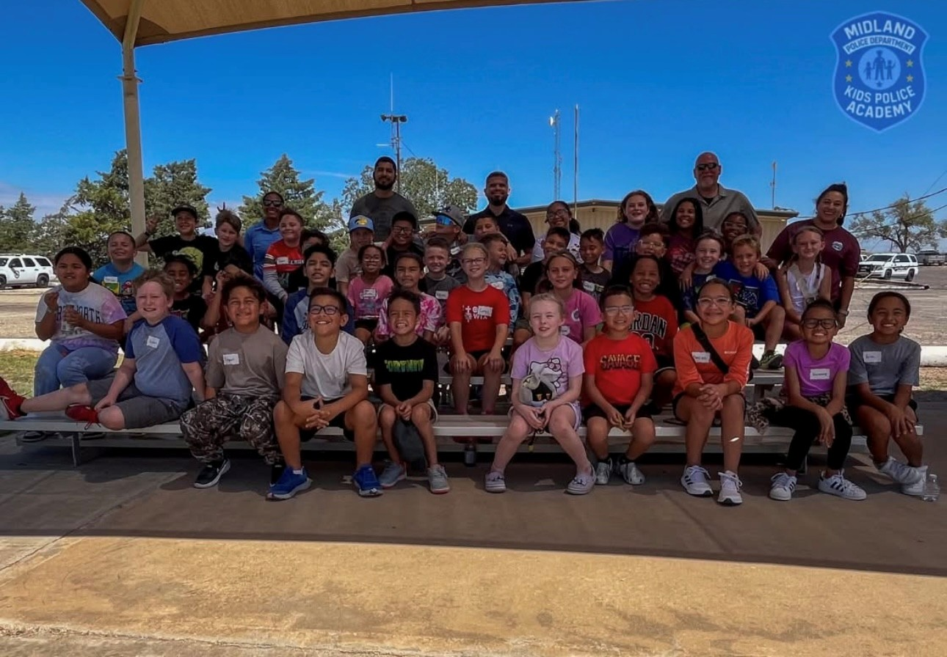
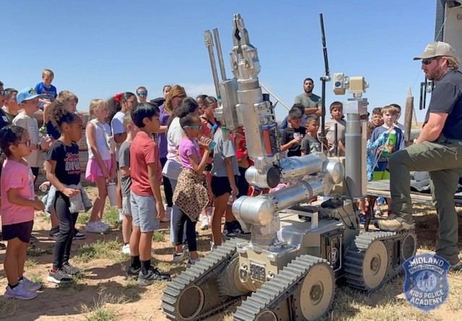
FY 2026 DELIVERABLES
Midland Police Department
Strengthen Ties Within the Community Through Collaboration and Community Outreach
The Midland Police Department will continue to support popular and valuable community outreach programs.
Run from the Cops
Pizza with a Cop
Jingle Bell Run with Snow
Citizen’s Police Academy
Citizens on Patrol
Kid’s Police Academy
54
Notes:
INSTRUCTIONS FOR THESE SLIDES. CREATE AS MANY SLIDES NEEDED FOR AS MANY STRATEGIES THAT YOU WANT TO SPECIFICALLY CALL OUT.
📋 How to Create Key Deliverables for Budget Goal Team Updates
Step 1: Start with the Strategy
Look at the exact wording of the Strategic Plan strategy assigned to your team. For example:
➡️ Strategy: Enhance Communication Efficiency and Effectiveness
This is the "what"—the high-level direction or goal. Your job is to define "how" your team will help achieve it.
Step 2: Identify Actionable Deliverables
Think about the specific, tangible actions, programs, or projects your team will complete in the fiscal year to advance the strategy. These are your Key Deliverables.
Ask:
✔️ What can we implement, launch, improve, or expand?
✔️ How will this action directly support the strategy?
✔️ Can this be tracked or measured by year-end?
Examples for the strategy above:
✅ Maximize the use of reverse 9-1-1 & citizen notification systems to improve emergency communication.
✅ Expand the use of Virtual Agent via RingCX to provide 24/7 phone system access for residents.
✅ Target messaging to specific populations using tools like geo-fencing or Spanish-language content on social media.
Step 3: Keep Deliverables Focused, Measurable, and Budget-Relevant
Key Deliverables should:
✔️ Be specific—not vague or general.
✔️ Be measurable—you should know when it’s done or if it’s working.
✔️ Tie back to budget decisions—does this require funding, staffing, or technology?
✅ Quick Tips for Writing Deliverables:
Start with an action verb: Implement, Expand, Launch, Complete, Deploy.
Be clear on the outcome: What will this change, improve, or deliver?
Think one fiscal year at a time—keep deliverables achievable within the FY.
👉 If your strategy is citywide (like communication), your department’s deliverables should reflect what you specifically control or influence—while working toward the larger goal.

Slide 55
FY 2026 DELIVERABLES
Midland Police Department
Be the Safest City in West Texas
Enhance Public Safety Programs to Reduce Crime.
The Midland Police Department will continue to work with City Legal to look at ordinances than can help improve public safety and/or help reduce the crime rate
Sexual Offender Residential Restriction
55
Notes:
INSTRUCTIONS FOR THESE SLIDES. CREATE AS MANY SLIDES NEEDED FOR AS MANY STRATEGIES THAT YOU WANT TO SPECIFICALLY CALL OUT.
📋 How to Create Key Deliverables for Budget Goal Team Updates
Step 1: Start with the Strategy
Look at the exact wording of the Strategic Plan strategy assigned to your team. For example:
➡️ Strategy: Enhance Communication Efficiency and Effectiveness
This is the "what"—the high-level direction or goal. Your job is to define "how" your team will help achieve it.
Step 2: Identify Actionable Deliverables
Think about the specific, tangible actions, programs, or projects your team will complete in the fiscal year to advance the strategy. These are your Key Deliverables.
Ask:
✔️ What can we implement, launch, improve, or expand?
✔️ How will this action directly support the strategy?
✔️ Can this be tracked or measured by year-end?
Examples for the strategy above:
✅ Maximize the use of reverse 9-1-1 & citizen notification systems to improve emergency communication.
✅ Expand the use of Virtual Agent via RingCX to provide 24/7 phone system access for residents.
✅ Target messaging to specific populations using tools like geo-fencing or Spanish-language content on social media.
Step 3: Keep Deliverables Focused, Measurable, and Budget-Relevant
Key Deliverables should:
✔️ Be specific—not vague or general.
✔️ Be measurable—you should know when it’s done or if it’s working.
✔️ Tie back to budget decisions—does this require funding, staffing, or technology?
✅ Quick Tips for Writing Deliverables:
Start with an action verb: Implement, Expand, Launch, Complete, Deploy.
Be clear on the outcome: What will this change, improve, or deliver?
Think one fiscal year at a time—keep deliverables achievable within the FY.
👉 If your strategy is citywide (like communication), your department’s deliverables should reflect what you specifically control or influence—while working toward the larger goal.

Slide 56
FY 2026 DELIVERABLES
Midland Police Department
Be the Safest City in West Texas
Enhance Public Safety Programs to Reduce Crime.
Goal of 1.5% Reduction in Crime
Build on partnerships with other Departments and Agencies to work joint operations
Grow and Retain Public Safety Resources
Goal of Shrinking the Sworn Officer Vacancy Rate to 5% (currently at 11.2%)
56
Notes:
INSTRUCTIONS FOR THESE SLIDES. CREATE AS MANY SLIDES NEEDED FOR AS MANY STRATEGIES THAT YOU WANT TO SPECIFICALLY CALL OUT.
📋 How to Create Key Deliverables for Budget Goal Team Updates
Step 1: Start with the Strategy
Look at the exact wording of the Strategic Plan strategy assigned to your team. For example:
➡️ Strategy: Enhance Communication Efficiency and Effectiveness
This is the "what"—the high-level direction or goal. Your job is to define "how" your team will help achieve it.
Step 2: Identify Actionable Deliverables
Think about the specific, tangible actions, programs, or projects your team will complete in the fiscal year to advance the strategy. These are your Key Deliverables.
Ask:
✔️ What can we implement, launch, improve, or expand?
✔️ How will this action directly support the strategy?
✔️ Can this be tracked or measured by year-end?
Examples for the strategy above:
✅ Maximize the use of reverse 9-1-1 & citizen notification systems to improve emergency communication.
✅ Expand the use of Virtual Agent via RingCX to provide 24/7 phone system access for residents.
✅ Target messaging to specific populations using tools like geo-fencing or Spanish-language content on social media.
Step 3: Keep Deliverables Focused, Measurable, and Budget-Relevant
Key Deliverables should:
✔️ Be specific—not vague or general.
✔️ Be measurable—you should know when it’s done or if it’s working.
✔️ Tie back to budget decisions—does this require funding, staffing, or technology?
✅ Quick Tips for Writing Deliverables:
Start with an action verb: Implement, Expand, Launch, Complete, Deploy.
Be clear on the outcome: What will this change, improve, or deliver?
Think one fiscal year at a time—keep deliverables achievable within the FY.
👉 If your strategy is citywide (like communication), your department’s deliverables should reflect what you specifically control or influence—while working toward the larger goal.

Slide 57
FY 2026 DELIVERABLES
Fire Department
Community Outreach & Engagement
  Expand public education and risk reduction
  Strengthen partnerships with residents, businesses, and organizations
Emergency Preparedness
  Enhance emergency response with targeted staff training
  Deliver public education to boost readiness
EMS System Modernization
  Launch EMS/MC billing model on October 1, 2025
  Goal: Increased revenue 15-30%
57

Slide 58
FY 2026 DELIVERABLES
Fire Department
Residential Access & Safety
  Implement Residential Knox Box Program to improve emergency access for high-risk residents. Goal: Identify and install 2/month.
Health Paramedicine (CHP) Program
  Advance CHP Program for high-utilizer support and care coordination. Goal: Reduce EMS usage by 50%
58

Slide 59
FY 2026 DELIVERABLES
Animal Services
Decrease Length of Stay
  Streamline processes, boost adoptions, and work with all rescue partners to move animals out faster. Goal: Decrease by 1 day
Adoption Campaigns:
  Launch themed events (e.g., Puppy Palooza, Kitten Shower) during slow months.
Community Education:
  Expand outreach on responsible pet ownership, wildlife coexistence, and bite prevention.
Volunteer Program:
  Grow volunteer roles for shelter support. Goal: Increase by 25%
Transport Program Study:
  Assess partnerships to relocate adoptable pets to high-demand areas.
59

Slide 60
FY 2026 DELIVERABLES
Health Department
Health Department Modernizes Permitting & Inspections
  Launching Inspect2Go:
    Mobile software for environmental permitting and inspections
  Online applications & digital records:
    Replaces outdated paper and carbon forms
  Real-time reports & mobile field access:
    Faster, more transparent service
  Boosts efficiency and customer satisfaction for local businesses and staff
  Goal: Complete application-to-inspection process in 7 business days (currently quoted as 14 days, but typically faster)
*Key step in bringing all divisions online and supporting local business growth.
60
Notes:
LIST OUT KEY ACCOMPLISHMENTS MADE IN FY2025. THESE SHOULD CLOSELY REFLECT THE PRIORITIES SET IN LAST YEARS PRESENTATION. ALSO INCLUDE ANY BIG HIGHLIGHTS OR WINS THAT WERE NOT CALLED OUT IN PREVIOUS PRESENTATIONS. CAN INCLUDE METRICS, GRAPHICS, ETC. BUT STILL KEEP THESE AT A HIGH LEVEL. ONLY THE MOST IMPACTFUL ACCOMPLISHMENTS SHOULD BE LISTED! USE AS MANY SLIDES AS YOU NEED, BUT DON'T GO OVER BOARD!
EACH DEPARTMENT WILL NEED A KEY ACCOMPLISHMENTS SLIDE(S).

Slide 61
FY 2026 DELIVERABLES
Health Department
Back-to-School Vaccination Clinics:
  Provide easy access to immunizations for school-aged children before the academic year to support public health and school requirements.
    Goal: increase by 5%
Participation in Community Events:
  Annual Fall Festival & Resource Fair:
    Host a citywide event offering health education, resources, and wellness services to the community.
  Engage families at community events to promote health awareness and connect residents with local services.
    Goal: 5% more public interactions
61
Notes:
LIST OUT KEY ACCOMPLISHMENTS MADE IN FY2025. THESE SHOULD CLOSELY REFLECT THE PRIORITIES SET IN LAST YEARS PRESENTATION. ALSO INCLUDE ANY BIG HIGHLIGHTS OR WINS THAT WERE NOT CALLED OUT IN PREVIOUS PRESENTATIONS. CAN INCLUDE METRICS, GRAPHICS, ETC. BUT STILL KEEP THESE AT A HIGH LEVEL. ONLY THE MOST IMPACTFUL ACCOMPLISHMENTS SHOULD BE LISTED! USE AS MANY SLIDES AS YOU NEED, BUT DON'T GO OVER BOARD!
EACH DEPARTMENT WILL NEED A KEY ACCOMPLISHMENTS SLIDE(S).

Slide 62
FY 2026 DELIVERABLES
Code Enforcement*
Strategy: Be the Safest City in West Texas
Remediate or demolish at least 8 dangerous buildings (i.e., substandard, vacant, and abandoned buildings)
Strategy: Implement Effective Code Enforcement Strategies
Close 95% of cases reported via SeeClickFix within the established service level agreement, and 90% of all code cases within 30 days of initial report
Strategy: Revitalize Neighborhoods
Partner with at least two organizations or secure two grants to expand home repair and affordable housing programs in underserved neighborhoods
62
*Other divisions of Development Services may lead some initiatives
Notes:
LIST OUT KEY ACCOMPLISHMENTS MADE IN FY2025. THESE SHOULD CLOSELY REFLECT THE PRIORITIES SET IN LAST YEARS PRESENTATION. ALSO INCLUDE ANY BIG HIGHLIGHTS OR WINS THAT WERE NOT CALLED OUT IN PREVIOUS PRESENTATIONS. CAN INCLUDE METRICS, GRAPHICS, ETC. BUT STILL KEEP THESE AT A HIGH LEVEL. ONLY THE MOST IMPACTFUL ACCOMPLISHMENTS SHOULD BE LISTED! USE AS MANY SLIDES AS YOU NEED, BUT DON'T GO OVER BOARD!
EACH DEPARTMENT WILL NEED A KEY ACCOMPLISHMENTS SLIDE(S).

Slide 63

MISSION
Deliver exceptional services and promote a high quality of life and place for ALL our citizens.

