Slide 1

PERMANENT AIRPORT LIGHTING
TITLE HERE
TITLE HERE
AUGUST 26, 2025

Slide 2

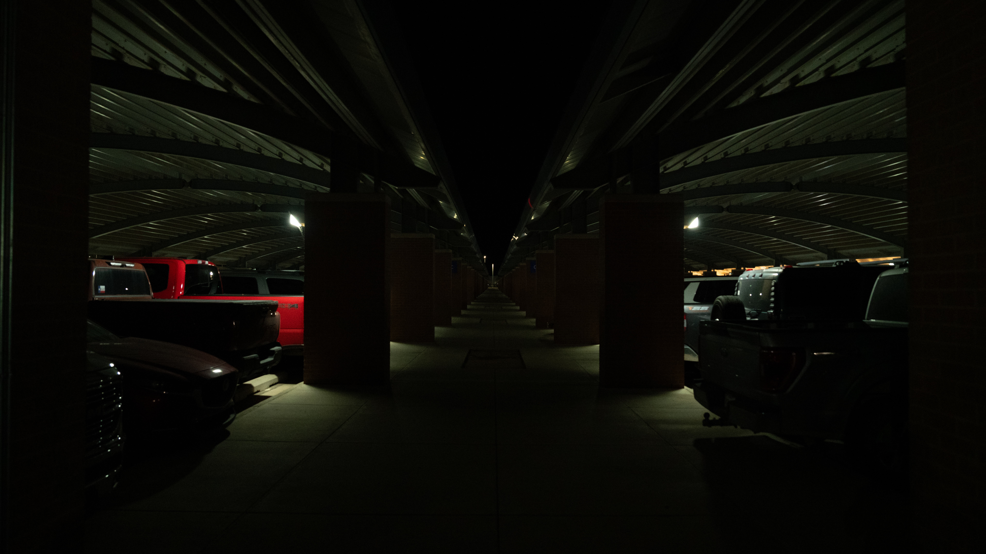
CURRENT STATE
2

Slide 3

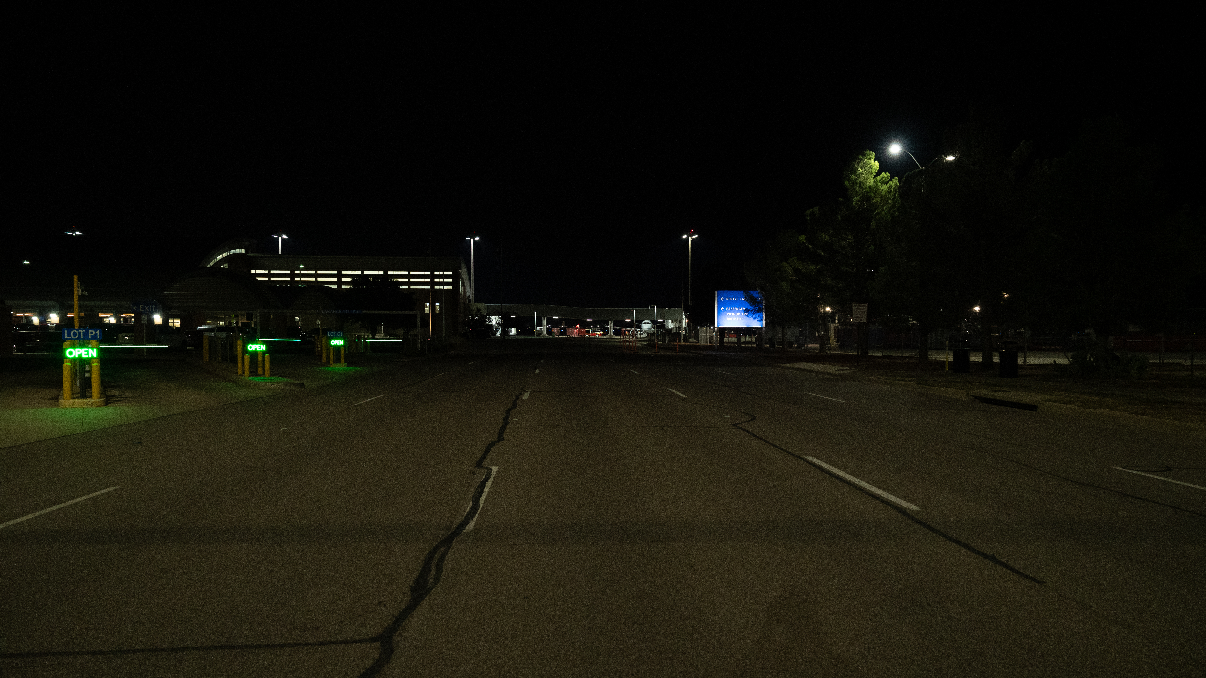
CURRENT STATE
3

Slide 4

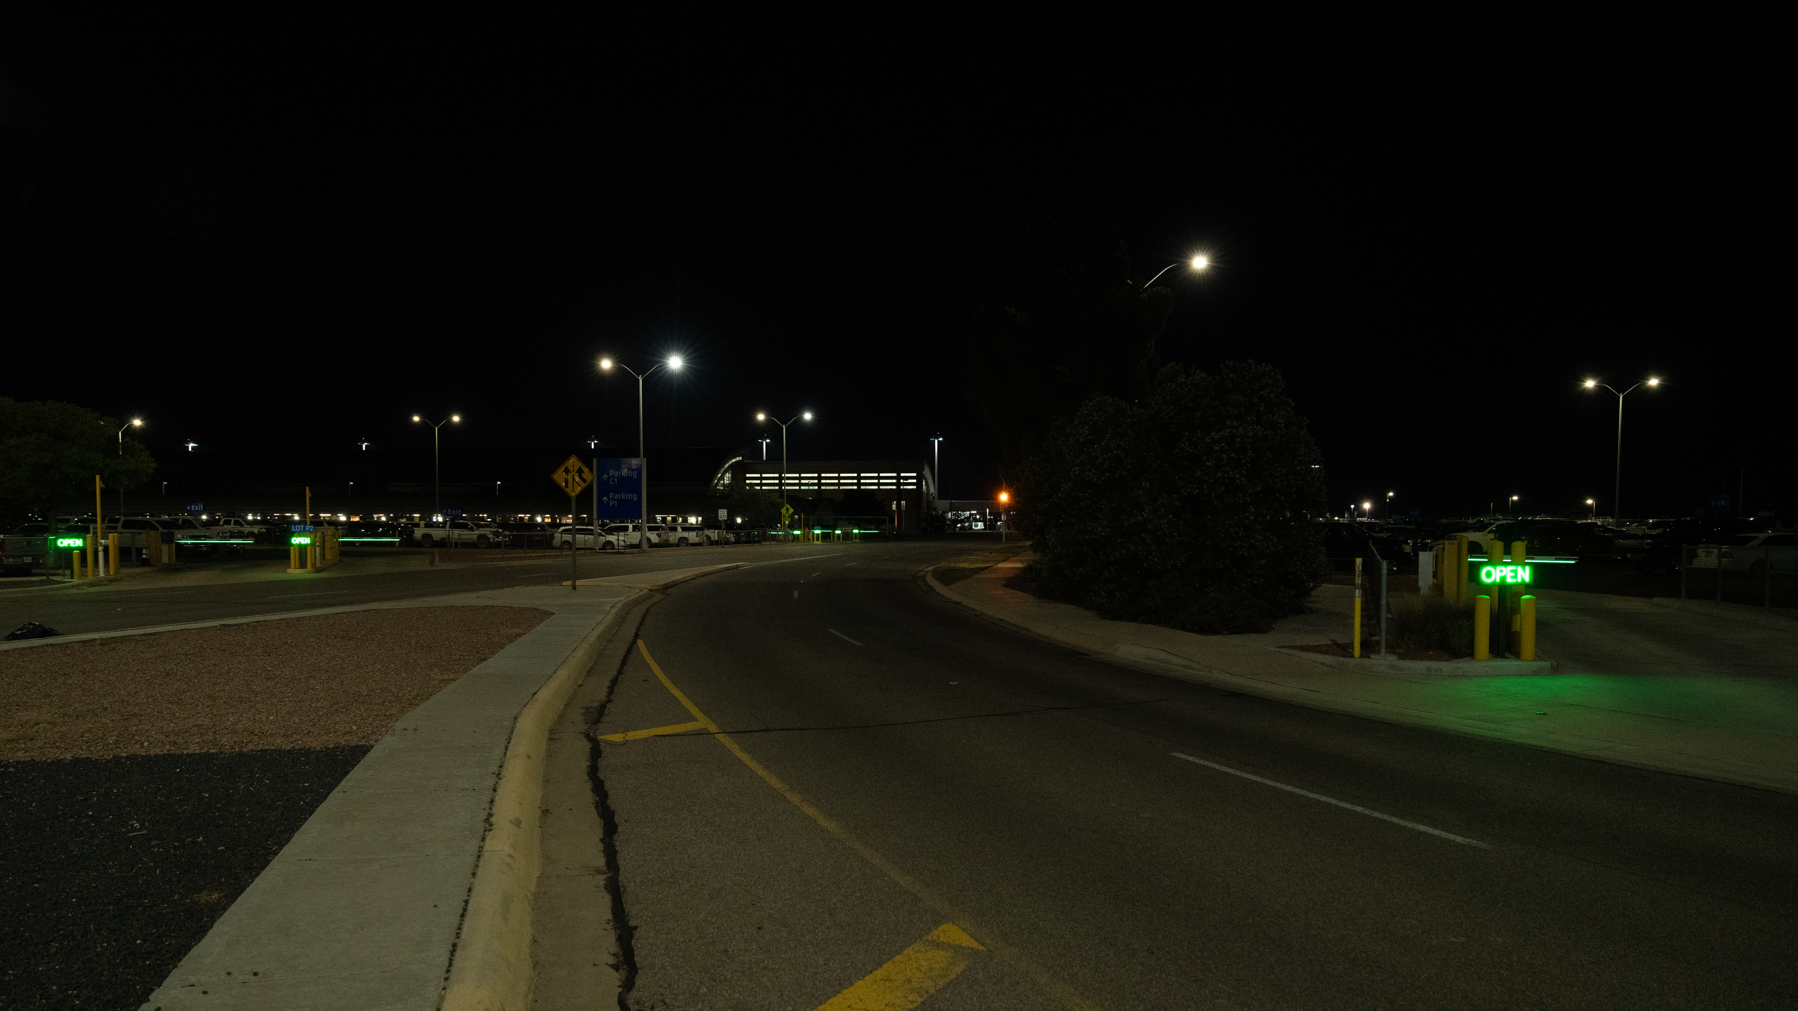
CURRENT STATE
4

Slide 5

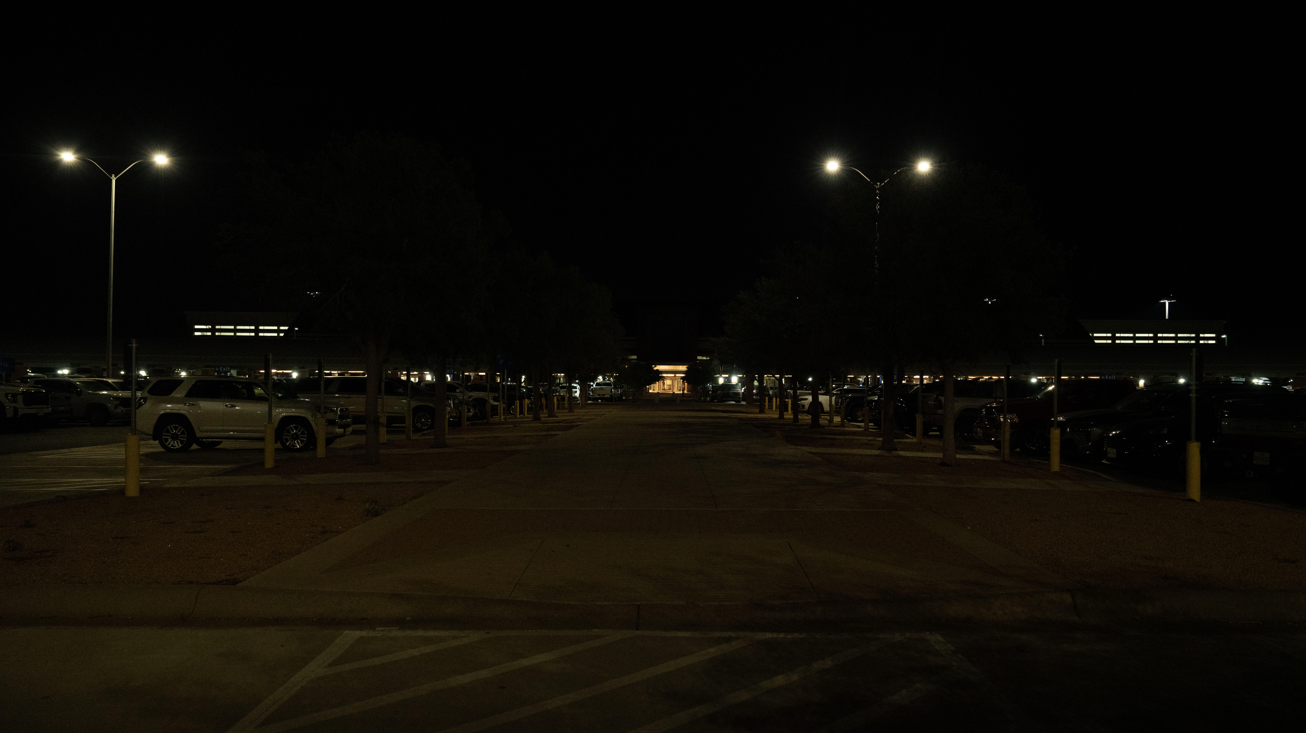
CURRENT STATE
5

Slide 6

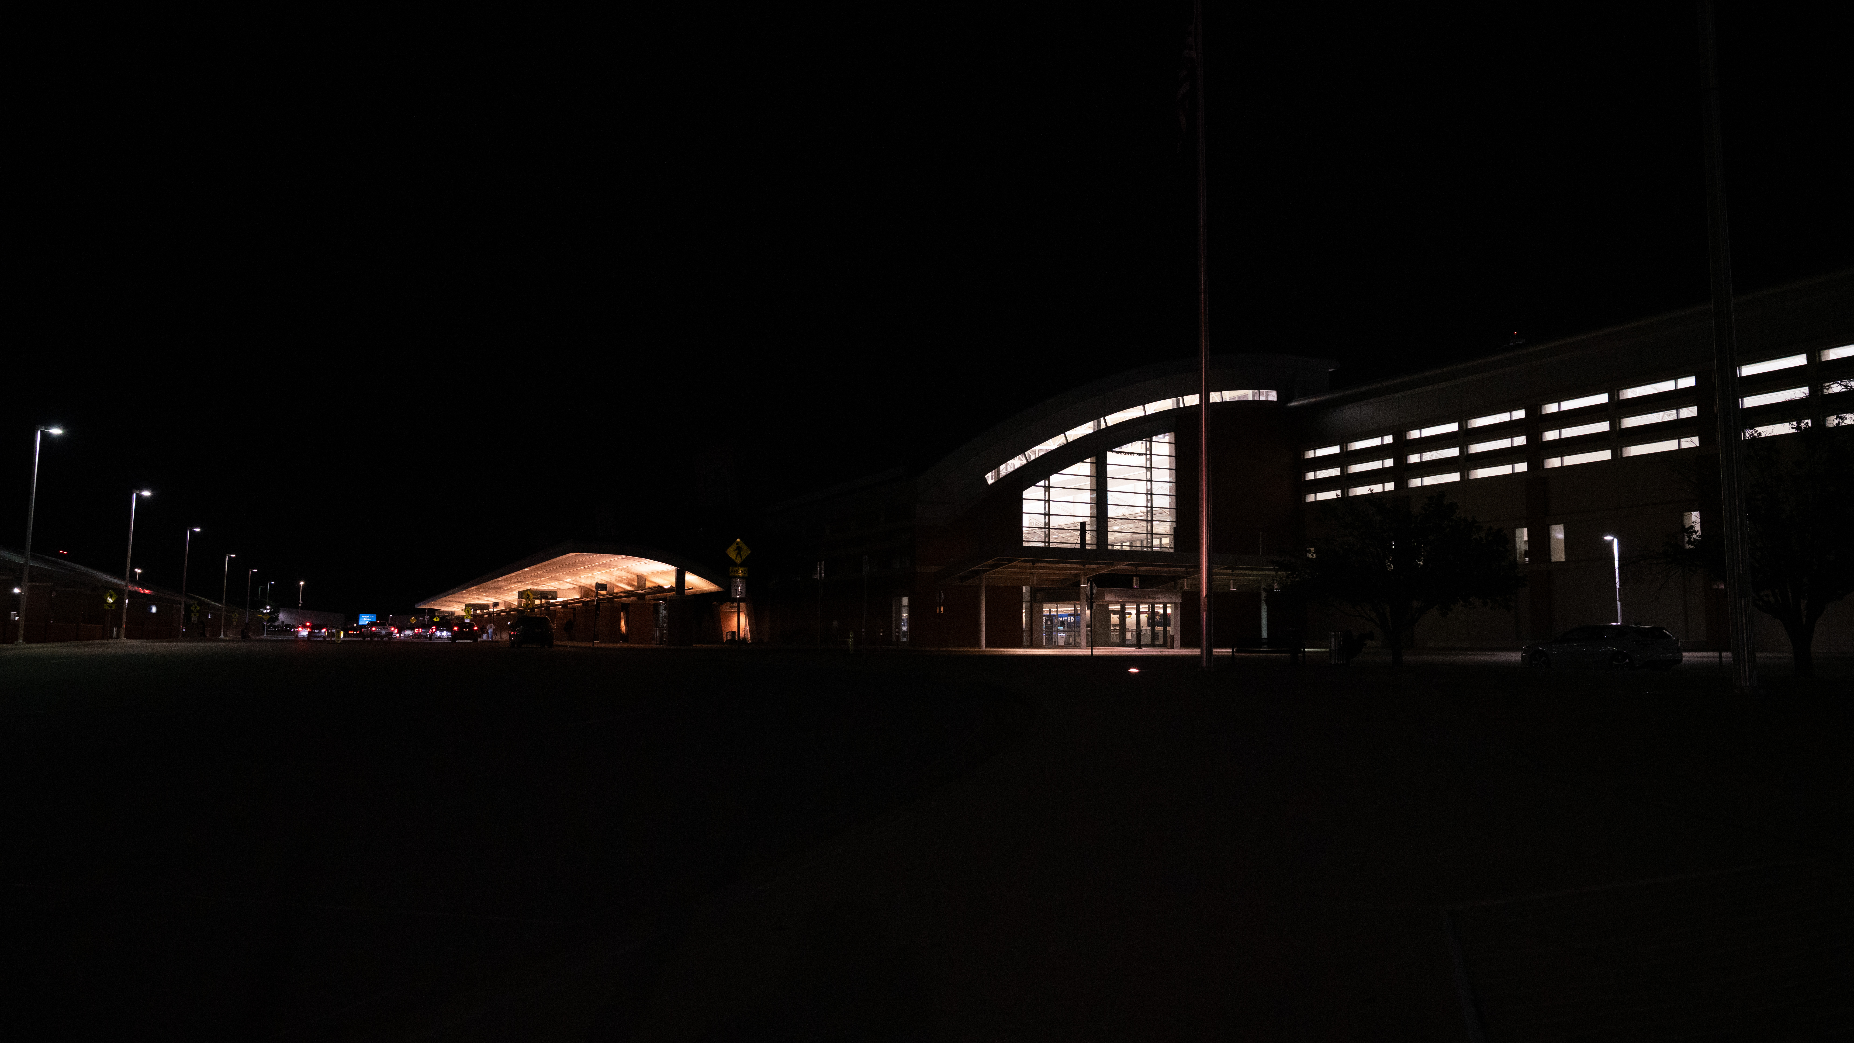
CURRENT STATE
6

Slide 7

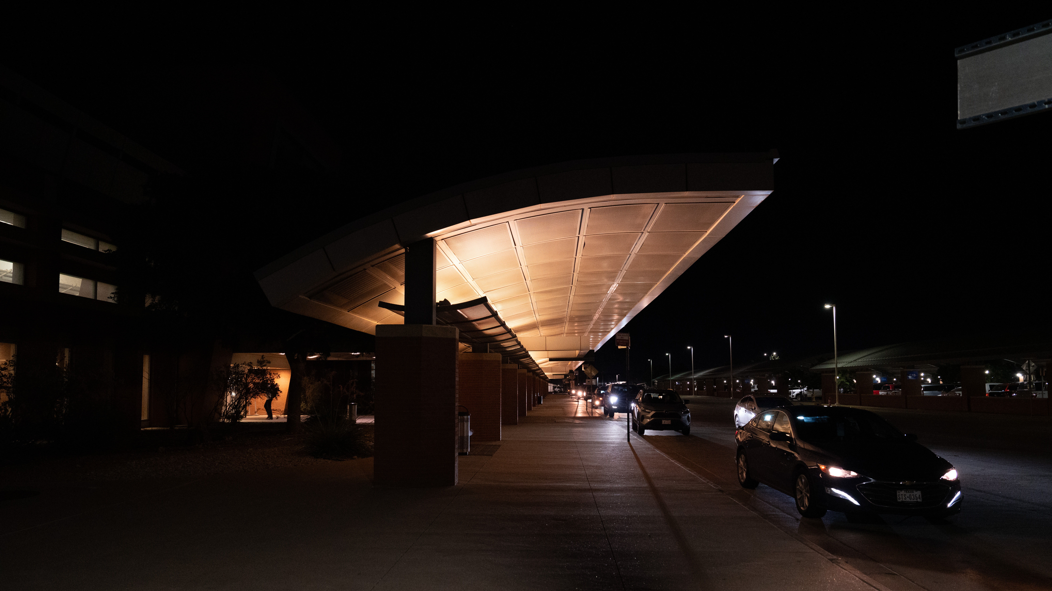
CURRENT STATE
7

Slide 8
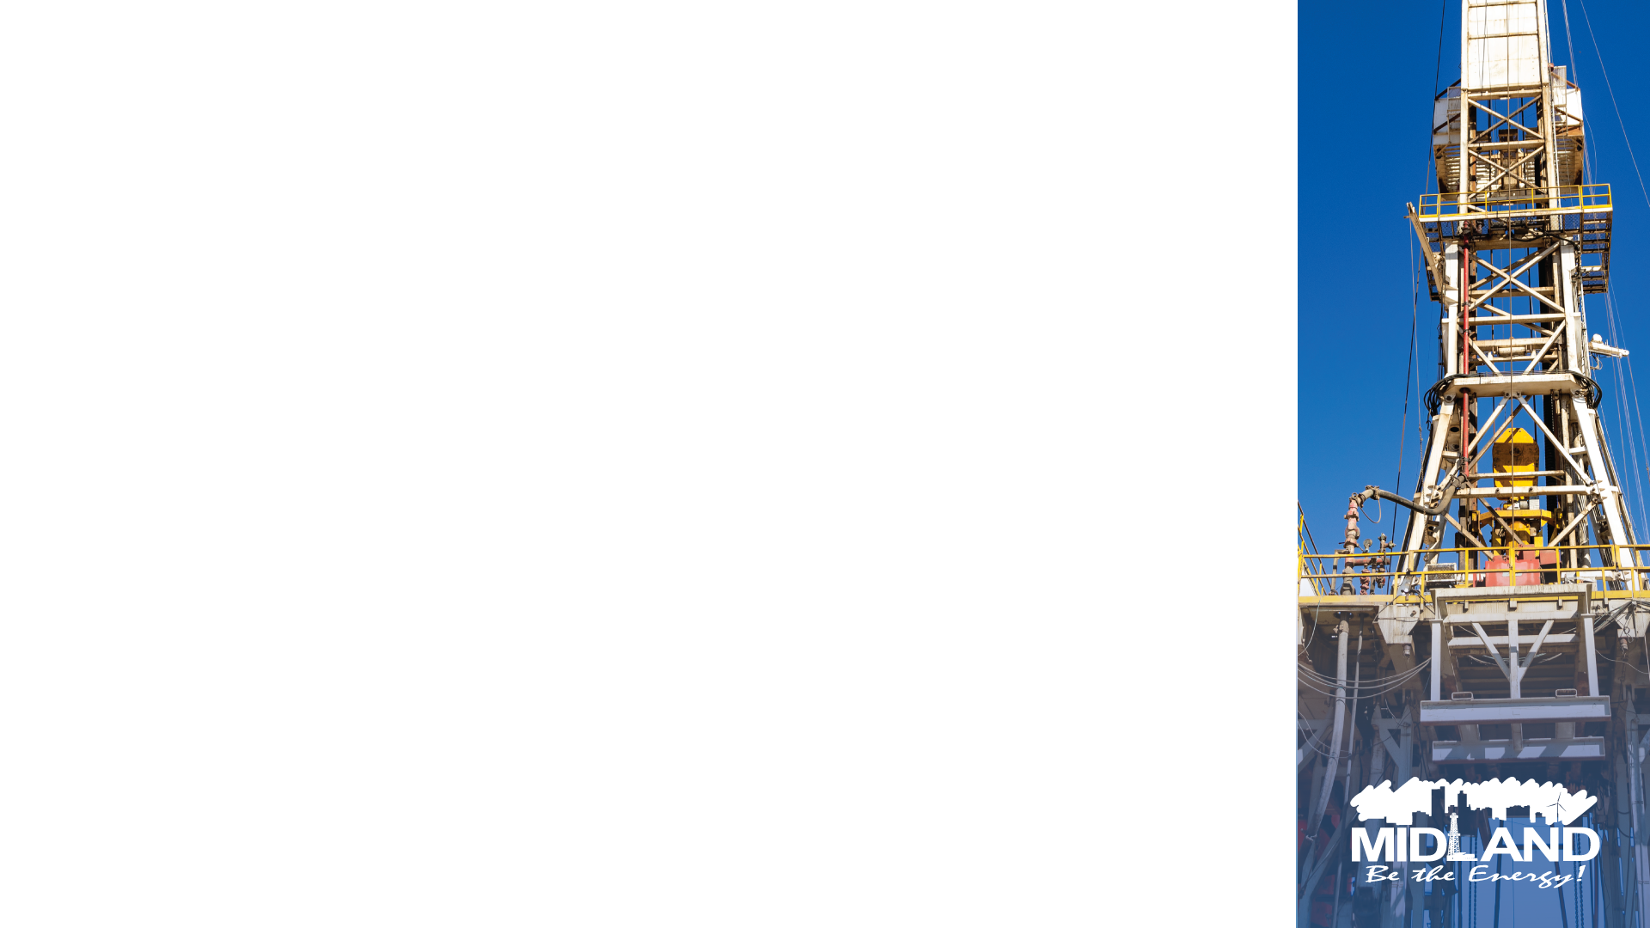
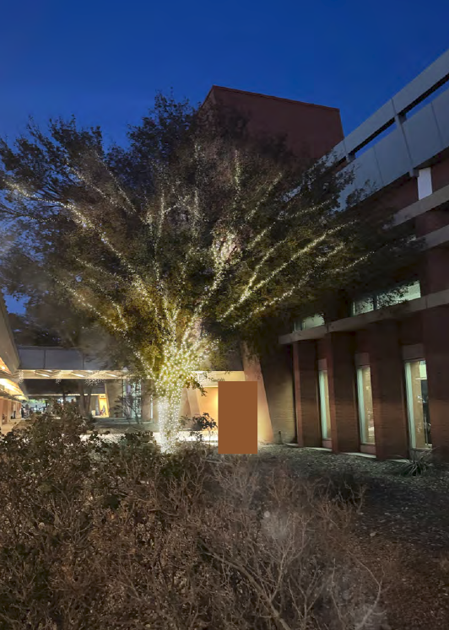
PERMANENT LIGHTING
8

Slide 9

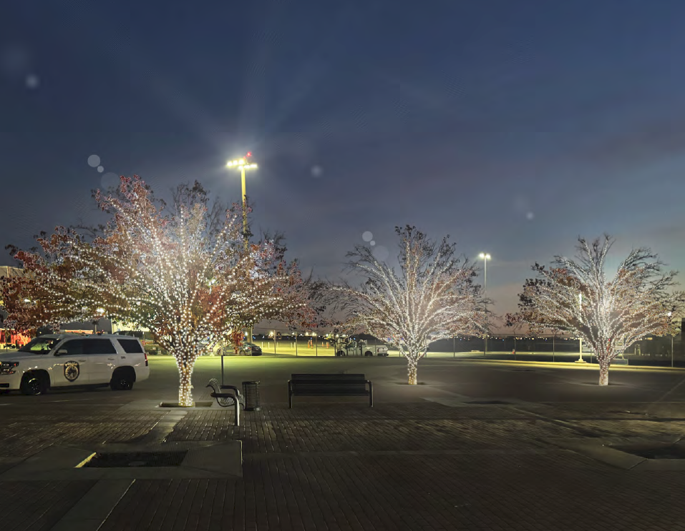
PERMANENT LIGHTING
9

Slide 10
PERMANENT LIGHTING
Expands with trees as they grow
Year-Round Lighting
Provides safety for travelers
Provides a warm welcome into and exiting the airport
Low maintenance. Company provides maintenance.
10

Slide 11

MISSION
Deliver exceptional services and promote a high quality of life and place for ALL our citizens.

