Slide 1

CITY AND MISD
TITLE HERE
TITLE HERE
PARTNERSHIP

Slide 2

STRATEGIC GOAL CONNECTIONS
Goal 6: Strengthen and Sustain our Infrastructure​:
6.2 Enhance infrastructure for economic growth: Improve competitiveness through infrastructure investments that includes collaboration with neighboring jurisdictions and exemplary peer agencies.​
6.5 Implement a funding stream for infrastructure: Establish reliable funding for continual growth.​
6.7 Develop and implement comprehensive road planning and maintenance initiatives: Ensure safe and maintained roads for existing and new developing areas and main thoroughfares.
2

Slide 3

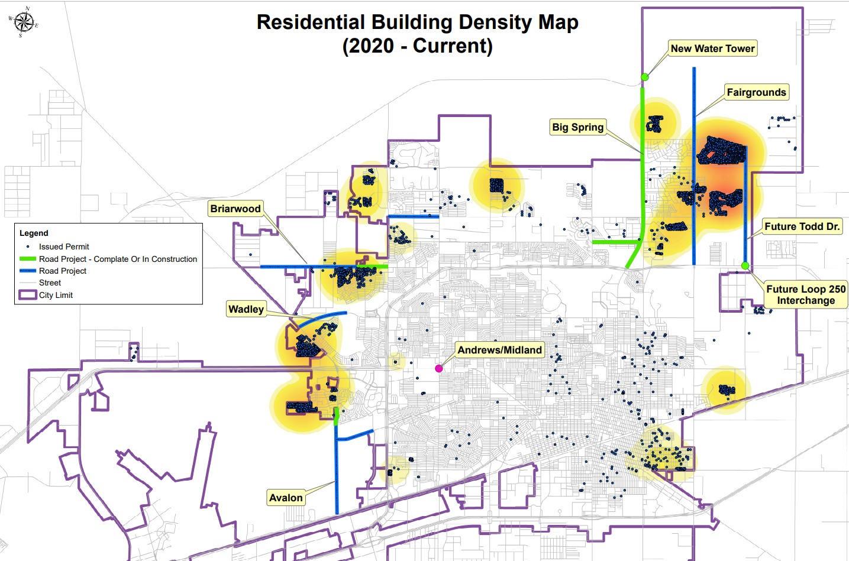
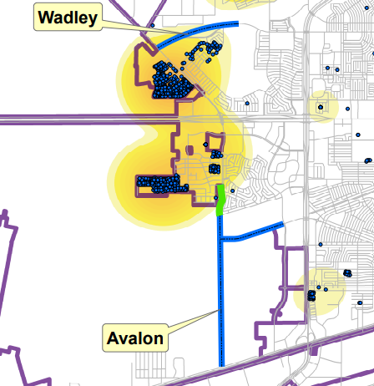
MIDLAND'S GROWTH
3

Slide 4

AVALON & THOMASON PROJECT BENEFITS
Part of 2019 10-Year Capital Improvement Plan
  Planning began in 2014
Improves distribution of traffic
Funding partnership with MISD
Serves high growth area
4

Slide 5

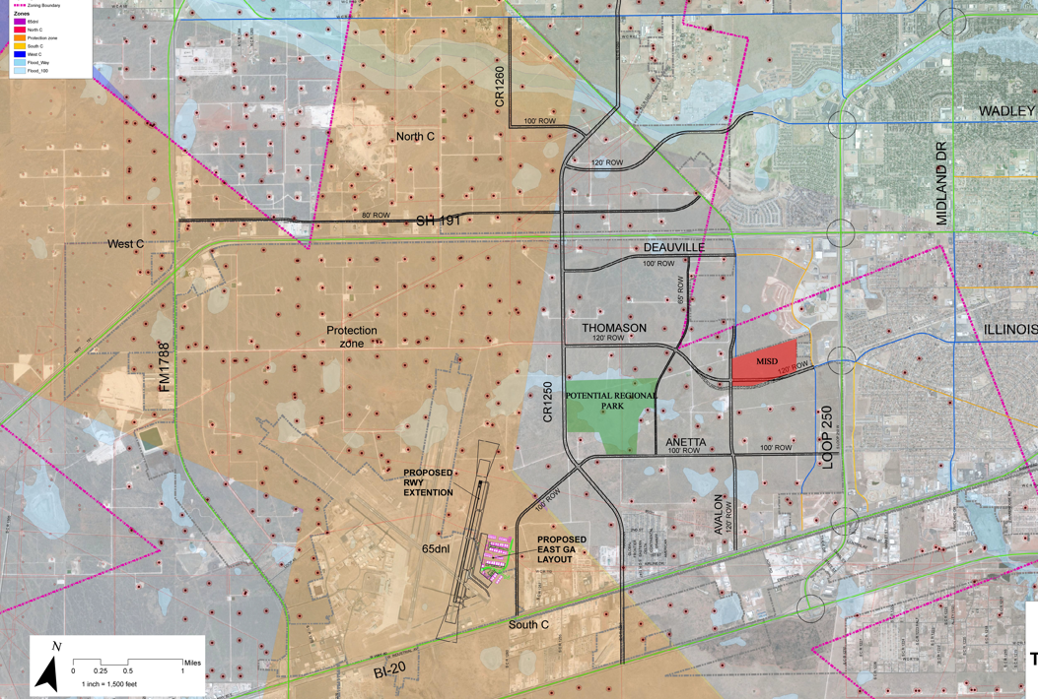
REGIONAL PLANNING IN WEST MIDLAND
5

Slide 6

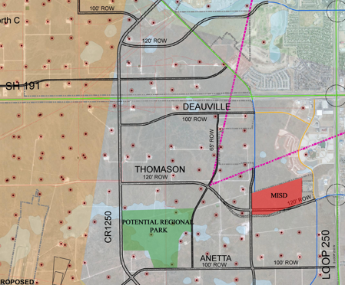
LOCATION
Land Acquisition Along Thomason and Avalon
MISD Dedication of Right-of-Way
Infrastructure Plan Preparation Began in 2014
6

Slide 7

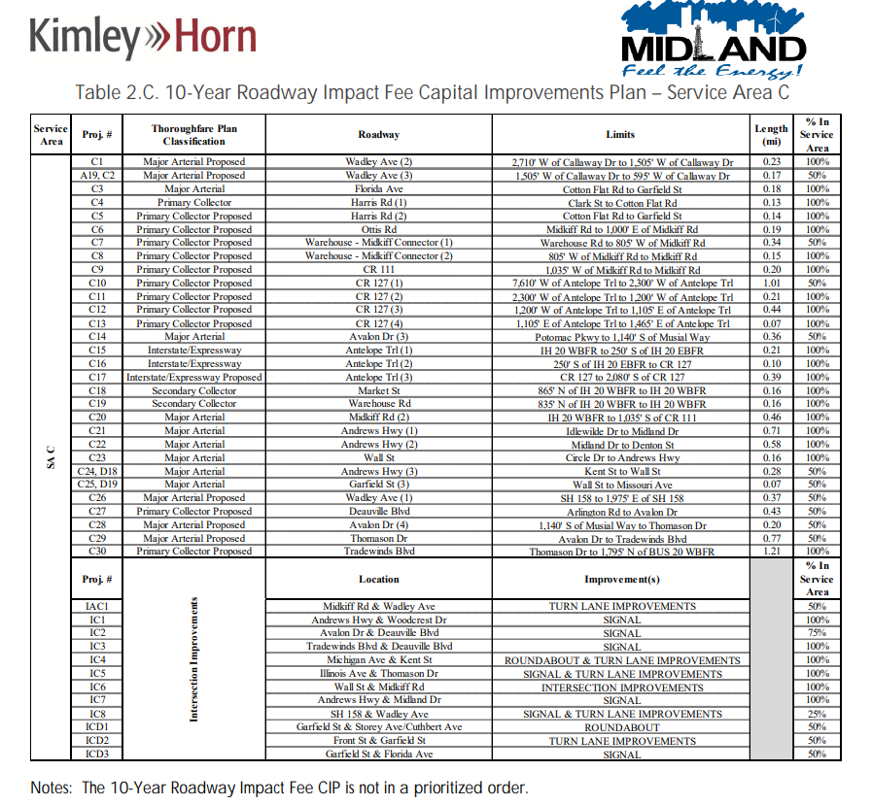
2019 IMPACT FEE CIP
7

Slide 8

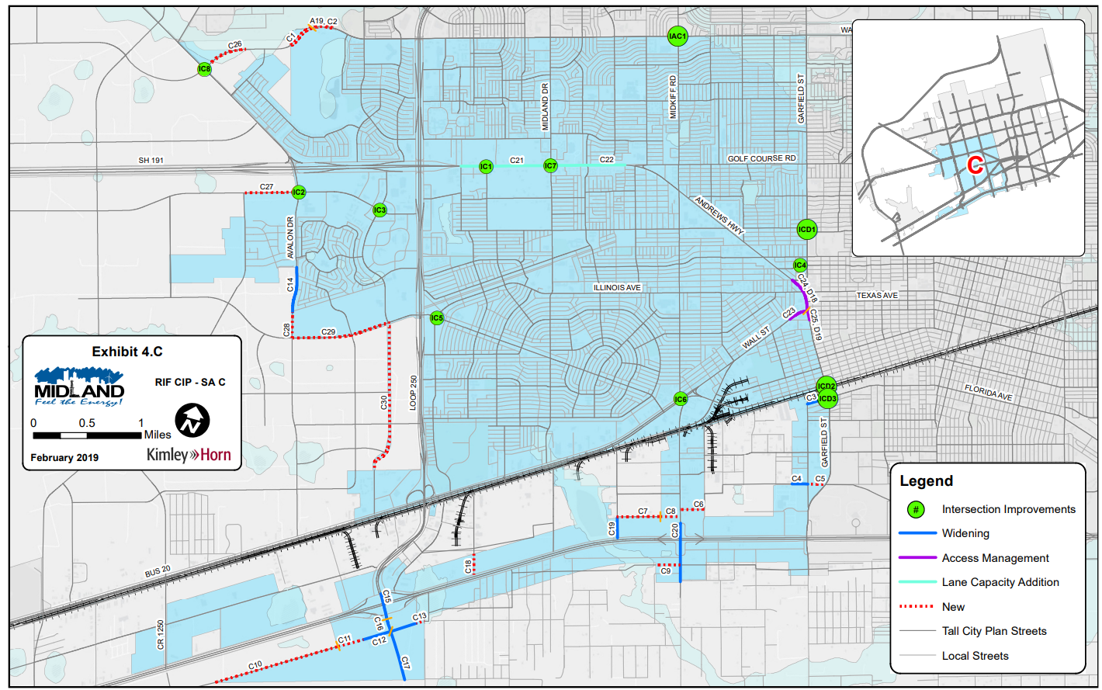
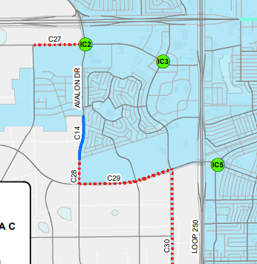
MIDLAND LEE HS 2019 CIP PLAN
8

Slide 9

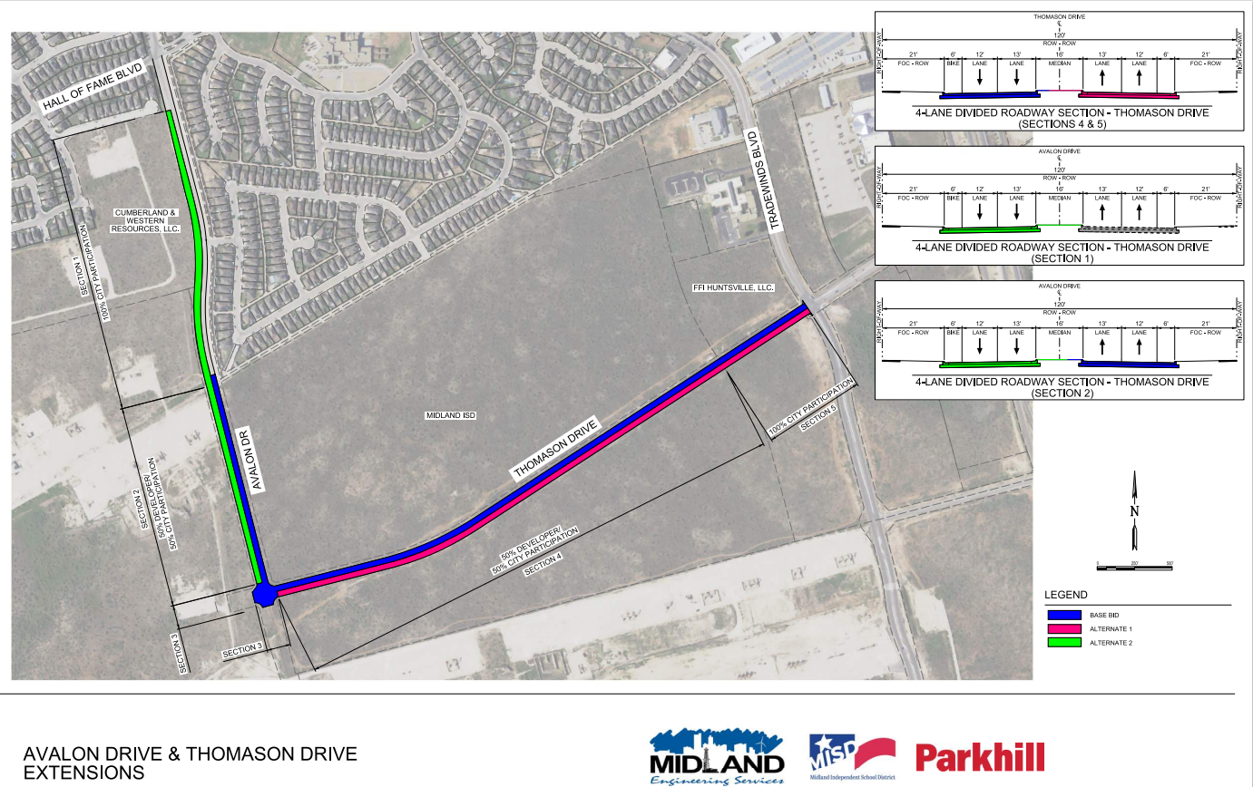
PROJECT MAP: MIDLAND LEE HIGH SCHOOL
Base bid: blue
Alternate 1:
red
Alternate 2:
green
9

Slide 10

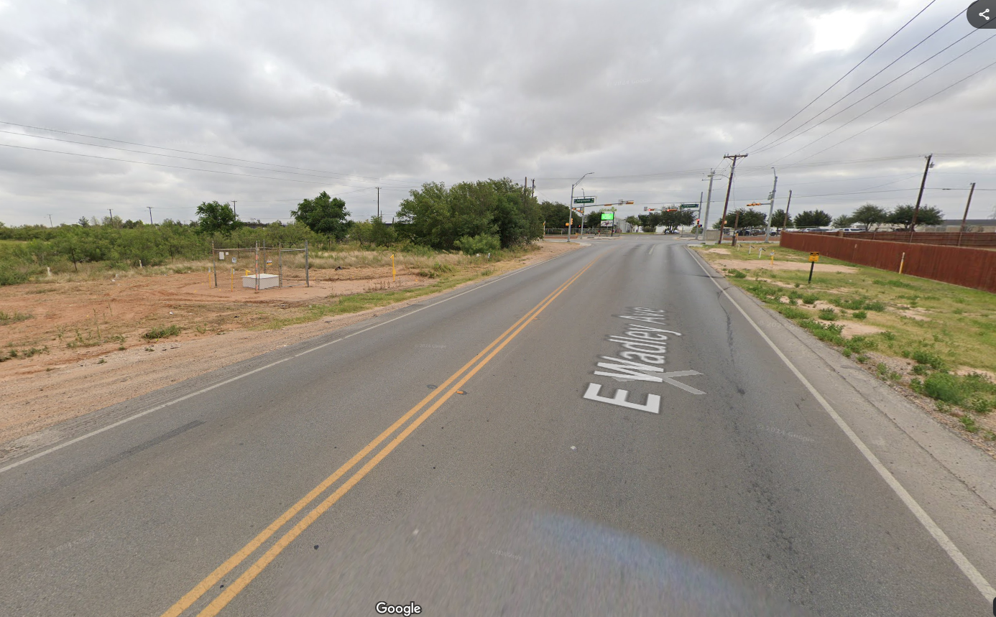
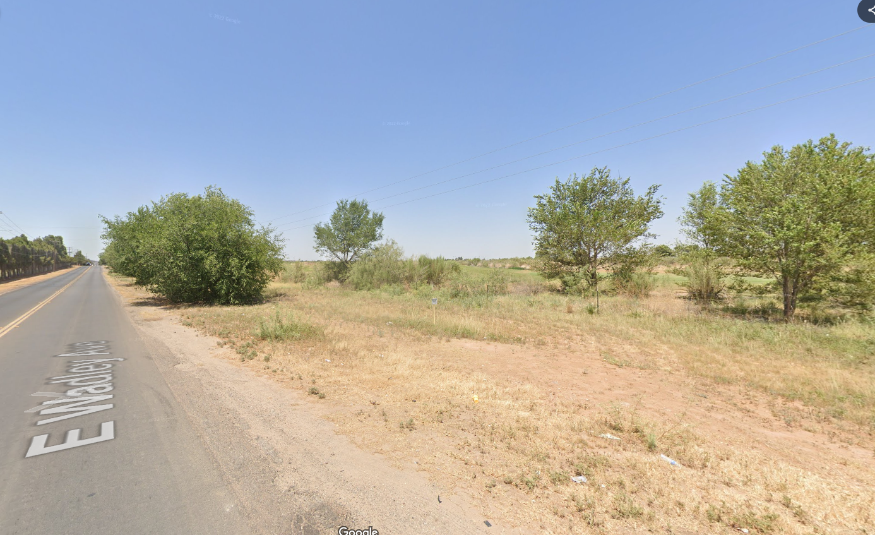
WADLEY AVE. PROJECT BENEFITS
Improves distribution of traffic
Part of 2019 10-Year Capital Improvement Plan
Funding partnership with MISD
Serves high growth area in northeast Midland
Current State

Slide 11
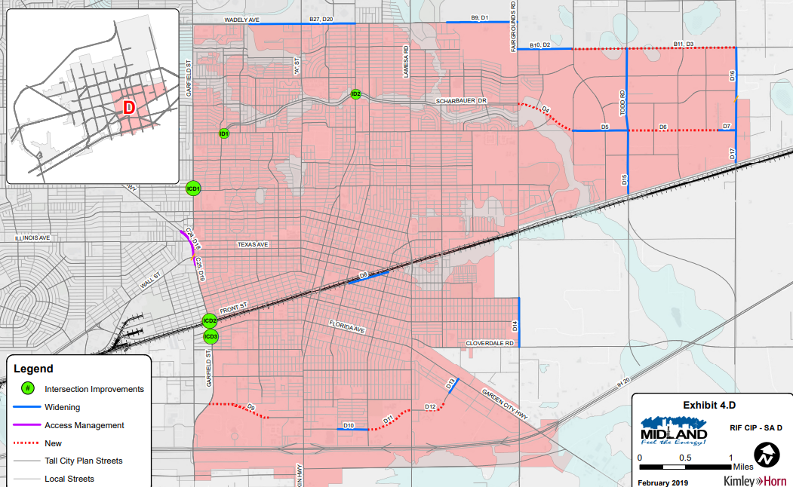
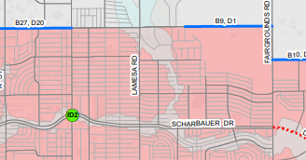
PROJECT MAP: MIDLAND HIGH SCHOOL

Slide 12

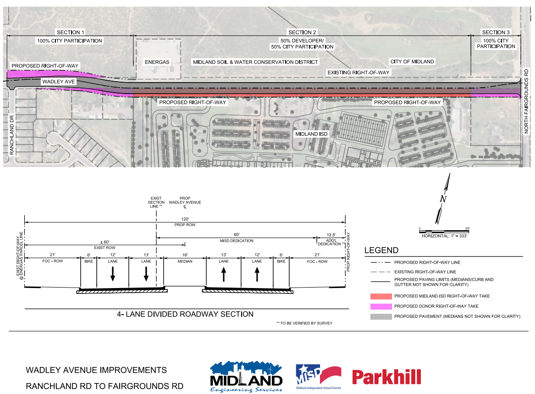
PROJECT MAP: MIDLAND HIGH SCHOOL
One base bid
MISD dedication of right-of-way for road project
Wadley widening compliments the growth in northeast Midland

Slide 13
FUNDING BREAKDOWN
Right-of-Way Infrastructure
Leveraging Funds
TOTAL INVESTMENT: $27,482,073.00 | MIDLAND HIGH SCHOOL | MIDLAND LEE HIGH SCHOOL
City Investment: $18,127,372 (66%) | $6,628,496 | $11,498,873
MISD Investment: $9,354,701 (34%) | $3,459,189 | $5,895,512

Slide 14
INFRASTRUCTURE
Road & Utilities (estimated cost)
100% of funds will be used for public Right of Way
2019 Estimates from Road and Utility Study | 2025 Estimates from MISD Consultant | 2030 Estimates with 5% Inflation
Avalon & Thomason $13M | Avalon & Thomason $18.1M | Avalon & Thomason 23M
Wadley $6.2M | Wadley $9.4M | Wadley 12M
Total: $19,200,000 | Total: $27,500,000 | Total: $35,000,000

Slide 15
LOCK IN TODAY’S PRICING-
PAY LATER
Reimbursement Schedule
  Reimburse MISD 1/3 in January of 2027
  Reimburse MISD 1/3 in January of 2028
  Reimburse MISD 1/3 in January of 2029
15

Slide 16

MISSION
Deliver exceptional services and promote a high quality of life and place for ALL our citizens.

