Slide 1

TITLE HERE
TITLE HERE

Slide 2
FY 2025-2026 BUDGET
TITLE HERE
TITLE HERE
September 9, 2025

Slide 3

STRATEGIC PLAN ALIGNMENT
Goal 5: Provide Sound Governance & Fiscal Management
5.7 Ensure Continued Financial Stability and Accountability: Maintain Financial Transparency
3

Slide 4

PROPERTY TAX RATES:
FY2022 to FY2025
Reduction of 185 Tax Basis Points
4

Slide 5

FY2025 TAX RATES-PEER CITIES
5

Slide 6

FY2025 TAX BILLS-PEER CITIES
6

Slide 7

REAL RESULTS FROM A STRATEGIC APPROACH
RECURRING EFFICIENCIES
Department/Area |  | Type | Amount
Utilities | Strategic Policy Changes & Process Improvements | Revenue | $10,000,000
ITSD | Enterprise IT Optimization | Savings/Cost Avoidance | $870,000
Utilities | Asterra Annual Leak Detection - Water Savings | Savings/Cost Avoidance | $2,101,980
Human Relations | Pre-employment Medical Testing Overhaul | Savings/Cost Avoidance | $500,000
Parks & Recreation | Hogan Golf Course YEARLY Subsidy Elimination | Savings/Cost Avoidance | $700,000
Airport | Airport YEARLY Subsidy Elimination | Savings/Cost Avoidance | $1,000,000
Utilities | Asterra Annual Leak Detection - Energy Savings | Savings/Cost Avoidance | $28,412
Total |  |  | $15,200,392.00
7
Notes:
Let’s zoom in on what this really looks like in action — because strategy without execution is just a plan on paper.
This slide is the proof point of what happens when strategy turns into action.
Across departments — from Utilities to Human Resources to IT — we’ve challenged ourselves to rethink how we operate. Not just to do things more cheaply, but to do them smarter, with more intention, more measurement, and more accountability.
And the result? $15.2 million in recurring, annual efficiencies — dollars that strengthen our base budget every single year going forward. That includes $10 million (and growing) just from billing reforms and policy changes in Utilities — getting our house in order and making sure we bill fairly and accurately.
It includes nearly $900,000 in IT savings — simply by eliminating software we don’t need or no longer use, calling vendors, renegotiating licenses, and tightening what we pay for.
We’ve reduced pre-employment medical testing costs, eliminated unnecessary subsidies, and even saved more than $2 million just by finding and fixing leaks in the water system, and saving water.
These aren’t one-time wins — they’re structural improvements. That means they benefit us year after year. They help to close the gap in the general fund outlook, reduce future budget pressure, and give us breathing room to invest in what matters. In five years time, that is $76 Million, just from these savings and revenue increases alone.
And again, this is just the beginning.
Last Council Meeting, you approved an EMS billing and collections contract to better collect on EMS and Ambulance services, largely from insurance companies— and that’s just one of several initiatives already underway that will grow these savings even further. There are additional efforts in motion — some early-stage, some pending validation — and while we’re not ready to report all of them just yet, we’re confident they’ll push these numbers even higher.
So when we say this is working, it’s not just anecdotal. It’s measurable. It’s repeatable.

Slide 8

STRATEGIC WINS THAT FUND THE FUTURE
ONE-TIME EFFICIENCIES
Department/Area |  | Type | Amount
Multiple | Fire Fighter Pension Obligation Bond Avoidance | Savings/Cost Avoidance | $60,000,000
Engineering | FHWA Safe Streets and Roads for All | Grant | $8,664,368
Airport | Airport Pay Back | Cost Recovery | $5,400,000
Finance | Hotel Occupancy Tax Audit | Cost Recovery | $530,000
Parks & Recreation | Beal Park | Private/Public Partnerships | $16,800,000
Parks & Recreation | Grasslands Park | Grant | $150,000
Parks & Recreation | Wildcatter Trail | Grants | $6,667,495
Utilities | Collection of Delinquent Accounts Receivable | Cost Recovery | $298,043
Airport | Federal ATP Grant for terminal modernization | Grant | $2,800,000
Total |  |  | $101,309,906
Notes:
Following the recurring efficiencies, this slide tells the rest of the story — the one-time wins. These aren’t about trimming fat; they’re about being bold, strategic, and proactive.
This is $101 million in financial impact — made possible through intentional efforts across departments and through Council direction.
Starting at the top:
The $60 million in pension obligation bond interest avoidance was a joint effort between City Council and the Midland Fire Department. It avoided locking taxpayers into decades of interest payments that would’ve gone straight to Wall Street.
This decision kept $60 million off the backs of residents — and kept those dollars local. That’s meaningful, long-term impact.
Looking at the Airport Payback:
This wasn’t new revenue — it was the Airport refunding the General Fund for a prior subsidy.
But what made that possible is even more important: we corrected our enplanement fee structure for the airlines, which means that going forward, the Airport can sustain itself — and we don’t have to keep backfilling with general fund dollars.
Across the board, we’ve taken steps to make one-time dollars do more:
$15 million in infrastructure and mobility grants to reduce local burden.
$530,000 recovered from hotel and motel audits — dollars that belonged to taxpayers, now back in the City’s hands. And enough, may I remind you, to pay for Midland’s Merry Lights in the first year.
$16.8 million in public-private leverage at Beal Park, which would’ve never been possible without the strategy in place.
And even more, with trail and park grants, utility collections, and capital reimbursements — all adding up. Little by little.
Altogether, these one-time wins total more than $101 million. But even more importantly, these types of wins weren’t happening before — not at this scale, and not with this level of coordination.
These outcomes are the direct result of a plan. A financial forecast. A strategy. All of which have only been in place for the last 18 months. That’s the difference leadership makes.
This is what happens when you stop waiting for opportunities — and start building systems to find them.

Slide 9

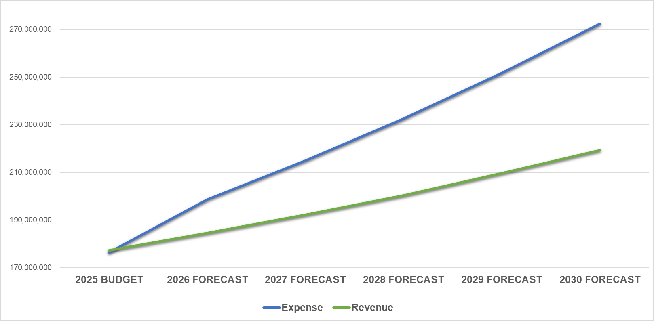
GENERAL FUND: 5-YEAR FORECAST
Average Annual Expense Increase, +8.1%
Average Annual Revenue Increase, +4.2%
Forecast for expenditures outpace revenue by 3.9%.
9

Slide 10
GENERAL FUND: 5-YEAR FORECAST
Natural Small Revenue Growth
State & Federal Funding
Partnerships
(Public & Private)
Remove Subsidies
User Fees
10

Slide 11
GENERAL FUND: 5-YEAR FORECAST
11

Slide 12

STRATEGIC PLAN FUNDING
GENERAL FUND
Strategic Goal | FY2025 Budget | FY2026 Proposed | Difference | Variance
Goal 1: Strong Economy & More Quality Jobs | 6,797,835 | 7,471,603 | 673,768 | 9.9%
Goal 2: Set Standard for a Safe & Secure City | 98,625,111 | 105,909,864 | 7,284,753 | 7.4%
Goal 3: Quality of Life & Place | 11,292,024 | 12,349,686 | 1,057,662 | 9.4%
Goal 4: Transparent & Consistent Communication | 12,790,742 | 13,350,965 | 560,223 | 4.4%
Goal 5: Sound Governance & Fiscal Management | 21,811,768 | 22,140,796 | 329,028 | 1.5%
Goal 6: Strengthen and Sustain Infrastructure | 25,022,222 | 26,235,446 | 1,213,224 | 4.8%
Grand Total | 176,339,702 | 187,458,359 | 11,118,658 | 6.3%
*Total City Budget is $460.9M – an increase of $1.4%
12

Slide 13
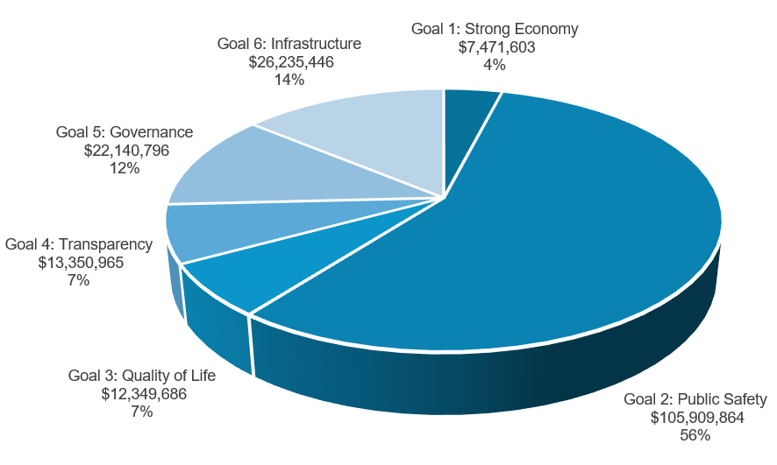
GENERAL FUND
13

Slide 14
GENERAL FUND HIGHLIGHTS
$6.5M Cost of Living and Merit Increases
$500K Police COLA
$1M Fire pay increase and COLA
$500K Fire Retirement Increased Contribution
$2.6M Park Maintenance Budget
$200K traffic calming and pavement marking
$2.1M CO for roads paid out of General Fund
14

Slide 15
WHAT WE HAVE ABSORBED
$100M 2017 Road Bond – did not raise taxes for the road bond referendum
$10M annual cost of Road Bond
$56.8M CO for Infrastructure and Quality of Life
$2M annually for Beal and RMN Parks
$2.1M annually for roads, paid out of General Fund
$2.5M additional costs of employee health and risk insurance
$500K Increase in Fire Retirement Contributions
*$35M in Public Safety Costs not covered by Property Taxes (Absorbed Annually)
15

Slide 16

DEFERRED GENERAL FUND SUPPLEMENTAL REQUESTS
$8.4M Total Requests vs. $3.3M Total Funded
Of $3.3M, $1.3M Funded for General Fund
$1.2M Engineering equipment deferred
$1.9M Animal, Health, and Fire personnel and software deferred
$1.3M Fire Alerting System deferred
$300K ITSD software deferred
$355K Parks personnel and equipment deferred
$5.1M Total deferred FY2026 requests
16
$14M deferred requests for All Funds – FY2025

Slide 17
PROPERTY TAX
Where do your property taxes go?
17

Slide 18



PROPERTY TAX
What do you get for your taxes?
$300,000
Valuation
$4,500
Total Tax Bill
$1,000
City Portion
18
Notes:
79.07 M Ad Valorem Revenue
To
49.628 M Fire (Public Safety)
45.816 M Police (Public Safety)
26.235 M Engineering (Infrastructure)
121.679 M (not including Debt)
153.888% back to Tax Payer

Slide 19






PROPERTY TAX
What do you get for your taxes?
Reduced Crime Rates
Increased Public Safety - ISO 1 Rated Fire Department
New and Upgraded Parks and Recreation
Road Expansions and Maintenance
New Sports Facility – Public Private Partnership
Downtown Activities and Events for the Family
19
Notes:
79.07 M Ad Valorem Revenue
To
49.628 M Fire (Public Safety)
45.816 M Police (Public Safety)
26.235 M Engineering (Infrastructure)
121.679 M (not including Debt)
153.888% back to Tax Payer

Slide 20
PUBLIC SAFETY VS PROPERTY TAX REVENUE
FY2017 to FY2026
$35 Million Deficit between Public Safety Expenses and Property Tax Revenue
20

Slide 21
Historical Tax Levy fy2006 to fy2026 (Represented In Cents PER $100 VALUATION)
Reduction in overall tax burden to the Citizens even after $100M Bond Referendum in 2017
21

Slide 22
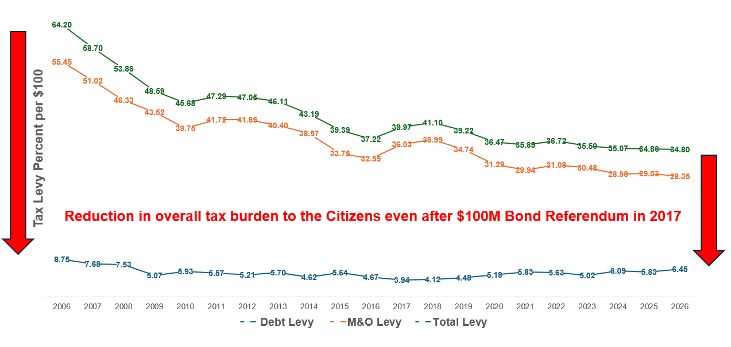
PROPERTY TAX STRATEGY
Total tax rate not increased to
account for $100M Road Bond –
absorbed by the General Fund
Strategically used Oil and Gas funds on hand to take care of 20-year fire retirement fund issue - $54M cash solution saving $60M in fees, interests and taxes associated with a Pension Obligation Bond
22

Slide 23
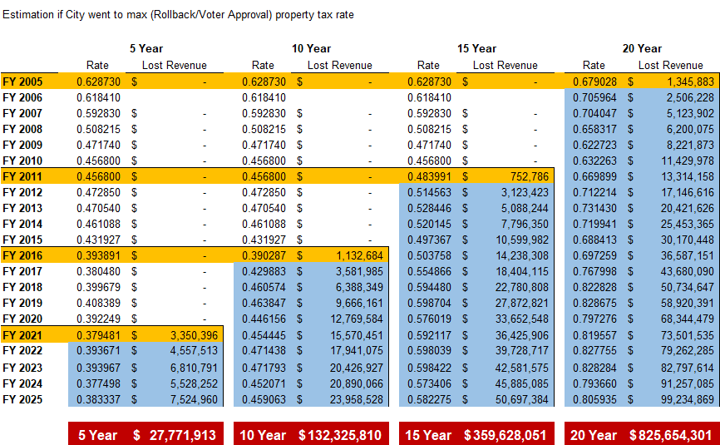
23

Slide 24
FY2025 TAX RATES-PEER CITIES
24

Slide 25


MIDLAND CITIZEN “FUND”:
GIVING BACK TO OUR CITIZENS
FY2026 VAR w/ Increment
FY2025
.348662
FY2026 VAR
$2.2 Million Left in the hands of Citizens
FY2026
NNR
FY2026 Proposed
Instead of adopting the maximum tax rate allowed by law, the City chose a lower rate - prioritizing our residents’ financial well-being
25

Slide 26
2026 PROPOSED TAX RATES*
Tax Rate | Adopted 2024-25 | Proposed 2025-26 | Revenue Inc/(Dec)
Proposed Tax Rate (Adopted for 2024-25) | .348662 | .347999 | $2.1M
No-New-Revenue Rate (NNR) | .344044 | .336458 | ($550K)
Voter-Approval Tax Rate (VAR) | .353200 | .354787 | $3.6M
Voter-Approval w/Increments | .361054 | .366483 | $6.3M
Interest & Sinking (Debt Service) | .058342 | .064451 | $2.1M
26

Slide 27


BUDGET FOCUS
WATER
ROADS
PARKS
PUBLIC SAFETY
27

Slide 28
WATER
$26M total Investment in Infrastructure (5.4%of total city budget)
Replacement of 4” water line, manhole rehab, UEP Program
Innovative maintenance like the Satellite Leak Detection service and Proactive Valve Replacement program
*A Total of $98M is set aside in the budget for Water & Sewer Services
28

Slide 29
ROADS
$9.2M Road Maintenance - Includes $600K
In-House Maintenance
$28M in Road and Signal Bond Projects underway
$2.6M Drainage Improvements – out of $75M in Drainage Needs
*A Total of $39.8M is set aside in the budget for Roads and Engineering
29

Slide 30

PUBLIC SAFETY
$200K Set Aside to Provide for Police Bullet Proof Vest Replacements (over 5 years) and other Equipment (Not budgeted for previously)
$2.3M increase in Replacement Vehicles for Police & Fire
$1M COLA increase for Police & Fire
$500k increase for all FF staff
$500k Contribution added to Fire Retirement Fund
*A Total of $99M is set aside in the budget for Public Safety
30
Notes:
Hire of Equipment for Orgs 001105 through 001125 (Police and Fire)
FY2025 – $9.5 M
FY2026 - $11.8 M

Slide 31
PARKS
$4M Upgrades and Replacements
$12.3M General Fund Park Budget – 18% Increase over last 2 years
$2M Set Aside for Future Park Updates and Replacement Needs
Ongoing Bond Projects for Parks
Public Private Partnership Projects - Over $20M invested
*A Total of $22M is set aside in the budget for Parks
31

Slide 32
INCREASED SERVICE LEVELS
“Thank you so very much for your assistance. I appreciate the many individuals that make our city work and their time and dedication. Thank you for your service.”
– Citizen after using SeeClickFix
“Thank you again for your concern and for your continued commitment to the city. We truly value being a part of this community and are committed to contributing in a meaningful and respectful way”
– Code Enforcement Requestor
“The Dallas builder submitted plans and let me know that in record time and in the smoothest process yet he was able to secure the permit! I just wanted to say thank you for the work you all are doing to continuing to refine this process! It is getting noticed!”
– Permitting Customer
32

Slide 33
BUDGETING BOTTOM LINE
Lower Tax Rate: 3rd Consecutive Year
Strong Investment in Water, Roads, Public Safety and Parks
Long-term Strategy to keep taxes low
Financial Discipline and Conservative Practices
33

Slide 34

MISSION
Deliver exceptional services and promote a high quality of life and place for ALL our citizens.

