Slide 1

TARGETED SAFETY ACTION PLAN
TITLE HERE
TITLE HERE
SEPTEMBER 9, 2025
Notes:
Today, together with Chief Snow and George, I’m presenting a Targeted Safety Action Plan for Downtown Midland.
The bottom line is this: safety drives economic growth.
Businesses, residents, and visitors choose where to spend time and money based on how safe they feel.
If downtown is safe, it thrives.

Slide 2
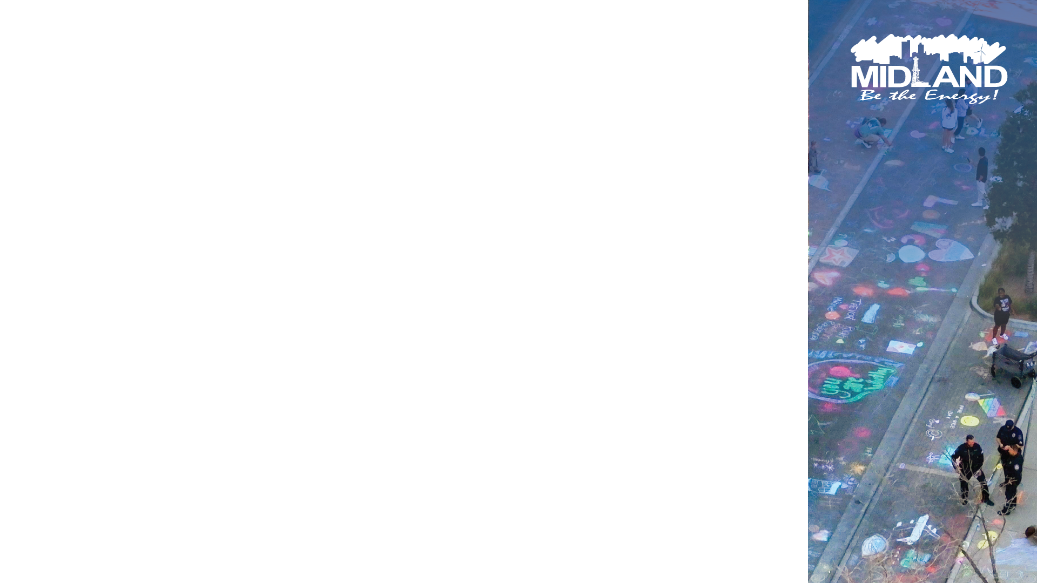
STRATEGIC GOAL CONNECTIONS
Goal 2: Set the Standard for a Safe and Secure City
2.1 Be the Safest City in West Texas
2.3 Implement Effective Code Enforcement Strategies
2.6 Grow and Retail Public Safety Resources
Goal 1. Strong Economy with More Quality Jobs
1.3 Continue Downtown and West Midland Redevelopment
1.9 Establish Our Community as a Premier Destination for Retail and Entertainment
2
Notes:
This plan directly supports our Strategic Goals: being the safest city in West Texas, continuing downtown redevelopment, and investing in technology to make limited resources go further.

Slide 3

STRATEGIC GOAL CONNECTIONS
Goal 3: Quality of Life and Place for Recruitment and Retention
3.3 Create an Attractive and Inclusive Living Environment
3.4 Establish Beautification Programs
Goal 6: Strengthen and Sustain Infrastructure
6.8 Empower Midland Through Smart and Secure Technology
3
Notes:
Safety is not just a policing issue—it’s foundational to Midland’s growth, investment, and quality of life.

Slide 4

SAFETY MATTERS
Safety is the foundation for downtown growth – businesses invest where people feel secure.
Safe streets drive foot traffic and nightlife, boosting sales and visitor spending.
Protecting safety safeguards past investments and builds confidence for future development.
4
Notes:
Safety is the foundation for downtown growth.
When streets feel safe, more people come downtown to eat, shop, and attend events.
That activity drives sales, tourism, hotel stays, and new investment.
Without safety, past investments are at risk, and future growth is harder to secure.

Slide 5

PRESENTATION PURPOSE
Share data on crime trends in Downtown Midland
Present a data-driven safety action plan to address hotspots through:
Enhanced Policing & Patrol
Security & Technology
Licensing & Regulation
5
Notes:
During this presentation, we’ll look at the data driving downtown crime and the focused plan to reduce it through patrols, technology, licensing, and partnerships

Slide 6
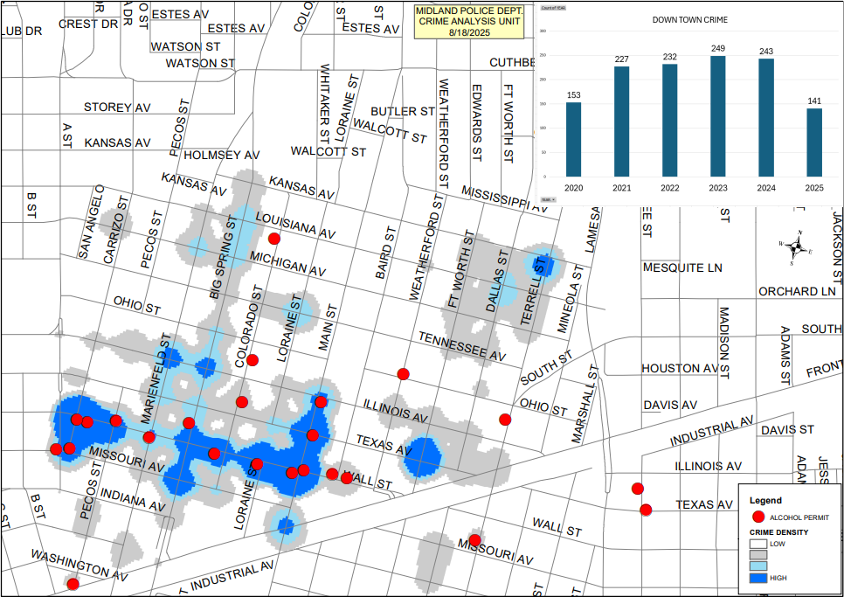
DOWNTOWN CRIME DATA SNAPSHOT
Notes:
Here’s where we stand.
Downtown incidents rose from 227 in 2021 to a peak of 249 in 2023.
They held high in 2024 at 243.
This year, 2025, we’re trending down, with 141 incidents to date.
That’s encouraging — but crime remains concentrated in just a few corridors.

Slide 7

DOWNTWON CRIME DATA SNAPSHOT
Incidents rose from 227 (2021) to 249 (2023), held high in 2024 (243); 2025 is trending down with 141 incidents to date.
Crime is concentrated in nightlife corridors – Missouri, Colorado, Big Spring, Wall Street.
Hot spots overlap with alcohol-permitted establishments
Notes:
The hot spots are Missouri, Colorado, Big Spring, and Wall Streets.
And these areas align almost exactly with alcohol-permitted establishments.
The pattern is clear: late-night activity tied to bars and restaurants is driving the bulk of downtown incidents.

Slide 8
A REVIEW OF BEST PRACTICES
Targeted Patrols
Downtown substation + dedicated late-night patrols reduced violent crime.
Extra officers and private security on nightlife corridor during peak hours.
Smarter Technology
Requires bars to adopt ID scanners and CCTV; and strong exterior lighting.
Safe bar program ties venue certification to surveillance and safety training.
8
Notes:
Other cities facing the same issue show us what works:
One city added a downtown substation and dedicated patrols.
Another paired police with private security on its busiest streets.
Others improved safety through added surveillance and exterior lighting.

Slide 9
A REVIEW OF BEST PRACTICES
Stronger Licensing & Regulation
After-midnight permit fee funds police details for nightlife areas.
Require security staff, cameras, and safety plans for late-night lounges.
Business & Community Partnerships
“Safe Bar” initiative trains bar staff in de-escalation and sexual assault prevention.
Nighttime Economy Manager coordinated funding for lighting in bar districts.
9
Notes:
Some cities focused on licensing and regulation, adding an after-midnight permit fee so bars share the cost of extra security of security
Others focused on licenses that require security staff, cameras, and safety plans for late-night lounges
Still others focused on partnerships with local bars and businesses to train security staff and establish public-private partnerships for additional lighting in bar districts.

Slide 10

IMPLICATIONS FOR ACTION
Patrols: Focus late-night police presence on Missouri-Colorado-Big Spring-Wall Street corridors.
Technology: Add lighting, cameras, and smart monitoring in highest-density areas.
Licensing & Enforcement: Strengthen requirements for bars in hot spot areas.
10
Notes:
The lesson is simple: the best results come from combining enforcement, technology, regulation, and partnerships.
And we’re applying that same four-part approach here

Slide 11
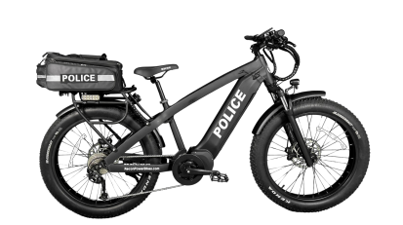
MIDLAND RESPONSE:
POLICING & PATROL
Implement data-driven patrol allocation, focusing on hot spots
Increase officer presence in hot spots during peak hours
Deploy specialized details (e.g., off-duty or bike patrols) for visibility
Bike Patrol Advantages
Mobility & Speed: Navigate crowds and traffic for faster response
Visibility & Engagement: Street-level presence is more visible and approachable
Cost & Efficiency: Lower cost than vehicles, enabling more coverage
Notes:
With respect to policing and patrol:
We will increase late-night presence in the hot spot corridors; and
Use data to deploy where incidents actually occur.
We also plan to establish a bike patrol, which is faster in crowds, highly visible, and more cost-efficient than cars.

Slide 12
TARGETED SAFETY ACTION PLAN
Deploy Specialized Detail: Unit staffed by overtime
Unit Composition: 2 ebike officers supported by 2-man patrol cruiser.
Deployment: Friday and Saturday from 10:00 p.m. to 3:00 a.m.
Enforcement Model: Unit designed to deploy to additional/other hot spot areas as they develop.
Potential Funding Source: Downtown TIRZ
12
Notes:
The unit is designed to be somewhat self-contained. The support cruiser will not only provide two more officers to deal with larger issues, but the cruiser will be able to transport prisoners, and provide additional equipment, such as first-aid resources.
The unit is designed to act independently and to effect on-duty resources minimally to none.

Slide 13
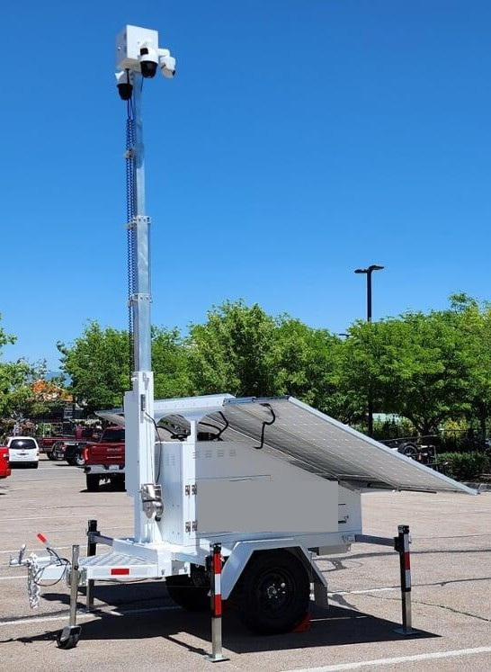
MIDLAND RESPONSE: MOBILE SURVEILLANCE TRAILERS
Highlights:
Rapid deployment & flexibility: Can be positioned quickly where needed.
Hybrid power systems: Battery, solar, and generator options for reliable uptime.
Long runtime & high capacity: Extended operation without frequent refueling.
Deterrence through visibility: Red/Blue lights, signage, and lighting discourage crime.
Benefits:
Flexible, scalable deployment.
Continuous operation, even off-grid.
Strong visual deterrent for public safety.
Notes:
First, we’ll use mobile surveillance trailers.
These can be rapidly deployed to hotspots, run reliably with hybrid power, and act as a visible deterrent with lighting and signage.

Slide 14
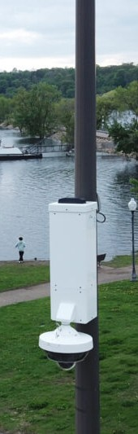
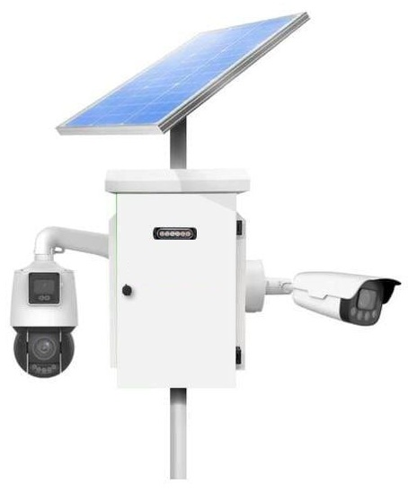
MIDLAND RESPONSE: LIGHT POLE-MOUNTED & EXPANDED CAMERA NETWORK
Highlights:
Add surveillance cameras to existing light poles.
Expand from limited coverage to wide-area monitoring.
Capture multiple angles with broad day/night visibility.
Blend into the streetscape without disrupting aesthetics.
Benefits:
Greater coverage with fewer blind spots.
Reliable video evidence for investigations.
Safer environment for businesses and residents.
Notes:
Second, we’ll expand our camera network by adding cameras to existing light poles.
This gives us broader coverage, fewer blind spots, and reliable video evidence, all while blending into the downtown streetscape.

Slide 15
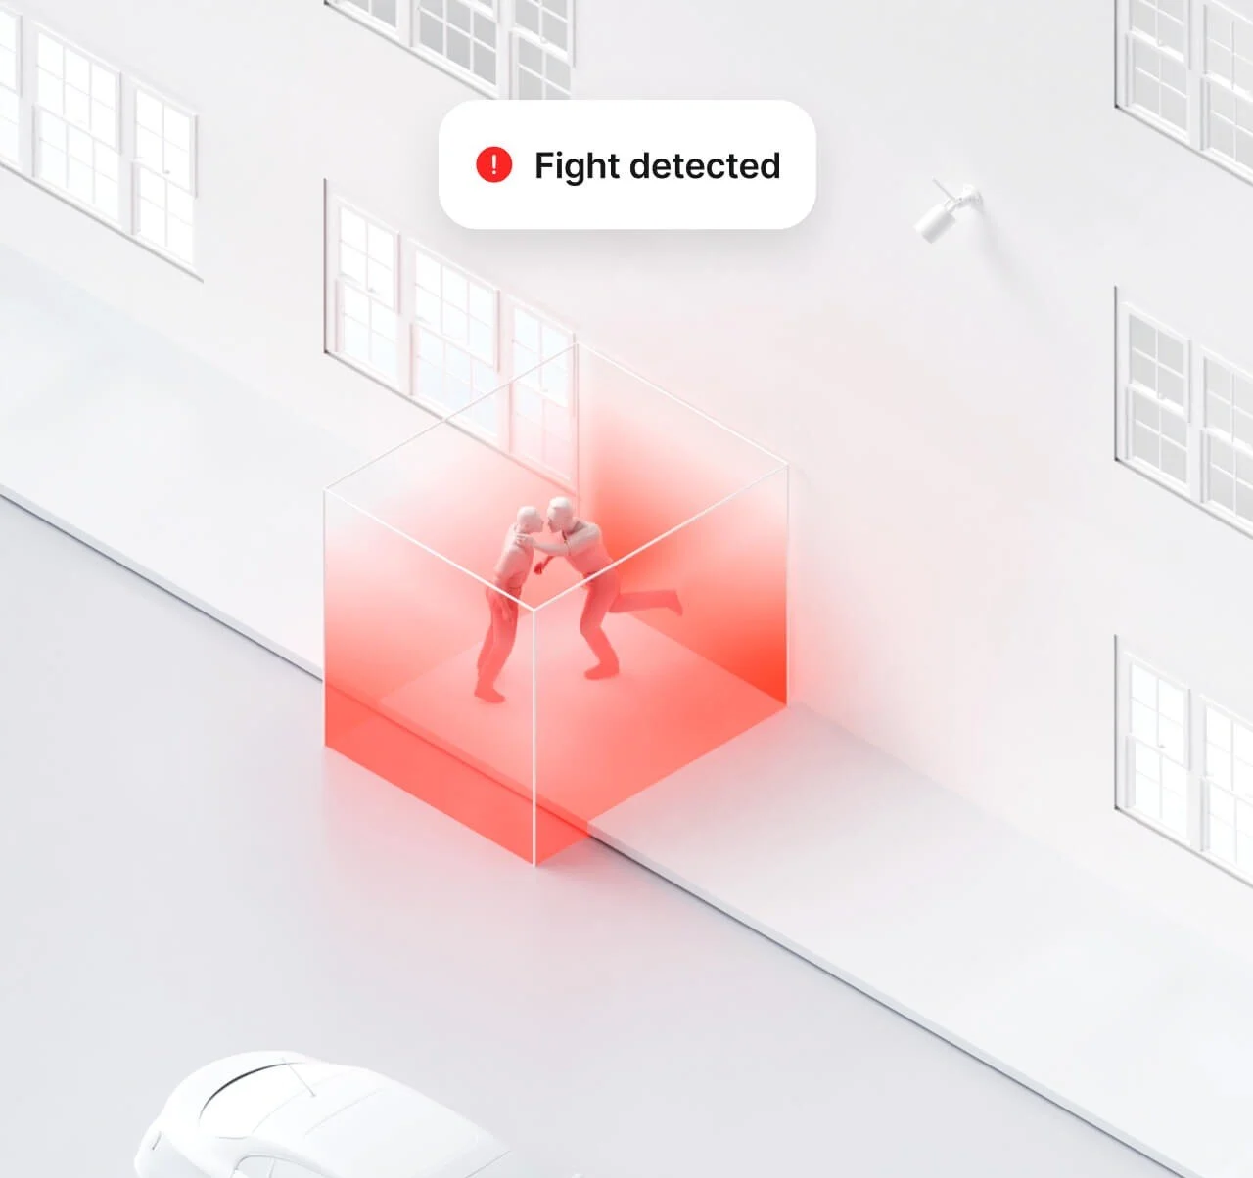
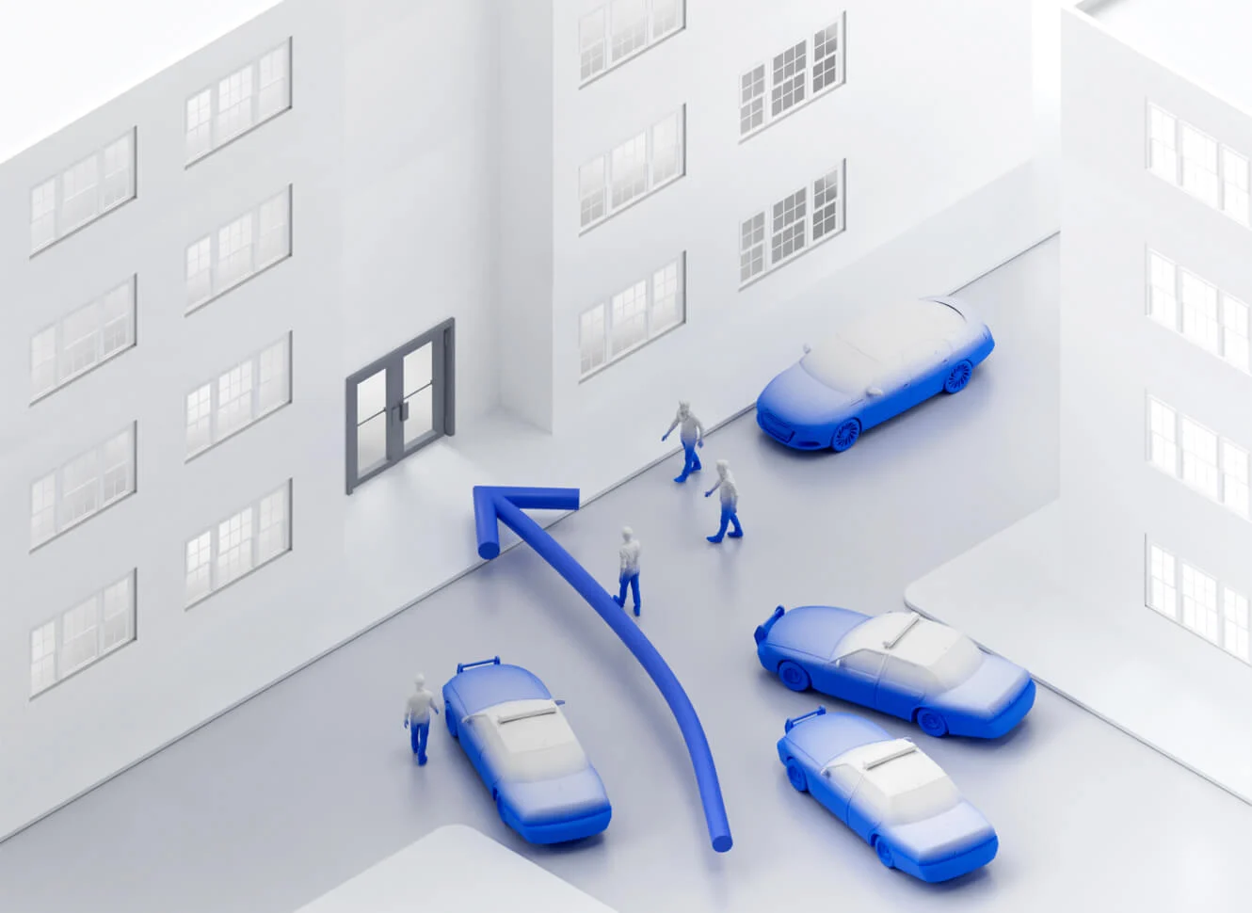
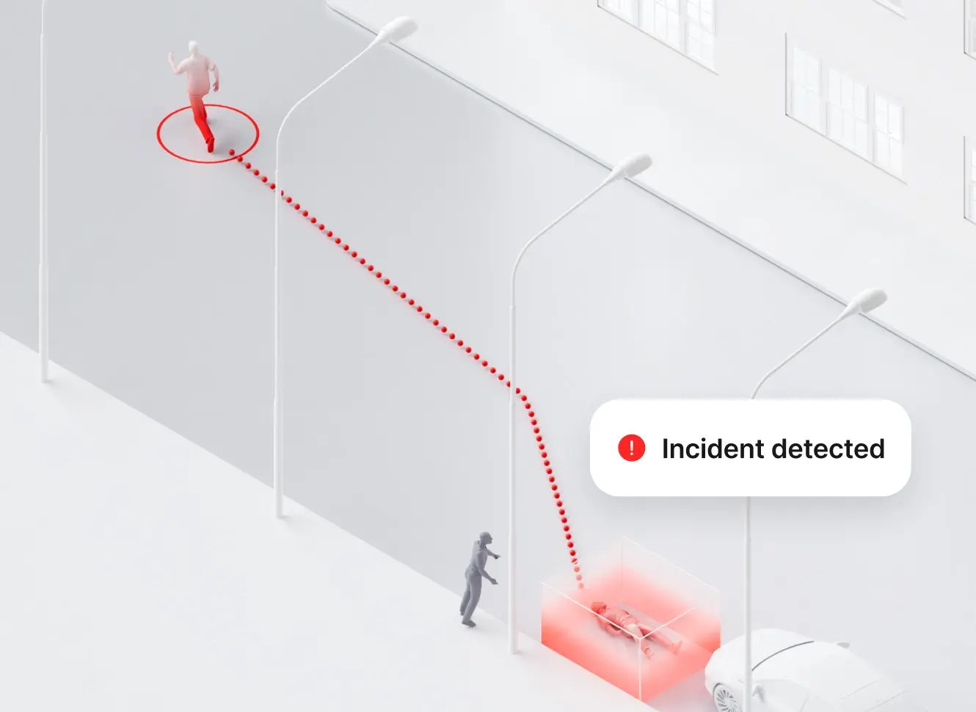
MIDLAND RESPONSE: AI-POWERED MONITORING – VIRTUAL FUSION CENTER
Highlights:
AI continuously monitors video feeds in real time.
Detects unusual activity, threats, or emergencies automatically.
Sends instant alerts to staff for rapid response.
Reduces the need for manual monitoring of every camera.
Benefits:
24/7 intelligent oversight.
Faster, more proactive responses.
Cost savings by reducing staffing needs.
Enhances community trust with smarter security.
Notes:
The third piece is the most important — AI-powered monitoring.
Instead of requiring staff to watch dozens of screens, AI continuously monitors video feeds, detects unusual activity, and sends instant alerts.
This means one officer can effectively cover many locations and respond where they’re most needed.
The bottom line: these tools extend our limited resources.
Technology allows us to multiply our coverage, deter crime before it happens, and support officers with real-time intelligence — all while keeping downtown safer and more secure.

Slide 16

MIDLAND RESPONSE:
LICENSING & REGULATIONS
Strengthen late-night licensing requirements (e.g., licensed security staff, safety plans)
Require bars/clubs to contribute to security costs if open past certain hours (permit fees)
Review nuisance establishments and apply escalating enforcement for repeated violations
Code Enforcement to support MPD in monitoring license compliance and addressing nuisance activity
16
Notes:
Looking at best practices, many cities apply additional licensing requirements to late-night venues, using hours of operation as the trigger.
We will return to Council with recommendations using this same approach.
These may include requiring late-night venues to provide licensed security staff and safety plans;
Applying permit fees for businesses that remain open past certain hours to help fund added surveillance and patrols: and
Ensuring Code Enforcement supports MPD by monitoring compliance with these requirements as well as other nuisance activity such as property maintenance.

Slide 17

IMPLEMENTATION PLAN
Short-term (next 3–4 months)
Deploy focused patrols at identified hotspots
Launch meetings with business/property owners
Mid-term (9–12 months)
Roll out licensing/regulatory changes
Install additional lighting and camera infrastructure
Long-term (12+ months)
Evaluate outcomes
Adjust patrol model and regulatory approach
17
Notes:
We’ll phase this work:
Next 3–4 months: Focused patrols at hot spots and launch business partnership meetings.
9–12 months: Roll out licensing changes and add new lighting and cameras.
12+ months: Evaluate results and adjust patrols and regulations as needed.

Slide 18

EXPECTED OUTCOMES
Reduce incidents in targeted zones
Improved perception of safety among employees, businesses, residents, visitors, and investors
Stronger accountability for establishments
Safer, more vibrant downtown economy
18
Notes:
The outcomes are clear:
Fewer incidents in nightlife corridors, stronger accountability for establishments, improved perceptions of safety, and a more vibrant downtown economy.

Slide 19

MISSION
Deliver exceptional services and promote a high quality of life and place for ALL our citizens.
Notes:
This plan is focused and practical. We are concentrating on the places, hours, and activities that drive incidents downtown.
By combining patrols, technology, licensing, and partnerships, we can reduce crime and strengthen downtown’s growth.

