Slide 1

ITEM 6
QUAIL COURSE RENOVATIONS
TITLE HERE
TITLE HERE

Slide 2
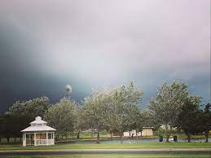

STRATEGIC GOAL CONNECTIONS
Goal 3: Quality of Life and Place
3.3 Create an Attractive and Inclusive Living Environment: Develop and enhance live, work, and play opportunities for our citizens.
3.6 Build the Best Parks System in Our Region: Offer diverse, accessible, and enjoyable green spaces, tournament-ready ball fields, safe playgrounds, and unique recreational opportunities that enhance the quality of life and quality of place for our community.
2

Slide 3
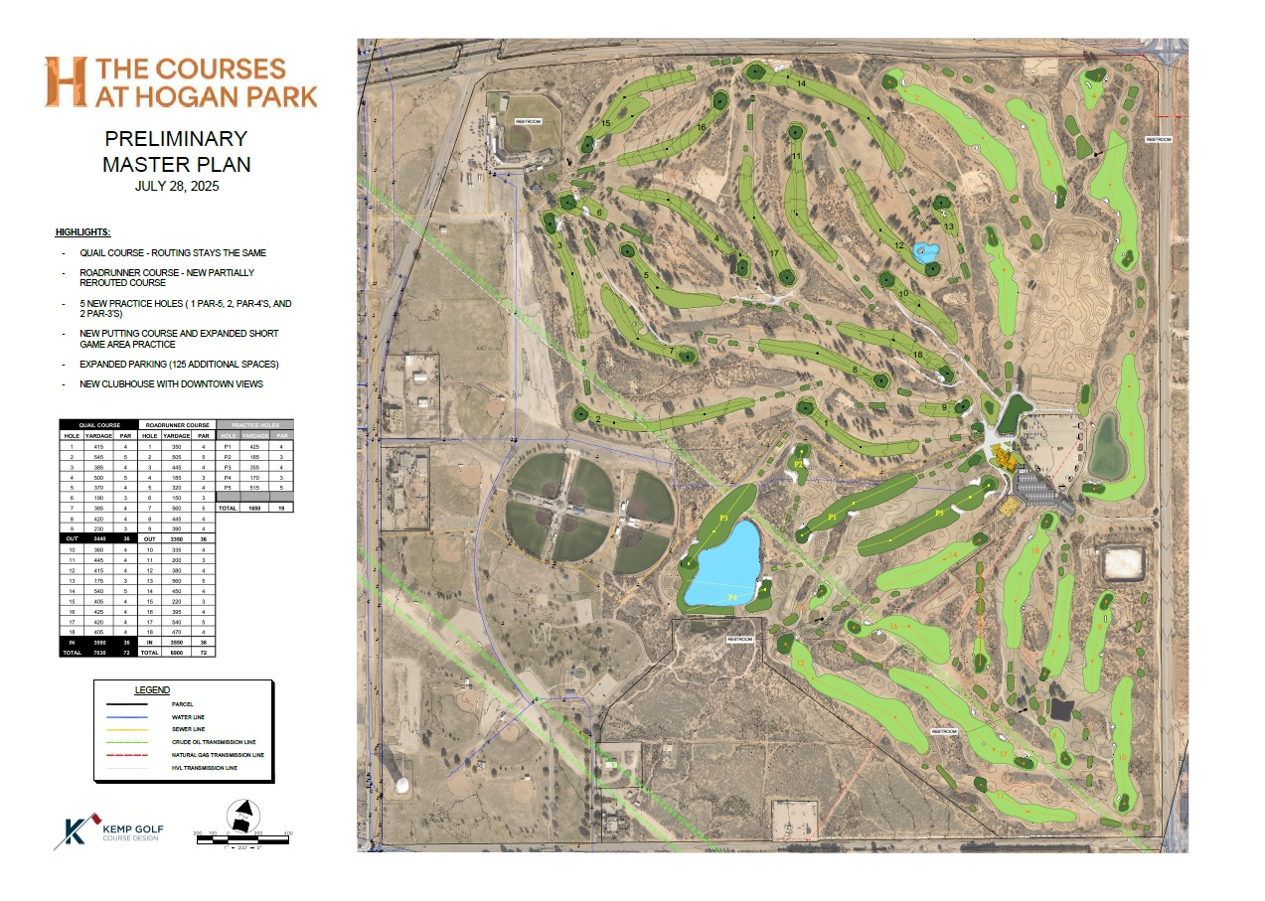

Slide 4
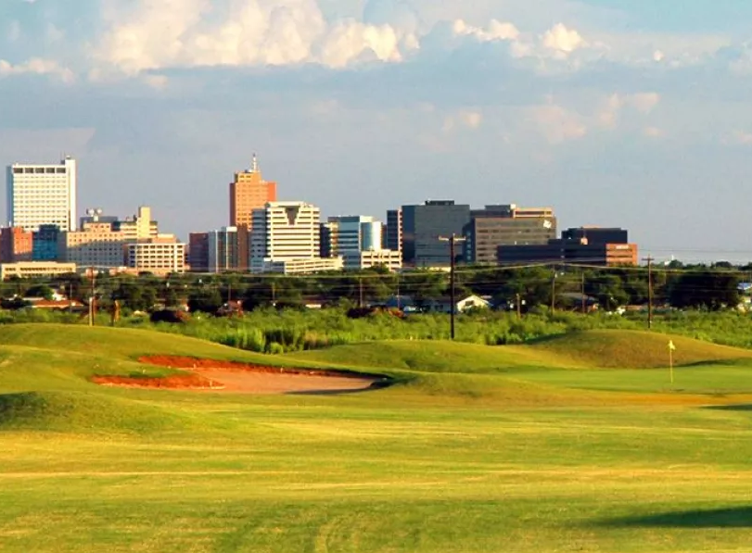

BIDS OPENED
ON SEPTEMBER 2
FOUR QUALIFIED BIDS RECEIVED
BASE BID: $9,739,563.62
ARCHITECT’S ESTIMATE: $9,725,838.75
Mid-America Golf and Landscape submitted the
Lowest bid for the project.

Slide 5
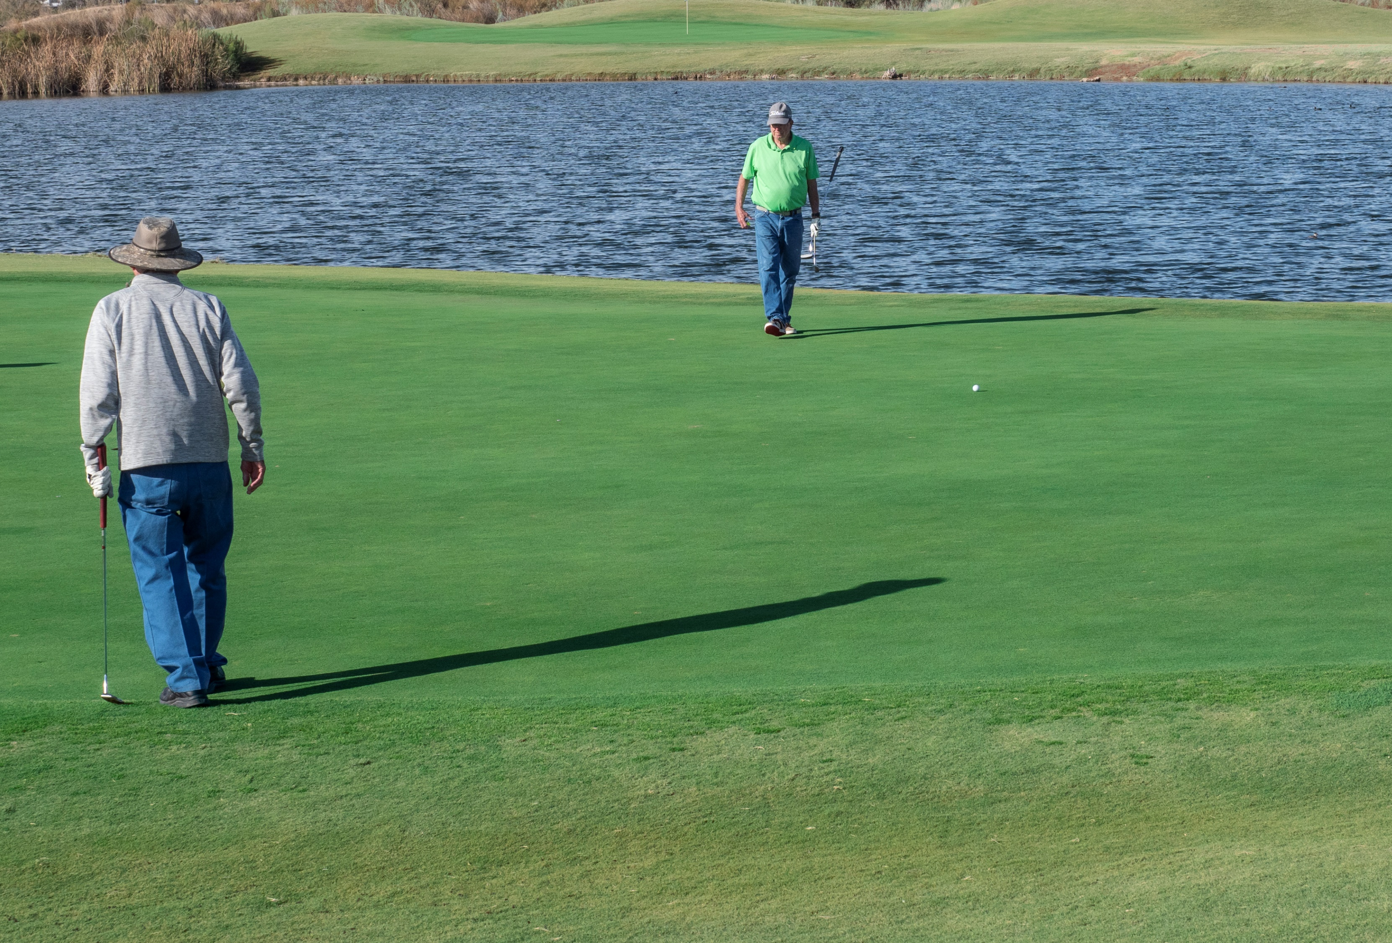
ALTERNATES TO CONTRACT
ALT 1 – 25 year irrigation warranty - no cost
ALT 2 – Furnish and install pump
house - add $114,000
ALT 5 – Deduction to change filtration system
house - deduct $100,758
ALT 12 – Additional Cart Path at holes 16 and
4 – add $28,750
TOTAL FOR ALTERNATES: $41,992

Slide 6
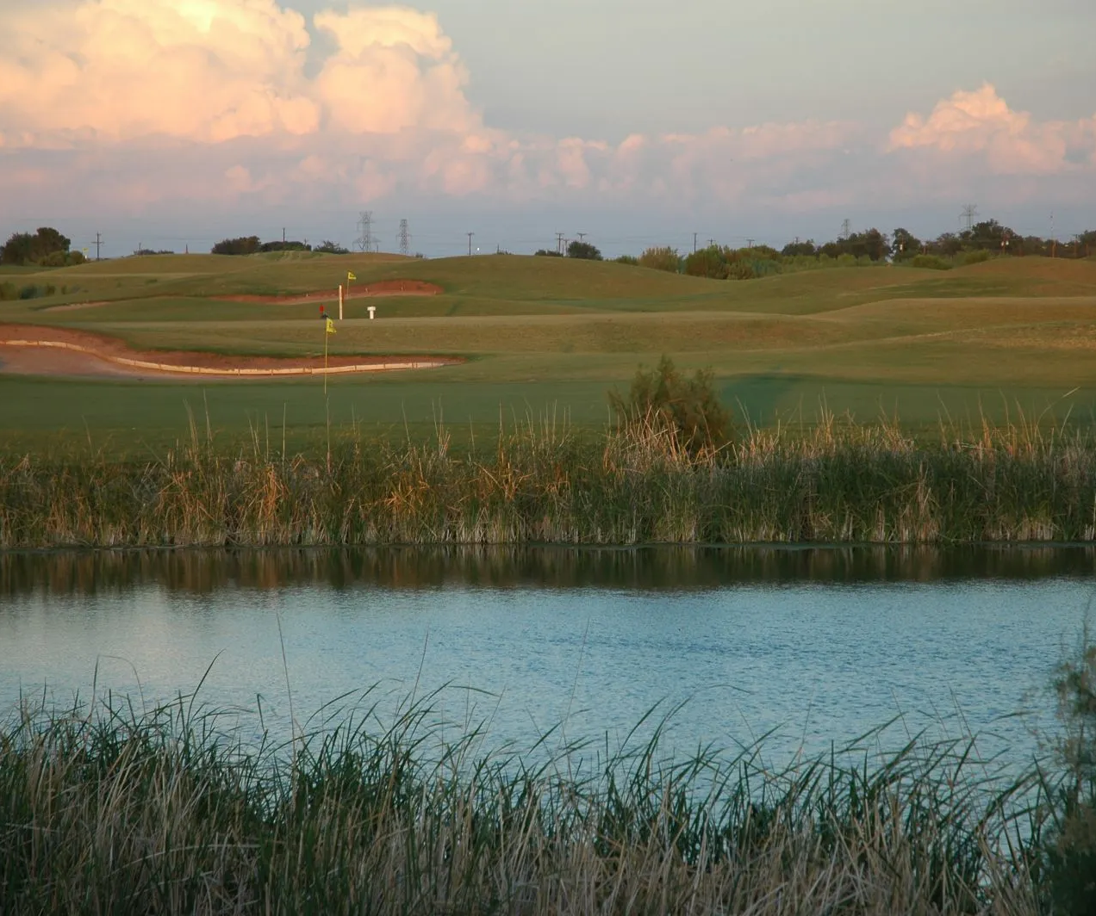
QUAIL COURSE RENOVATION TIMELINE
Construction Start Date – November 3, 2025
Completion anticipated September 2026

Slide 7

ACTION NEEDED
Amend the Resolution to include Alternate 1,at no cost to the City of Midland, and award a contract for the Hogan Park Quail Course Renovation Project to Mid-America Golf and Landscape, Inc., for a cost of $9,781,555.62; approving $500,000 for Project Related expenses; Appropriating Funds; and Authorizing Payment for said Project.
7

Slide 8

MISSION
Deliver exceptional services and promote a high quality of life and place for ALL our citizens.

