Slide 1


Mockingbird Lane
Improvement Project from Midland Dr. to Holiday Hill Rd.
August 2025
TITLE HERE
TITLE HERE

Slide 2

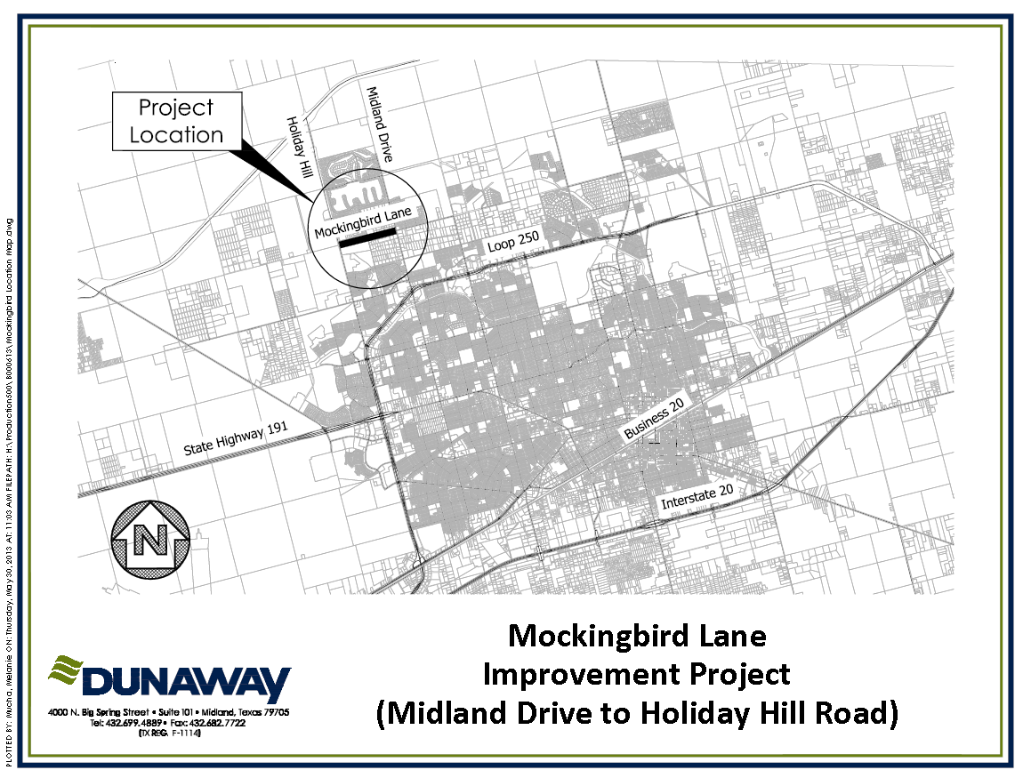
Project Location

Slide 3

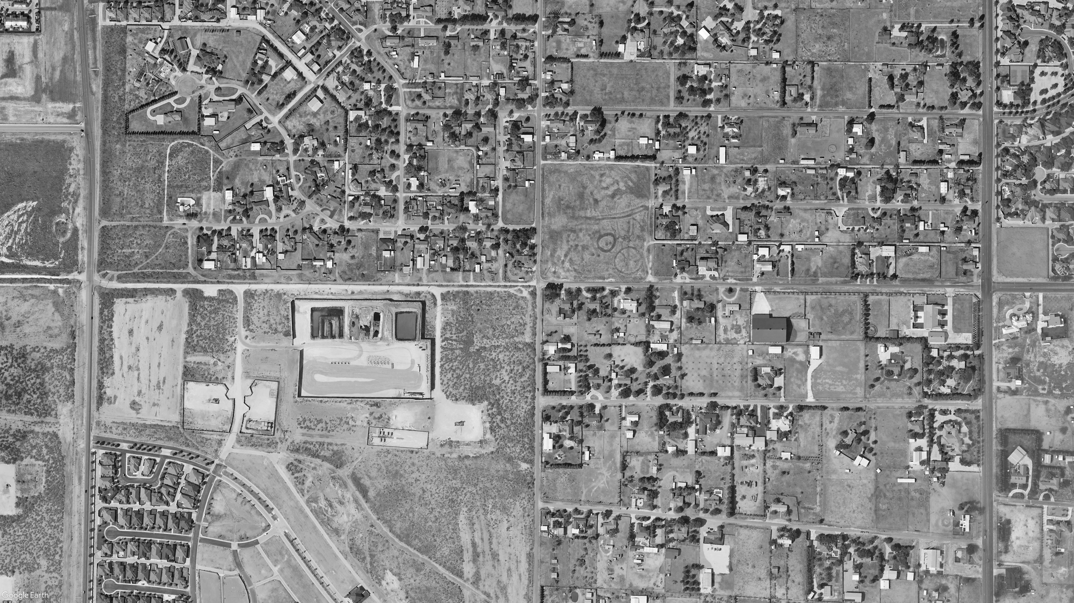
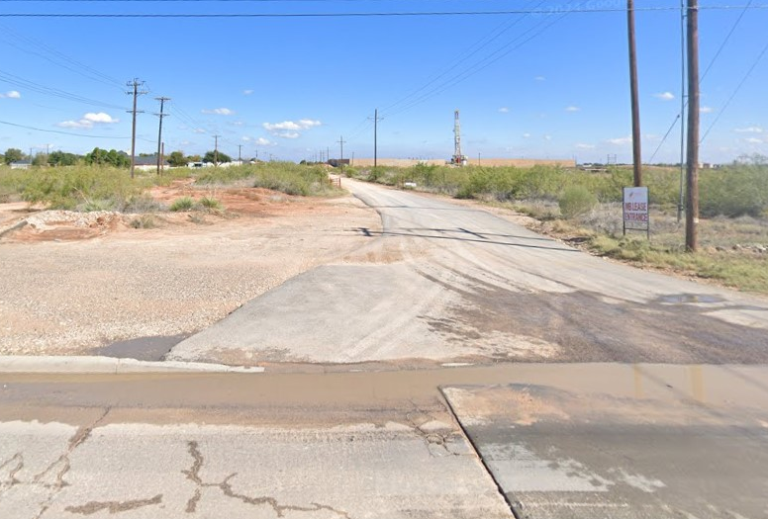
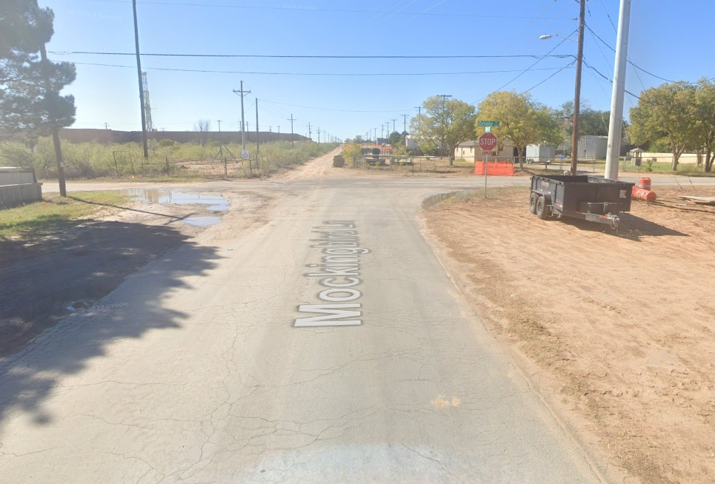
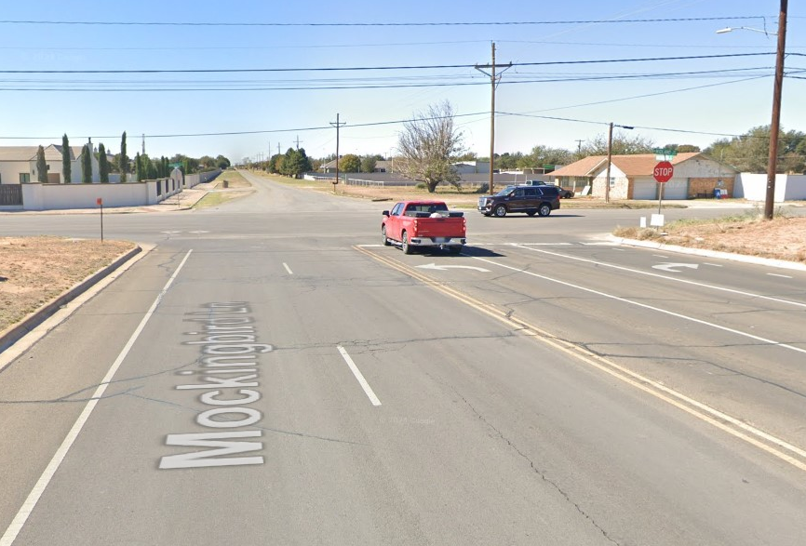
Existing Conditions
Oriole Drive
Holiday Hill Road
Midland Drive
Mockingbird Lane
HOLIDAY RD. LOOKING EAST
ORIOLE DRIVE LOOKING WEST
MIDLAND DRIVE LOOKING WEST

Slide 4

Existing Traffic Patterns
Holiday Hill Road
Oriole Drive
Midland Drive
Mockingbird Lane
Two-Way Traffic
Restricted Access Drive
Mockingbird Ln.
Two-Way Traffic
Residential Use with Oil and Gass Access

Slide 5

Existing Traffic Intersections
Oriole Drive
Holiday Hill Road
Midland Drive
Mockingbird Lane
Intersections.
One 3 Way Stop at Mockingbird and Oriole.
One 2 way Stop at Mockingbird and Midland

Slide 6

Intersection Improvements
Oriole Drive
Holiday Hill Road
Midland Drive
Mockingbird Lane
Intersection Improvements:
Widen Road and Addition of Sidewalks
Improved Circulation
New Roundabout

Slide 7

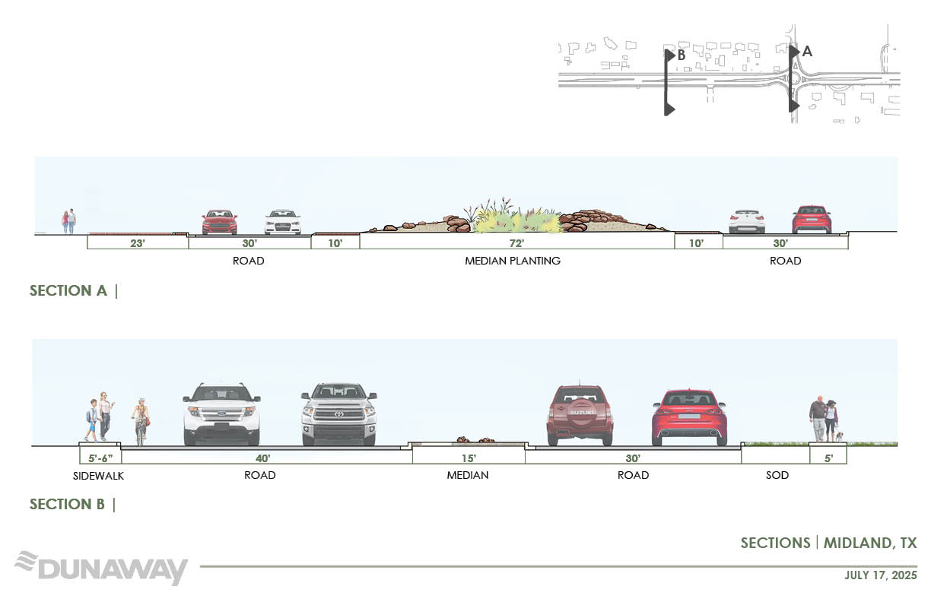
Illustrative Sections

Slide 8
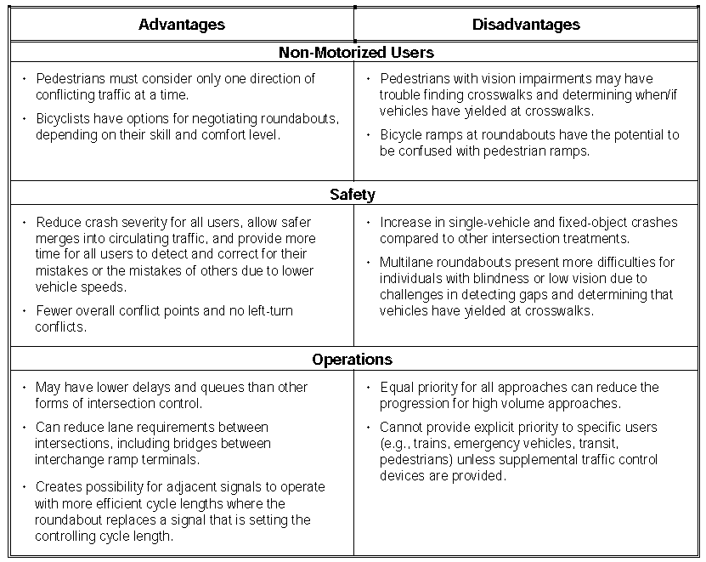
Roundabout Pros and Cons

Slide 9

MISSION
Deliver exceptional services and promote a high quality of life and place for ALL our citizens.

Slide 10

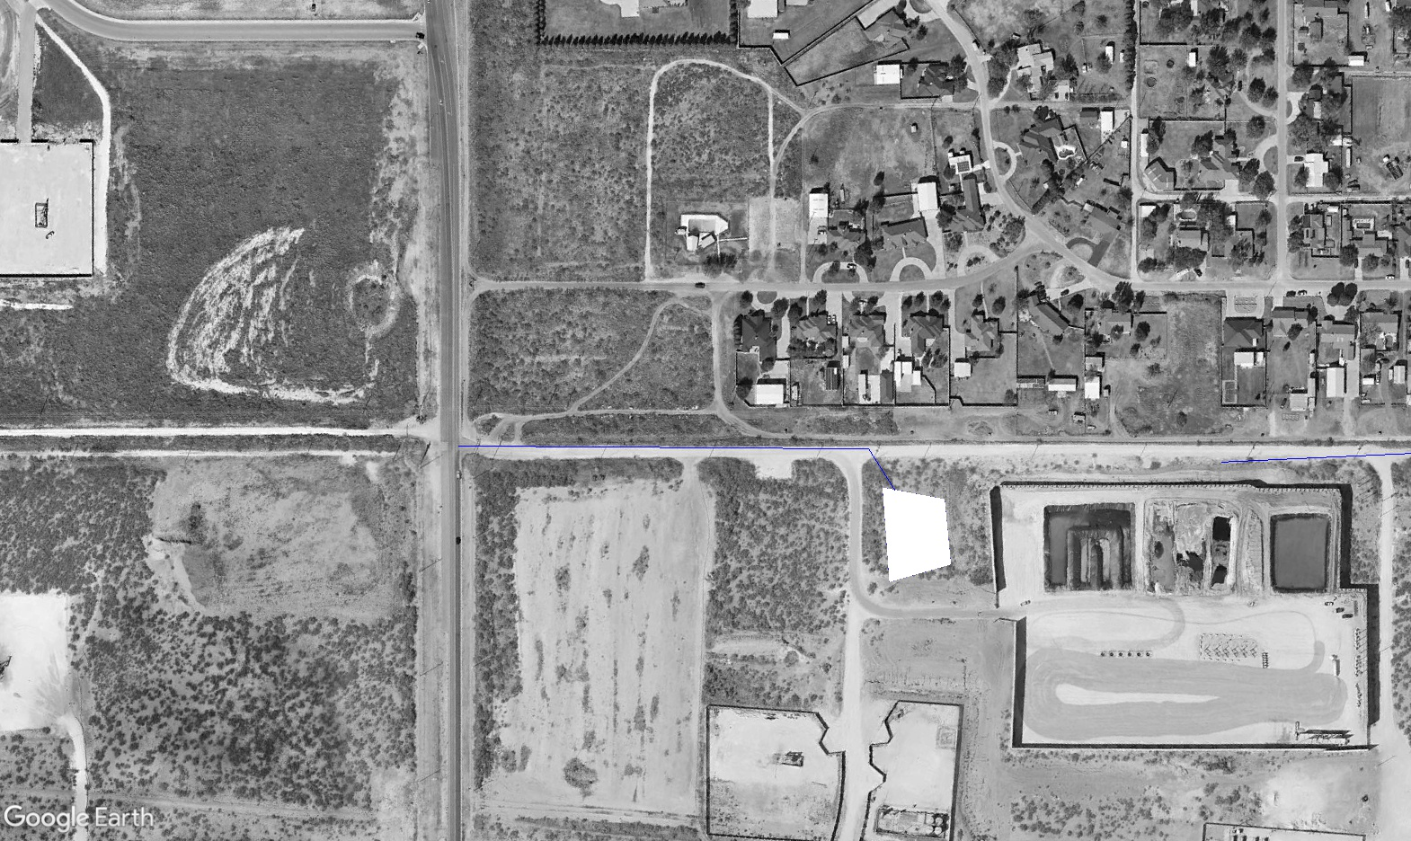
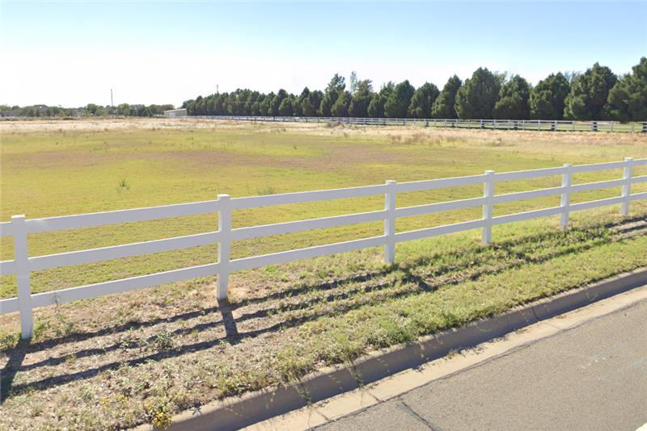
Drainage Exhibit A
Holiday Hill Road
Pimlico Drive
Tattenham Corner
Mockingbird Lane
FUTURE POND
Farm Rd 1369

Slide 11
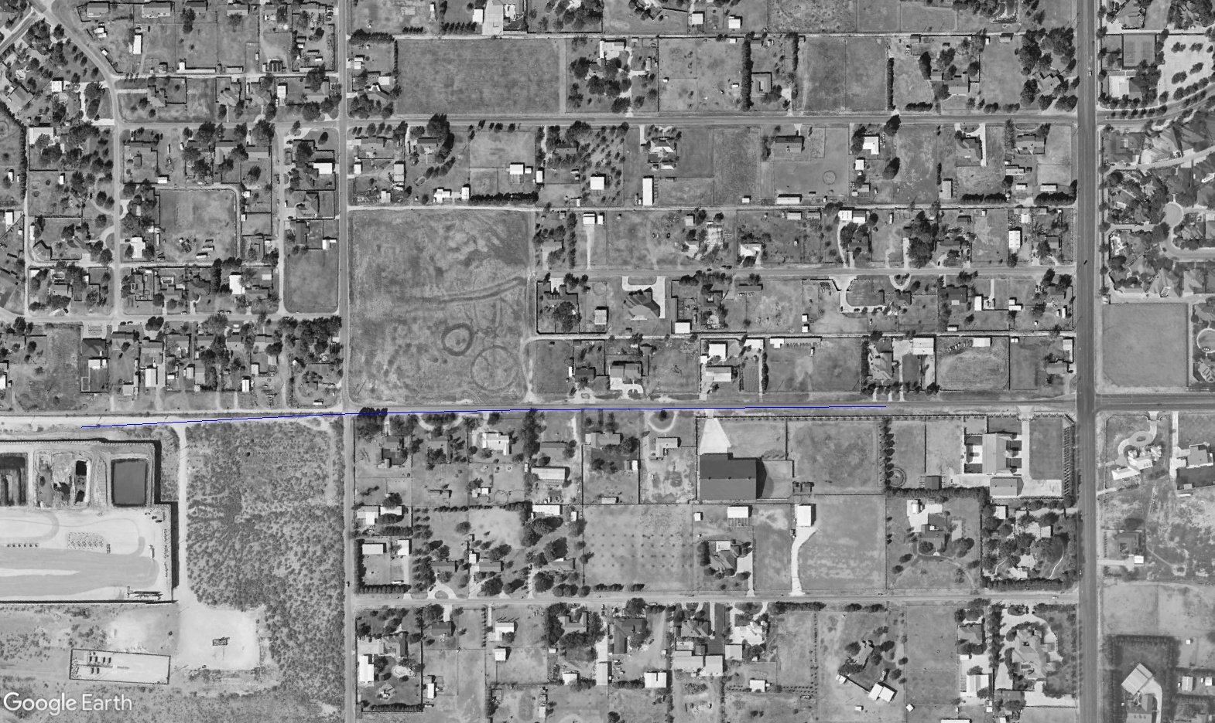
Drainage Exhibit B
Oriole Drive
Tanforan Avenue
Midland Drive
Tattenham Corner
Tattenham Corner
Mockingbird Lane

