Slide 1

SAVINGS & EFFICIENCIES STRATEGIES
SEPTEMBER 23, 2025
TITLE HERE
TITLE HERE
Notes:
Good morning Mayor and Council,
At Council’s request, we wanted to bring this topic back up, as discussed in recent meetings and at the budget workshop. This remains a priority, and it’s important we keep revisiting it.

Slide 2

FACING THE FUTURE: 5 YEAR FORECASTS
🟦Why It Matters:
Forecasting is a Best Practice among high performing cities and organizations.
Helps us Plan ahead and anticipate future needs.
📊What it Tells Us:
Our 5-Year forecast identifies a potential future financial gap.
This gap is not due to overspending but the Result of:
Rising Costs
Growing Population
A limited tax base
💡What it Reinforces:
The need for long-term discipline
Importance of innovative financial Strategies
That we must continue to find ways to close the gap year by year
2
Notes:
There has been recent public conversation about a "looming budget shortfall" and I want to make sure to clear that up. While forecasts are valuable tools to help us look ahead, they are not certainties. Our responsibility is to use them as a guide for proactive planning.
That’s why we are continuing to implement savings, cost recoveries, and strategic fees to stay ahead of potential gaps. A budget is a plan and a tool—it reflects priorities and strategies, but it’s flexible and meant to be refined over time.
A forecast showing a possible gap is not “look how bad it’s going to be”—it’s a signal to use the tools we have to plan ahead. Rising costs in areas like public safety, benefits, and infrastructure are real, which is why proactive planning is so important.
With that in mind, I want to transition into how we are closing these potential gaps.

Slide 3
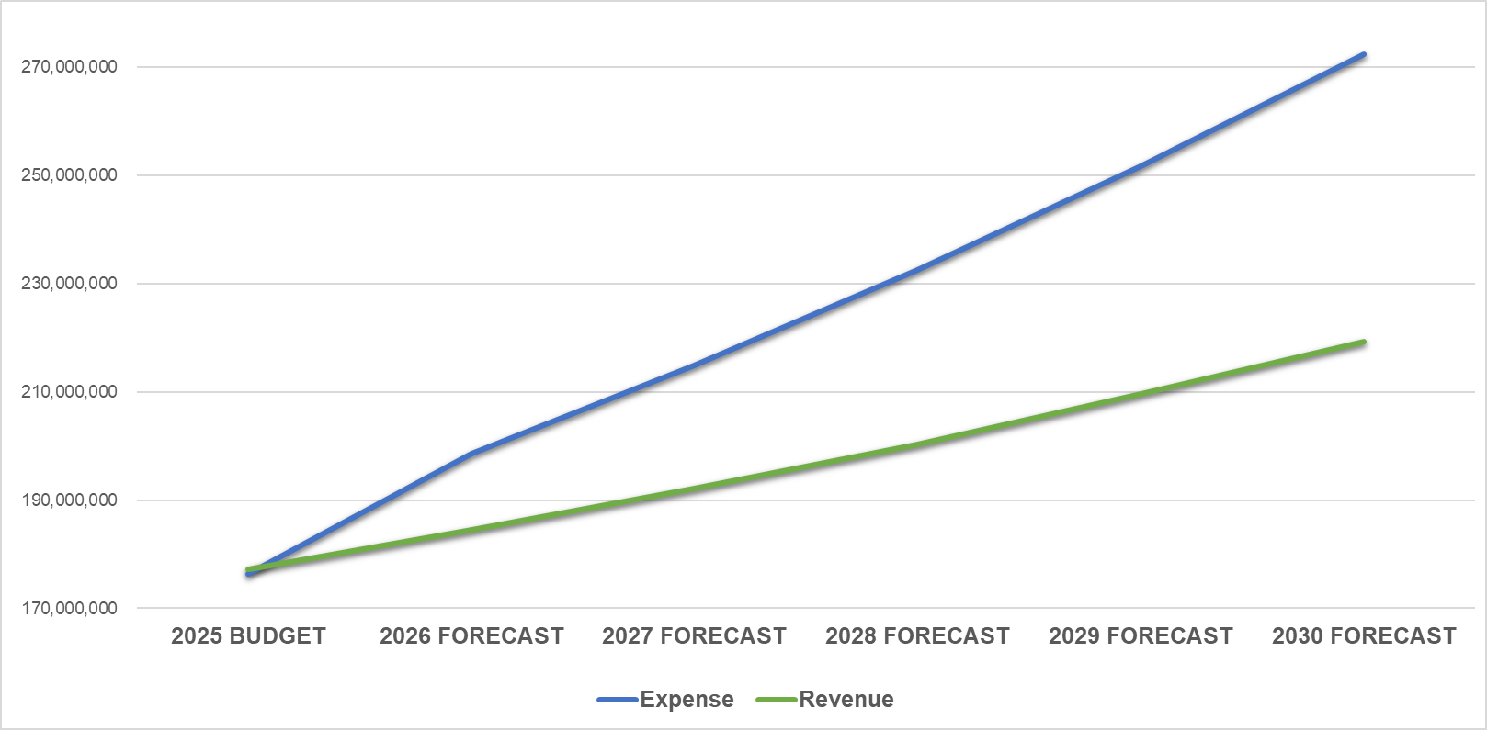

TOOLS TO CLOSE THE 'GAP'
State & Federal Funding
Partnerships
(Public & Private)
User Fees
Removed Subsidies
Natural Small Revenue Growth
Savings & Efficiencies
3
Notes:
When we talk about forecasting, the numbers matter—they give us a clear picture of where we are and where we’re headed. Maybe more important, though, are the practical business tools we’re putting in place to stay ahead. Forecasting isn’t about predicting problems—it’s about planning smartly.
First, let's talk about State and Federal Funding. Through strategic planning, we’ve unlocked new dollars. The vision zero Comprehensive Safety Action Plan made us eligible for $8.6M in federal funding to improve Lamesa Road and citywide signal timing. With $2M in planning funds from MDC, we leveraged $32M in state funding for the Todd Road Overpass and Wadley Extension, a 1,500% ROI—and accelerating projects by years. This doesn't even include the multiple projects that the county has worked with us on to improve infrastructure throughout the city with public partnerships.
Private Partnerships are also transforming Midland without heavy taxpayer reliance. The Midland Athletic Syndicate is bringing a $35M youth indoor sports facility on City owned land, and Beal Park’s expansion has over $18M in outside funding, making it the premier soccer and recreation hub in West Texas.
Another important tool is right-sizing user fees. We’re aligning fees with market standards so that services are paid for by those who use them, rather than by all taxpayers.
At the airport, enplanement fees have been adjusted from $2.25 (among the lowest regionally) to $10, now in line with other airports. This increases revenues significantly, enabling major traveler experience upgrades like the terminal modernization and expansion project.
With these right-sized fees, we’ve also eliminated the $1 million annual subsidy from the General Fund to the airport.
The Golf Course is also now self-sustaining—those who use it pay for it, freeing up taxpayer dollars for other needs, while also allowing reinvestment into the course to maintain it as a premier municipal facility.
We've also made major strides through savings and efficiencies. Council’s Strategic Plan drives a culture of efficiency. This year alone, we presented significant one-time and recurring savings that simply didn’t exist two years ago.
Finally, we can't over look incremental natural growth. As Midland grows both residentially and commercially, so do revenues—helping offset rising costs.
And while putting all these tools to work, Council has also delivered on a promise to taxpayers—lowering the tax rate two years in a row. That’s been achieved while providing more than ever before:
A record number of new and updated roads,
More investment in public safety,
More progress on water and infrastructure, and
More new and updated parks than Midland has ever seen.

Slide 4


CURRENT 5 YEAR FORECAST
Average Annual Expense Increase, +8.1%
Projected Funding Gap We Must Close
Average Annual Revenue Increase, +4.2%
Forecast for expenditures outpace revenue by 3.9%.
Notes:
As we’ve just discussed, the City has been using a wide range of tools to close the gap and keep our financial footing strong.
This slide is important because it shows why those tools are so necessary. This was the original five-year forecast before we began putting those measures in place. As you can see, expenses were projected to grow at over 8% annually, while revenues were expected to grow at just over 4%. That difference created the projected funding gap you see here.

Slide 5
FY 2026: 5 YEAR FORECASTS
Notes:
Now this slide shows a different picture. For FY 2025 and 2026, we’ve already begun closing the funding gap through user fees, partnerships, subsidies removed, state and federal funding, efficiencies, and natural growth.
Like an accordion, the gap widens as forecasted costs outpace forecasted revenues, and we contract it back through foresight and proactive planning. It’s not a one-time fix—it’s steady, year-after-year work, putting the right tools in place before challenges become problems.
That’s how we keep taxes low while still delivering more roads, more public safety, more infrastructure, and more parks than ever before.

Slide 6

REAL RESULTS FROM A STRATEGIC APPROACH
RECURRING EFFICIENCIES
Department/Area |  | Type | Amount
Utilities | Strategic Policy Changes & Process Improvements | Revenue | $10,000,000
ITSD | Enterprise IT Optimization | Savings/Cost Avoidance | $1,200,000
Utilities | Asterra Annual Leak Detection - Water Savings | Savings/Cost Avoidance | $2,101,980
Human Relations | Pre-employment Medical Testing Overhaul | Savings/Cost Avoidance | $500,000
Parks & Recreation | Hogan Golf Course YEARLY Subsidy Elimination | Savings/Cost Avoidance | $700,000
Airport | Airport YEARLY Subsidy Elimination | Savings/Cost Avoidance | $1,000,000
Utilities | Asterra Annual Leak Detection - Energy Savings | Savings/Cost Avoidance | $28,412
Total |  |  | $15,530,392
6
Notes:
This slide is just a snapshot of recurring savings already built into our operations. We’ve covered this before, but it’s worth keeping in front of you—these efficiencies help close the forecasted gap.
Next, you’ll see some one-time savings that also moved the needle.

Slide 7

STRATEGIC WINS THAT FUND THE FUTURE
ONE-TIME EFFICIENCIES
Department/Area |  | Type | Amount
Multiple | Fire Fighter Pension Obligation Bond Avoidance | Savings/Cost Avoidance | $60,000,000
Engineering | FHWA Safe Streets and Roads for All | Grant | $8,664,368
ITSD | One Time Savings | Savings | $715,000
Airport | Airport Pay Back | Cost Recovery | $5,400,000
Finance | Hotel Occupancy Tax Audit | Cost Recovery | $530,000
Parks & Recreation | Beal Park | Private/Public Partnerships | $18,200,000
Parks & Recreation | Grasslands Park | Grant | $150,000
Parks & Recreation | Wildcatter Trail | Grants | $6,667,495
Utilities | Collection of Delinquent Accounts Receivable | Cost Recovery | $298,043
Airport | Federal ATP Grant for terminal modernization | Grant | $2,800,000
Total |  |  | $103,424,906
Notes:
At the end of the day, all of this—whether it’s efficiencies, new business tools, right-sizing fees, or leveraging partnerships—comes back to one purpose: delivering more for Midland while keeping taxes low. The strategic plan that this Council put into place two years ago has guided every one of these steps, ensuring we’re not just reacting, but being proactive and strategic with the dollars entrusted to us.
That’s why we do this work—and why we’ll keep doing it.

Slide 8

MISSION
Deliver exceptional services and promote a high quality of life and place for ALL our citizens.
Notes:
Thank you! As a reminder all of our presentations are made available online after the council meetings, I’m happy to take any questions or feedback.

Slide 9

DOING MORE WITH LESS
HOW IT SAVED $1 MILLION
✅ $1M+ in Annual Recurring Savings ✅ Services improved, not reduced ✅ Aligned with Council’s strategic priorities
9

Slide 10

IT SAVINGS BREAKDOWN - YTD
🟢 Recurring Annual Savings – $1,174,815.64
Category | Annual Savings
Software/Services Cancellations & Consolidations | $1,164,815.64
Minor Renewal Adjustments (3% Cap) | $10,000+
🔵 One-Time Savings (2025) – $715,612.36
Category | One-Time Savings
Vendor Competition – Nutanix Data Center Servers | $270,000
Vendor Competition – New Codes, Ordinances | $136,511
Multi-year Agreement – Juniper Network Switches | $160,000
Agreement Negotiation – Motive GPS & Cameras | $41,975
Refund for past 5 years – After Rate Adjustment | $107,126.36
✅ Total Savings - YTD: $1,890,428.00
10

Slide 11
Refund for the past 5 years after the license rate adjustment
11

Slide 12

WHAT $1 MILLION IN SAVINGS MEANS
Digital Service or Tool | Annual Cost | Customer Impact
SeeClickFix 311 and AskJacky AI Chatbot | $70,000 | Residents and staff can quickly report, ask, and resolve issues online without phone calls or visits.
Qualtrics - Customer Experience Mgmt | $53,000 | Helps departments gather feedback from the public to improve service delivery.
Public Emergency Alert System | $40,000 | Sends timely alerts during storms, outages, or emergencies to keep the public safe.
Digital Agenda & Meeting Software | $22,000 | Makes Council meetings more accessible and transparent for the public and staff.
Online Permitting and Inspection Software | $110,000 | Speeds up permit processing and lets contractors and residents track progress online.
Online Health Inspection Software | $63,000 | Restaurants and health providers can view and manage inspections online without paperwork delays.
CityWorks Work Order Management | $140,000 | Field staff can receive and complete work orders digitally, improving response time.
ProCore Project Management Software | $130,000 | Allows Engineering and Capital Projects teams to manage large construction projects more efficiently.
Microsoft 365 Licensing | $400,000 | Gives all staff access to modern tools like Outlook, Word, and Teams to improve productivity and communication.
Total | $1,028,000

Slide 13

HOW WE DID IT
🔍 Reviewed all software and tech contracts ♻️ Eliminated redundant and underused tools 🧩 Provided modern, often better-performing replacements 💬 Renegotiated contract terms and capped increases 🛒 Created vendor competition for major purchases
13

Slide 14

WHAT’S NEXT
🔄 Regular reviews of contracts and subscriptions 📉 Upcoming renegotiations:
Motorola Radio System: $508K to $773K (by year 10)
Tyler Munis ERP: $300K+/Year
NeoGov HR/Payroll: $350K+/Year
💬 Expanding vendor engagement to reduce renewal hikes 📈 Reinvesting savings into digital products that align with the Council’s Strategic Plan
14

Slide 15
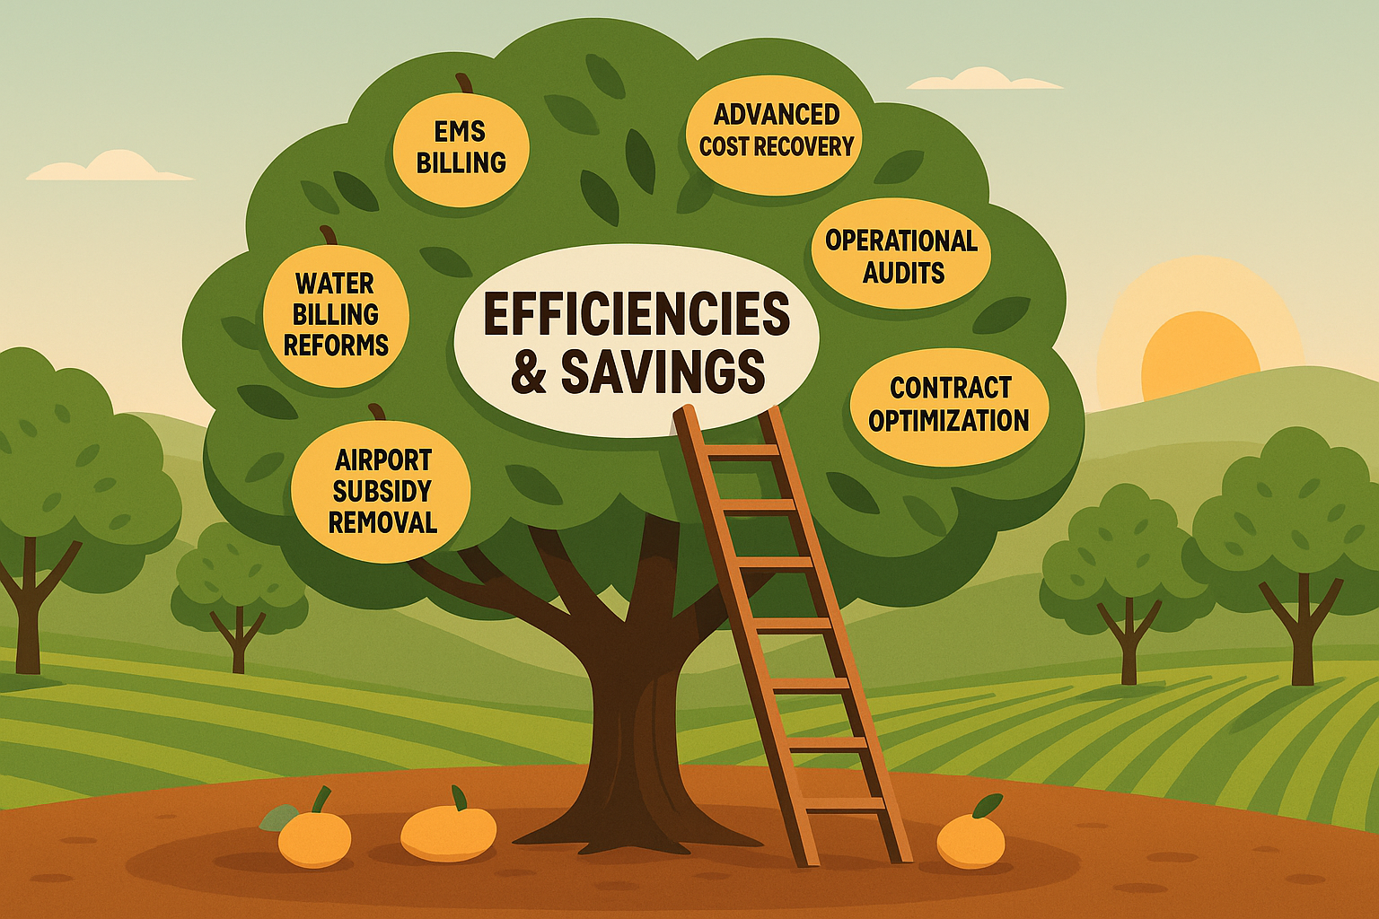
WHERE WE GO FROM HERE
Strategic Progress and the Climb Ahead
15
Notes:
This presentation is just a snapshot — a high-level look at the work underway across the City of Midland to deliver more with what we have. We’ve tried to capture as much as possible without overwhelming anyone, but this is far from the full story.
We’ll continue to report on efficiencies and savings — both recurring gains that build our base budget and one-time wins that create capacity to reinvest.
And it’s worth saying clearly: much of what you’ve seen today would not have happened without this Council’s vision. These wins — whether through grants, cost recovery, or smarter management — have been made possible because we now have a strategic plan and five-year financial forecast in place. Most of these results have come in just the last 18 months.
At this stage, we’ve gathered much of the low-hanging fruit. The obvious fixes. The foundational changes. Now, like an orchard that’s been well-tended, the next fruit is higher up — still there, still valuable, but harder to reach. That means grabbing the ladder.
It will take more creativity, more coordination, and yes — more risk. But with that risk comes greater reward. The most forward-thinking governments — like the most successful companies — push past routine. They think differently, act decisively, and stay committed to improvement.

Slide 16

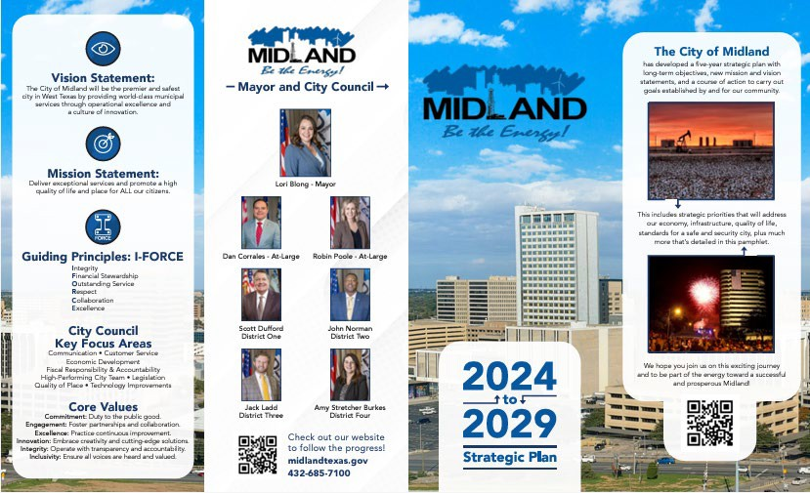
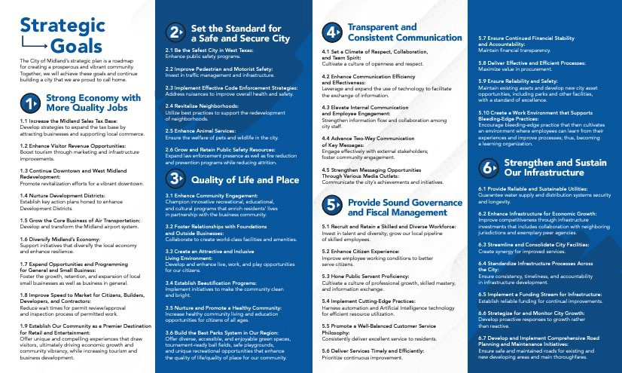
A STRATEGIC START: COUNCIL’S VISION
Council asked for a forward-looking strategic plan; a living document, not one that was just sitting on a shelf.
We delivered with clear priorities, long-term forecasts, and strong fiscal planning.
The result: Foundation set for a resilient, high-performing government.
16
Notes:
Your leadership as a Council has been clear: build a stronger, smarter city. This began with your support for a strategic plan that doesn’t just meet today’s needs — but establishes a solid, forward-looking foundation for the future.
That means:
Clear priorities
Long-term forecasting
Responsible budgeting
And an expectation that we operate like a high-performing organization.
The success we’re reporting today began with your vision. This Council made it clear: Midland needed a strategic plan — not just for today’s needs, but to build a stronger foundation for the future.
You asked for forward-looking planning, data-driven decision-making, and sound fiscal discipline. And as a team, we are delivering that together.

Slide 17

THE MANDATE: GOVERNMENT THAT WORKS LIKE A BUSINESS
TRADITIONAL GOVERNMENT | MODERN GOVERNMENT
Reactive | Proactive
Budget-Heavy | Lean & Strategic
Tax-Dependent | Diversified Revenue
Process-Driven | Outcome-Focused
Manual Workflows | Automated & Digital Solutions
Short-Term Focus | Long-Term, Strategic Planning
Minimal Transparency | Open Data & Communication
One-Size-Fits-All Services | Customer-Centered Service Design
Static Budgets | Rolling Forecasts & Adaptability
17
Notes:
Let me take a moment to step back and explain why this shift matters.
When you think of a traditional government, it often operated with a reactive mindset: budgets were heavy, systems were slow, and too often, the approach was to just do things “the way they’ve always been done.” Revenue came mostly from property or sales taxes, and customer service was more of an afterthought than a goal.
But this Council set a different expectation — and we are hearing you.
We’re embracing the mindset that a city government should operate more like a high-performing business:
We’re cost-conscious in every department.
We’re revenue-smart, identifying creative and new streams beyond property and sales tax.
We’re customer-focused, treating residents not just as users of services, but as people whose experience matters.
And we’re accountability-driven, measuring outcomes, not just effort.
This isn’t about buzzwords. It’s about making decisions rooted in data, strategy, and value.
We’ve moved beyond managing line items. Now we manage results:
We renegotiate contracts instead of renewing them automatically.
We optimize software licenses instead of overpaying for what we don’t use.
We recover dollars that would’ve previously gone uncollected — like the $500K from hotel audits.
And we’re realigning enterprise funds like the Airport and Golf Course so they stand on their own — just like private-sector entities would.
So when we say we’re acting like a business, it’s not a slogan — it’s a shift. And it’s one that’s helping us serve more people, more effectively, with the same limited dollars.
But how do we know it’s working?
We’re measuring outcomes through two key methods:
1. Key Performance Indicators (KPIs): Every department is tracking what matters — from service turnaround times to maintenance response rates to permit processing, as you just heard. These aren’t vanity metrics. They’re practical, operational signals that help us identify gaps, spot inefficiencies, and make better decisions — faster.
2. Survey Data: We’re listening. Whether it’s internal staff surveys or resident feedback from SeeClickFix and citywide outreach, we’re using that input to adjust and improve — in real time. These insights shape hiring, budgeting, and customer experience — not just process improvement on paper.
Together, these tools are building a feedback loop. One that helps every department learn, adapt, and grow stronger every quarter.
So yes — we’re acting like a business. But more importantly, we’re acting like a learning organization. One that values progress over perfection and performance over paperwork. And that shift is starting to take root — across teams, service lines, and interactions.

