Slide 1

ITEM 9
HALEY PARK PLAYGROUND

Slide 2
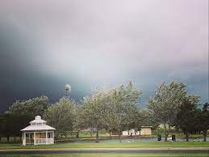

STRATEGIC GOAL CONNECTIONS
Goal 3: Quality of Life and Place
3.3 Create an Attractive and Inclusive Living Environment: Develop and enhance live, work, and play opportunities for our citizens.
3.6 Build the Best Parks System in Our Region: Offer diverse, accessible, and enjoyable green spaces, tournament-ready ball fields, safe playgrounds, and unique recreational opportunities that enhance the quality of life and quality of place for our community.
2

Slide 3

PLAYGROUND FUNDING
$250,000 is in a project, approved for playground improvements.
The Grasslands playground funding is also in the project, and that playground proposal will be brought to Council for approval before the end of 2025.
3

Slide 4
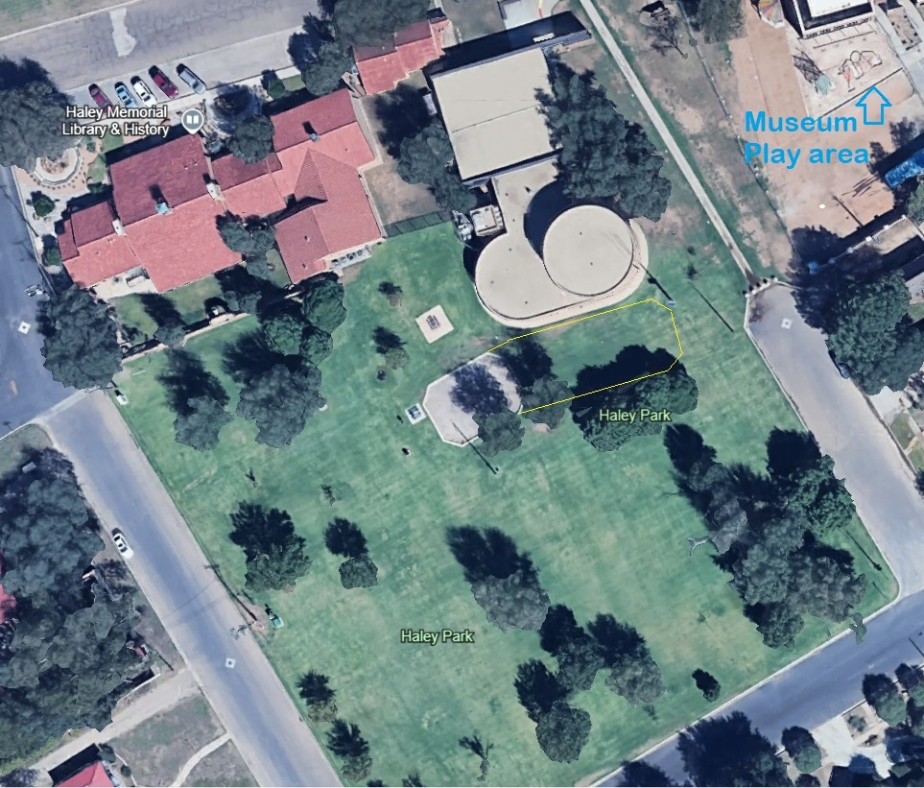

HALEY PARK Budget: $250,000

Slide 5
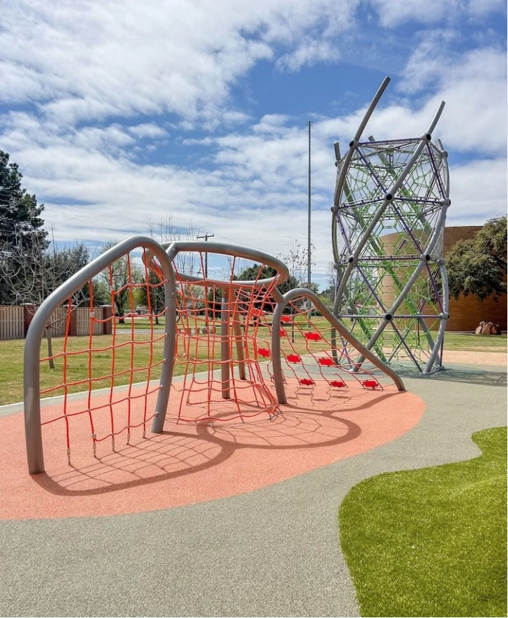
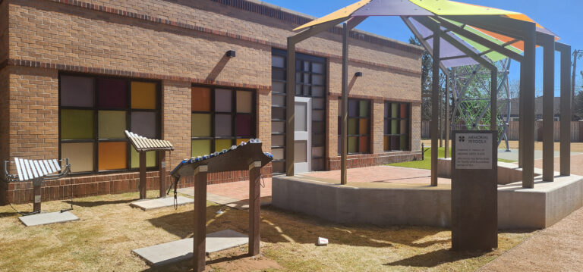

MUSEUM OF THE SOUTHWEST CHILDREN’S MUSEUM PLAYGROUND Climbers and Musical Play Open to the Public

Slide 6
Parks and Recreation
Commission Recommendation
At the September meeting of the Parks and Recreation Commission, 4 options for playgrounds at Haley Park were reviewed.
The 4 options were from two different playground companies.
The commission voted unanimously to recommend the Twig and Treetops playground by Exerplay.
6

Slide 7
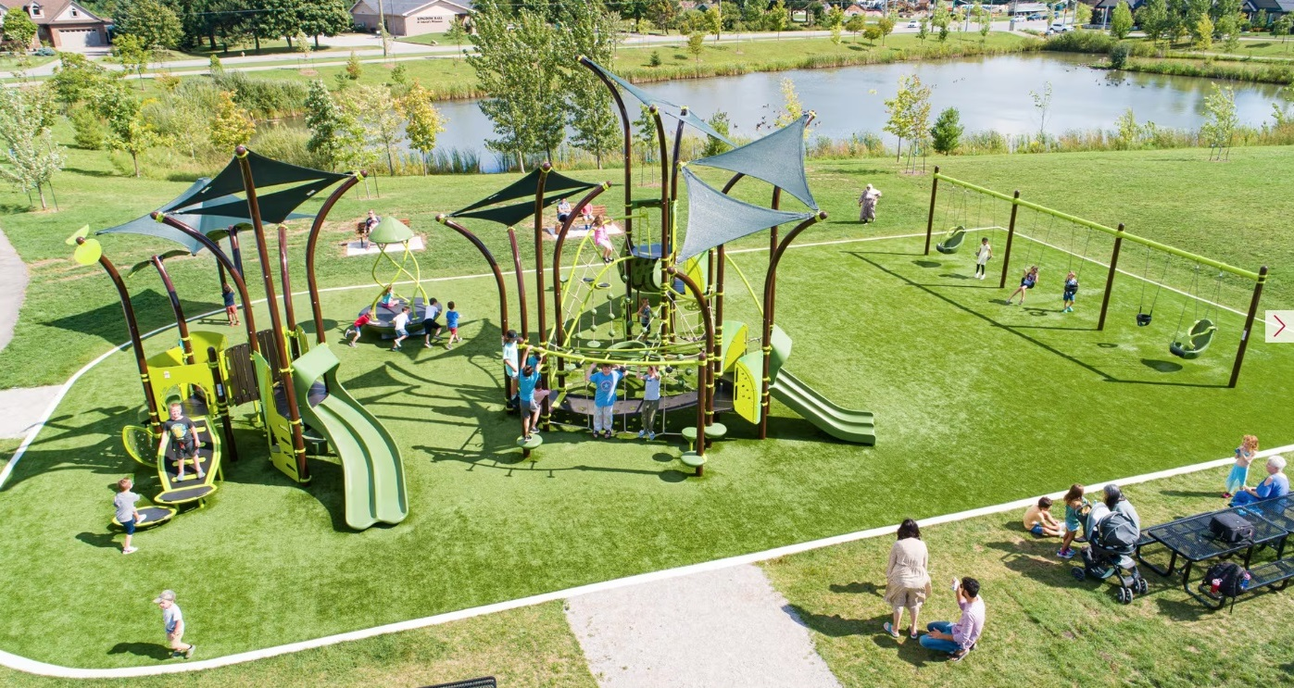
TWIG AND TREE TOPS

Slide 8
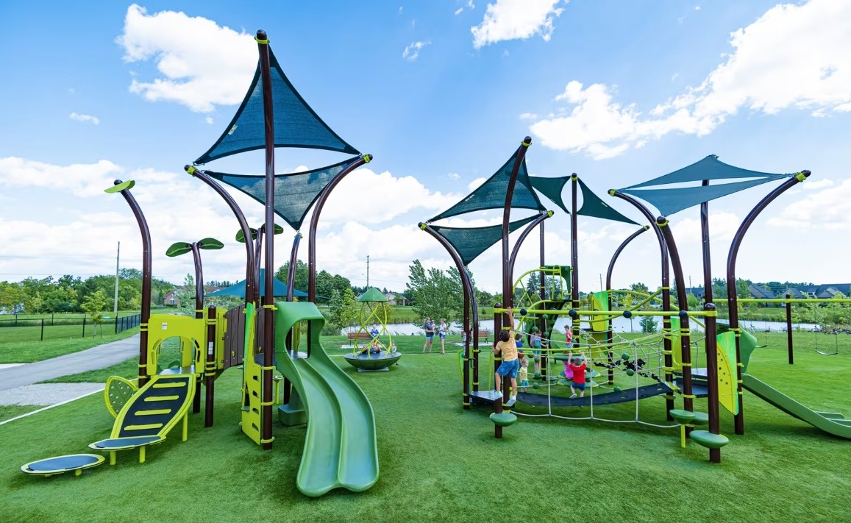

Slide 9
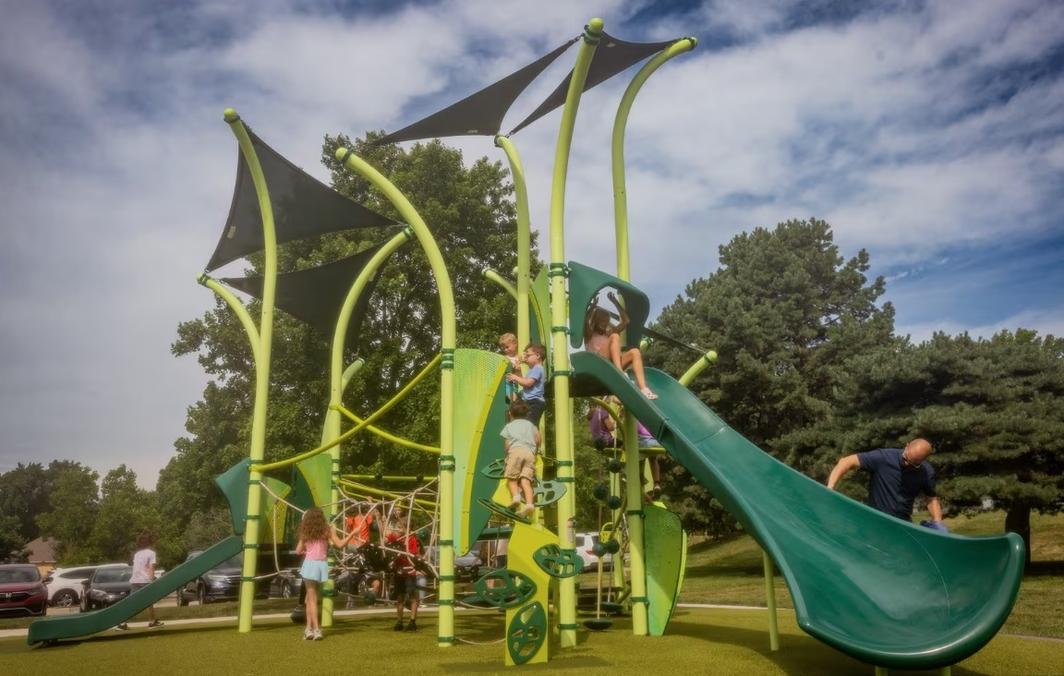

Slide 10
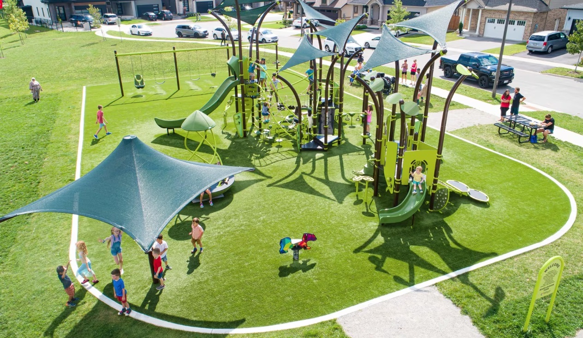

Slide 11
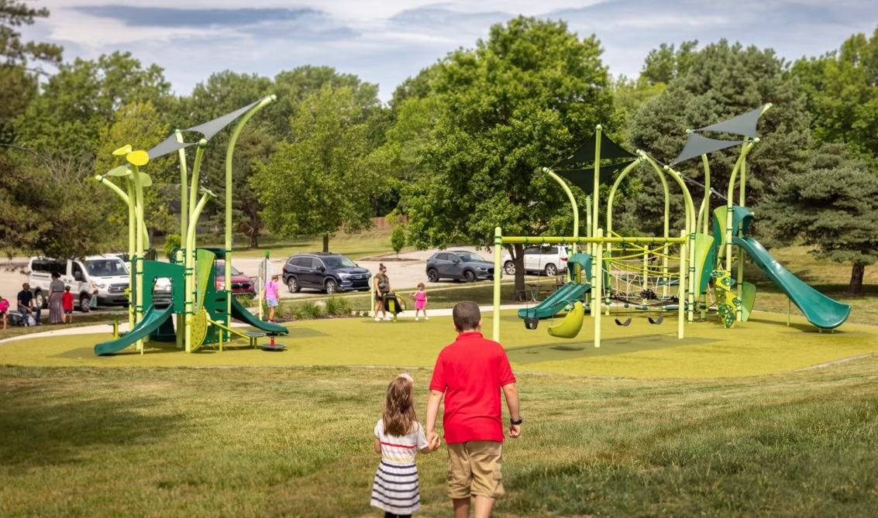


Slide 12
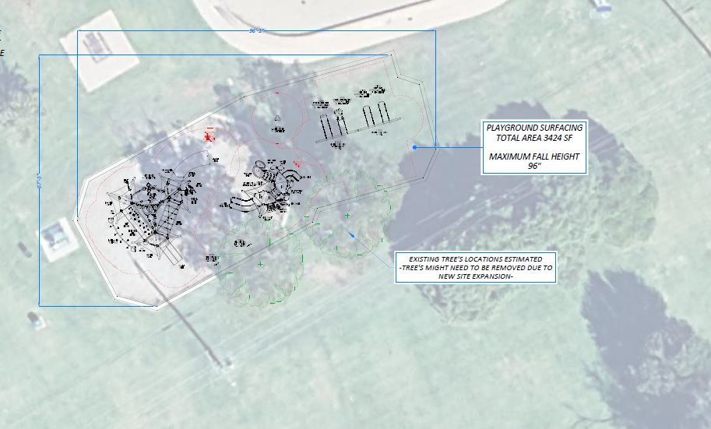

Slide 13

MISSION
Deliver exceptional services and promote a high quality of life and place for ALL our citizens.

