Slide 1
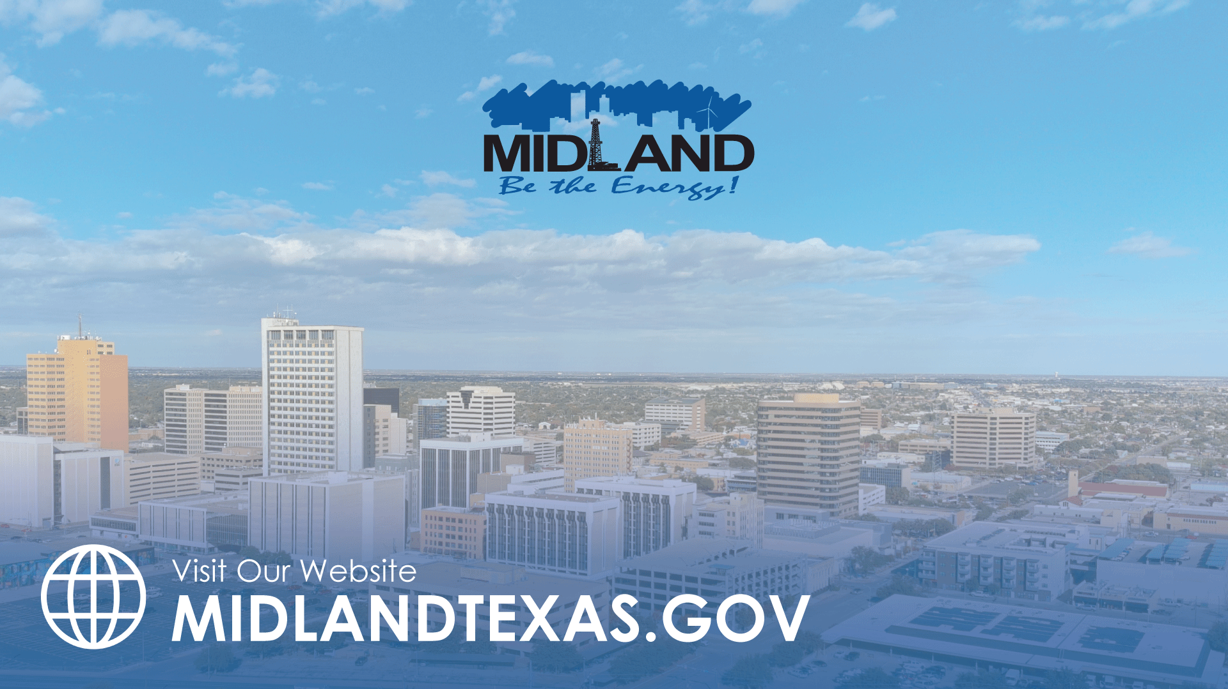
STRENGTHEN AND SUSTAIN OUR INFRASTRUCTURE- ROADS
TITLE HERE
TITLE HERE

Slide 2

STRATEGIC GOAL CONNECTIONS
Goal 3: Quality of Life & Place
  3.2 Foster relationships with foundations and outside businesses: Collaborate to create worldclass facilities and amenities.
  3.3 Create an attractive and inclusive living environment: Develop and enhance live, work, and play opportunities for our citizens.
Goal 5: Provide Sound Governance and Fiscal Management
  5.7 Ensure continued financial stability and accountability: Maintain financial transparency.
Goal 6: Strengthen and Sustain Our Infrastructure
  6.2 Enhance infrastructure for economic growth: Improve competitiveness through infrastructure investments that includes collaboration with neighboring jurisdictions and exemplary peer agencies.
  6.5 Implement a funding stream for infrastructure: Establish reliable funding for continual improvements.
  6.6 Strategize for and monitor City Growth: Develop proactive responses to growth rather than reactive.
  6.7 Develop and Implement Comprehensive Road Planning and Maintenance Initiatives: Ensure safe and maintained roads for existing and new developing areas and main thoroughfares
2

Slide 3

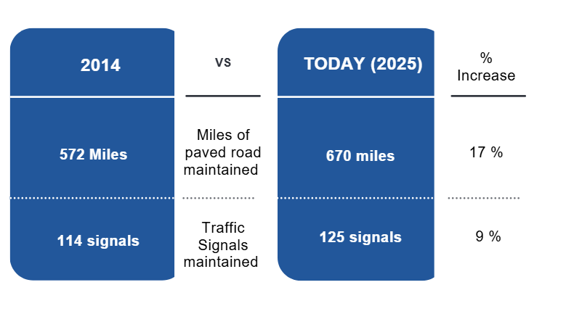
CITY OF MIDLAND ROADS
3
Notes:
Since the inception of our PCI in 2014 we have grown miles of paved road maintained from 572 miles to 670 miles. Signals have increased from 117 in 2014 to 125 in 2025, with more planned.
While growth is important to look at, we also need to understand that existing roadways that have poor conditions due to deferred maintenance. We have to be able to balance the need for growth with the need to maintain existing roadway.
The Bond Program was largely an effort to catch up on deferred maintenance

Slide 4
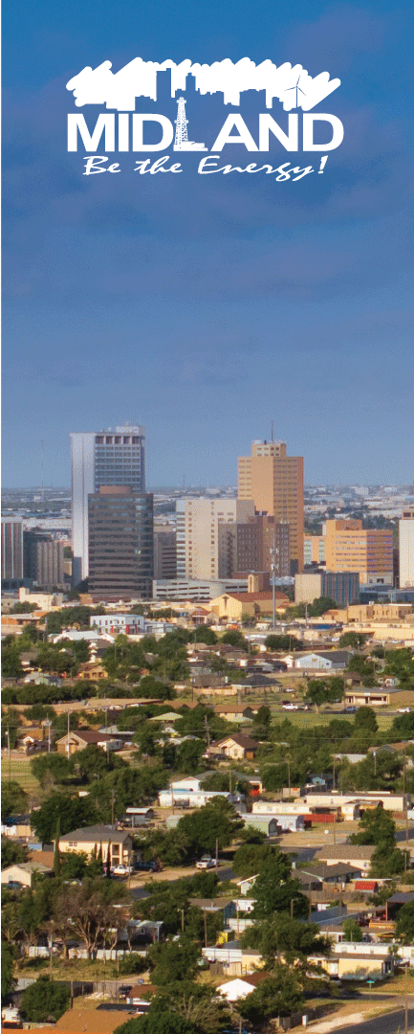
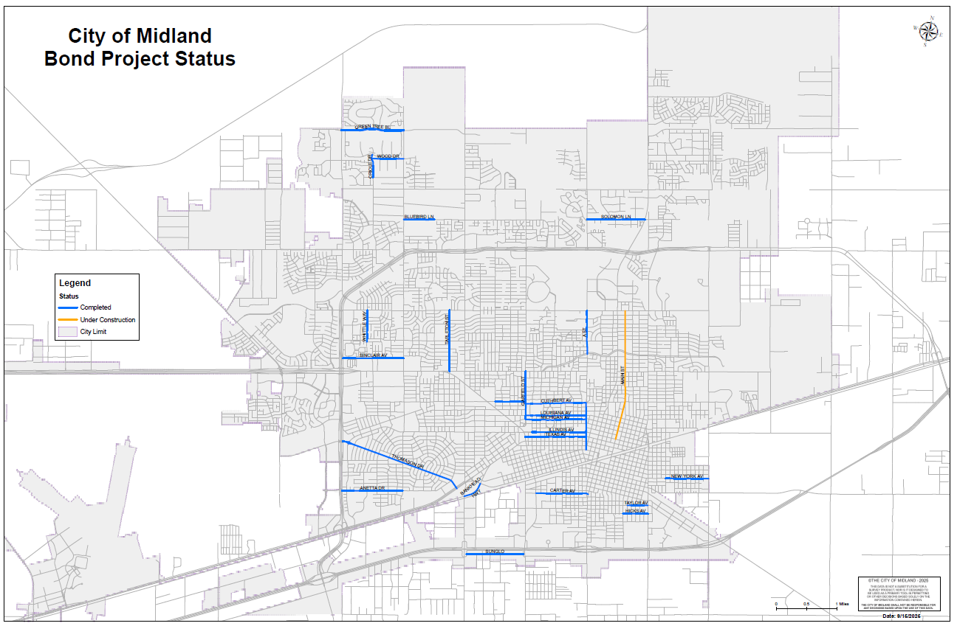
BOND UPDATE
Notes:
One street left in the bond program- main St. Which will be done this calendar year.
While focused on existing roadway the city was growing but we are working more proactively to develop roads to keep up with growth

Slide 5
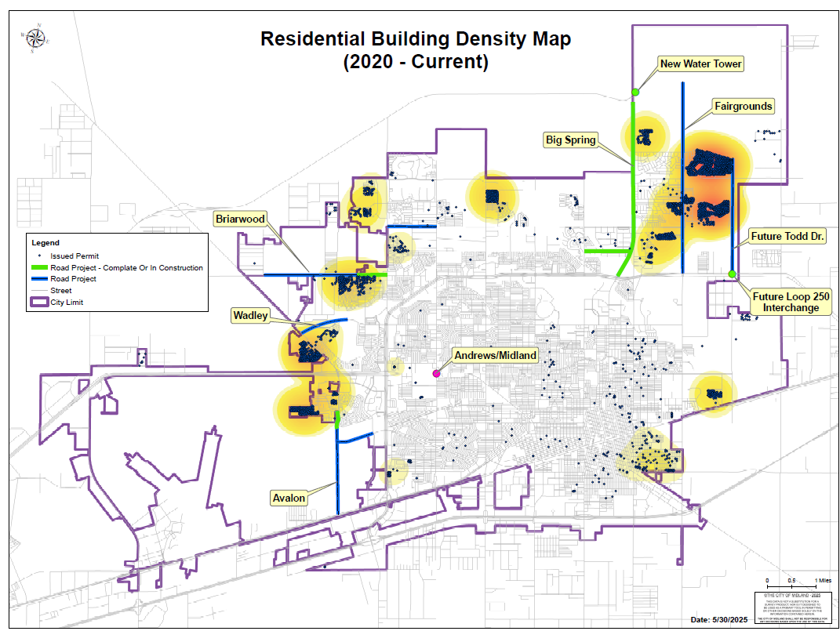

Slide 6
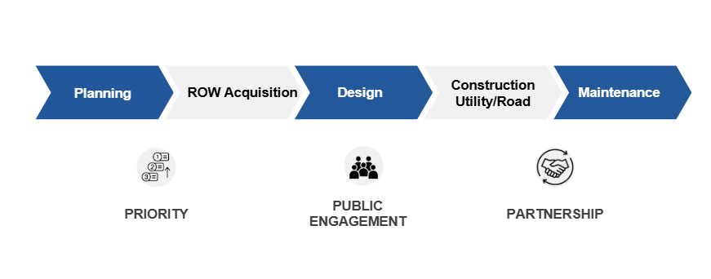
PROCESS
Notes:
the engineering department touches all phases of project that encompasses how we plan, and prepare for growth in a strategic way. These processes for projects include planning, ROW acquisition, design, construction and maintenance

Slide 7
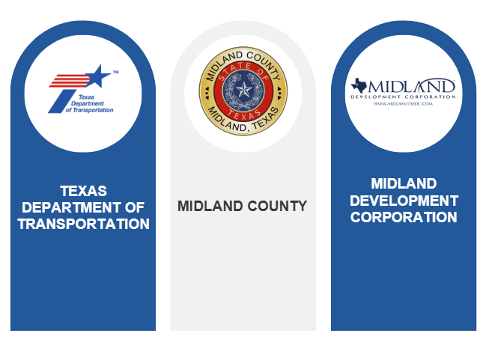
PARTNERSHIPS
7
Notes:
To keep up with growth we partner with Midland County, TXDOT, MDC, and Developers- now an emphasis has been placed on growth and how we can better plan and be partners to avoid to silos.
JUST LAST WEEK we had huge successes with all of these:
TXDOT awarded two projects totaling: For Brairwood and ???
Midland County approved a pledge to widen Briarwood east of SH 158 of $2.5 Million
MDC on Monday approved two contracts: $2,099,100.00 for the design of CR 1250 and SH 191 and $1,668,754.00 for the Water line at Todd Road and Loop 250

Slide 8
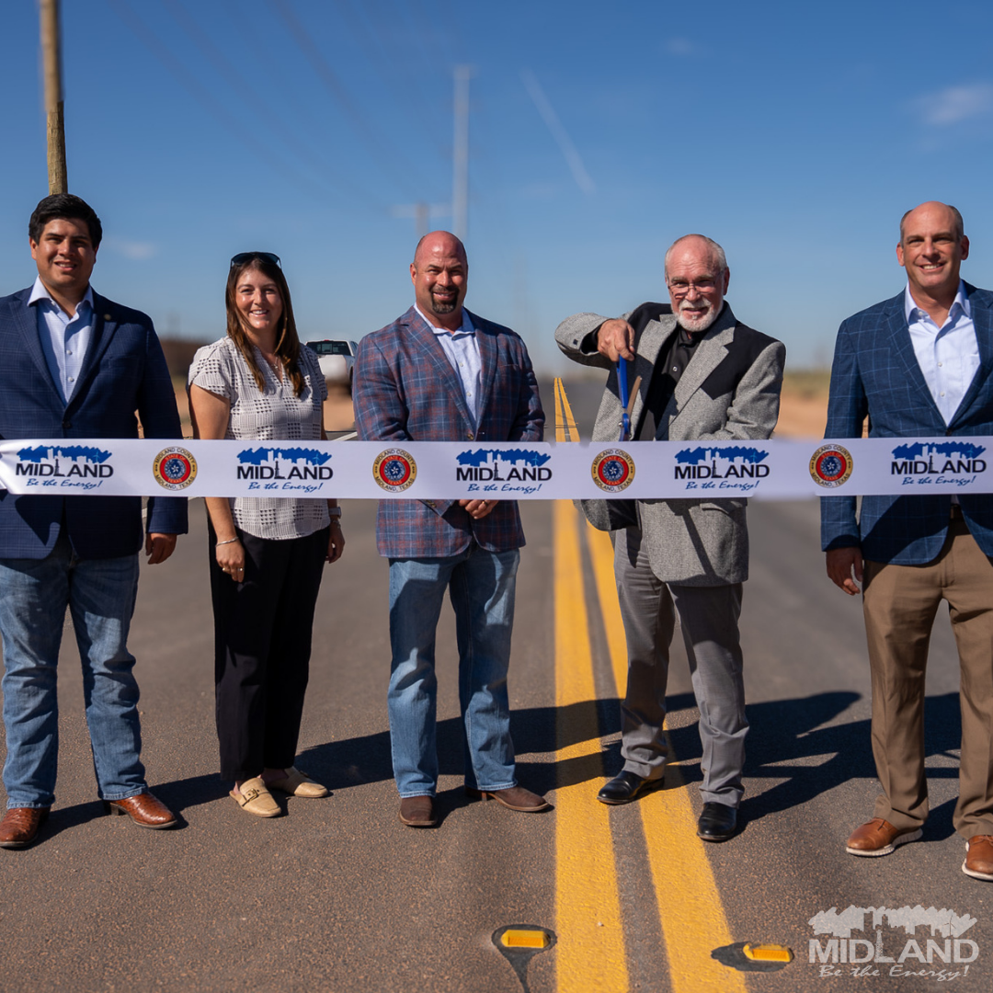
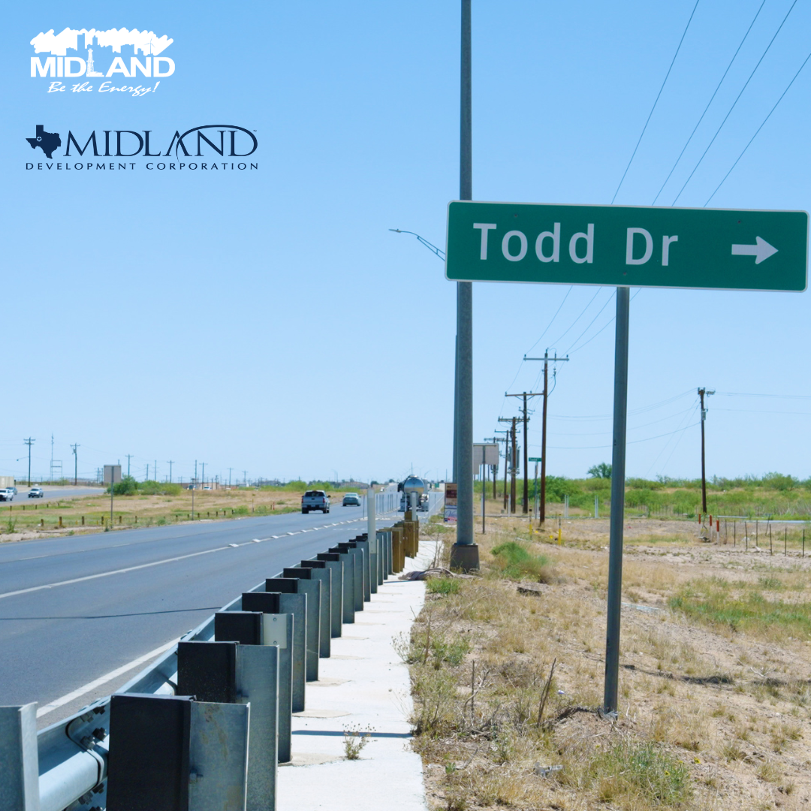
PROJECTS
8
Notes:
Examples of these partnerships include the Occidental Rd. Extension with Midland County, The MDC investment that moved up the Todd Dr. Overpass at Loop 250 for TXDOT letting from 2031 to 2026!($26 million)
This continues, MDC just voted to assist with the design efforts of CR 1250 and SH 191 for growth in the Costco area.
Development of new roads relieve congestion on existing roadways better distribution of traffic- traffic volume is increasing better distribute as a result

Slide 9

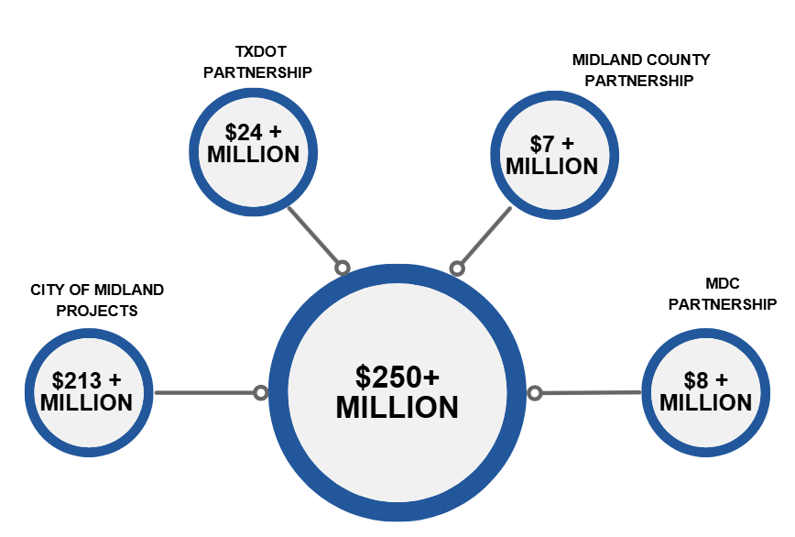
ENGINEERING DEPARTMENT
In recent years, the Engineering Department has worked on:
9
*These numbers do not include pothole repair & service
8- widening and repaving project

Slide 10
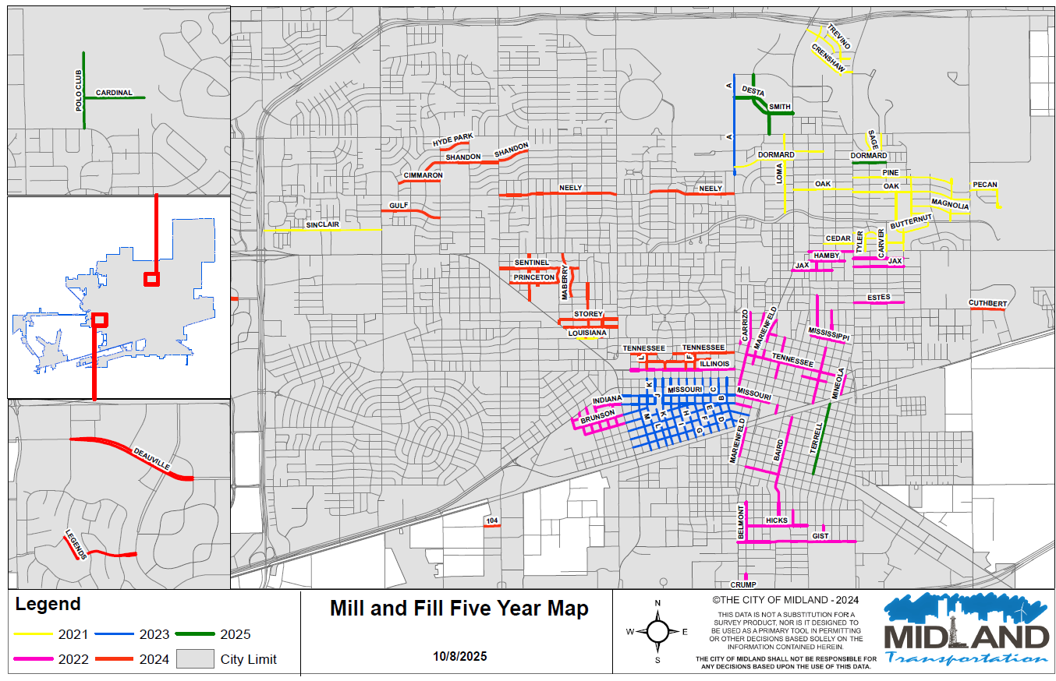

Slide 11
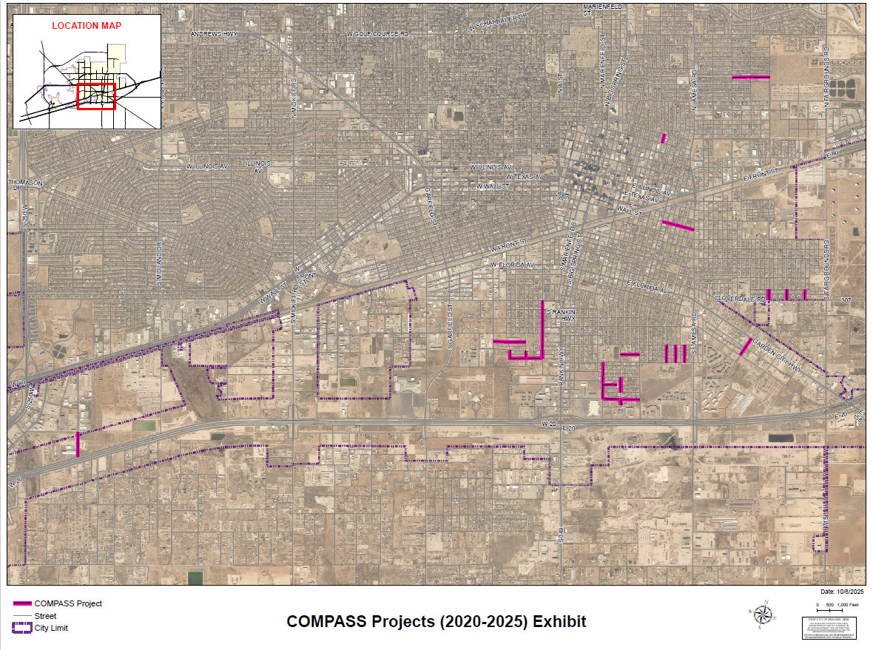

Slide 12
CAPITAL IMPROVEMENT PROGRAM
Working towards:
  5-year plan of upcoming projects citywide
    Proactive vs reactive
    Updated annually
  Functions as:
    Budget planning guide
    Departmental guide for year ahead
    Streamlined procedure for projects
  Cross Functional Team
    Led by Lindsey Adams and Carl Craigo
    Made up of team members from departments across the city including: Engineering, Utilities, Airport, Solid Waste, Parks, Development Services, Police Department, Fire Department, ITSD and Finance.
GOAL: Help us plan strategically for a balanced approach to keeping up with growth and address existing maintenance needs across the City of Midland
12
Notes:
now that we stood up a CIP and have plans for a 5 year, we can continue to plan strategically for a balanced approach to address existing roadways and keep up with growth
he Capital Improvement Plan (CIP) is a list of projects for the next five years. For example, if we are in FY2025, the plan will include projects for FY2025 (active) as well as planned projects for FY2026, FY2027, FY2028, FY2029, and FY2030. This plan serves as the guidebook for all capital projects citywide throughout the five-year period. It is updated annually to add the next 5th year (e.g., in FY2026, FY2031 projects will be added).

Slide 13

MISSION
Deliver exceptional services and promote a high quality of life and place for ALL our citizens.

