Slide 1
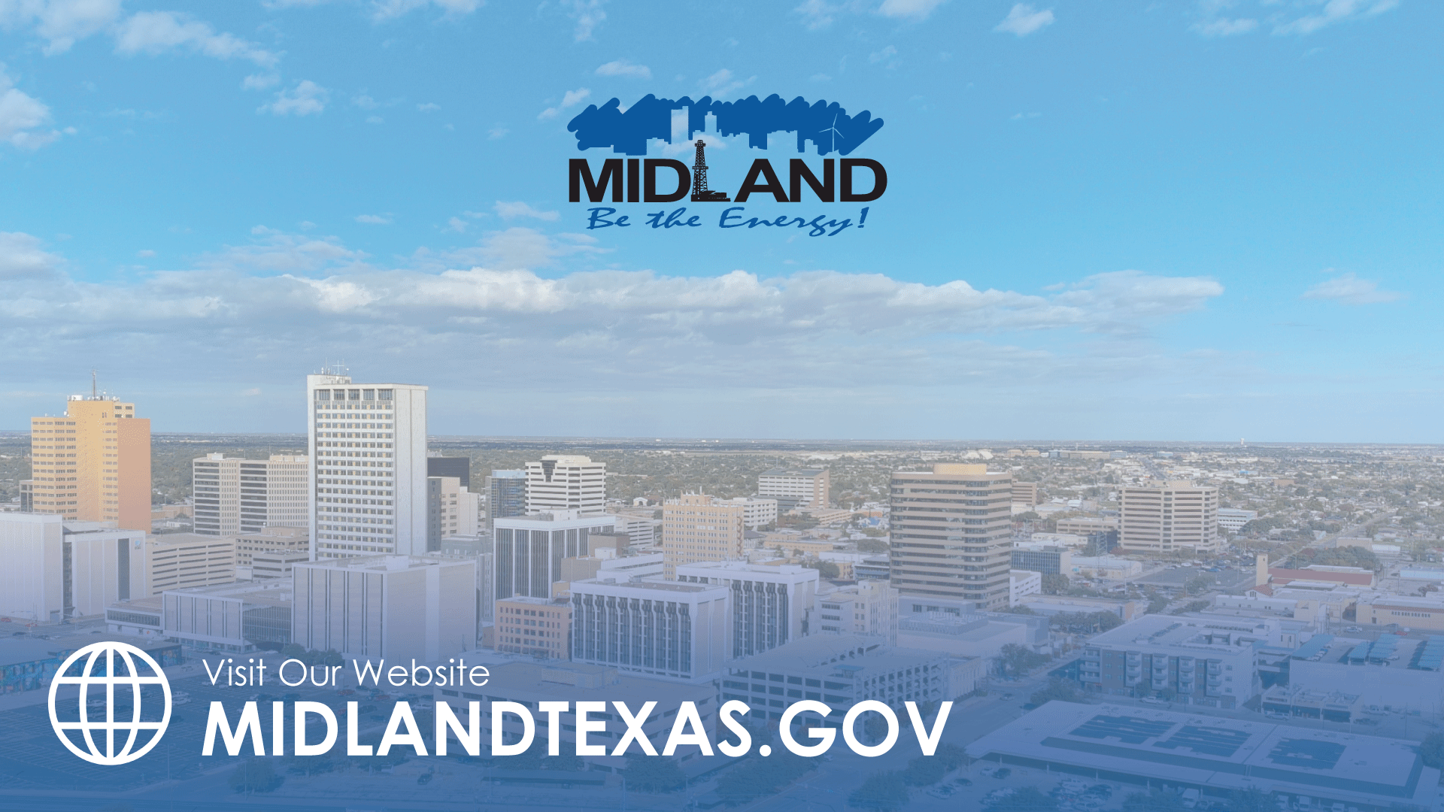
STRENGTHEN AND SUSTAIN OUR INFRASTRUCTURE- WATER
TITLE HERE
TITLE HERE

Slide 2
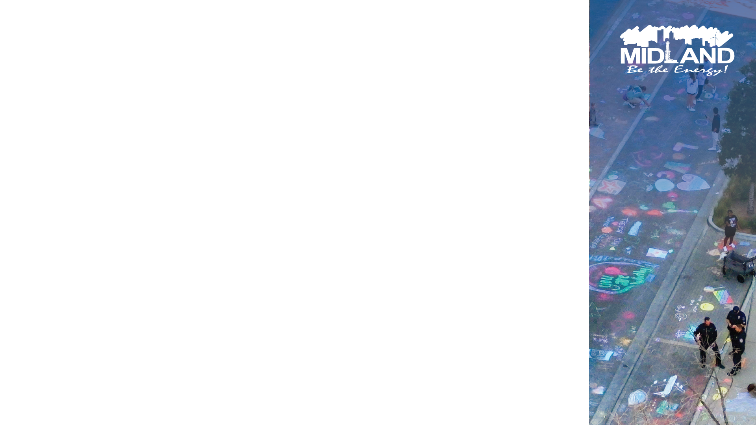
TABLE OF CONTENTS
Background & Context – Goals 4.1, 4.2, 4.3; 5.2
Restoration of Water Treatment & T-Bar Capacity – Goals 6.1, 6.5
Satellite Leak Detection – Goals 6.5; 5.6
Redundancy & System Resilience – Goals 6.1, 6.5
Valve Program & Real-Time Pressure Monitoring – Goals 6.5; 5.10
Water Main Replacement & Targeted Upgrades – Goals 6.5; 5.6
Paul Davis Well Field Revitalization – Goals 6.1, 6.5
T-Bar Advanced Treatment Pilot–Lessons Learned–Goals 6.1; 5.6
Zebra Mussel Mitigation – Goals 6.5; 5.10
Future Water Supply – Ft Stockton & Reuse – Goals 6.1, 6.5
Conclusion – Goals 4.3; 5.6; 6.5
2

Slide 3
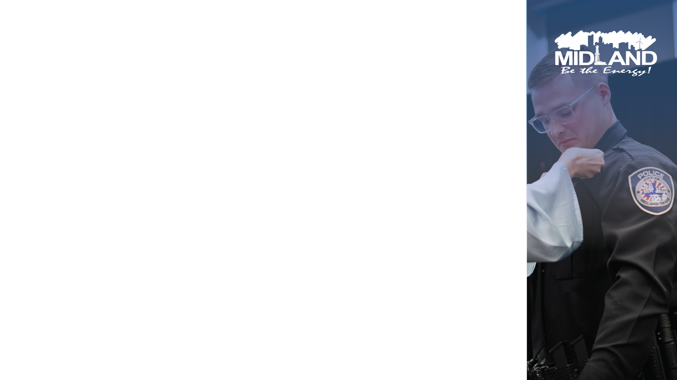
COMPREHENSIVE WATER SYSTEM PROGRESS AND STRATEGIC ALIGNMENT
By collaborating with City Council, City Management, and local industry leaders, we conducted a first-of-its-kind After-Action Review (AAR) for our utility—an unprecedented step to strengthen existing processes and identify opportunities for new systems.
My department fully embraced the resulting changes.
After successfully preventing a boil water notice in March, we continued to seek ways to enhance our performance—optimizing tools such as satellite leak detection and water main replacement, while developing new processes for active pressure monitoring and valve maintenance. Through strong leadership and dedicated partnerships, we continue to improve every day.
3

Slide 4

GUIDING LEADERSHIP
THROUGH ADVERSITY
In depth AAR
Create backups and contingency
  System Bypass
  Sensors
  Leak detection
Consistent MGD production with a look into the future.
4

Slide 5

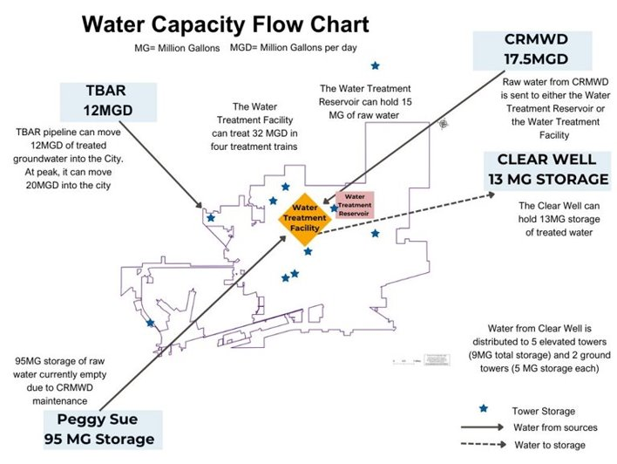
5

Slide 6

RESTORATION OF WATER TREATMENT AND T-BAR CAPACITY – FROM 8 MGD TO FULL OPERATION
Background – What Happened
Water Purification Plant: Normally capable of 32 MGD, the plant dropped to 8 MGD after:
  A contractor flooded the electrical system during sump pump repairs, taking two treatment trains offline.
  A third train was down for planned maintenance on mussel-related solids handling equipment.
T-Bar Well Field: Normally capable of 20 MGD, delivery was restricted to 7 MGDS by a pressure reducing valve (PRV) malfunction at SH 158, caused by a sheared gear.
6

Slide 7

RESTORATION ACTIONS
Rapid electrical repairs and sump pump upgrades at the plant.
Excavated and replaced the PRV gearbox at T-Bar.
Temporarily routed treated T-Bar water directly into the plant clearwell via hydrant lines, boosting capacity from 8 to 16 MGD within 24 hours.
Sequentially returned treatment trains to service until full 32 MGD capacity was restored.
7

Slide 8
8

Slide 9

OPERATIONAL IMPROVEMENTS
Added PRV inspections to preventive maintenance schedules.
Integrated PRV monitoring into SCADA alarms.
Advanced zebra mussel mitigation to reduce solids loading.
Initiated procurement for a bypass pipeline from T-Bar to the clearwell.
RESULTS
Sustained over 45 MGD peak delivery in July 2025 without service interruptions.
Pressure monitoring caught a minor PRV pressure drop in June 2025, resolved before affecting customers.
9

Slide 10
REDUNDANCY
Edgewood Backup Groundwater
  Hydraulic modeling and design underway for a backup groundwater source to Edgewood.
  Will sustain essential east side service during surface water interruptions.
T-Bar to Water Plant Bypass
  Modeled to deliver 10 MGD directly to the plant clearwell while maintaining 4 MGD to T-Bar tank.
  Procured owners representative to initiate a Design-Build to accelerate delivery.
10

Slide 11
RESULTS
Will eliminate the need for temporary hydrant lines as used in the March 2025 incident.
Provides redundancy for future surface water challenges
11

Slide 12
SATELLITE LEAK DETECTION –
PROACTIVE ASSET MANAGEMENT IN ACTION
Background
Historically, most underground leaks were discovered only after surfacing. In May 2025, the City contracted Asterra for satellite leak detection to proactively find leaks as small as ~1 gallon per minute.
Implementation & Results
  Two aerial scans per year, GIS-mapped results.
  First scans identified dozens of non-surfacing leaks for scheduled repairs.
  Integrated leak data into the City’s capital planning and main replacement program

Slide 13
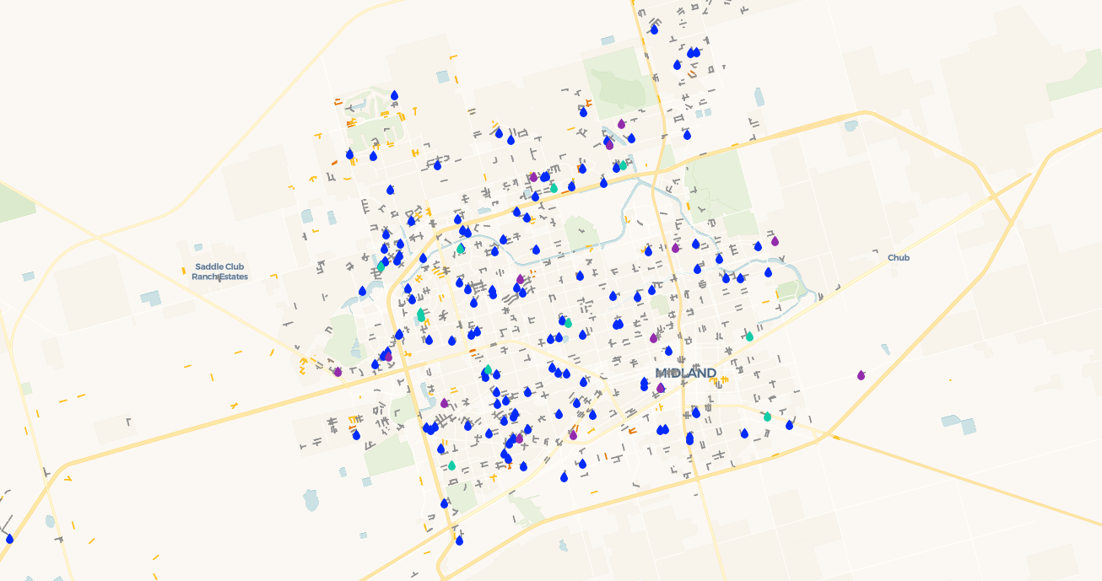

Slide 14
VALVE PROGRAM & REAL-TIME PRESSURE MONITORING
Multi-Year Valve Program
Citywide valve location, testing, exercising, and repair program.
Focus on 12” and smaller diameter and isolation valves.
Pressure Monitoring
30 monitors installed, 34 currently being installed.
Alerts sent via cloud platform to multiple staff if readings go out of range.
14

Slide 15
IN ACTION
RESULTS
June 2025:
  One pressure monitor sent low pressure alert to staff.
  Initial call to Water Plant evaluated elevated towers and elevation of the tank was normal
  Staff evaluated other monitors and pressures in the zone were dropping
  Water Plant staff visually inspected on site at tower and the elevation was low, the SCADA system had froze, the tank was 15’ lower than system reported.
  SCADA system was reset and elevation and pressure got restored.
July 2025:
  One pressure monitor in the airport/T-bar system showed several pressure drops over a 6-hour period.
  Through a several step process (monitor check, visual check, and Tower check) it was determined that the monitor was malfunctioning.
  Process led to creation of a monitor assessment SOP.
15

Slide 16
WATER MAIN REPLACEMENT & TARGETED UPGRADES
Water Main Program
$4M/year for priority replacements based on break history, age, and hydraulic modeling.
Coordinated with street rehab projects.
Targeted Upgrades
Two critical valves replaced at the plant.
New Hwy 158 flow meter installed for accurate groundwater flow tracking.
Results
Lowered water main repair work orders from 206 workorders in 2024 to 150 in 2025.
16

Slide 17
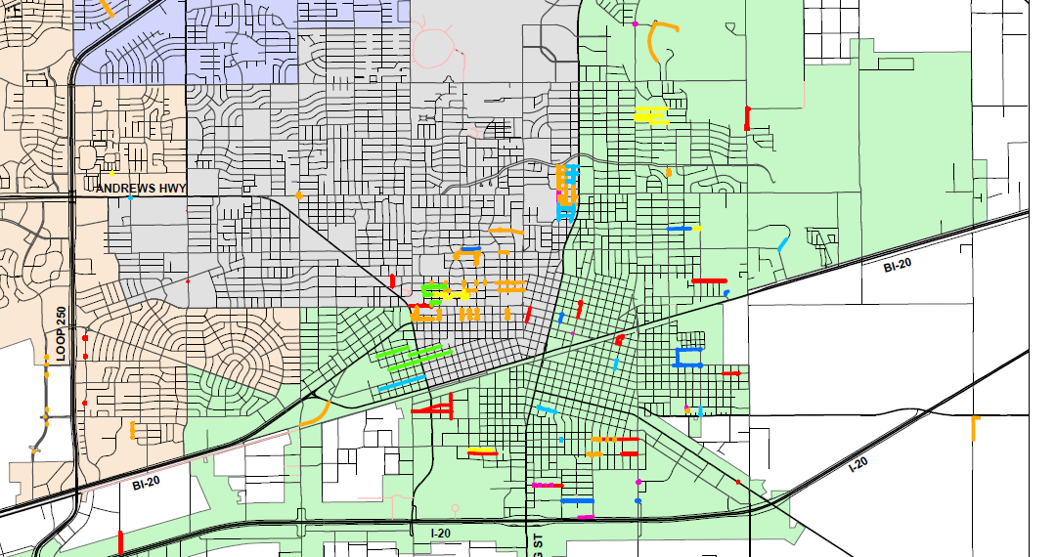

Slide 18

ZEBRA MUSSEL MITIGATION
Actions
CRMWD began copper sulfate treatment at Lake Ivie in 2025.
Adjusted solids handling protocols and maintenance schedules.
Results
30% decrease in solids accumulation in July 2025 compared to 2024.
Reduced mussel shells in raw water screens since source-level treatment began.

Slide 19
19

Slide 20
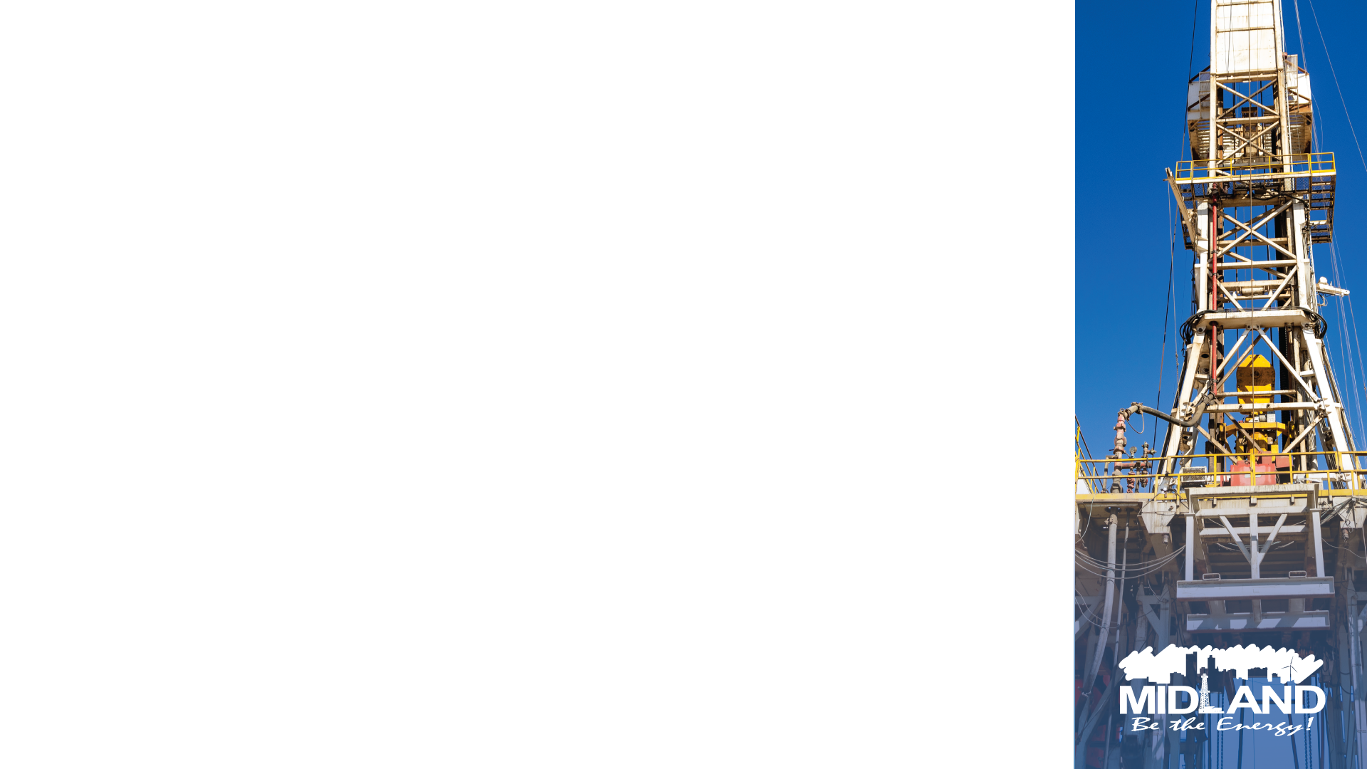
DEVELOPMENT OF GROUNDWATER FOR STABILITY
Paul Davis Well Field Revitalization
Background
Previously offline due to poor water quality, Paul Davis is being redeveloped as a supplemental source.
Actions
Five new wells drilled and tied into the system.
Infrastructure and telemetry upgrades.
Capacity now 13 MGD with all wells operating.
Results
July 2025 testing: three wells produced 7 MGD for 48 hours without drawdown issues.
T-Bar Advanced Treatment Pilot – Lessons Learned
Treatment Pilot did not meet performance targets for consistent arsenic removal.
Contract ended; focus shifted to advanced treatment at Paul Davis.
Continue blending T-Bar with other sources to meet TCEQ standards.
20

Slide 21
FUTURE SUPPLY DEVELOPMENT
Working on future water supplies with a possible additional 66 MGD supply.
Fort Stockton Groundwater (WTWP Partnership)
Phase 1 development with WTWP underway.
Water quality varies; proceeding under conventional permitting/export rules.
Targeting wells balancing yield and treatment cost.
Potable Reuse Feasibility
Studying Direct and Indirect Potable Reuse options.
Leveraging Bed & Banks Permit for potential future implementation.
21

Slide 22
CONCLUSION
Since March 2025, the Utilities Department has turned short-term emergency fixes into a long-term resilience strategy. Through targeted infrastructure investments, enhanced monitoring, source diversification, and lessons learned from the AAR, Midland is better prepared than ever to deliver reliable water service — even under challenging conditions.
22

Slide 23

MISSION
Deliver exceptional services and promote a high quality of life and place for ALL our citizens.

