Slide 1

DOWNTOWN MIDLAND ON-STREET PARKING PROGRAM
TITLE HERE
TITLE HERE

Slide 2

PURPOSE OF PARKING ORDINANCE
Establish a clear framework for paid and time-limited on-street parking
Authorize administrative management of regulated parking spaces
Enable consistent rules for time limits, signage, enforcement, and payment
Provide flexibility for active curb and parking management
Effective February 1, 2026
2

Slide 3

PURPOSE OF THE ON-STREET PARKING PROGRAM (PHASE ONE)
Improve customer access to downtown businesses
Increase turnover in high-demand curbside areas
Reduce circling and inefficient parking behavior
Support downtown walkability and revitalization
Create a fair, consistent, and predictable parking system
3

Slide 4

STRATEGIC PLAN ALIGNMENT
Goal 1: Strong Economy with More Quality Jobs
Supports downtown access and business activity
Goal 2: Set the Standard for a Safe and Secure City
Reduces congestion and unsafe circulation
Goal 6: Strengthen and Sustain Our Infrastructure
Improves management of public right-of-way assets
4

Slide 5
WHY DOWNTOWN: POLICY & PLANNING CONTEXT
Downtown Master Plan identifies parking as a barrier to walkability
Short-term, convenient parking is a top public priority
Oversupply of surface parking limits economic potential
Active curb management supports retail, dining, and events
5

Slide 6
ACE PARKING STUDY – KEY FINDINGS
Peak demand 10 am to 4 pm on weekdays
Overall supply exists, but curbside spaces are misused
Up to 25% of vehicles exceed posted time limits
Employee parking is displacing customers
Inconsistent signage contributes to non-compliance
6

Slide 7
ACE PARKING STUDY: RECOMMENDED APPROACH
Paid parking in downtown core (2-hour maximum @ $1.50 per hour)
Time-limited parking (2-hour maximum) on surrounding blocks
Monday-Friday enforcement, 8 am to 6 pm
Shift long-term parking to garages and off-street lots
Use scan-to-pay technology to reduce hardware costs
7

Slide 8


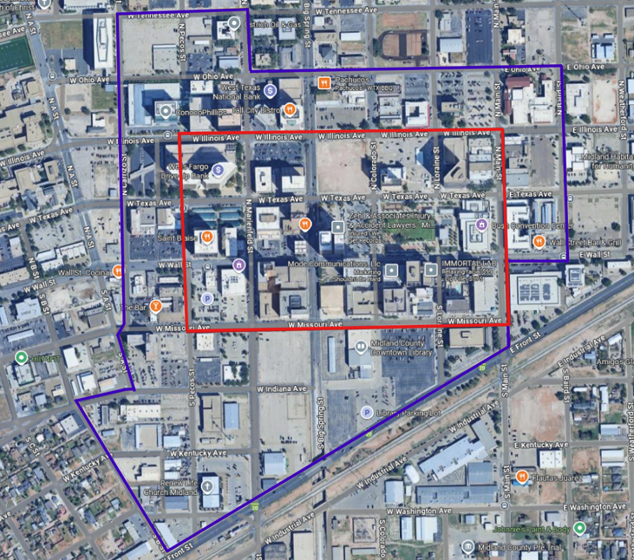
PROPOSED PARKING MANAGEMENT AREA
2-Hour Time Limited Parking
2-Hour Time Limited, Paid Parking

Slide 9
PARKING ORDINANCE: WHAT IT ENABLES
Administrative designation and adjustment of regulated parking areas
Use of digital payment platforms
Clear authority for signage, time limits, and enforcement
Temporary removal or re-designation of spaces for events, construction, and access needs
9

Slide 10
DOWNTOWN IMPLEMENTATION: HOW THE ORDINANCE IS USED
Downtown is the initial and only application area
Implementation guided by the Ace Parking Study and the Downtown Master Plan priorities
Ordinance allows:
  Paid parking in core blocks
  Time-limited parking on surrounding blocks
  Temporary removal or re-designation of spaces for construction, special events, and loading and access needs
10

Slide 11
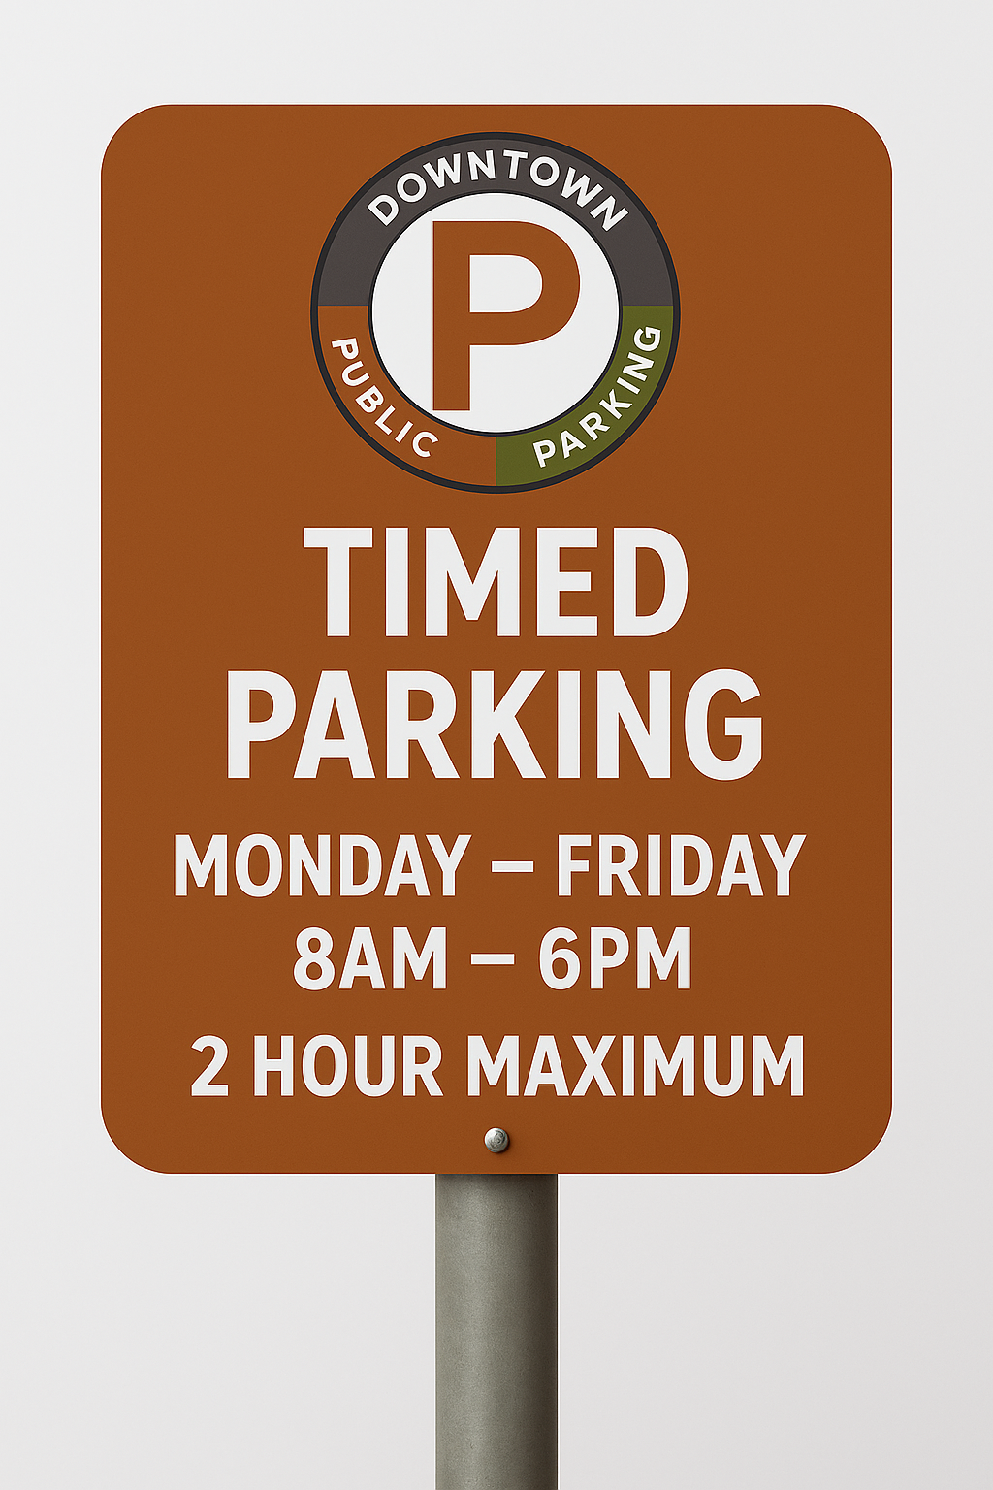
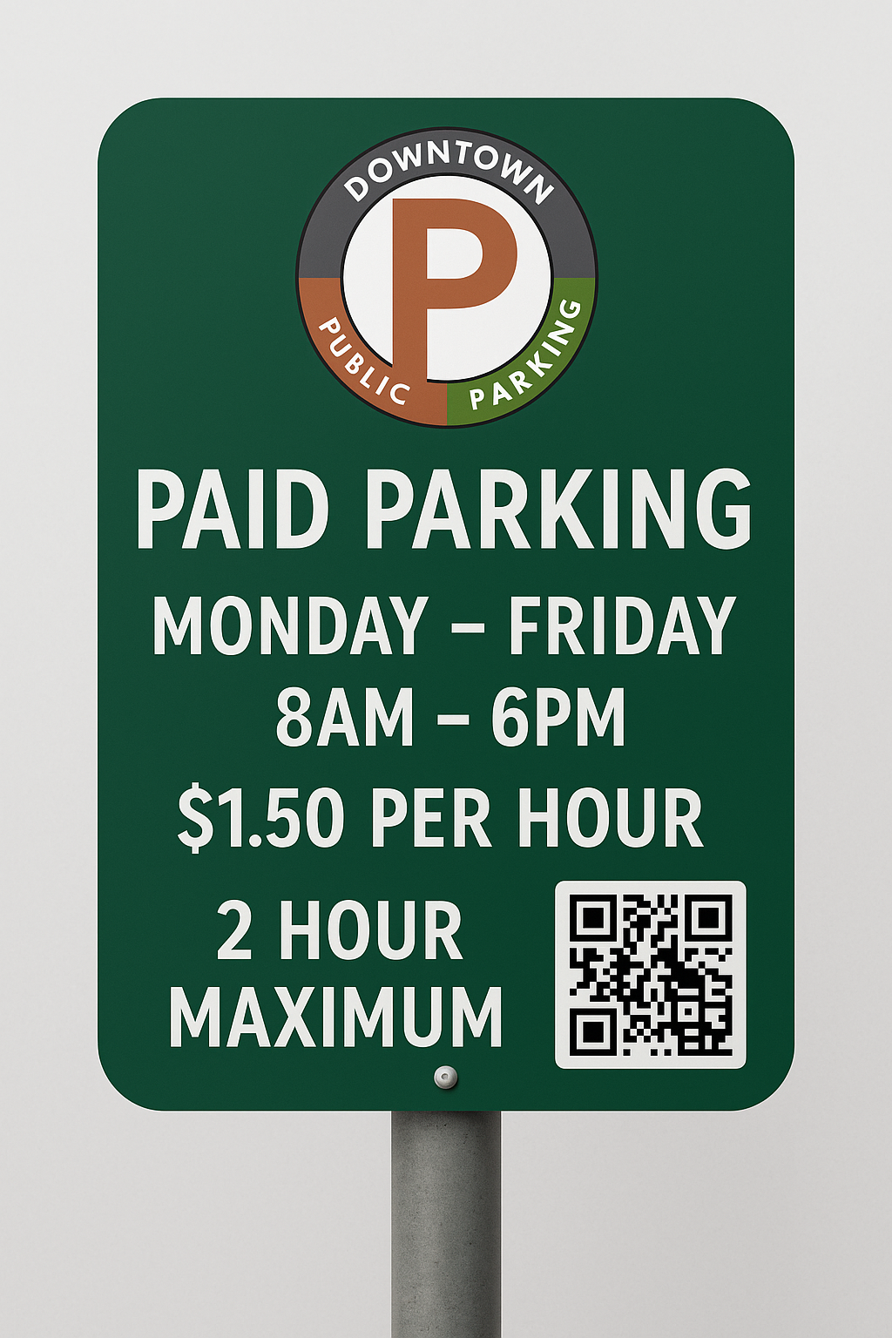
SIGNAGE & WAYFINDING UPDATES
Standardized design for all regulated parking areas
Clear spacing and placement requirements for signs
Consistent branding across downtown
Improved visibility and intuitive wayfinding to garages and lots
8

Slide 12
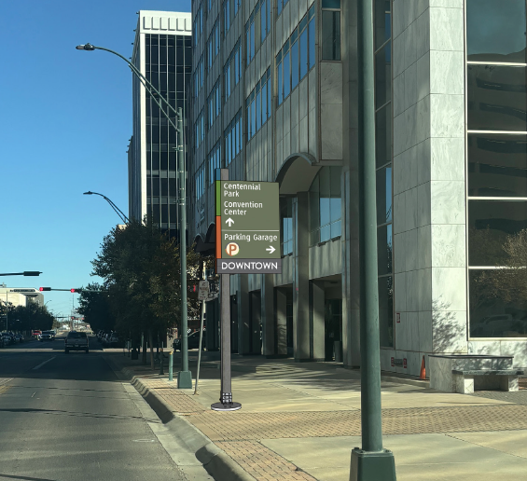
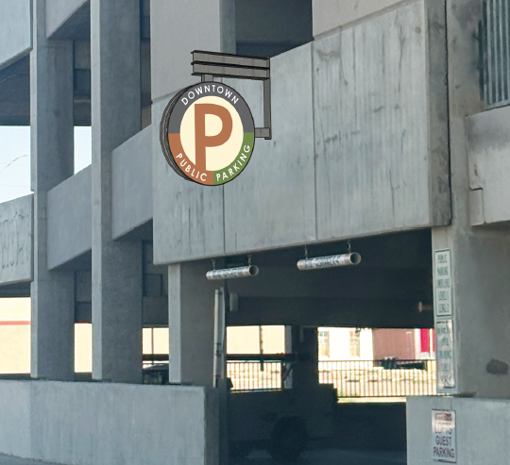
NEXT STEPS
Adopt ordinance and amended fee schedule
Stakeholder engagement and public education
Install signage and launch technology
Phased rollout beginning Q1 2026
12

Slide 13

MISSION
Deliver exceptional services and promote a high quality of life and place for ALL our citizens.

