Slide 1

SEX OFFENDER ORDINANCE PROPOSAL
TITLE HERE
TITLE HERE
Detective Sergeant Michael Ball- Crimes Against Persons/Sex Offender Compliance

Slide 2
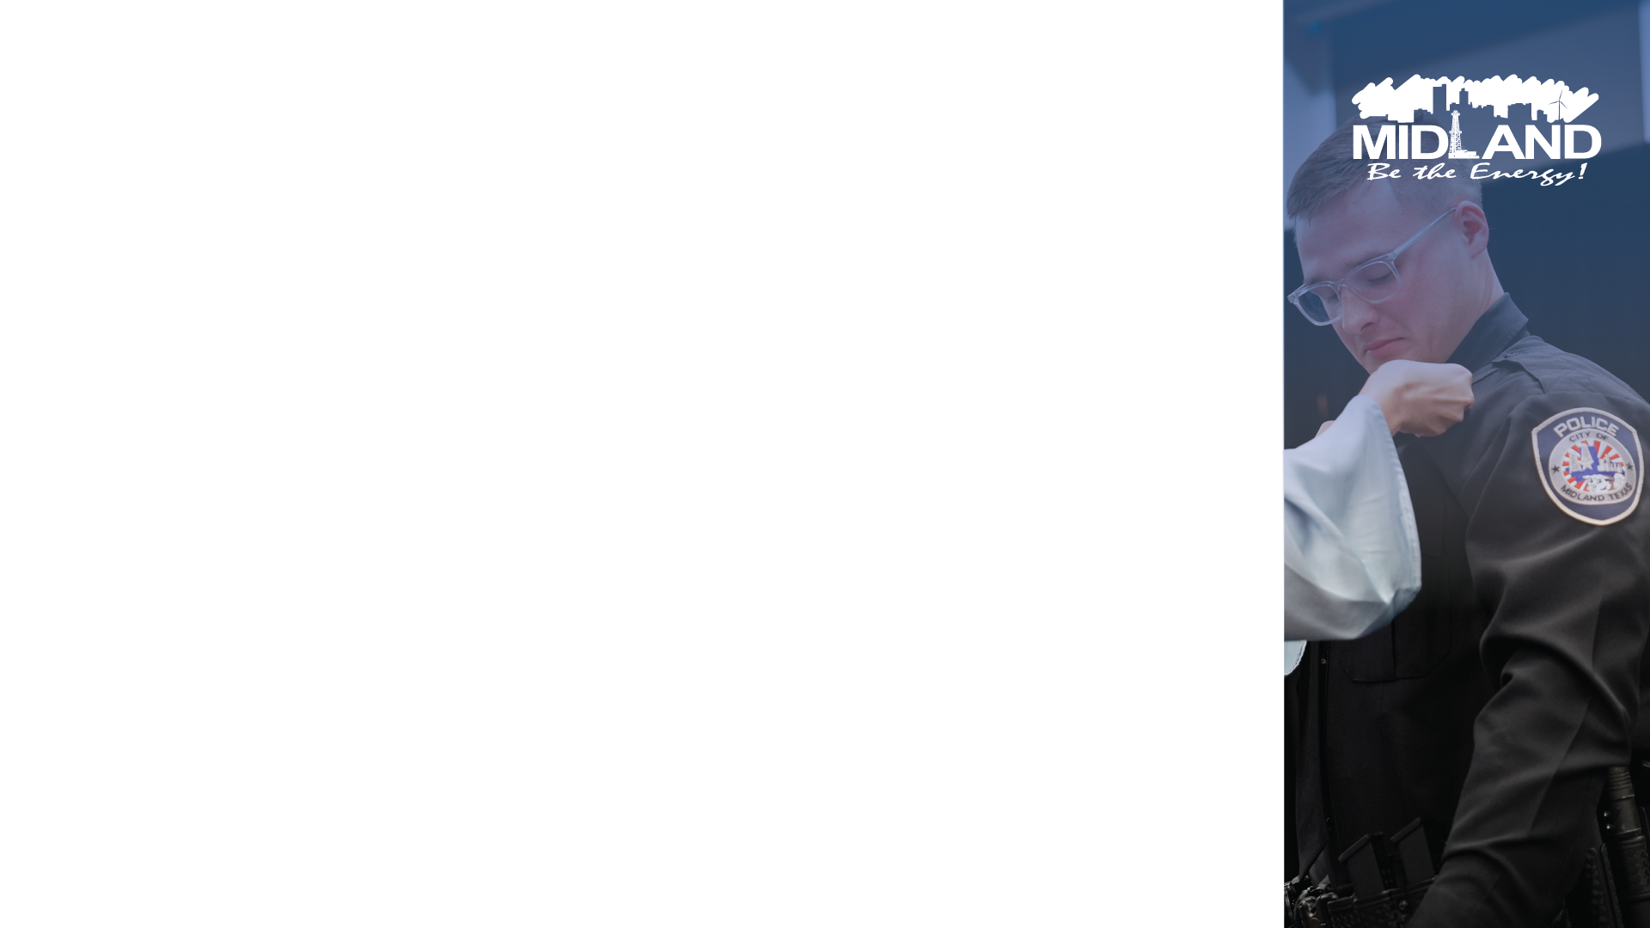
PURPOSE
To propose the implementation of a Sex Offender Ordinance for the City of Midland.
Promote, protect and improve the health, safety and welfare of the citizens of Midland and to be in line with The City of Midland Strategic Plan by:
Creating areas around locations where children regularly congregate where registered sex offenders would be prohibited from establishing permanent residency
Prohibit Sex Offenders from loitering inside child safety zones.
2

Slide 3

STRATEGIC GOAL ALIGNMENT
Goal 2: Set the Standard for a Safe and Secure City Strategies:
2.1: Be the safest city in West Texas: Enhance public safety programs.
2.6 Grow and retain public safety resources: Expand law enforcement presence.
3

Slide 4
STRATEGIC GOAL ALIGNMENT
Goal 3. Quality of Life and Place
3.5 Nurture and promote a healthy community: Increase healthy community living and education opportunities for citizens of all ages
3.6 Build the best parks system in our region: Offer diverse, accessible, and enjoyable green spaces, tournament ready ball fields, safe playgrounds, and unique recreational opportunities that enhance the quality of life/quality of place for our community.
4

Slide 5
PURPOSE OF SEX OFFENDER RESTRICTIONS
Protecting Vulnerable Populations
Children are at greater risk: Young individuals are often less aware of dangers and may not understand how to protect themselves. Restrictions on sex offenders aim to minimize their exposure to potential harm.
Preventing Recidivism
Reducing opportunities: By limiting where sex offenders can live or visit, the ordinance creates barriers that could prevent repeat offenses. The more difficult it is for offenders to access environments where children are present, the lower the likelihood of new incidents.
5

Slide 6
PURPOSE OF SEX OFFENDER RESTRICTIONS
Community Awareness and Safety
Enhancing community vigilance: Restrictions serve as a reminder to communities about the presence of sex offenders. This can promote greater vigilance among parents and caregivers, encouraging them to supervise children more closely in public spaces.
Enhancing Reporting and Response
Increased monitoring: Areas with restrictions often have increased law enforcement presence and community awareness, which can facilitate quicker responses if any suspicious activity arises.
6

Slide 7

HOW DOES ONE BECOME A SEX OFFENDER?
Reportable conviction or adjudication" means a conviction or adjudication, including an adjudication of delinquent conduct or a deferred adjudication, that, regardless of the pendency of an appeal, is a conviction for or an adjudication for or based on:
Section 21.02 (Continuous sexual abuse of young child or disabled individual)
21.03 (Continuous sexual abuse)
21.09 (Bestiality)
21.11 (Indecency with a child)
21.15 (Invasive visual recording)
22.011 (Sexual assault)
22.021 (Aggravated sexual assault)
25.02 (Prohibited sexual conduct)
43.04 (Aggravated promotion of prostitution)
43.05 (Compelling prostitution)
43.25 (Sexual performance by a child)
43.26 (Possession or promotion of child pornography)
43.021 (Solicitation of Prostitution)
20.04(a)(4) (Aggravated kidnapping) if the actor committed the offense or engaged in the conduct with intent to violate or abuse the victim sexually.
30.02 (Burglary) if the actor committed the offense or engaged in the conduct with intent to violate or abuse the victim sexually.
the second violation of Section 21.08 (Indecent exposure)
33.021 (Online solicitation of a minor)
20A.02(a)(3), (4), (7), or (8) (Trafficking of persons)
20A.03 (Continuous trafficking of persons)
7

Slide 8
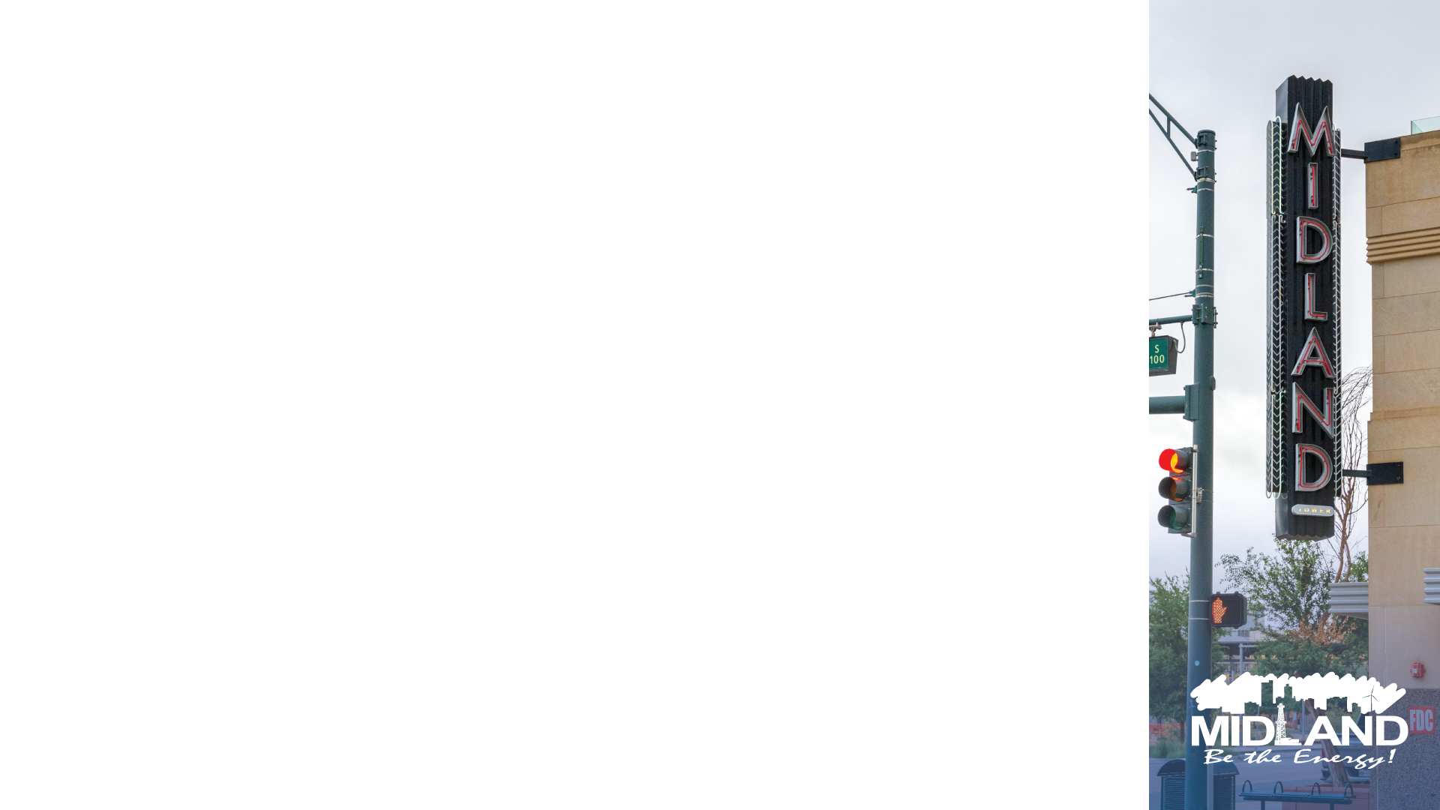
TEXAS RISK LEVELS
There is not a risk level of NO DANGER!
Low Risk Sex level
A designated range of points on the sex offender screening tool indicating that the person poses a low danger to the community and will not likely engage in criminal sexual conduct
Moderate Risk Level
A designated range of points on the sex offender screening tool indicating that the person poses a moderate danger to the community and might continue to engage in criminal sexual conduct
High Risk Level
A designated range of points on the sex offender screening tool indicating that the person poses a serious danger to the community and will continue to engage in criminal sexual conduct

Slide 9
Non-reported Risk Levels
Federal cases/out of state Sex Offenders
01
A risk level is not attributed, because the Federal Prison System does not have risk levels as a requirement, or the risk system was not implemented at the time of conviction due to the sex offender not being convicted in the State of Texas.
02
Most all federal cases are sex offenders convicted of online solicitation of minors, and or possession of child pornography
03
9

Slide 10
Risk Level Breakdown for Midland
Low Risk
79 registered sex offenders
Mod Risk
121 registered sex offenders
Not reported
43 registered sex offenders
High Risk
10 registered sex offenders
253 Registered Sex Offenders
In the City Of Midland.
That’s more sex offenders than Police Officers!
10

Slide 11
Current City of Midland Sex Offender-criminal history
The 253 known Sex Offenders inside the City of Midland, have been arrested a combined total number of 1,401 times for a class B misdemeanors and above. These include but are not limited to:
Examples:
DWI arrests
87
Fail to comply W/ Sex Offender Req
174
Narcotics arrests
185
11

Slide 12
CURRENT CITY OF MIDLAND SEX OFFENDER RESIDENCE CRIMINAL HISTORY
REMOVING ALL FAIL TO REGISTER CHARGES, ONLY SHOWING LAWS BROKEN BY THEM THAT YOU AND I ARE ALSO REQUIRED TO FOLLOW:
1,227 serious criminal arrests
12

Slide 13

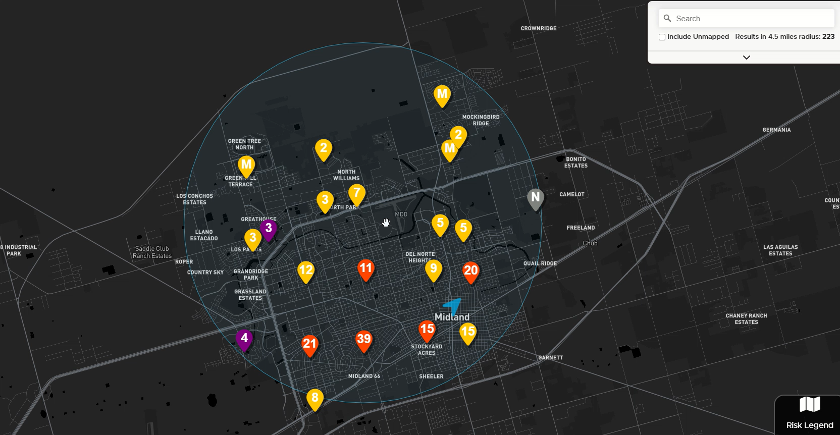
13

Slide 14
Child Safety Zone-
TX Gov Code 508.187
Child safety zone means premises where children commonly gather. The term includes a school, day-care facility, stadium, public park, public playground, public or private youth center, public swimming pool, video arcade facility, or other facility that regularly holds events primarily for children. The term does not include a church, as defined by Section 544.251, Insurance Code.
01
14

Slide 15

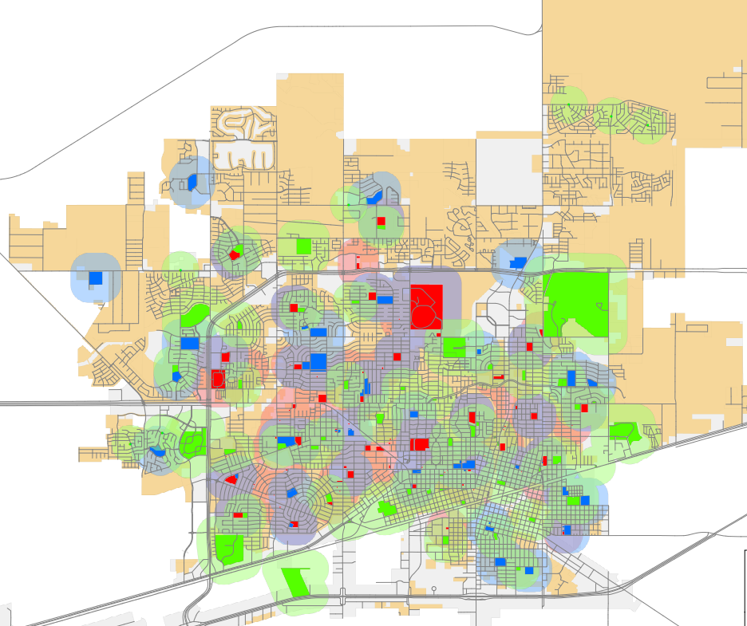
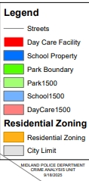
15

Slide 16
Texas cities with restrictions (23 cities) (population, date of restriction, Approximate number of sex offenders. Sex offenders per 1000 population. In blue comparable to Midland size
Argyle 5,800 (2017) approx. 2 (.3)
Coppell 41,000 (2006) approx. 9 (.2)
Haltom City 45,000 (2007) approx. 27 (.6)
Justin 5,900 (2017) approx. 2 (.3)
Lewisville 133,000 (2006) approx. 20 (.15)
McKinney 213,000 (2012) approx. 35 (.16)
Richland Hills 8,000 (2006) approx. 9 (1.1)
Roanoke 10,000 (2006) 1 sex offender (.1)
Saginaw 25,000 (2007) approx. 14 (.5)
Southlake 31,000 (2008) 1 sex offender (.03)
The Colony 45,000 (2006) 17 sex offenders (.4)
Colleyville 25,000 (2025) 9 sex offenders (.3)
Bedford 48,000 (2023) approx. 24 (.5)
Denton 158,000 (2011) approx. 90 (.57)
Flower Mound 81,000 (2007) approx. 13 (.16)
Grapevine 50,000 (2014) approx. 8 (.1)
Keller 46,000 (2021) approx. 8 (.1)
Plano 290,000 (2006) approx. 100 (.3)
North Richland Hills 70,000 (2011) approx. 60 (.8)
Carrollton 132,000 (2006) approx. 9 (.07)
Grand Prairie 202,000 (2008) approx. 80 (.4)
Irving 255,000 (2019) approx. 113 (.4)
Watuga 23,000 (2012) approx. 13 (.5)
16

Slide 17

All the previously mentioned ordinances listed are available online.
17

Slide 18
Conclusion:
These Texas Cities with Sex Offender restrictions at any distance average (.39) sex offenders per 1000 citizens
18

Slide 19
City Of Midland with NO restrictions number of sex offenders per 1000 population
City Of Midland 143,000 at 253 registered sex offenders (1.77) per 1000 citizens
That is More than 4X greater than cities with any restrictions!
19

Slide 20

City of Midland Sex Offender Ordinance
6-11-1.Purpose.
The purpose of this Chapter is to protect children by prohibiting sex offenders from residing within 1,500 feet of premises where children commonly gather and from entering premises where children commonly gather.
20

Slide 21
Texas drug free zones
THE CITY OF MIDLAND ALREADY ENFORCES DRUG FREE ZONES OF 1000 FEET AROUND CHILD SAFETY ZONES AND HAVE SINCE THE EARLY 1990’S (OVER 36 YEARS).
Just as drug-free zones are designed to limit drug exposure around places where children gather, sex offender restrictions aim to prevent offenders from being near places where children gather.
This is our opportunity to align with other laws to protect children from not only violent gang members and drugs but also from sexual predators.
21

Slide 22
residence
Residence means:
a place where a person abides, lodges or resides for 14 or more consecutive days;
a place where a person abides, lodges or resides for a period of 14 or more days in the aggregate during any calendar year; or
a place where a person routinely abides, lodges or resides for a period of four or more consecutive or nonconsecutive days in a month.

Slide 23
exceptions
1. That the sex offender established the residence prior to the effective date of this Chapter and has complied with all applicable state laws concerning sex offender registration since the effective date of this Chapter;
2. That the sex offender established the residence prior to the establishment of the child safety zone within 1,500 feet of the residence and has complied with all applicable state laws concerning sex offender registration since the establishment of such child safety zone;
3. That the sex offender was a minor when he or she committed the offense that gave rise to his or her status as a sex offender and was not convicted of such offense as an adult;
4.That the sex offender is a minor; or
5. That the sex offender was expressly authorized by an order of a court of competent jurisdiction to establish or maintain the residence.
23

Slide 24
exceptions
6-11-4. Prohibited entry; exception; penalty; affirmative defenses.
(A) Prohibited entry. A sex offender shall not enter the premises of a child safety zone.
(B) Exception. It is an exception to the application of Subsection (A):
1. that an exemption was granted to the sex offender in accordance with Section 6-11-6 and that the sex offender was acting in compliance with the exemption;
2. that the sex offender entered the premises of the child safety zone for the limited purpose of attending a meeting of a governmental body that was occurring on the premises of the child safety zone; or
3. that a polling place was located on the premises of the child safety zone, the sex offender was qualified to vote at such polling place, and the sex offender entered the premises of the child safety zone for the limited purpose of voting.
(C) Penalty. A person who violates Subsection (A) shall be guilty of a misdemeanor and fined in a sum not to exceed $500.00. A person commits a separate and distinct offense for each separate violation of a provision of Subsection (A). A person commits a separate and distinct offense each day during which a violation of Subsection (A) is committed or continued. Evidence of a culpable mental state is not required to prove a criminal offense under Subsection (A). It is hereby declared that, for all offenses prosecuted under Subsection (A), the culpable mental state required by Section 6.02 of the Texas Penal Code is specifically negated and clearly dispensed with
24

Slide 25
In Conclusion:
Without Restrictions:
City of Midland with no restrictions average (1.77) sex offenders per 1000 citizens
With Restrictions:
Cities with any restrictions for sex offenders at any distance average (.39) sex offenders per 1000 citizens
25

Slide 26

Set the Standard for a Safe and Secure City. Be the Safest City in West Texas:
Adopt the proposed ordinance and create the safest city in west Texas.
Set the standard for the region. Be the first major city in West Texas to adopt this ordinance to further protect our community.
Create a safe environment for the current and future citizens of Midland.
In all circumstances take up the shield of faith, with which you can extinguish all the flaming darts of the evil one Eph 6:16
26

Slide 27
Set the Standard for a Safe and Secure City. Be the Safest City in West Texas:
Studies of Sex Offender's crimes and what they HAVE done, does not show what they will do.
There are no studies that quantify when a crime has not been committed. There are multiple studies that address how crimes effect victims and their families.
The importance of Child Safety Zones is that they are a proactive step in safeguarding children and preventing the occurrences of future victimization.
In all circumstances take up the shield of faith, with which you can extinguish all the flaming darts of the evil one Eph 6:16
27

Slide 28

MISSION
Deliver exceptional services and promote a high quality of life and place for ALL our citizens.

