Slide 1

TITLE HERE
TITLE HERE
FLOCK SAFETY LPR RENEWAL

Slide 2


2

Slide 3
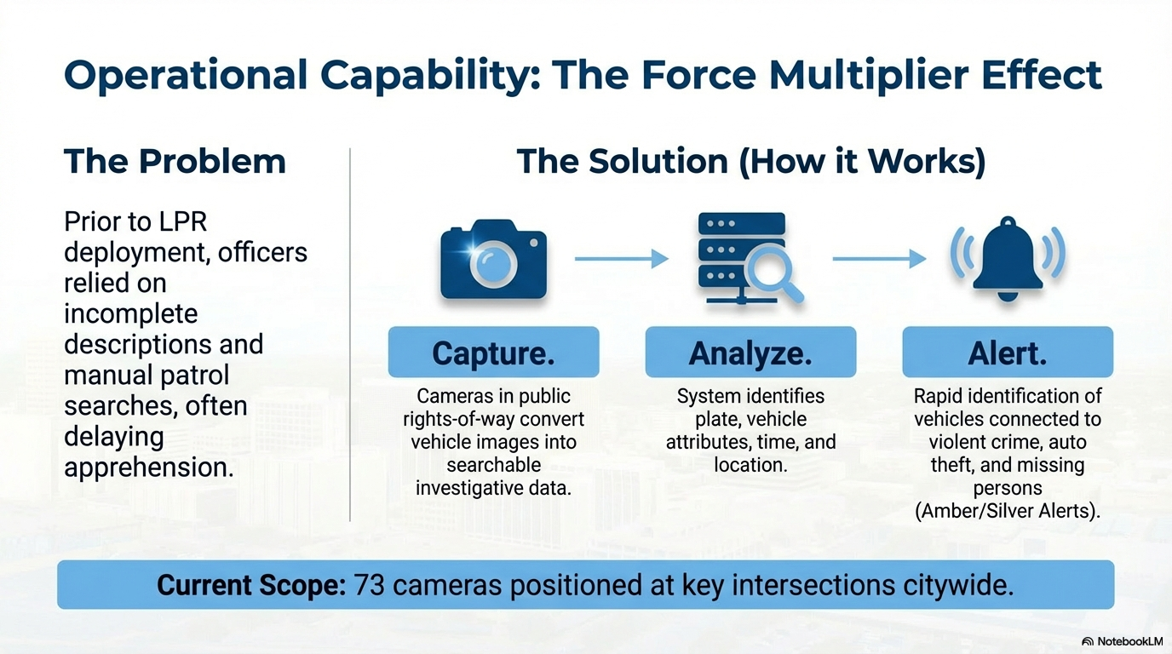

3

Slide 4

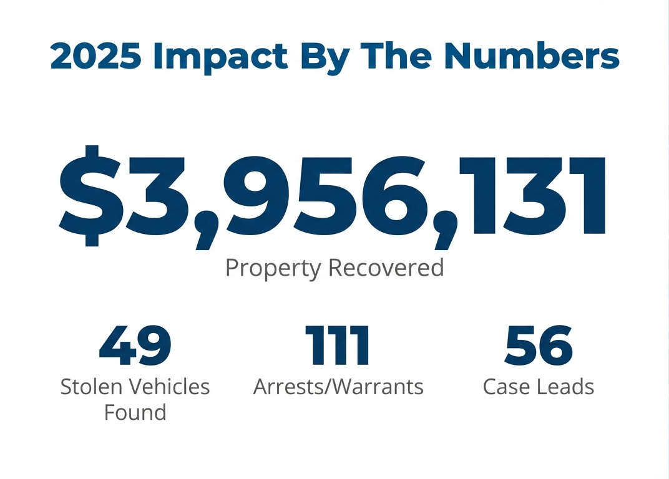
4

Slide 5
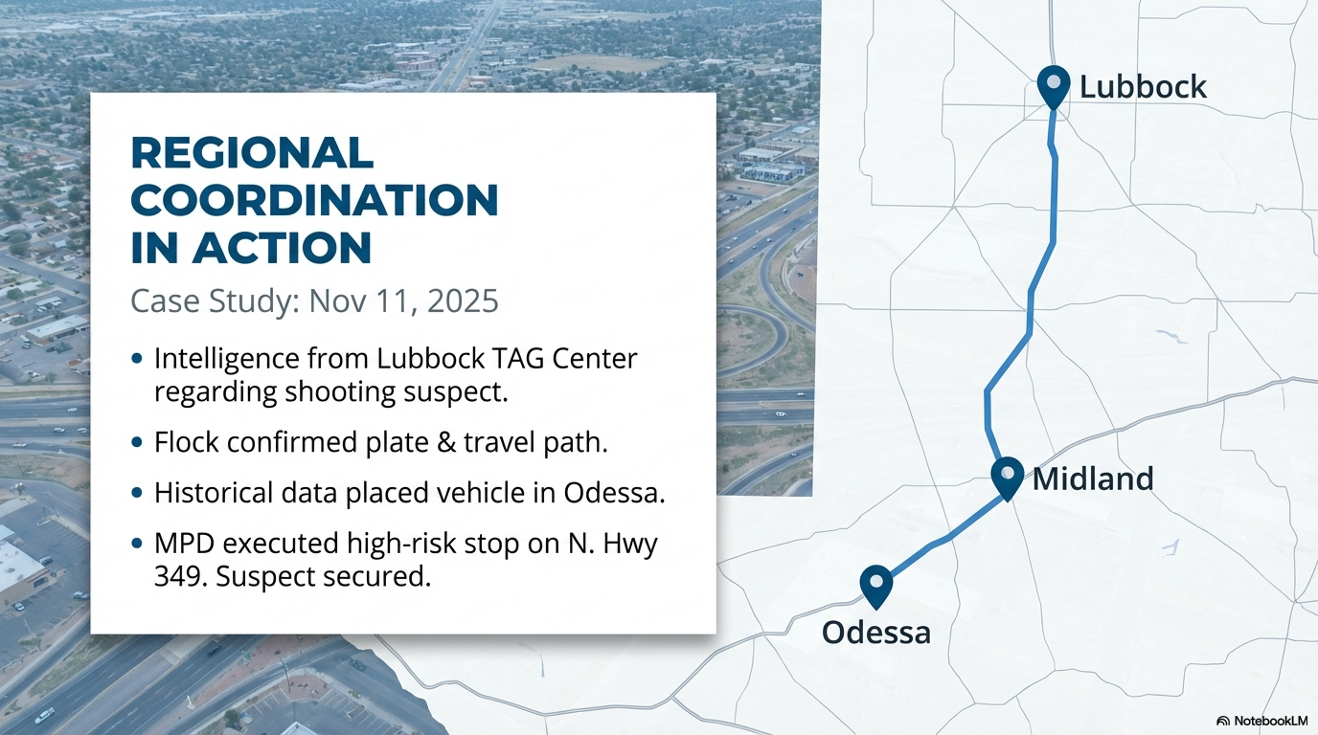
5

Slide 6
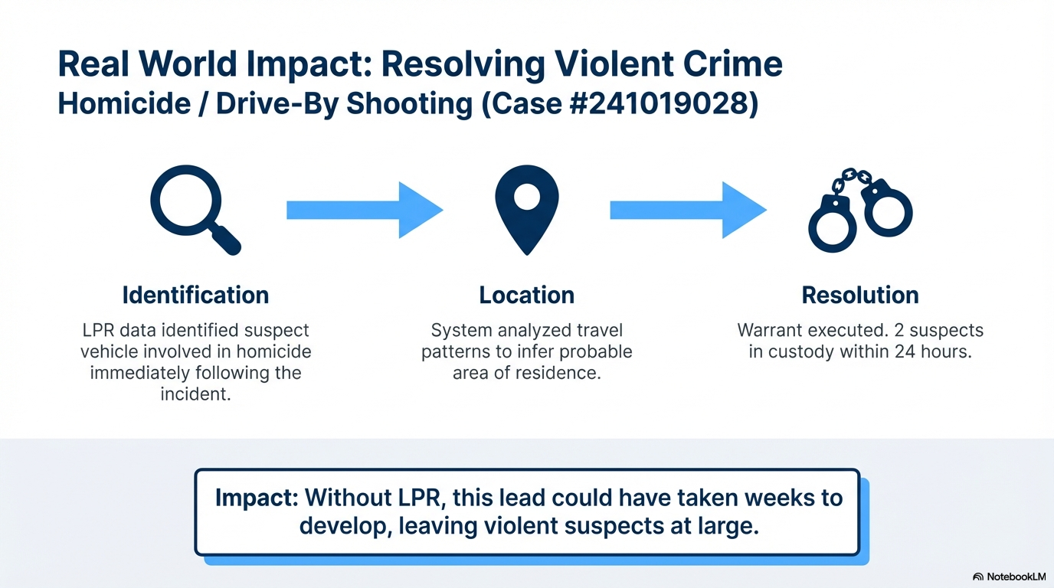
6

Slide 7
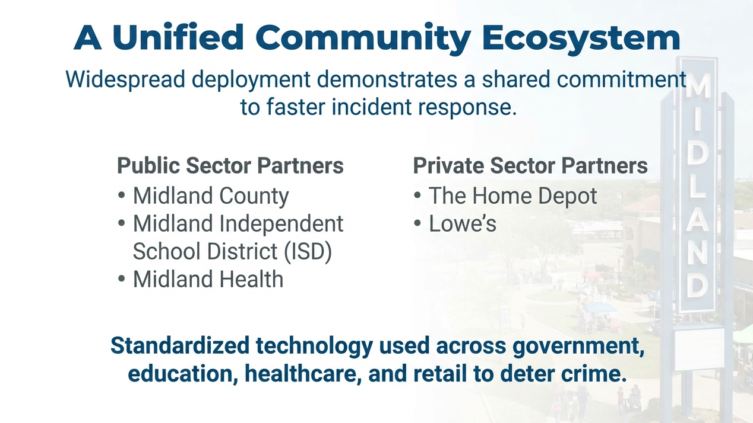
7

Slide 8
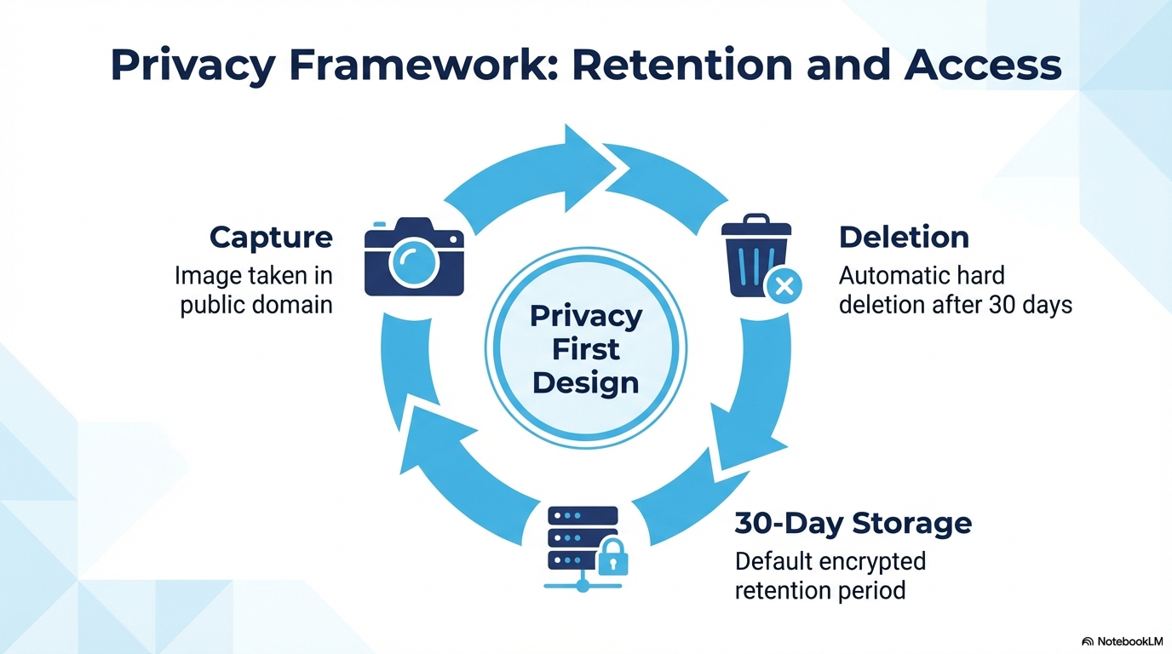

Slide 9
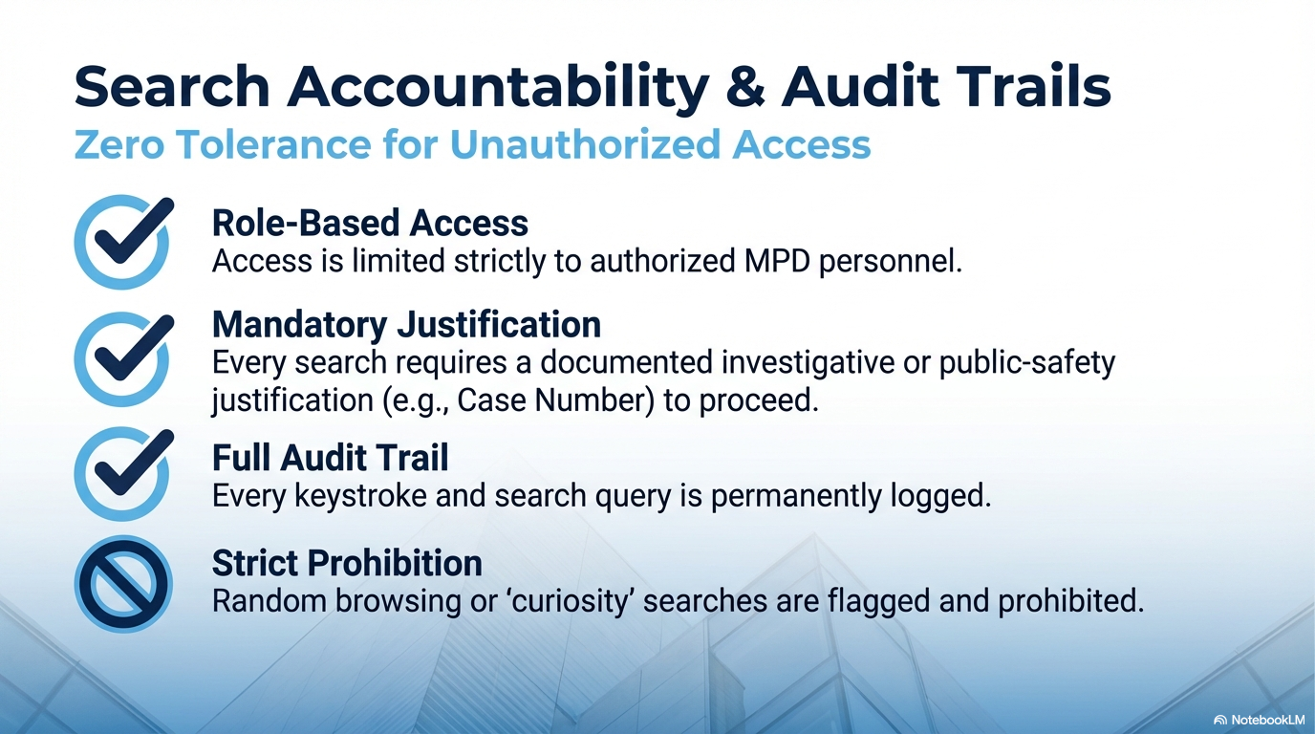

9

Slide 10

MISSION
Deliver exceptional services and promote a high quality of life and place for ALL our citizens.

