Slide 1

ANIMAL SERVICES ADVISORY COMMISSION MEETING
FEBRUARY 11TH, 2026

Slide 2

ORDER OF BUSINESS
Roll Call
Approval of Minutes
2025 Year in Review
Shelter Metrics
New Programs-Shelter Vet
Public Comment
Adjournment
2

Slide 3

ANIMAL SERVICE 2025 YEAR IN REVIEW
Time Period:
January 1st-December 31st, 2025
3

Slide 4
INTAKES
5069- Total Intakes
3563- Dogs
1412 Cats
4
2025: January 1st- December 31st, 2025

Slide 5

INTAKES
18.46% Increase since 2023
5
2025: January 1st- December 31st, 2025

Slide 6
INTAKES
6
2025: January 1st-December 31st, 2025

Slide 7
OUTCOMES
7
2025: January 1st- December 31st, 2026

Slide 8


LIVE RELEASE RATE 2025*
2025 LRR= 72%
*LRR calculated with dogs and cats only, using intake numbers against Died in Care and Euthanized Outcomes (DOA’s and ORE are not counted)
8

Slide 9
LIVE RELEASE RATE 2025*
2025 LRR= 72%
2024 LRR= 68%
2023 LRR= 73%
*LRR calculated with dogs and cats only, using intake numbers against Died in Care and Euthanized Outcomes (DOA’s and ORE are not counted)
9

Slide 10
FIELD WORK Dispatch Call Reasons
Total of 6,899 Activities Filed
Top 3 – 67% of Calls
Loose/Loose Owned
Loose Confined
Deceased Animal
District 2 making up 32% of Activities
10
2025: January 1st-December 31st, 2025

Slide 11
CITATIONS
1 Dangerous Dog Hearing & 1 Animal Cruelty Hearing
226 Citations Processed
in Municipal court
11
2025: January 1st- December 31st, 2025

Slide 12

COMMUNITY
TNR & Vouchers
241 Cats were TNR through The City of Midland
2,979 Spay Neuter Vouchers Issued
1,270 Spay Neuter Vouchers Redeemed
836 Vouchers issued for Ferals- 435 Ferals Redeemed
42% approx. redemption rate
52% approx. redemption rate
676 Ferals through MAS and Vouchers
12

Slide 13
ANIMAL SERVICE METRICS
Q1
November 1st 2025-January 31st, 2026
13

Slide 14
INTAKES CONT.
991- Total Intakes
743- Dogs
237- Cats
14
Q1: November 1^{st,} 2025-January 31st, 2026

Slide 15
INTAKES Q1 & YTD COMPARISON
15
Q1: November 1st 2025-January 31st, 2026

Slide 16
INTAKES CONT.
16
Q1: November 1st 2025-January 31st, 2026

Slide 17
OUTCOMES
17
Q1: November 1st 2025-January 31st, 2026

Slide 18
OUTCOMES Q1 COMPARISON
18
Q1: November 1st 2025-January 31st, 2026

Slide 19
OUTCOMES YTD COMPARISON
19
Q1: November 1st 2025-January 31st, 2026

Slide 20
ADOPTIONS Q1 COMPARISON
20
Q1: November 1st 2025-January 31st, 2026

Slide 21
ADOPTIONS YTD 2026
21
Q1: November 1st 2025-January 31st, 2026

Slide 22
TRANSPORT & RESCUE PARTNERTERS
237 Total Rescue Transfers
22
Q1: November 1st 2025-January 31st, 2026

Slide 23
LIVE RELEASE RATE Q1*
Q1 LRR= 76%
Dogs= 73%
Cats= 81%
*LRR calculated with dogs and cats only, using intake numbers against Died in Care and Euthanized Outcomes (DOA’s are not counted)
23

Slide 24
LIVE RELEASE RATE Q1 COMPARISON
24
*LRR calculated with dogs and cats only, using intake numbers against Died in Care and Euthanized Outcomes (DOA’s are not counted)

Slide 25
FIELD WORK DISPATCH CALL REASONS
Total of 1,625 Activities Filed
Top 3 – 68% of Calls
Loose Animal
Deceased Animal
Confined Animal
25
Q1: November 1st 2025-January 31st, 2026

Slide 26
FIELD WORK DISTRICTS AND COUNTY
Top Activity
CD1- Loose Animal
CD2- Loose Animal
CD3- Deceased Animal
CD4- Deceased Animal
County- Bite Investigation
260+ Impoundments related to CD2 case activities
26
Q1: November 1st 2025-January 31st, 2026

Slide 27
COMMUNITY
TNR & Events Q1
97 Cats were TNR through The City of Midland
November and December Holiday meals for the pets with MASA
Pawlidays Adoption Event
Q1: November 1st 2025-January 31st, 2026
27

Slide 28

UPCOMING EVENTS
March Madness
Doggie Day Out Public Launch March
Vaccine Clinic March or April
28
Q1: November 1st 2025-January 31st, 2026

Slide 29
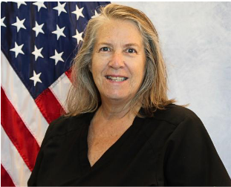
NEW VETERINARIAN!
Dr. Shawna McCune is a 1990 graduate of OSU College of Veterinary Medicine. She practiced private veterinary for 35 years in Lawton, Ok where she built a strong reputation for excellence in companion animal care. Since August 2024, Dr. McCune has been the Shelter Veterinarian for Lawton Animal Welfare. In her time at Lawton, Dr. McCune established an externship program for 4th year veterinary students from OSU. She is community minded promoting responsible pet ownership, public education, community-based animal care and animal welfare.
29

Slide 30
2026 ASAC MEETING SCHEDULE
February 11th
May 13th
August 19th
November 11th→ Moved to November 18th due to Holiday (Veterans Day)
30
Q1: November 1st 2025-January 31st, 2026

Slide 31
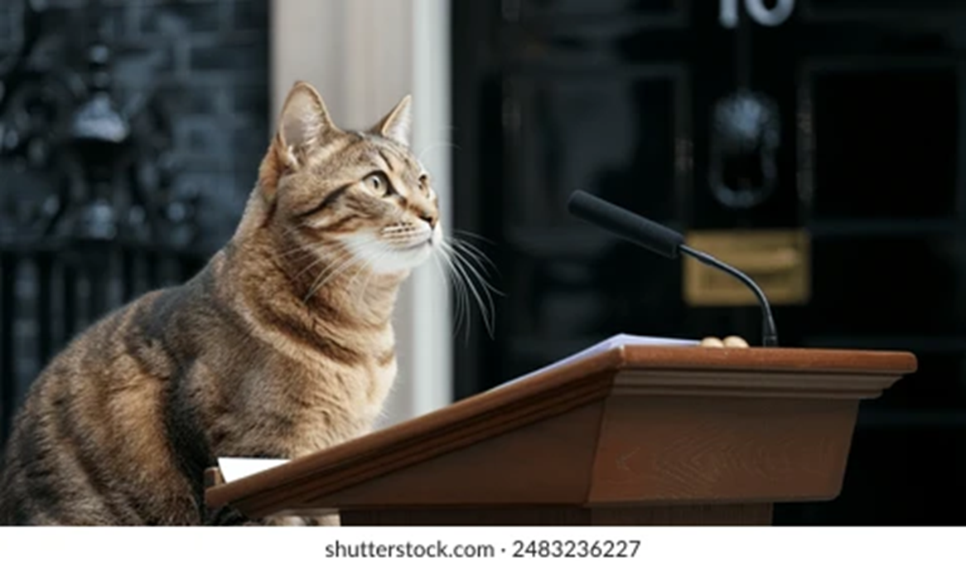
PUBLIC COMMENT
Invitation to hear citizens and board members on items other than what was on the agenda, comments will be limited to 3 minutes.
31

Slide 32

MISSION
Deliver exceptional services and promote a high quality of life and place for ALL our citizens.

