Slide 1

ITEM 5
SPARKS PARK RESTROOM REPLACEMENT
TITLE HERE
TITLE HERE

Slide 2
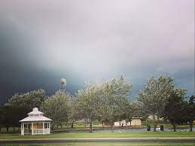

STRATEGIC GOAL CONNECTIONS
Goal 3: Quality of Life and Place
3.3 Create an Attractive and Inclusive Living Environment: Develop and enhance live, work, and play opportunities for our citizens.
3.6 Build the Best Parks System in Our Region: Offer diverse, accessible, and enjoyable green spaces, tournament-ready ball fields, safe playgrounds, and unique recreational opportunities that enhance the quality of life and quality of place for our community.
2

Slide 3
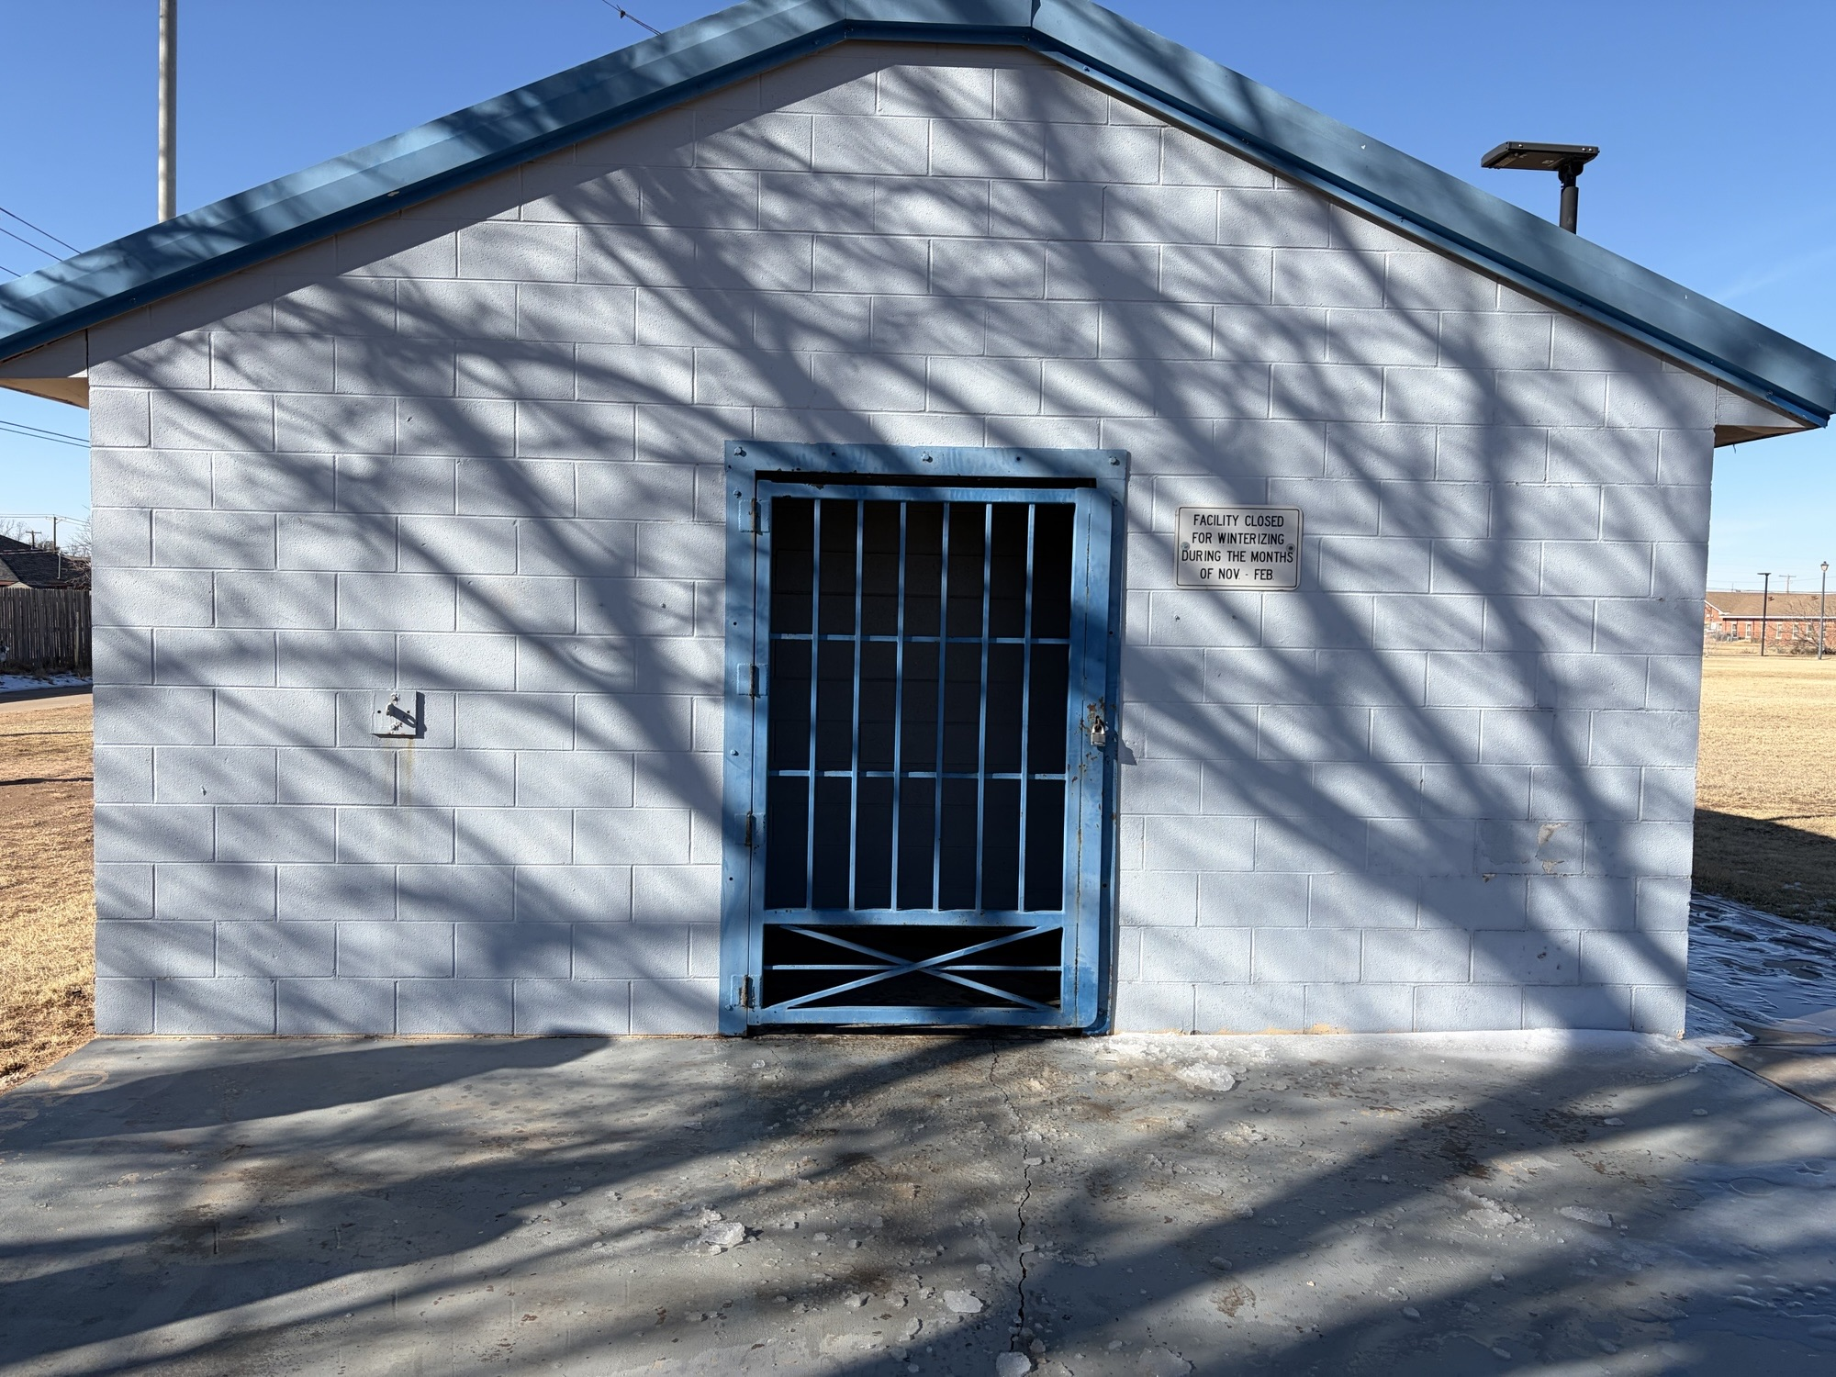
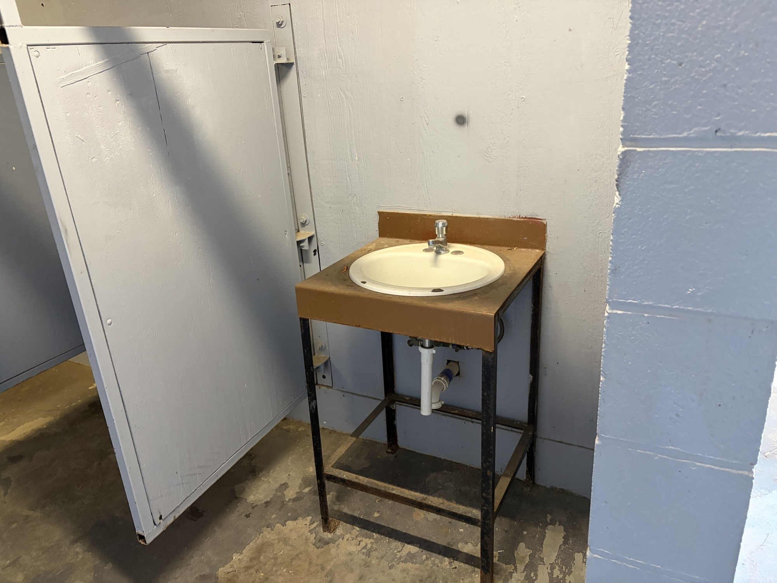
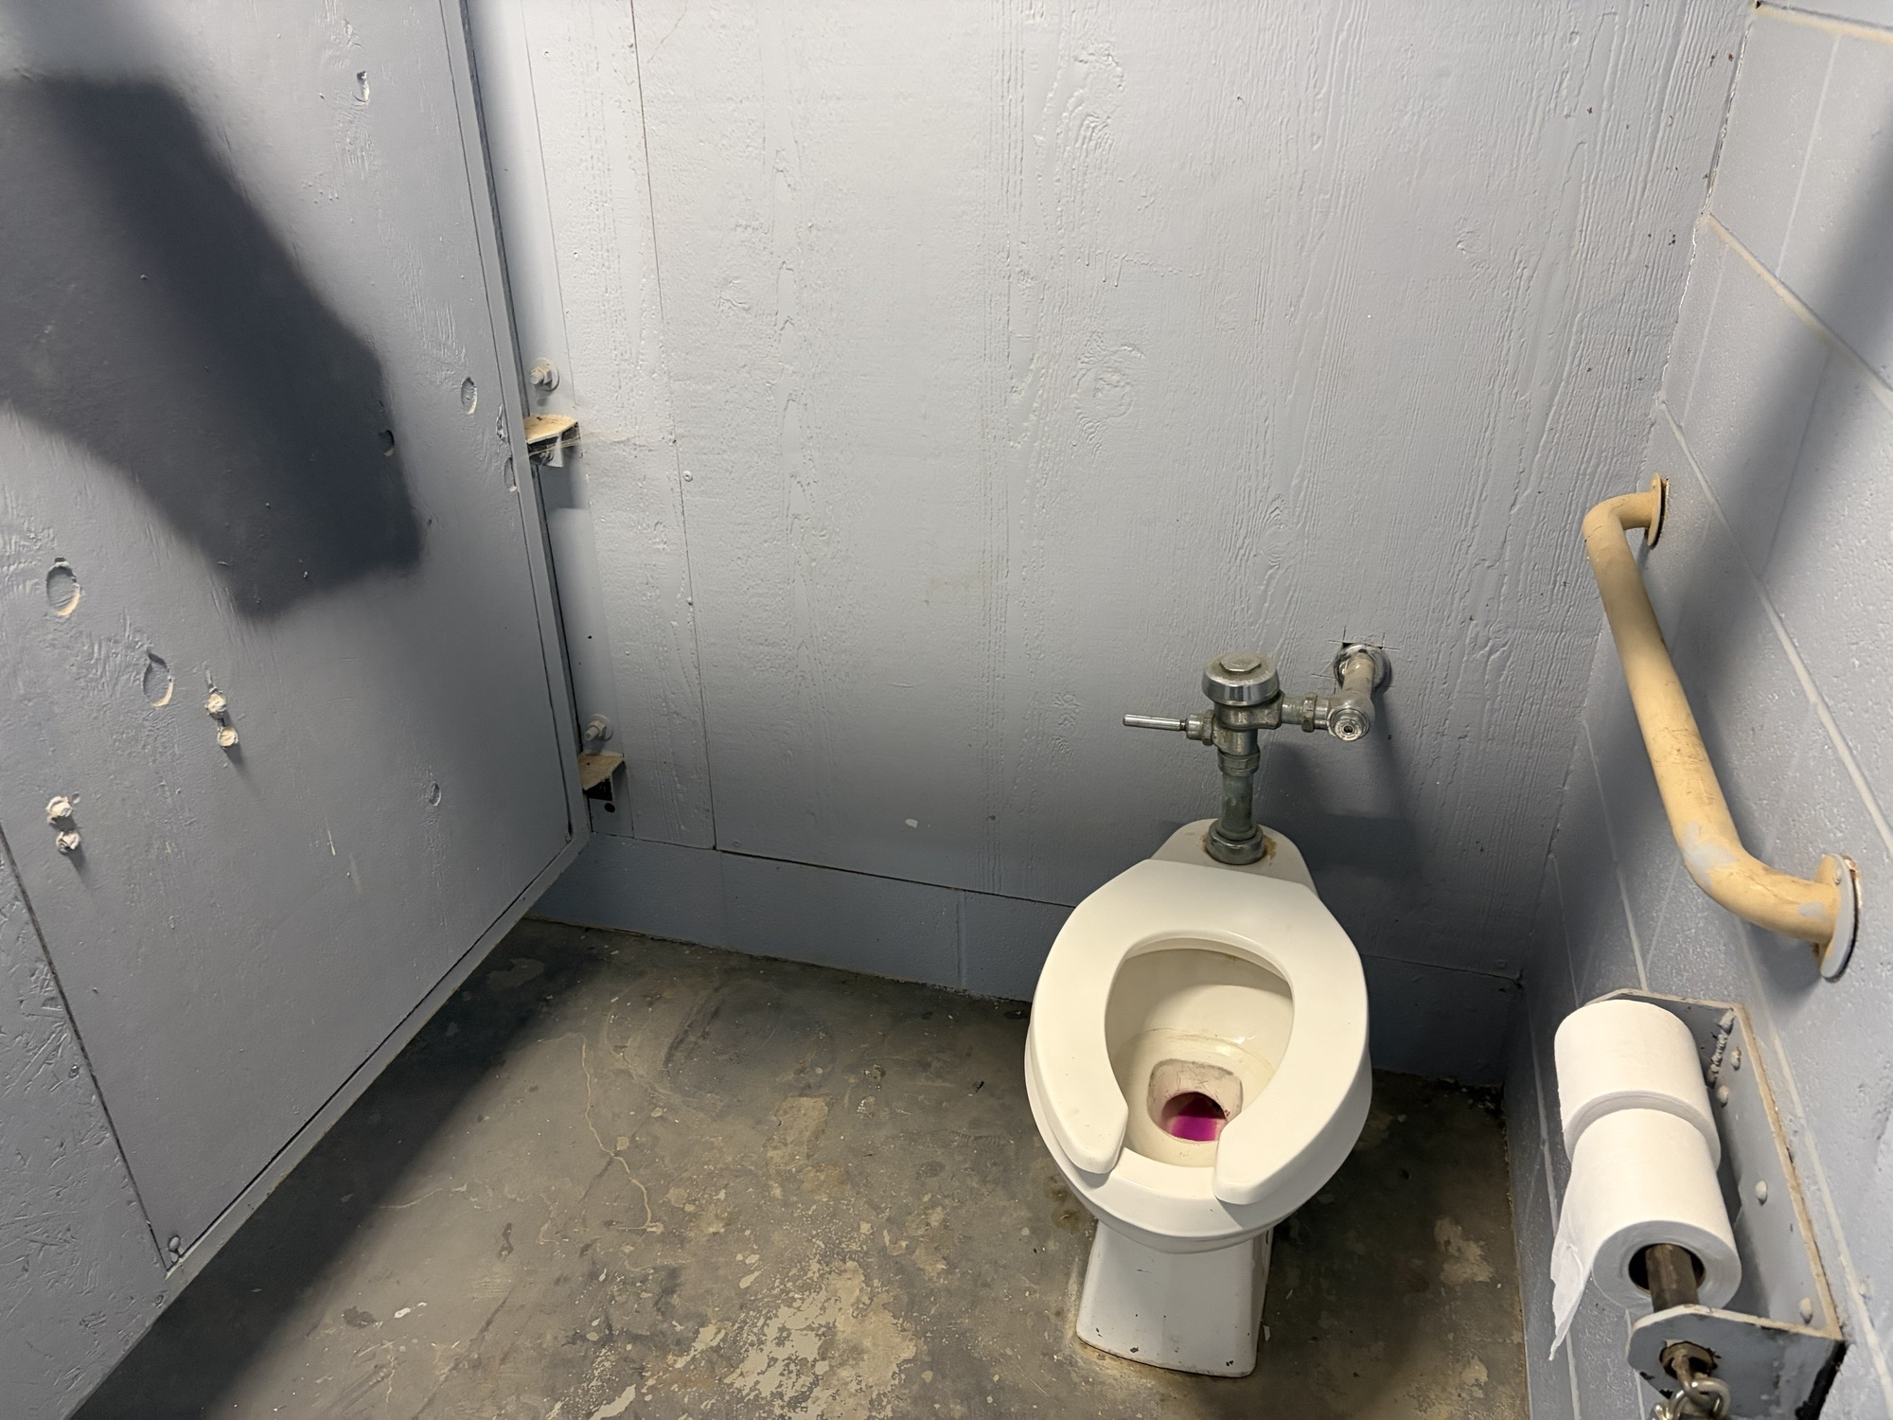
SPARKS PARK RESTROOM
Staff requested $275,000 in 2026 CDBG funding to replace the restrooms at Sparks Park.
This facility is outdated, difficult to maintain, and doesn’t meet current ADA standards.
3

Slide 4

CDBG FUNDING REQUEST
Restroom Building Cost $243,772.00
Project related costs $31,228.00
Total Project Cost $275,000.00
CDBG FUNDING HAS BEEN AWARDED IN THIS AMOUNT TO COMPLETE THE PROJECT
4

Slide 5

CDBG FUNDING REQUEST
Project Related Funds will be utilized for
Demolition of the existing structure
Preparation of the building pad
New Electrical Service
Plumbing connections
New water line will be installed that will be dedicated for the building only.
5

Slide 6
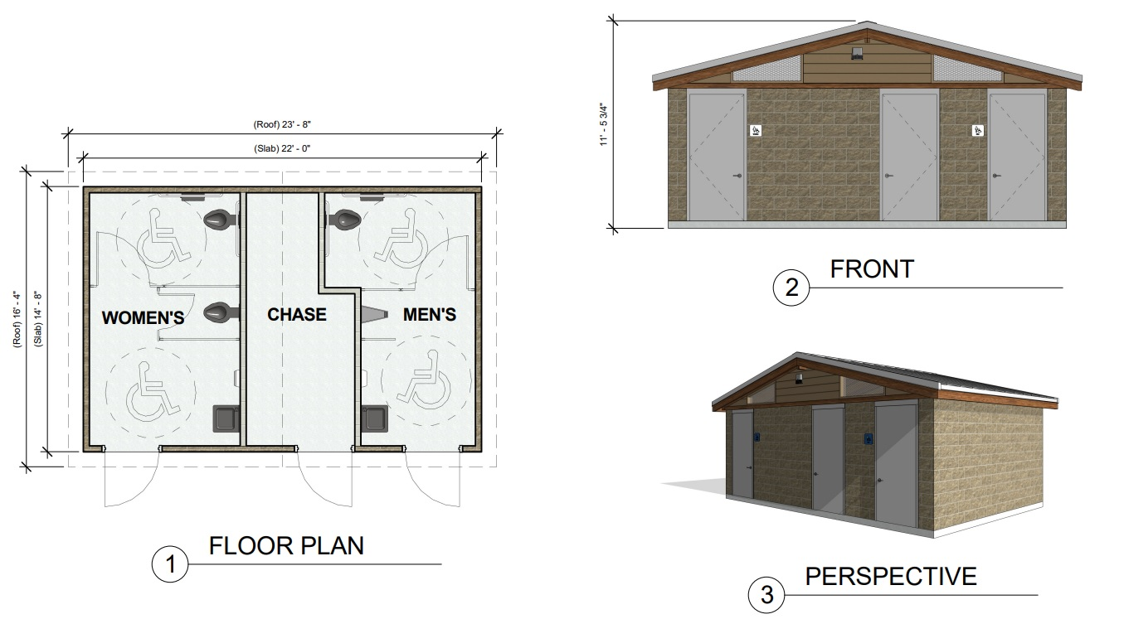
COMMUNITY IMPACT
A new restroom facility at Sparks Park will have a life expectancy of 40-50 years.
The existing facility is over 40 years old.
6

Slide 7
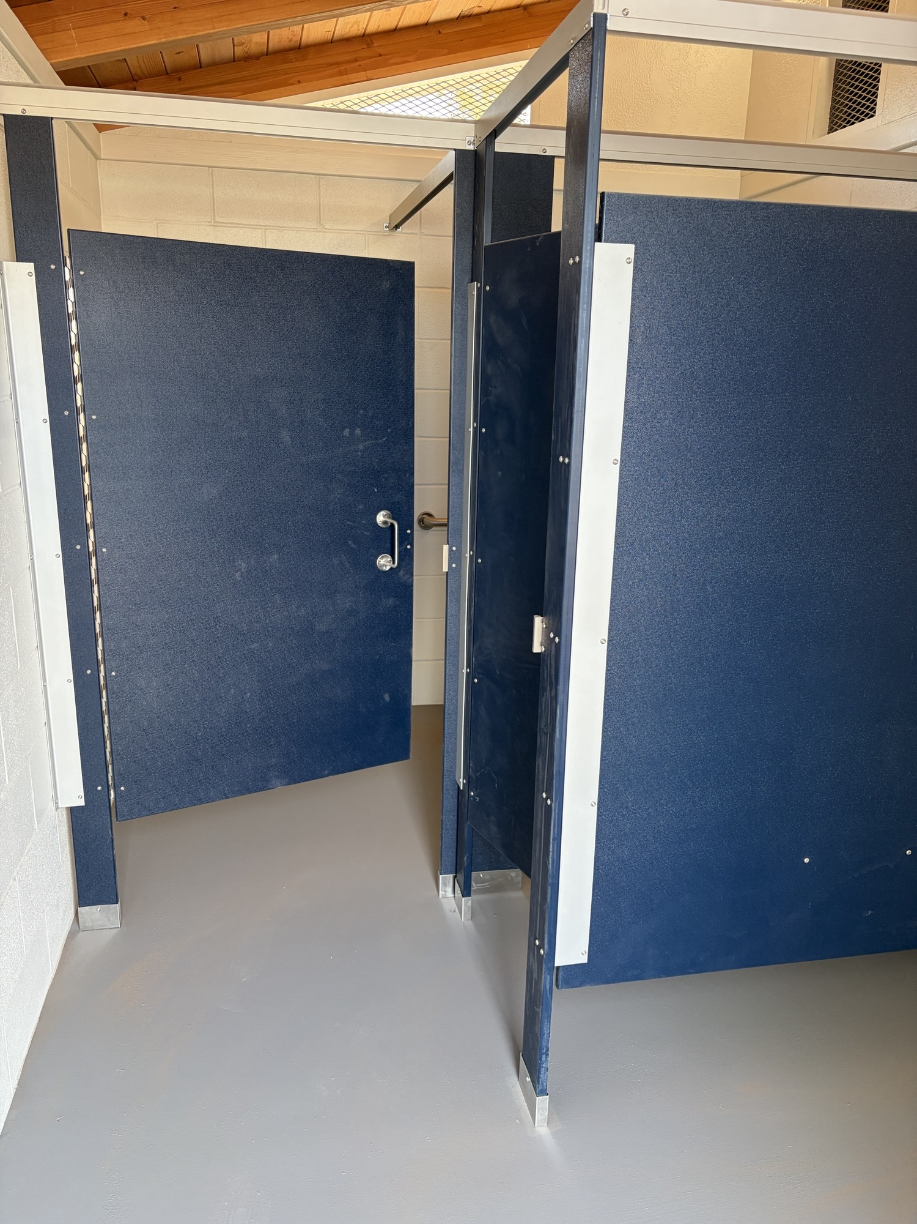
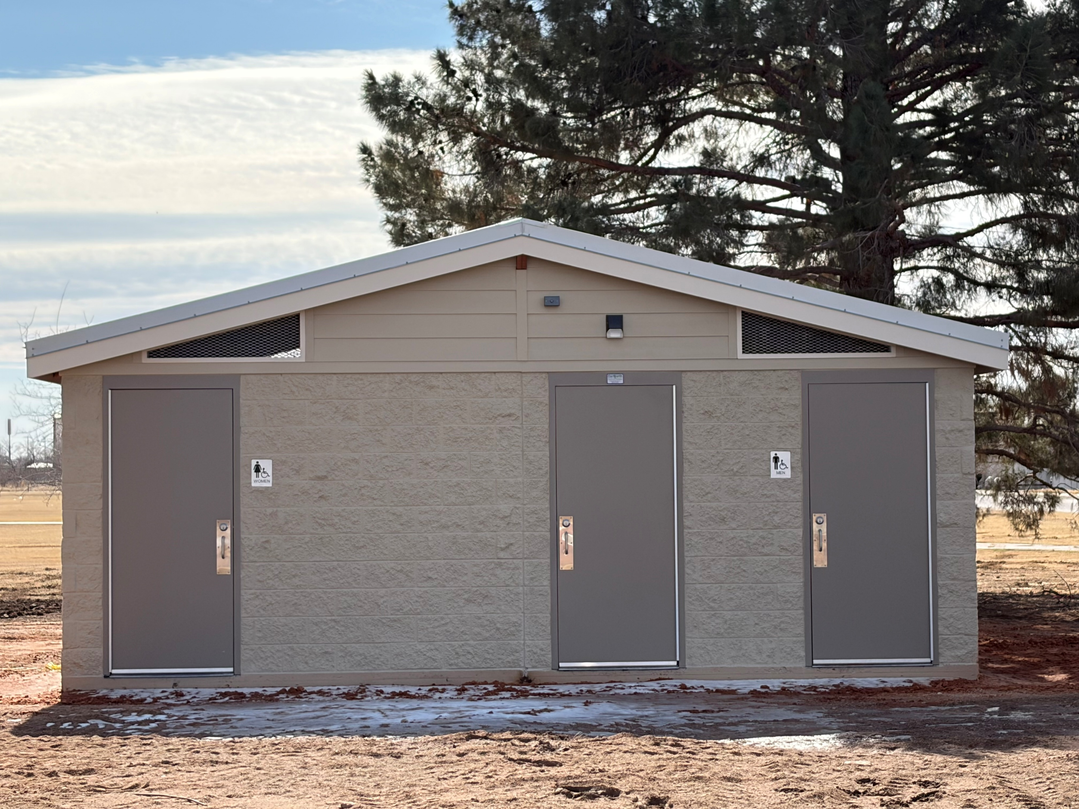
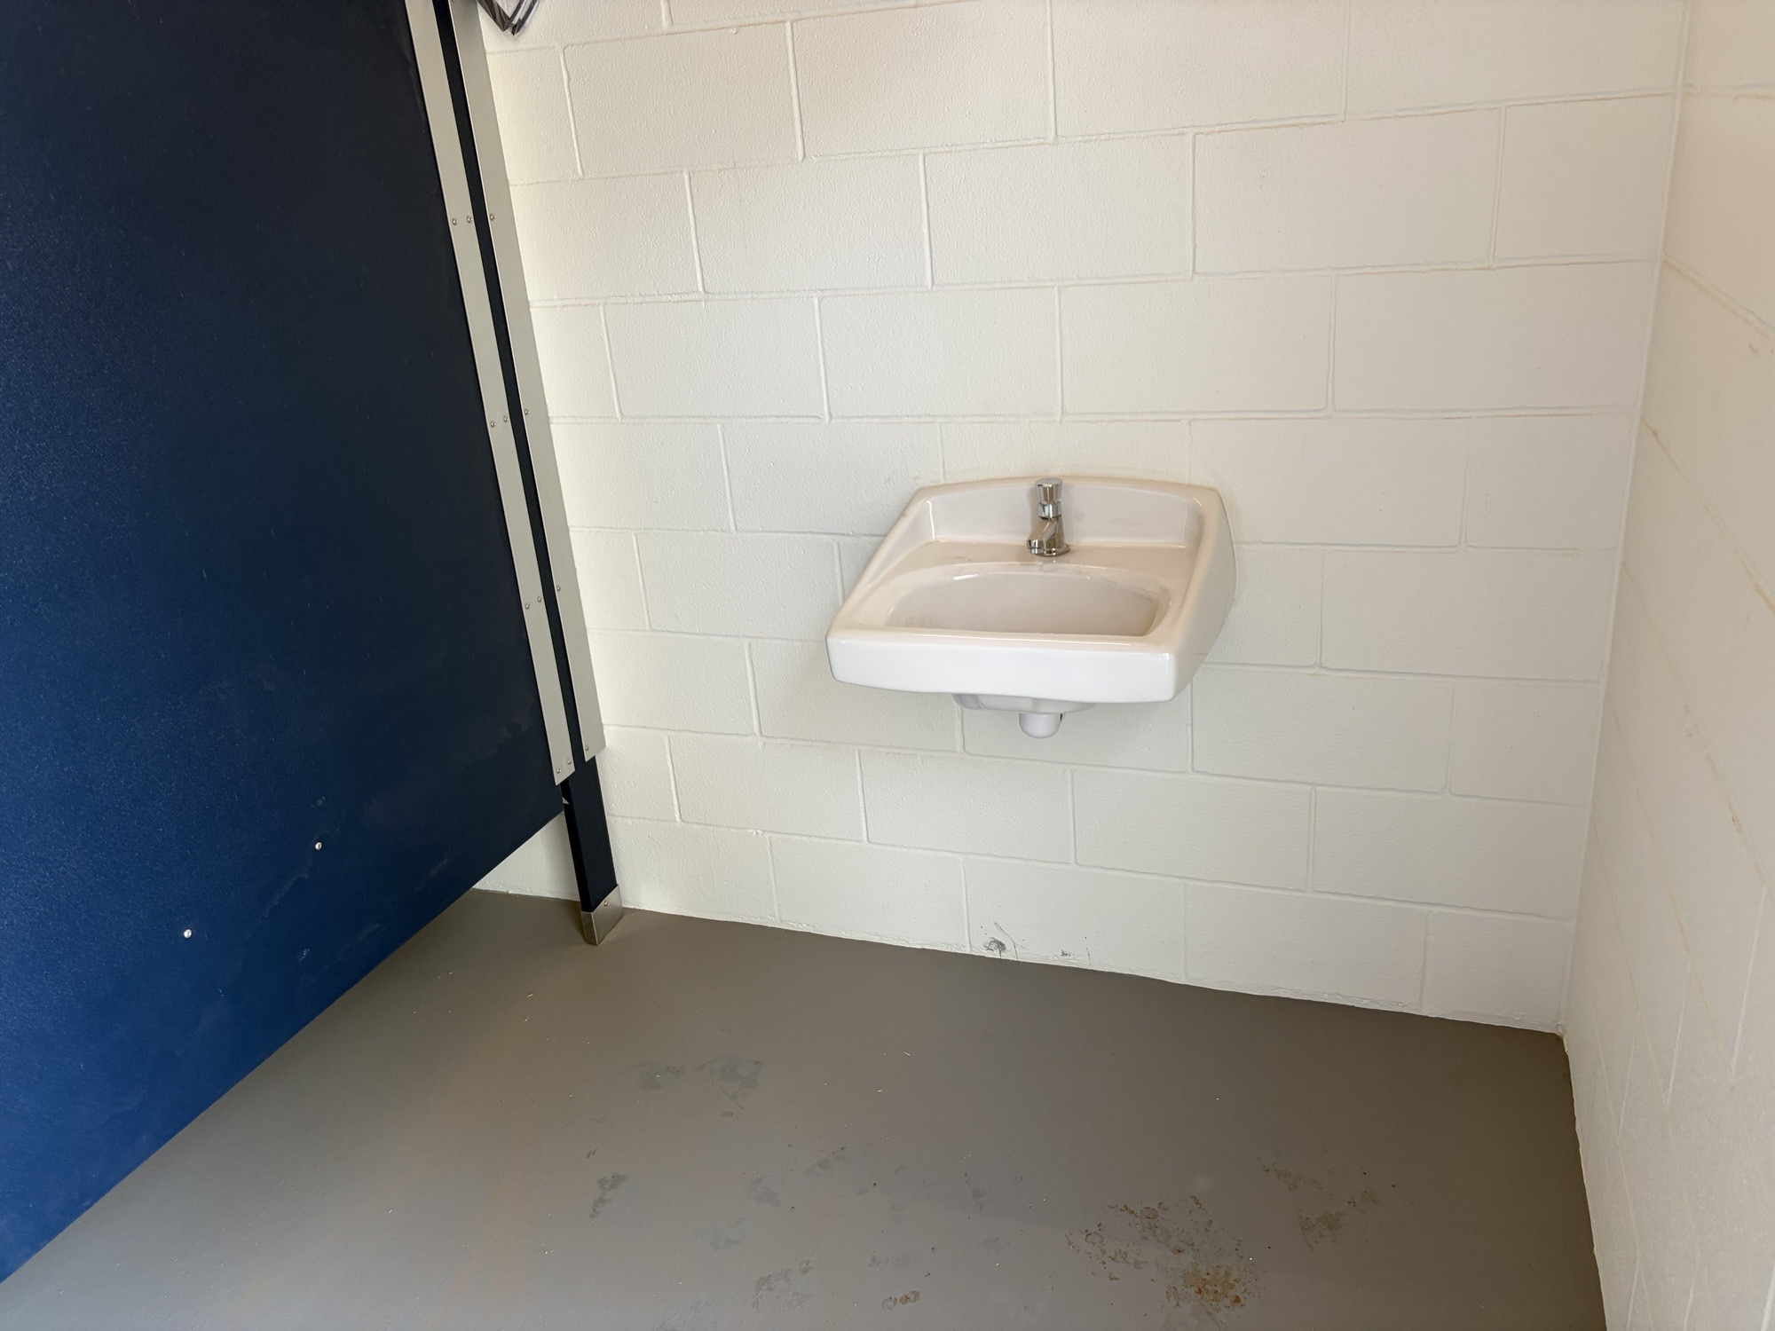
COMMUNITY IMPACT
This is the new facility at Dunagan Park.
The proposed facility at Sparks Park will be identical.

Slide 8

CONSTRUCTION METHOD COMPARISON
Staff has investigated costs of three potential methods of construction for the Sparks Park restroom:
On site turn-key construction with contractor following architectural plans.
Kit construction. Purchase of building kit and contractor assembly of restroom kit. This requires 2 contracts.
Ready-built construction with building assembled off-site and set in place.
8

Slide 9

CONSTRUCTION METHOD COMPARISON
Turn-key on site construction quote $315,000
Construction and sealed plans $300,000
Additional costs (demo, water line, electrical, bonds) $ 15,000
Kit Construction $275,000
Building kit delivered to site $130,000
On-site construction $130,000
Additional costs (demo, water line, electrical, bonds) $ 15,000
Ready-built Construction $275,000
Building and installation $243,772
Additional costs $ 31,228
(demo, building pad, water line, electrical, bonds)
9

Slide 10
READY-BUILT STRUCTURES IN PARKS
Hogan Park Playground (14 years)
Washington Playground
2 restroom/concession building at Sports Complex Auxiliary Fields
MUGS restroom
Dennis the Menace Park Restroom
Dunagan Restroom
These installations have proven to be high quality and low maintenance. Life expectancy is 40-50 years.
10

Slide 11

ACTION NEEDED
Resolution approving a contract with Restroom Facilities, Ltd., through Buyboard, for the purchase and installation of a restroom facility structure at Sparks Park for a cost of $243,772.00; approving $31,228 for project related expenses for a total cost of $275,000.00; and appropriating CDBG funds for said project.
11

Slide 12

MISSION
Deliver exceptional services and promote a high quality of life and place for ALL our citizens.

