Slide 1

PUBLIC SAFETY INVESTMENTS
TITLE HERE
TITLE HERE

Slide 2
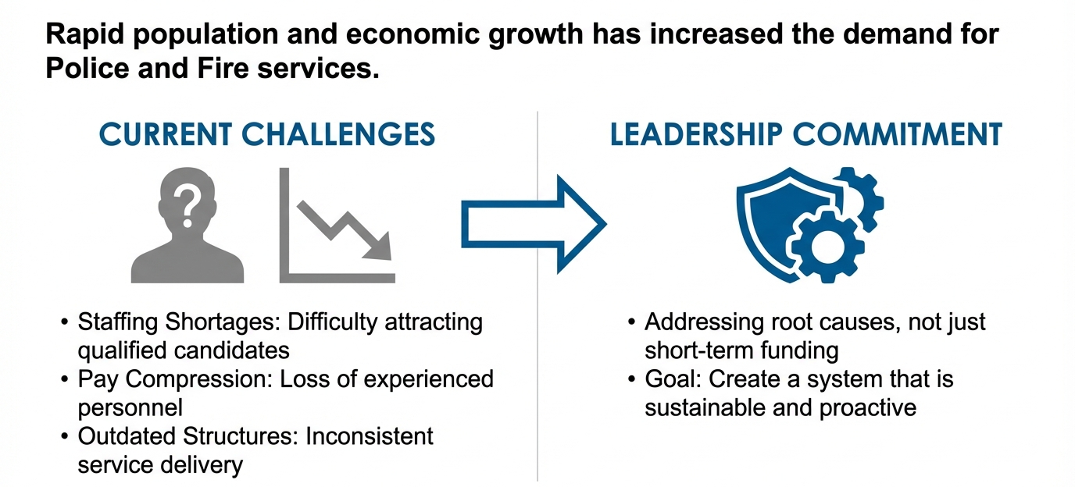
PUBLIC SAFETY IS A PRIORITY
CHALLENGES
LEADERSHIP COMMITMENT
2

Slide 3

PUBLIC SAFETY VS PROPERTY TAX GROWTH
3
Notes:
Public safety investment outpaced property tax growth

Slide 4
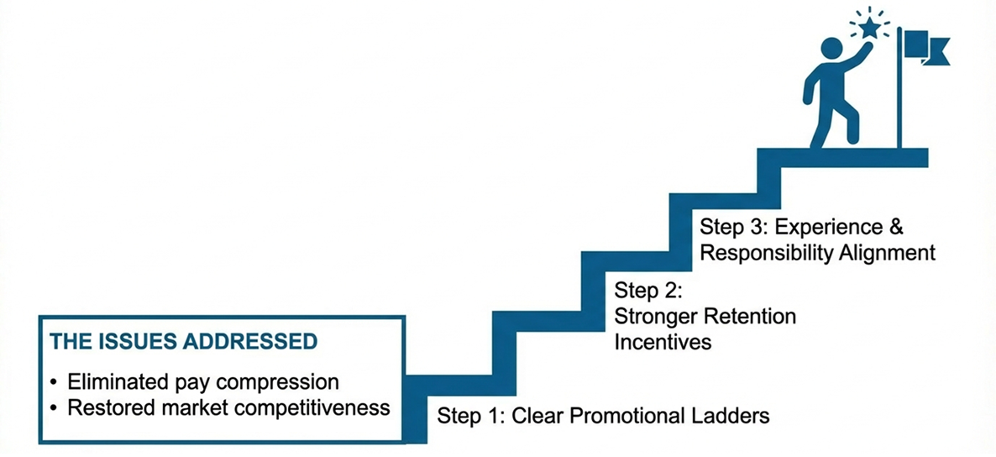
COMPENSATION MODERNIZATION
4

Slide 5
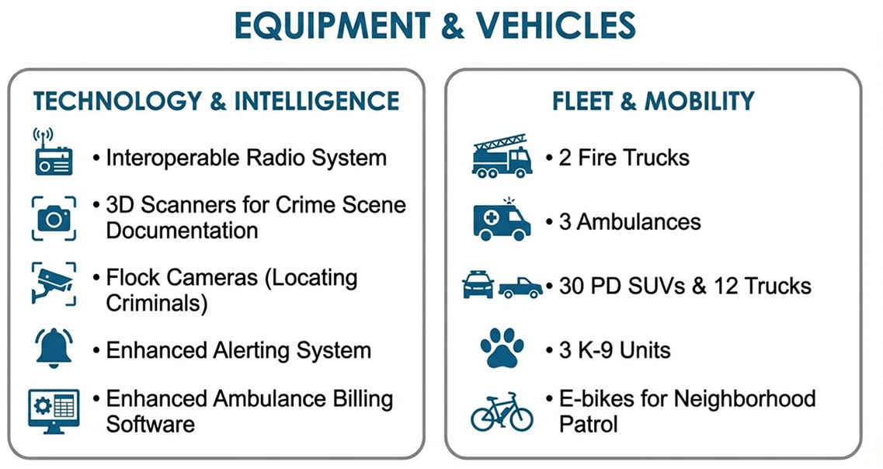
EQUIPMENT & TECHNOLOGY
5

Slide 6
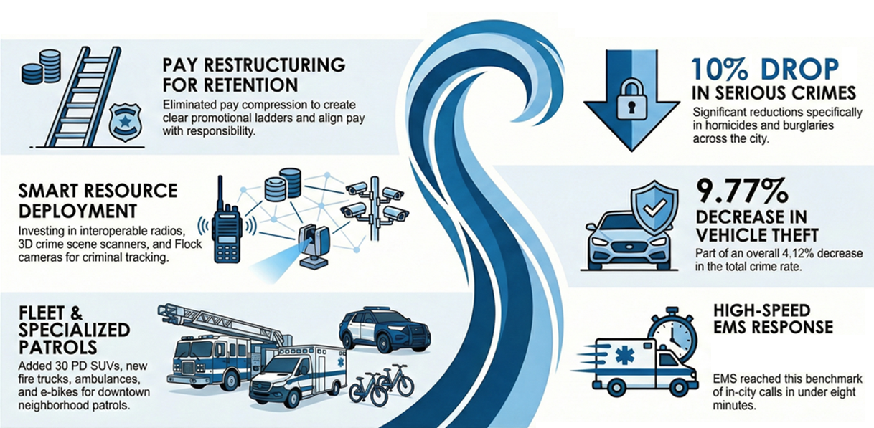
INVESTMENTS
MEASURABLE RESULTS
10% DROP
9.77%
82.04%
6

Slide 7
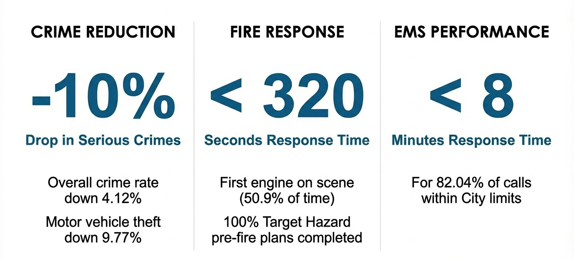
STATISTICS SNAPSHOT
7

Slide 8
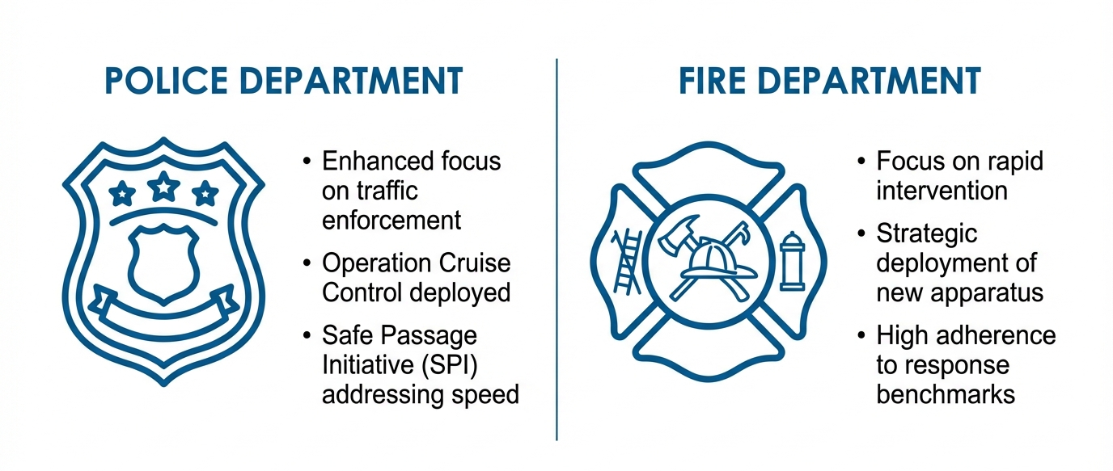
DEPARTMENT HIGHLIGHTS
8

Slide 9
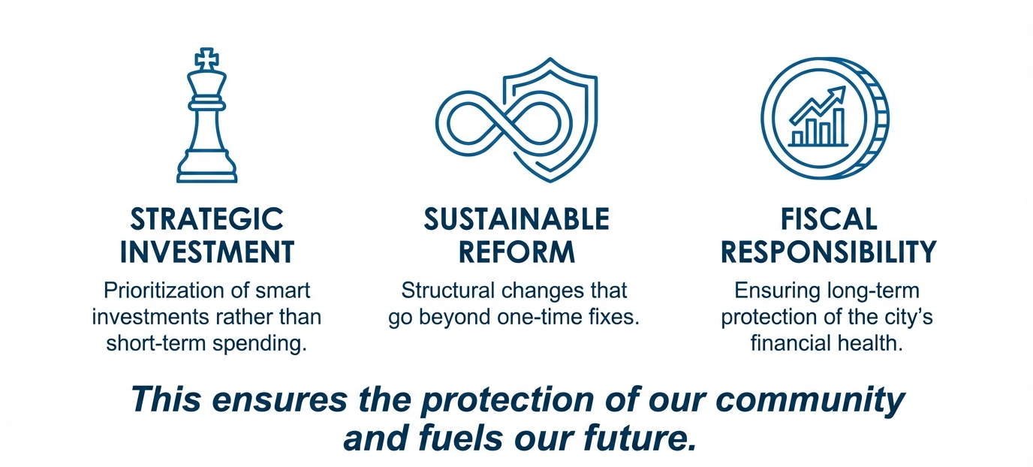
WHAT THIS DEMONSTRATES
9

Slide 10

MISSION
Deliver exceptional services and promote a high quality of life and place for ALL our citizens.

