Slide 1

5-Year Budget Forecast
March 19, 2024
1

Slide 2

What we will cover
Budget timeline
5-year Budget Forecast
Fiscal Management Strategies
2

Slide 3
Strategic Goal Connections
Goal 2: Set the Standard for a Safe and Secure City
2.6 Grow and Retain Public Safety Resources: Expand law enforcement presence as well as fire reduction and prevention programs while reducing attrition.
Goal 3: Quality of Life and Place
3.6 Build the Best Parks System in Our Region: Offer diverse, accessible, and enjoyable green spaces, tournament-ready ball fields, safe playgrounds and unique recreational opportunities that enhance the quality of life / quality of place for our community.
Goal 5: Provide Sound Governance & Fiscal Management
5.7 Ensure Continued Financial Stability and Accountability: Maintain financial transparency.
Goal 6: Strengthen and Sustain Our Infrastructure
6.6 Strategize for and Monitor City Growth: Develop proactive responses to growth rather than reactive.
3

Slide 4


Taking Action
Strategic Plan
Encompasses a City’s vision for the future
Goals
Long-term
Align with the Strategic Plan
Action Items
Short-term, “Steps” toward achieving Goals
4
Notes:
Proactive vs Reactive

Slide 5
BUDGET TIMELINE
Spring
Summer
Late Summer
Department Requests and
Forecasting
Prelim. Property Values
City
Management Review
City Council briefings
Budget Workshop
Set Tax Ceiling
Public Hearings
Adoption of 2025 Budget and Tax Rate
Finance Review
Certified Valuation
Fee Ordinance
PLANNING
PRESENTING
PASSING
5
Notes:
Department Input
5- year budget forecast
Budget compiled and reviewed
Preliminary Property values from MCAD
Departments budget meetings with City Management
City Council Briefings
Receive Certified valuation
Fee Ordinance
Budget Workshop with Council
Set Tax Ceiling (Maximum Tax rate)
Public Hearings and Adoption of 2025 Budget and Tax Rate

Slide 6
Expenses vs Revenue to FY2029
$33.8M
$43.2M
$26.2M
$19.6M
$11.8M
Average Annual Expense Increase, +9.41%
Average Annual Revenue Increase, +5.53%
6

Slide 7




Strategic Plan Alignment
Public Safety
Parks
Roads and Infrastructure
7
Notes:
Focus on properly equipping public safety forces with the personnel, pay, and equipment they need to serve the City
Continue to focus on building up the Parks system to be the best in the region (Beal)
Continue to focus on roads and infrastructure

Slide 8
Forecasted Expenses
Safe City
Fire pension stabilization payment
$500,000 – 2% increase to City’s Fire Pension contribution
Restructure Fire and Police Compensation
Focus on Police recruitment to fill vacancies
Community Patrol
8

Slide 9
Forecasted Expenses
Premier City
Sports Complex balloon payment, FY2026/2027
Beal Park and Reyes Mashburn Nelms O&M
$2 M a year to Parks Maintenance fund – additional maintenance estimated to be $650K extra
9

Slide 10
Forecasted Expenses
Operational Excellence
Investment in Human Capital
Maintaining growing parks and infrastructure
10
Notes:
As the city increase in size and population, so must our personnel needs

Slide 11
Revenue Strategies
TIRZ
Grant Funding
Oil & Gas fund
User fees
Collection efforts
Set aside
11
Notes:
TIRZ – Downtown plus two more planned
Maximize Grant Funding where possible
Use Oil & Gas funds to help with Park initiatives
Strategically implement user fees (roads, franchise fees maximization, franchise riders)
Greater emphasis on collection efforts
General Fund set aside of excess sales taxes

Slide 12
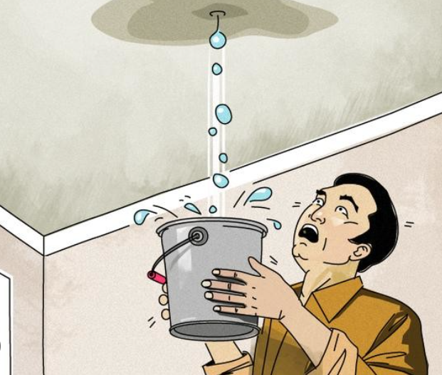
Now (Bond) vs. Later (Cash)
Roof repair – fix now or wait to gather the cash
Conservative and prudent
Benefits match to beneficiaries
12
Notes:
*NOTES* Bonding projects versus the speed of inflation may be a wash.
- In the long run that is not a conservative not a prudent thing to do financially.
- If the roof of our home needs to be repaired but we wait till we have the cash we would have water damage in every room and that may cost double or triple the cost 5, 10 years from now.

Slide 13
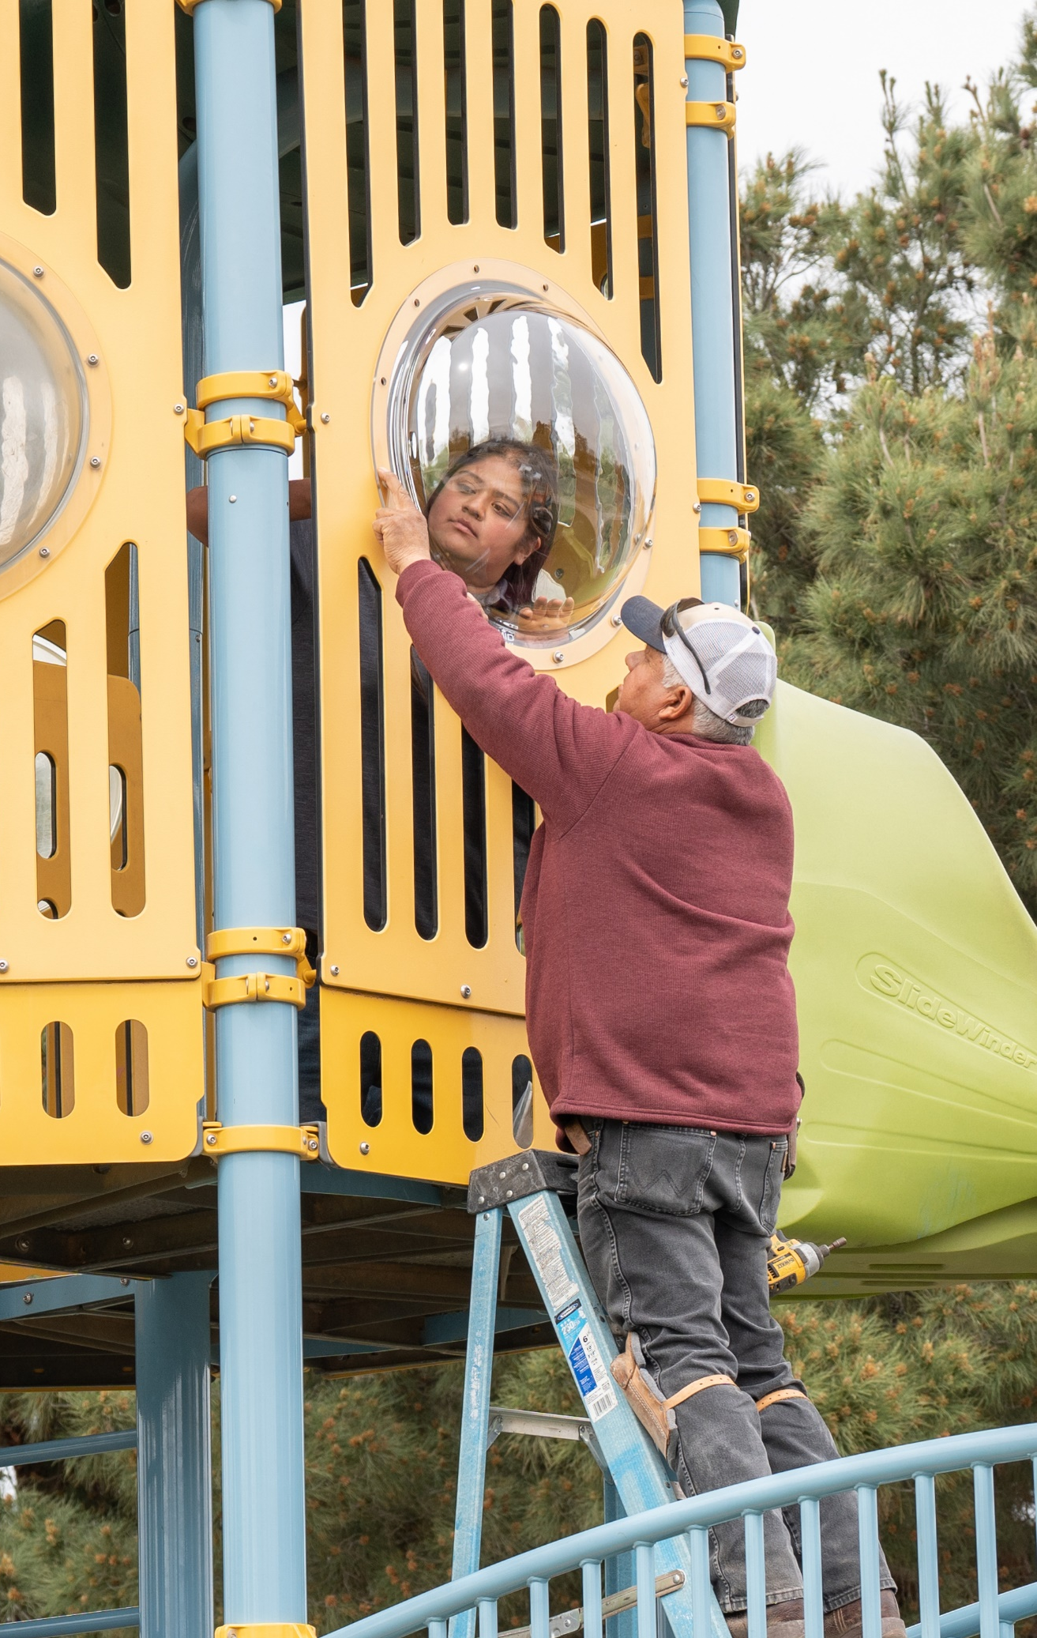
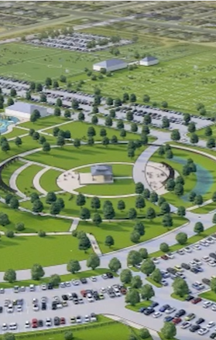
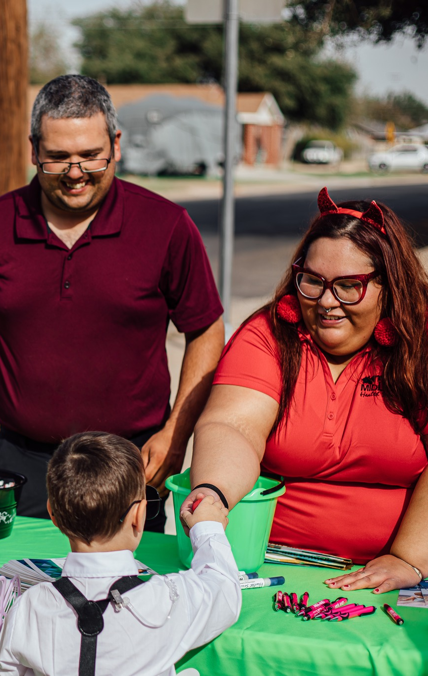
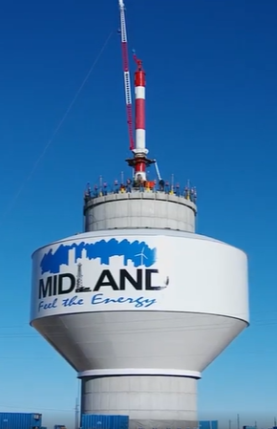
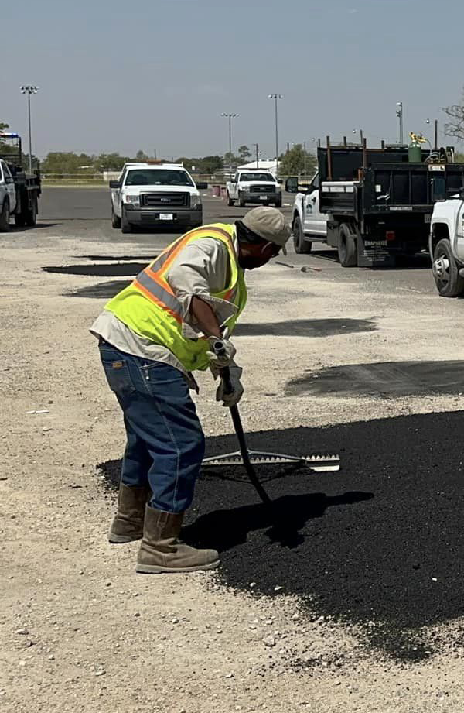
Plan
People
Process
Performance
13

Slide 14
2023 Audit
ZERO findings
50+ findings over last 20 years
Certificate of Achievement for Excellence in Financial Reporting has been achieved for 40 years through 2022 audit
14

Slide 15
MISSION
Deliver exceptional services and promote a high quality of life and place for ALL our citizens.
15

