Slide 1

Solid Waste
Needs
April 23, 2024
1

Slide 2
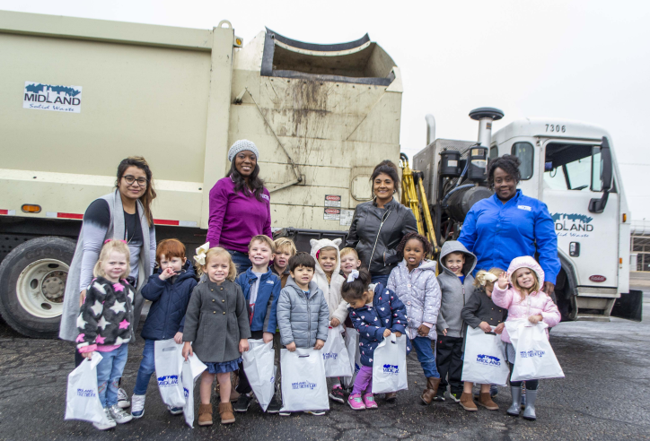
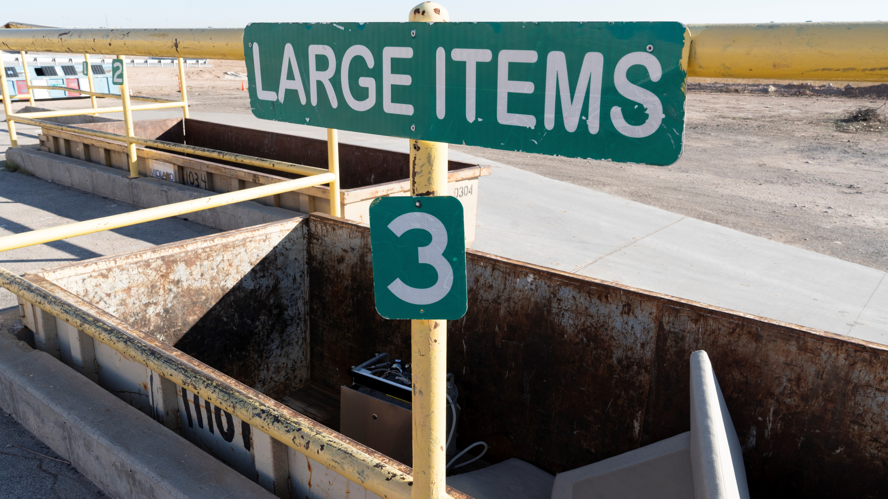

Strategic Goals
5. Provide Sound Governance and Fiscal Management
5.2 Enhance Citizen Experience
5.6 Deliver Services Timely and Efficiently: Prioritize continuous improvement.
6. Strengthen and Sustain our Infrastructure
6.1 Provide Reliable and Sustainable Utilities
6.5 Implement a Funding Stream for Infrastructure: Establish reliable funding for continual improvements.
6.6 Strategize for and Monitor City Growth: Develop proactive responses to growth rather than reactive.
2

Slide 3
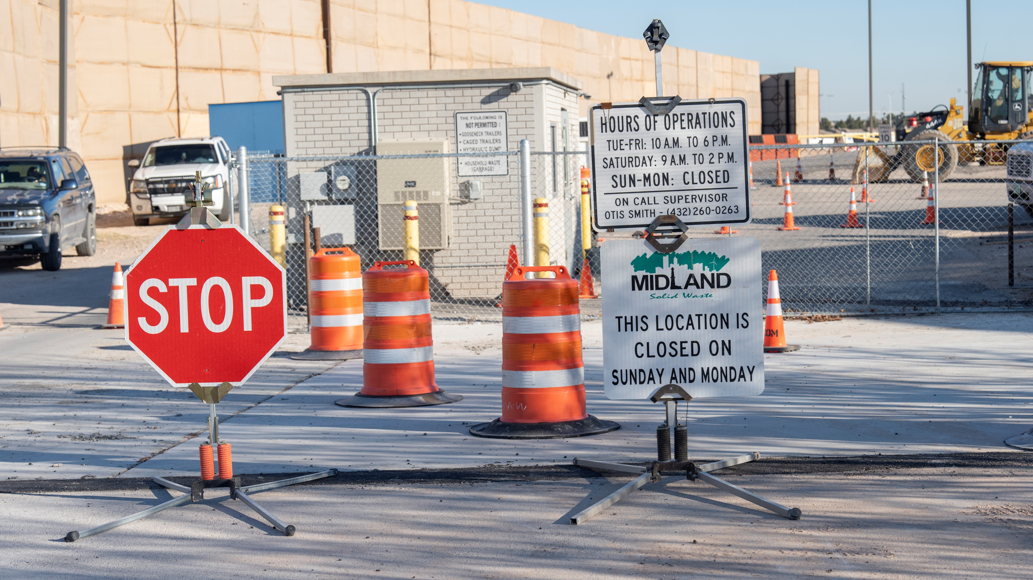
Solid Waste Capital Projects
North Citizen Collection Station:
To be built on north 349 near the new water tower.
Bid Costs: $4,104,911.30
West Citizen Collection Station:
To be built on West Hwy 80 near Big Sky Drive-in movie theater.
Bid Costs: $3,670,288.40
Landfill Entrance Road Reconstruction:
The landfill entrance road is beyond repair and is in dire need of reconstruction. Design and bid documents are complete and ready to bid.
EOPC: $3,500,000
Other Expenditures:
Estimated: $7,000,000
3

Slide 4
Solid Waste Capital Projects
Landfill Gas Flare System:
Federal emission guidelines require existing landfills to calculate the annual non-methane organic compounds (NMOC) emission rate. The NMOC emission rate is required until emissions surpass 34 Mg/Yr. Once the emission rate surpasses 34 Mg/Yr. The landfill must construct a gas control system to manage the landfill gas. The City of Midland Landfill is expected to exceed 34 Mg/yr. in 2025.
Estimated Engineering and Gas Flare System Construction Costs: $5,500,000
Landfill Cell Construction:
A new landfill cell will be required by 2030, adding approximately 20 years of capacity to the landfill.
Estimated Engineering and Cell Construction costs: $11,000,000
ITSD Tower Relocation: $2,000,000 & Oil Well Relocation: $1,000,000
Total CIP Estimated Cost: $37M (Not Factoring Cost of Inflation)
4

Slide 5
Service Comparisons
Frequency of Service Provided
Twice Per Week Collection | Once Per Week Collection
Midland | Odessa
Lubbock | Dallas
Abilene | Ft. Worth
 | Denton
 | Corpus Christi
 | Austin
5

Slide 6
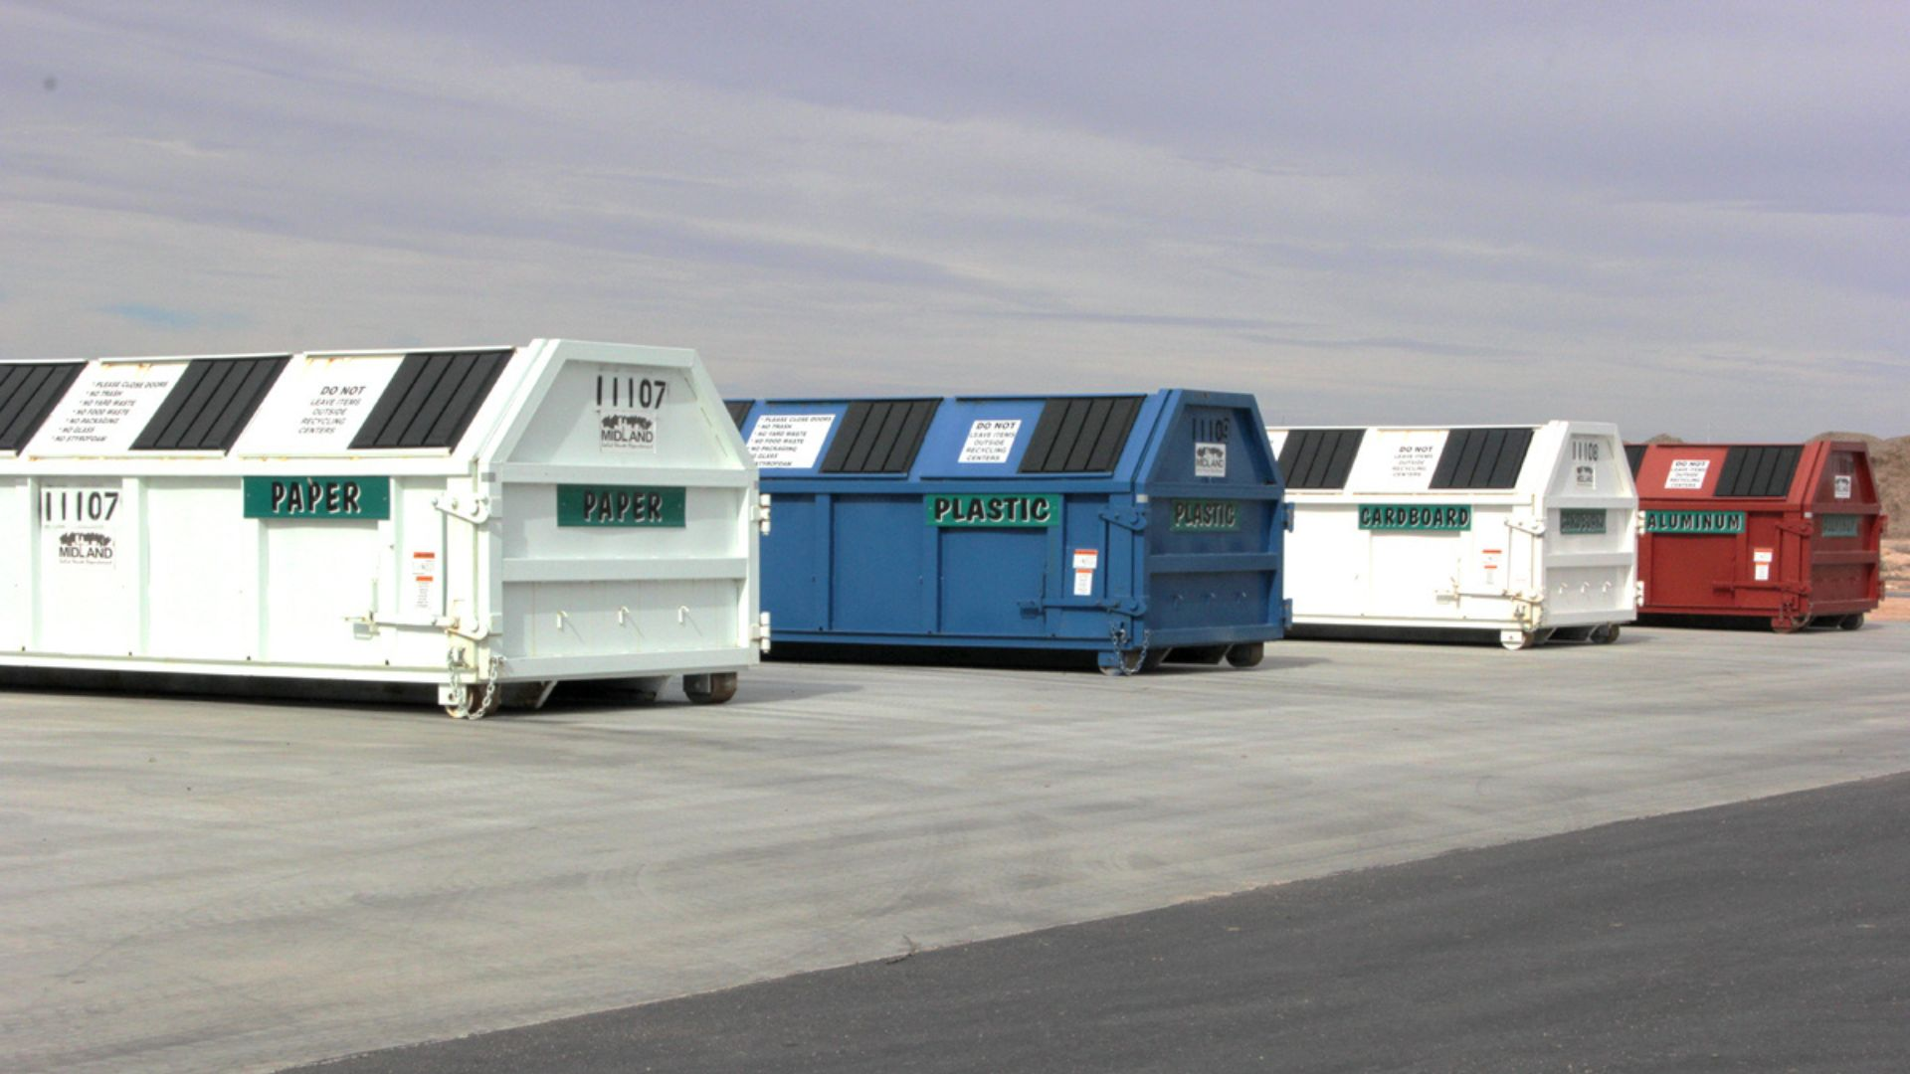
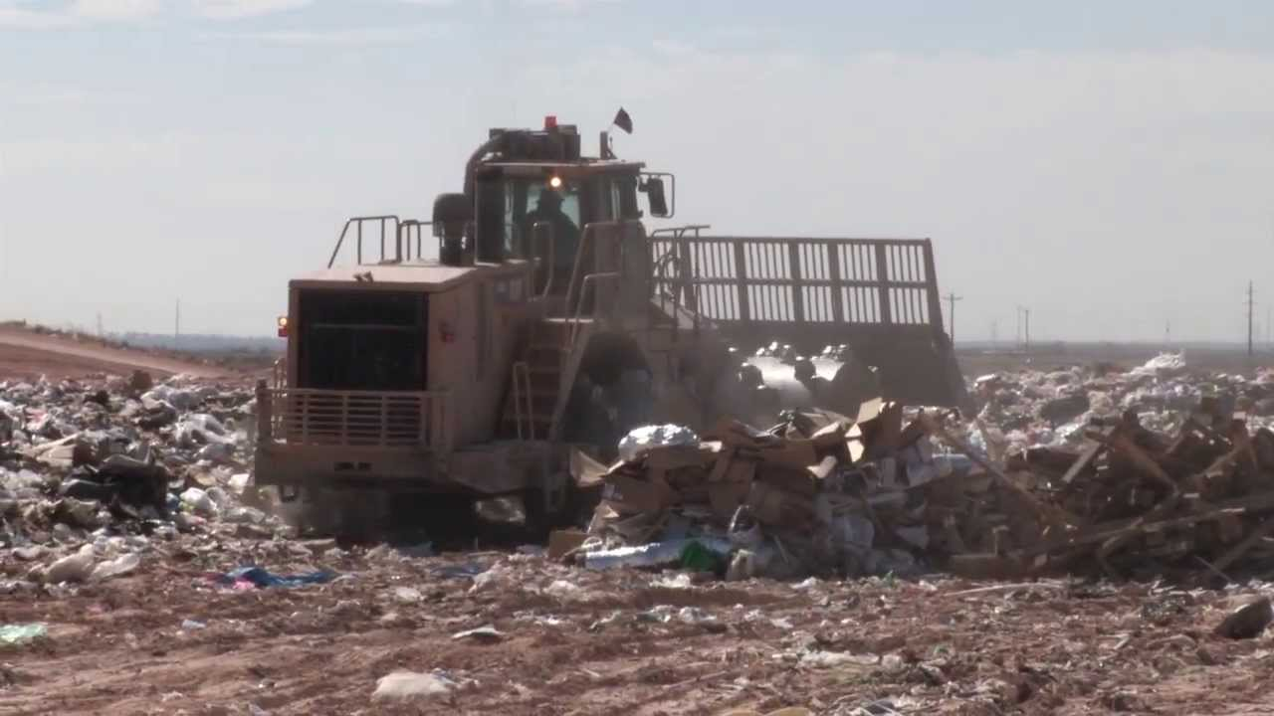
Next Steps
Staff Follow-Up:
Determine Potential Funding Sources
Establish a Funding Plan for the Solid Waste Department
Funding Plan Proposal in May 2024 to be Presented to Council
Citizen Collection Stations
6

Slide 7
MISSION:
Deliver exceptional services and promote a high quality of life and place for ALL our citizens.
7

