Slide 1
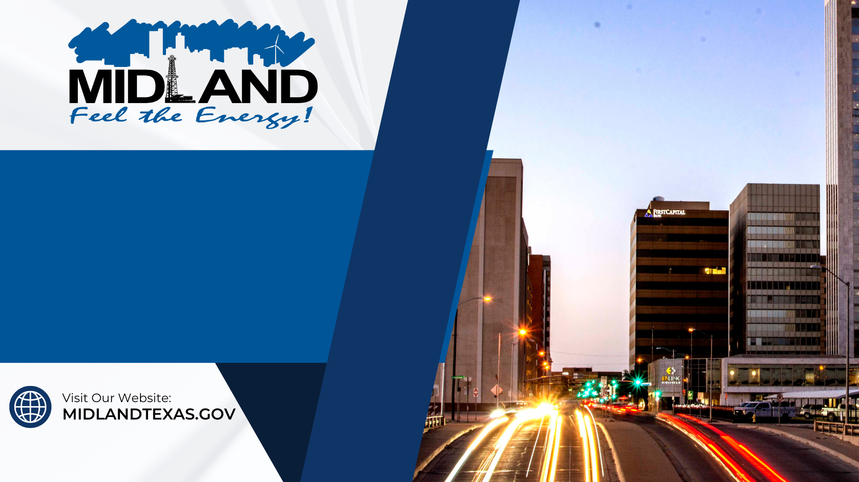
Budget
Breakdown:
Fixed Costs

Slide 2

What are Fixed Costs
Predictable
Historical data provides cost trends and supports the development of budget strategies
Majority
Most of the budget is comprised of fixed costs that are needed to keep the City running year round

Slide 3
General Fund
FY2024 Budget
Fixed $157.4 M
One-Time $10.1 M

Slide 4








Basis of Budgeting
Maintenance of Capital
Contracts & Services
Utilities
Water, Electric & Gas
Personnel
Salary & Benefits
Software & Technology

Slide 5
General Fund
FY2024 Budget
Fixed
vs
One-Time
One-Time Costs
Fixed Costs

Slide 6
General Fund
FY2024 Budget
Personnel Salary
47%
Facilities Maintenance
4%
Personnel Tax & Benefits
17%
Supplies & Minor Equipment
2%
Equipment Rental & Maintenance
9%
Utilities
2%
Contracts & Services
9%
Capital
5%
Software & Technology
4%
Transfers & Misc
1%

Slide 7

What affects Fixed Costs
Inflation
Anticipate changing costs from inflation in
order to pay for fixed costs
Supply Chain
Increased demand or lack of supply can
result in higher costs or delayed purchases
in a given period
Growth
Account for additional maintenance and
personnel necessary for new capital as well
as for City population growth

Slide 8
General Fund
Five Year
Notes:
2020
$11.9 M for Animal Shelter
$400K Washington Park multipurpose building
$800K playground replacements
$318K Engineering Design Manual
$990K 3 brush trucks
$1 M to Priority Midland
$1.1 to Fire Station 11
$1.5 Fairgrounds Road
$1.6 Slurry Seal
2021
$1.5 Slurry Seal
$500K Marienfeld traffic signal
2022
$1.4 Mill and Inlay
$300K Police Station Roof
$200K Public Safety Training Facility Plans
2023
$6.8 Radio Project
$6.1 Wadley Extension
$2.5 Safety Training Facility Design and Construction Admin Services
$1.7 Traffic signal Hwy 349 250 Loop
$929K Health Services Facility design
$168K Fire and PD renovations
2024
Most of this is road maintenance

Slide 9
Breakdown on Fixed Costs
Predictable
Majority of budgeted costs
Includes Utilities, Maintenance, Software, Personnel, Rent
Affected by inflation, supply chain and growth
What Remains?
One-Time variable costs
Capital and Transfers to Projects
Limited flexibility without impacting fixed costs

Slide 10






Personnel increases in FY2023
All General Fund Departments +9%
Fire Dept +11%
Police Dept +4%
Parks +14%

Slide 11


Operating expense increases in FY2023
Utilities +13%
Fleet Maintenance +15%
Technology Expense +24%
Park & Facility Maintenance +30%
Road Maintenance +48%

Slide 12
Mission
We, the employees of the City of Midland, are PASSIONATE and ENERGETIC about the service we provide to EACH OTHER and OUR COMMUNITY

