Slide 1

5 Year Forecast
December 12, 2023

Slide 2
Strategic Goal Connections
Goal 4: Transparent & Consistent Communication
4.4 Advance two-way communication of key messages: Engage effectively with external stakeholders; foster community engagement.
Goal 5: Provide Sound Governance & Fiscal Management
5.7 Ensure continued financial stability and accountability: Maintain financial transparency.
Goal 6: Strengthen and Sustain our Infrastructure
6.6 Strategize for and monitor City Growth:
Develop proactive responses to growth rather than reactive.

Slide 3


Taking Action
Strategic Plan
Encompasses a City’s vision for the future
Goals
Long-term
Align with the Strategic Plan
Action Items
Short-term, “Steps” toward achieving Goals

Slide 4


Strategic Plan:
Determines WHAT to fund
Forecasting:
Determines HOW to fund

Slide 5
Purpose of 5-Year Budget Forecast
We must Look at Future Budget Years – Not Just One Year at a Time
Utilize 5-Year Budget Model to Make Real-Time Course Corrections
5-Year Budget Model Helps Better Plan Each Annual Budget Cycle
Transparency with the Public of Future Expenses
Better planning and alignment with the Strategic Planning Process

Slide 6
Forecasting:
Start by looking at the last five years and find the average increase
%
The average increase is applied to the next year in the forecast
+%
The average increase is then applied again to the following year
+%

Slide 7
Forecasting Assumptions
City revenue and expenses will continue to increase (growth)
The forecast will follow historical trends (average % increase)
Average increases are calculated from a five-year time span: FY2019 to FY2023 – forecasted forward for FY2024 to FY2029 which aligns with Strategic Plan 5-Year window
Effects of oil and gas revenue have been removed from 5 year forecast due to allocation to parks

Slide 8
Challenges Ahead
Fire Pension Funding at Appropriate Levels
Horses and Hay – Upkeep of Aging Facilities, Roads, Infrastructure and Parks

Slide 9
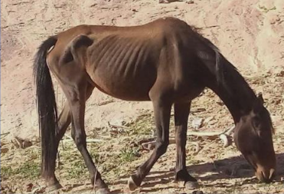
Horses and Hay
  Street Maintenance Needs (Reconstruction & Resurfacing)
  Parks Maintenance Increases
  Dwindling Sports Complex Fund
  5-year CIP schedule (Plan for More Horses & Hay)

Slide 10
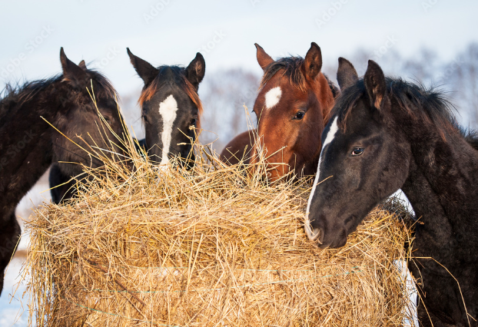
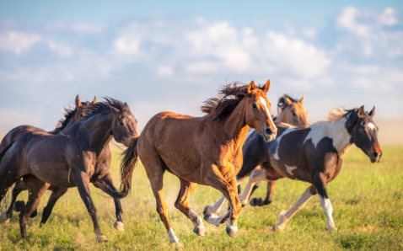
Horses and Hay
=

Slide 11
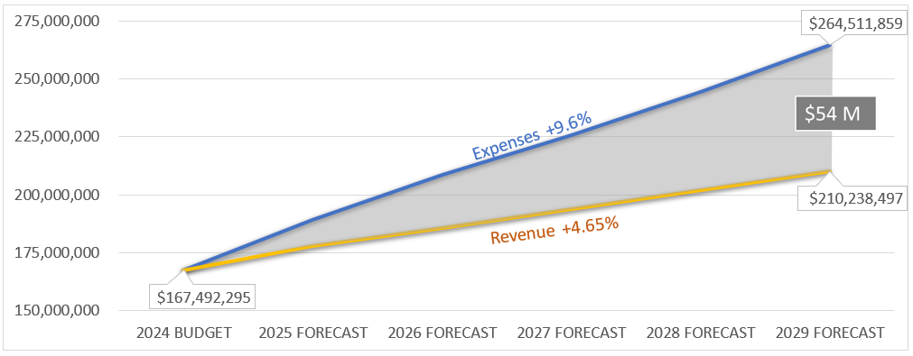
Expenses vs Revenue to FY2029

Slide 12
Financial Discipline
Strategic Plan
5 Year Financial Forecasting
5 Year CIP Development for all Funds [General – (Streets/Parks) & Enterprise Funds]
Identify funding streams

Slide 13
Financial Discipline Continued
Cost Recovery of all Funds and Activities – OR IT BECOMES GENERAL FUND RESPONSIBILITY
Enterprise Funds
  Airport
  Sports Complex
  Golf Course
Fire Pension

Slide 14
Opportunities /Cost Containment /Revenues
Facilities Consolidation
Implement User Fees for Cost Recovery
Economic Development Opportunities
Public Private Partnerships
Donations

Slide 15
Possible Revenue Sources
Street Maintenance Fee
Hotel Motel Rate Increase
Airport Vendor Fees Increases
General Fund Set-aside of Excess Sales Tax
State and Federal Grants
Franchise Fee Assignment from Rate Increases
Franchise Rider Program

Slide 16
MISSION
Deliver exceptional services and promote a high quality of life and place for ALL our citizens.

