Slide 1

Making Our Priorities a Priority
February 13, 2024
1

Slide 2

Strategic Goal Connections
Goal 2: Set the Standard for a Safe and Secure City
2.6 Grow and Retain Public Safety Resources: Expand law enforcement presence as well as fire reduction and prevention programs while reducing attrition.
Goal 3: Quality of Life and Place
3.6 Build the Best Parks System in Our Region: Offer diverse, accessible, and enjoyable green spaces, tournament-ready ball fields, safe playgrounds and unique recreational opportunities that enhance the quality of life / quality of place for our community.
Goal 5: Provide Sound Governance & Fiscal Management
5.7 Ensure Continued Financial Stability and Accountability: Maintain financial transparency.
Goal 6: Strengthen and Sustain Our Infrastructure
6.6 Strategize for and Monitor City Growth: Develop proactive responses to growth rather than reactive.
2

Slide 3
Vision Block Connections
Safe City
Goal #2 Set the Standard for a Safe and Secure City
Premier City
Goal #3 Quality of Life and Place
Operational Excellence
Goal #5 Provide Sound Governance & Fiscal Management
3

Slide 4
Presentation Outline
Funding our Priorities through:
Sound Governance
Non-Sworn Employee Pay to Remain Competitive
Police and Fire Pay & Personnel
Quality of Life Projects
Infrastructure improvements and opportunities
4

Slide 5


Taking Action
Strategic Plan
Encompasses a City’s vision for the future
Goals
Long-term
Align with the Strategic Plan
Action Items
Short-term, “Steps” toward achieving Goals
5

Slide 6
Funding Our Priorities
Strategic Goal | FY 2023 . | FY 2024 . | $ Variance . | % Variance .
Priority 1: Economic Development | 4,787,448 | 5,417,909 | 630,461 | 13.17% .
Priority 2: Public Safety | 84,786,415 | 97,827,862 | 13,041,447 | 15.38% .
Priority 3: Quality of Life and Place | 9,745,159 | 10,877,780 | 1,132,621 | 11.62% .
Priority 4: Communication | 8,457,379 | 8,666,402 | 209,023 | 2.47% .
Priority 5: Governance | 14,759,211 | 15,510,930 | 751,719 | 5.09% .
Priority 6: Infrastructure | 26,158,015 | 29,191,412 | 3,033,397 | 11.60% .
Total Expenses | 148,693,628 . | 167,492,295 . | 18,798,667 . | 12.64% .
6

Slide 7
Funding Our Priorities
7

Slide 8
SOUND GOVERNANCE:
Vision for Our City
Strategic Plan for the Organization
New Organizational Chart Aligned with Vision & Strategic Plan
Human Resources Higher Priority
Adjusted Vacancies in Alignment with Strategic Goals
FAA Finding resolution
Fire Pension cash solution:
Saves $58 million in bond interest
Made use of “rainy day” funds
8

Slide 9
NON-SWORN EMPLOYEE PAY:
5% COLA
5% Salary Table Adjustment
3% Pay Progression
Reclass select positions
Add certification/incentive pays where appropriate
9

Slide 10
SAFE & SECURE CITY:
INCREASED PAY FOR POLICE
2023 → 2024
2023 → 2024
2023 → 2024
COMPENSATION ADJUSTMENTS FOR RETENTION/ RECRUITMENT
5% increase across the board to base pay
Cost: $1.1 M
Pay steps decreased from 9 steps to 7 steps
Cost: $1.4 M
The years to reach max pay (step 7) decreased from 18 years to 10 years
10

Slide 11
SAFE & SECURE CITY:
INCREASED PAY FOR FIRE
2023 → 2024
2023 → 2024
*Opportunity*
PROVIDING FOR GROWTH AND IMPROVED RESPONSE TIMES
5% increase across the board to base pay
Cost: $1.2 M
13 positions added:
- 1 training engineer
- 6 EMS crew
- 6 firefighters to cut down on OT
Cost: $1.0 M
Research and plan for Fire Step Compensation Pay Adjustment for competitive base pays
11

Slide 12
SAFE & SECURE CITY:
Fire Pension Solution Steps
Firemen – went into effect January 1, 2024
Remove effects of extra OT from pension calculation
Calculation based on 60 consecutive months
City – went into effect January 1, 2024
2% Increase in City contribution to pension
Cost - $480K
12

Slide 13
QUALITY OF LIFE AND PLACE:
REYES, MASHBURN, NELMS PARK
DOWNTOWN HOTEL
BEAL PARK
PARKS CONSTRUCTION & IMPROVEMENTS
4-Year plan incl. 62 soccer fields, additional restrooms and amenities
$26 M City Contribution and $10 M from PPP
Economic Development agreement approved
$15 M incentive over a 10 year span
Construction of 6 new fields using Oil & Gas funds
$16.2 M
13

Slide 14
INFRASTRUCTURE:
ROAD BOND
Bond Amount
Time Frame
Roads Constructed
Final Projects
$100 Million
2017 – Vote
2018 – first $25M 2023 – final $25M Two streets left
24 out of 26 roads completed
Main Street
Garfield
14

Slide 15
INFRASTRUCTURE:
STREET IMPROVEMENTS
SCHOOL FLASHERS
3 NEW TRAFFIC SIGNAL LIGHTS
EQUIPMENT
COMPASS
VISION ZERO
$1,525,507
$750,000
$1,500,000
$1,500,000
$200,000
TOTAL: $5,475,507 in current year budget
15

Slide 16
INFRASTRUCTURE:
New opportunities
5-year CIP development for all departments
New Grant personnel to maximize General Fund $$
Wildcatter Trail awarded $4.2M w/ $830K match
Interfund loans – saves on interest costs
Building consolidation to save an estimated $100 million in construction, maintenance and interest costs
TIRZ – Downtown and in two additional locations
16

Slide 17
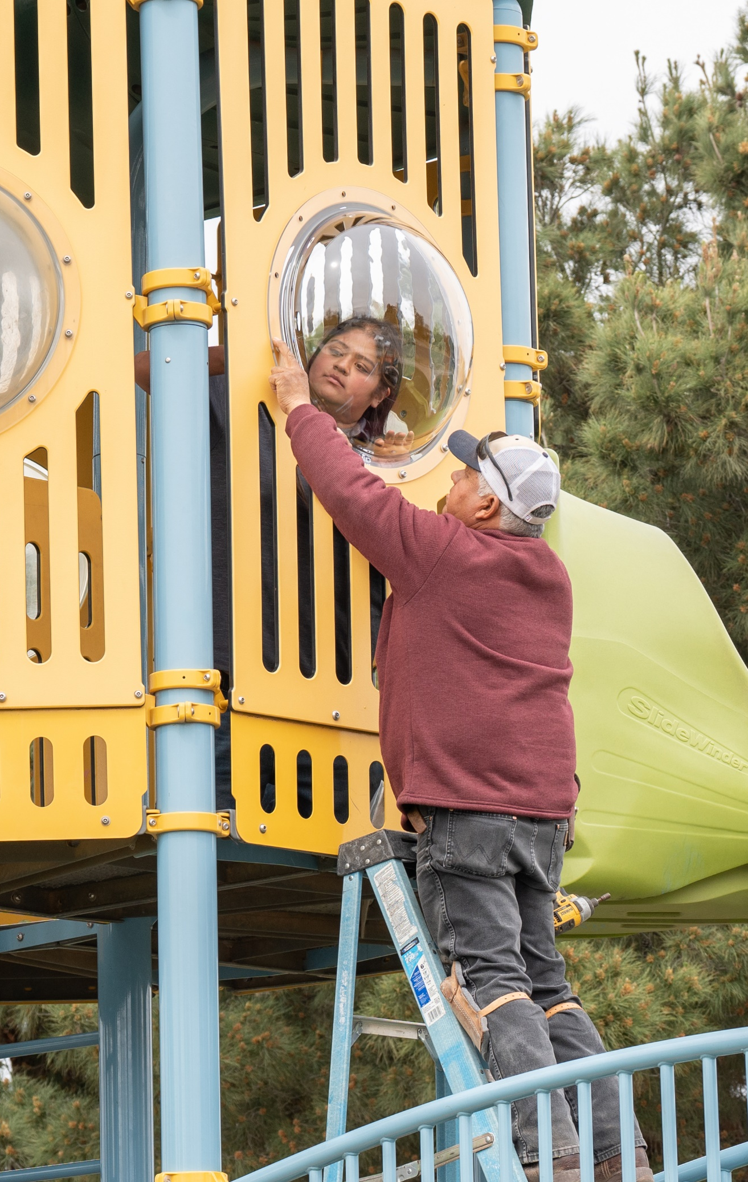
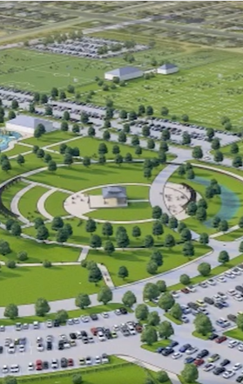
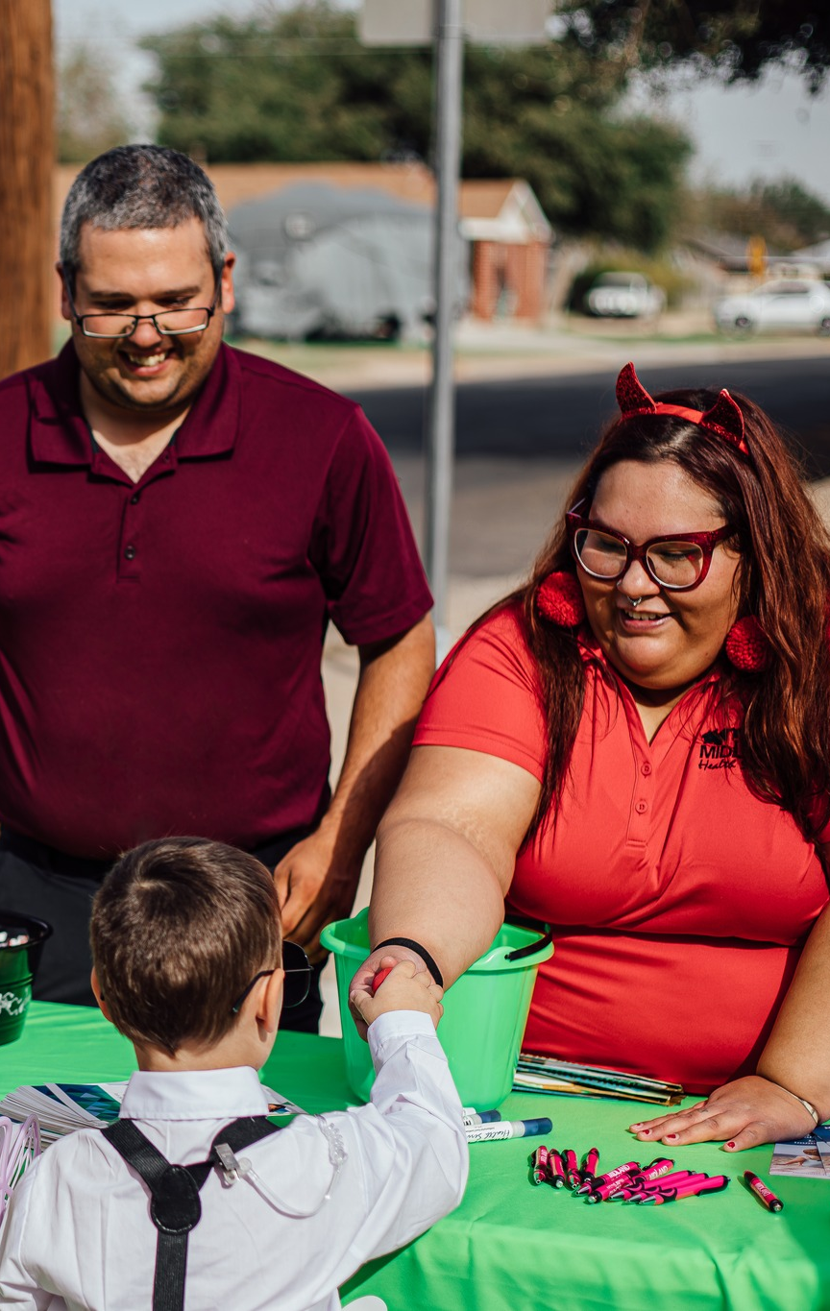
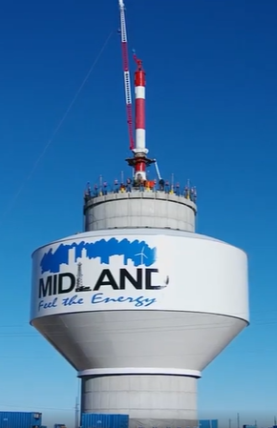
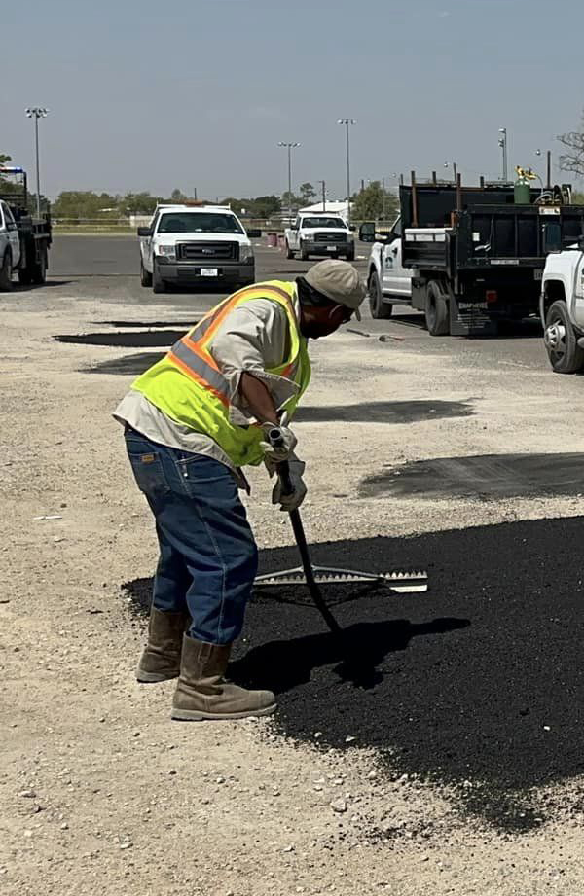
Plan
People
Process
Performance
17

Slide 18
MISSION
Deliver exceptional services and promote a high quality of life and place for ALL our citizens.
18

