Slide 1
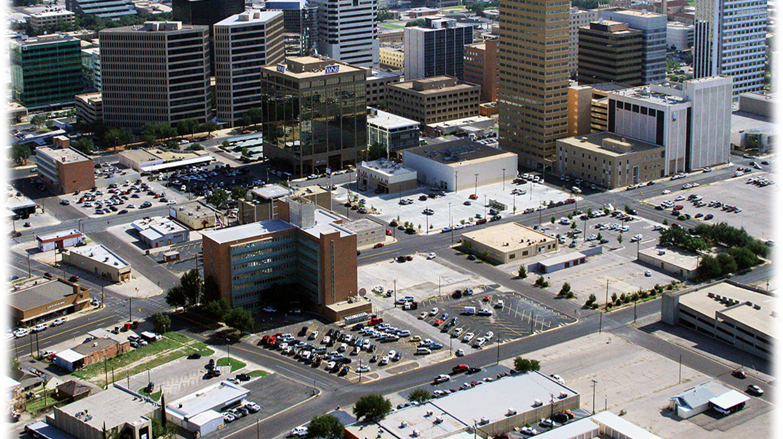
2024 BUDGET
City of midland

Slide 2
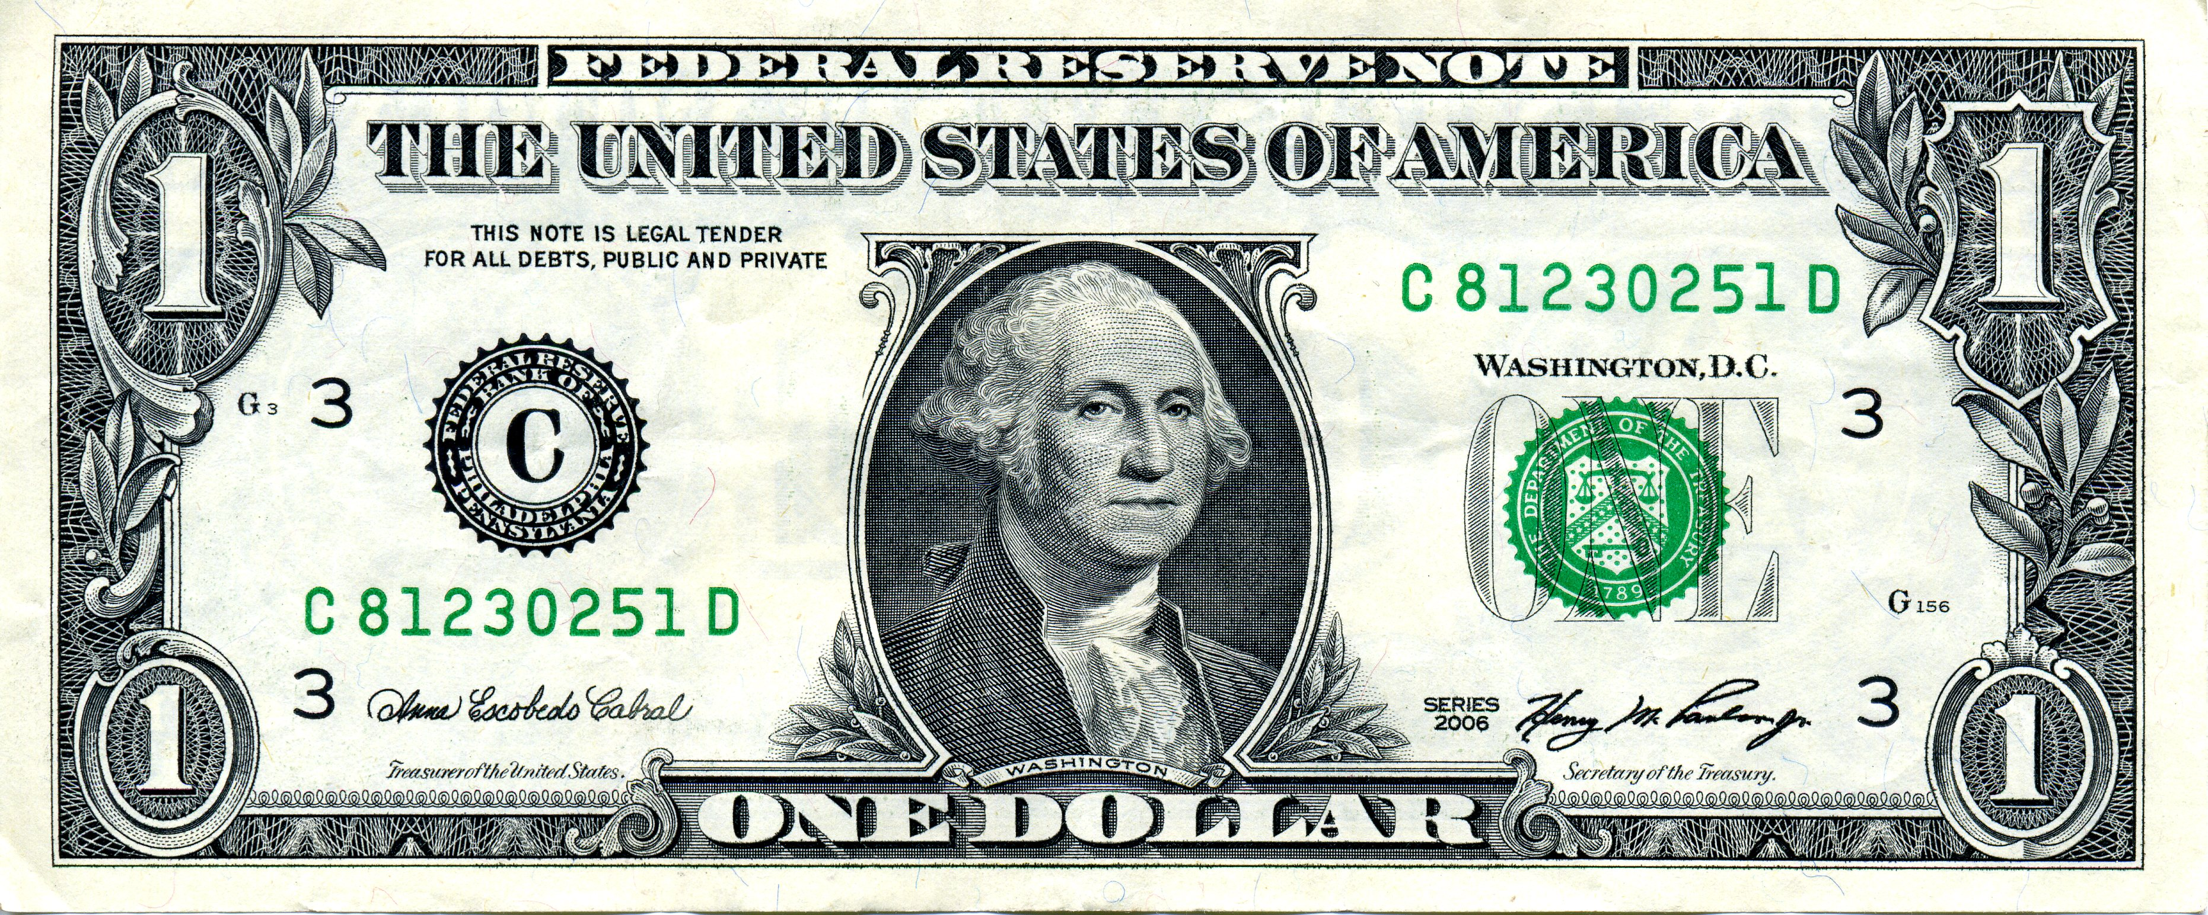
2023-2024 Property Tax By Entity
City of Midland 25%
Midland Hospital 5%
Midland ISD 62%
Midland College 6%
Midland County 2%

Slide 3
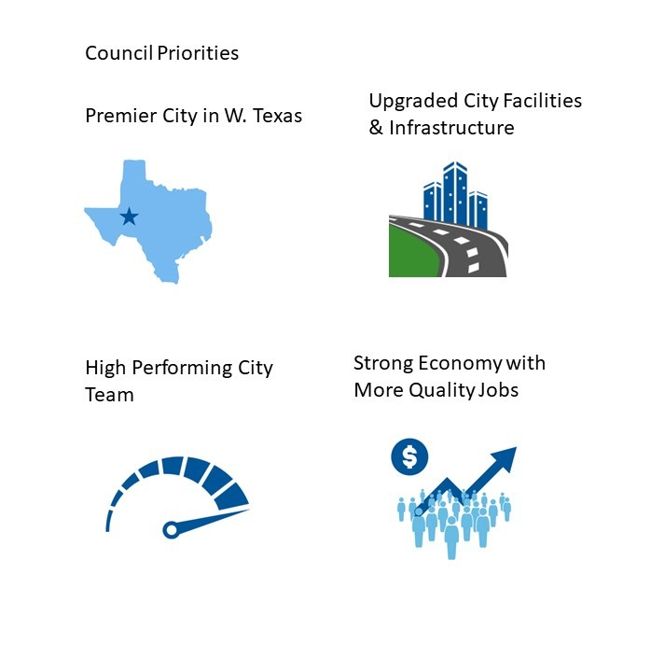
FY 2024 Budget Priorities
Notes:
Council has established 4 budget priorities for 2024.

Slide 4





Street maintenance- street resurfacing and street reconstruction*
Park maintenance - fields and facilities
City facilities maintenance
City’s fleet maintenance schedule
Personnel
*7 million allocated. Does not include 4 million for slurry for potholes

Slide 5








We need to be able to PROPERLY maintain new facilities we build.
Maintenance and Operations must come from Operational revenue sources: Property Tax, Sales Tax and Fees
OPERATING REVENUE
OPERATING EXPENSES

Slide 6

We must keep fund balance resources (the city’s “savings”) for a rainy day and not rely on it for operational expenses
Items outside of the umbrella are covered by fund balance (a “one-time” resource) should be used for one-time expenditures.
OPERATING REVENUE
OPERATING EXPENSES
MAINTENANCE

Slide 7
General Fund Balance
Notes:
The graph provides the history of unappropriated fund balance (including the reserve of 35% of GF expenditures).
City policy that we retain this 35% for emergencies, for our bond holders
The reduction in fund balance is from FY2023 supplemental requests and transfers out to projects (i.e. Wadley and Radio) as well as the transfer of oil and gas revenue to Parks Oil and Gas fund.

Slide 8
GENERAL FUND
Est Bal at YE 2023 $ 90,300,000
Less Reserve 35% ($59,000,000)
Available $ 31,300,000
Less Oil & Gas ($20,000,000)
Available for $ 11,300,000
Staff requests ===========

Slide 9
Historical Tax Levy fy2004 to fy2024 Proposed (Represented In Cents PER $100 VALUATION)
9
Notes:
This levy will generate $6.7 million more in revenue than last years’ budget (2.9 million increase to General fund M&O)
Tax rate continues trended downwards the last 20 years, and valuations continue to climb.
SB2:
Property Tax adjustment will be limited. A comprehensive review of fiscal policies is needed including:
Watching General Fund Reserves
Continue to examine all fees for service and review annually during budget season. Become familiar with other GF revenues and reduce dependence on our three main sources.
Strategies for appropriate use of debt management- only necessary capital expenditures are charged to debt proceeds.
Long-term financial planning: think long-term on capital and operations
Infrastructure management strategies: Contract with infrastructure management company to survey the city- contact local council of government for shared services. This facilitates objective, fact-based allocation of resources.
Operating cost containment: contain growth year to year. Be cautious of projects or additions that have carryover effects.

Slide 10
PROPERTY TAX VALUATION
Per $100,000 of Home Value
FY 2024 Proposed Tax Rate: $353.16
FY 2023 Taxes: $355.04
Change: ($1.88)
Average Home Value for 2022: $325,000 Taxes are $1,153.87
Average Home Value for 2023: $380,000
Taxes are $1,342.02
Notes:
This is estimated from MCAD certified valuation on July 25th.
Assessed valuation has increased from preliminary numbers in July 10th.
Average home value this year is $380,000, taxes estimated at $1342.02

Slide 11

FY 2024 PROPOSED TAX RATES
Tax Rate | Adopted FY 2022-23 | Proposed 2023-24
Proposed Tax Rate | .355039 | .353162
Voter-Approval Tax Rate | .361731 | .380408
No-New-Revenue Rate | .355039 | .328693
Voter-Approval M&O Rate | .311536 | .292310
No-New-Revenue M&O Tax Rate | .304844 | .267841
Interest & Sinking (Debt Service) | .050195 | .060852
FF
NOTE: The Proposed Tax Rate is .0018 (or 0.18 cent) lower than the rate adopted in 2023.

Slide 12
2023-2024 Property Tax Rates Compared
Notes:
In order to build our expenses we have to have revenue:
Midland total 2023 tax rate is $1.562397
General Fund is a three legged stool – property tax, sales tax, and fees
-Must have an estimate of City of Midland’s valuation to estimate the tax rate. Tax rate determines our revenue. Certified will be delivered on July 25th
This is the proposed tax rate in comparison to similar metropolitan areas.
Tyler shows a lower city rate than Midland partly because they do not have any debt covered by property taxes, and, therefore, do not have a debt rate

Slide 13
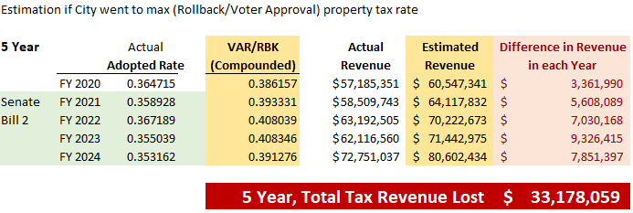

Slide 14
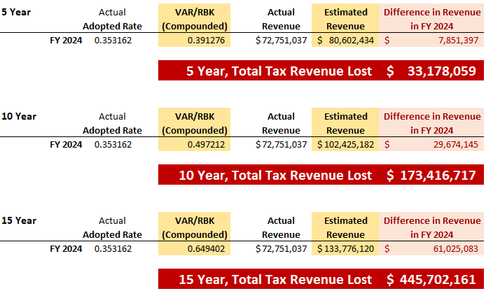

Slide 15
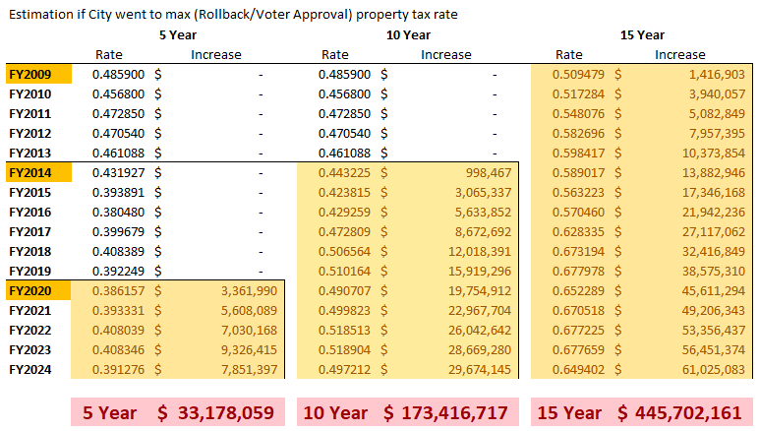

Slide 16
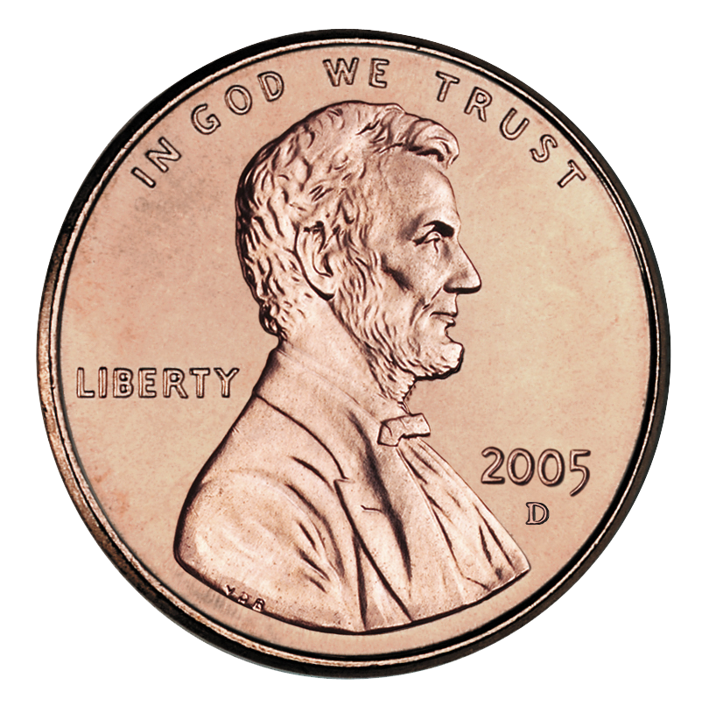
PROPOSED RATE
.353162
$72,751,036
PROPOSED, LESS
-
~($1,000,000)
PROPOSED, LESS
-
~($2,000,000)
PROPOSED, LESS
-
~($3,000,000)
PROPOSED, LESS
-
~($4,000,000)
NO NEW REVENUE
.328693
~($5,000,000)

Slide 17
General Fund Portion
Debt Service Portion
PROPOSED RATE
.353162
~$60,330,000
$12,413,901
PROPOSED, LESS
-
~$59,330,000
$12,413,901
PROPOSED, LESS
-
~58,330,000
$12,413,901
PROPOSED, LESS
-
~$57,330,000
$12,413,901
PROPOSED, LESS
-
~$56,330,000
$12,413,901
NO NEW REVENUE
.328693
~$55,330,000
$12,413,901
Debt Service rate and dollars stay the same in every scenario. Only General Fund is impacted by rate reduction.

Slide 18
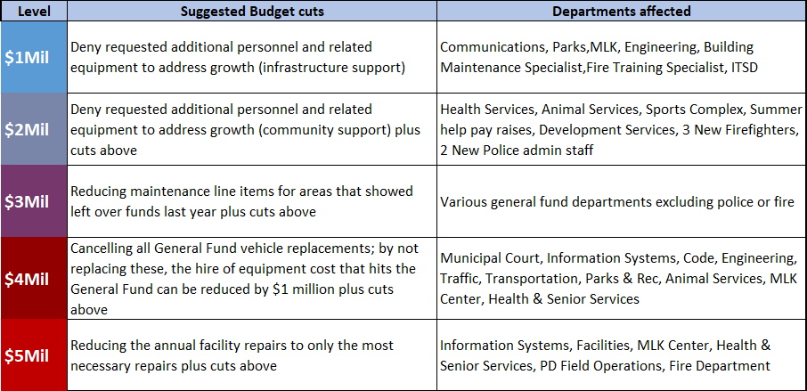

Slide 19
GENERAL FUND INCREASE BREAKDOWN
$20 million
$4.9M – Airport Police and Fire
$7 M – COLA and pay progression
$3 M – new positions and reclasses
$1.6M – facilities and road maintenance
$3.5M – operational expenses
+13%
FISCAL YEAR 2023
$148,550,541
FISCAL YEAR 2024
$168,533,718
19
Notes:
Airport Police and Fire were budgeted under Airport fund for the last two years. These divisions have been moved back to General Fund for FY24 and Airport fund will reimburse General Fund the cost of FTE’s (Salary and Benefits).
$10M increase employee salaries and additional staff to meet city growth and needs.
$3.5 M for increase costs in vehicle and technology maintenance, as well as replacement of fleet.
Fire and Police is $89.7 million of the $168.5 million General Fund Budget.
This $29.4 million over FY2024 budgeted proper tax revenue of $60.3 million. Even just Fire and Police Personnel, at $72.6 million, still exceeds budgeted property tax revenue by $12.3 million

Slide 20
GENERAL FUND INCREASE BREAKDOWN
$20 million
$6.5 M Police (~$2.2M Airport Police)
$6.0 M Fire (~$2.4M Airport Fire)
$2.1 M Community Services
$2.1 M Engineering Services
$1.0 M General Services
$2.3 M All Other
+13%
FISCAL YEAR 2023
$148,550,541
FISCAL YEAR 2024
$168,533,718
20
Notes:
FIRE $44,272,402
POLICE $45,435,754
ENGINEERING $23,617,083
COMMUNITY SERVICES $16,994,825
ITSD $8,093,482
GENERAL SERVICES $6,597,402
DEVELOPMENT SERVICES $5,470,192
OTHER 10,516,628
NON-DEPARTMENTAL $7,535,950
Fire and Police is $89.7 million of the $168.5 million General Fund Budget.
This $29.4 million over FY2024 budgeted proper tax revenue of $60.3 million. Even just Fire and Police Personnel, at $72.6 million, still exceeds budgeted property tax revenue by $12.3 million

Slide 21
GENERAL FUND EXPENDITURES By Department
TOTAL GENERAL FUND BUDGET $168,533,718
21
Notes:
FIRE $44,272,402
POLICE $45,435,754
ENGINEERING $23,617,083
COMMUNITY SERVICES $16,994,825
ITSD $8,093,482
GENERAL SERVICES $6,597,402
DEVELOPMENT SERVICES $5,470,192
OTHER 10,516,628
NON-DEPARTMENTAL $7,535,950
Fire and Police is $89.7 million of the $168.5 million General Fund Budget.
This $29.4 million over FY2024 budgeted proper tax revenue of $60.3 million. Even just Fire and Police Personnel, at $72.6 million, still exceeds budgeted property tax revenue by $12.3 million

Slide 22
EXPENDITURES BY MAJOR FUND
TOTAL BUDGET $425,034,576
22
Notes:
Total City Budget approximately $425.0 million
General Fund - $168.5 million
Water & Sewer - $93.9 million
Airport - $14.7 million
Debt Service $33.3 million
Drainage $2.5 million
Garage $30.6 million
Hotel/Motel $6.5 million
Risk Funds $22.0 million
Sanitation $25.3 million
Special Rev $21.0 million
Tech Fund $6.7 million

Slide 23
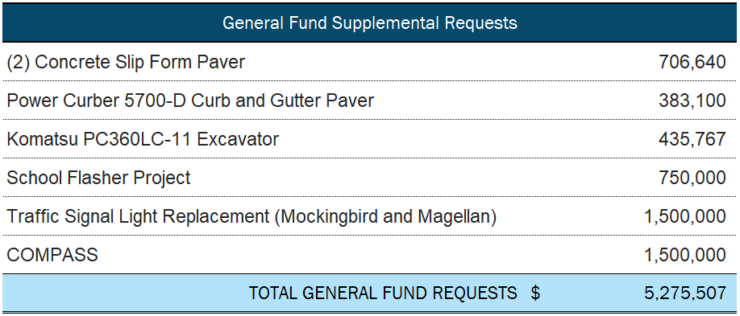
Premier West Texas City
Upgrade City Facilities and Infrastructure
Notes:
$5,275,507 in supplemental requests to General fund, out of the $11,300,000 fund balance.

Slide 24
GENERAL FUND
Est Bal at YE 2023 $ 90,300,000
Less Reserve 35% ($59,000,000)
Available $ 31,300,000
Less Oil & Gas ($20,000,000)
Available for $ 11,300,000
Staff requests ===========
Notes:
After the Supplemental Requests, this would leave $6 million in the fund balance

Slide 25
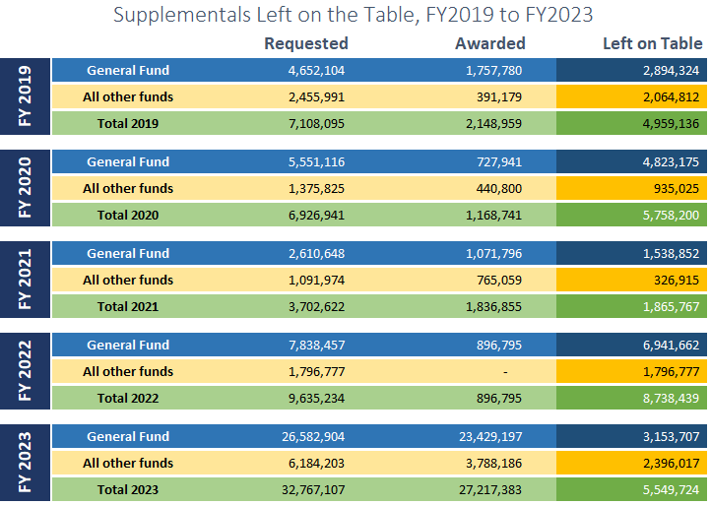
Total Supplementals Left on Table: $32,483,688
Notes:
After the Supplemental Requests, this would leave $6 million in the fund balance

Slide 26
PARKS OIL AND GAS FUND PROJECTS
New Senior Center Design - $2,500,000
Improvements to Southeast Senior Center $2,500,000
Construction of two Auxiliary Fields - $6,500,000
Golf Cart Barn - $1,000,000
Parks Oil & Gas Fund Total - $12,500,000
Notes:
Total of $12,500,000 out of the $50,300,000 fund balance (with movement of Oil & Gas Revenue from General Fund)

