Slide 1
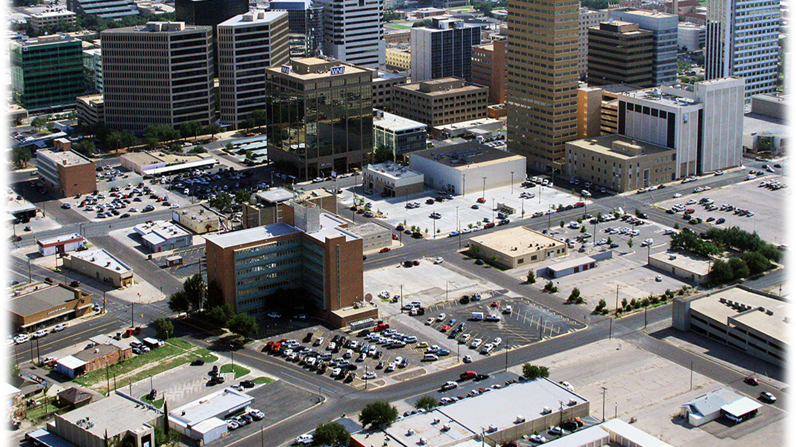
2024 Budget Workshop
City of midland
Notes:
Budget process began in January with preliminary departmental needs assessments
Department heads have met to discuss supplemental requests and to measure large projects against a rating scale
Been through several levels of review

Slide 2
BUDGET CALENDAR
August 2nd
Council to establish proposed tax rate
August 7th
File Proposed Budget and post to website
August 22nd
Public Hearing on Budget
Public Hearing on Tax Rate
Ordinance First Readings
Council to Adopt Budget Ordinance (1st Reading)
Adopt Tax Rate Ordinance (1st Reading)
August 29th
Ordinance Second Readings
Council to Adopt Budget Ordinance (2nd Reading)
Adopt Tax Rate Ordinance (2nd Reading)
SENATE BILL 2:
Concessions made to expedite tax rate adoption process include:
Only one required tax rate hearing if city proposes a rate that does not exceed the voter-approval tax rate
The public hearing can be held at the same meeting as the adoption of the tax rate.
Notes:
Purpose of today is to give you an understanding of the 2024 budget and to give you a chance to ask questions.
Also required today is a vote on what we call the “ceiling” of the property tax rate. This is just to make it clear Council intends to stay within the tax range not requiring an election. This is only a ceiling.
First public tax hearing is on August 22 at a regular meeting.
Requirement is for the tax rate to be passed within 7 days of that hearing. This will be the purpose of the August 29 meeting.

Slide 3
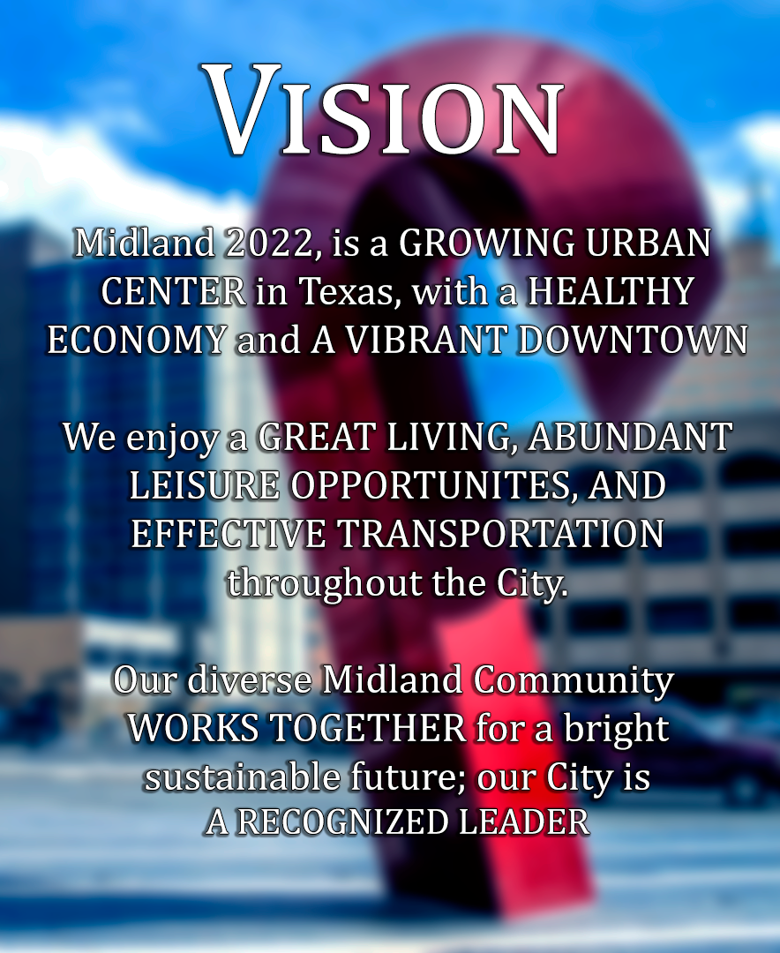
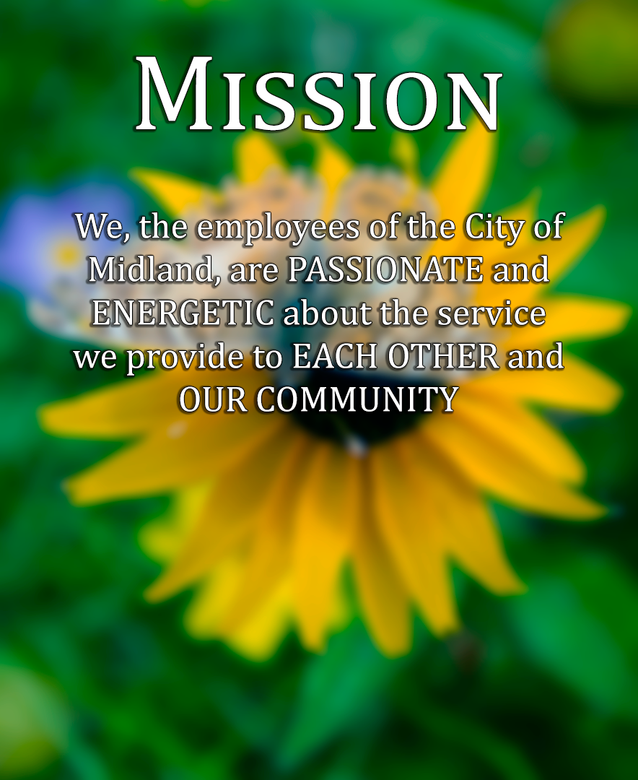

City of Midland
Vision
Midland 2023, is a Growing Urban Center in Texas, with a Healthy Economy and a Vibrant Downtown.
We enjoy a Great Living, Abundant Leisure Opportunities, and Effective Transportation throughout the City.
Our diverse Midland Community Works Together for a brighter sustainable future; our City is a Recognized Leader
Mission
We, the Employees of the City of Midland, are Passionate and Energetic about the services we provide to Each Other and Our Community
Guiding Principles
Demonstrate Integrity, Respect and Value to everyone.
Exhibit Professionalism by being Accountable and Dependable.
Exercise Cooperation through a Dedication to serve others.
Notes:
We prepared the budget with the City of Midland’s Vision , Mission and Guiding Principles in mind.
From the Vision we are reminded we are part of a City that provides abundance, opportunities and leads communities around us.
Our Mission reminds us we are here to serve our community in the best way possible.
And the Guiding Principles remind us to do this with integrity, professionalism and dedication.
The City of Midland values their employees and community. We have prepared a budget that allows for maintenance and growth of infrastructure and human capital to provide value and quality of life to our taxpayers while maintaining fiscal responsibility.

Slide 4
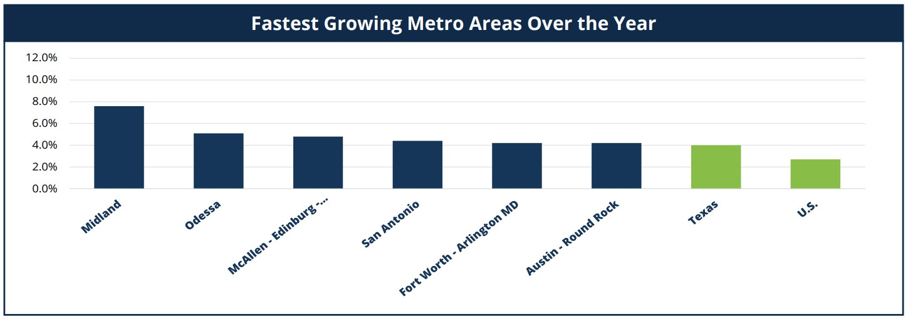
Midland job market is still growing, continuing to outpace other major Texas Metro Areas.
- TWC Labor Market Review,
May 2023 Report

Slide 5
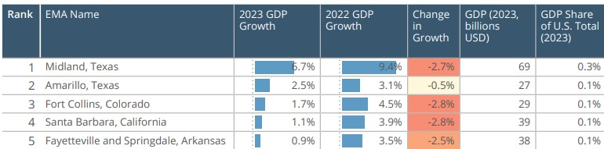
Midland remains the fastest growing Midsize US City by GDP
- Kenan Institute of Private Enterprise, Feb 2023 Report
Note: Per the article, Midland’s economy is projected to grow more than twice as fast as the San Francisco Bay area in 2023.
Notes:
More from Kenan Institute of Private Enterprise:
Midland’s economy is projected to grow more than twice as fast as that of the San Francisco Bay Area (leader among the 50 largest cities for 2023).
Midland’s productivity – economic output per employee – is 25% larger than San Francisco’s (from analysis of productivity that San Francisco’s productivity is almost double the U.S. national average)

Slide 6
Notes:
CW TO WORK W SARA ON THESE GRAPHS –
The City was in growth mode when COVID hit.
The City was very frugal and cautious into for the 2021 budget and stayed flat for the 2022 budget. This affected personnel, supplies, equipment and vehicle replacements, facility maintenance and capital projects.
The 2023 budget addresses the following priorities:

Slide 7
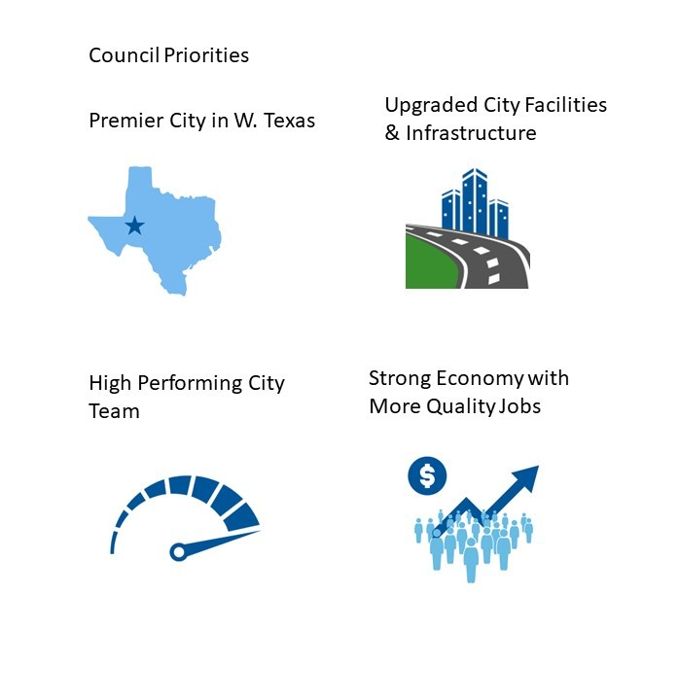
FY 2024 Budget Priorities
Notes:
Council has established 4 budget priorities for 2024.

Slide 8
CREATE THE PREMIER CITY IN WEST TEXAS
Oil and gas revenues budgeted for various park projects (RMN and DM)
Remaining Park CO funds to be used on parks improvements (Hogan, Beal)
Personnel additions to increase service level to the citizens
Notes:
Oil and Gas revenue funds
Constructing Phase 1 of the Reyes-Mashburn-Nelms master plan
Fitness court at Dennis the Menace Park
Improvements to the Golf Course.
June of 2021, certificates of obligation, 25 million total
$10 million - the master plan
$13 million - irrigation and turf pilot program at four city parks
$2 million - convert two soccer/football fields to artificial turf
$13 million spent as of 2023, with the following planned to begin 2024
Completing Hogan Park Phase 2
Replacing the deteriorating park signs
Implementation of the Beal Park master plan
Health Services Facility
To be built on City owned land.
Meet top priority of low-cost health services to a growing community.
Senior Services
$2.5 million in improvements are requested for the Southeast Senior Center
$2.5 million is requested for design of a new Midland Senior Center
Wildcatters Trail
Connect the communities of Midland and Odessa.

Slide 9
CREATE THE PREMIER CITY IN WEST TEXAS
REQUESTED PROJECTS
Planning for New City Hall
New Health Services Facility
New Midland Senior Center
Upgrades to Southwest Senior Center
Design work for the Wildcatters Trail
Golf Cart Barn
Auxiliary fields at Sports Complex
Land purchase in NW Midland
Notes:
Oil and Gas revenue funds
Constructing Phase 1 of the Reyes-Mashburn-Nelms master plan
Fitness court at Dennis the Menace Park
Improvements to the Golf Course.
June of 2021, certificates of obligation, 25 million total
$10 million - the master plan
$13 million - irrigation and turf pilot program at four city parks
$2 million - convert two soccer/football fields to artificial turf
$13 million spent as of 2023, with the following planned to begin 2024
Completing Hogan Park Phase 2
Replacing the deteriorating park signs
Implementation of the Beal Park master plan
Health Services Facility
To be built on City owned land.
Meet top priority of low-cost health services to a growing community.
Senior Services
$2.5 million in improvements are requested for the Southeast Senior Center
$2.5 million is requested for design of a new Midland Senior Center
Wildcatters Trail
Connect the communities of Midland and Odessa.

Slide 10

UPGRADE CITY FACILITIES AND INFRASTRUCTURE
$7 million in road construction and improvements
2017 Road bond – projects are either complete or scheduled to be completed in 2024
$7 million in utilities maintenance and replacement
$3 million for unpaved roads still being completed from ARPA funds
$3.9 million for maintenance and operation of the acquired Midland Freshwater Supply District assets
$1.8 million allocated in budget for facilities capital improvements
Radio interoperability project underway
Notes:
Midland Freshwater Supply District
increased the storage of water
ensures additional water supply for the City
saves overhead expenses for the department
Five-year funding plan for water needs
New northeast water system is complete, and the wastewater system is underway
Operating funds will be budgeted for other necessary improvements
Plant farm pond lining replacement
Replace lift stations (Airport and Mockingbird)
Replace outfall lines to wastewater plant
Replace 50 manholes in wastewater system
Replace the annual amount of 4” iron water mains
Annual utility extension and taps program
New water wells at Paul Davis Well Field
Continue to provide leadership in the West Texas Water Partnership
Improve/maintain city transportation
approximately $1.5 million for maintenance of city streets
approximately $6.2 million for new infrastructure and capital improvements
annual signal system maintenance on City streets per the 5-year plan
expansion and widening of Mockingbird Lane
Facilities capital improvements
Replacement of cast iron plumbing at City Hall
Fire Stations require roof repairs, new fences and gates, and other infrastructure improvements
HVAC upgrades for the MLK Center
Replace police training facility restrooms and east side ramp
Parking lot security fence for Police
Repair roof leaks on multiple fire stations and other upgrades
Replace Fire’s SCBA Compressor
Replace Golf Course Carpet
Replace inground lifts at the Garage
Upgrade security gate at the Garage
Supplemental new/improved facilities
$10 million for the design for a new City Hall
Police and Fire Regional Training Facility estimated at $20.5 million
$2.5 million for the design of a new Midland Senior Center
$2.5 million improvements to the Southeast Senior Center
Construction of a new Health Services Facility estimated at $15 million

Slide 11
UPGRADE CITY FACILITIES AND INFRASTRUCTURE
REQUESTED PROJECTS
New City Hall facility design
Police and Fire Training Facility
New Health Facility
New Senior Center and remodel
Mockingbird Lane expansion and widening
Notes:
Midland Freshwater Supply District
increased the storage of water
ensures additional water supply for the City
saves overhead expenses for the department
Five-year funding plan for water needs
New northeast water system is complete, and the wastewater system is underway
Operating funds will be budgeted for other necessary improvements
Plant farm pond lining replacement
Replace lift stations (Airport and Mockingbird)
Replace outfall lines to wastewater plant
Replace 50 manholes in wastewater system
Replace the annual amount of 4” iron water mains
Annual utility extension and taps program
New water wells at Paul Davis Well Field
Continue to provide leadership in the West Texas Water Partnership
Improve/maintain city transportation
approximately $1.5 million for maintenance of city streets
approximately $6.2 million for new infrastructure and capital improvements
annual signal system maintenance on City streets per the 5-year plan
expansion and widening of Mockingbird Lane
Facilities capital improvements
Replacement of cast iron plumbing at City Hall
Fire Stations require roof repairs, new fences and gates, and other infrastructure improvements
HVAC upgrades for the MLK Center
Replace police training facility restrooms and east side ramp
Parking lot security fence for Police
Repair roof leaks on multiple fire stations and other upgrades
Replace Fire’s SCBA Compressor
Replace Golf Course Carpet
Replace inground lifts at the Garage
Upgrade security gate at the Garage
Supplemental new/improved facilities
$10 million for the design for a new City Hall
Police and Fire Regional Training Facility estimated at $20.5 million
$2.5 million for the design of a new Midland Senior Center
$2.5 million improvements to the Southeast Senior Center
Construction of a new Health Services Facility estimated at $15 million

Slide 12
MAINTAIN A HIGH PERFORMING MIDLAND CITY TEAM
COLA and pay progression for employees
New PTO system to improve benefits and retention
Software to automate Health Inspectors’ forms
Notes:
Salary increases
All positions budgeted with 5% cost of living increase
Non-sworn personnel budgeted with 3% progression pay
Sworn employees will continue to receive their annual step increase on the anniversary of their hire date
The new PTO system will combine current Vacation and Sick leave into one type of leave 10/1/2023
New positions
Police
5 officers
A crime scene technician
A public safety communication QA analyst.
Fire
6 firefighters for growth
6 firefighters for an additional ambulance at Station 4
Training specialist.
City Managers/PIO
A Multimedia Comm Specialist
Community Services
3 kennel techs
a veterinary technician
2 turf specialists (parks)
A maintenance specialist (Parks)
A sports coordinator
2 maintenance specialists (Golf Course)
Development Services
An assistant oil and gas coordinator
Engineering
An operations planner
ITSD
An program analyst
A systems analyst
General Services
A new building maintenance specialist
A new Garage light side technician
Airport
An airport maintenance specialist
Sanitation
2 employees for the recycle division
A sanitation driver for growth
A environmental officer.
Utilities
2 Customer service representatives
A meter shop foreman.

Slide 13
MAINTAIN A HIGH PERFORMING MIDLAND CITY TEAM
PERSONNEL ADDITIONS
Fire (11), EMS (3) and Police (5) for city growth
Community Services: Animal Services (4) & Parks (4)
General Services (2) to support City government infrastructure
Sanitation Recycling (2) and Solid Waste (2) divisions
Customer Service (3)
Notes:
Salary increases
All positions budgeted with 5% cost of living increase
Non-sworn personnel budgeted with 3% progression pay
Sworn employees will continue to receive their annual step increase on the anniversary of their hire date
The new PTO system will combine current Vacation and Sick leave into one type of leave 10/1/2023
New positions
Police
5 officers
A crime scene technician
A public safety communication QA analyst.
Fire
6 firefighters for growth
6 firefighters for an additional ambulance at Station 4
Training specialist.
City Managers/PIO
A Multimedia Comm Specialist
Community Services
3 kennel techs
a veterinary technician
2 turf specialists (parks)
A maintenance specialist (Parks)
A sports coordinator
2 maintenance specialists (Golf Course)
Development Services
An assistant oil and gas coordinator
Engineering
An operations planner
ITSD
An program analyst
A systems analyst
General Services
A new building maintenance specialist
A new Garage light side technician
Airport
An airport maintenance specialist
Sanitation
2 employees for the recycle division
A sanitation driver for growth
A environmental officer.
Utilities
2 Customer service representatives
A meter shop foreman.

Slide 14
MAINTAIN A HIGH PERFORMING MIDLAND CITY TEAM
KEY PERSONNEL ADDITIONS
Senior Manager I
IGR
Golf Maintenance Specialist
Internal/External Communications Specialist
Permitting (2 positions)
ITSD (2 positions)
Communications (2 positions)
Grant Writer
Veterinarian
Notes:
Salary increases
All positions budgeted with 5% cost of living increase
Non-sworn personnel budgeted with 3% progression pay
Sworn employees will continue to receive their annual step increase on the anniversary of their hire date
The new PTO system will combine current Vacation and Sick leave into one type of leave 10/1/2023
New positions
Police
5 officers
A crime scene technician
A public safety communication QA analyst.
Fire
6 firefighters for growth
6 firefighters for an additional ambulance at Station 4
Training specialist.
City Managers/PIO
A Multimedia Comm Specialist
Community Services
3 kennel techs
a veterinary technician
2 turf specialists (parks)
A maintenance specialist (Parks)
A sports coordinator
2 maintenance specialists (Golf Course)
Development Services
An assistant oil and gas coordinator
Engineering
An operations planner
ITSD
An program analyst
A systems analyst
General Services
A new building maintenance specialist
A new Garage light side technician
Airport
An airport maintenance specialist
Sanitation
2 employees for the recycle division
A sanitation driver for growth
A environmental officer.
Utilities
2 Customer service representatives
A meter shop foreman.

Slide 15
BUILD A STRONG ECONOMY WITH MORE QUALITY JOBS
$400,000 from the TIRZ fund will be added to the 1,000,000 allocation (from previous years) to further Downtown Development
Current and future 380 agreements
Notes:
As the city continues to grow in GDP, jobs and wages, and unemployment stays low at 2.7%
In addition, an allocation is set aside in the General Fund to pursue options for an Entertainment District and research the potential of a Cultural District in Downtown Midland
Management is offering agreements under Chapter 380 of the Texas Local Government Code to encourage activity and future development in the downtown district as well as in key areas of the City
Current and future 380 agreements will be pursued selectively as opportunities arise

Slide 16


Premier West Texas City
Upgrade City Facilities and Infrastructure
Beal Park Soccer Fields - $5,200,000
New Health Services Facility - $15,000,000
PD/FD Training Facility - $20,500,000
Construction of two Auxiliary Fields - $6,500,000
New Senior Center Design - $2,500,000
Wildcatter Trail Planning - $900,000
Improvements to Southeast Senior Center $2,500,000
Golf Cart Barn - $1,000,000
New City Hall Facility Design - $10,000,000
Community Health Assessment - $250,000
Mockingbird Lane Expansion/Widening - $7,500,000
Sports Complex
$6,500,000
Parks Oil & Gas Fund
$1,900,000
Parks Bond Fund
$5,200,000
General Fund
$22,750,000
Certificate of Obligation
$35,500,000
Notes:
Total of 71,850,000

Slide 17
TAX RATE CALCULATION
M&O RATE
UNUSED INCREMENT
VOTER APPROVAL RATE
DEBT RATE

Slide 18
Important Definitions
Debt Rate = The rate calculated to pay debt service for the year.
No New Revenue Rate = The rate per $100 of taxable value that would produce the same amount of revenue received in previous year on the existing property.
Voter Approval Rate = The NNR M&O rate plus a 3.5% increase, plus any unused increments equals the maximum tax rate without requiring an election.

Slide 19
UNUSED INCREMENT
2021 = $.020553
2022 = $.000001
2023 = $.006692
TOTAL
$.027246

Slide 20

FY 2024 PROPOSED TAX RATES
Tax Rate | Adopted FY 2022-23 | Proposed 2023-24
Proposed Tax Rate | .355039 | .353162
Voter-Approval Tax Rate | .361731 | .380408
No-New-Revenue Rate | .355039 | .328693
Voter-Approval M&O Rate | .311536 | .292310
No-New-Revenue M&O Tax Rate | .304844 | .267841
Interest & Sinking (Debt Service) | .050195 | .060852
FF
NOTE: The Proposed Tax Rate is 1.8 cents lower than the rate adopted in 2023.

Slide 21
Historical Tax Levy 2004 to Proposed 2024
21
Notes:
This levy will generate $6.7 million more in revenue than last years’ budget (2.9 million increase to General fund M&O)
Tax rate continues trended downwards the last 20 years, and valuations continue to climb.
SB2:
Property Tax adjustment will be limited. A comprehensive review of fiscal policies is needed including:
Watching General Fund Reserves
Continue to examine all fees for service and review annually during budget season. Become familiar with other GF revenues and reduce dependence on our three main sources.
Strategies for appropriate use of debt management- only necessary capital expenditures are charged to debt proceeds.
Long-term financial planning: think long-term on capital and operations
Infrastructure management strategies: Contract with infrastructure management company to survey the city- contact local council of government for shared services. This facilitates objective, fact-based allocation of resources.
Operating cost containment: contain growth year to year. Be cautious of projects or additions that have carryover effects.

Slide 22
2022-2023 Property Tax Rates Compared
Notes:
In order to build our expenses we have to have revenue:
General Fund is a three legged stool – property tax, sales tax, and fees
-Must have an estimate of City of Midland’s valuation to estimate the tax rate. Tax rate determines our revenue. Certified will be delivered on July 25th
This is the proposed tax rate in comparison to similar metropolitan areas.
Tyler shows a lower city rate than Midland partly because they do not have any debt covered by property taxes, and, therefore, do not have a debt rate

Slide 23
2022-2023 Total Property Tax Rates Compared
Notes:
This is the total 2023 tax rate in comparison to similar metropolitan areas, with totals.
Midland total 2023 tax rate is $1.562397

Slide 24
MIDLAND COMBINED TAX RATE
Notes:
FY 2023
City of Midland - 0.355039
Midland County - 0.131112
Midland ISD - 0.91480
Midland College - 0.08000
Midland Hospital - 0.081446
TOTAL - 1.562397

Slide 25
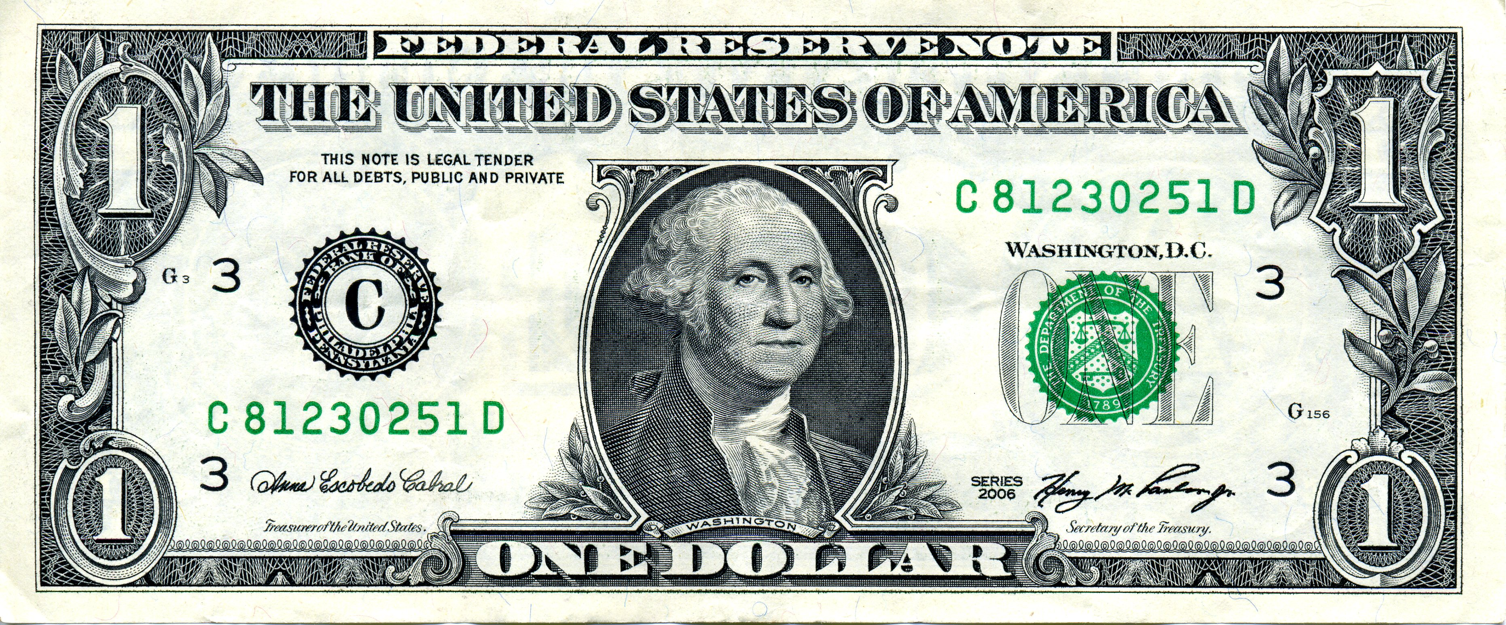
Midland Hospital 5%
City of Midland 23%
Midland ISD 59%
Midland College 5%
Midland County 8%

Slide 26
PROPERTY TAX VALUATION
Per $100,000 of Home Value
FY 2024 Proposed Tax Rate: $353.16
FY 2023 Taxes: $355.04
Change: ($1.88)
Average Home Value for 2022: $325,000 Taxes are $1,153.87
Average Home Value for 2023: $380,000
Taxes are $1,342.02
Notes:
This is estimated from MCAD certified valuation on July 25th.
Assessed valuation has increased from preliminary numbers in July 10th.
Average home value this year is $380,000 taxes estimated at $1,338.28

Slide 27
GENERAL FUND REVENUES BY TYPE
BUDGET $168,533,718
27
Notes:
The three-legged stool:
Property tax includes levy, delinquency, interest and misc. tax office revenue
Sales tax is projected at $65 million based on projections from the City’s consultant and the Finance office
The sales tax budget for FY23 was $57 million, and through July the City has receipted $56 million. We project $66 - 68 million by the end of the fiscal year.

Slide 28
General Fund Balance
Notes:
The graph provides the history of unappropriated fund balance (including the reserve of 35% of GF expenditures).
City policy that we retain this 35% for emergencies, for our bond holders

Slide 29
GENERAL FUND EXPENDITURES
BUDGET $168,533,718
29
Notes:
General Fund expenditures by category, with Personnel the largest at 64% and contracted services at 24%.
Personnel $108.1 million
Contracted services $40 million
Operating Expenses $9.9 million
Capital $9.5 million
Transfers & Other $1.6 million

Slide 30
GENERAL FUND EXPENDITURES By Department
30
Notes:
FIRE $44,272,402
POLICE $45,435,754
ENGINEERING $23,617,083
COMMUNITY SERVICES $16,994,825
ITSD $8,093,482
GENERAL SERVICES $6,597,402
DEVELOPMENT SERVICES $5,470,192
OTHER 10,516,628
NON-DEPARTMENTAL $7,535,950
Fire and Police is $89.7 million of the $168.5 million General Fund Budget.
This $29.4 million over FY2024 budgeted proper tax revenue of $60.3 million. Even just Fire and Police Personnel, at $72.6 million, still exceeds budgeted property tax revenue by $12.3 million

Slide 31
EXPENDITURES BY MAJOR FUND
TOTAL BUDGET $425,034,576
31
Notes:
Total City Budget approximately $425.0 million
General Fund - $168.5 million
Water & Sewer - $93.9 million
Airport - $14.7 million
Debt Service $33.3 million
Drainage $2.5 million
Garage $30.6 million
Hotel/Motel $6.5 million
Risk Funds $22.0 million
Sanitation $25.3 million
Special Rev $21.0 million
Tech Fund $6.7 million

Slide 32
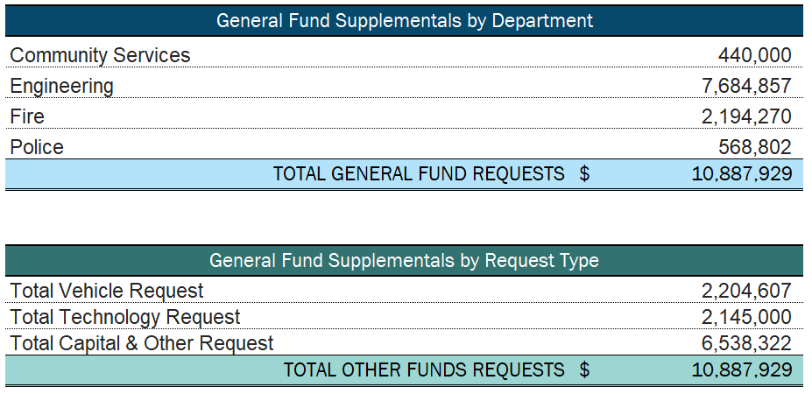
Additional Department Requests – General Fund

