Slide 1

Item 3e
Hogan Golf Course:
Embracing a Unique Market Position
Elizabeth Triggs
Planning & Development Officer
MAY 14, 2024
1

Slide 2

Strategic Goal Connections
Goal 1: Strong Economy with More Quality Jobs
1.2 Enhance visitor revenue opportunities: Boost tourism through marketing and infrastructure improvements
Goal 3: Strong Economy with More Quality Jobs
3.3 Create an attractive and inclusive living environment: Develop and enhance live, work, and play opportunities for our citizens
3.5 Nurture and promote a healthy community: Increase healthy community living and education opportunities for citizens of all ages
3.6 Build the best parks system in our region: Offer diverse, accessible, and enjoyable green spaces, tournament-ready ball fields, safe playgrounds, and unique recreational opportunities that enhance the quality of life / quality of place for our community
2

Slide 3
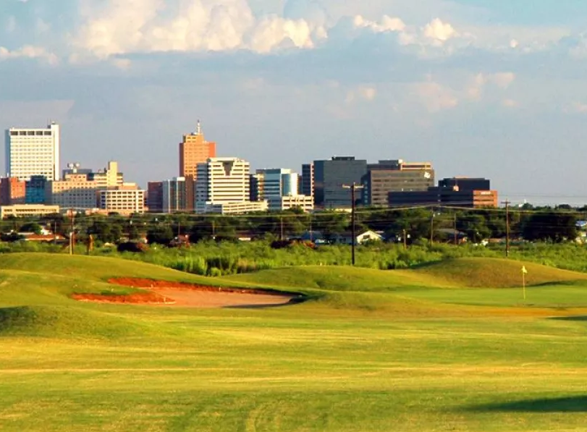
Strategic Goal Connections
Goal 5: Provide Sound Governance and Fiscal Management
5.6 Deliver services timely and efficiently: Prioritize continuous improvement
5.7 Ensure continued financial stability and accountability: Maintain financial transparency
5.9 Ensure reliability and safety: Maintain existing assets and develop new city asset opportunities, including parks and other facilities, with a standard of excellence
3

Slide 4
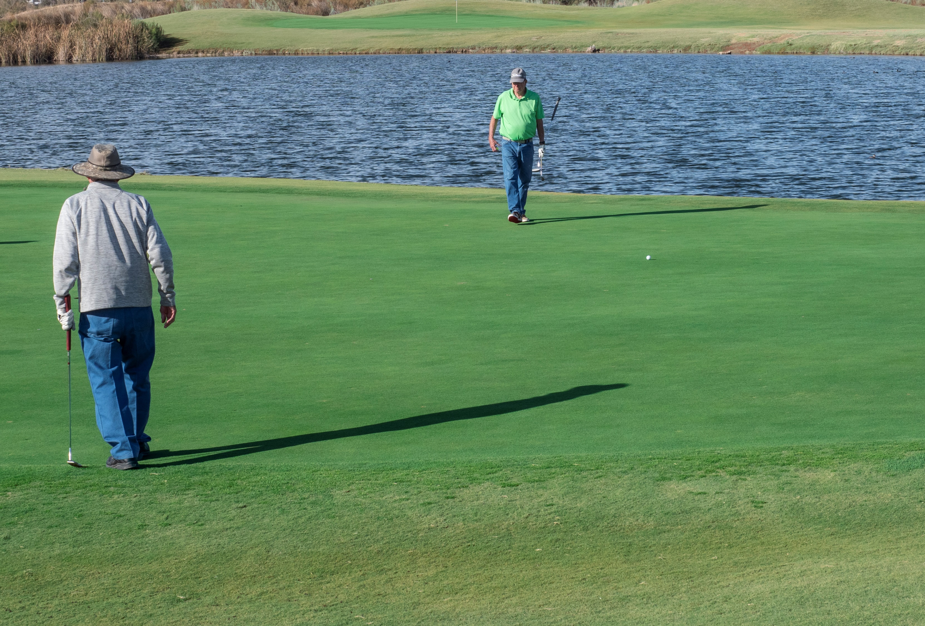
Maximizing Hogan’s Potential
Seizing a Unique Market Position: Hogan holds a unique market position in the wake of recent and upcoming competitor closures, positioning Hogan to be the only public golf course within 20 miles, serving a population of more than 225,000.
Adjusting Fees Strategically: According to the Hogan Financial Master Plan, despite static fees 30 percent below national benchmarks and 20 percent less than comparable courses, Hogan achieved modest positive cashflow in 2023 primarily due to an uptick in rounds played.*
*Direct competitor charges $32 for 18 holes Friday through Sunday, compared to Hogan’s charge of $21.25 for unlimited play on Friday and $26.25 for unlimited play on Saturday and Sunday
4
Notes:
Closing of Ranchland Hills and Nueva Vista can only mean increased demand at Hogan
Golf business has surged since 2020:
Rounds up 6.2 percent yearly over 2023 (Hogan saw a 17 percent increase in rounds from 2022 to 2023 – from 65k rounds to more than 76k rounds)
2023 set a record nationally with 26.6 million individuals playing 531 million rounds (Hogan followed same trend seeing historic high in rounds played in 2023)

Slide 5
Maximizing Hogan’s Potential
Optimizing Capacity Utilization: Operating at an average 45 percent capacity over the last two years, Hogan has fallen short of the national average of 69 percent
  Largely because 80 percent of playable Fridays and Saturdays are booked for tournaments
  Achieving or surpassing the national benchmark through improved scheduling practices could potentially add $1.6 million in new revenue annually, based on the 2023 fee structure
Utilization: National Average | 68.8%
Utilization: Hogan Park (average 70,873 rounds divided by max capacity of 158,340 rounds) | 44.8%
Underutilization at Hogan Park | 24.0%
Additional Rounds to Reach National Average Utilization Rate (max capacity of 158,340 rounds x 24.0%) | 38,065
2023 Average Revenue per Round | $42.46
Potential Additional Revenue at National Capacity Benchmark | $1,614,000
5
*Source: Hogan Park Financial Master Plan dated May 6, 2024
Notes:
Ironically, in the community survey conducted, respondents indicated that the availability of tee times was their number one concern
Likely because 52 percent of the 199 tournaments scheduled for 2024 on Friday or Saturday at the standard green fee rate.
Of the 38 annual playable golf days on Friday and Saturday, tournaments conducted on 29 and 31 days, respectively, limiting public play
Tournaments should be assessed, mainly if conducted on Friday – Sunday, at a premium rate with player guarantees of at least 120 golfers
Beyond the additional revenue that can be generated by requiring tournament contracts, player count within 10-day guarantees before the event, and deposits increase utilization of the golf course

Slide 6
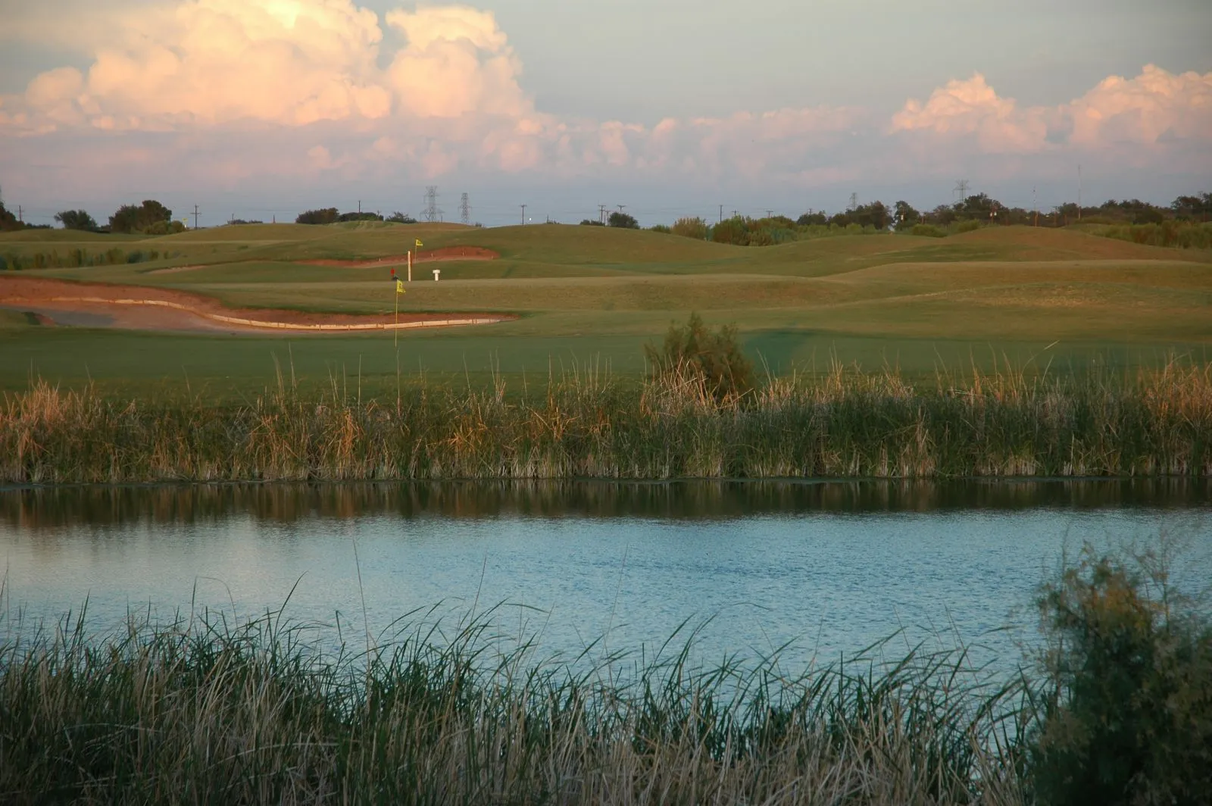
Challenges to Maximizing Potential
Lack of Capital Investment: Since the construction of Quail in 1959, the Roadrunner back nine in 1983, and the Roadrunner front nine in 2009, there has been little to no capital investment in the courses
  Industry best practices suggest major reinvestment begins after 10 years, with a complete renovation necessary after 30 years.
Capital Fund Balance: As of the end of January 2024, the capital fund balance for Hogan Golf Course is just over $1.14M
Capital Needs: Including improvements to ancillary buildings (clubhouse, cart barn, and tournament pavilion), there is more than $24M in capital needs*
6
*Original estimate adjusted for inflation

Slide 7
Capital Needs
Capital Improvement | Need | Reason | Amount
Cart Barn* | Immediate | Structurally unsafe, fire hazard | $1,000,000
Bathroom Renovation | Immediate | Five Bathrooms | $1,250,000
Clubhouse Renovation | Immediate | Paint and uplift to modernize | $500,000
Master Plan | Immediate | Anticipate maintenance and renovations | $250,000
Irrigation Systems | Immediate | Beyond their useful life | $6,000,000
RO System | Immediate | Address poor water quality | $3,000,000
Roadrunner greens | Short Term | Address poor drainage | $2,500,000
Quail greens | Short Term | Address poor drainage | $2,500,000
Clubhouse Rebuild + Expansion | Mid-Term | Insufficient bathrooms, kitchen and dining | $6,500,000
Tournament Pavilion Rebuild | Mid-Term | Lack of kitchen facilities and storage | $1,000,000
Total |  |  | $24,500,000
7
*Included in FY24 Budget
Notes:
1.8

Slide 8
Local Rate Comparison
 | Hogan* | Public Golf Courses |  |  | Private / Semi-Private Golf Courses**
 |  | Ratliff (Odessa) | Andrews County | Big Spring | Ranchland Hills | Midland Country Club | Green Tree Country Club | Odessa Country Club
Weekday Green Fee | $21.25 | $25.00 | $25.00 | $25.00 | $65.00 | $95.00 | $130.00 | $107.00
Weekend Green Fee | $26.25 | $32.00 | $35.00 | $30.00 | $80.00 | $120.00 | $130.00 | $123.05
Senior Weekday | $20.00 | $17.00 | $20.00 | $20.00 | * | * | * | *
Cart Fee (per rider) | $13.75 | $15.00 | $20.00 | $13.50 | Included | Included | Included | Included
Weekday Tournament | $40.00 | $53.00 | $50.00 | * | * | * | * | *
Weekend Tournament | $45.00 | $60.00 | $65.00 | * | * | * | * | *
Initiation Fee | $0.00 | $0.00 | $0.00 | $0.00 | $3,000.00 | $75,000.00 | $40,000.00 | $35,000.00
Monthly Fee | $0.00 | $0.00 | $0.00 | $0.00 | $433.00 | $920.13 | $718.00 | $765.62
8
*Hogan weekends currently consist of Saturday and Sunday only, unlike other regional courses, which include Friday, Saturday, and Sunday
**Weekday and weekend fees are guest fees; members are covered under membership fees

Slide 9
Proposed Rate Realignment
 | Current |  |  | Proposed*
Day | Green Fee (Day Pass) | Cart | Tournament Green Fee + Cart | Green Fee (per 18 holes) | Cart (per rider) | Tournament Green Fee + Cart
Monday | $21.25 | $13.75 | $40.00 | $30.00 | $15.00 | $55.00
Tuesday | $21.25 | $13.75 | $40.00 | $30.00 | $15.00 | $55.00
Wednesday | $21.25 | $13.75 | $40.00 | $30.00 | $15.00 | $55.00
Thursday | $21.25 | $13.75 | $40.00 | $30.00 | $15.00 | $55.00
Friday | $21.25 | $13.75 | $40.00 | $35.00 | $15.00 | $65.00
Saturday | $26.25 | $13.75 | $45.00 | $35.00 | $15.00 | $65.00
Sunday | $26.25 | $13.75 | $45.00 | $35.00 | $15.00 | $65.00
*Seniors, over the age of 60 continue to receive discounted rate of $20.00 per 18-holes, Monday through Thursday
**Proposed realignment based on Hogan Park Financial Master Plan and regional benchmark comparison
9

Slide 10
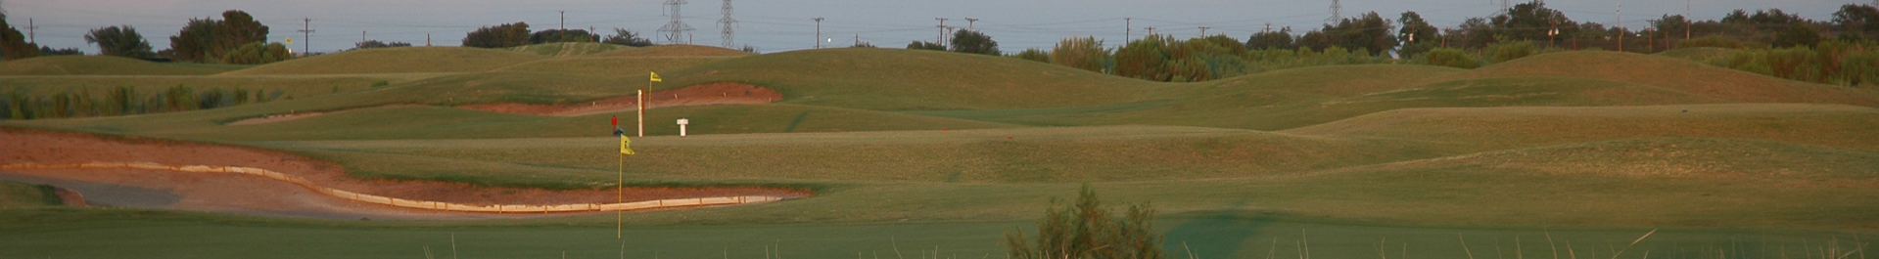
Proposed Rate Realignment
Annual Senior Pass (60+ years) Rate Adjustment: $500 per year plus $5.00 charge per 18 holes, compared to current rate of $450 per year plus $3.75 per 18 holes)
Tournament Policy Adjustment to Optimize Golf Course Utilization:
  Each tournament will post a 10% deposit or $500 (whichever is greater) upon contract signing
  Tournaments will have ability to adjust player counts up to 10 days in advance
  Cooker fee increases from $3.00 per player to $5.00 per player
10
*Proposed realignment based on Hogan Park Financial Master Plan and regional benchmark comparison

Slide 11
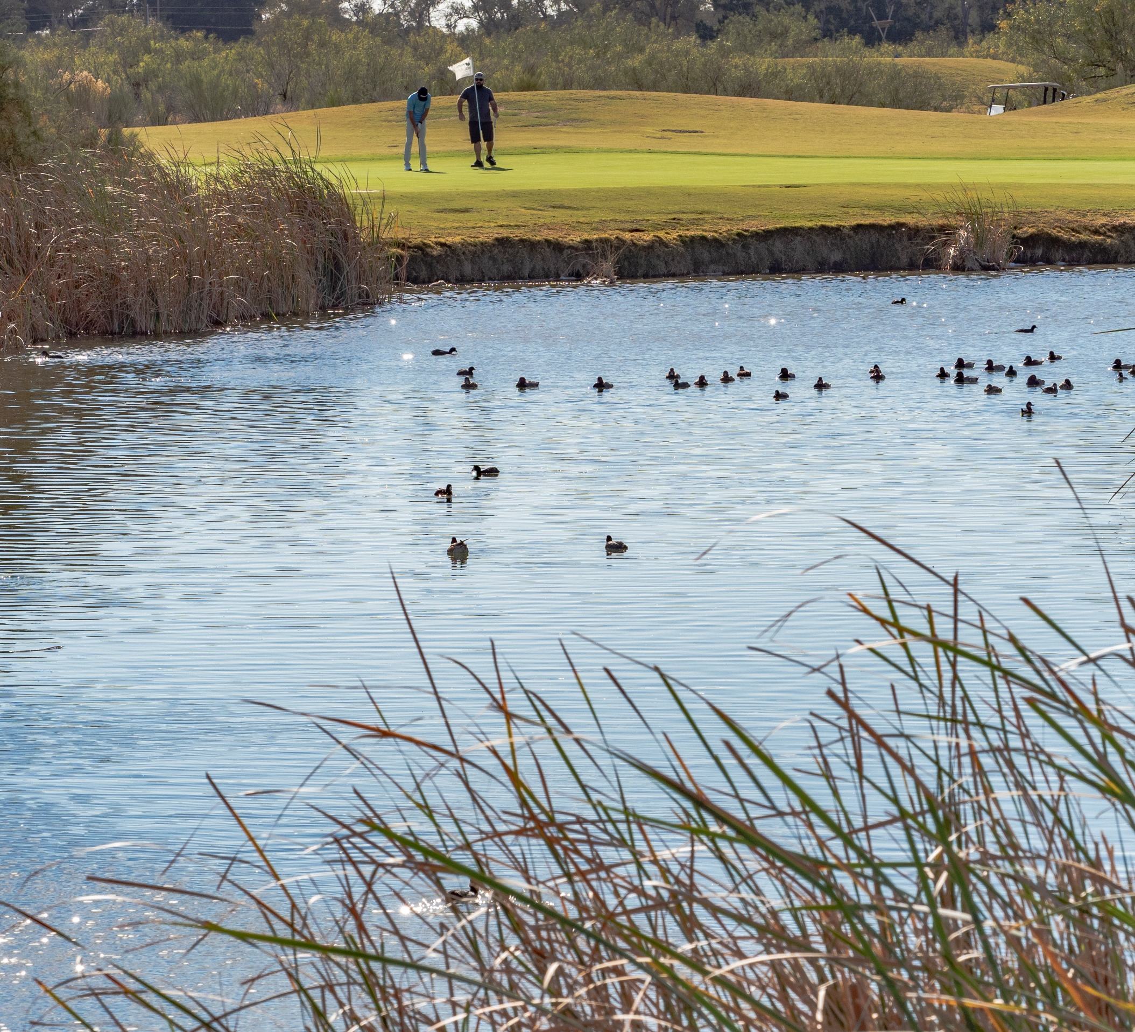
New Revenue for Improvements
Description | Annual New Revenue for Improvements*
Green Fees (including seniors discounts + tournaments) | $760,000
Cart Fees | $92,000
Rentals & Driving Range** | $107,000
Total | $959,000
*Estimates based on 2023 Hogan Park Golf Course usage
**New revenue generated by adjustments to equipment rentals and driving range fees not included in previous report
11

Slide 12
Next Steps
Consider adoption of Capital Funding Plan for Golf Course Improvements (Today)
Consider authorization to issue $11M in bonds to address immediate needs (Today)
Consider ordinance adopting rate realignment (June)
New rates go into effect July 1, 2024
New revenue generated by user fee rate realignment will fund needed capital improvements
12
Notes:
25 yr debt at 4.6 percent interest (although the 20 year was also supported – Hilltop will restructure schedule to provide relief on the first Principal payment to give time to accumulate surplus)
New Golf Fees begin July 1, 2024
First P&I payment will be March 1, 2025 (estimated $490k); interest only on September 1, 2025 (and all years after) (estimated $250k)
Total $750k per year payment estimated

Slide 13
MISSION
Deliver exceptional services and promote a high quality of life and place for ALL our citizens.
13

