Slide 1
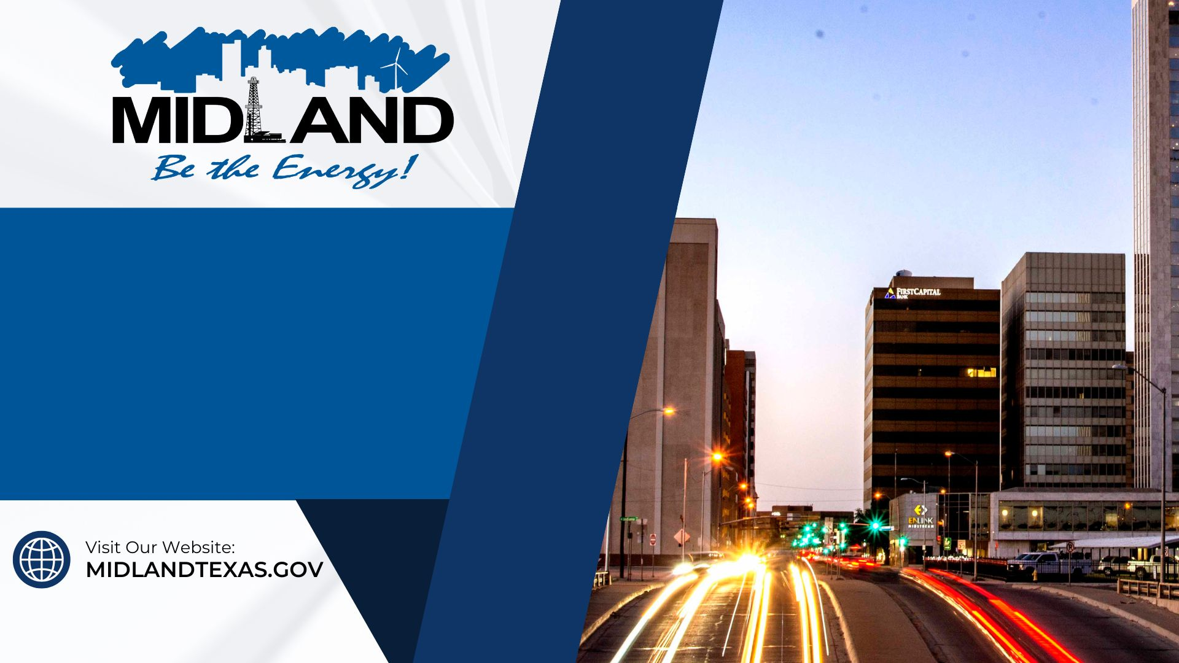
Comprehensive Water Strategy
May 14, 2024
1

Slide 2
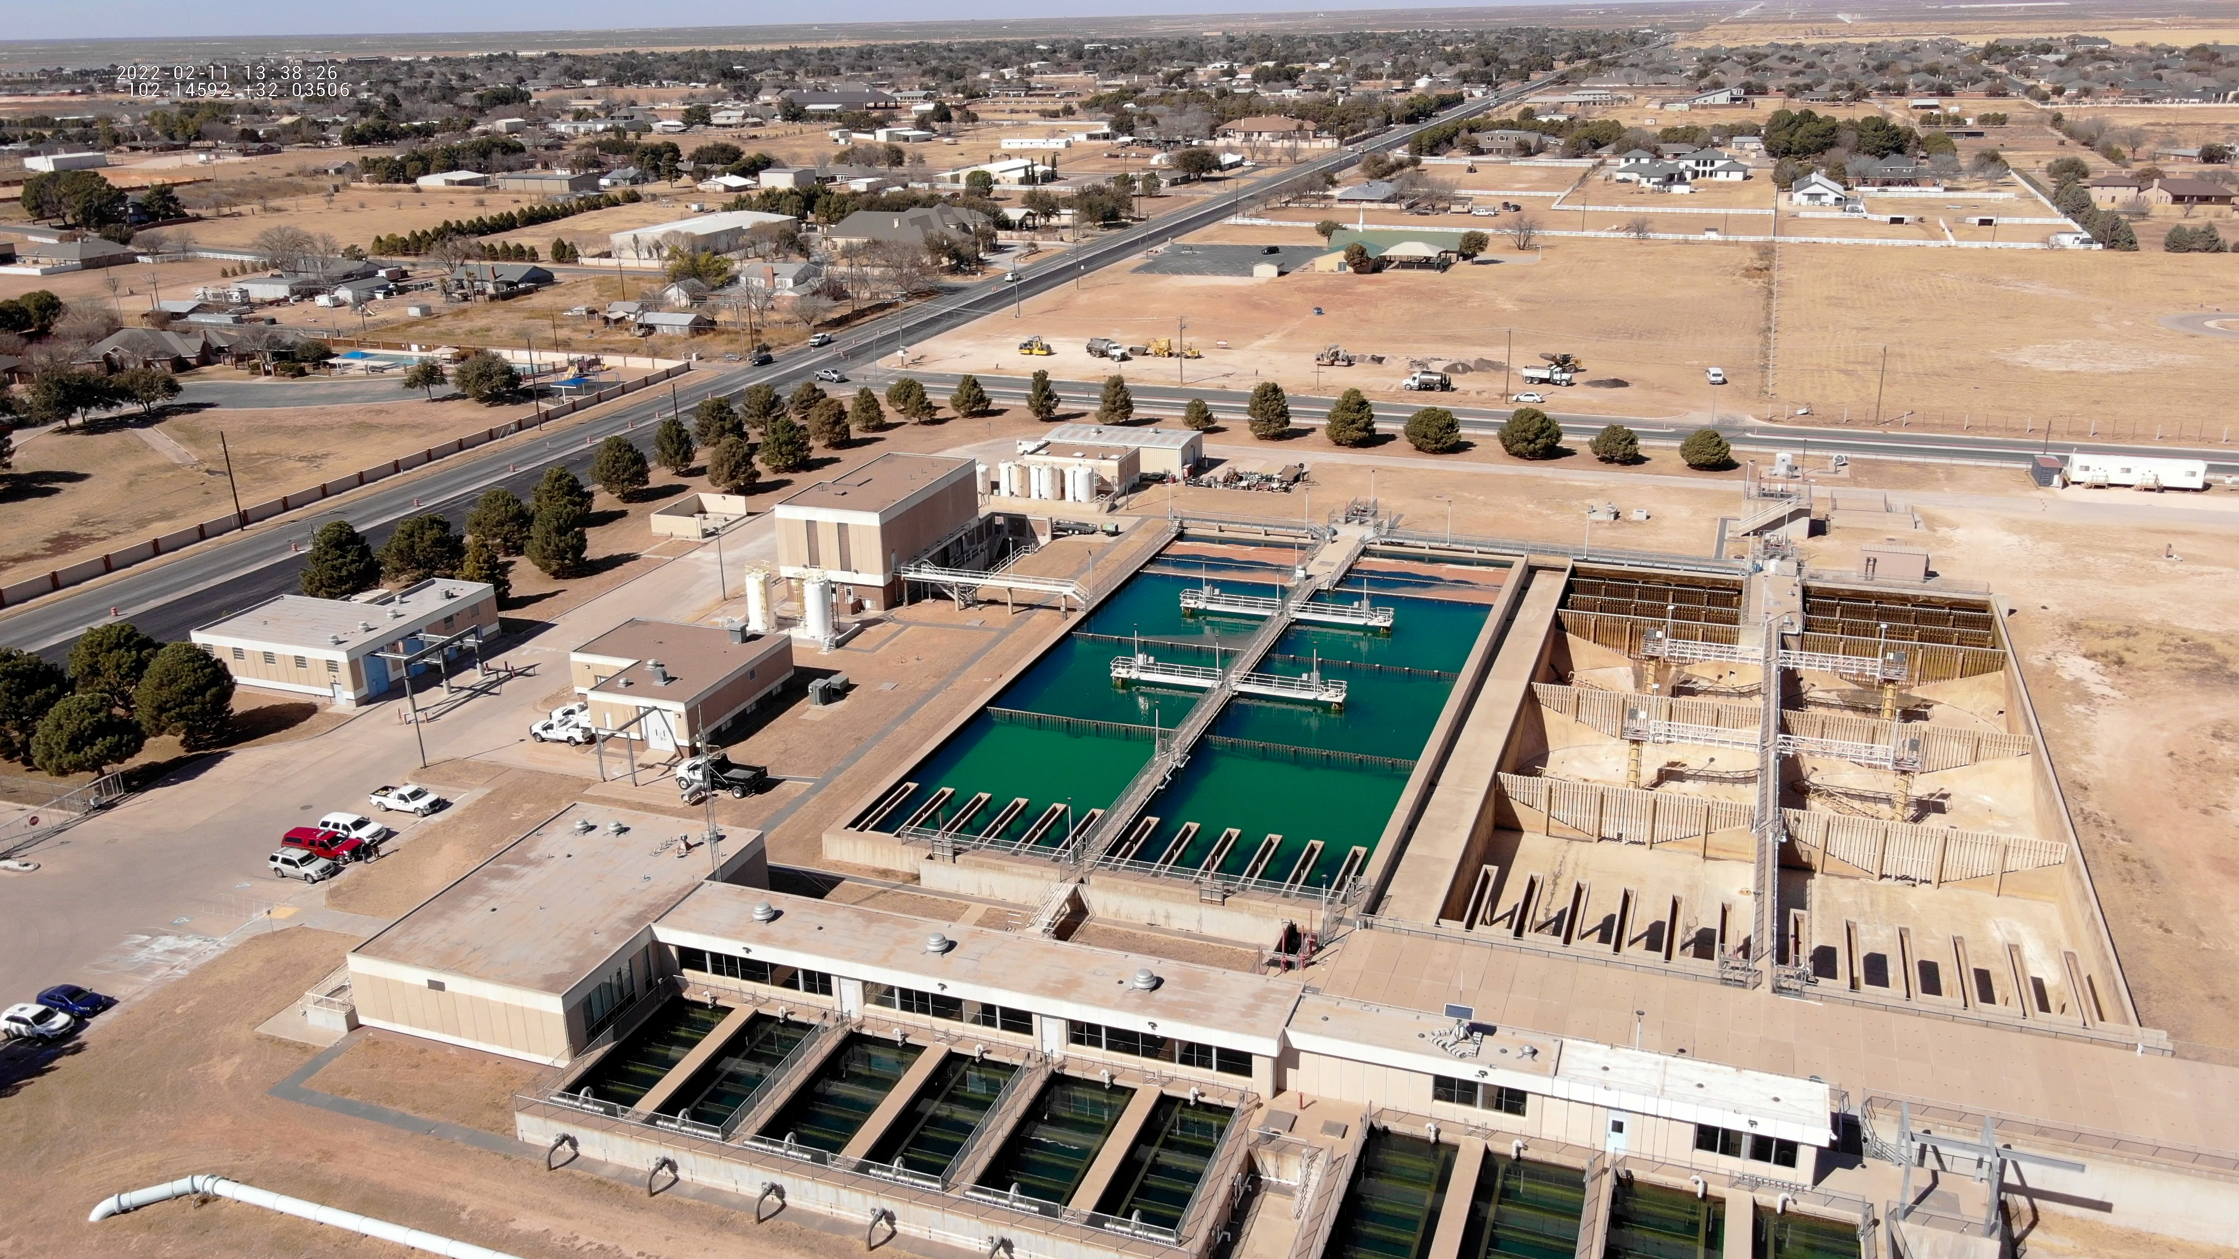

Presentation Outline
Strategic Goal Connections
Vision Block Connections
Strategic Initiatives
Vision for the Next Five Years
Sustainability: Future Water Investments
Infrastructure Modernization
Future Water Investments – Capital
Water Sources
Drought Preparation
Midland’s Water Reclamation Facility
Community Impact
2

Slide 3
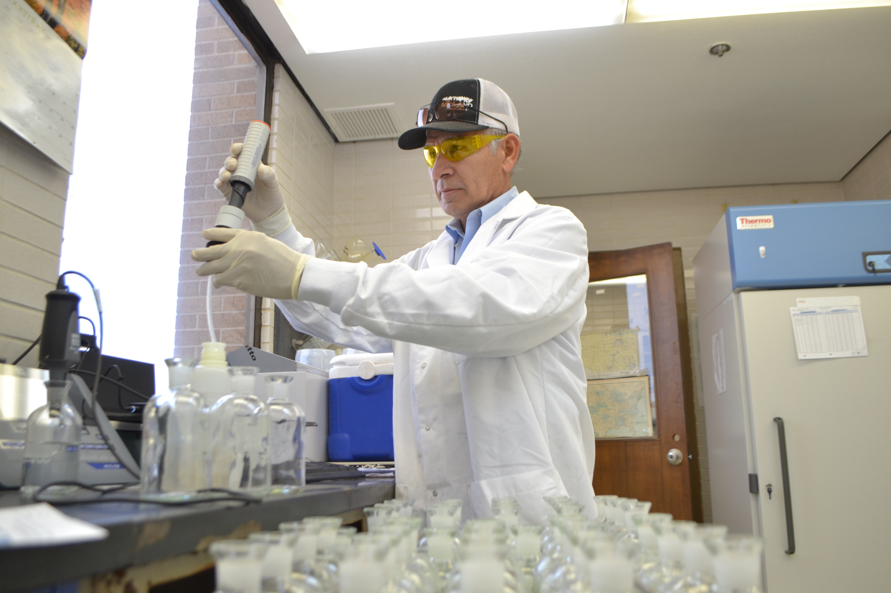
Strategic Goal Connections
Goal 6: Strengthen and Sustain our Infrastructure
6.1 Provide Reliable and Sustainable Utilities
Guarantee water supply and distribution systems security and longevity.
6.6 Strategize for and Monitor City Growth
Develop proactive responses to growth rather than reactive
3

Slide 4
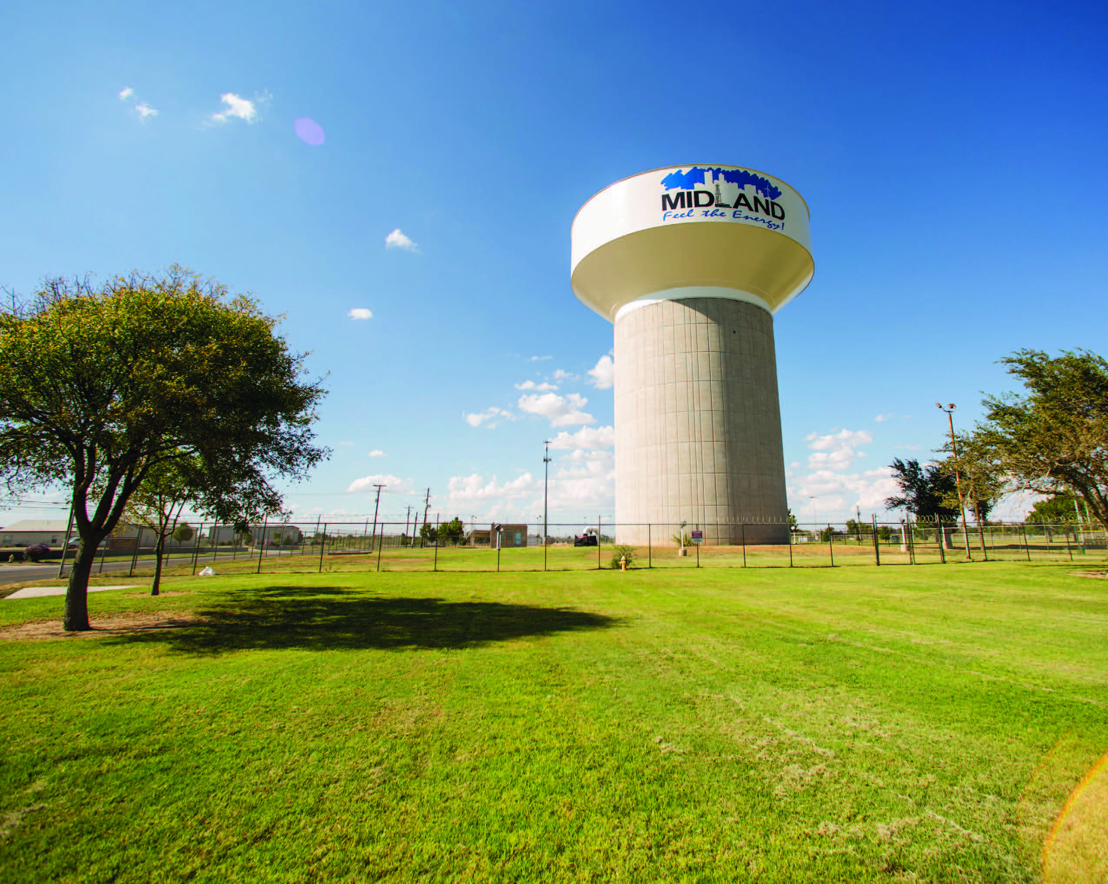
Vision Block Connections
Premier City
Goal #3: Quality of Life and Place
World Class Service
Goal # 6: Strengthen and Sustain our Infrastructure
4

Slide 5

Strategic Initiatives
Here’s What We Are Doing:
Ensuring 100 Years of Water Supply
Proactively renegotiating the CRMWD water supply contract before its expiration in 2030.
Taking Proactive steps evaluating potential water sources.
Enhancing Water Quality and Safety to Get to 75 Years of Water Supply
Evaluating advanced treatment options to meet health and environmental standards.
Reassessing Paul Davis water supply with these options to ensure a 75-year water supply with current assets.
Collaborative Regional Water Strategy
Developing an interlocal agreement with Abilene and San Angelo to utilize the Fort Stockton groundwater source.
Demonstrating regional cooperation to enhance water security.
5

Slide 6
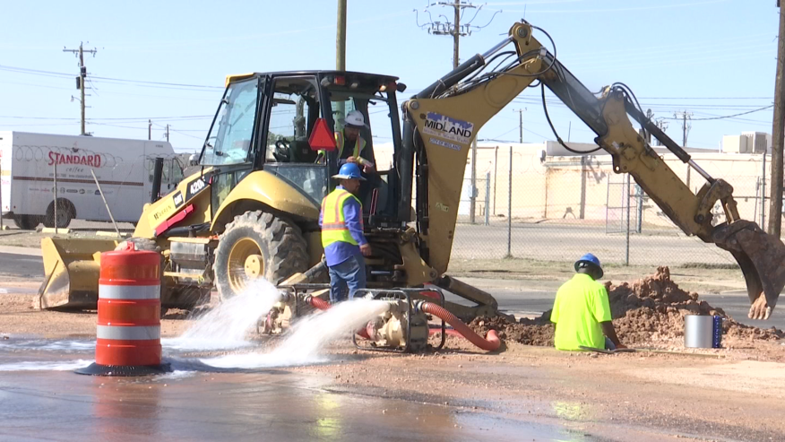
Vision for the Next Five Years
Future Planning and Sustainability
Future rate adjustments planned to reach 75 Year Water Supply & 100 Year Water Supply
Long-term investments to ensure resource efficiency
Innovative Water Reuse Projects
Exploring further uses of reclaimed water to reduce freshwater consumption and support industrial and agricultural needs.
Infrastructure Modernization Initiatives
Implementing satellite leak detection technology and transitioning to AMI smart meters for real-time water use data.
Focused annual investment of $6 million for replacing aging infrastructure and maintaining water quality.
6

Slide 7
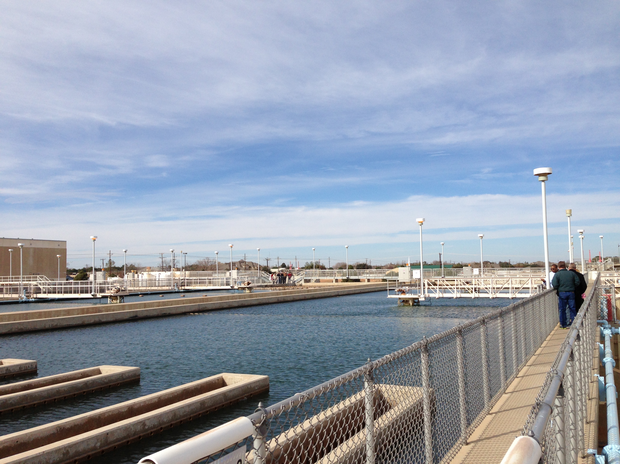
Sustainability: Future Water Investments
Necessity of Rate Increases: Anticipated rate adjustments are essential to accommodate the acquisition of the Fort Stockton groundwater source, rising chemical and labor costs, and inflation of material costs. The last utility rate increase was on October 1, 2018.
Structured Rate Increase Plan: A carefully studied and structured rate increase plan is proposed, with increments spread over the next 8 years, featuring adjustments every other year for financial predictability and stability.
Expert Rate Model Development: The rate model, constructed by Raftelis in 2020 and updated in 2022, forms the basis for these planned rate adjustments, ensuring they are data-driven and aligned with the city's needs.
7

Slide 8
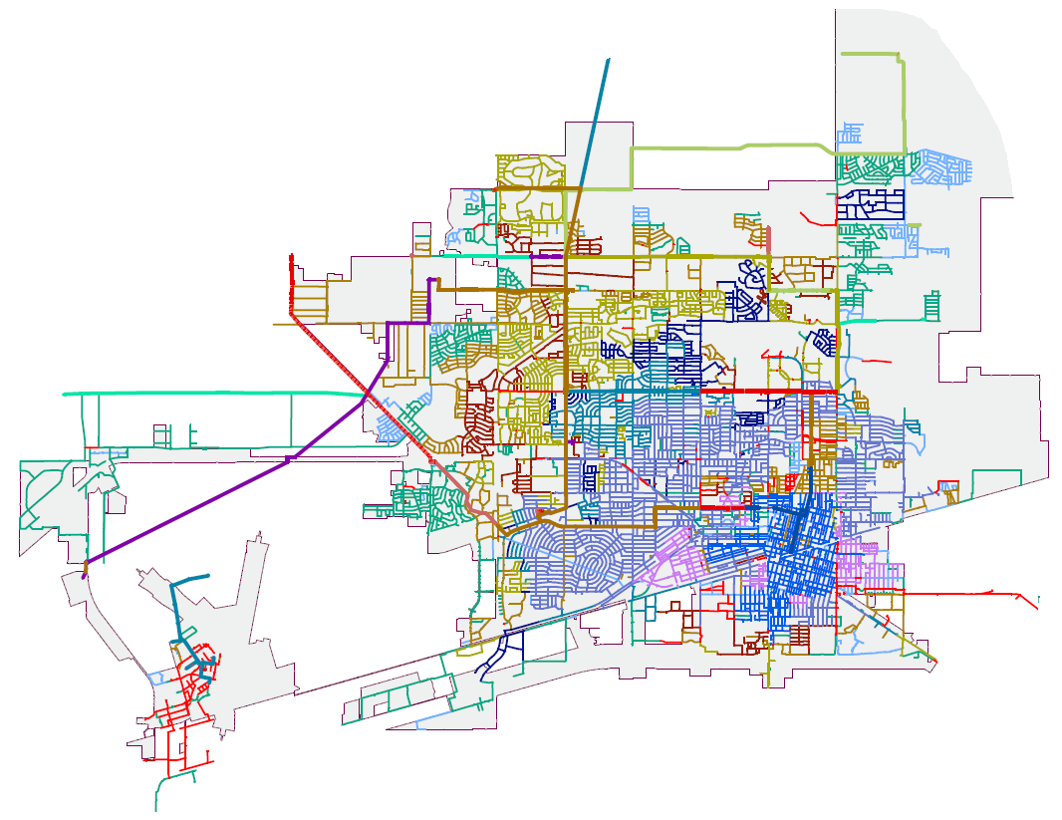
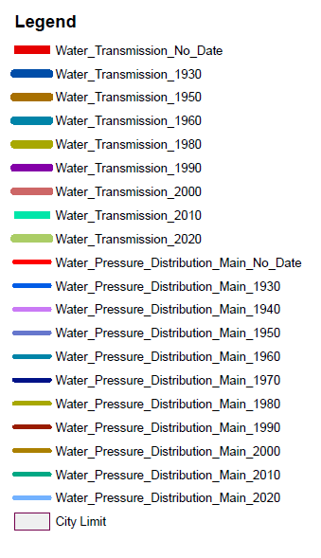
Infrastructure Modernization
8

Slide 9
Future Water Investments
Current Rate Structure
Does not pay operating & capital costs
5% Rate increase FY25, FY27, FY29
Covers Dept, operations, and planned maintenance
O&M
O&M
9

Slide 10
CO for Capital and Refunding
Refund NE Sewer Main
Phase 1 of advanced treatment of Paul Davis
Design and permitting of Sludge tank at WRF
Airport and Mockingbird lift stations
replacement.
5% Rate increase FY25, FY27, FY29
With $25 million bond FY25 $40 million FY28
Covers Dept, operations, and planned maintenance
O&M
10

Slide 11
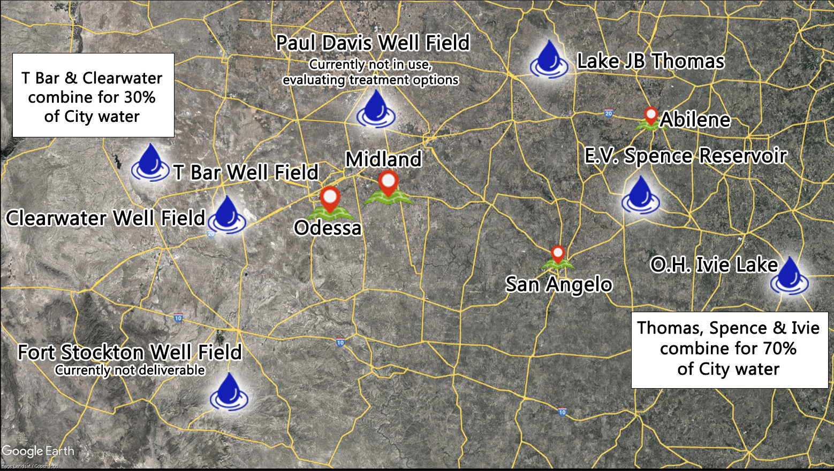
Water Sources
11

Slide 12
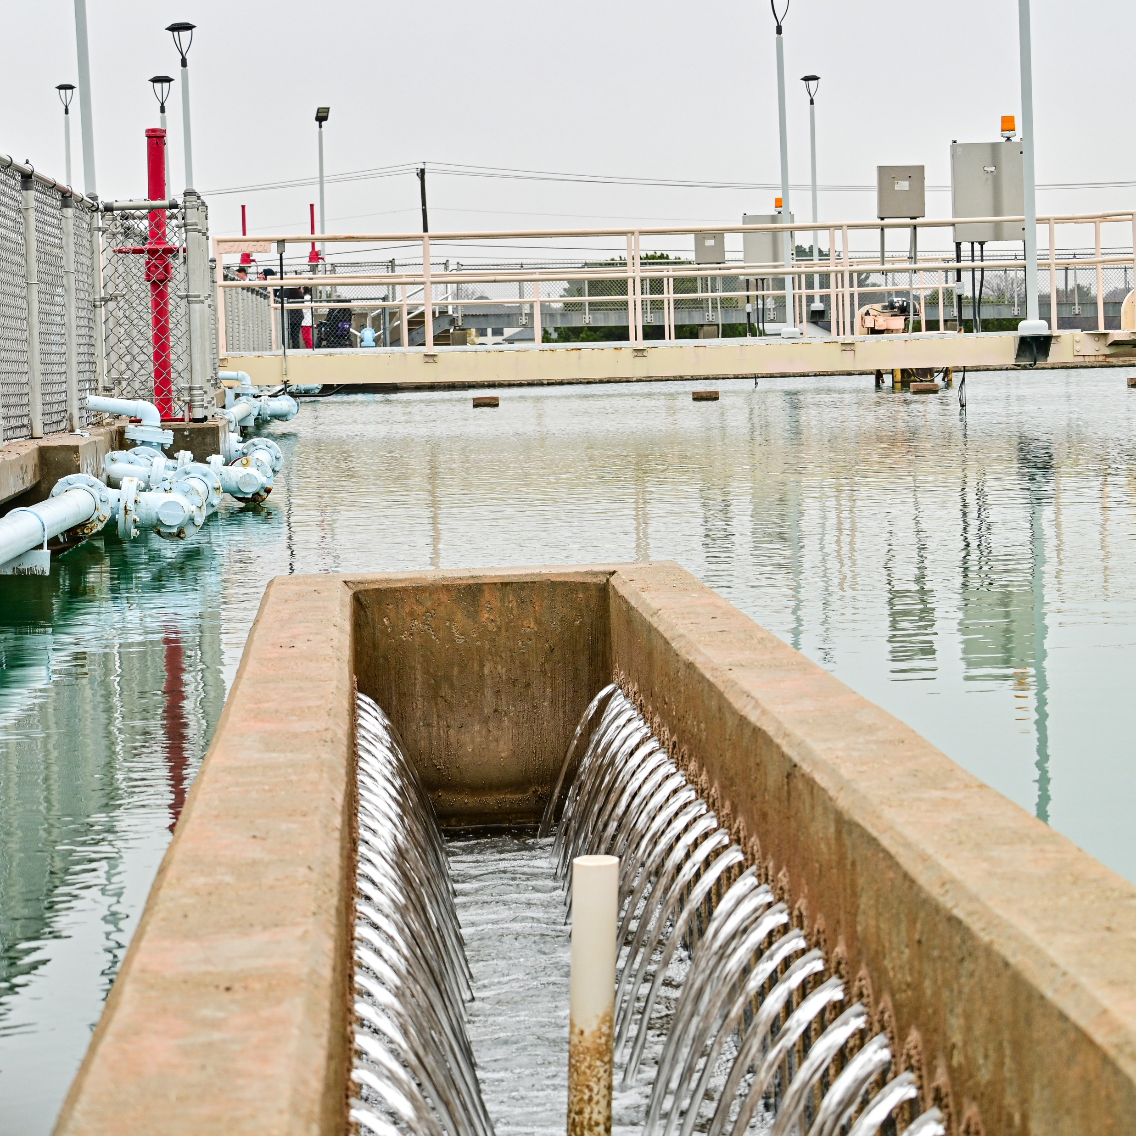
Water Sources
Surface Water Contracts: Midland secures approximately 70% of its water use through two contracts with the Colorado River Municipal Water District (CRMWD), highlighting the reliance on surface water.
Groundwater Sources: The T-bar Ranch (including Clearwater Ranch) provides about 30% of the city's water supply.
Evaluating New Sources: Efforts underway to integrate Fort Stockton groundwater ranch, Midland's newest water source, with routes being assessed to bring this additional supply to the city. The city searches for and evaluates for future sources to ensure and abundant supply.
12

Slide 13
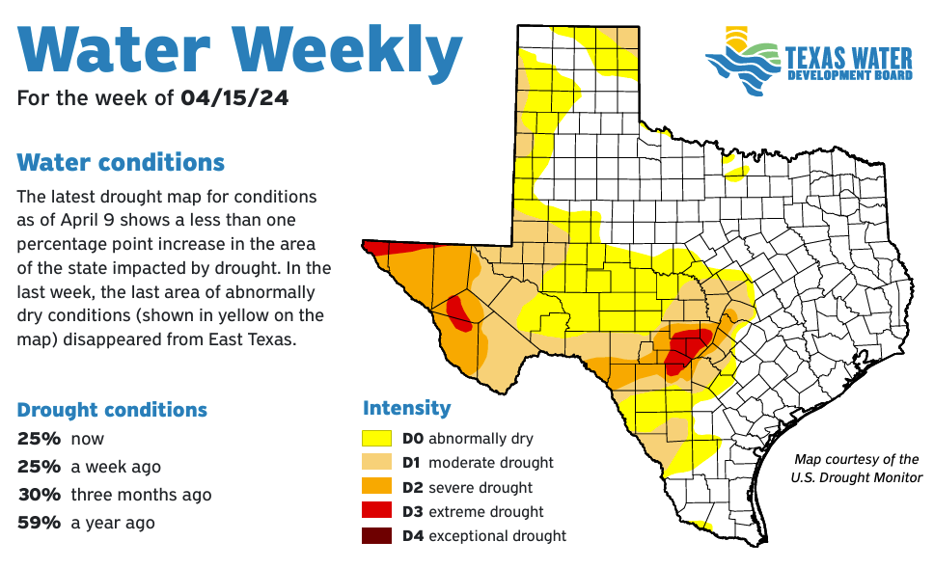
Drought Preparation
Proactive Drought Management Initiatives: Enhancing the Paul Davis groundwater source with the addition of five new public water wells and a new pump station.
Infrastructure Developments for Sustainable Water Use: Launched an RFP for advanced treatment technologies aimed at increasing the use of our groundwater sources.
Adjustment of Watering Schedule as a Precautionary Step: Revising the City’s outdoor watering schedule, reducing watering days from four to three per week.
13

Slide 14
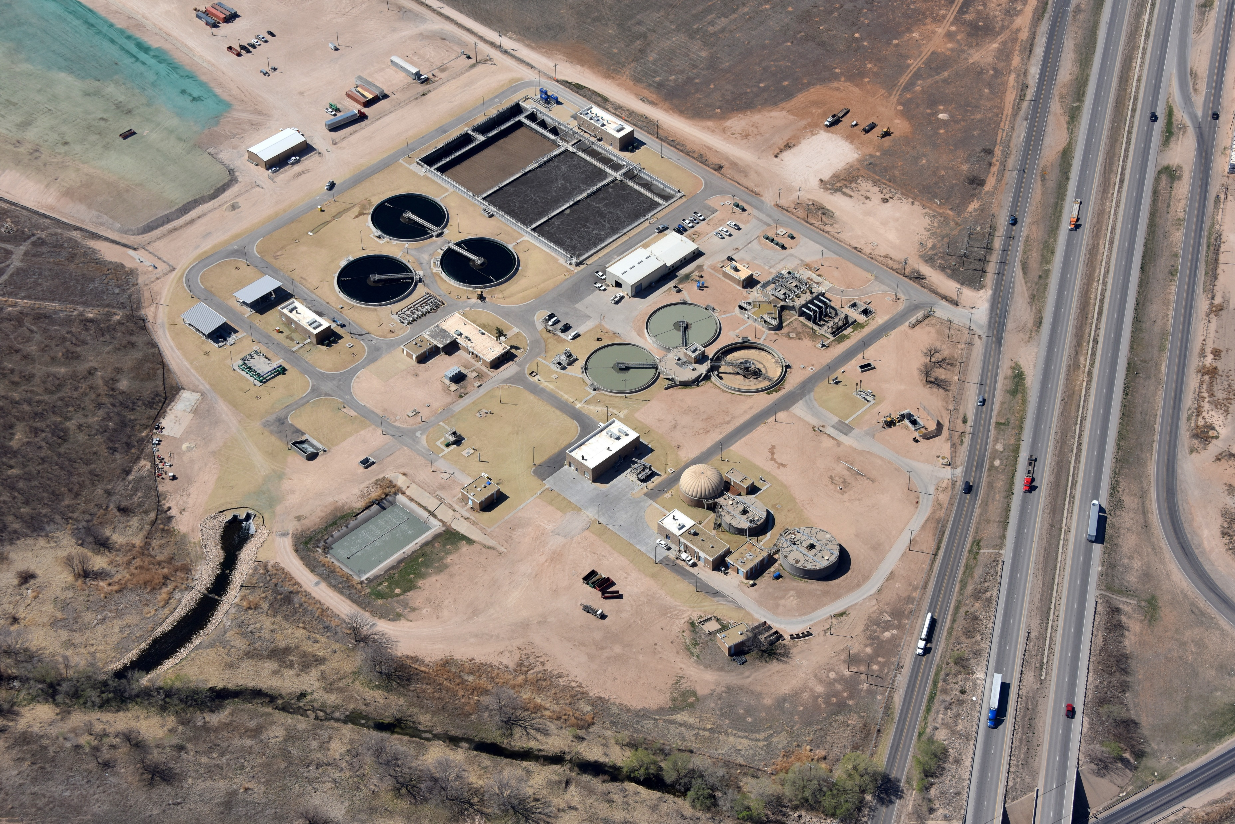
Midland's Water Reclamation Facility
Reclaimed Water for Industry: The treatment facility focuses on reclaiming wastewater to be utilized by Pioneer Natural Resources in the oil industry, showcasing a symbiotic relationship between the city and local businesses.
State-of-the-Art Facility Upgrade: A significant upgrade in partnership with Pioneer 4 years ago has modernized the plant, incorporating Bioreactor basins, cloth disk filtration, and UV treatment trains to enhance the treatment process.
Commitment to Sustainability: These advancements reflect Midland's commitment to sustainable practices, reducing freshwater consumption in industrial activities, and leading in environmental stewardship.
14

Slide 15
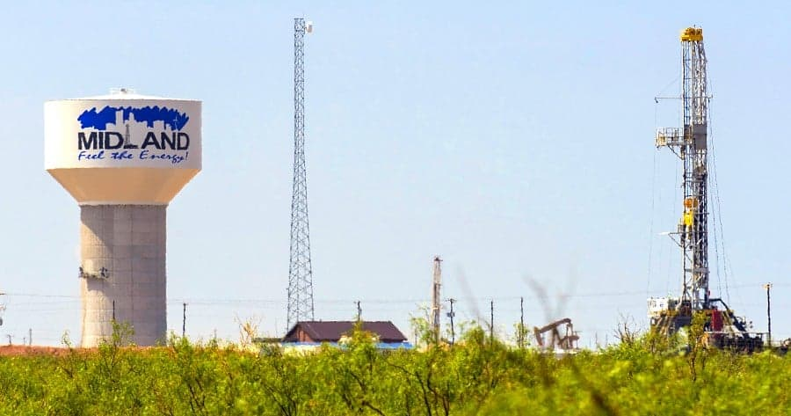
Community Impact
Water and wastewater planning is essential for Midland’s current operations and future welfare, ensuring reliable services crucial for health, economy, and ecosystem protection.
This planning supports sustainable growth and prepares the city to manage drought, infrastructure stress, and population increases, all of which contribute to long-term community prosperity.
15

Slide 16
MISSION
Deliver exceptional services and promote a high quality of life and place for ALL our citizens.
16

