Slide 1

Financing the Water Strategy
May 28, 2024
1

Slide 2
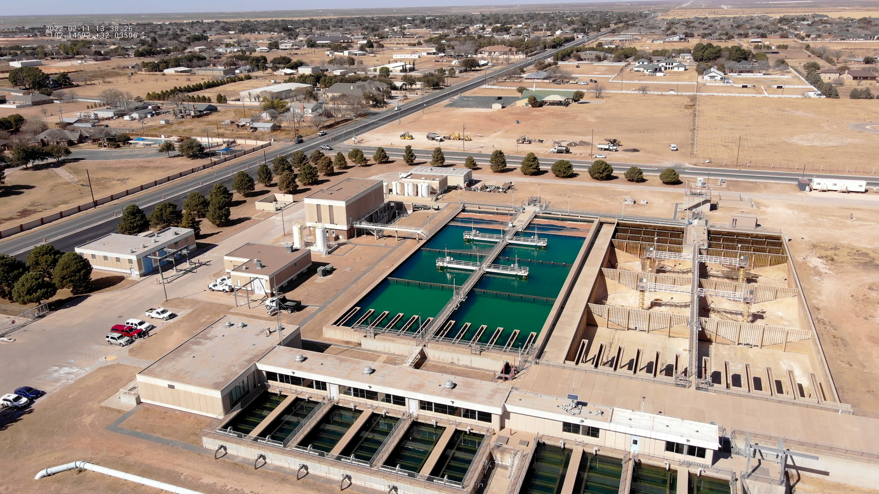

Presentation Outline
Strategic Goal Connections
Vision Block Connections
Sustainability: Future Water Investments
Bonds for Capital and Refunding
Financing Strategy: Rate Adjustment
Community Impact
2

Slide 3
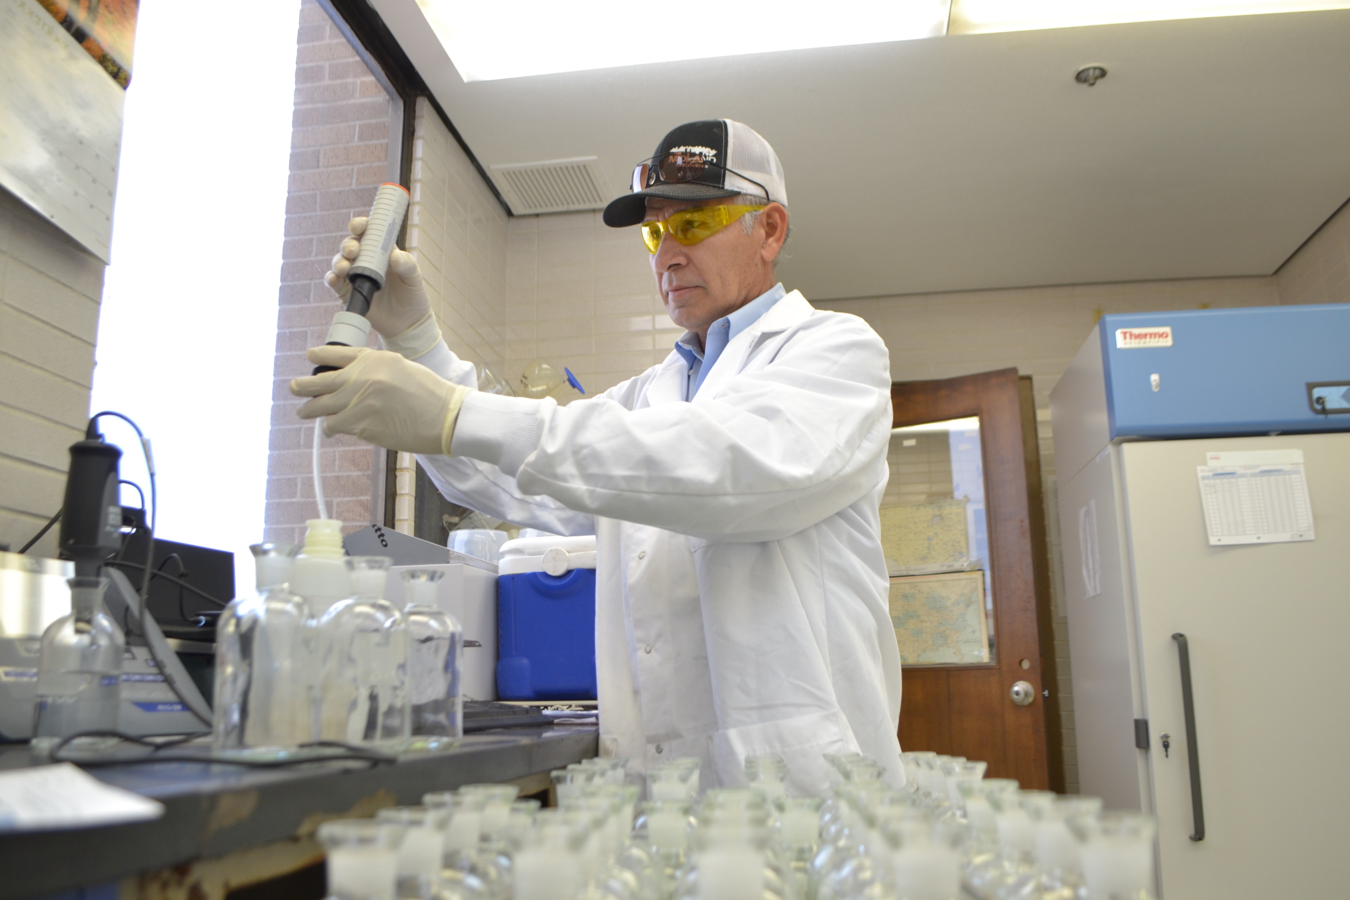
Strategic Goal Connections
Goal 6: Strengthen and Sustain our Infrastructure
6.1 Provide Reliable and Sustainable Utilities
Guarantee water supply and distribution systems security and longevity.
6.6 Strategize for and Monitor City Growth
Develop proactive responses to growth rather than reactive
3

Slide 4
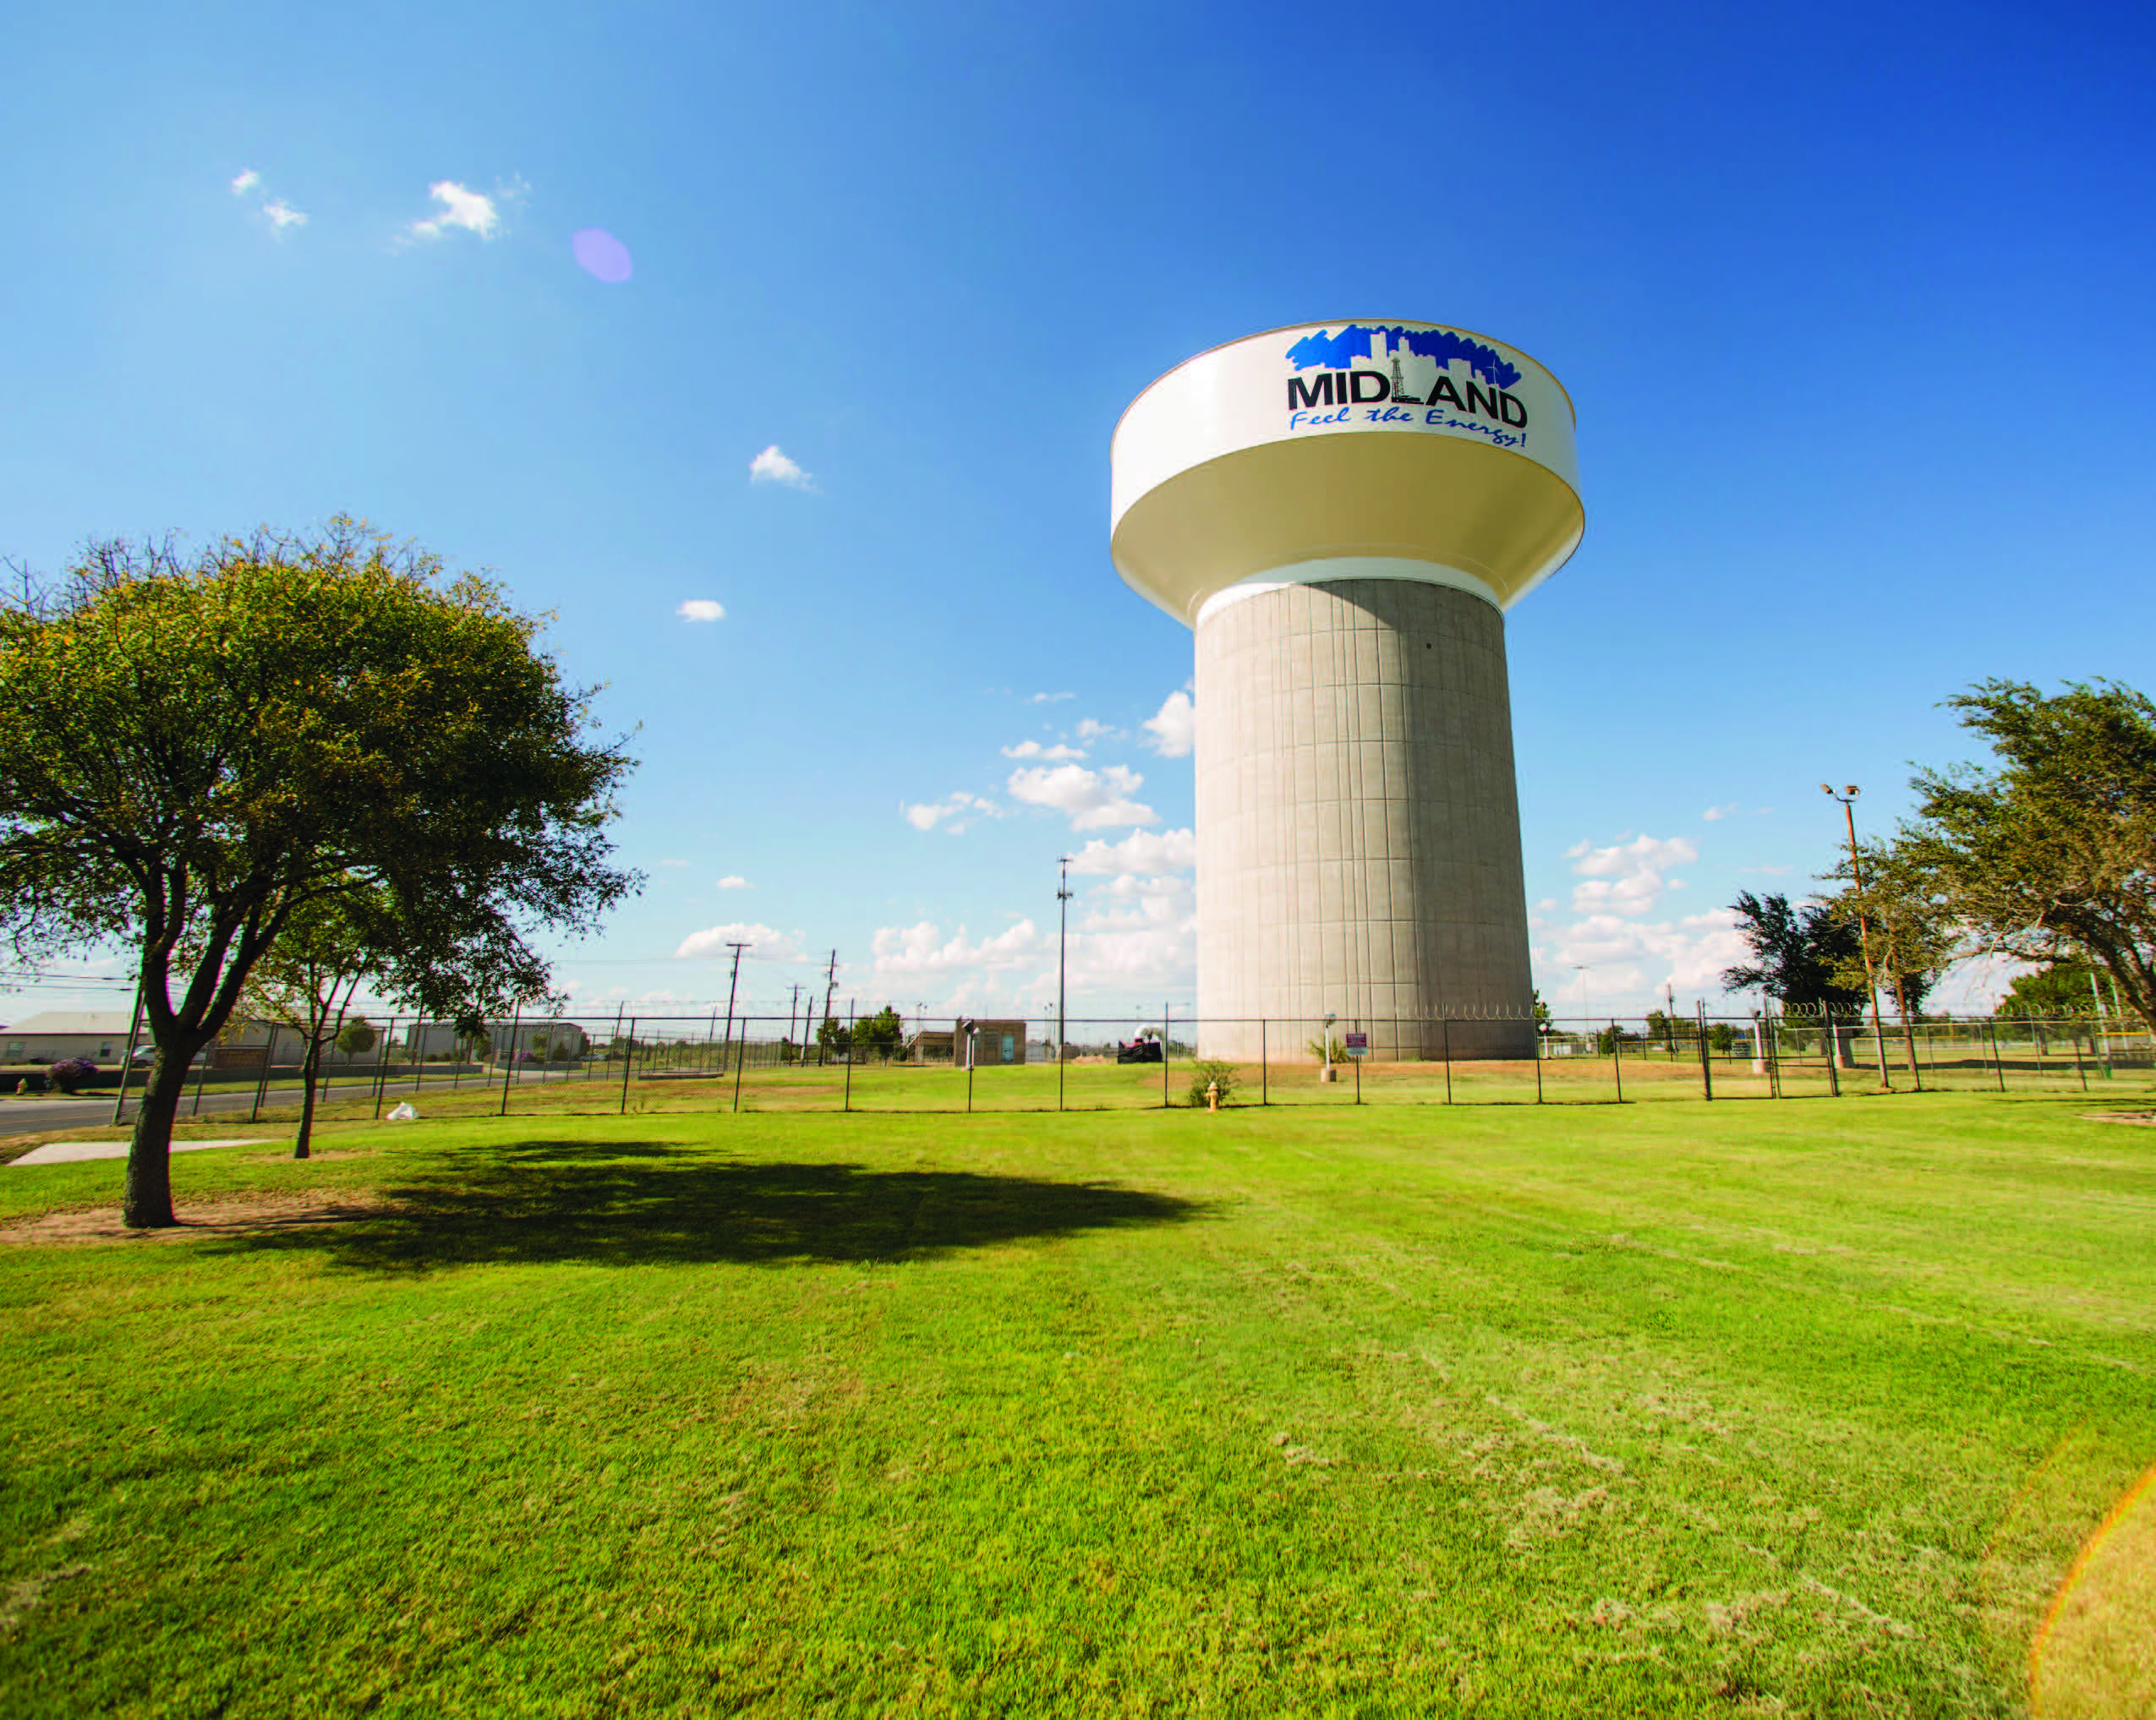
Vision Block Connections
Premier City
Goal #3: Quality of Life and Place
World Class Service:
Goal # 6: Strengthen and Sustain our Infrastructure
4

Slide 5

Strategic Initiatives
Here’s What We Are Doing:
Ensuring 100 Years of Water Supply
Proactively renegotiating the CRMWD water supply contract before its expiration in 2030.
Taking Proactive steps evaluating potential water sources.
Enhancing Water Quality and Safety to Get to 75 Years Water Supply
Evaluating advanced treatment options to meet health and environmental standards.
Reassessing Paul Davis water supply with these options to ensure a 75-year water supply with current assets.
Collaborative Regional Water Strategy
Developing an interlocal agreement with Abilene and San Angelo to utilize the Fort Stockton groundwater source.
Demonstrating regional cooperation to enhance water security.
5

Slide 6
Sustainability: Future Water Investments
Capital Project Bond Funding:
FY25 refunding and funding of capital projects
FY28 funding of advanced treatment and Sludge handling
Rate Adjustments:
FY25 Catchup increase
FY26-29 Annual increases
6

Slide 7
Bonds for Capital and Refunding
FY25 $25 million for Project construction and Refunding
Refund NE Sewer Main: $16 Million
Airport Wastewater Lift Station Construction: $3 Million
Wadley (I to Garfield) Utility Construction: $3 Million
Golf Course at Scharbauer Utility Construction: $3 million
FY28 $40 Million Funding
Design, permitting, and construction of Sludge tank at WRF $10 Million
Phase I Paul Davis Advanced Treatment $30 Million
7

Slide 8
Financing Strategy: Rate adjustments
The City of Midland hasn’t increased utility rates since October 2018.
A study performed by Raftelis in 2020 outlined that Rates needed to be adjusted annually.
During the Raftelis study Utilities received a Rate model allowing through 2029 for Utilities to perform
the rate study.
The City of Midland’s rates are below the mid-point of similar sized City’s for combined utility rates:
8

Slide 9
Financing Strategy: Rate adjustments
Proposed Rate Adjustment:
FY25 5% rate increase
FY26-29 2.5% annual Rate increase
Current Water Rates (Effective July 1, 2020) |  | 5%
Monthly Base Rate (includes 2,000 gallons) | $21.61 | $22.69
Apartment Monthly Base Rate Per Unit (includes 2,000 gallons) | $17.60 | $18.48
Gallons 2,000 and under* | Included
Gallons 2,001 to 10,000* | $6.11 | $6.42
Gallons 10,001 to 25,000* | $8.03 | $8.43
Gallons Above 25,000* | $10.80 | $11.34
Gallons Above 50,000* | $13.50 | $14.18
*Rates are per 1,000 gallons after the first 2,000 gallons.
Current Sewer Rates (Effective July 1, 2020) |  | 5%
Monthly Base Rate (includes 2,000 gallons per connection/unit) | $21.79 | $22.88
Rate per 1,000 gallons (after initial base rate/2,000 gallons)* | $0.88 | $0.92
*based on customer’s winter quarter average
9

Slide 10
Financing Strategy: Rate adjustments
Current Rate Structure
Does not pay operating & capital costs
Proposed rate
With $25 million bond FY25 $40 million FY28
Covers Dept, operations, and planned maintenance
O&M
O&M
10

Slide 11
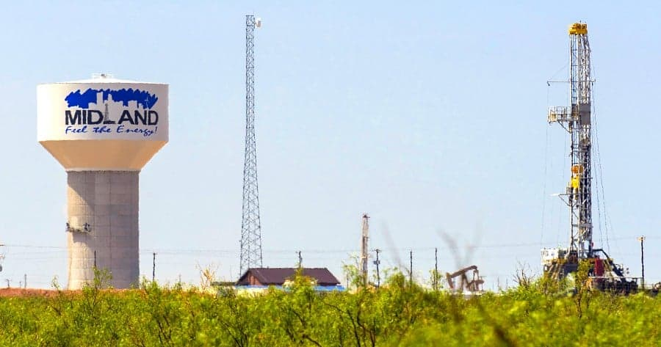
Community Impact
Water and wastewater planning is essential for Midland’s current operations and future welfare, ensuring reliable services crucial for health, economy, and ecosystem protection.
This planning supports sustainable growth and prepares the city to manage drought, infrastructure stress, and population increases, all of which contribute to long-term community prosperity.
11

Slide 12
MISSION
Deliver exceptional services and promote a high quality of life and place for ALL our citizens.
12

