Slide 1

All Funds Summary
May 28, 2024
1

Slide 2

What we will cover
General Fund – Parent Fund
Enterprise Funds – Need to be Self Sustaining
Internal Service Funds
Special Revenue Funds
2

Slide 3
Strategic Goal Connections
Goal 5: Provide Sound Governance & Fiscal Management
5.7 Ensure Continued Financial Stability and Accountability: Maintain financial transparency.
3

Slide 4
General Fund
Main Operational Fund of a Municipality
Includes Police, Fire, Streets, Parks and Recreation, and Animal Services
Parent Fund – must support all funds if they are not sustained
Must maintain reserve to shield against economic instability – 120 days
4

Slide 5
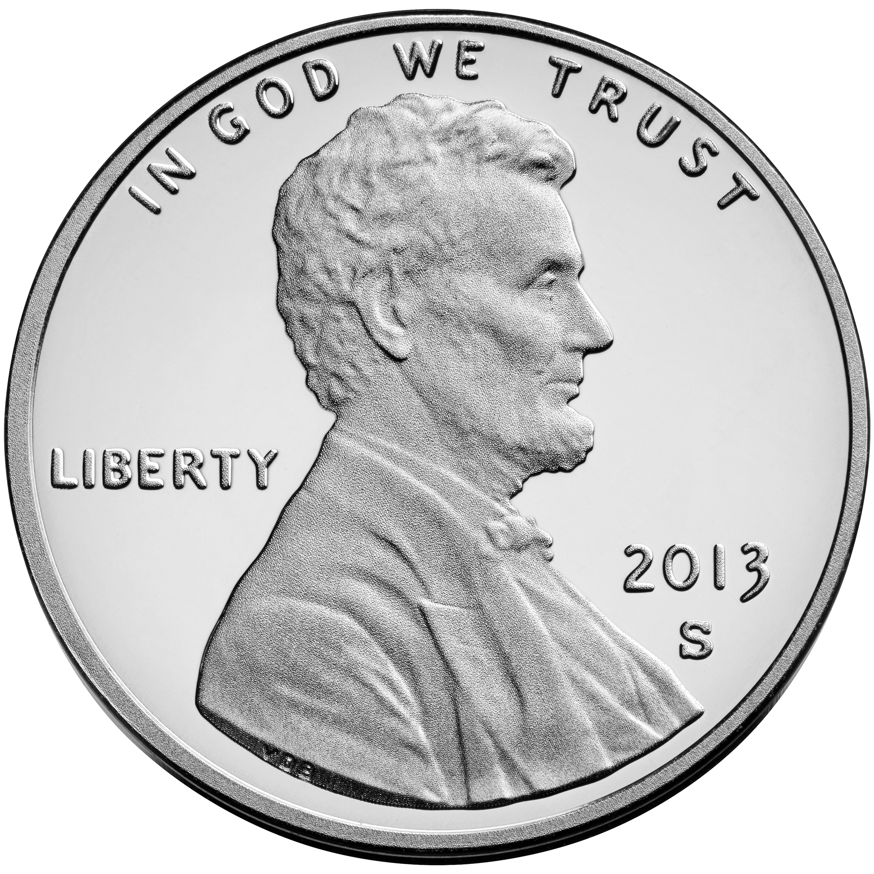
General Fund
1.25%
Revenue Streams:
Property Taxes
Sales Tax
Fines and Fees for Services
City Sales Tax 1.25% - most cities enjoy full 2%
Midland County, .50%
Midland Memorial Hospital, .25%
This loss amounts to $48M Annually
County
City
Hospital
5

Slide 6
Sales Tax – City of Midland
1.25%
City
County
Hospital
Most Cities get Full 2.0%
6

Slide 7
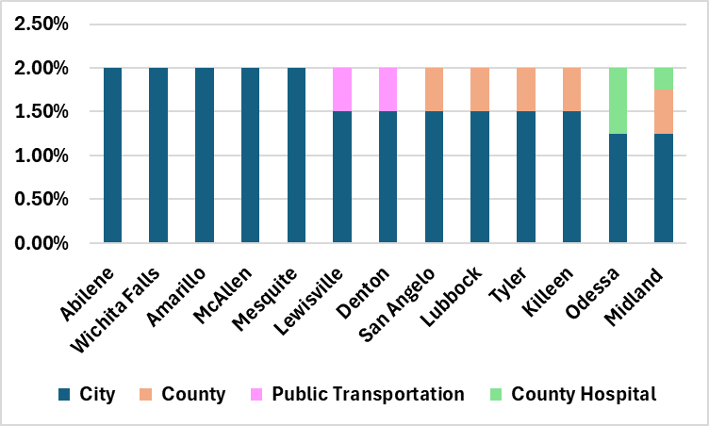
Sales Tax Rates by City
1.25%
7

Slide 8
General Fund Needs
Police and Fire Staffing & Compensation
Public Safety Equipment
Streets Maintenance - $35 M
Parks Maintenance - $11.6 M
Decreased General Fund Revenue Consequences:
Deteriorating Infrastructure, Roads, Utilities
Maintaining Parks, Community Centers, Attractions to the City
Less flexibility to address emergencies or downturns
Necessitates Prioritization of Needs
8

Slide 9
Enterprise Funds
Airport
Water & Sewer
Sanitation
Drainage
Golf Course
Sports Complex
9

Slide 10
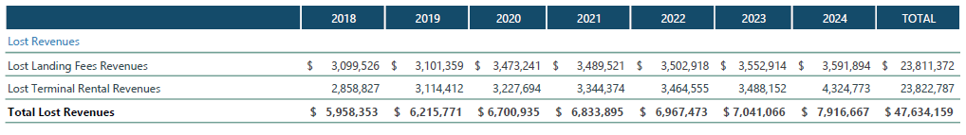
Enterprise Funds - Airport
Rates and Charges study shows rates have not remained consistent with industry standards
The airport has been subsidized for several years by the General Fund – the Parent due to inadequate fees
$47 Million in Lost Revenue since 2018 in Landing Fees and Terminal Rental Revenues
Airport Needs Include: Parking, Runway Extensions, Gates, Customs Building
$47M
10

Slide 11
Airline Cost Per Enplanement
Airport | 2018 | 2019 | 2020 | 2021 | 2022
MAF | $2.08 | $2.84 | $3.00 | $3.47 | $2.53
AMA | $7.28 | $8.64 | $15.46 | $13.09 | $10.16
BHM | $12.22 | $11.03 | $13.76 | $18.69 | $12.72
LBB | $8.86 | $8.17 | $12.03 | $10.25 | $8.64
LEX | $10.66 | $10.23 | $11.36 | $13.57 | $11.64
LIT | $10.59 | $10.76 | $19.68 | $12.20 | $11.41
JAN | $12.11 | $11.13 | $19.52 | $15.23 | $11.83
11

Slide 12
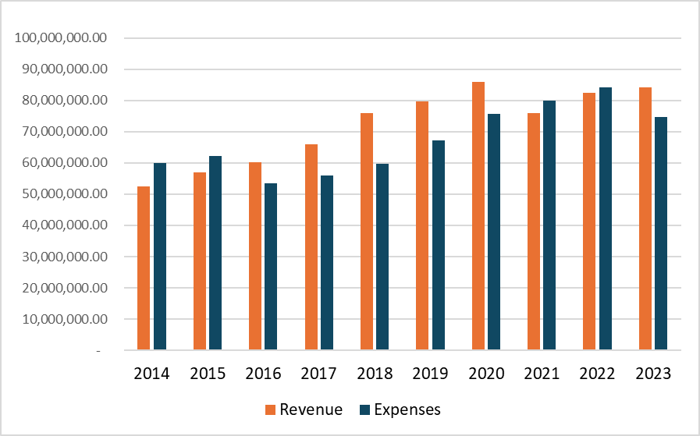
Enterprise Funds – Water & Sewer
Responsible for Safe and Efficient Water Sourcing for the Community – Now and into the Future
Historically Sound – Many Projects Funded from Cash
Projections for 2024 Show a Shift with Expenses Outpacing Revenue
Inflation has Affected the Costs of Labor, Materials and Construction
12

Slide 13
Water & Sewer Capital Needs
Projects and System Modernization needed in 2025
Refund NE Sewer Main: $16 Million
Airport Wastewater Lift Station Construction: $ 3 Million
Wadley (I to Garfield) Utility Construction: $ 3 Million
Golf Course Road at Scharbauer Utilities: $ 3 Million
$25 Million
13

Slide 14
Enterprise Funds – Drainage Fund
Established in 2018 – fees began in 2019
Annual revenue of $2.5 Million
Projects include a 5-year plan of $5.5 million out of $75M identified needs
Continual escalation of costs for improvement projects is a challenge
14

Slide 15
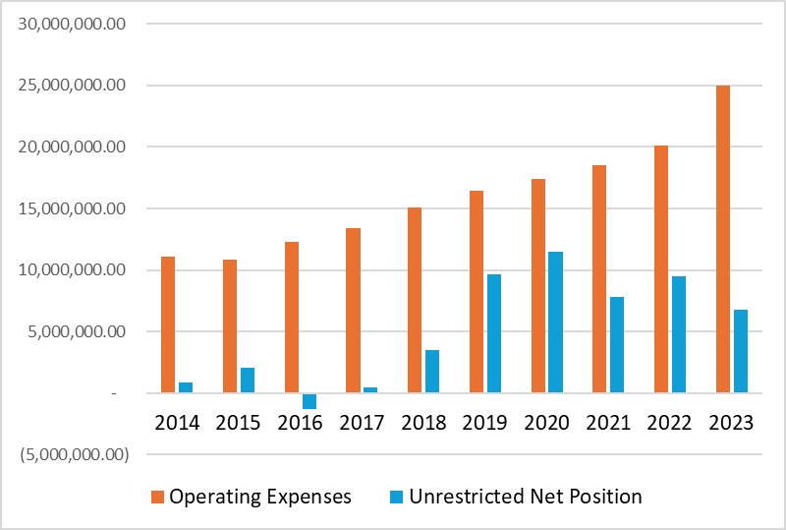
Enterprise Funds - Sanitation
Plays an Important Role in Health and Public Safety of the Community and the Environment
Pay as you go for Projects has Left Limited Cash Reserves
Maintain Twice a Week
Service
Double Citizen
Convenience Center
Location
Triple Landfill Lifespan
15

Slide 16
Sanitation Capital Needs
$11.5M 2025 needs
16

Slide 17
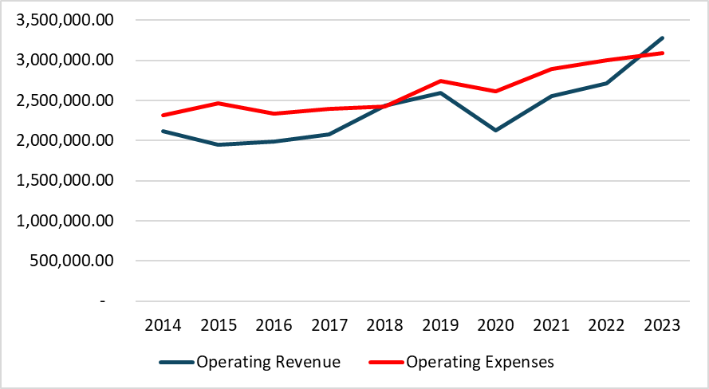
Hogan Golf Course Fund
Has Hovered around Break Even for Years – Historically Relied on General Fund for Shortfalls
Backlog of Course and Facility Improvements
Rates not in Step with Industry Standards
Influx of Added Rounds Per Year Expected
17

Slide 18
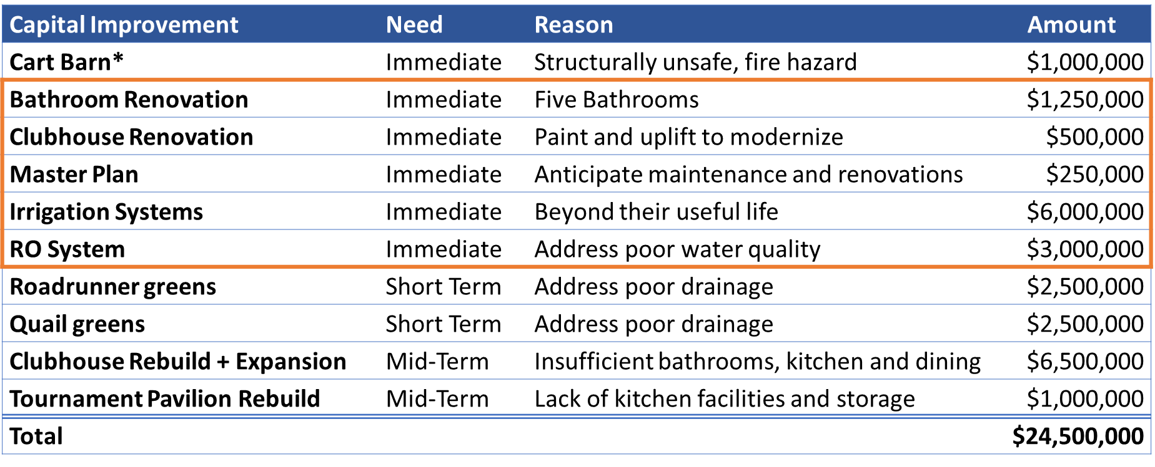
Hogan Golf Course Capital Needs
*Included in FY24 Budget
18

Slide 19
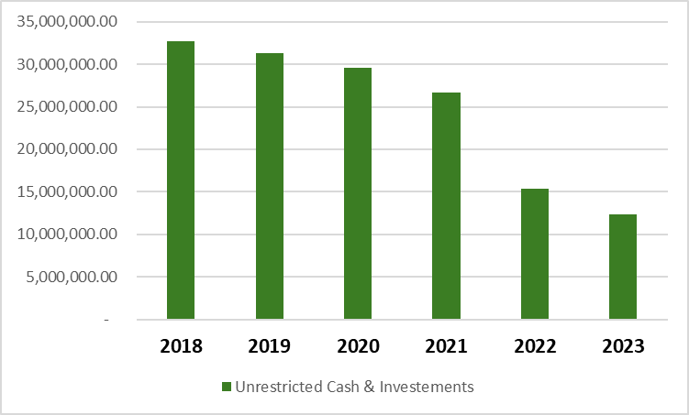
Sports Complex
Fund Balance Left from 4B Sales Tax is Dwindling – 3 Years
Expenses Outpace Revenue Each Year; Improvements Funded by Fund Balance
TIRZ Being Considered for Revenue for Construction and Related Maintenance
19
Notes:
Cessation of 4B Sales Tax

Slide 20
Internal Service Funds
20
Notes:
Charge Backs
Revenue Sources Come from the external serving departments

Slide 21
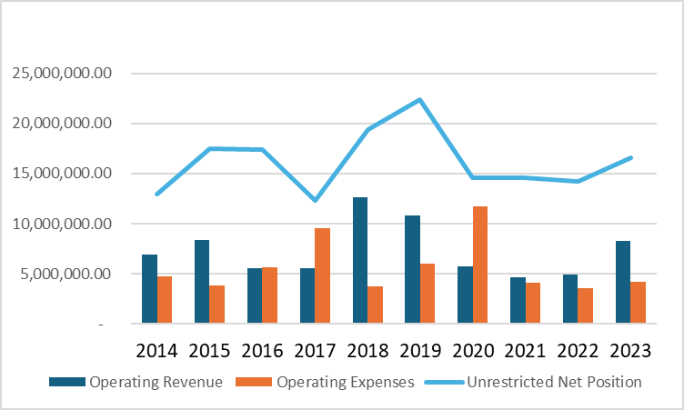
Special Revenue Funds – Hotel / Motel
Promotes Tourism and the Convention and Hotel Industry
Revenue Climbing Back after Drop During COVID
Maintains a Healthy Fund Balance - $15 M; Expenses Decided by Committee
21

Slide 22
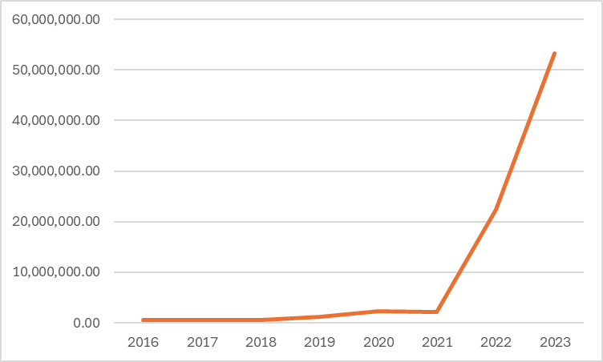
Special Revenue Funds – Parks Oil & Gas
Oil & Gas Revenues were Historically able to be used for other General Fund Operational Items Including Infrastructure needs.
Council Had Dedicated this fund to Parks Special Projects & Improvements
22
Notes:
Add slide after this with graph after this slide to show the amounts spent on RMN and Beal Parks and what the fund is doing with these monies now and actively.

Slide 23
Special Revenue Funds – Oil & Gas
Beal Park Expense estimates for the next 3 years: 2025 $15.5M
2026 $ 8.5M
2027 $ 1.0M
$25.0M
23
Notes:
Add slide after this with graph after this slide to show the amounts spent on RMN and Beal Parks and what the fund is doing with these monies now and actively.

Slide 24
MISSION
Deliver exceptional services and promote a high quality of life and place for ALL our citizens.
24

