Slide 1
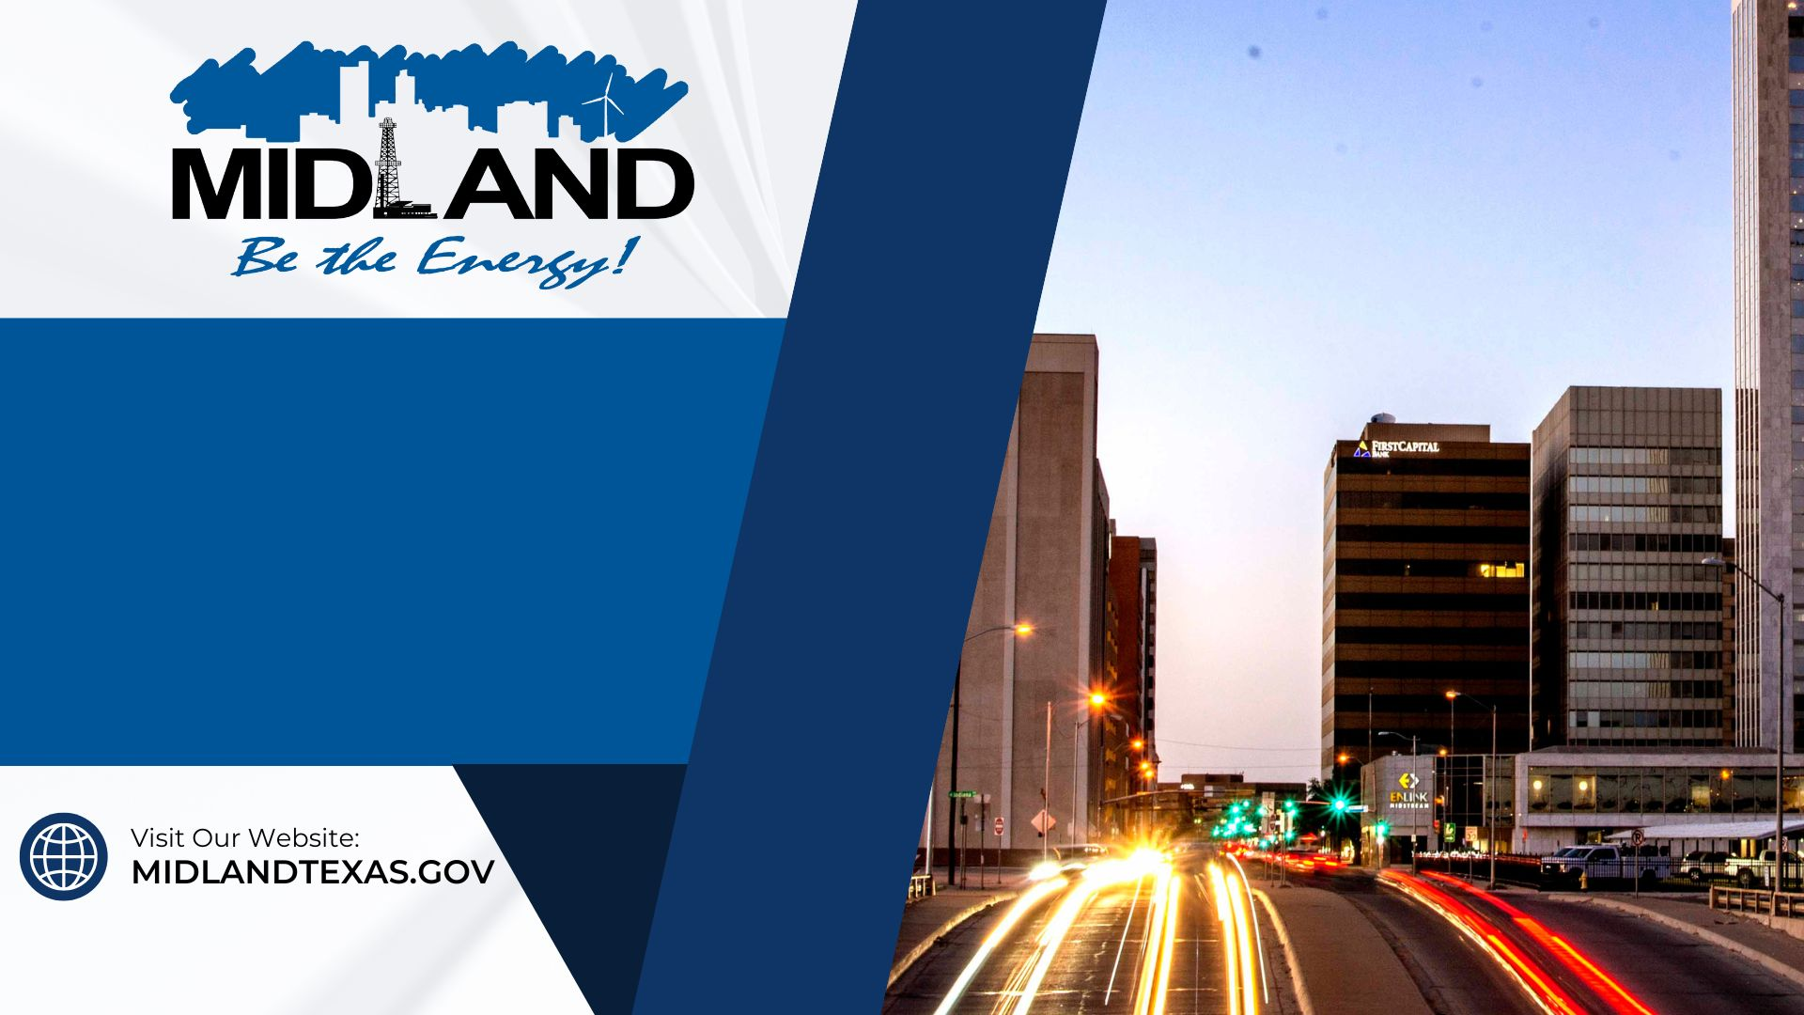
CLEANER AND BETTER MIDLAND
May 28, 2024
1

Slide 2

Presentation Outline
Strategic Goal Connections
12-Corridor Update
Accomplishments
Opportunities
2

Slide 3
Strategic Goal Connections
Goal 2: Set the Standard for a Safe and Secure City
Be the safest City in West Texas
Improve pedestrian and motorist safety
Implement effective code enforcement strategies
3

Slide 4
Strategic Goal Connections
Goal 3: Quality of Life and Place
Enhance Community Engagement
Foster relationships with foundations and outside businesses
Establish beautification programs
4

Slide 5
12 Corridors Program: Update
Key Goals Include:
Improving infrastructure and
Creating a safer, visually appealing cityscape.
The 12-Corridor Program represents a cross-functional effort aimed at addressing an all-inclusive list of issues encountered across our 12 most-traveled roadways, spanning over 50 miles
5

Slide 6
12 Corridors Program: Update
This program has resulted in over 425 mobilizations to maintain the integrity of our 12 Most Traveled Roads. Accomplishments include:
12 Corridors Mobilizations
Litter Abatement | 60 | Enhancements for Pedestrians | 14
Pothole Repair | 49 | Improved Lighting | 67
Landscape Enhancements | 23 | ADA Compliance | 11
Road & Signage Improvements | 16 | Rectifying Buckled Curb & Sidewalks | 48
Vegetation Control | 84 | Street Sweeping | 59
6

Slide 7

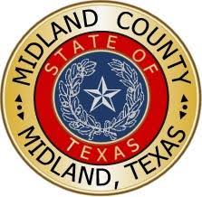




Public & Private Partners
7

Slide 8
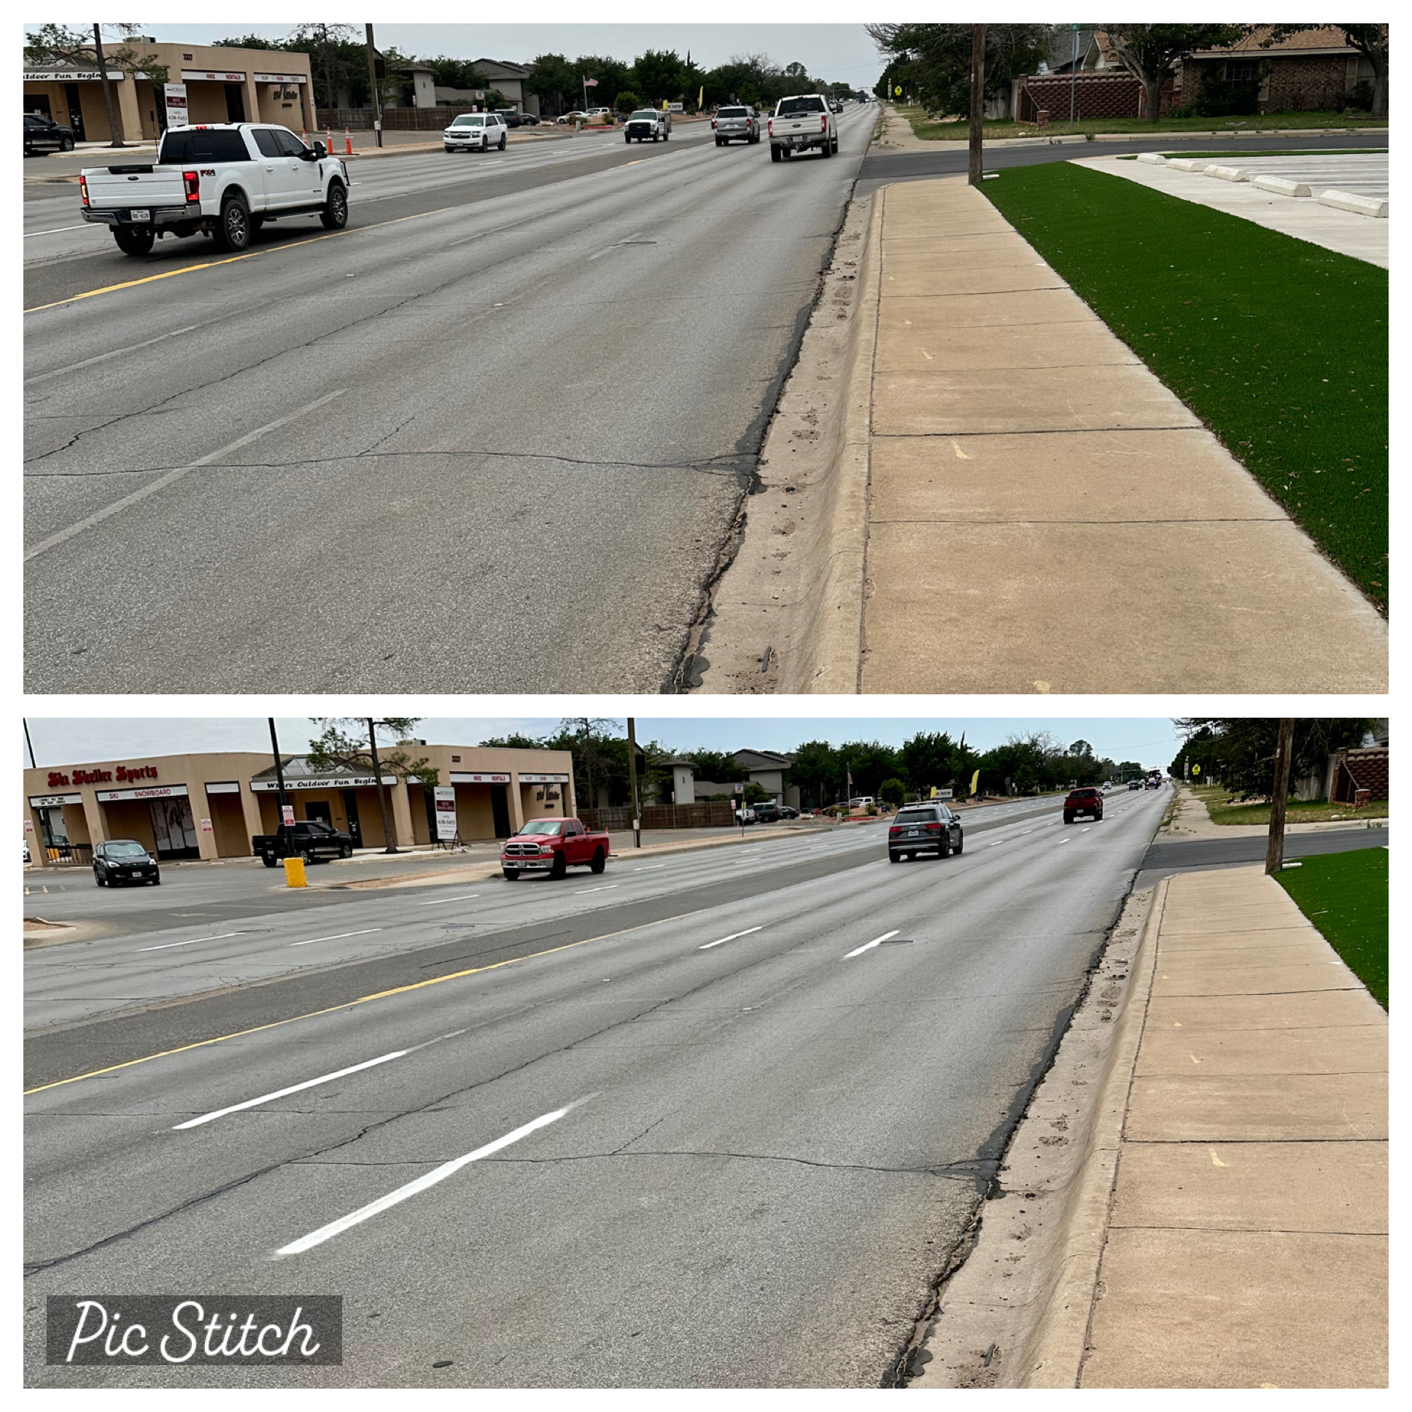
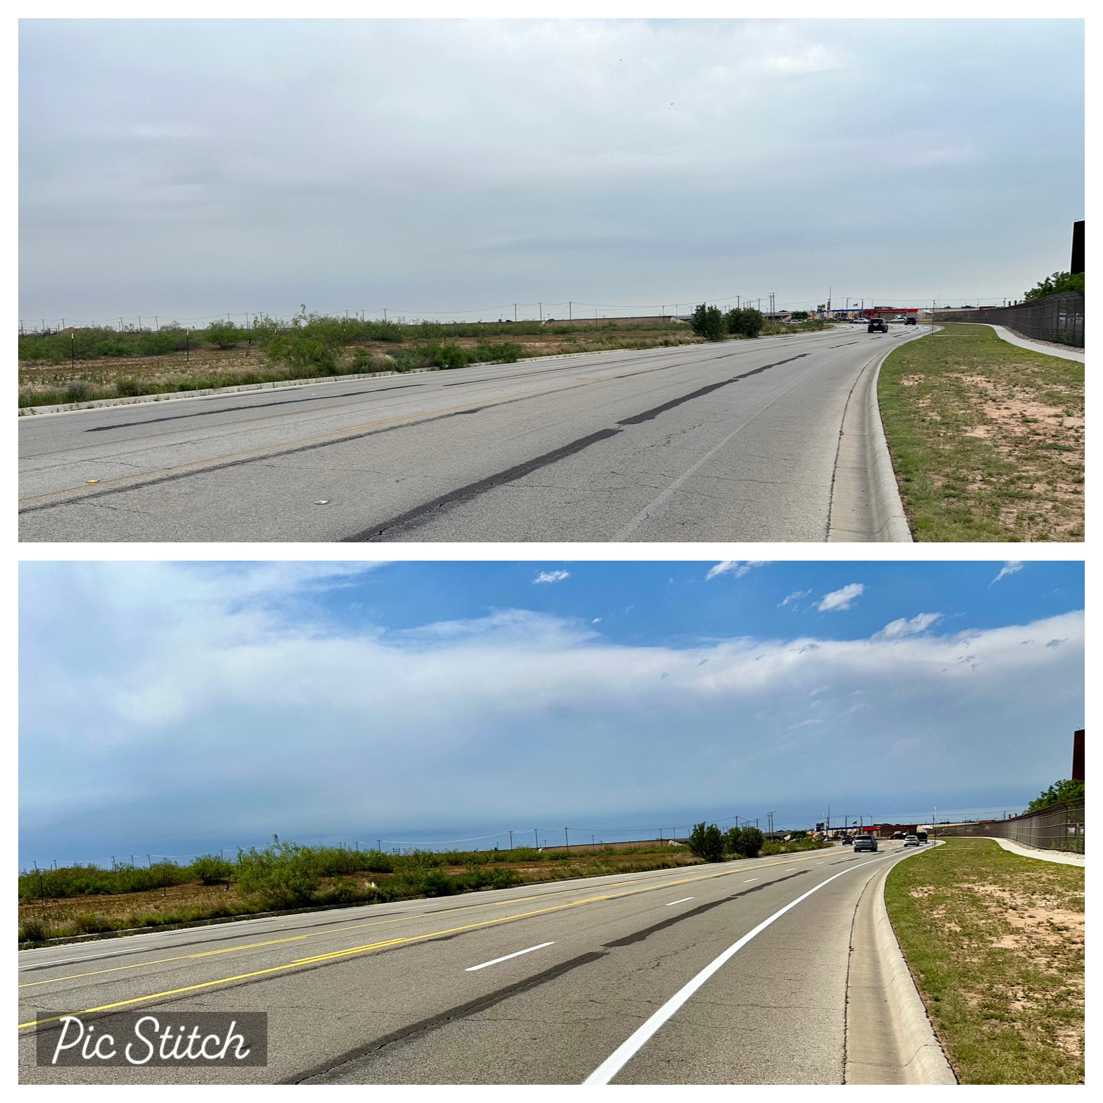
Roadway Striping
Wadley Avenue
8

Slide 9
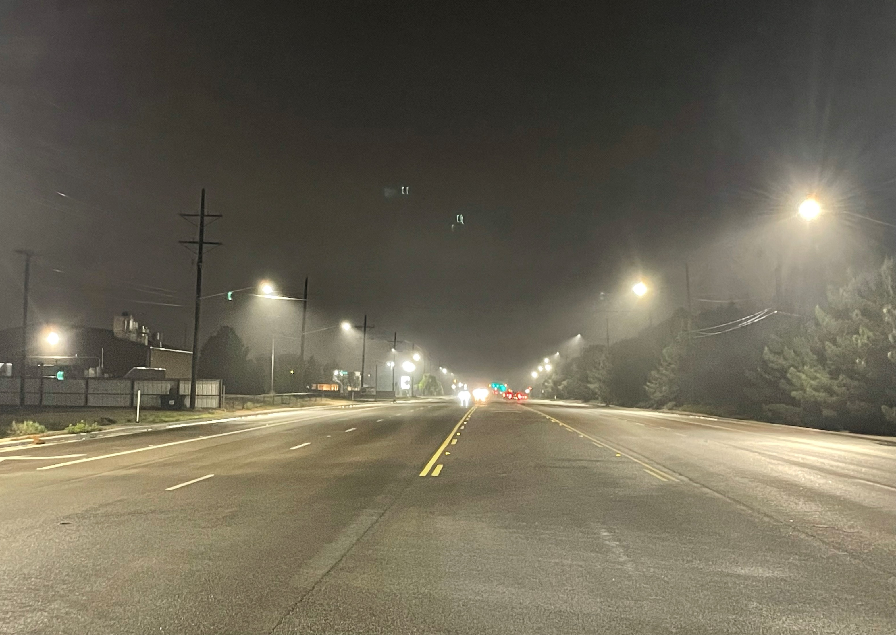
Street Lighting
Big Spring – North of Loop 250
9

Slide 10
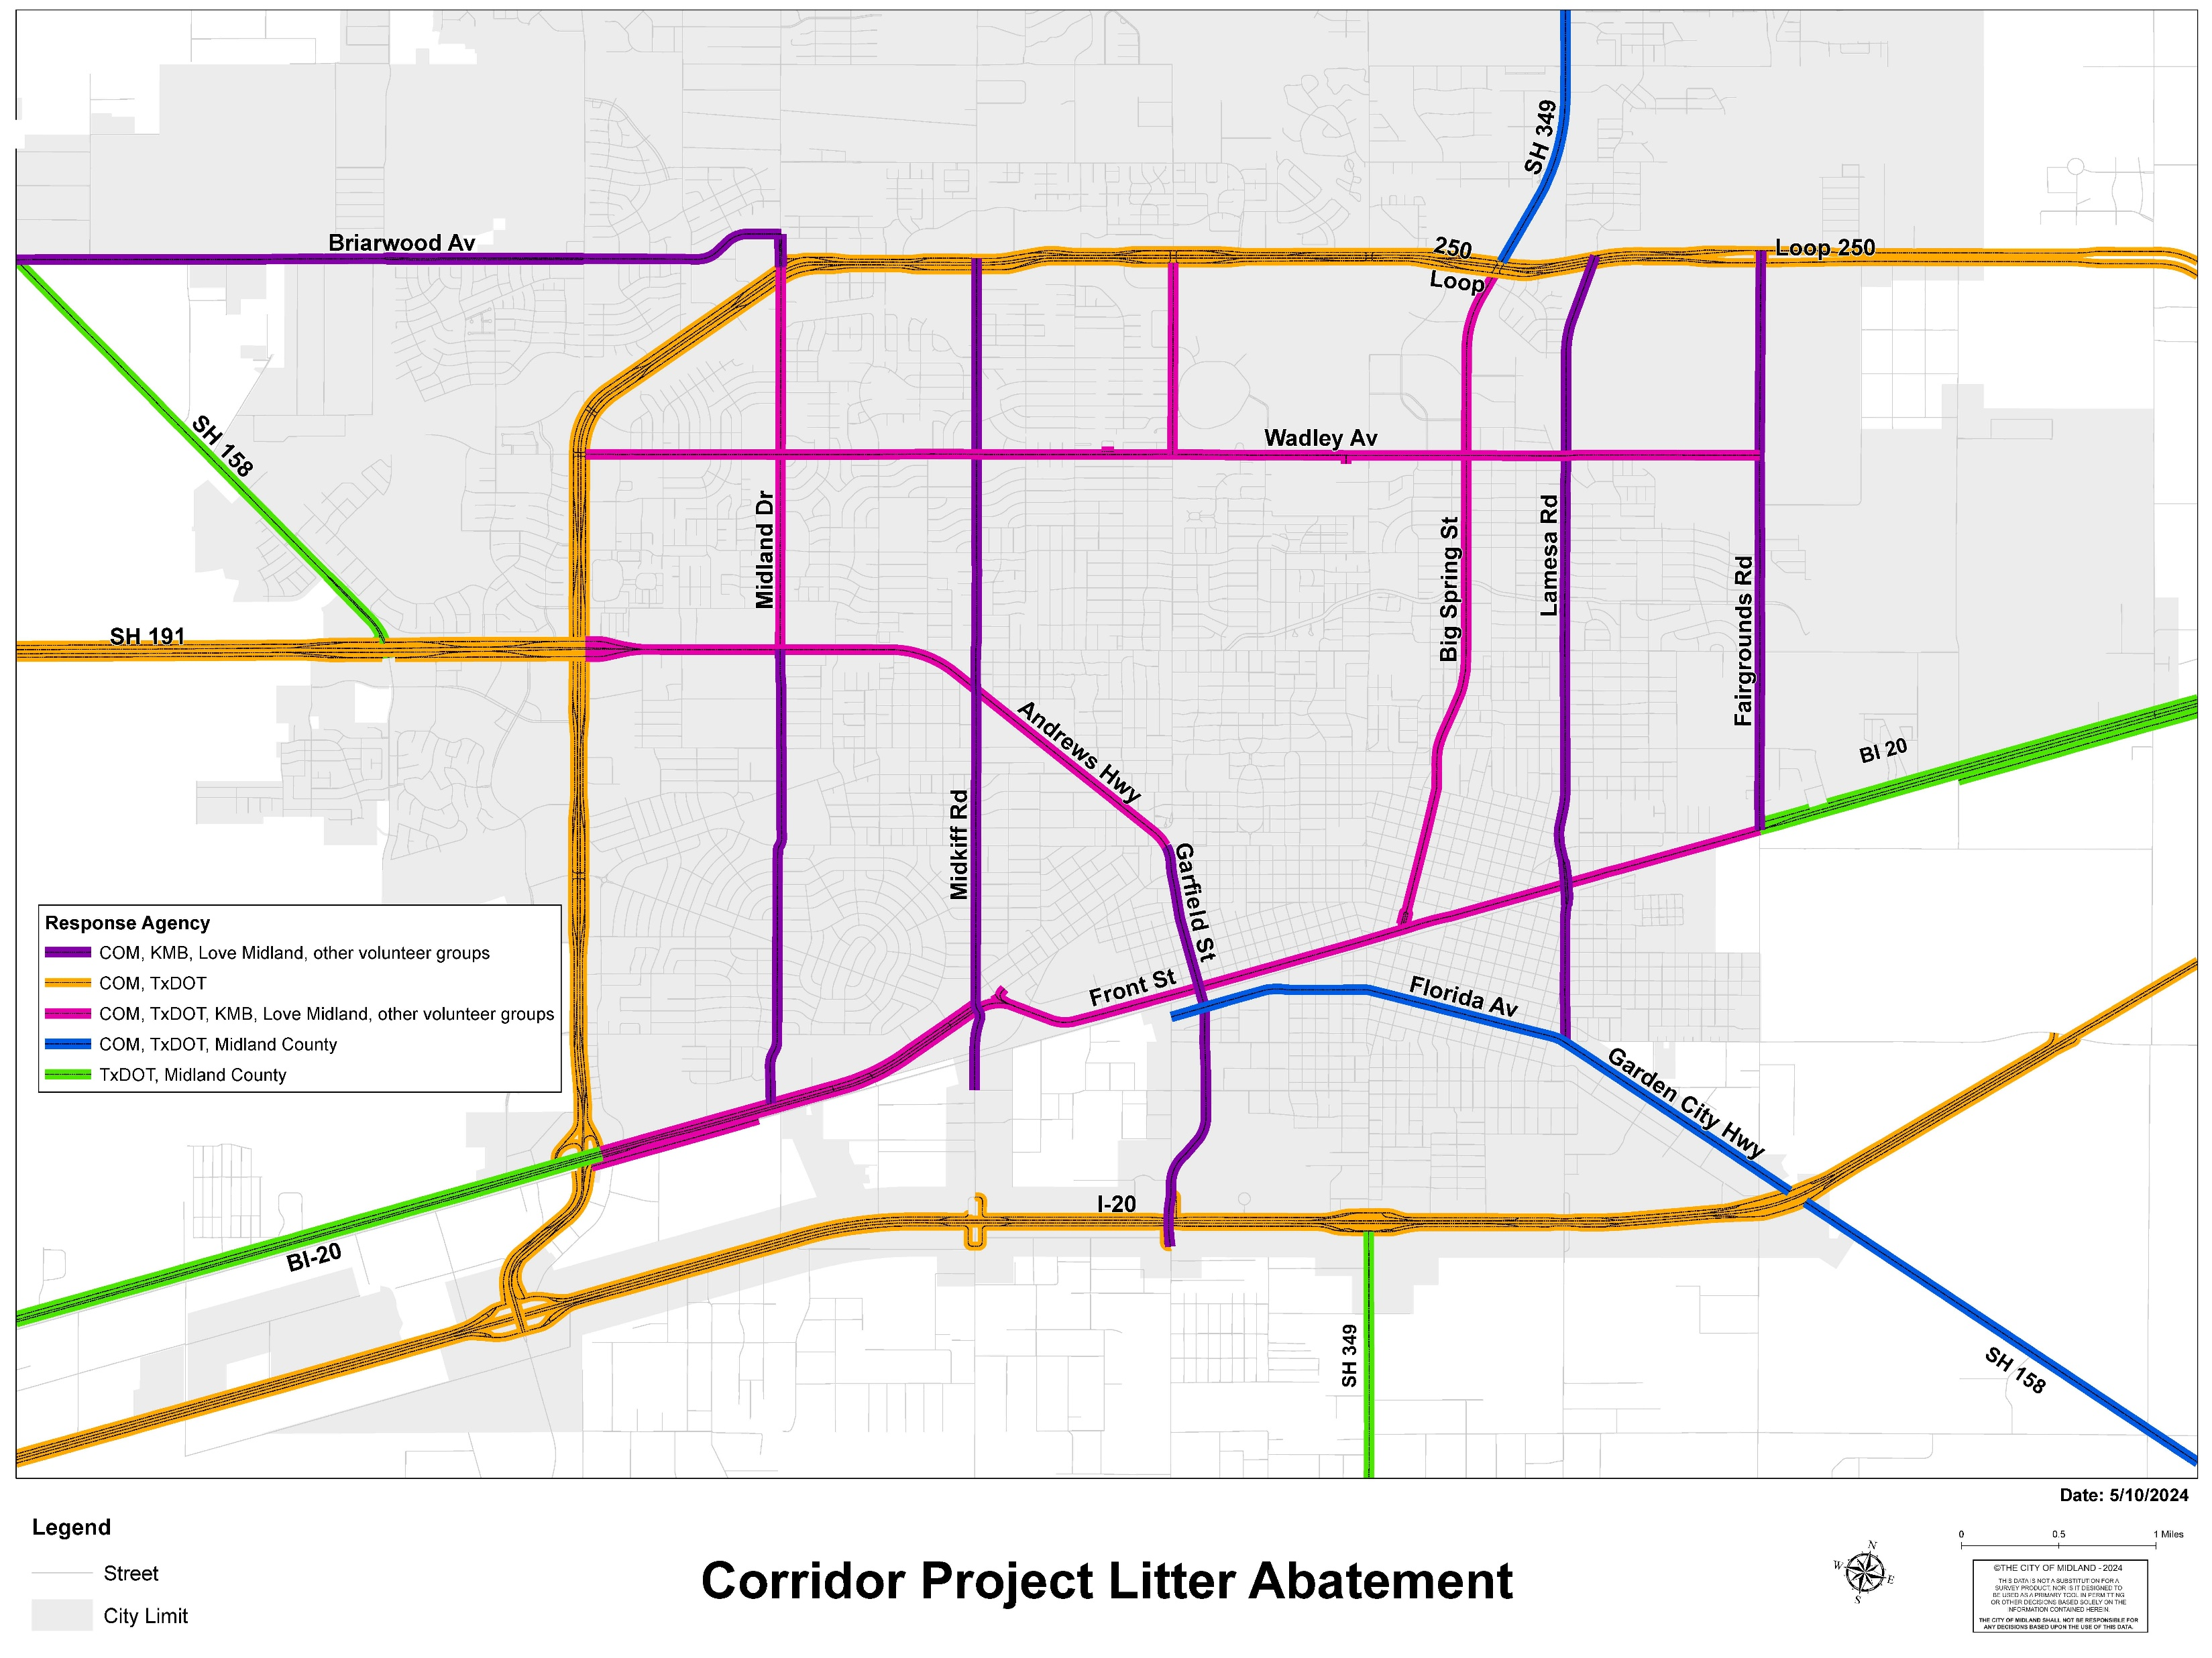
12 Corridors Litter Abatement
10

Slide 11
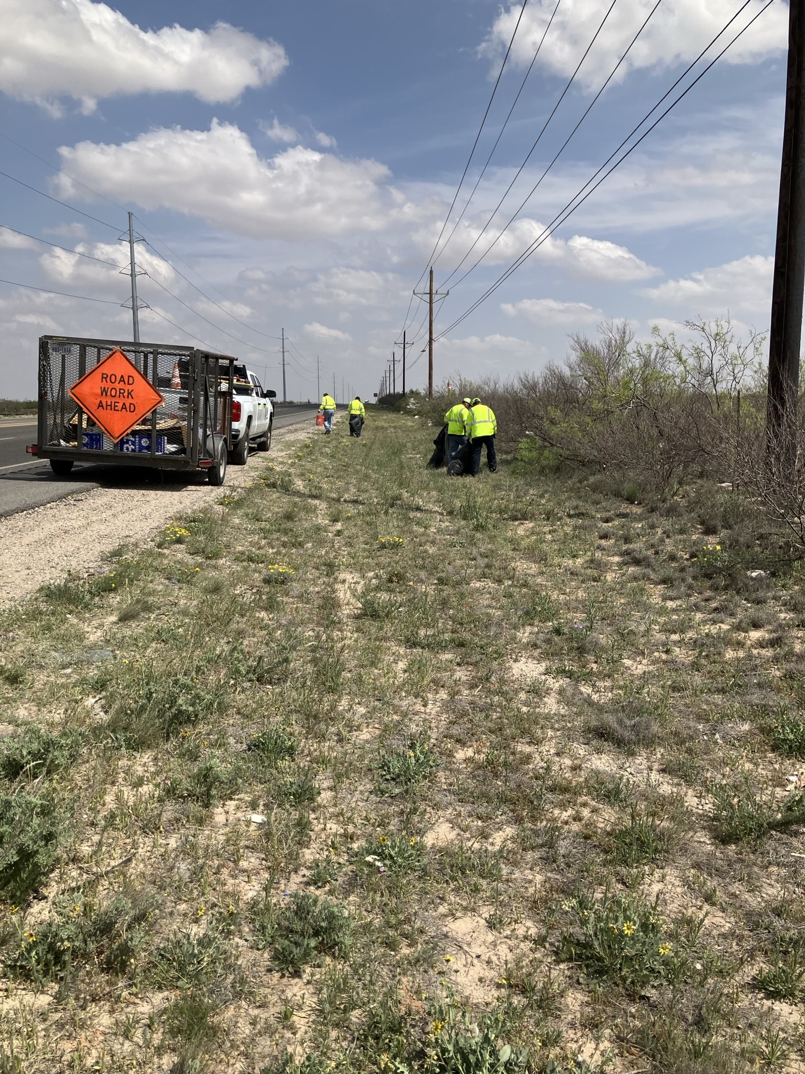
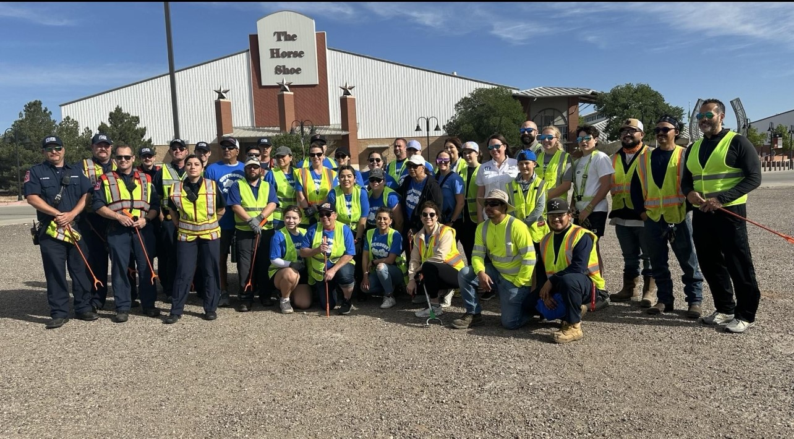
Litter Abatement
11

Slide 12
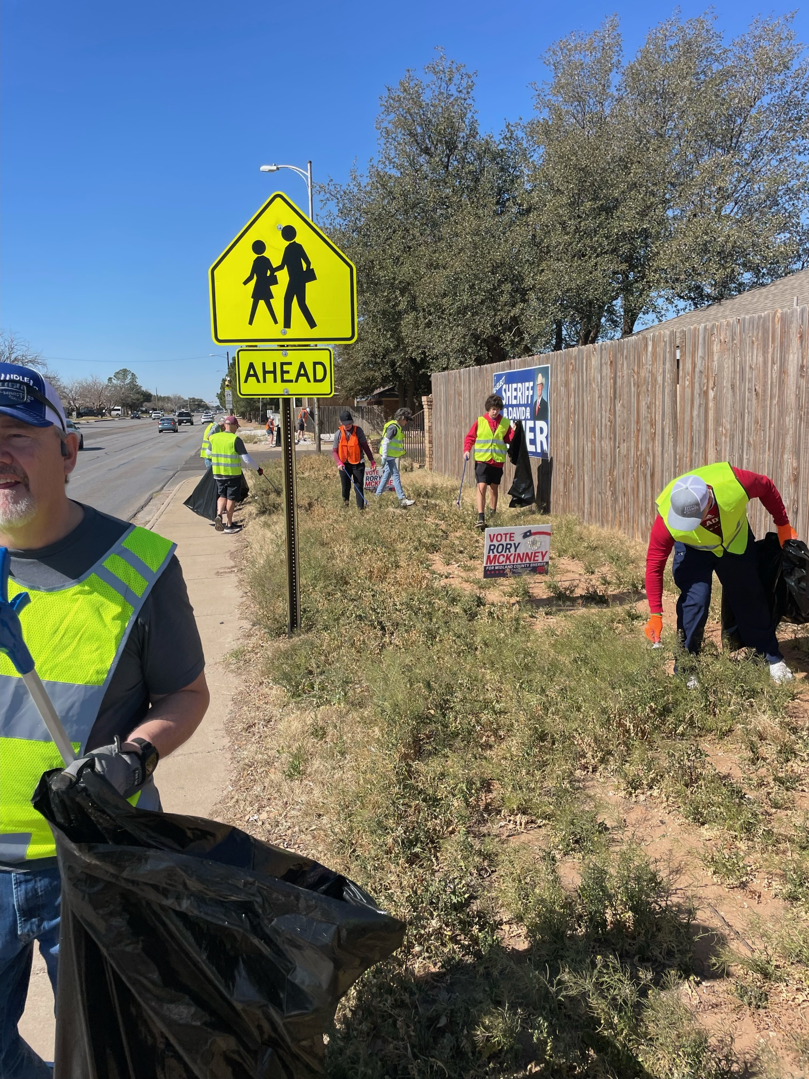
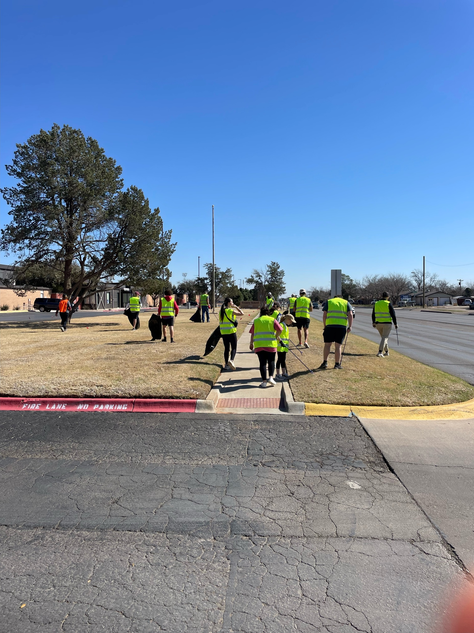
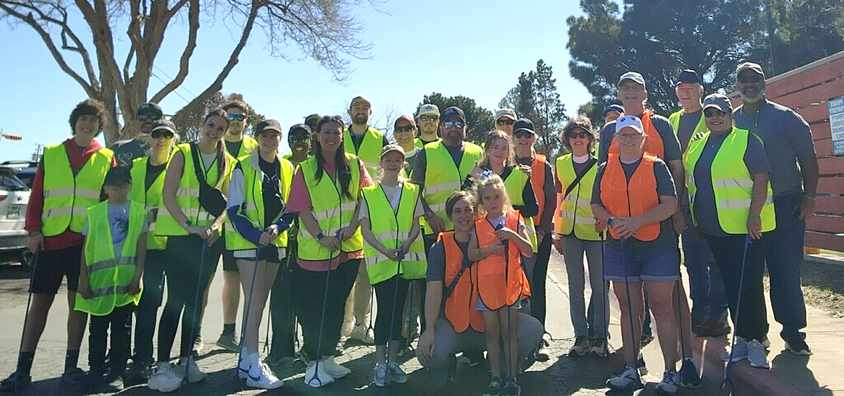
Litter Abatement
On February 24, the LOVE Midland project commenced a litter abatement project on W Wadley Ave from Midland Dr to Midkiff Rd
12

Slide 13
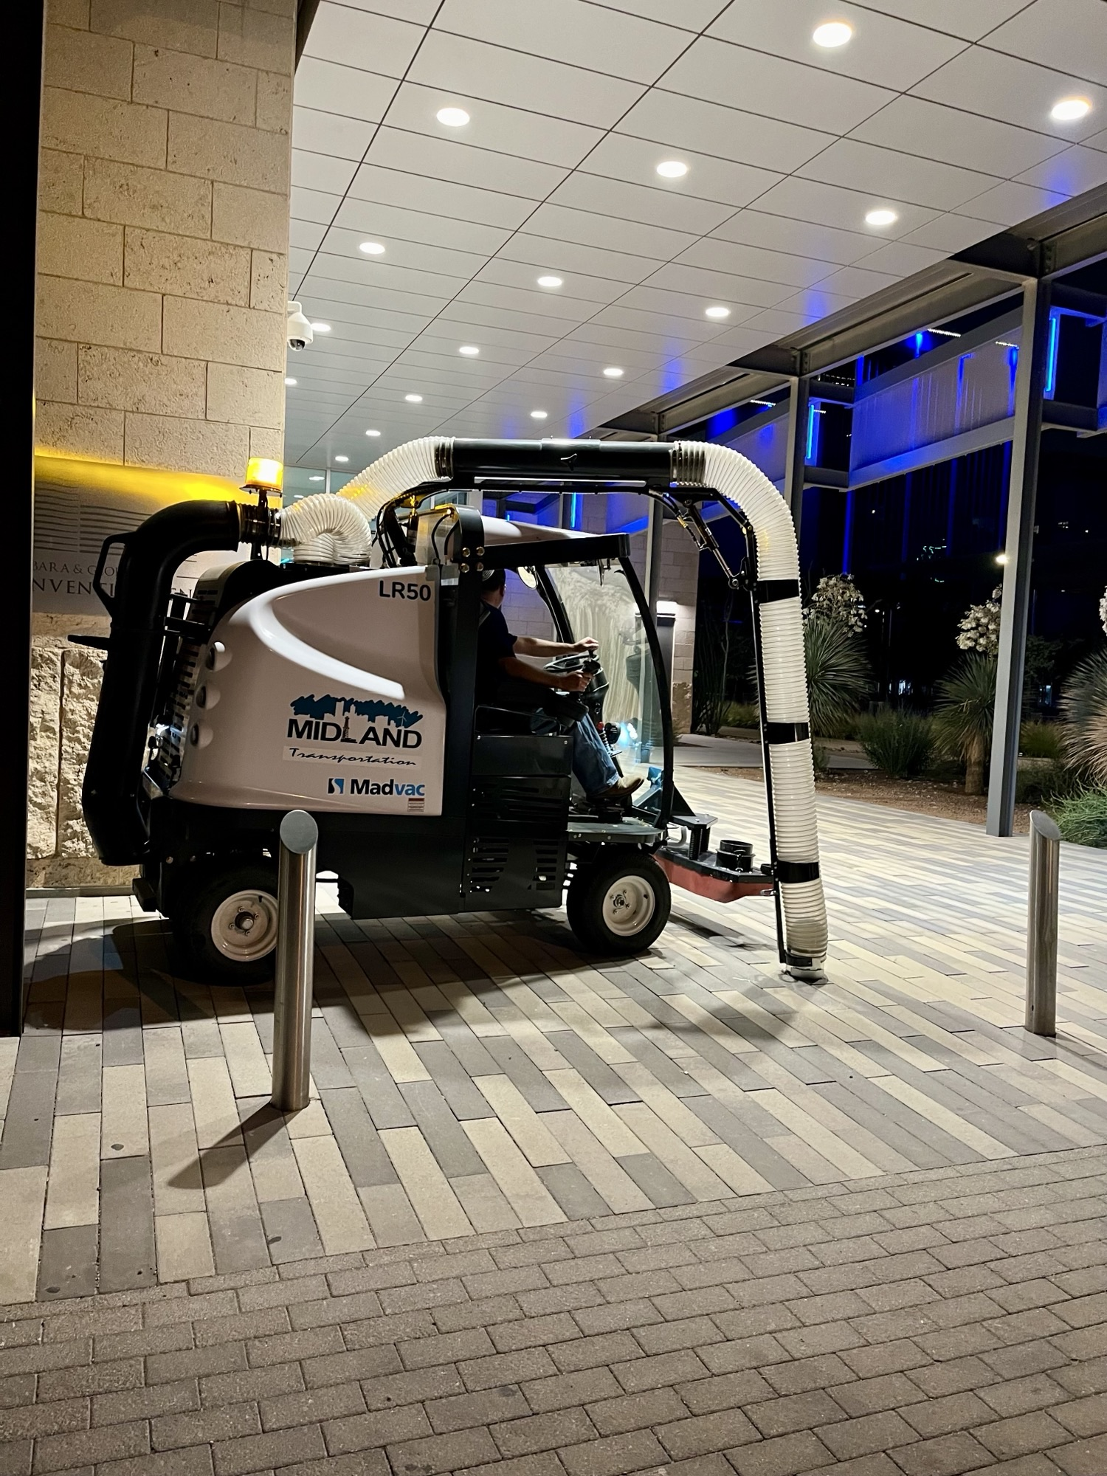
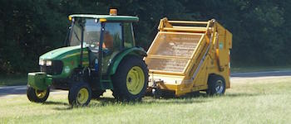
Litter Abatement
City of Midland New Litter Collection Tools
13

Slide 14
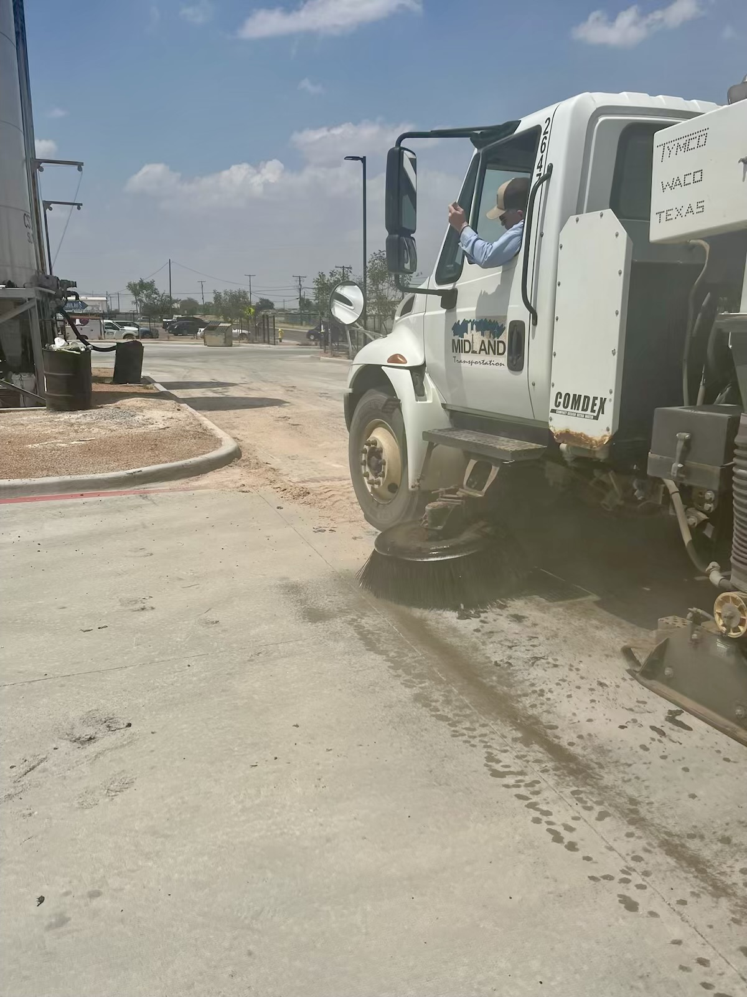
Street Sweeping
14

Slide 15
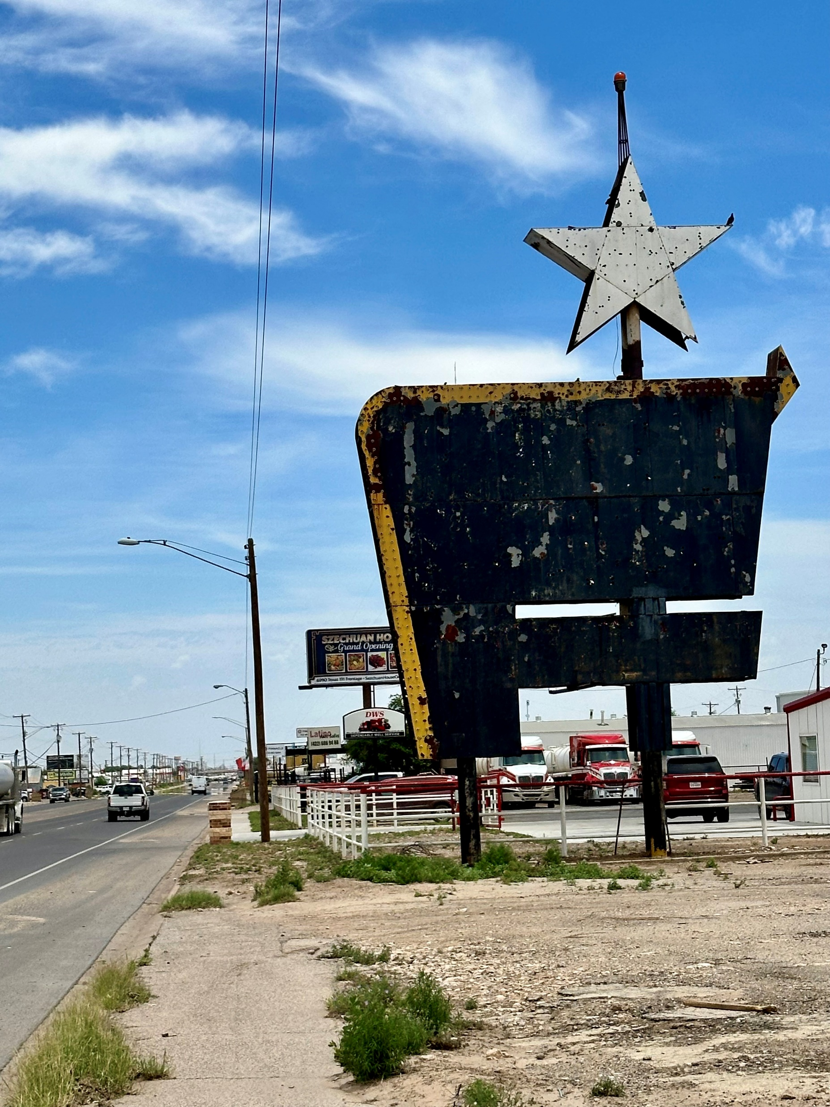
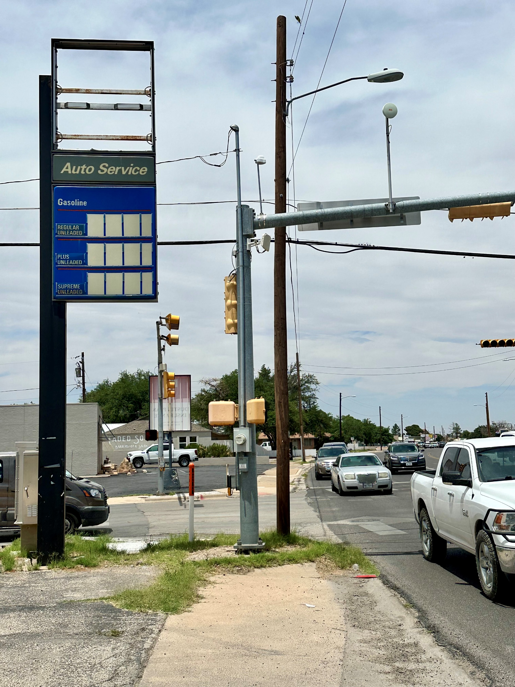
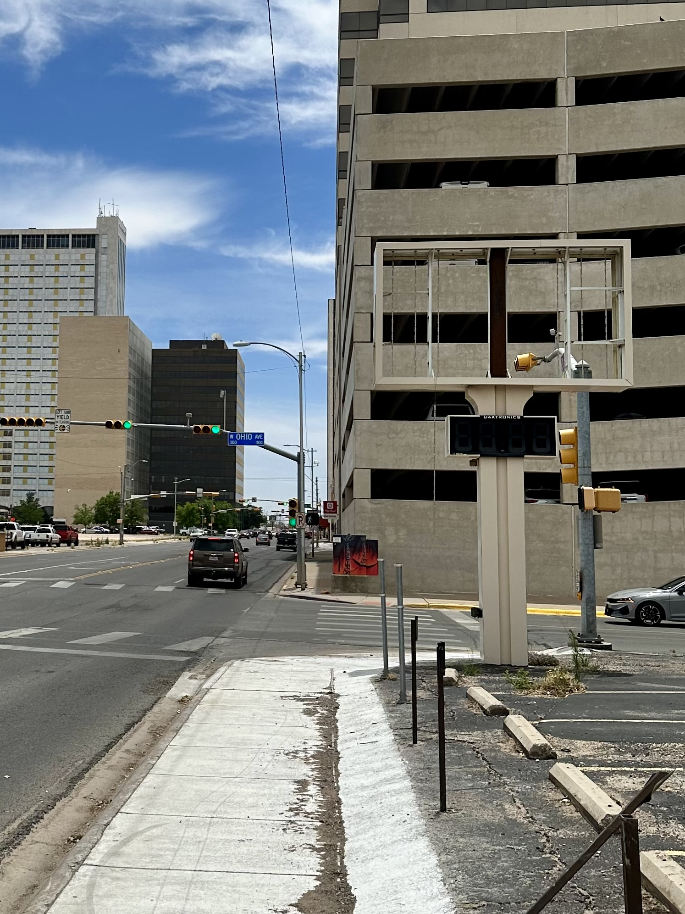
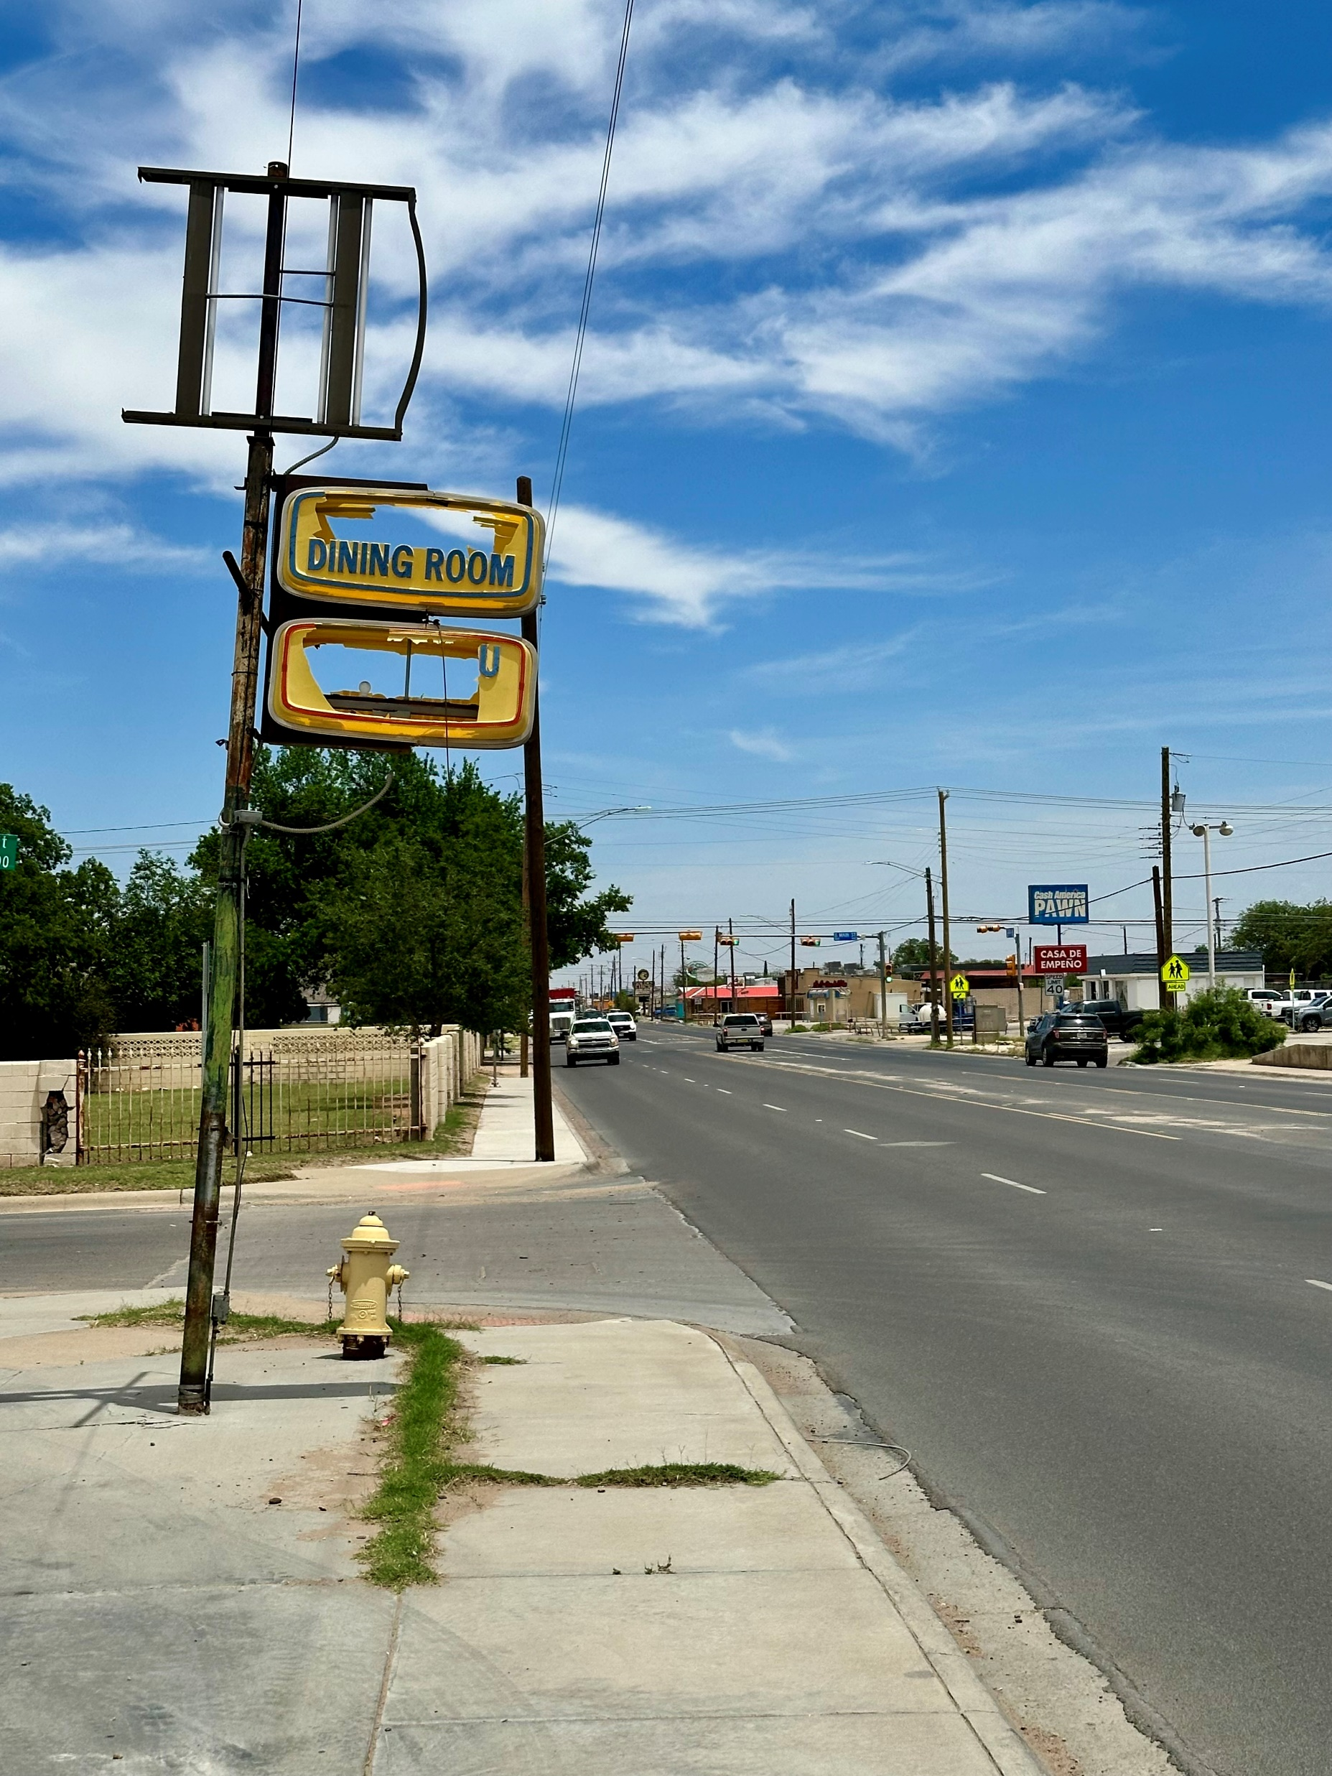
Opportunities
1506 Garden City Hwy
Big Spring and Ohio
Big Spring and Cuthbert
Florida and Loraine
15

Slide 16
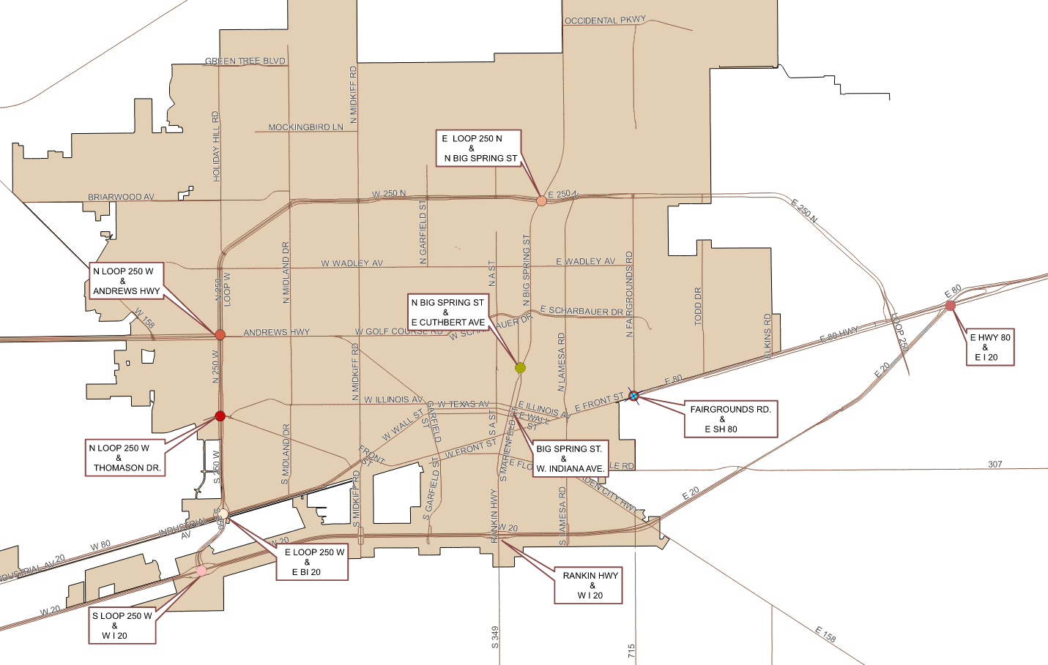
Entryway Landscaping Opportunities
16

Slide 17
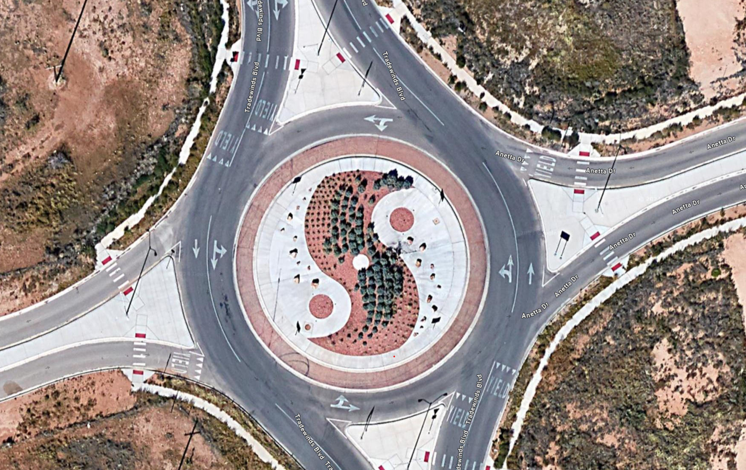
Traffic Island/Median Enhancement Project:
The Traffic Island Improvement Project seeks to transform our city's traffic islands into aesthetically pleasing spaces.
This initiative aims to enhance the visual appeal of these often-overlooked areas, especially in our 12 Most Traveled Corridors.
These enhancements will greatly contribute to a more inviting and vibrant urban landscape.
Tradewinds Blvd & Anetta Dr
17

Slide 18
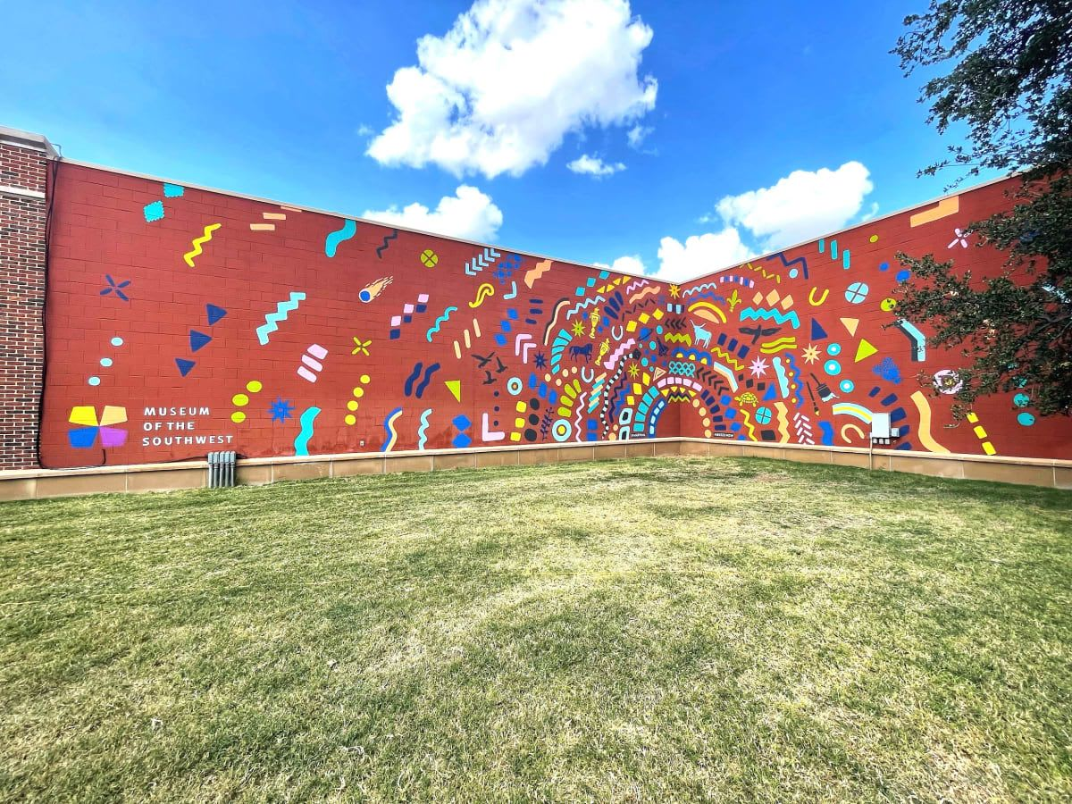
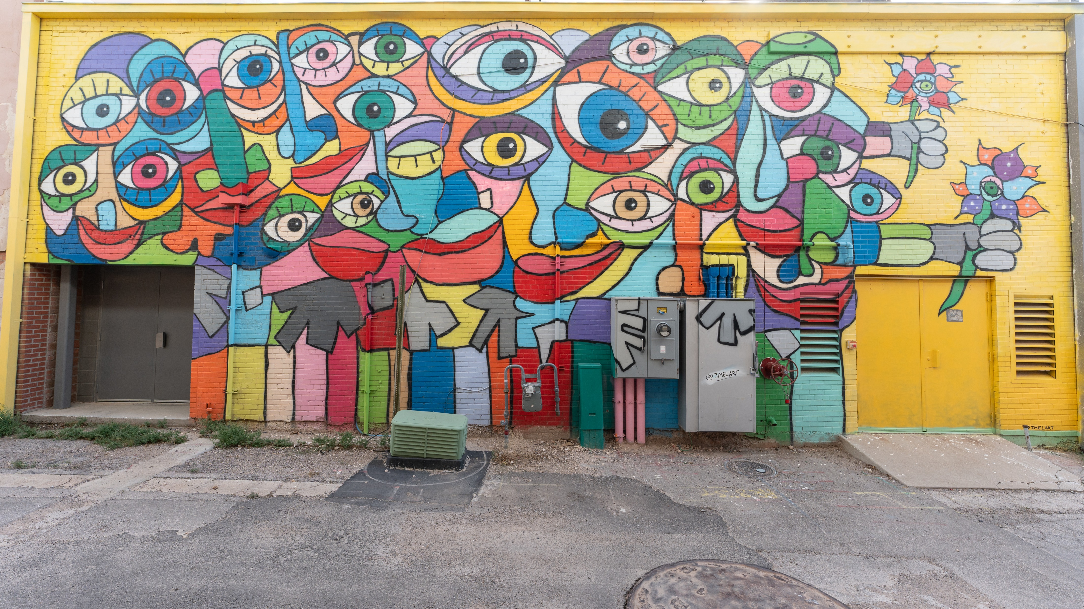
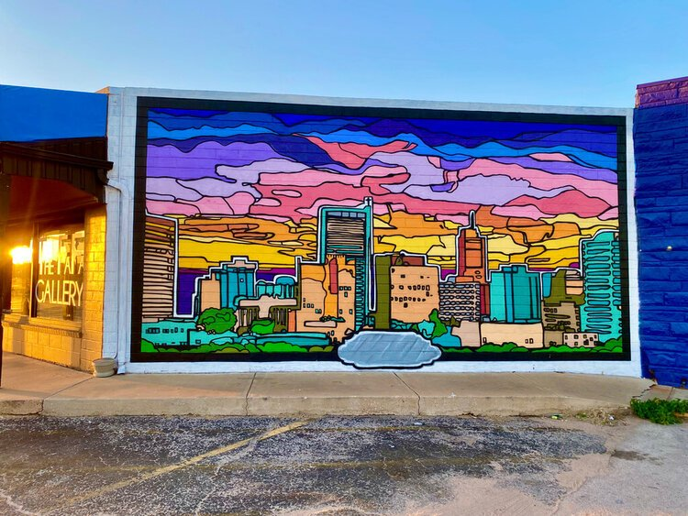
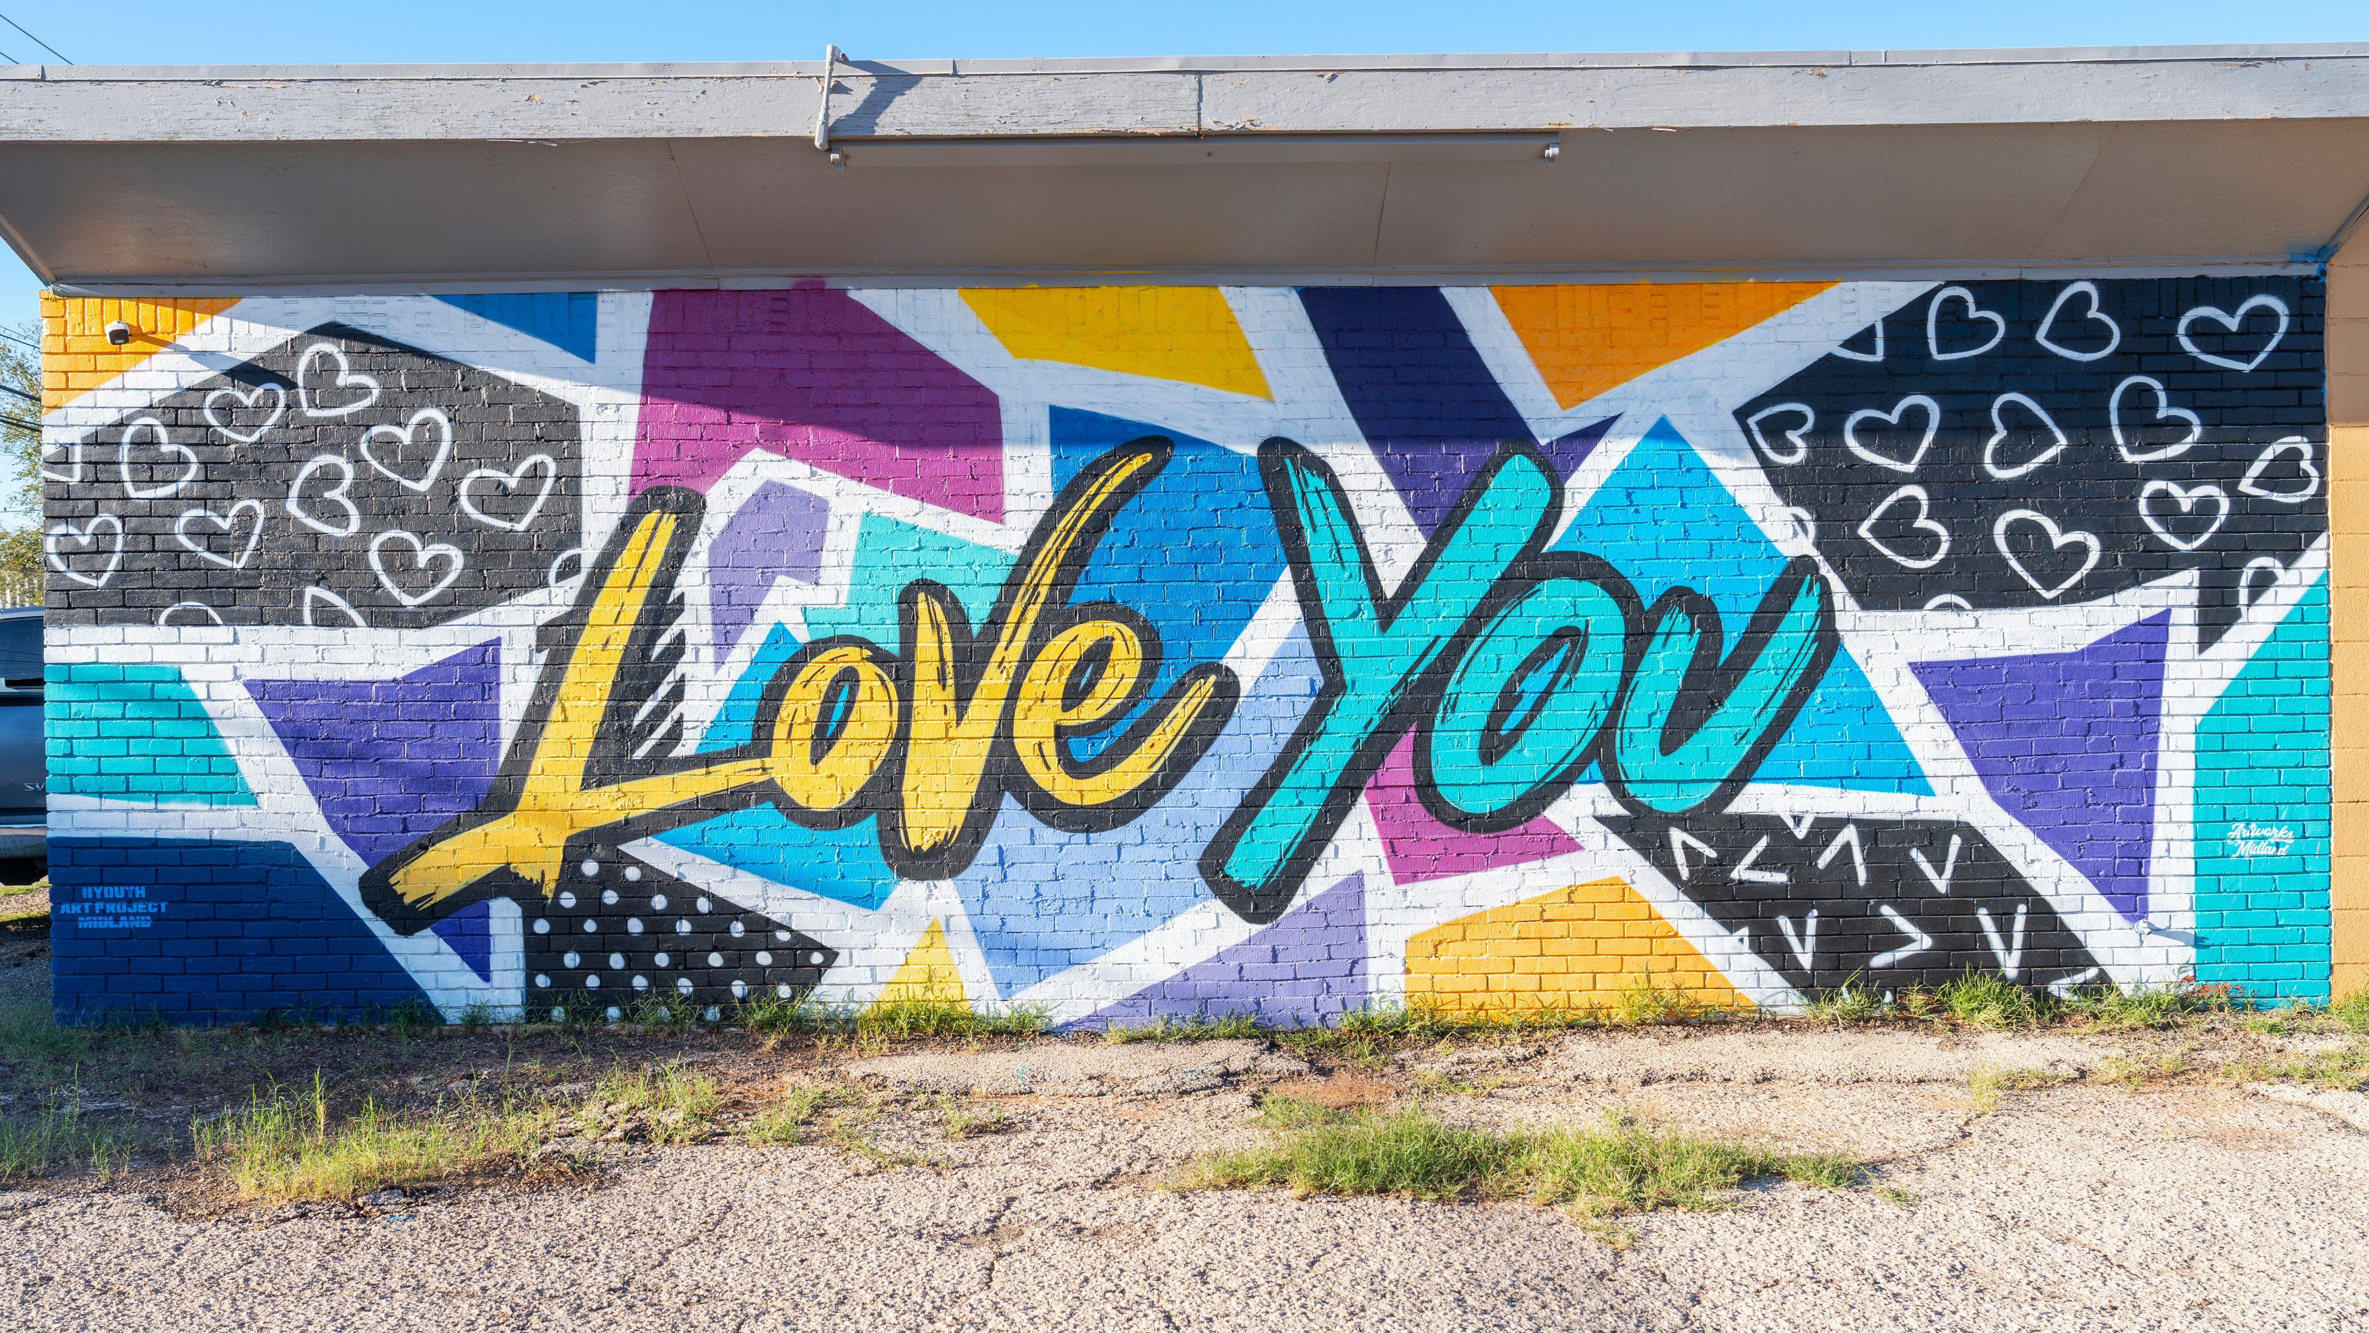
Public Mural Project
The Public Mural Project is a collaborative initiative highlighting our community's cultural identity through visually stunning murals by local artists.
The Mural Project aims to enhance the city's appeal, potentially attracting tourists and benefiting local businesses near the murals.
18

Slide 19
MISSION
Deliver exceptional services and promote a high quality of life and place for ALL our citizens.
19

Slide 20
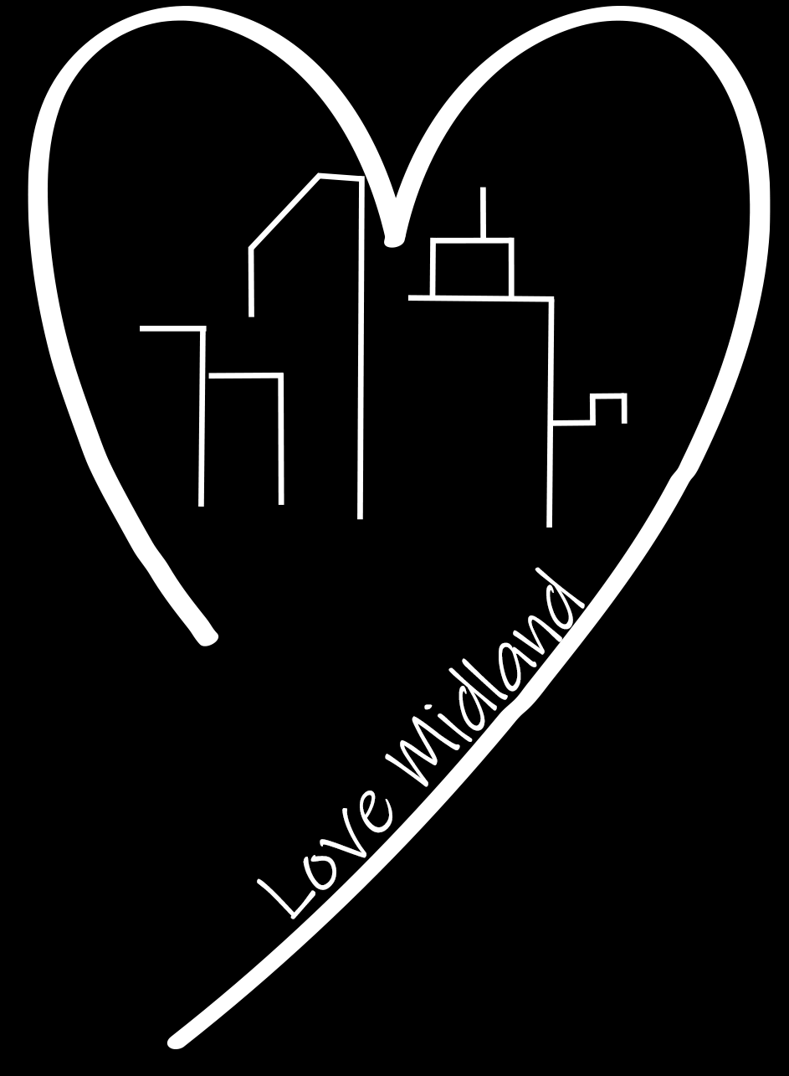
Additional accomplishments:
On February 24, the LOVE Midland project commenced a litter abatement project on W Wadley Ave from Midland Dr to Midkiff Rd
20

Slide 21
Litter Abatement Allocations:
Trash for Cash is a program where non-profit groups can pick up litter to earn money for their organization.
The City also helps to support a partial salary for the litter coordinator with Keep Midland Beautiful.
• Keep Midland Beautiful Contract: $120,000
• Trash for Cash - $50,000
• Litter Coordinator – $18,000
The City has a contract with a company to provide Right-of-way litter collection. This group will go out daily to clean littered areas, weather permitting. This company will typically focus on main thoroughfares in the City of Midland. Loop 250, I-20, 158, 191 etc.
• $240,000
Solid Waste will assist Code with lot clearing/cleaning and illegal dump sites. When we have emergency clean-up’s such as homeless encampments and large-scale illegal dump sites, we may hire a contractor to clean these areas before they become a larger nuisance.
• Cleaning lots: $25,000
• Illegal Dumping/Large scale litter clean-up: $67,000
Above Allocation: $520,000
21

Slide 22
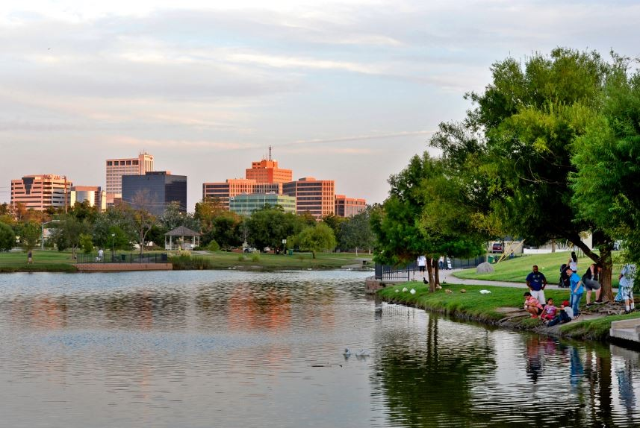
Park Enhancement Project:
The Park Enhancement Project is an initiative aimed at revitalizing City parks to create more vibrant, accessible, and sustainable public spaces. Envisioning a park that not only meets the diverse recreational needs of our community but also serves as a welcoming oasis for residents of all ages.
22

Slide 23
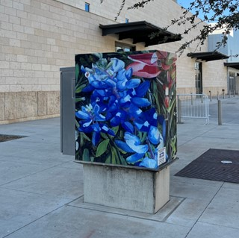
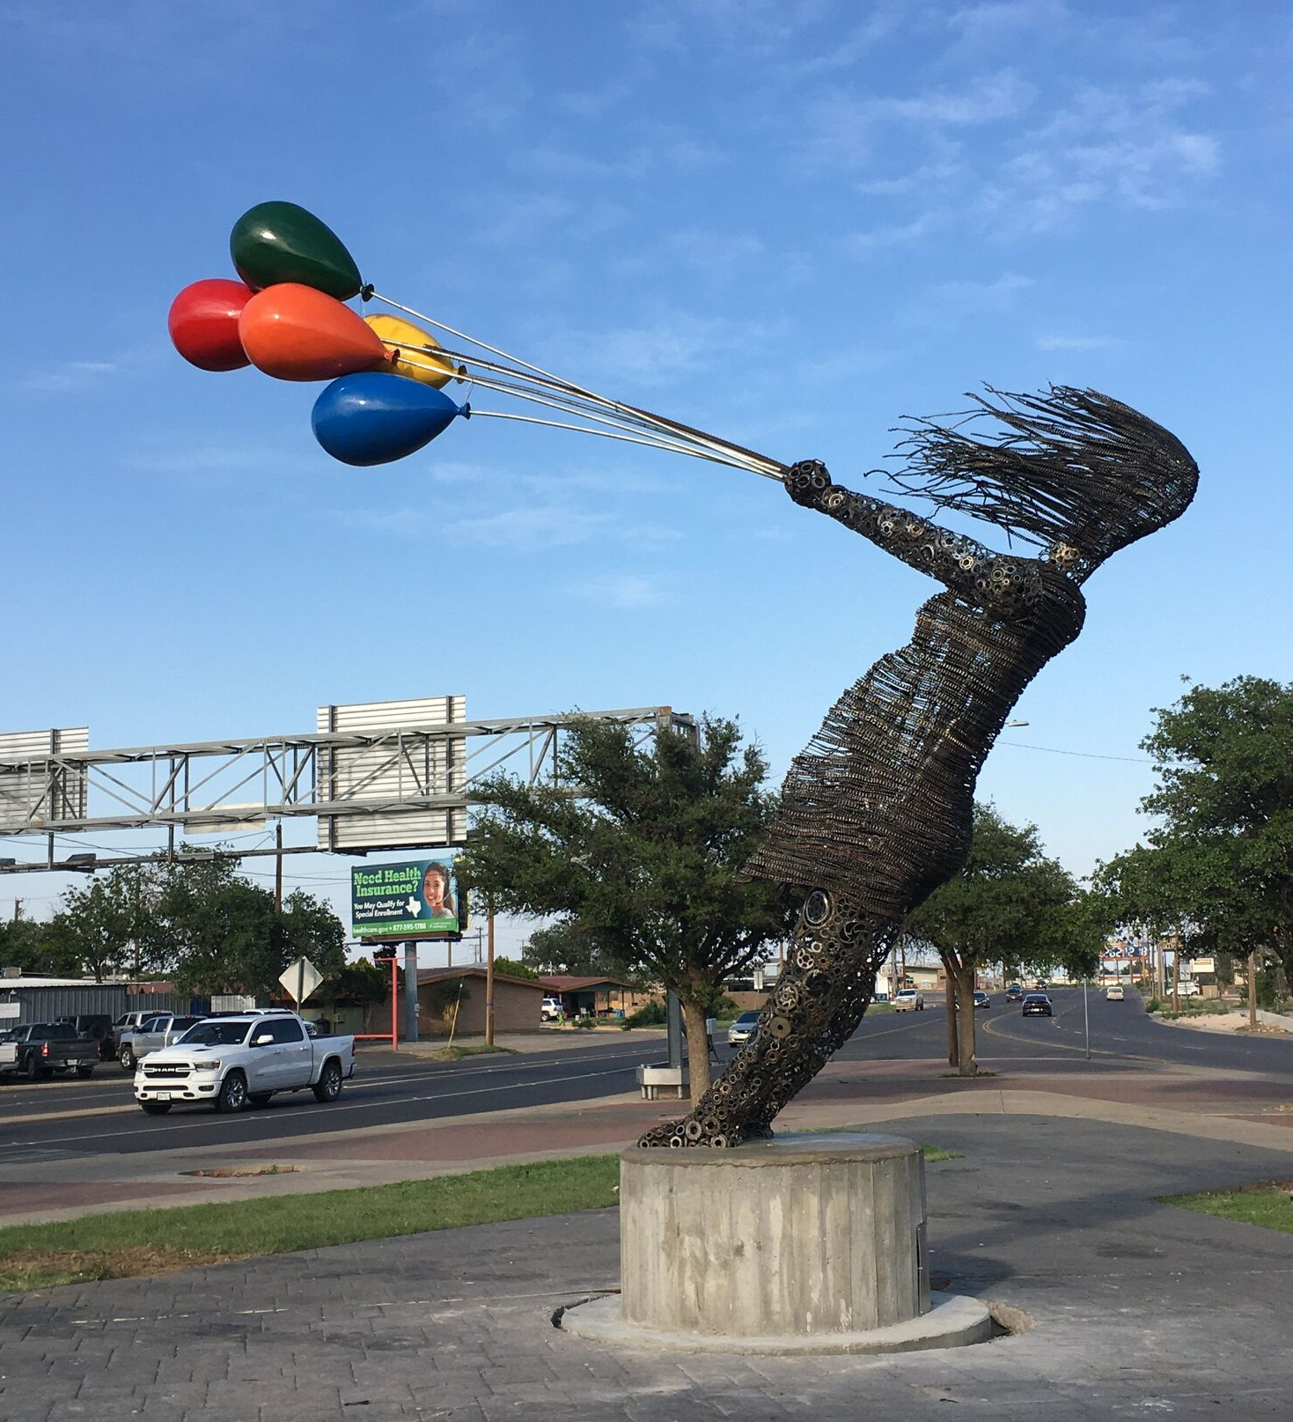
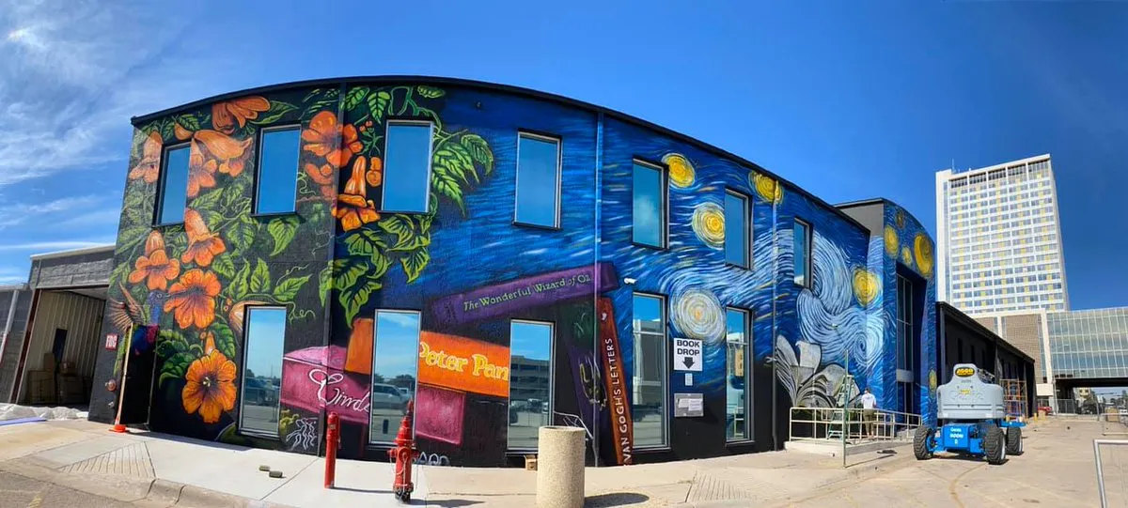
Public Art Installation Project:
The Public Art Installation Project aims to enrich our community by integrating visually captivating artworks into public spaces. This initiative seeks to enhance the aesthetic appeal of our city, foster cultural expression, and create engaging landmarks that reflect the diversity and creativity of our residents.
23

Slide 24




Anticipated Benefits to the Community
Improved Mobility Pedestrian-Friendly Economic Vitality Community Pride
Repair of buckled sidewalks, curbs and ADA ramps where needed, Surface treatments and repairs of roadways.
Removal of overgrown vegetation of debris from curbline and sidewalk areas to enhance the walkability of these arterial roadways.
A clean and litter-free city projects an image of care and prosperity, which can attract new businesses, investors, and residents.
Clean, well-maintained cities leading to increased engagement in community activities and initiatives.
24

Slide 25
Project Timeline
1
2
3
The initial planning phase, involving comprehensive inspections to determine needs and desires to enhance these areas
Collaboration in multiple phases between City Departments and community agencies begins, plans for improvements are devised.
Work to complete identified issues, the City will maintain and monitor the improved corridors to ensure their long-term viability.
This project is ongoing, encompassing both continuous needs and the potential emergence of new ones over time. Through sustained engagement, the relationships cultivated will evolve into integral components of our collective efforts to enhance the overall aesthetic appeal of the City of Midland
25

Slide 26
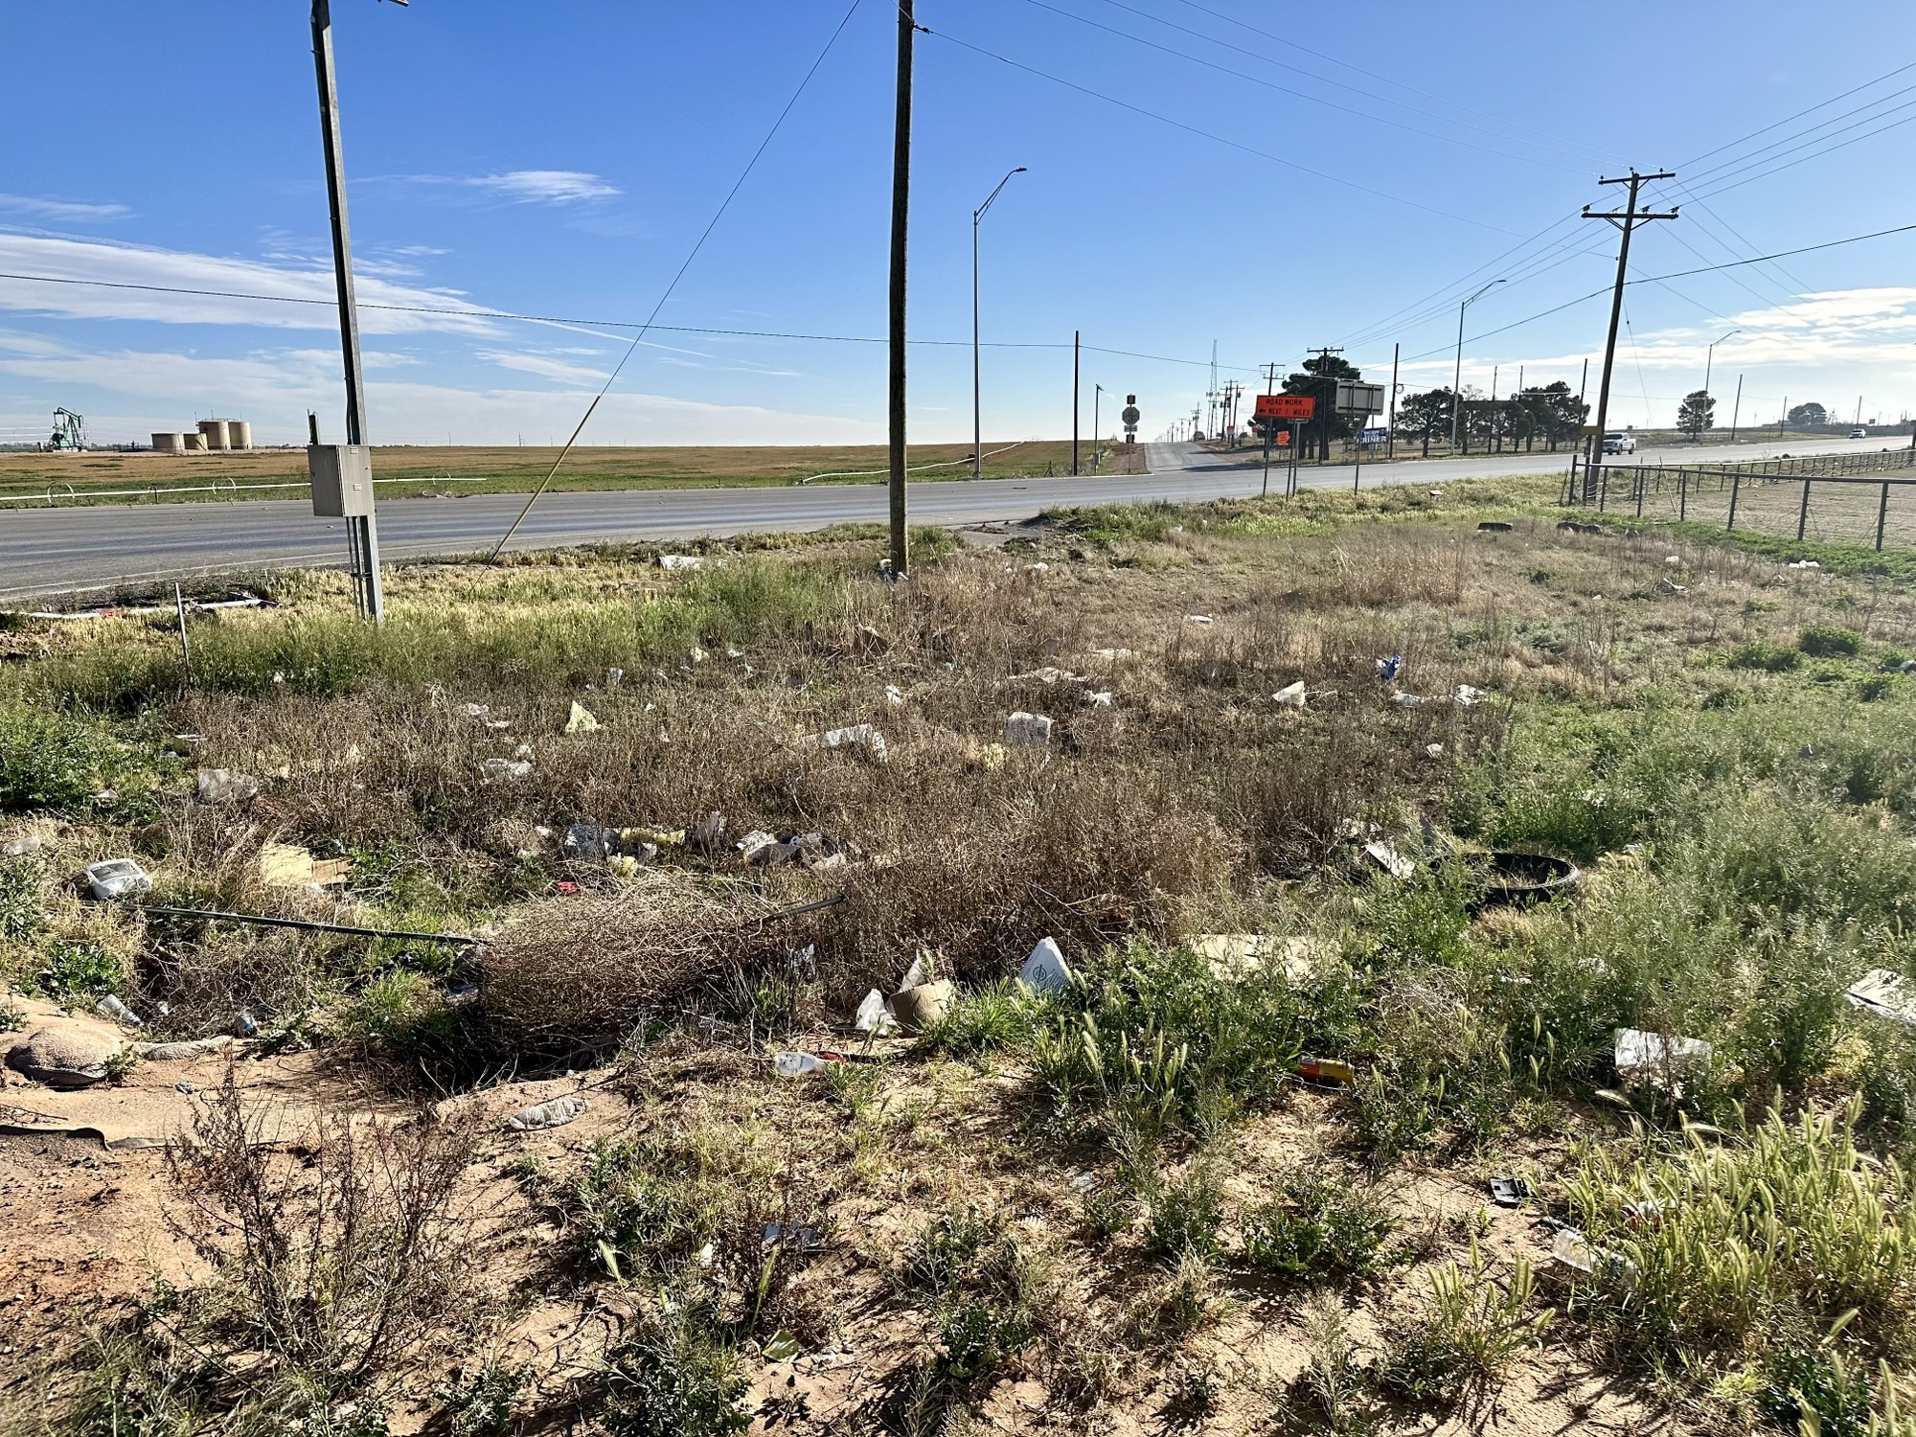
Litter Abatement Project:
An ongoing and collaborative effort to improve our cities cleanliness and visual appeal. This initiative encourages stakeholders to actively participate in revitalizing public spaces, fostering a sense of community pride, and contributing to the overall well-being of our city.
HWY 158 & ECR 120
26

