Slide 1

ITEM 3c
Dangerous Buildings Update
MAY 28, 2024
1

Slide 2
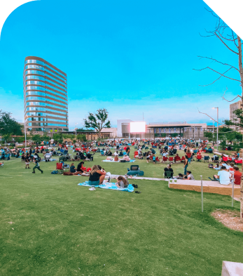

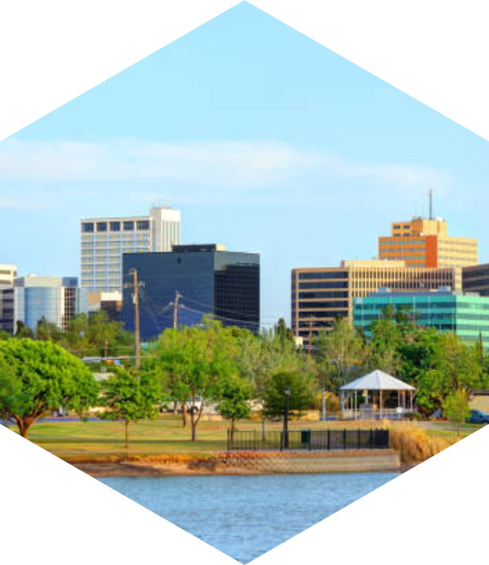



WHAT WE WILL COVER
STRATEGY
UPDATES + RESULTS
NEXT STEPS
2

Slide 3
Strategic Goals
Goal 2. Set the Standard for a Safe and Secure City
2.1 Be the Safest City in West Texas: Enhance public safety programs
2.3 Implement Effective Code Enforcement Strategies: Address nuisances to improve overall health and safety
2.4 Revitalize Neighborhoods: Utilize best practices to support the redevelopment of neighborhoods
Goal 3. Quality of Life and Place
3.3 Create an Attractive and Inclusive Living Environment: Develop and enhance live, work, and play opportunities for our citizens
3.4 Establish Beautification Programs: Implement initiatives to make the community clean and bright
3

Slide 4






Strategy: Addressing Dangerous Buildings
Develop + Maintain Dangerous Building Inventory
Prioritize high risk structures:
Streamline Building Safety Codes
Empower City for immediate action when a building is a public safety threat
Enhance Business Standards
Establish local hotel & motel license for standards and inspections
Encourage Redevelopment
Vacant + Unsecure
Crime Hotspots
Secure appropriately
Enhance property maintenance standards to improve public health + safety
Establish multi-family ordinance for standards and inspections
Incentivize Infill Development
Provide Small Business Grants
Target Downtown Redevelopment
High Risk Uses
Land Banking for Affordable Housing
4
Notes:
Prioritize, Secure, Strengthen, & Encourage Redevelopment

Slide 5
What is a “Dangerous” Building?
A “Dangerous” or “Substandard” Building is a building that:
Does not meet the standards set out by the City’s adopted Building, Electrical, Plumbing, Gas, Swimming Pool, Mechanical, Residential, or Energy Codes as they relate to buildings;
Endangers or is likely to endanger persons or property;
Is unfit for human habitation or a hazard to the public health, safety, and welfare;
Regardless of its structural condition, is unoccupied and unsecured from unauthorized entry or use by vagrants or other uninvited persons as a place of harborage, or by children;
Is a danger to the public, despite being boarded up, fenced or otherwise secured from entry;
Is secured by means that are inadequate to prevent unauthorized entry; or
Is in the process of being constructed, repaired, remodeled, or demolished and unfit for human occupancy or habitation for a period greater than: three years for a single-family dwelling, townhouse, duplex, or triplex; or five years for any other building.
5
Codified in Section 4-8-1(b) of the City of Midland Municipal Code

Slide 6
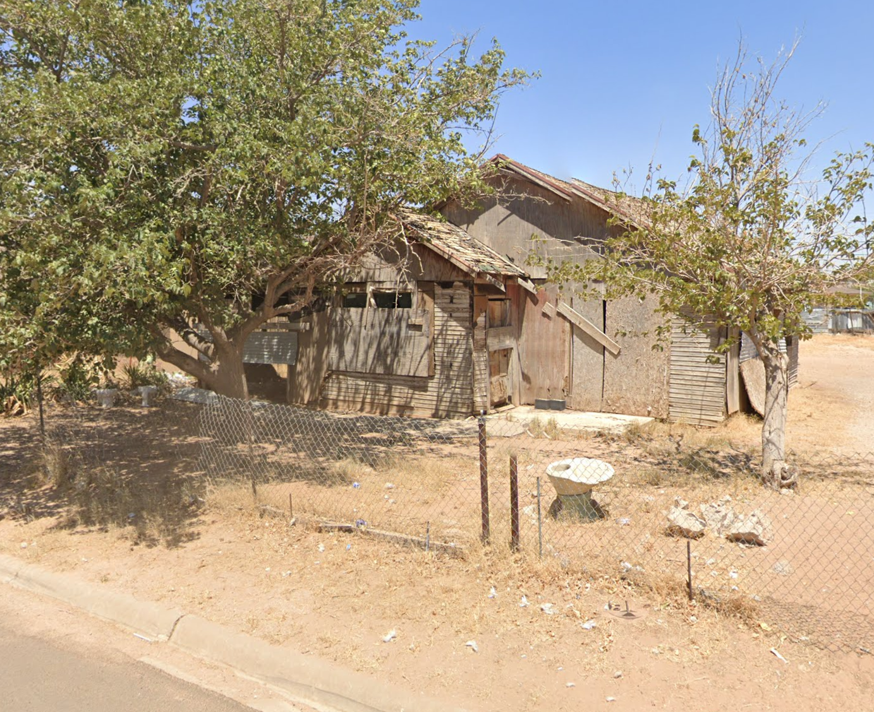
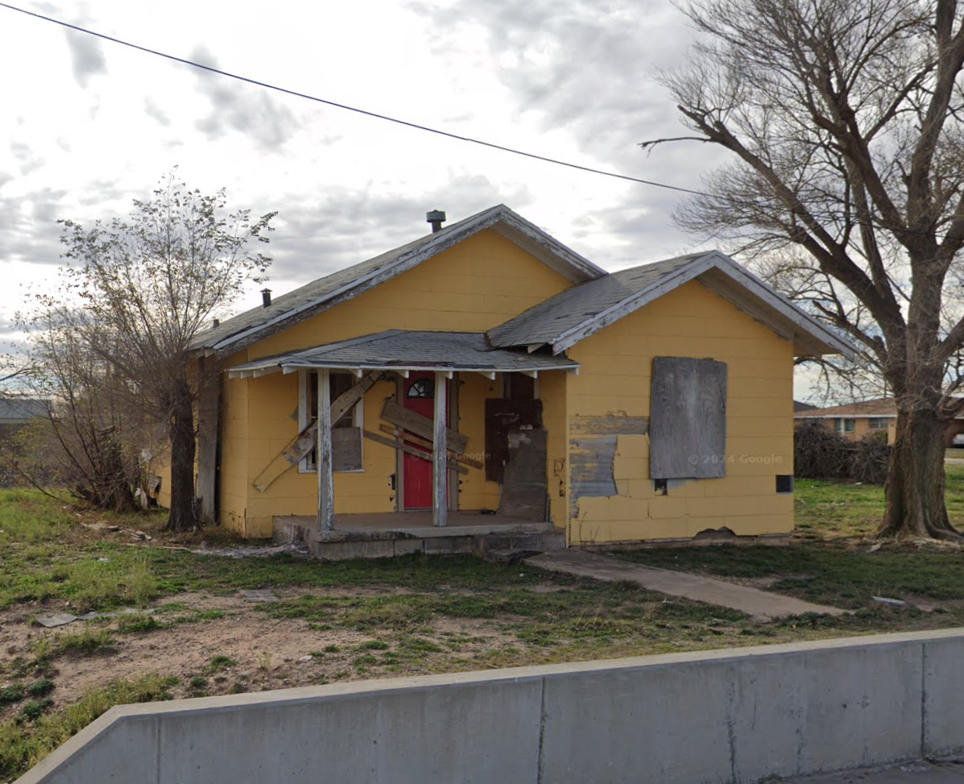
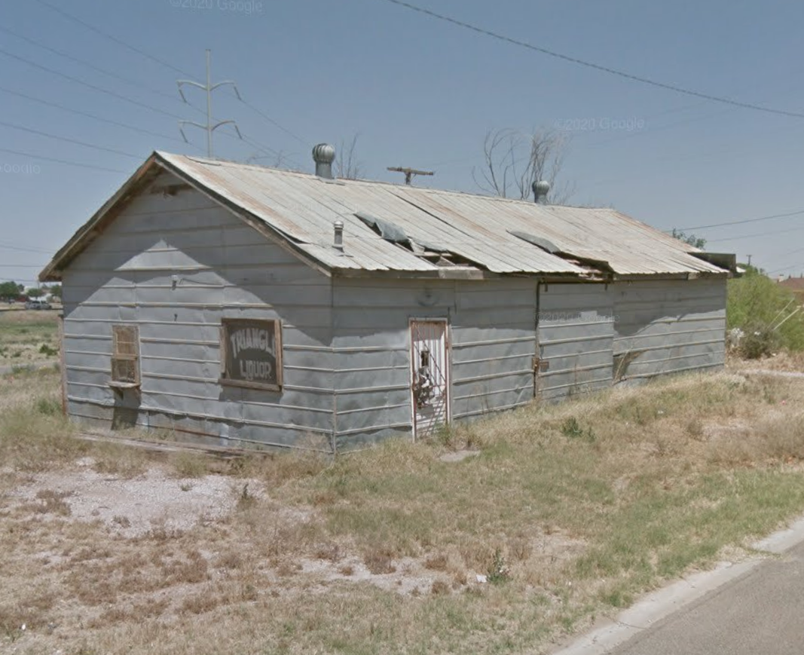
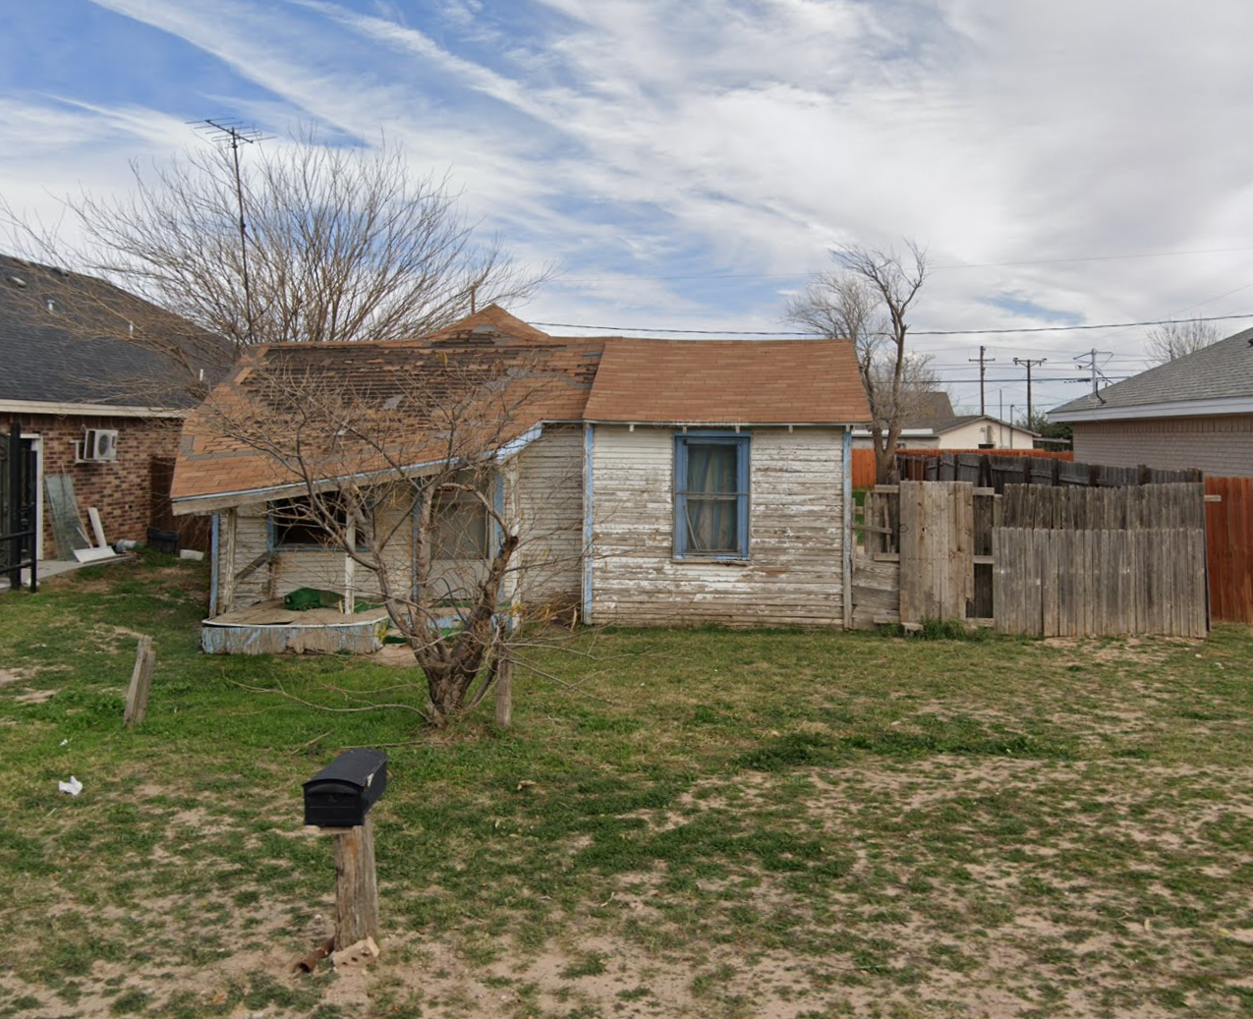
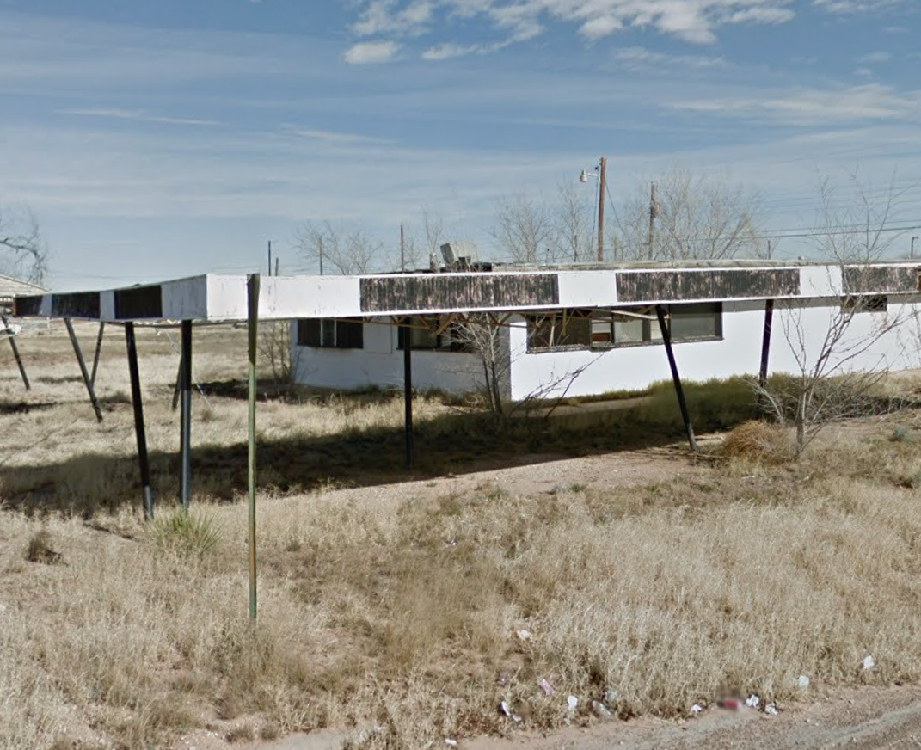
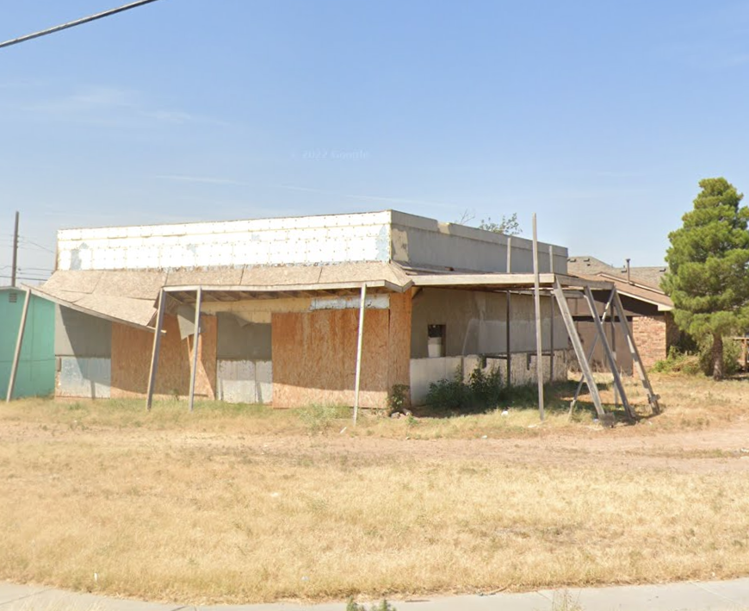
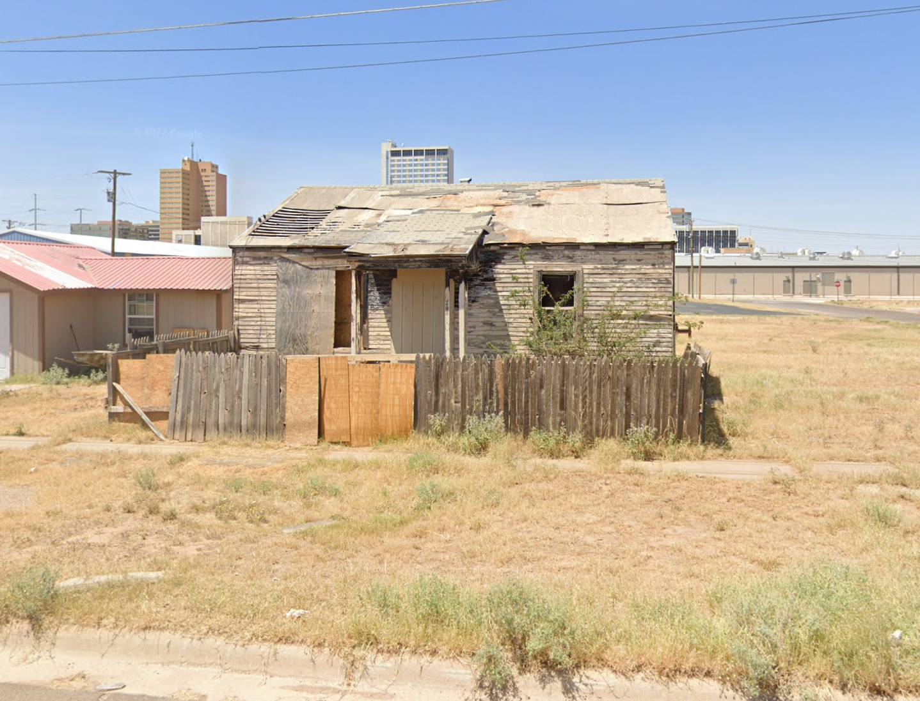
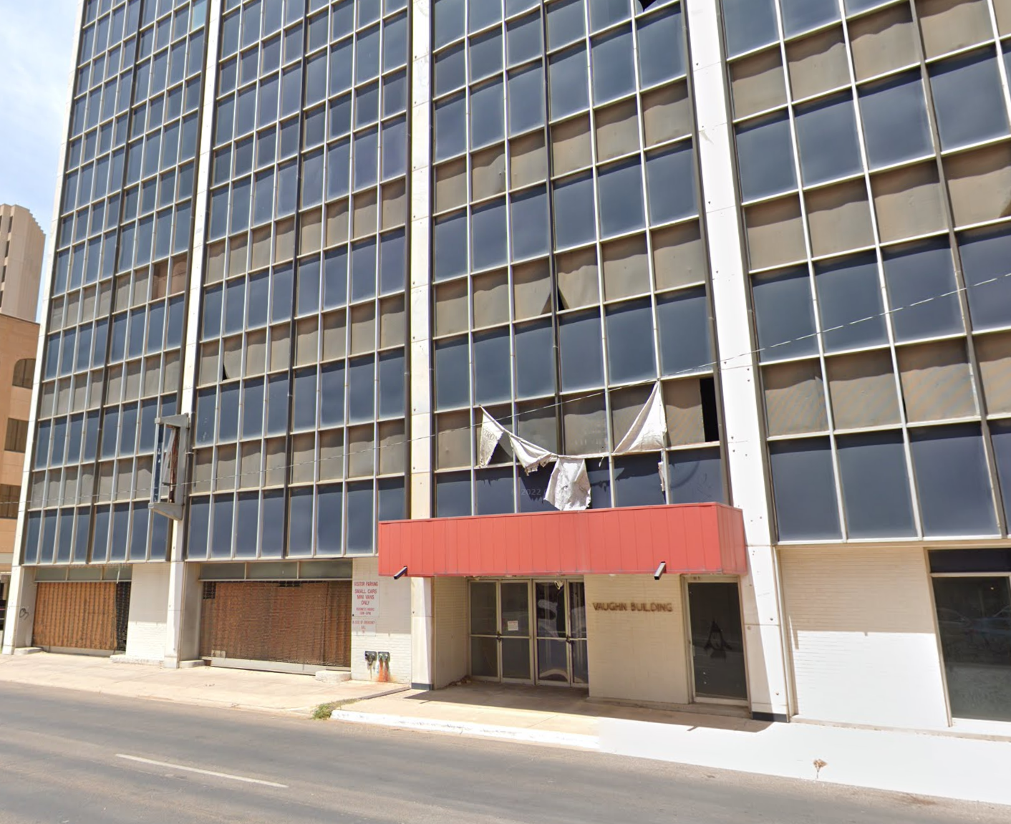
What is a “Dangerous” Building?
6

Slide 7
Update + Results
Strategy: Streamlining Building Safety Codes
ACTION: In March 2024, City Council approved code amendment, allowing City to immediately board unsecured, vacant, and dangerous buildings.
Reduces red tape and improves City’s efficiency from >130 days to <14 days
Ensures immediate safety, critical in urgent cases
Permitted by state statute upon City ordinance adoption
Best practice in various Texas cities
RESULT: Vaughn Building secured in April 2024
7
Notes:
Next Steps –
Moving through lien process
Made contact with owner’s representative
Consider redevelopment options

Slide 8
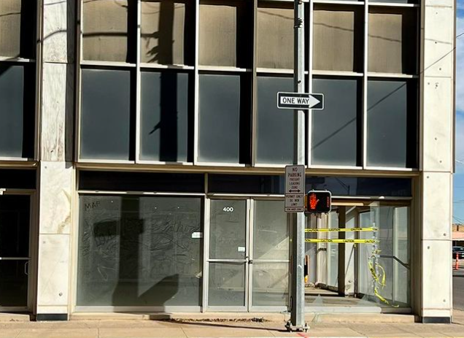
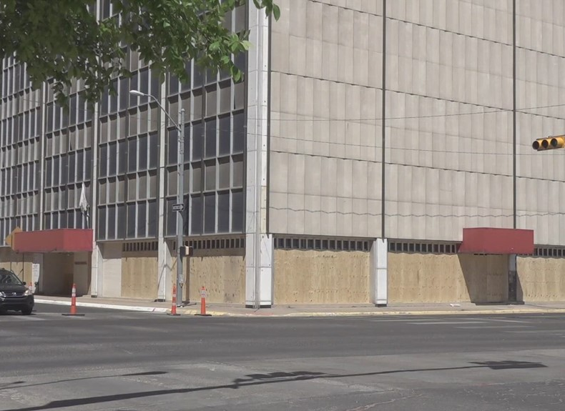
Update + Results
Vaughn Building: Before + After
BEFORE
AFTER
8
Notes:
Next Steps –
Moving through lien process
Made contact with owner’s representative
Consider redevelopment options

Slide 9
Next Steps
Strategy: Develop + Maintain Dangerous Building Inventory
Strategy
Develop + maintain a list of dangerous properties to seal, demolish, acquire, or assist the property owner in repairing or demolishing
Outcome
Enhanced Public Safety
Targeted strategy to focus on 50 to 100 properties that need action as soon as possible
Mitigating Health Risks
Revitalized Neighborhood
Address affordable housing needs
Stimulate economic growth through new small business ventures
Improve quality of life for neighborhood residents
New tax revenue is reinvested into the community
9
Notes:
Targeting: An effective code enforcement system will not only pursue violations on a complaint-driven basis but will also create priorities through proactive and strategic targeting practices intended to further substantive policy goals.
Enhanced Public Safety: By addressing hazardous structures, the strategy reduces the risk of accidents, fires, and criminal activities, contributing to a safer environment for residents.
Mitigating Health Risks: Removing structures with hazardous materials or structural deficiencies mitigates health risks associated with exposure to toxins, mold, or collapsing buildings, promoting community health and well-being.
Revitalized Communities: Redeveloping vacant or blighted properties creates opportunities for new housing, commercial ventures, or green spaces, revitalizing neighborhoods and stimulating economic growth.
Addressing Housing Needs: Repurposing or rebuilding structures can help alleviate housing shortages by providing quality, affordable housing options for residents, thereby enhancing overall livability.
Overall, a robust strategy to address dangerous or substandard buildings not only enhances public safety but also contributes to the overall prosperity, attractiveness, and well-being of the community.

Slide 10
Next Steps
Inventory Summary: 75 Identified Properties
10

Slide 11
Next Steps
Repair, Board & Secure, or Demolition (Standard Process)
Inspection + Research
Notify Property Owner
Re-Inspect
City Council Hearing
Re-Inspect
Board & Secure or Demolish
45 Days
30 Days
10 Days
30 Days
15 Days*
$50,000 in CDBG funding has been set aside to assist with repair or demolitions for properties located within an Enterprise Zone, prioritizing those single-family residences that are occupied
Majority of properties identified will follow this process
Board and secure and/or demolition should not be the end of the process – end goal is redevelopment
11
*May take longer depending on time to secure utility disconnects and asbestos clearance
Notes:
130-day long process
Majority of properties identified will follow this process, however, occupied properties and/or properties other than single-family residential or retail properties may take additional time to address
35 percent delinquent – referred for tax suit and/or tax warrant program (~6 months) – deprioritize these properties unless city wishes to retain them

Slide 12
Strategy: Addressing Dangerous Buildings
Develop + Maintain Dangerous Building Inventory
Prioritize high risk structures:
Streamline Building Safety Codes
Empower City for immediate action when a building is a public safety threat
Enhance Business Standards
Establish local hotel & motel license for standards and inspections
Encourage Redevelopment
Vacant + Unsecure
Crime Hotspots
Secure appropriately
Enhance property maintenance standards to improve public health + safety
Establish multi-family ordinance for standards and inspections
Incentivize Infill Development
Provide Small Business Grants
Target Downtown Redevelopment
High Risk Uses
Land Banking for Affordable Housing
12
Notes:
Prioritize, Secure, Strengthen, & Encourage Redevelopment

Slide 13
MISSION
Deliver exceptional services and promote a high quality of life and place for ALL our citizens.
13

