Slide 1

Goal 3
Quality of Life + Place
FY 2025 Budget Presentation
July, 2024
1

Slide 2

Table of Contents
Strategic + Organizational Alignment
Priorities Focus
Major Variances
Expenses
FY 2024 Key Accomplishments
FY 2025 Key Deliverables
2

Slide 3

Vision Block Connections
“The City of Midland will be the Premier and Safest City in West Texas by Providing World Class Municipal Services through Operational Excellence and a Culture of Innovation”
Premier City (Goals 1, 3)
3

Slide 4

Strategic Alignment
Goal 3. Quality of Life and Place
Strategies
3.1 Enhance Community Engagement: Champion innovative recreational, educational, and cultural programs that enrich residents’ lives in partnership with the business community
3.2 Foster Relationships with Foundations and Outside Businesses: Collaborate to create world-class facilities and amenities
3.3 Create an Attractive and Inclusive Living Environment: Develop and enhance live, work, and play opportunities for our citizens
3.4 Establish Beautification Programs: Implement initiatives to make the community clean and bright
4

Slide 5
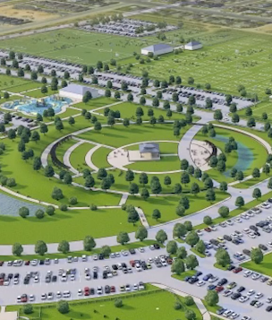

Strategic Alignment
Goal 3. Quality of Life and Place
Strategies (continued)
3.5 Nurture and Promote a Healthy Community: Increase health community living and education opportunities for citizens of all ages
3.6 Build the Best Parks System in Our Region: Offer diverse, accessible, and enjoyable green spaces, tournament ready ball fields, safe playgrounds, and unique recreational opportunities that enhance the quality of life/quality of place for our community
5

Slide 6
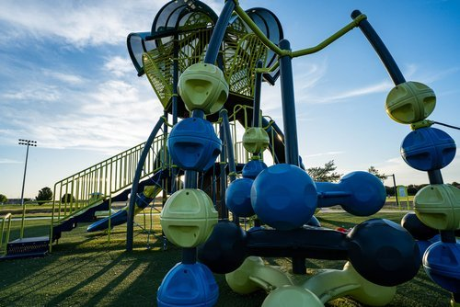
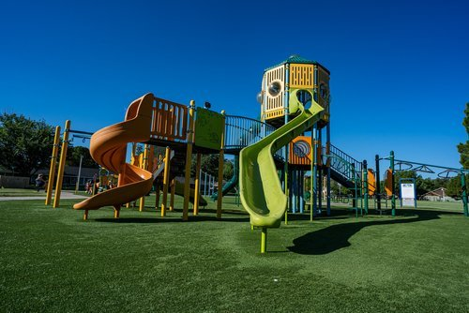
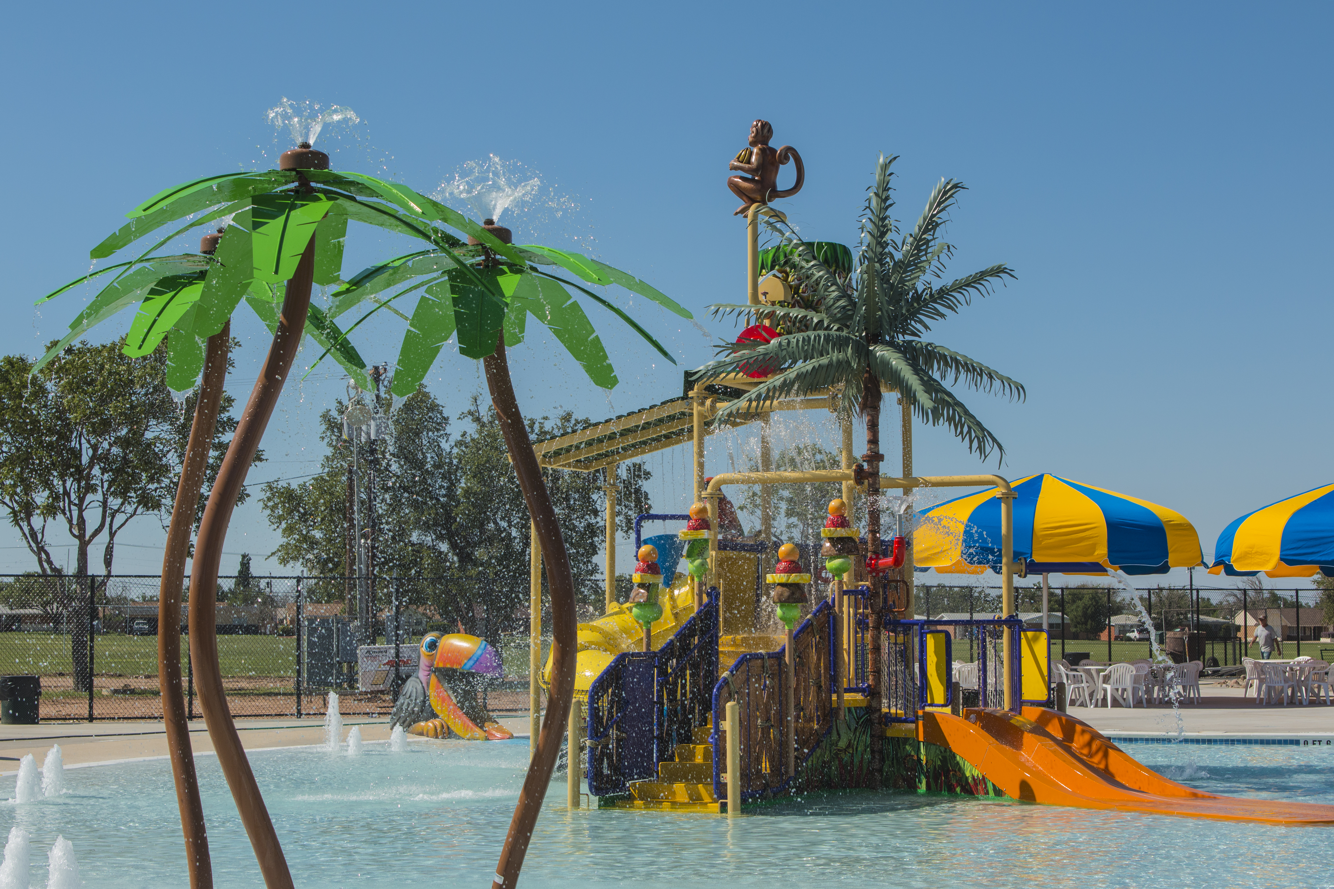
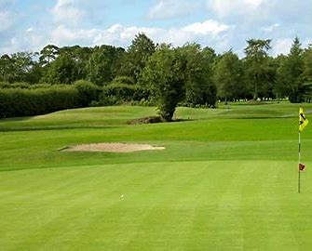
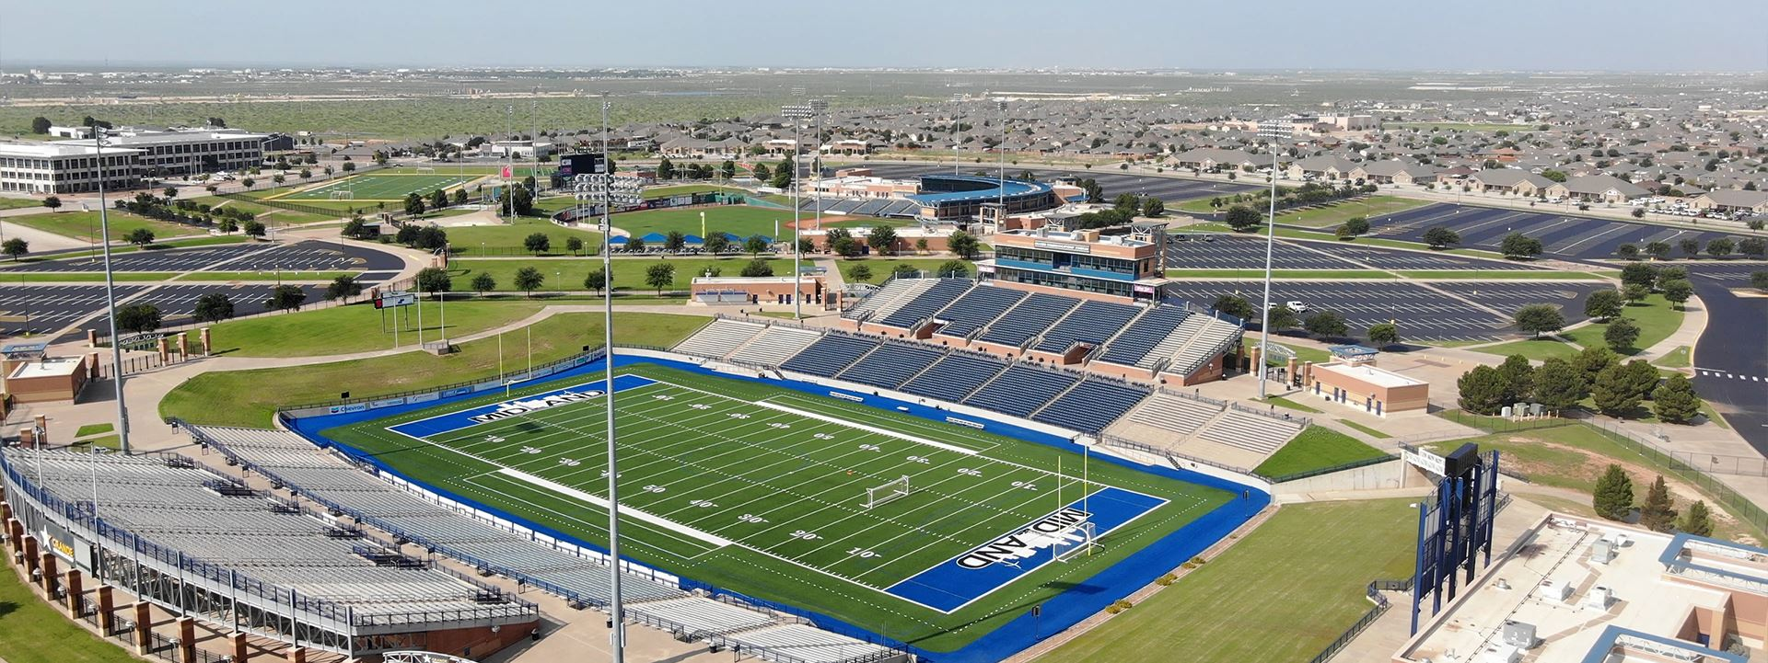
Departments
Organizational Alignment
Parks & Recreation
Midland Parks
Midland Pools
Community + Senior Centers
Hogan Park Golf Course
Scharbauer Sports Complex
6

Slide 7
Quality of Life + Place
FY 2025 ALL FUNDS BUDGET: $40,754,831
7
Notes:
CLEAN SLIDE UP!

Slide 8
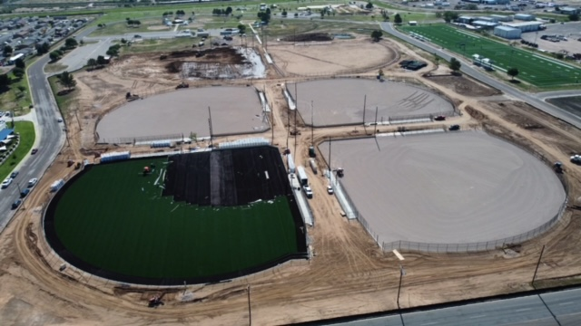
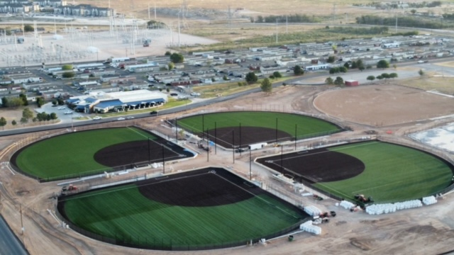
Goal Three: Quality Life + Place
Parks & Recreation
FY 2025 Priorities
Build partnerships to bring new sports tournaments to Midland, while providing updated and well-maintained facilities
New Reyes-Mashburn-Nelms baseball fields
New indoor volleyball/basketball facility at the Sports Complex developed by the Midland Athletic Syndicate
New auxiliary fields at Scharbauer Sports Complex
New soccer fields at Beal Park
8

Slide 9
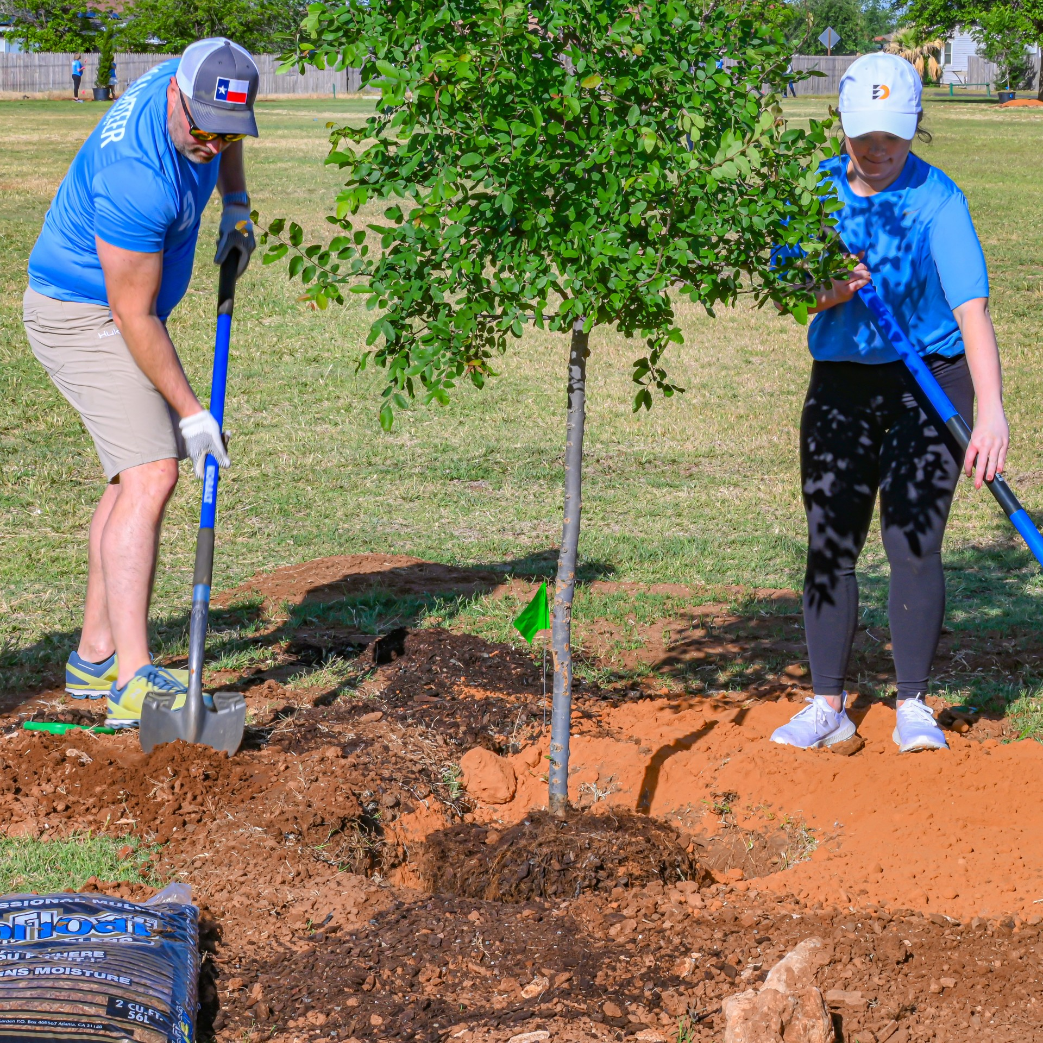
Goal Three: Quality Life + Place
Parks & Recreation
FY 2025 Priorities
Foster existing relationships + develop new public / private partnerships to enhance the quality of life for Midland
Tree planting + beautification efforts (Keep Midland Beautiful, Diamondback Energy, Texas Forest Service)
Enhanced amenity opportunities at Grasslands Park, Beal Park, and Hogan Park Golf Course
Advance the progress of the Wildcatters Trail
9

Slide 10
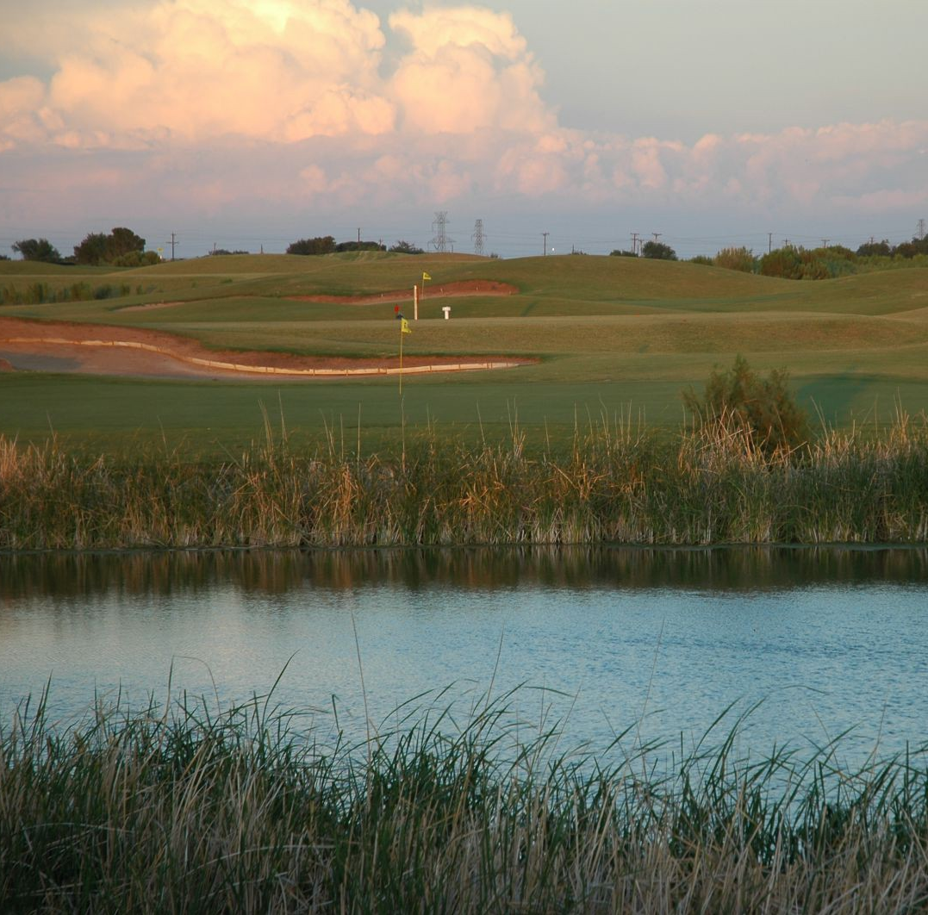
Goal Three: Quality Life + Place
Parks & Recreation
FY 2025 Priorities
Rise to the challenge of providing residents with improved facilities to play golf at the only public golf course in Midland
Begin Master Plan + phase I capital improvements
Improved course management
Ease of scheduling tee times
Improve ability to maintain course
10

Slide 11
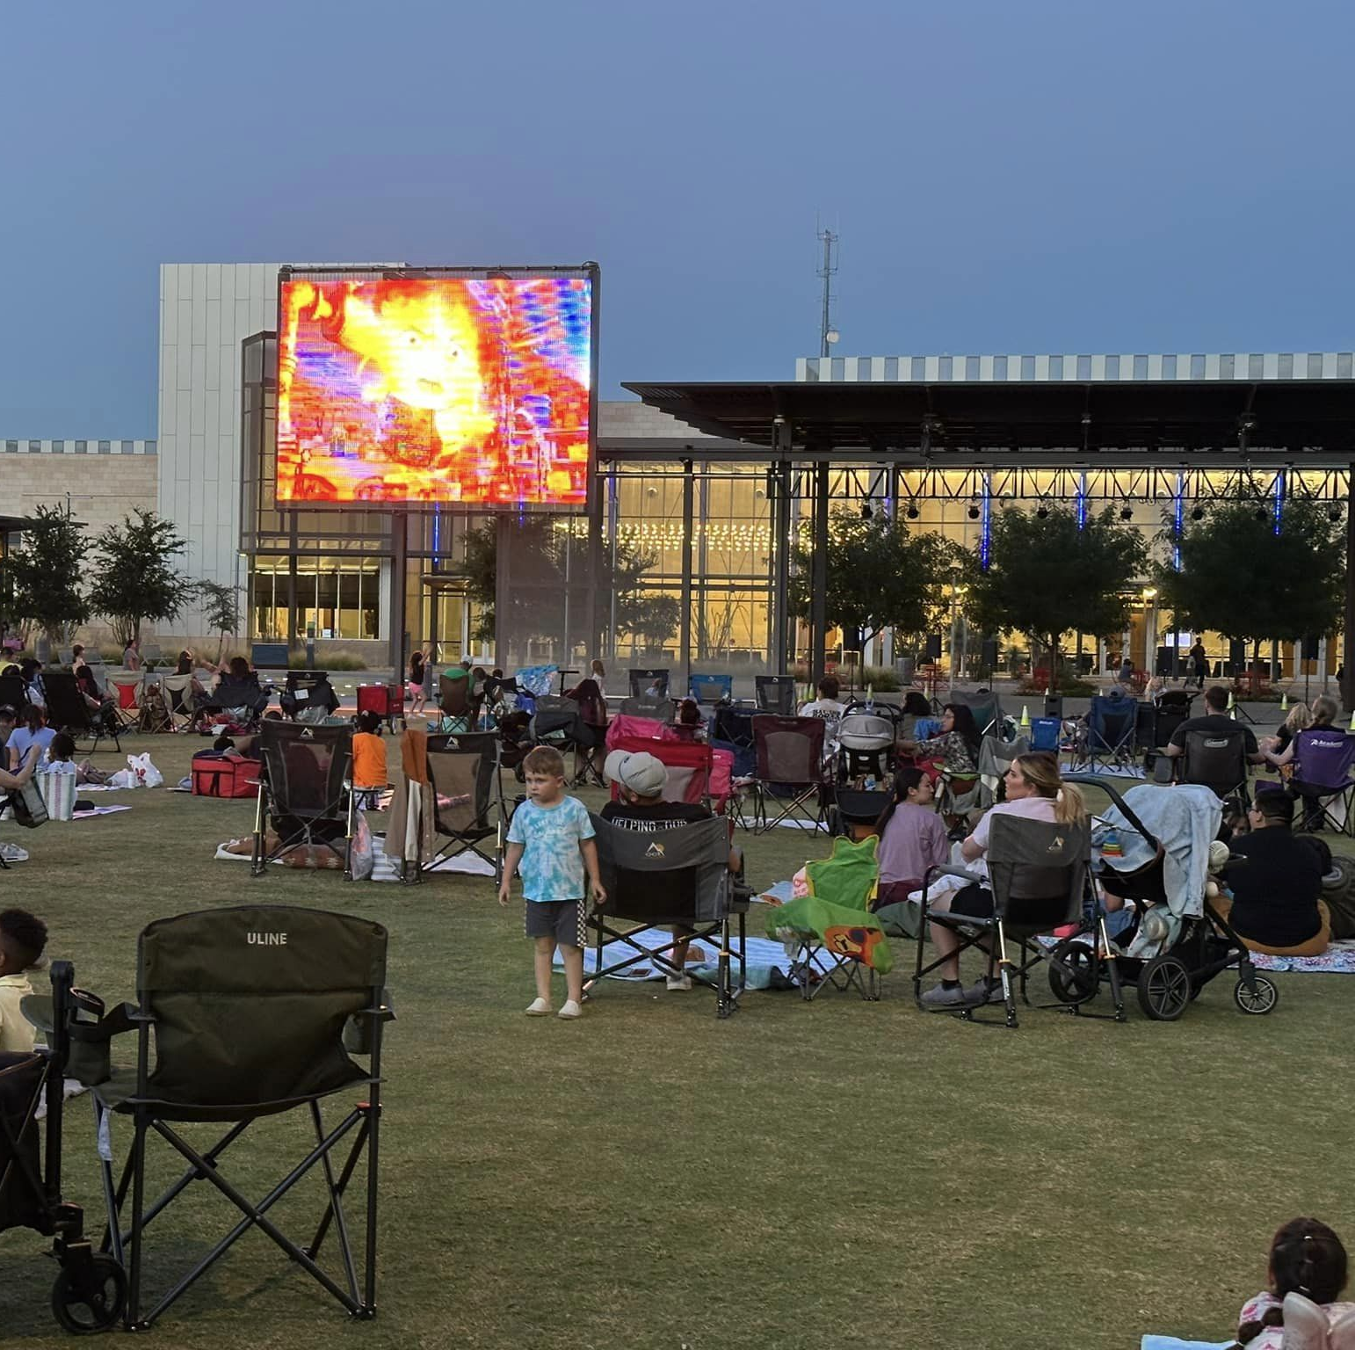
Goal Three: Quality Life + Place
Parks & Recreation
FY 2025 Priorities
Identify + develop plans for new recreational opportunities for Midlanders of all ages
Expanded programming (Chalk the Block, Holiday Lights + Mistletoe Market, Movies in the Park)
Begin scoping for updated Parks Master Plan
Multi-generational facility
Indoor playground opportunity
11

Slide 12

Major Variances
Internal services - GC and SC Tech and General liability increase
Personnel - City wide increases, Position Reclasses (Maintenance Specialists and SC Supervisor)
Capital - Beal Park project, Phase II (Oil & Gas Fund)
Transfers - Funding for Hogan Park Golf Course capital improvements
12

Slide 13
Expenses by Department
13

Slide 14
Expenses by Type
14
Notes:
3.6 percent increase in general fund; 36% increase in non-general fund

Slide 15
Staffing
15

Slide 16
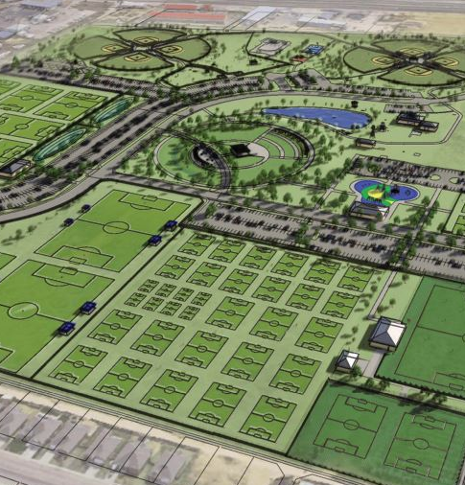
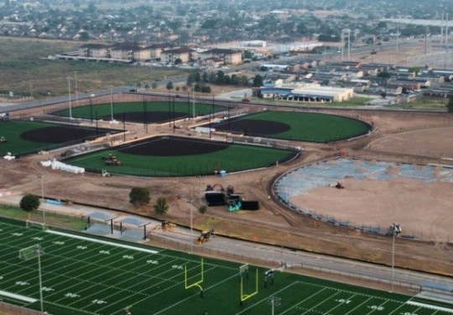
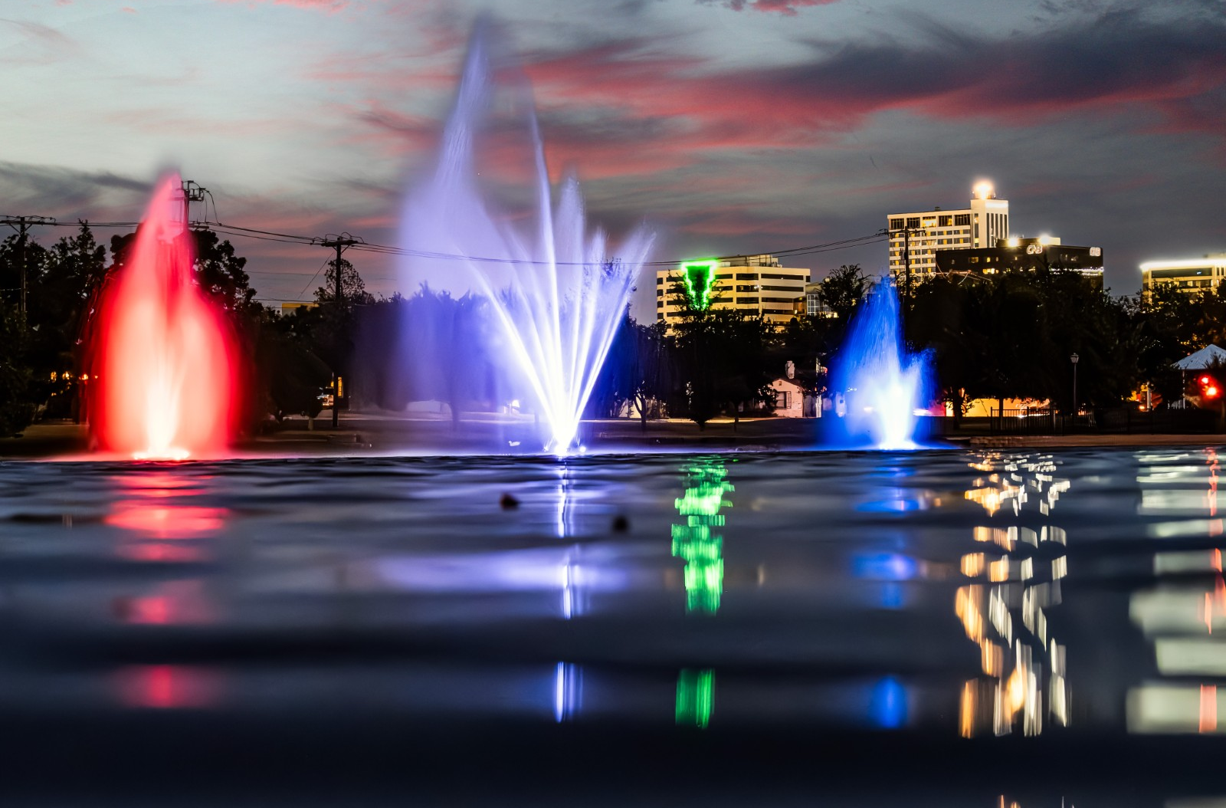
Key Accomplishments
Parks & Recreation
FY 2024
Parks + Recreation Facilities
Construction of Phase I improvements at Reyes Mashburn Nelms
Funding plan for Beal Park approved + Phase I plans underway
Wadley Barron Duck Pond fountain enhancements
Plans for Doug Russell bathhouse replacement
Add outdoor patio for SE Senior Center
Add 100+ trees in parks through partnerships
Plans for playgrounds at Grasslands + Tumbleweed Parks
16

Slide 17
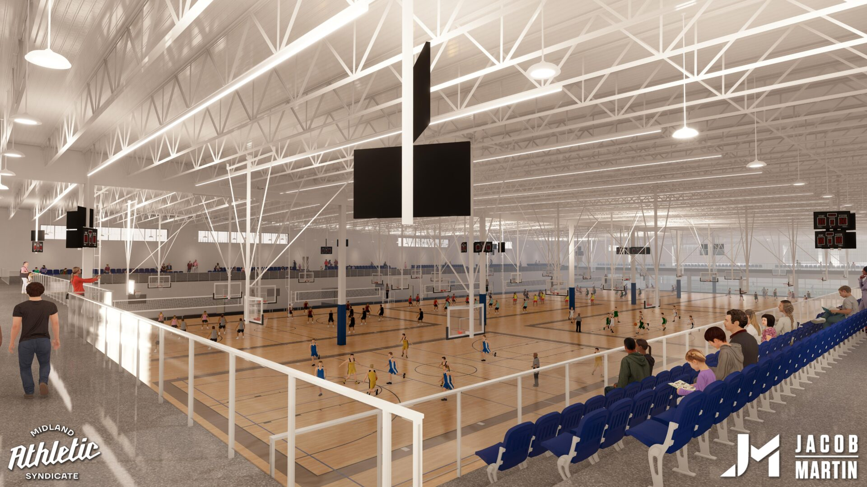
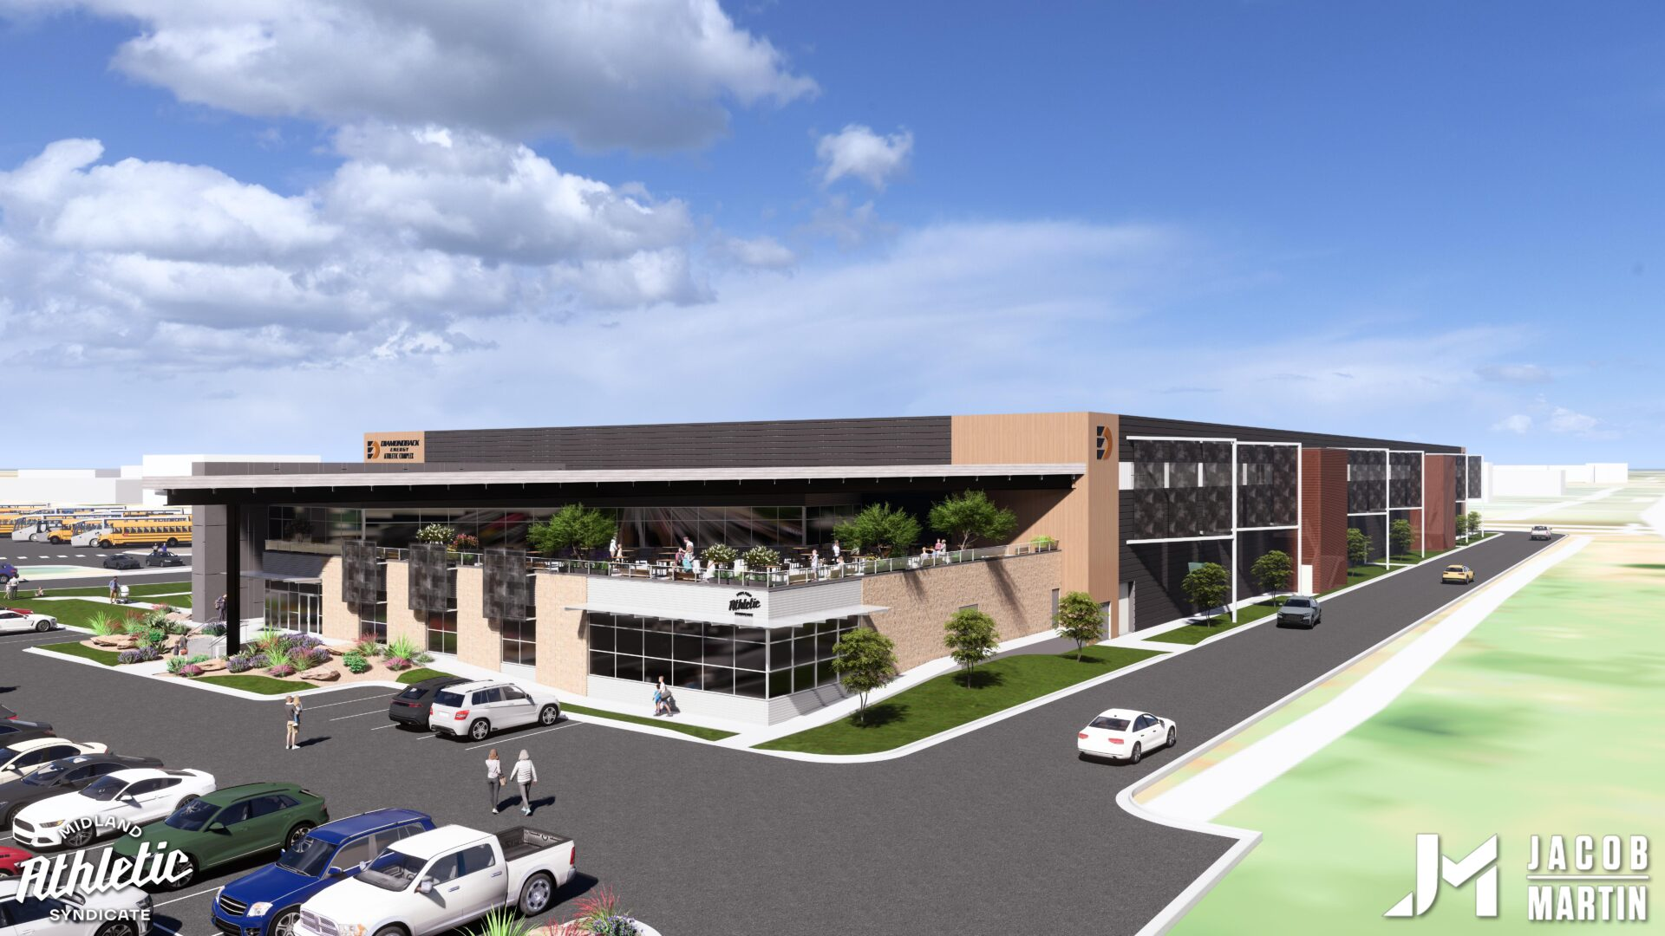
Key Accomplishments
Parks & Recreation
FY 2024
Scharbauer Sports Complex
Lease to Midland Athletic Syndicate for development of indoor volleyball, basketball + soccer facility
Completed Major League Baseball required renovations
Installed restrooms + concession stand on two auxiliary fields
Hosted 20 playoff games, 4 regular season college football games, 1 NCAA Division 2 playoff game
MISD contract for Astound Broadband Stadium approved
17

Slide 18
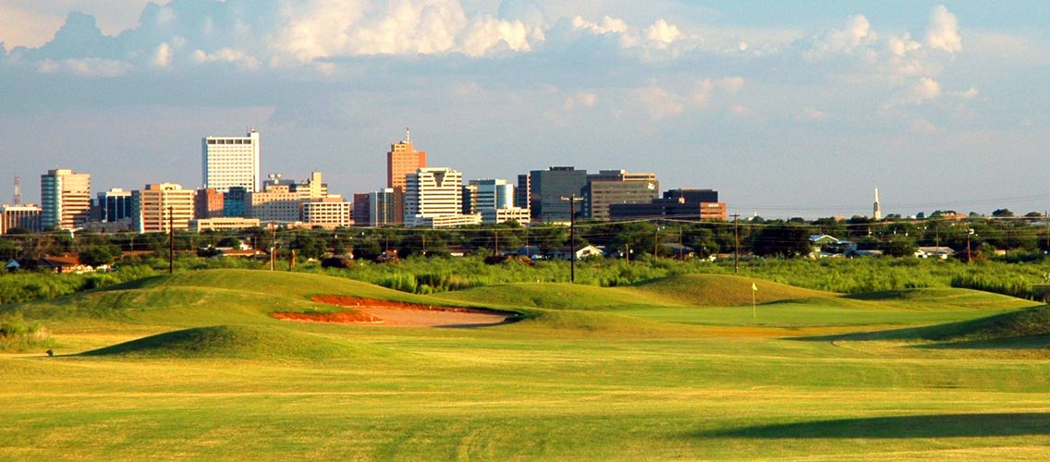
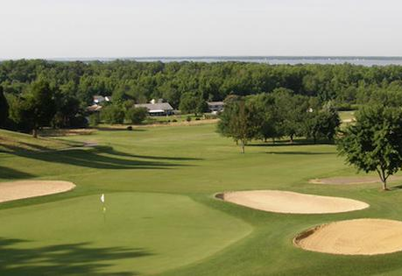
Key Accomplishments
Parks & Recreation
FY 2024
Hogan Park Golf Course
Funding plan for $22M+ in capital improvements approved - $11M in initial funding approved to begin Phase I
Adjustment to fees implemented to provide funds for capital improvements
Record sales for Pro Shop ($900k+)
Implemented new system for online tee times
Cart Barn replacement design underway
18

Slide 19
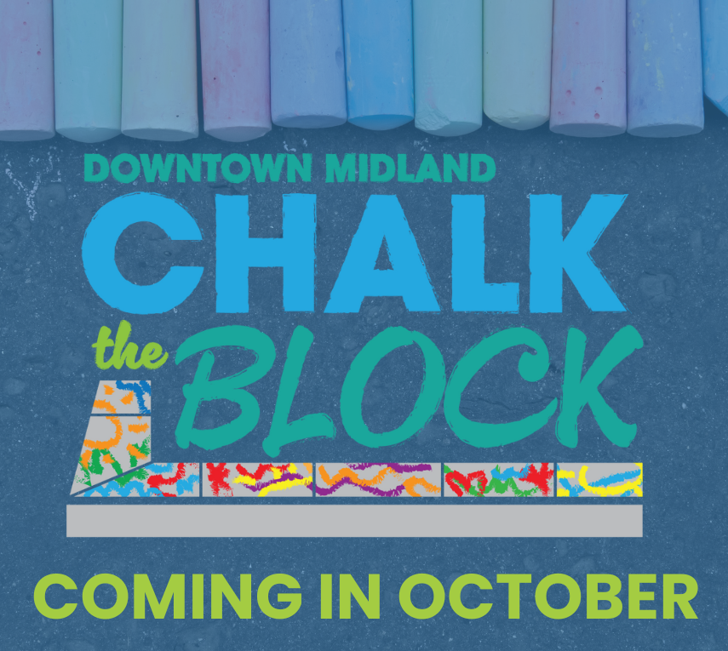
FY 2025 Key Deliverables
Strategy: 3.1 Enhance Community Engagement
Continue partnerships with sports associations to maximize use of game play fields for youth sports
Partner with local organizations to increase tournament play
Continue + expand programming:
Movies in the Park
Downtown Programming
Strategy: 3.2 Foster relationships with foundations and outside businesses
Grow partnerships to enhance park amenities with an emphasis on Beal Park
19

Slide 20
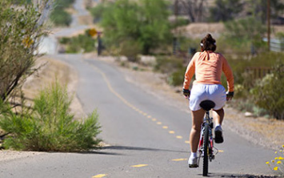
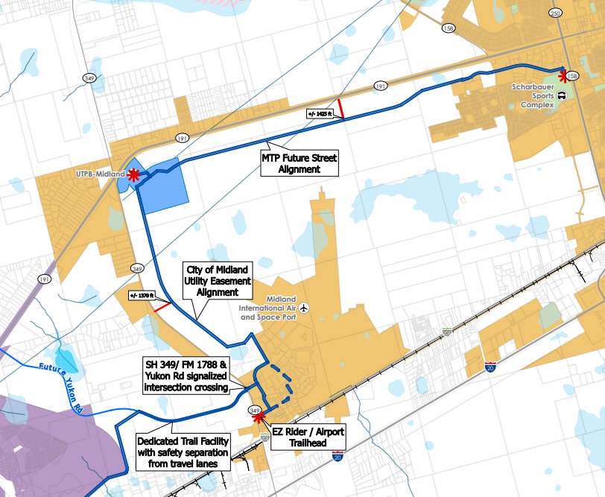
FY 2025 Key Deliverables
Strategy: 3.3 Create an attractive and inclusive living environment
In alignment with the Parks + Recreation Master Plan, begin development of parkland ordinance to ensure residents across the City have access to parks + recreational amenities
Strategy: 3.4 Establish beautification programs
Grow tree planting program in partnership with Keep Midland Beautiful and other local businesses – plant over 100 trees
Design + develop funding plan for replacement of park signage
Strategy: 3.5 Nurture and promote a healthy community
Begin design of Wildcatters Trail
Develop scope of work for Hike + Bike Trail Masterplan update
20

Slide 21
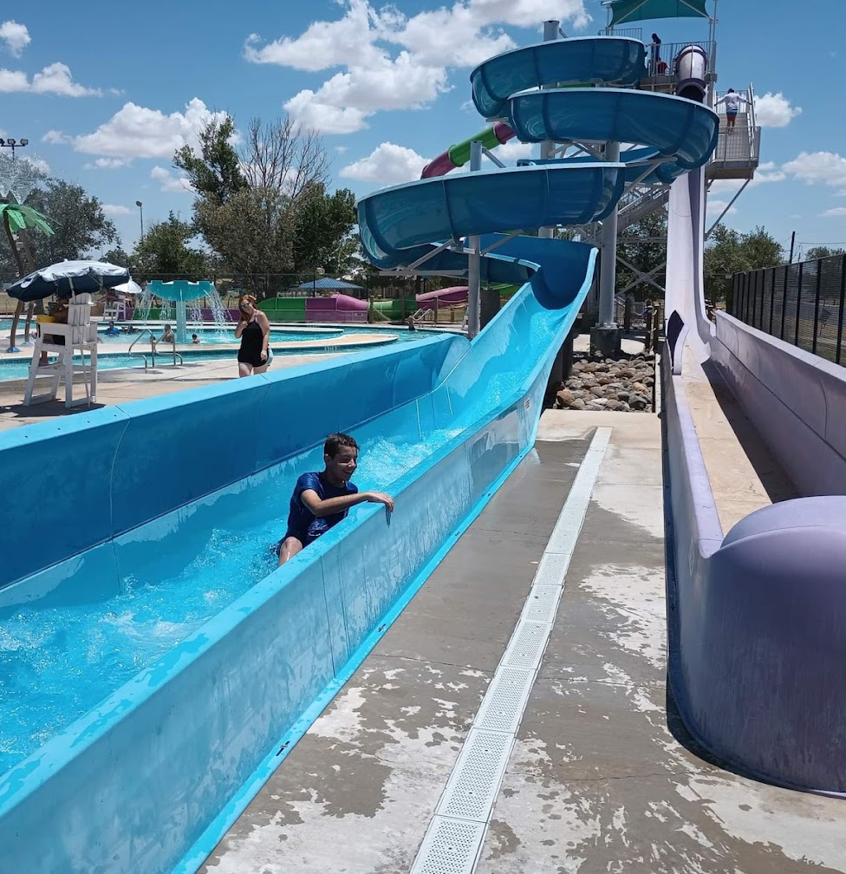
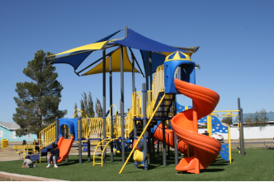
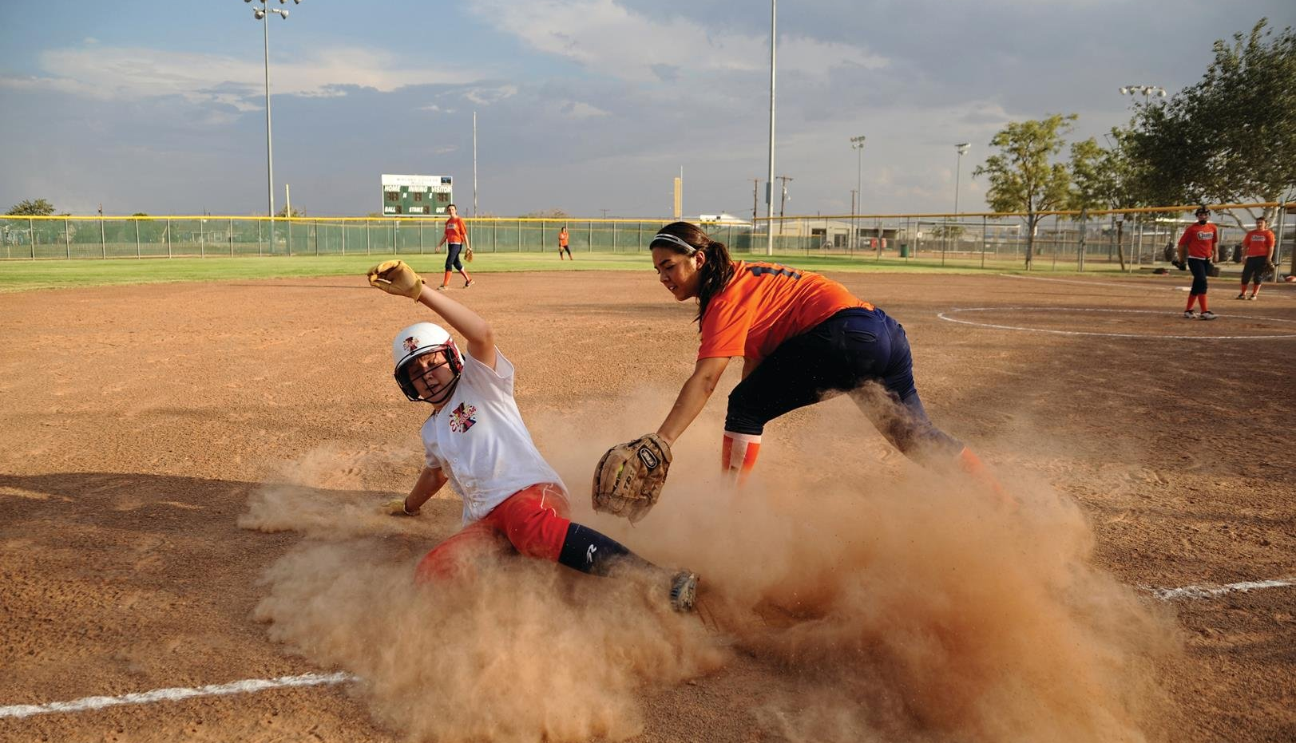
FY 2025 Key Deliverables
Strategy: 3.6 Build the best parks system in our region
Continue Reyes-Mashburn-Nelms improvements
Complete Phase I construction
Complete Phase II design for 2 baseball fields
Continue Beal Park improvements
Begin Phase I construction
Complete Phase II and III design
Improve playgrounds, fields + facilities
Install lights at MUGS + Windlands Parks
Construct new bathhouse at Doug Russell Pool
Install playgrounds at Grasslands + Tumbleweed Parks
Complete CDBG-funded projects: Washington Park slide repair + Dunagan Park restroom repair
21

Slide 22
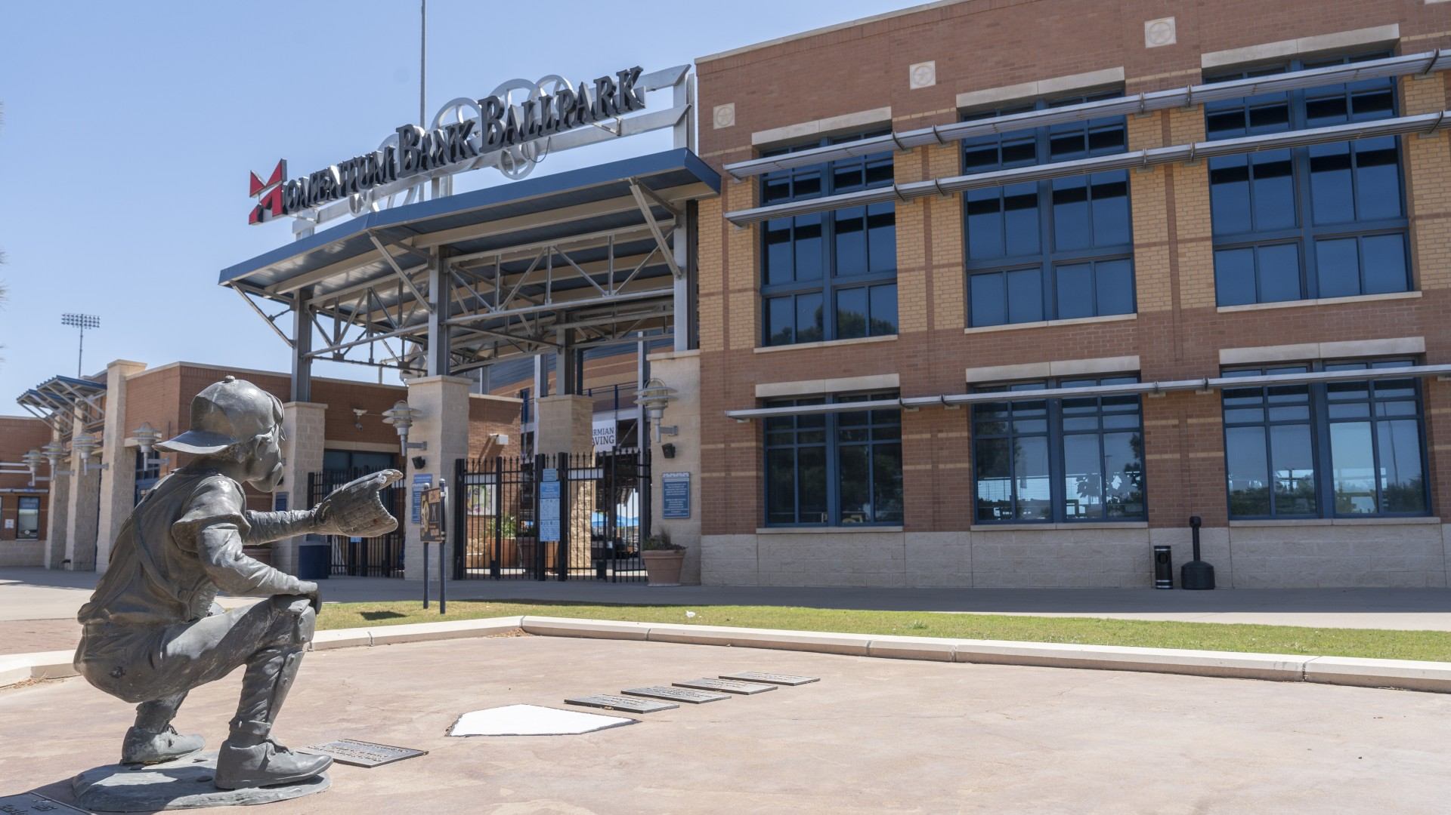
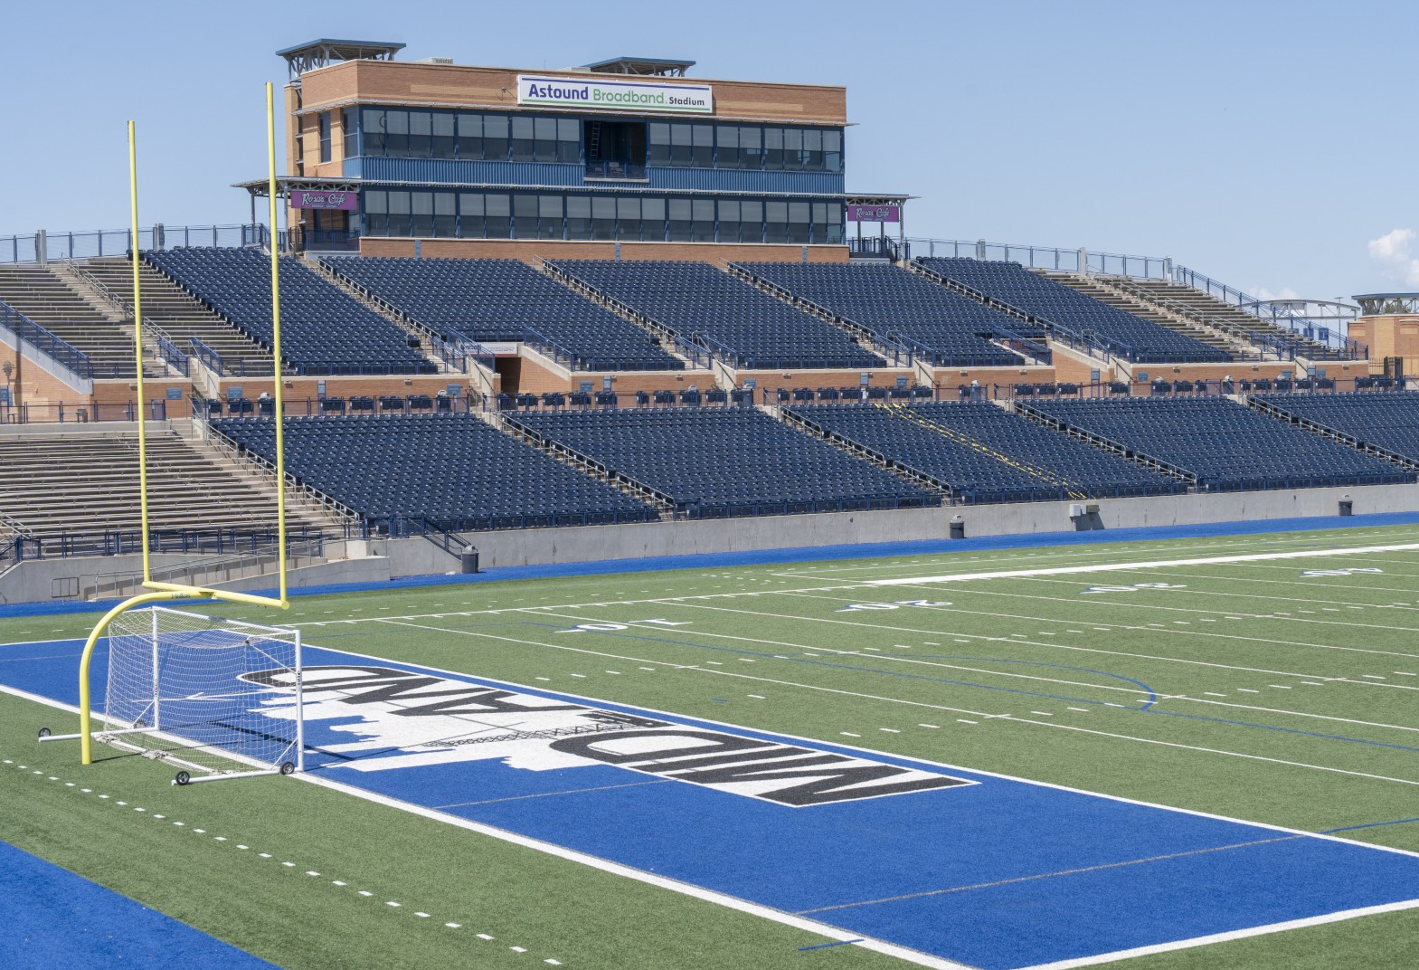
FY 2025 Key Deliverables
Strategy: 3.6 Build the best parks system in our region
Begin Phase I Hogan Park Golf Course improvements
Complete Master Plan
Complete new Cart Barn
Replace 5 restrooms + clubhouse renovation
Begin irrigation system redesign and RO system installation
Continue to improve customer experience, leveraging technology
Grow + maintain the Scharbauer Sports Complex
Develop and build 2 new auxiliary fields
Diversify stadium usage by hosting at least 25 playoff games, 5 NCAA games, and at least 1,200 auxiliary field rentals
22

Slide 23
MISSION
Deliver exceptional services and promote a high quality of life and place for ALL our citizens.
23

