Slide 1

Budget 2024-25
August 14, 2024
1

Slide 2

Year Round Budget Discussion
Oct 10th Fixed Costs
Oct 24th 5 Year Forecast
Dec 11th 5 Year Forecast (Update)
Feb 13th Making our Priorities a Priority
Mar 19th 5 Year Forecast (Update)
Apr 23rd Budget Update
2

Slide 3

Outline
Budget Timeline
Sound Fiscal Practices
Funding Our Priorities
3

Slide 4

Alignment with Strategic Plan
Goal 5: Provide Sound Governance & Fiscal Management
5.7 Ensure Continued Financial Stability and Accountability: Maintain Financial Transparency.
4

Slide 5

BUDGET PROCESS
HERE
Department Requests and
Forecasting
Prelim. Property Values
City
Management Review
Certified Valuation
City Council briefings
Budget Workshop
Set Tax Ceiling
Public Hearings
Adoption of 2025 Budget and Tax Rate
Finance Review
Fee Ordinance
Spring
Summer
Late Summer
PLANNING
PRESENTING
PASSING
5

Slide 6
Upcoming Dates
August 14 – Council Budget Workshop and Set Tax Rate Ceiling – Action Required
September 10 – Public Hearing of Budget and Tax Rate – First Reading
September 17 – Public Hearing of Budget and Tax Rate – Adoption
6

Slide 7

Sound Fiscal Practices
Strategic Plan
Healthy fund balance
Oil and Gas funds for Parks
Parks Maintenance Fund created - $2M set aside
TIRZ #2 – Downtown
Two Additional TIRZ in Planning
TIRZ/PID for Master Plan Housing Developments
Strategic Use of 380 Agreements for Development
Vacancies Funded Positions to Execute Strategic Plan
7

Slide 8

Sound Fiscal Practices
Collection Practices Implemented
Audits underway of Franchise Fees, Hotels, Sales Tax
Optimization of State and Federal Funding – Grant Team and Policy Development
Organizational Audit with Zero Findings
General Fund Subsidies
Revenue and Fee Restructuring of Enterprise Funds
Cost Recovery from Airport
8

Slide 9
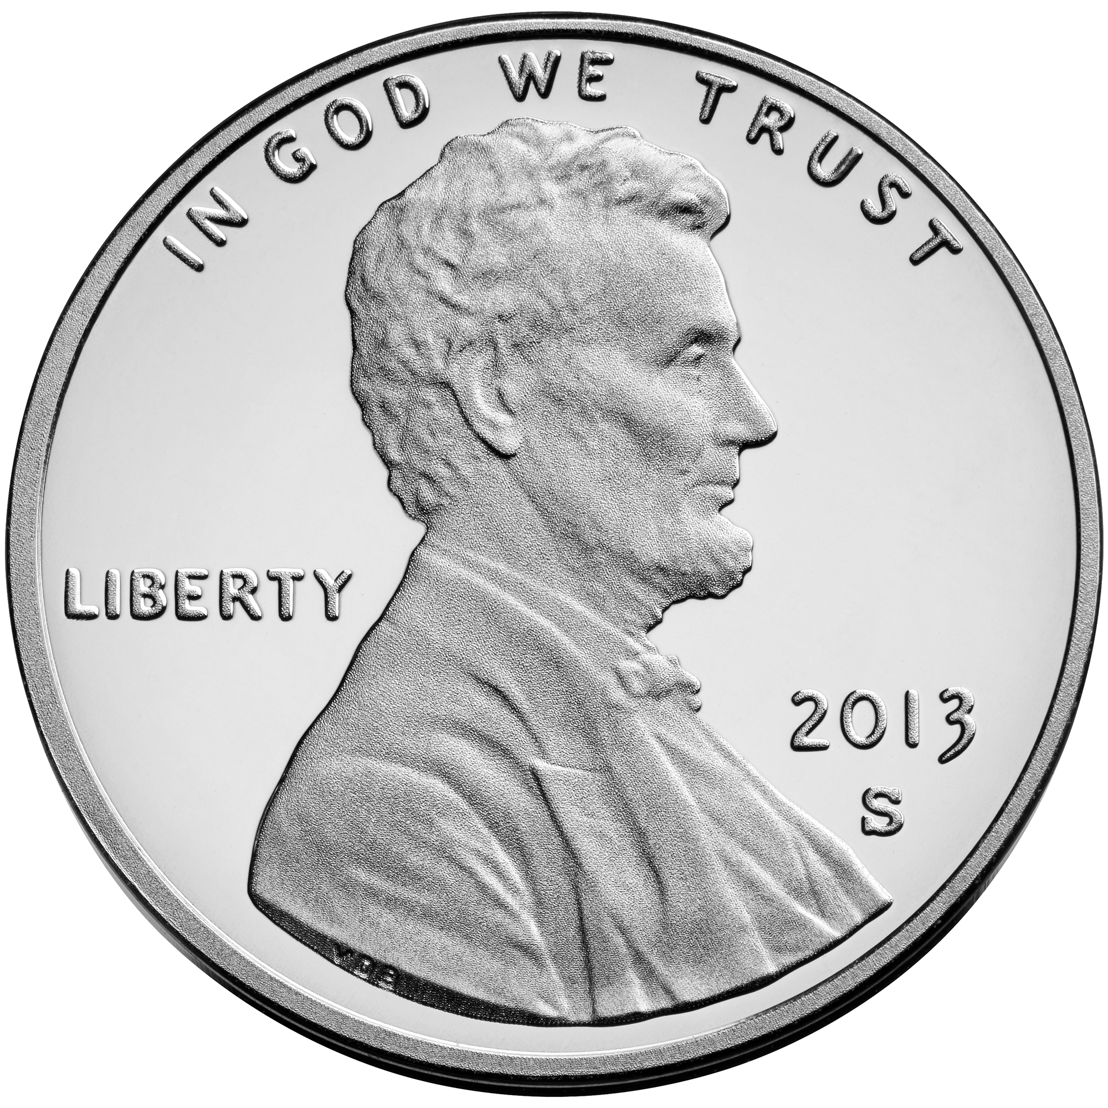
General Fund & Funding
City of Midland Revenue Streams
Property Taxes
Sales Tax
Fines and Fees for Services
City of Midland Sales Tax Rate is 1.25% - Most Texas Cities Enjoy the Full 2%
Midland County, .50%
Midland Memorial Hospital, .25%
This loss amounts to $48M Annually
City
1.25%
County
.50%
Hospital
.25%
9

Slide 10
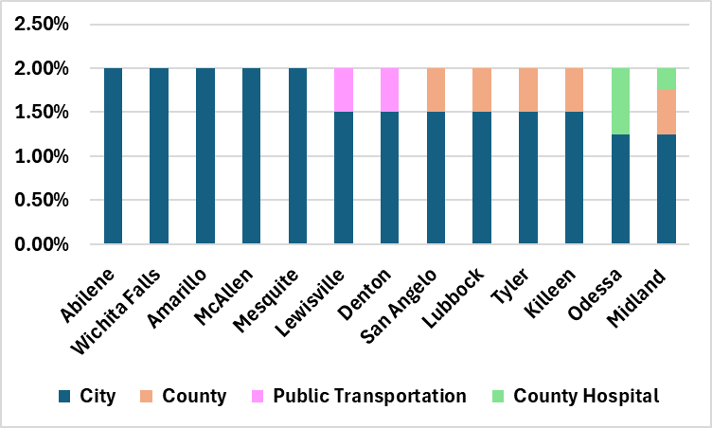
Sales Tax Rates by City
1.25%
10

Slide 11
2025 Proposed Tax Rates
Tax Rate | Adopted 2023-24 | Proposed 2024-25
Proposed Tax Rate (Adopted for 2023-24) | .350662 | .350662
Voter-Approval Tax Rate | .353162 | .353200
Voter-Approval Tax Rate w/ Increment | .380408 | .361054*
No-New-Revenue Rate | .328693 | .344044**
Interest & Sinking (Debt Service) | .060852 | .058342
*Ceiling
**Floor
11

Slide 12
Property Tax Valuation
 | FY 2024 Adopted | FY 2025 Proposed | Difference
Property tax Rate (Cents per $100) | 0.350662 | 0.350662 | -
Per $100,000 of Home Value | $350.66 | $350.66 | -
On a $300,000 Home Valuation | $1,051.99 | $1,051.99 | -
12

Slide 13
Property Tax Valuation, FY2023-FY2025
 | FY2023 Adopted | FY 2024 Adopted | FY 2025 Proposed | Two Year Difference
Property tax Rate (Cents per $100) | 0.355039 | 0.350662 | 0.350662 | -0.004377
Per $100,000 of Home Value | $355.04 | $350.66 | $350.66 | -$4.38
On a $300,000 Home Valuation | $1,065.12 | $1,051.99 | $1,051.99 | -$13.13
13

Slide 14
Property Tax Rates, FY2023-FY2025
Reduction of 44 Tax Basis Points
14

Slide 15
Property Tax Revenue Correction
Initial proposed rate revenue - $62.3 M
MCAD Valuation Correction - $63.5 M
Revenue above Operating Budget - $1.2 M
Additional funds will be allocated to the fund balance. Fund balance is at the lowest it’s been in 5 years.
15

Slide 16
Commercial vs Residential
16

Slide 17
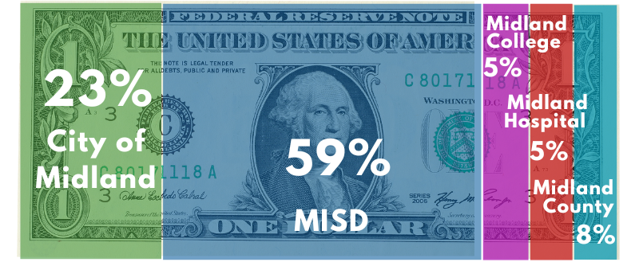
FY2024 Property Tax By Entity
17
Notes:
Midland – 0.350662
MISD – 0.877000
County – 0.120430
Hospital – 0.073120
College – 0.077410
Total – 1.498622

Slide 18
FY2024 Tax rates – Peer Cities
*Tyler does not have Debt tied to their Property Tax
18

Slide 19
FY2024 Tax rates – Peer Cities
Tax Bill on a $300,000 Valuation Property
19

Slide 20
FY2024 Tax Bills – Peer Cities
20

Slide 21
Public Safety vs Property Tax Revenue
21

Slide 22
Historical Tax Levy fy2005 to fy2025 (Represented In Cents PER $100 VALUATION)
22
Notes:
This levy will generate $ million more in revenue than last years’ budget ($ million increase to General fund M&O)
Tax rate continues trended downwards the last 20 years, and valuations continue to climb.
SB2:
Property Tax adjustment will be limited. A comprehensive review of fiscal policies is needed including:
Watching General Fund Reserves
Continue to examine all fees for service and review annually during budget season. Become familiar with other GF revenues and reduce dependence on our three main sources.
Strategies for appropriate use of debt management- only necessary capital expenditures are charged to debt proceeds.
Long-term financial planning: think long-term on capital and operations
Infrastructure management strategies: Contract with infrastructure management company to survey the city- contact local council of government for shared services. This facilitates objective, fact-based allocation of resources.
Operating cost containment: contain growth year to year. Be cautious of projects or additions that have carryover effects.

Slide 23
Closing the Gap in General Fund
Action | Deferred
Reduced Supplemental Requests | $14 Million
Hire of Equipment – Reduced Due to Slow Delivery/Production | $3 Million
Reallocating Dollars from Hard to Fill Positions | $1 Million
Tech Charge – Re-distributed Tech Charges | $1 Million
Deferred Facilities Maintenance | $1 Million
23

Slide 24
Focus on Roads, Parks, & Water Needs
ROADS AND PUBLIC INFRASTRUCTURE
$6.7M for Road Maintenance and Resurfacing
12 Corridors and Vision Zero Focus
Wildcatter Trail to begin construction
Completion of Garfield and Main Street projects
$28.8M Certificate of Obligation for Road and Public Infrastructure Projects
24

Slide 25
Focus on Roads, Parks, & Water Needs
ROADS AND PUBLIC INFRASTRUCTURE – $28M Bond
Sinclair Backage Road (SH 158 to CR 1250) $9.0M
Mockingbird Lane (Holiday Hill – Midland Drive) $7.5M
COMPASS Program, Plan Designs for Eastside $3.0M Development, Summit, & Bridge for Emergency Response Time (St. 12)
Avalon (Briarwood – Mockingbird LN) $4.5M
Wadley/Jal Draw Multiuse Trail $2.0M
Public Infrastructure $2.8M
Total: $28.8M
25

Slide 26
Focus on Roads, Parks, & Water Needs
PARKS
$2M Annual Allocation from Oil & Gas Fund to Maintenance Fund for Parks
$18M in Construction funds for Beal Park Renovation
$11M CO for Hogan Golf Course Irrigation System, Restrooms, Clubhouse, and Cart Barn
Additional maintenance position added to address growing park system
26

Slide 27
Focus on Roads, Parks, & Water Needs
WATER
$4M Annually Over the Next 5 Years to Change out Water Mains and Valves throughout City
$2M Wastewater Manholes & Draws Rehab
5 Year CIP Implementation
$500k Line Maintenance from Operating Budget
Fort Stockton Agreement for Future Water Source
Northeast Water System Improvements in construction
Advance Groundwater Treatment of TBAR
27

Slide 28
Strategic Plan Funding – All City Funds
Strategic Goal | FY2024 Budget | FY2025 Proposed | Difference | Variance
Goal 1: Strong Economy & More Quality Jobs | $26,608,999 | $29,494,333 | $2,885,334 | 10.8%
Goal 2: Set Standard for a Safe & Secure City | 95,442,408 | 99,662,154 | 4,219,746 | 4.4%
Goal 3: Quality of Life & Place | 31,007,907 | 40,754,831 | 9,746,924 | 31.4%
Goal 4: Transparent & Consistent Communication | 18,869,485 | 22,045,677 | 3,176,192 | 16.8%
Goal 5: Sound Governance & Fiscal Management | 73,491,307 | 76,435,673 | 2,944,366 | 4.0%
Goal 6: Strengthen and Sustain Infrastructure | 178,572,497 | 185,919,653 | 7,347,156 | 4.1%
Grand Total | $423,992,603 | $454,312,320 | $30,319,717 | 7.1%
28

Slide 29
Strategic Plan Funding – General Fund
Strategic Goal | FY2024 Budget | FY2025 Proposed | Difference | Variance
Goal 1: Strong Economy & More Quality Jobs | $5,417,409 | $6,822,793 | $1,405,384 | 25.9%
Goal 2: Set Standard for a Safe & Secure City | 94,326,508 | 98,659,730 | 4,333,222 | 4.6%
Goal 3: Quality of Life & Place | 10,877,780 | 11,308,778 | 430,998 | 4.0%
Goal 4: Transparent & Consistent Communication | 12,167,756 | 12,828,499 | 660,743 | 5.4%
Goal 5: Sound Governance & Fiscal Management | 21,126,562 | 21,660,256 | 533,694 | 2.5%
Goal 6: Strengthen and Sustain Infrastructure | 23,575,730 | 25,059,646 | 1,483,916 | 6.3%
Grand Total | $167,491,745 | $176,339,702 | $8,847,957 | 5.3%
29

Slide 30
General Fund Increase Breakdown
$11 M Increase
$5.2 M – Cost of Living Adjustment (COLA) and Pay Progression for City Staff
$2.5 M – Personnel positions and Re-classes
$2.0 M – Software & Liability Coverage Increases
$500k – Increase to Power & Utilities
$500k – City Increase to Midland Firemen's Relief and Retirement Fund Contribution; 22.2% to 24.2%
$350k – 3% increase on Health Insurance Premiums
+5.3%
FY 2024
$167 M
FY 2025
$176 M
30

Slide 31





Fixed Costs Increases FY2025
Staffing & Compensation +7.5%
City FRRF Contribution +9.0%
Power, Gas & Utilities +14.4%
External Insurance (5 year avg) +28.4%
Technology & Software +37.6%
31

Slide 32
Unassigned Fund Balance vs Budget
32
*Planned Spend down of Fund Balance FY2023:
$20M Transfer to Parks Oil & Gas
$26M in Supplementals and Projects

Slide 33
Start of Year Unassigned Fund Balance
33
Notes:
Based on $176M budget
The graph provides the history of unappropriated fund balance (including the reserve of 35% of GF expenditures) by the end of each Fiscal year and necessary reserve .
City charter requires that we retain 25% for emergencies, 35% is retained due to the volatility of Sales Tax Revenue

Slide 34
Expenses vs Revenue to FY2029
$16M Delta
Average Annual Expense Increase, +8.44%
Average Annual Revenue Increase, +5.35%
34
Notes:
Subsidize Sports Complex – May be covered by TIRZ
Streets - Annual Repair/Inlay
Park Maintenance – 2.5 million more needed annually
Fire Step restructure – 1.5 to 2.5 Million cost over two year period
Wildcatter – Match, one time cost

Slide 35
General Fund Forecast through FY2029
Expenses vs Revenues
$37.9M
$50.5M
$27.5M
$18.0M
Average Annual Expense Increase, +8.44%
Average Annual Revenue Increase, +3.81%
35

Slide 36
Assumptions of No New Revenue
$43.0M
$57.2M
$30.9M
$19.8M
$169k
Average Annual Expense Increase, +8.44%
Average Annual Revenue Increase, +3.28%
36

Slide 37
Budget 2024-25
August 14, 2024
37

Slide 38
2025 Proposed Tax Rates
Tax Rate | Adopted 2023-24 | Proposed 2024-25
Proposed Tax Rate (Adopted for 2023-24) | .350662 | .348662
Voter-Approval Tax Rate | .353162 | .353200
Voter-Approval Tax Rate w/ Increment | .380408 | .361054*
No-New-Revenue Rate | .328693 | .344044**
Interest & Sinking (Debt Service) | .060852 | .058342
*Ceiling
**Floor
38

Slide 39
Property Tax Valuation
 | FY 2024 Adopted | FY 2025 Proposed | Difference
Property tax Rate (Cents per $100) | 0.350662 | 0.348662 | -0.002000
Per $100,000 of Home Value | $350.66 | $348.66 | -$2.00
On a $300,000 Home Valuation | $1,051.99 | $1,045.99 | -$6.00
39

Slide 40
Property Tax Valuation, FY2023-FY2025
 | FY2023 Adopted | FY 2024 Adopted | FY 2025 Proposed | Two Year Difference
Property tax Rate (Cents per $100) | 0.355039 | 0.350662 | 0.348662 | -0.006377
Per $100,000 of Home Value | $355.04 | $350.66 | $348.66 | -$6.38
On a $300,000 Home Valuation | $1,065.12 | $1,051.99 | $1,045.99 | -$19.13
40

Slide 41
All City Funds
FY2025 Budget
All Funds
Total
$454 Million
41

Slide 42
General Fund
FY2025 Budget
General Fund Total
$176 Million
42

