Slide 1

Goal 1
Strong Economy with More Quality Jobs
FY 2025 Budget Presentation
July, 2024
1

Slide 2

Table of Contents
Strategic + Organizational Alignment
Priorities Focus
Major Variances
Expenses
FY 2024 Key Accomplishments
FY 2025 Key Deliverables
2

Slide 3

Vision Block Connections
“The City of Midland will be the Premier and Safest City in West Texas by Providing World Class Municipal Services through Operational Excellence and a Culture of Innovation”
Premier City (Goals 1, 3)
3

Slide 4

Strategic Alignment
1. Strong Economy with More Quality Jobs
Strategies:
1.1 Increase the Midland Sales Tax Base: Develop strategies to expand the tax base by attracting businesses and supporting local commerce
1.2 Enhance Visitor Revenue Opportunities: Boost tourism through marketing and infrastructure improvements
1.3 Continue Downtown and West Midland Redevelopment: Promote revitalization efforts for a vibrant downtown
1.4 Nurture Development Districts: Establish key action plans honed to enhance Development Districts
1.5 Grow the Core Business of Air Transportation: Develop and transform the Midland airport system
4

Slide 5
Strategic Alignment
1. Strong Economy with More Quality Jobs
Strategies (continued):
1.6 Diversify Midland’s Economy: Support initiatives that diversify the local economy and enhance resilience
1.7 Expand Opportunities and Programming for General and Small Business: Foster the growth, retention, and expansion of local small businesses as well as business in general
1.8 Improve Speed to Market for Citizens, Builders, Developers, and Contractors: Reduce wait times for permit review/approval and inspection process of permitted work
1.9 Establish Our Community as a Premier Destination for Retail and Entertainment: Offer unique and compelling experiences that draw visitors, ultimately driving economic growth and community vibrancy, while increasing tourism and business development
5

Slide 6
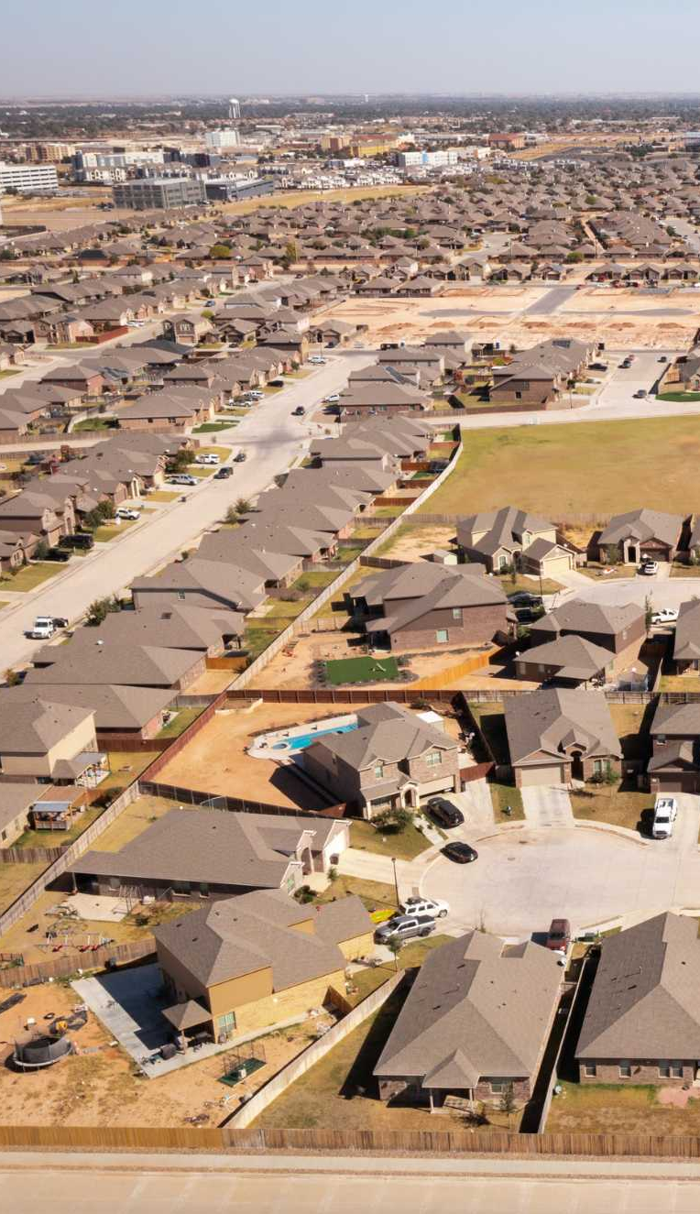
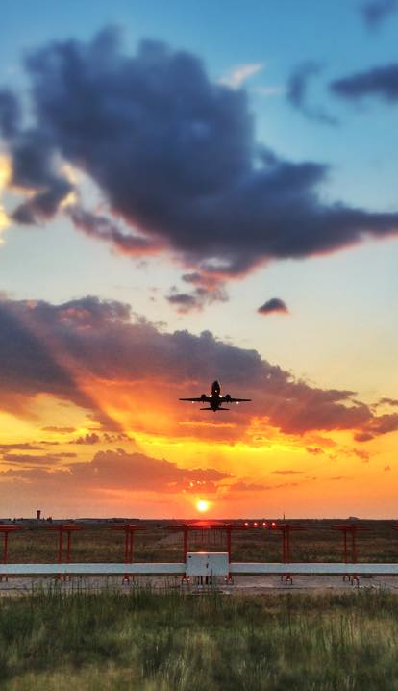

Departments
Organizational Alignment
Airports
Development Services
The Oilfield Photographer, Inc.
6

Slide 7
Strong Economy with More Quality Jobs
FY 2025 ALL FUNDS BUDGET: $29,494,333
7
Notes:
CLEAN SLIDE UP!

Slide 8
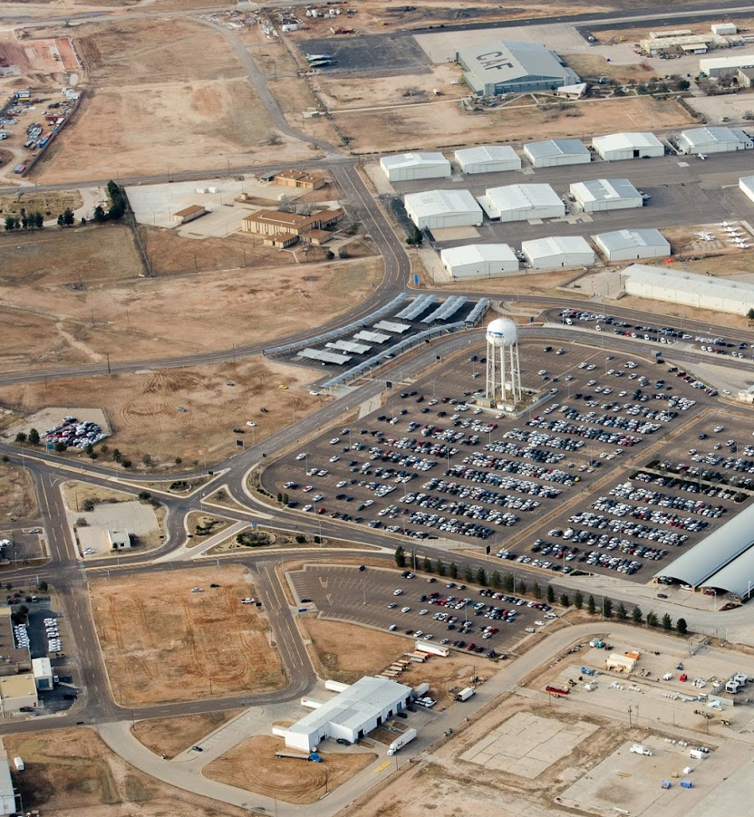
Goal One: Strong Economy
Airports: FY 2025 Priorities
Advance + Complete Capital Improvements
Midland International Air & Spaceport
Secure funding for construction of Terminal Expansion
Complete fence line improvements
Complete design of Airport Entrance Road Beautification
Complete reconstruction of asphalt apron and blast pad
Complete wildlife management improvements
Midland Airpark
Construction of self-serve fueling
Complete design + begin Midland Airpark Hangar Project
Complete Airfield Rehabilitation Project
8

Slide 9
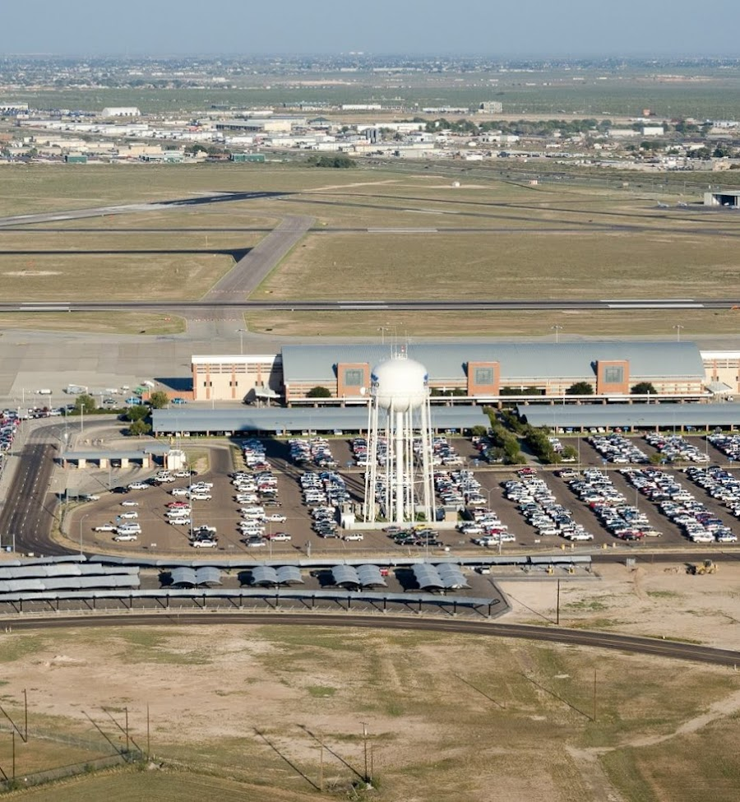
Goal One: Strong Economy
Airports: FY 2025 Priorities
Advance Airport-Owned Real Estate Development
Coordinate with Millionaire FBO to meet lease conditions for a new FBO
Continue aerospace development efforts with MDC
Update Master Plan for Midland International Air + Spaceport
Complete annexation of east MAF + incorporate into master plan
Work with Development Services on master planning and sale of airport-owned land in Northeast Midland
Continue Air Service Development
Complete airline agreements and begin new lease agreements
9

Slide 10
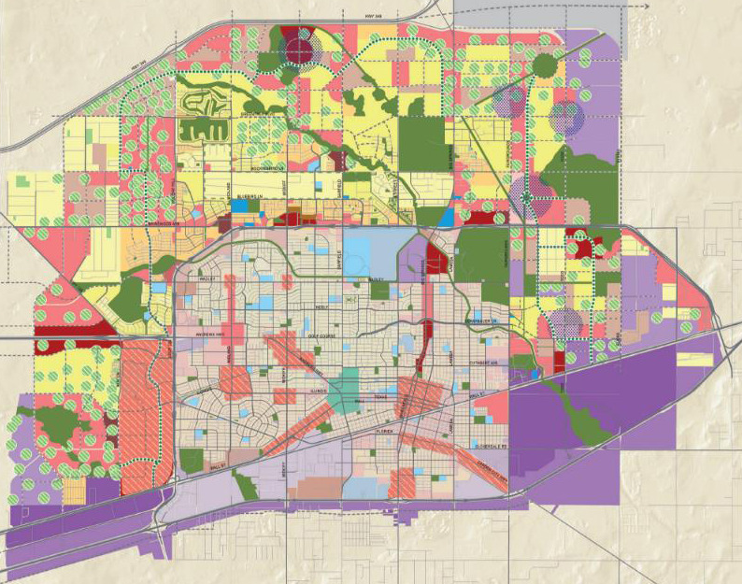
Goal One: Strong Economy
Development Services:
FY 2025 Priorities
Proactively Plan for and Facilitate Future Growth
Initiate the Tall City Tomorrow Comprehensive Plan update
Develop action plans for key development districts
Leverage City real estate assets for economic development
10

Slide 11
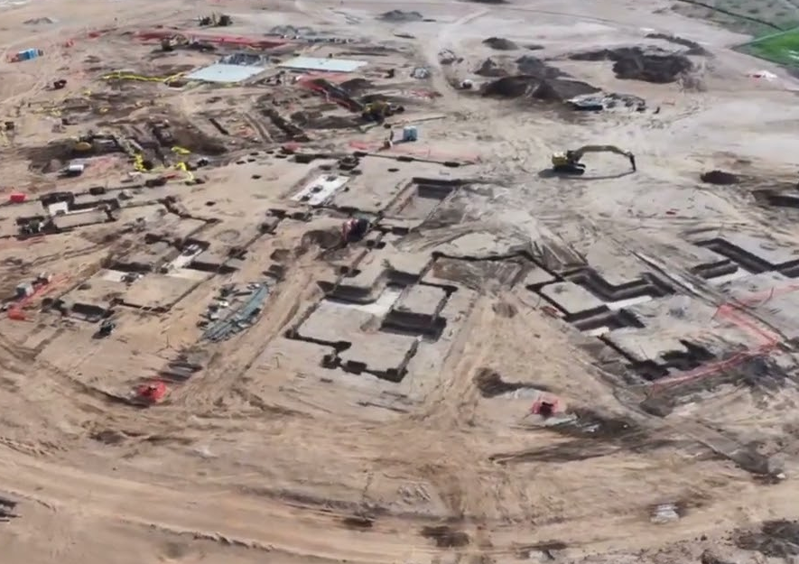
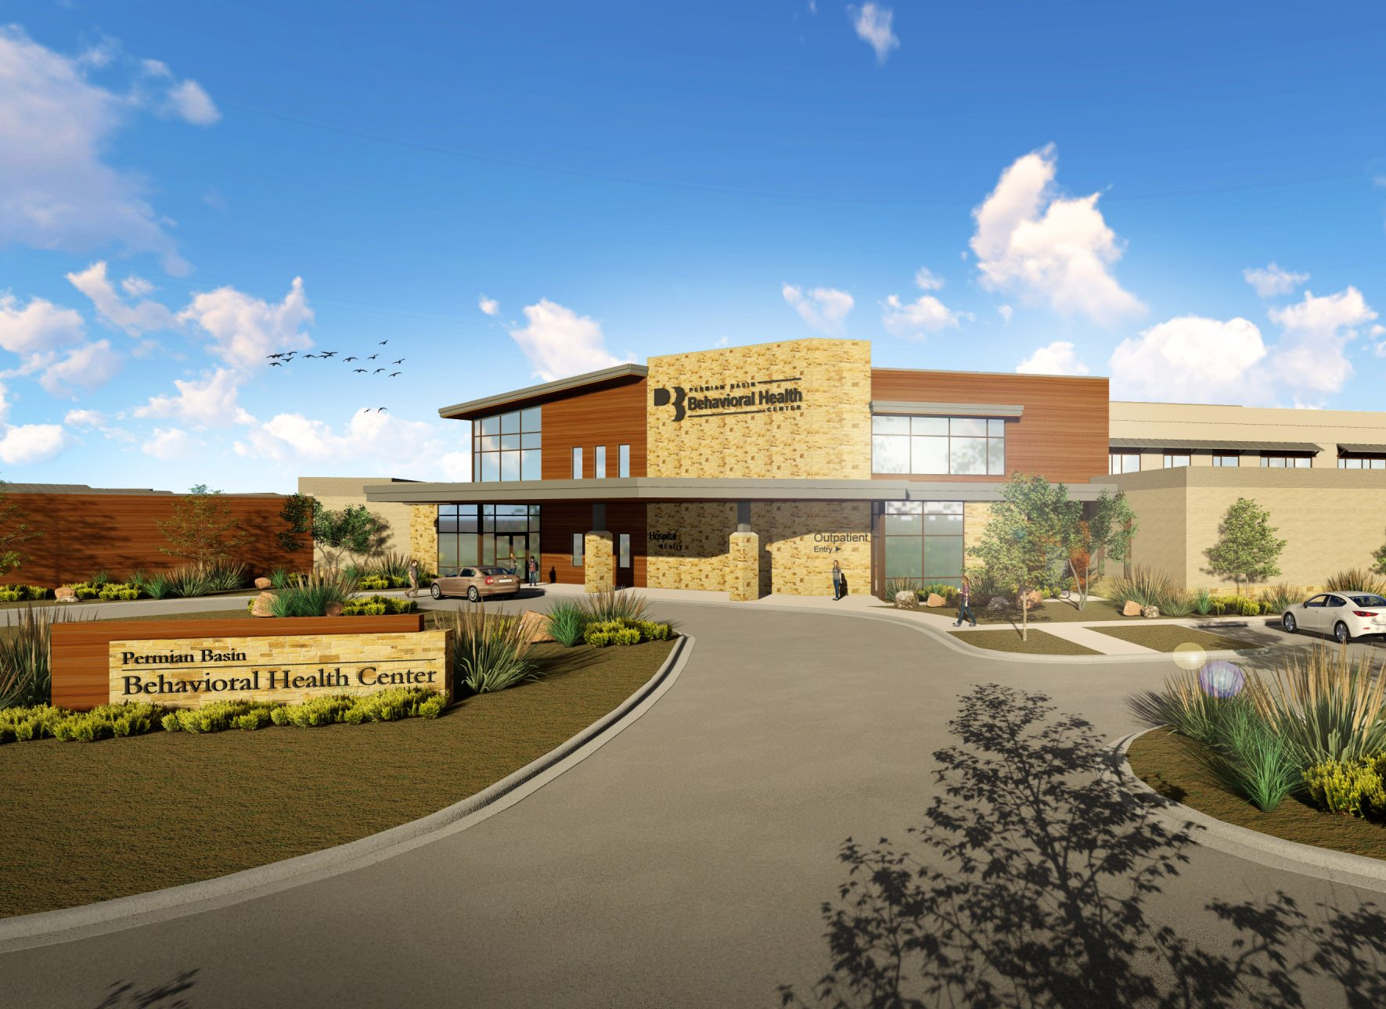
Goal One: Strong Economy
Development Services:
FY 2025 Priorities
Improve Development Speed to Market
Enhance the customer experience with technology
Streamline entitlement, permitting, and inspection processes
Invest in planning staff retention and growth
Encourage Strategic Economic Development
Promote economic growth in key industries
Support small business development
Foster destination retail and entertainment growth
Advance (re)development initiatives, including Downtown
11

Slide 12

Major Variances
Airports
Runway and building maintenance
General Fund Transfer, Liability Insurance, Hire of Equipment, and Technology Charge
Development Services
Increase in staffing to address economic development priorities, improve permitting processes, and improve effectiveness of code enforcement
Transfer of intergovernmental relations and grants team to Development Services
Increase to contractual services to begin comprehensive and master planning initiatives
12

Slide 13
Expenses by Department
Goal 1. Strong Economy
13

Slide 14
Expenses by Type
Goal 1. Strong Economy
14

Slide 15
Staffing
Goal 1. Strong Economy
15

Slide 16
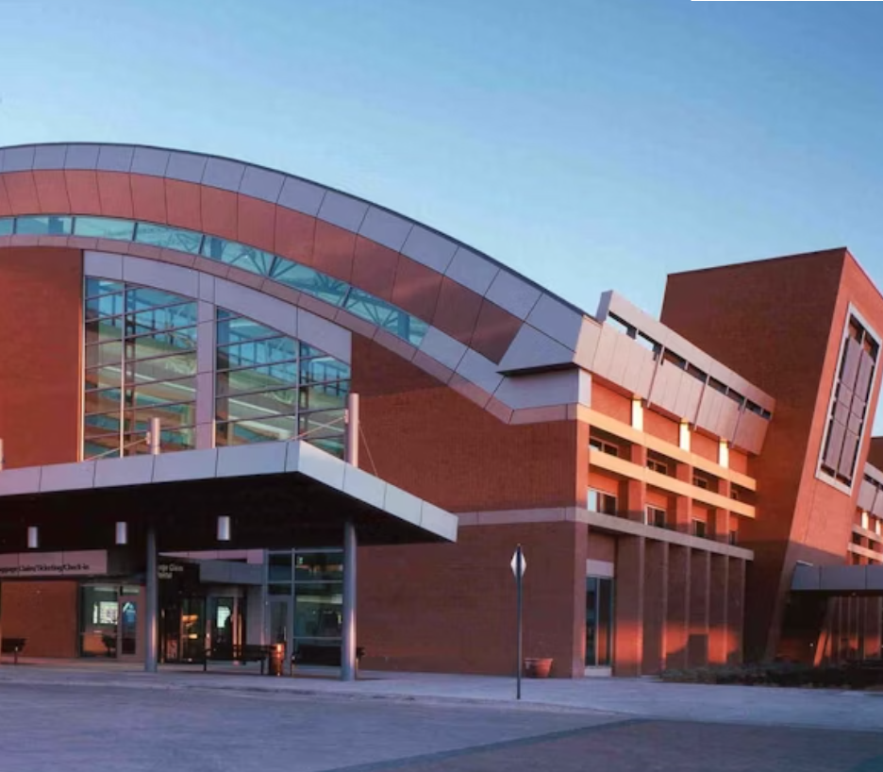
Key Accomplishments
Airports
FY 2024
Capital Improvements
Completed $7.7M MAF Multi-Facilities Project
Completed $2.7M NW Drainage Basin Wildlife Project
Completed $3.6M Taxiway E Reconstruction
Secured $2.7M for Terminal Expansion + Modernization Project design
Airpark Fence Project underway to replace the fence line along Loop 250
16

Slide 17
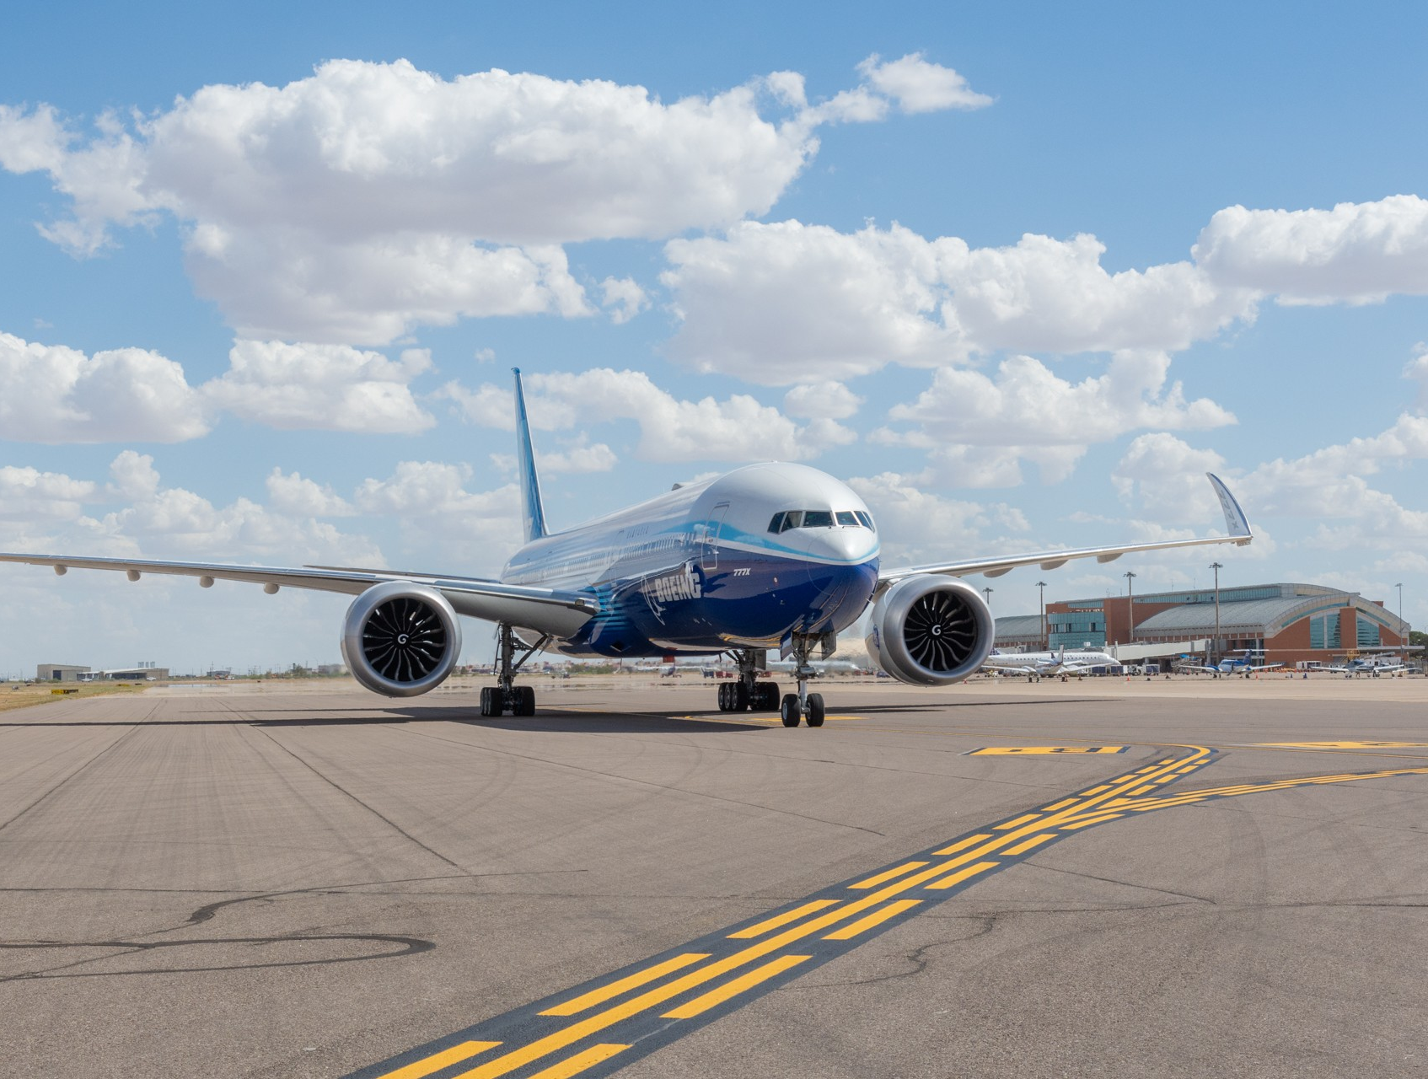
Key Accomplishments
Airports
FY 2024
Air Service Development
Delta Airlines began service in April 2024 with three daily flights to Austin
Completed a Rates & Charges Analysis to compute the fair rates and charges for airlines and tenants
17

Slide 18
Key Accomplishments
Development Services
FY 2024
Permitting & Inspections
Reduced commercial permit issue times by 53%, on average (as of May)
Reduced residential permit issue times by 73%, on average (as of July)
Permitting volume returned to pre-COVID era
Notable permits issued: Memorial Hospital, Behavioral Health, The Summit
18

Slide 19
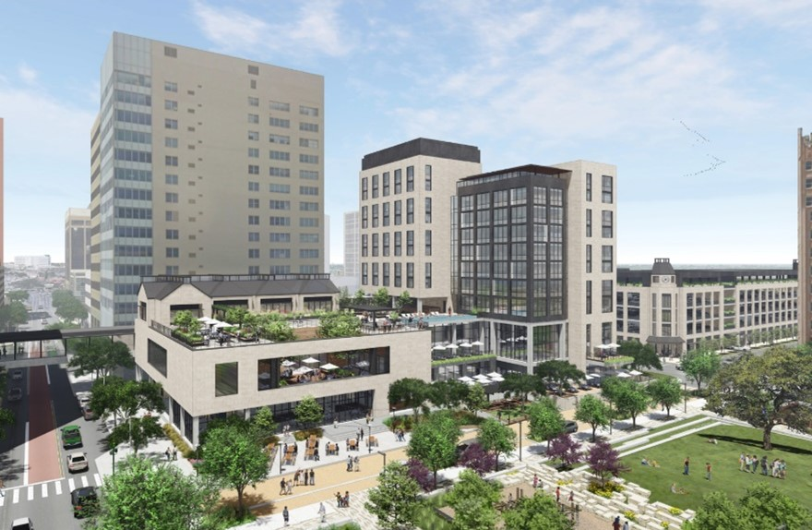
Key Accomplishments
Development Services
FY 2024
Downtown Redevelopment
Downtown TIRZ re-established, including 4 participating taxing entities
Entertainment Overlay approved
Development Agreement for 4-star Downtown Hotel approved
19

Slide 20
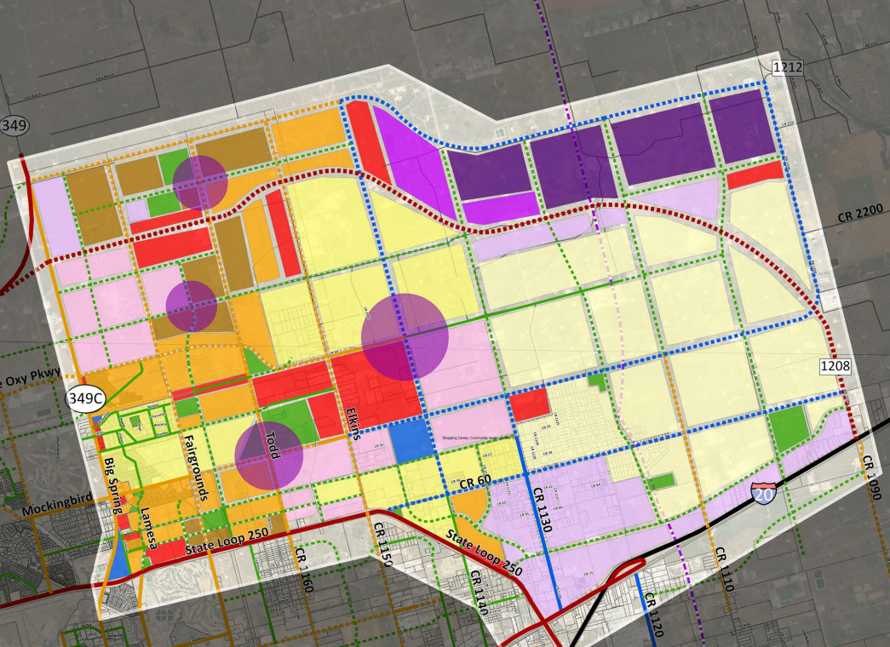
FY 2025 Key Deliverables
Strategy: 1.1 Increase the Midland Sales Tax Base
Improve shovel-readiness of key sites for destination retail and/or entertainment opportunities
Master plan Airport-owned land in Northeast Midland
Strategy: 1.2 Enhance Visitor Revenue Opportunities
Increase hotel uses in Downtown Midland
Begin or complete park facilities’ improvements to attract youth sports tournaments
20

Slide 21
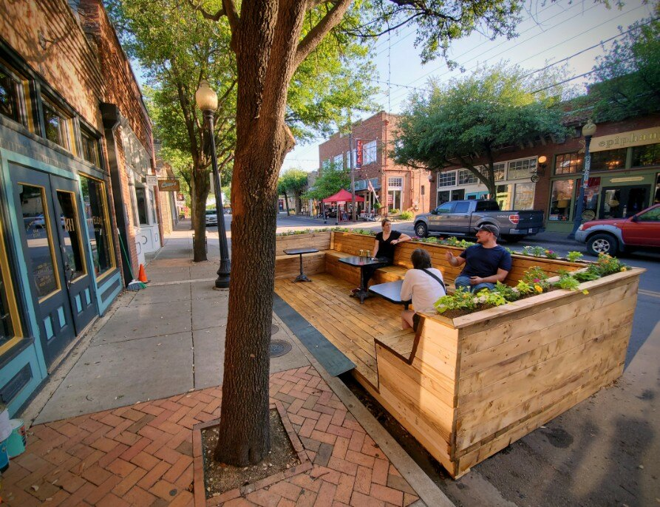
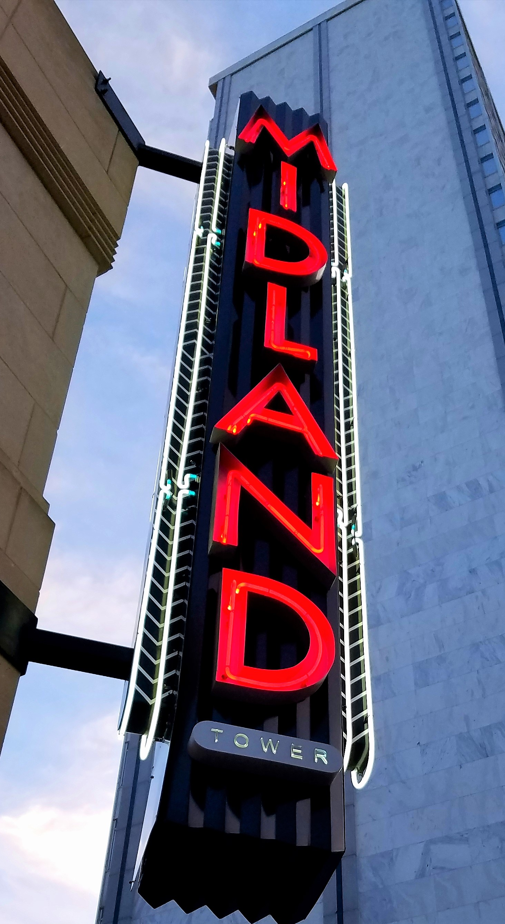
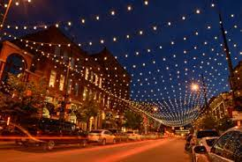
FY 2025 Key Deliverables
Strategy: 1.3 Continue Downtown and West Midland Redevelopment
Implement downtown parking management strategy
Adopt parklet ordinance to increase outdoor dining
Increase Downtown programming (e.g., Chalk the Block, holiday lights)
Enhance the Wall Street corridor with lighting and signage
Adopt two new tax increment reinvestment zones in west Midland to encourage retail development and leverage the sports complex as an economic driver
Partner with residential developers to develop master planned communities
21

Slide 22
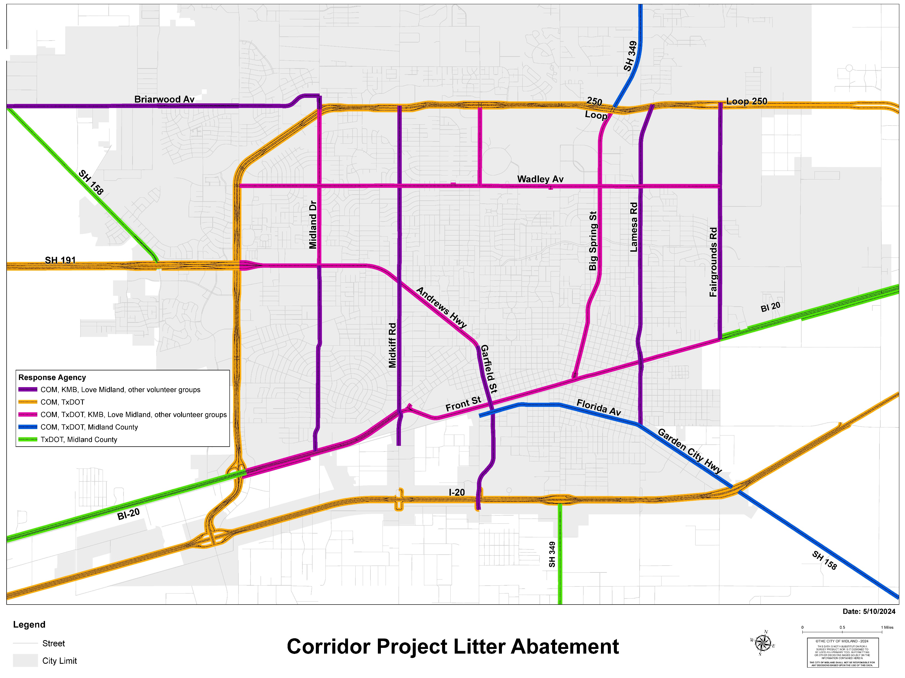
FY 2025 Key Deliverables
Strategy: 1.4 Nurture Development Districts
Implement economic development finance tools to drive development in key areas, including:
Incentive policy targeting downtown redevelopment and retail development
Tax increment financing to encourage continued growth of downtown and west Midland
Infill development policy to encourage commercial development along key corridors
Invest in enterprise zones using the COMPASS program, leveraging CDBG funding
22

Slide 23
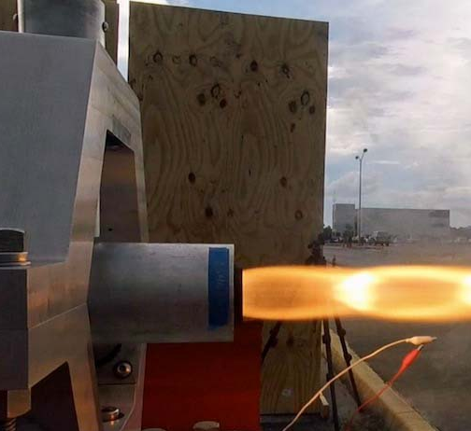
FY 2025 Key Deliverables
Strategy: 1.5 Grow the Core Business of Air Transportation
Complete airline negotiations and begin new lease agreements
Strategy: 1.6 Diversify Midland’s Economy
Adopt an incentive policy that targets retention and recruitment in key industries, including aerospace, in alignment with MDC targeted industries
Strategy: 1.7 Expand Opportunities and Programming for General and Small Business
Adopt small business incentive policy to include implementation of tools that increase small business access to capital
23

Slide 24
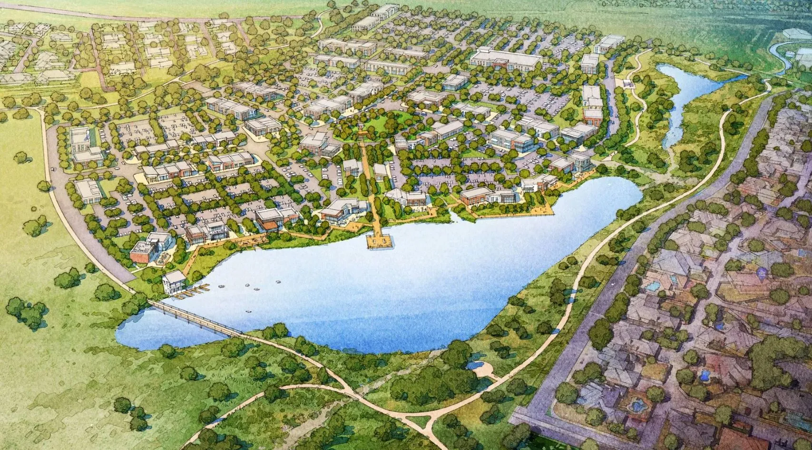
FY 2025 Key Deliverables
Strategy: 1.8 Improve Speed to Market for Citizens, Builders, Developers, and Contractors
Continue to reduce permit time to issuance through process improvements and leveraging technology
Implement online permitting portal
Begin development of inspection scheduling app
Facilitate permitting for major projects including: the Zoo, the Preserve, two MISD high schools
Strategy: 1.9 Establish Our Community as a Premier Destination for Retail and Entertainment
Recruit destination retail and/or entertainment opportunities
24
24

Slide 25
MISSION
Deliver exceptional services and promote a high quality of life and place for ALL our citizens.
25

