Slide 1

Goal Two
Safe and Secure City
FY 2025 Budget Presentation
July, 2024
1

Slide 2

Table of Contents
Priorities Focus
Major Variances
Expenses
FY 2024 Key Accomplishments
FY 2025 Key Challenges
FY 2025 Key Deliverables
2

Slide 3

Vision Block Connections
“The City of Midland will be the Premier and Safest City in West Texas by Providing World Class Municipal Services through Operational Excellence and a Culture of Innovation”
Safe City (Goal 2)
Provide Sound Governance & Fiscal Management (Goal 5)
3

Slide 4

Strategic Alignment
2. Set the Standard for a Safe and Secure City
Strategies:
2.1 Be the safest city in West Texas: Enhance public safety programs.
2.2 Improve pedestrian and motorist safety: Invest in traffic management and infrastructure.
2.3 Implement effective code enforcement strategies: Address nuisances to improve overall health and safety.
2.4 Revitalize neighborhoods: Utilize best practices to support the redevelopment of neighborhoods.
2.5 Enhance animal services: Ensure the welfare of pets and wildlife in the city.
2.6 Grow and retain public safety resources: Expand law enforcement presence and fire reduction & prevention programs while reducing attrition.
4

Slide 5
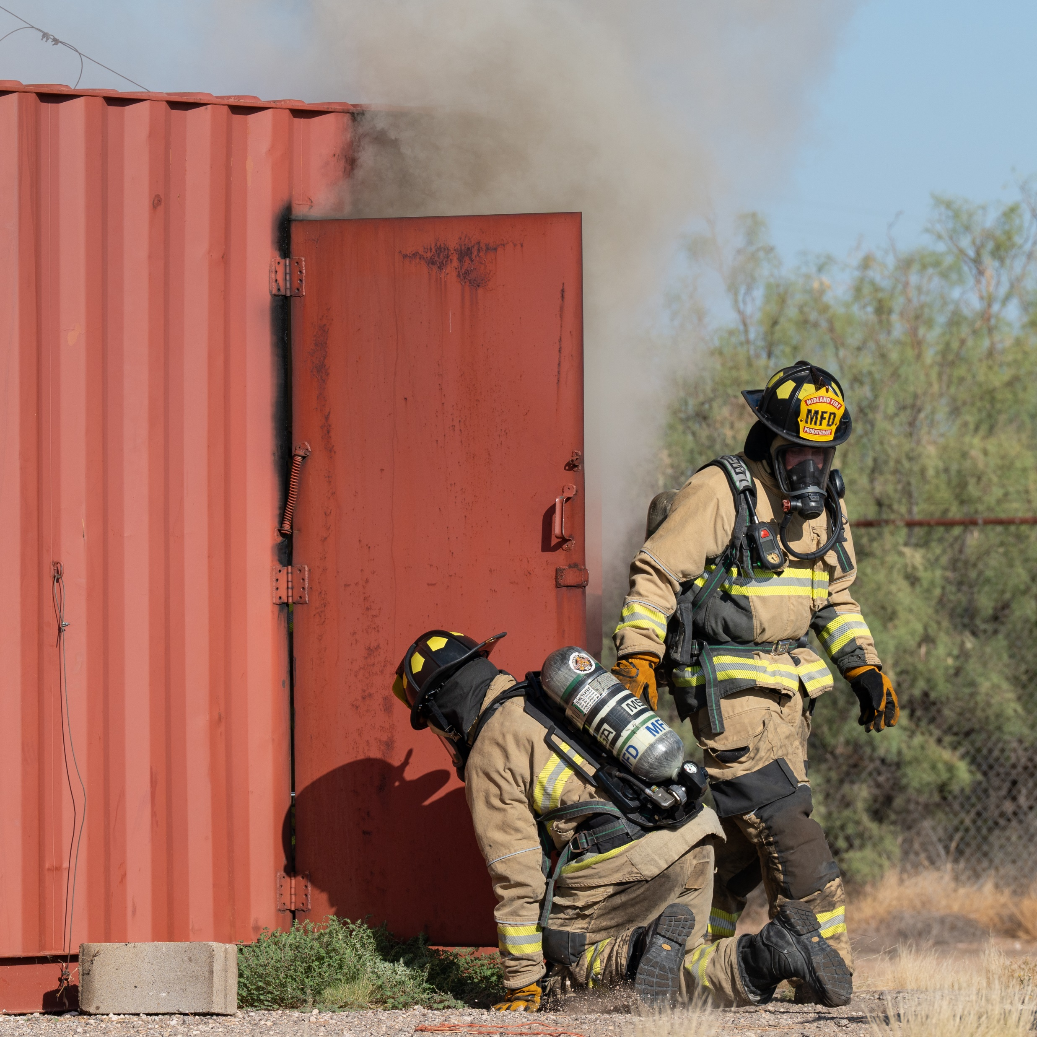
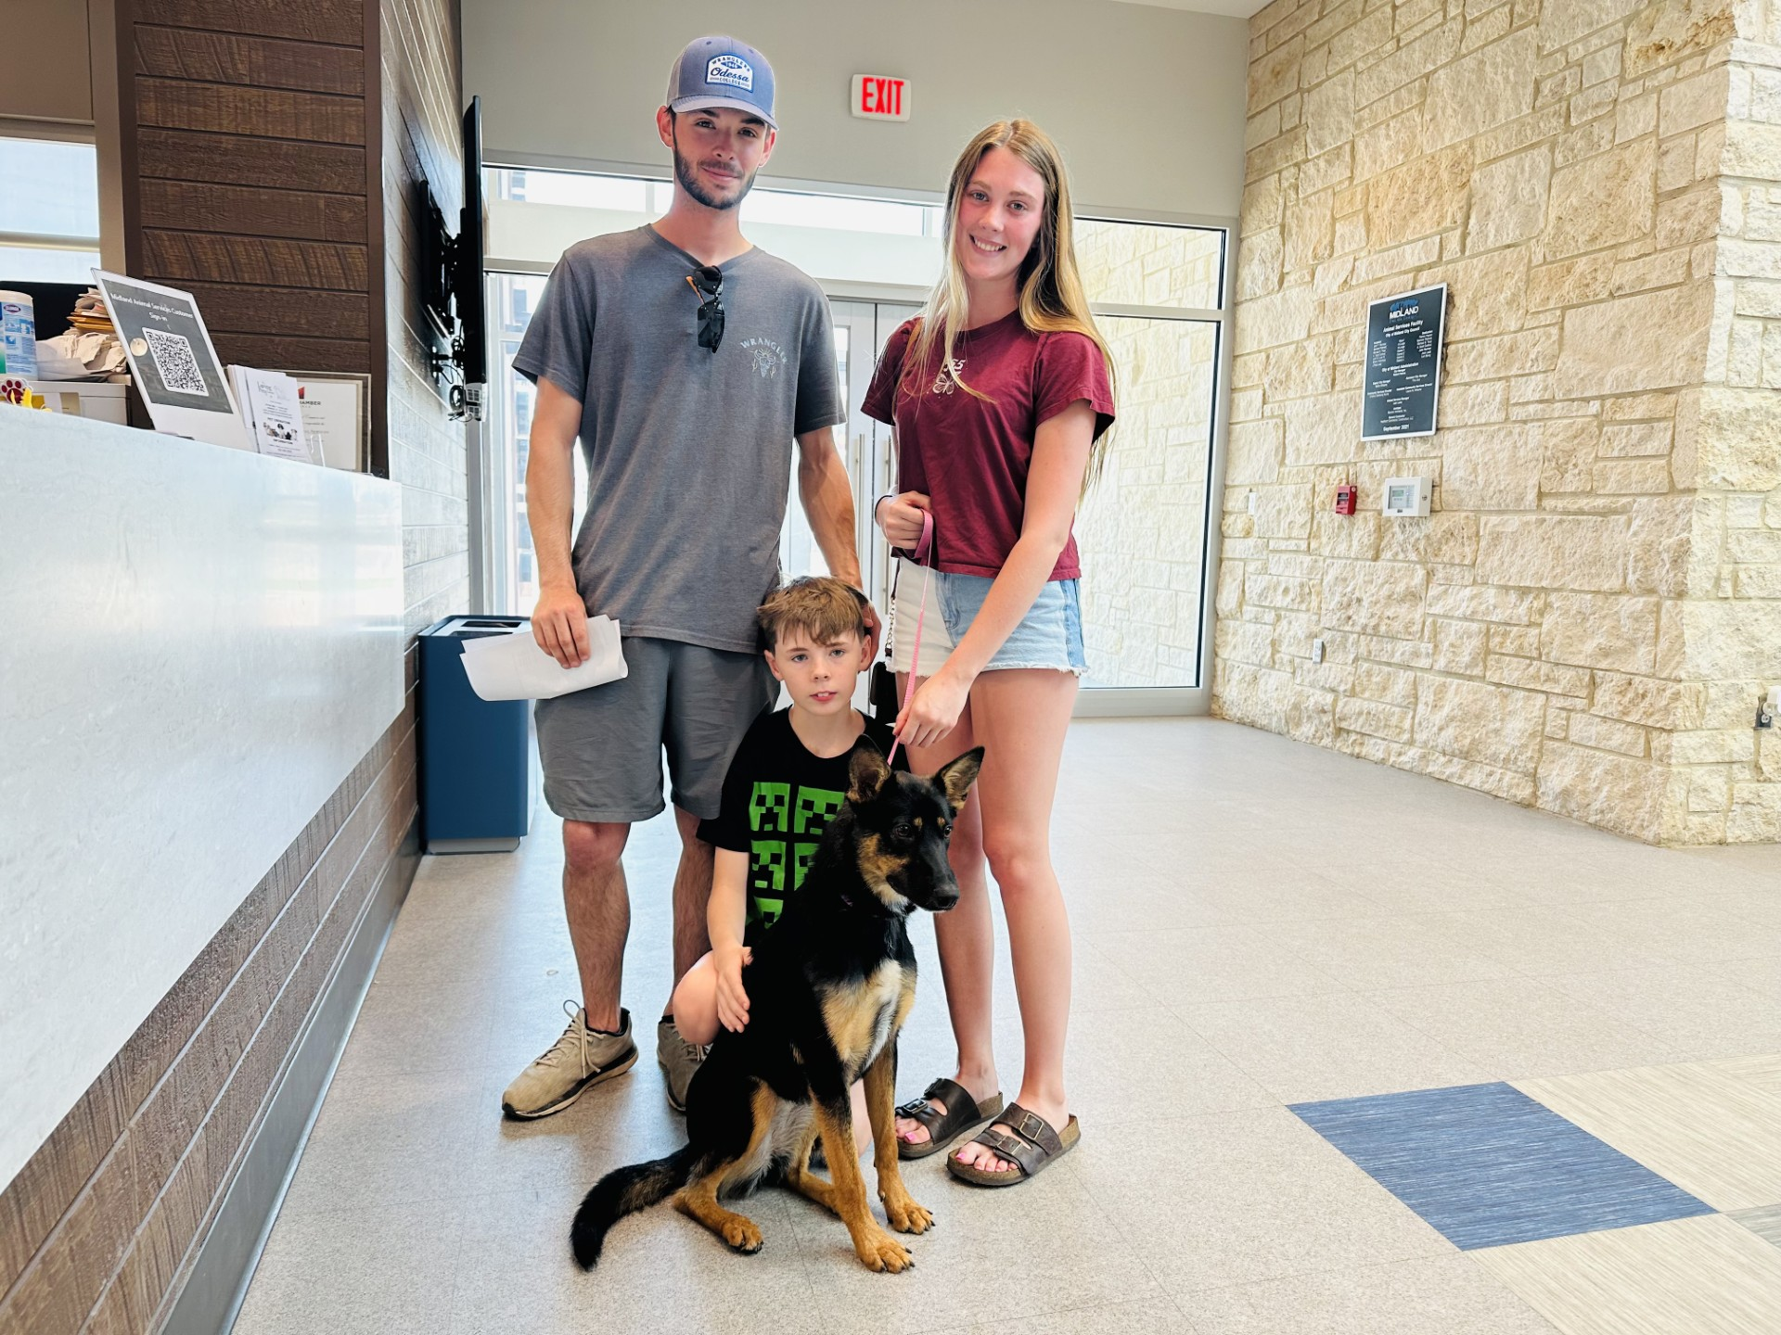
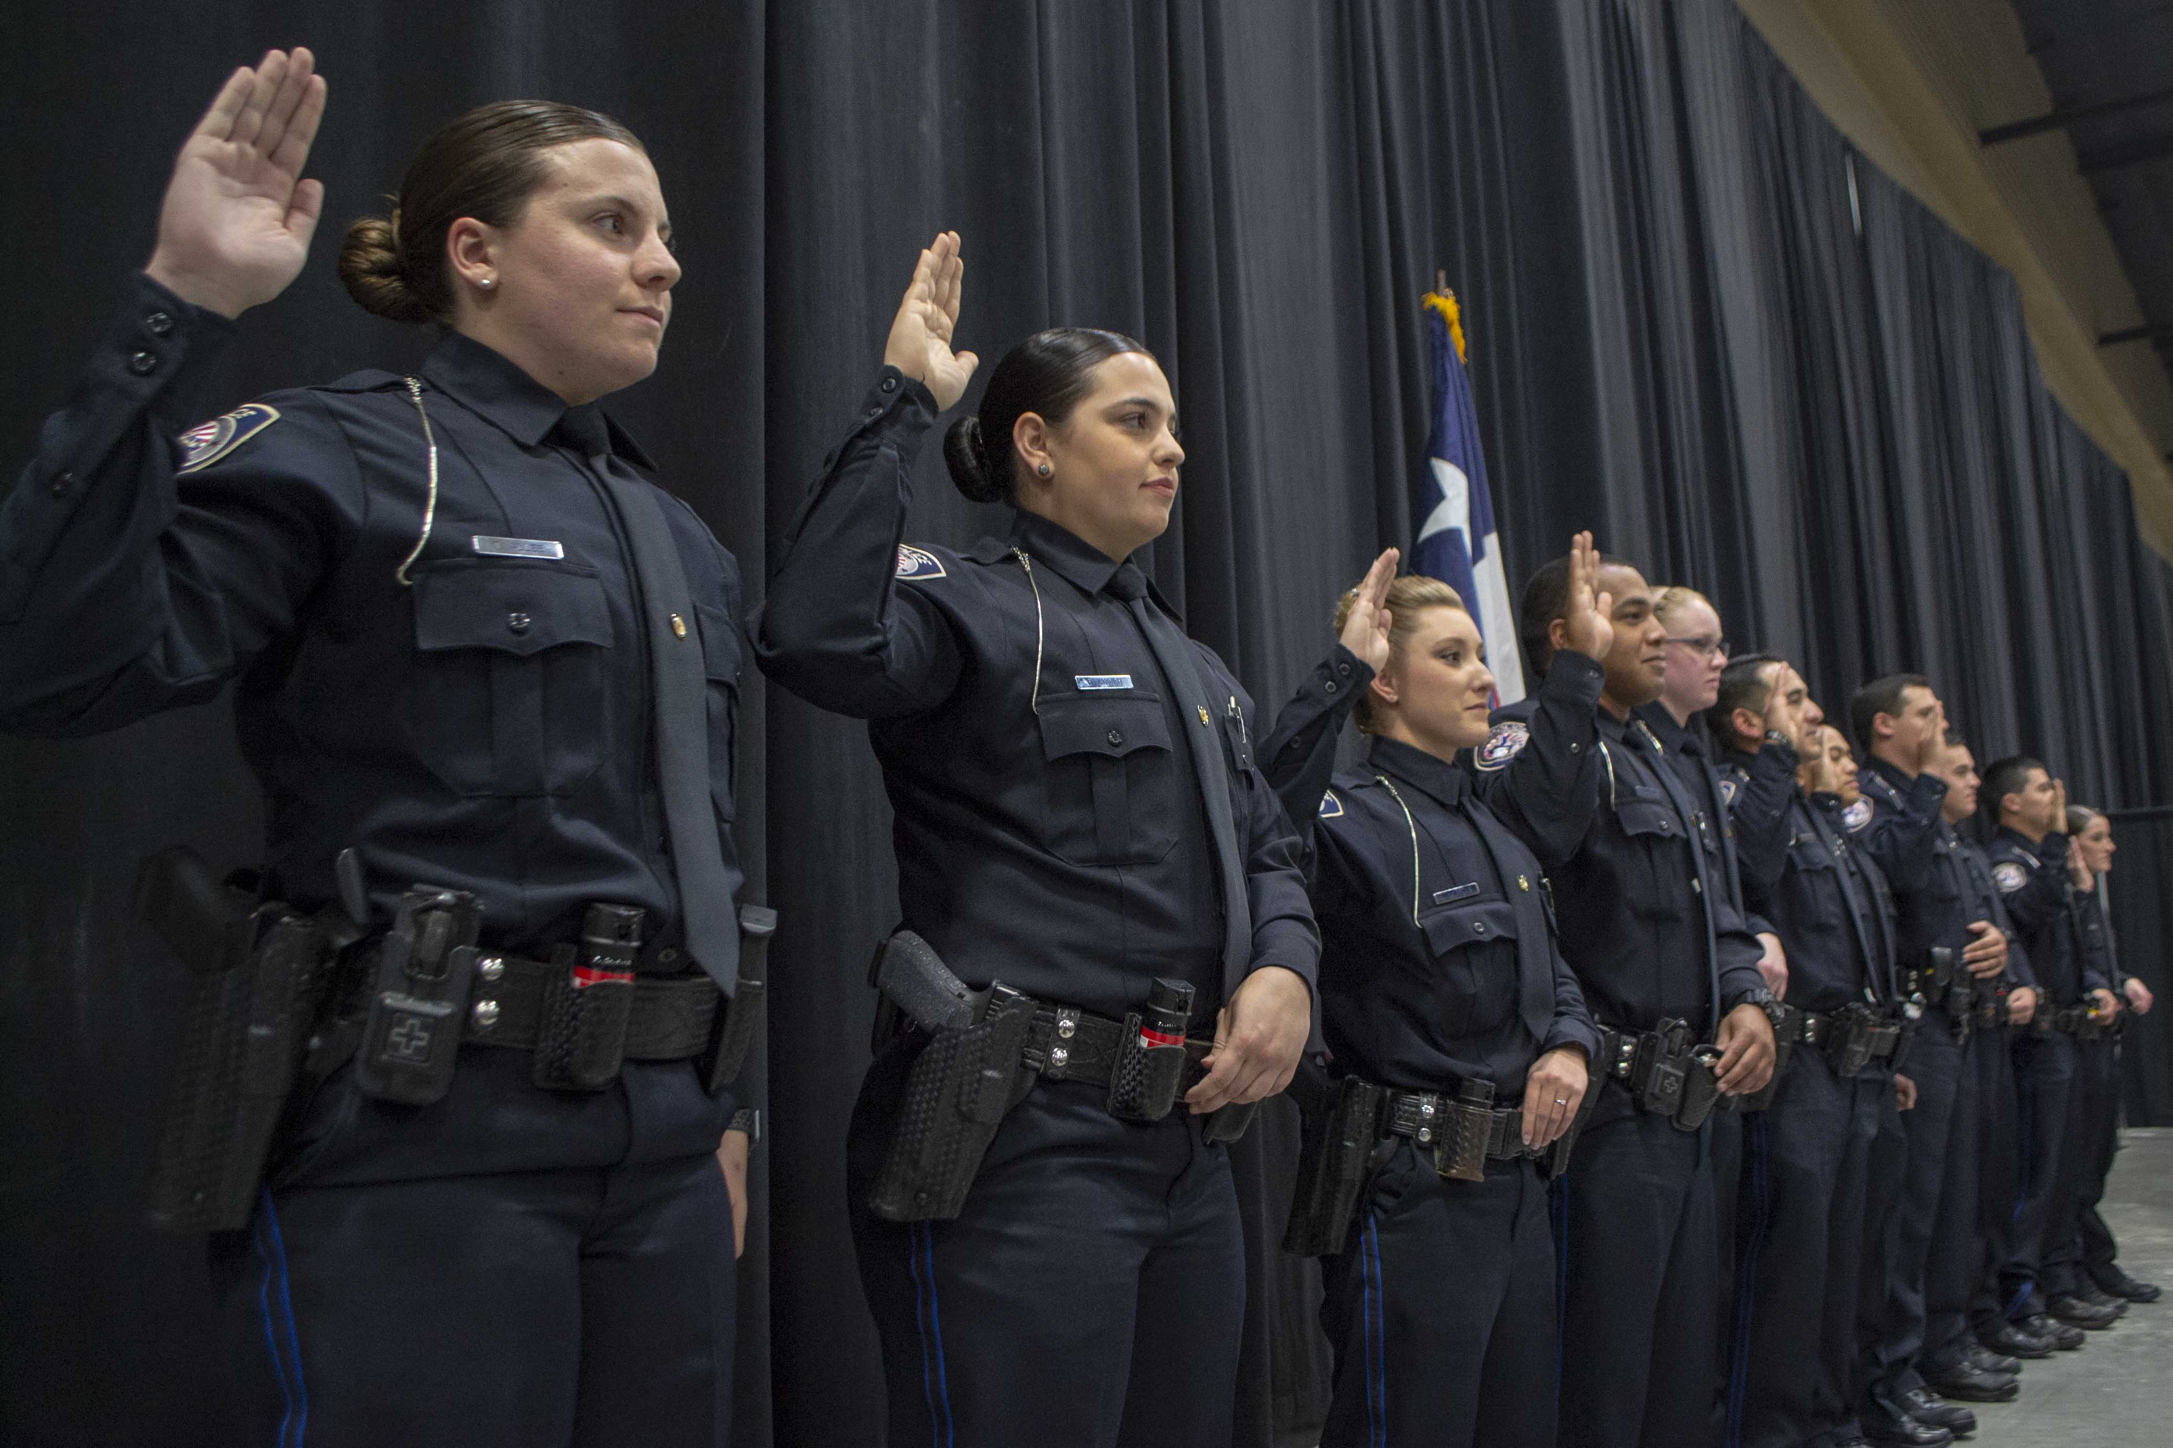
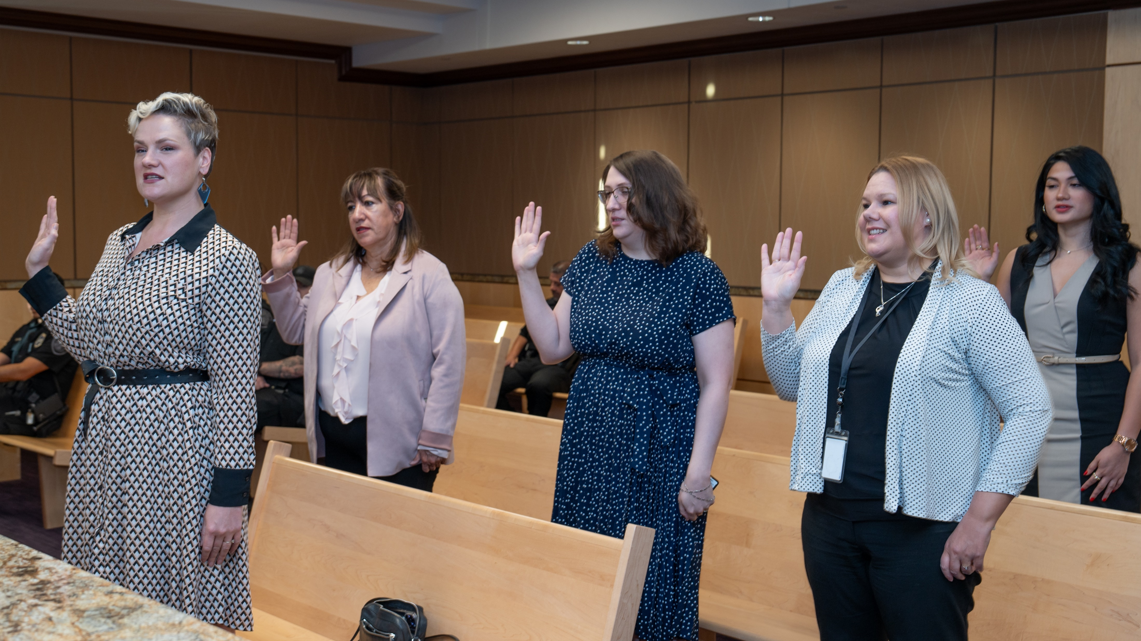
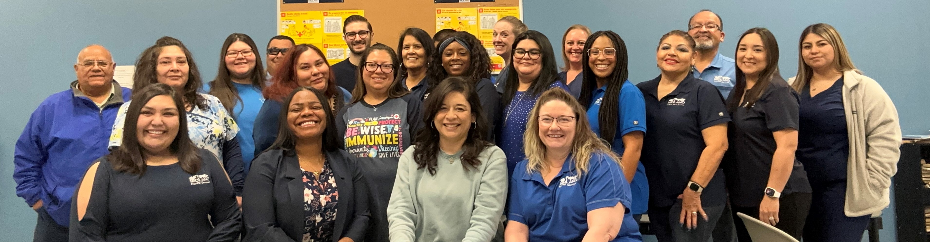
Departments
Organizational Alignment
Police Department
Fire Department
Animal Services
Health Department
Municipal Court
5

Slide 6

Safe and Secure City
FY 2025 ALL FUNDS BUDGET: $99,662,154
6

Slide 7

Goal Two: Safe and Secure City
Police Department
FY 2025 Priorities
Set the Standard for a Safe and Secure City
2.1 Be the safest city in West Texas: Enhance public safety programs.
  Enhance Public Safety Programs to Reduce Crime
  Strengthen Ties Within the Community Through Collaboration and Community Outreach
2.2 Improve pedestrian and motorist safety: Invest in traffic management and infrastructure.
  Enhance Public Safety Through Targeted Enforcement Campaigns
7

Slide 8
Goal Two Safe and Secure City
Fire Department
FY 2025 Priorities
Set the Standard for a Safe and Secure City
Implement IPAWS – Integrated Public Alert & Warning System
  Phone based notifications (In testing now)
Continuation of Class 1 ISO procedures
  Training, Response Model Evaluation, Inspection/Maintenance of Hydrants
Strengthening Strategic Partnerships
  Continue work with local, state, and federal partners
8

Slide 9

Goal Two Safe and Secure City
Animal Services
FY 2025 Priorities
Enhance Adoption Rates
Decrease Euthanasia Rate
Boost Return-to-Owner Success Rates
9

Slide 10
Goal Two
Health Department
FY 2025 Priorities
Intelligence technology for efficient resource utilization.
Improve technological systems for a more structured patient and customer experience
Community Health Needs Assessment to identify gaps in the health of the community
Employee development to remain knowledgeable on current public health practice
10

Slide 11
Goal Two
Code Enforcement*
FY 2025 Priorities
Transition to strategic code enforcement that is effective + efficient.
Plan: Use data to prioritize key health and safety issues and allocate resources
People: Train and provide ongoing education for code enforcement officers
Process: Evaluate and streamline processes, leveraging technology to reduce manual processes
Performance: Identify and track key performance indicators to measure effectiveness and efficiency – adjust as needed
11
*Although Code Enforcement is budgeted in Goal 1 with Development Services, its function is strongly connected to Goal 2.
Notes:
What is Code Enforcement?
Housing and building code enforcement is a system of laws and policies used by the City to seek compliance with minimum property standards in support of safe and healthy neighborhoods for all.
Why is it important?
Code Enforcement is a critical tool to improve community health, safety, quality of life, and neighborhood vibrancy.

Slide 12

Major Variances
Increase in personnel costs
Technology Costs and Needs Increased
12

Slide 13
Expenses by Department
13

Slide 14
Expenses by Type
14

Slide 15
Staffing
15

Slide 16
Key Accomplishments
Police Department
FY 2024
Accreditation-2023 marked the 30th year that the Midland Police Department has met the rigorous demands of CALEA’s Accreditation standards.
The Midland Police Department established its own Police Academy, staffed by MPD personnel and tailored to our unique demands. Through five academy classes, 41 recruits have successfully graduated.
Implemented and deployed the FLOCK camera system. So far, 145 vehicles and $8,040,691.00 worth of property have been recovered, and 178 warrants/arrests made.
The MPD cares about the mental health of its employees. As a result, MPD has engaged the services of a psychologist specifically trained to deal with the unique issues related to first responders and military personnel.
16

Slide 17
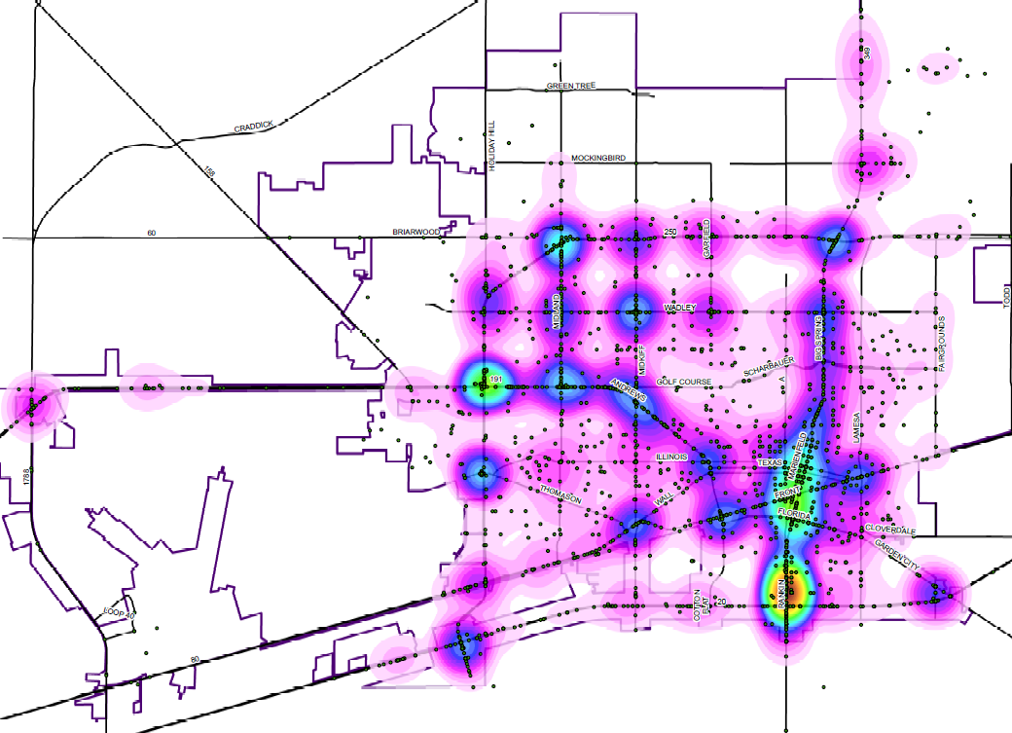
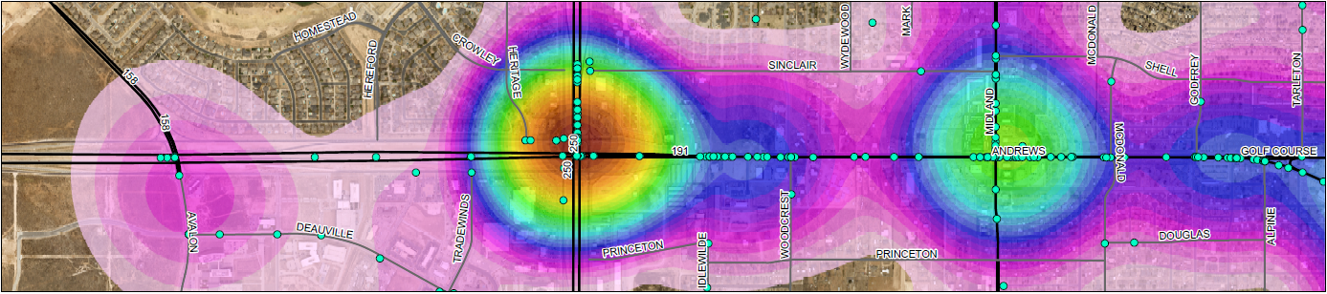
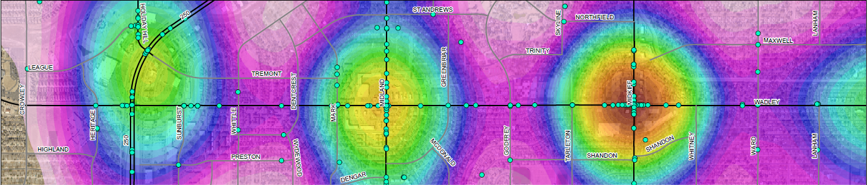
FY 2025 Key Deliverables
Midland Police Department
Enhance Public Safety Through Targeted Enforcement Campaigns on 10 of the Most Dangerous Intersections in Midland based on the Vision Zero Safety Action Plan:
  Midkiff/Wadley, Andrews Hwy/Midland, Midland/Wadley, Midkiff/Wall, Andrews Hwy/Loop 250, Andrews Hwy/Midkiff, Garfield/Wadley, Belmont/Longview, Andrews Hwy/Illinois, Midland/Loop250
  Since the Traffic Plan was rolled out on June 17, 2024, over 936 Traffic Stops have been made, 744 citations have been issued and at least 15 arrests made.
  *Maps provided through collaboration with COM Engineering/Traffic.
Andrews Hwy
Wadley
17

Slide 18


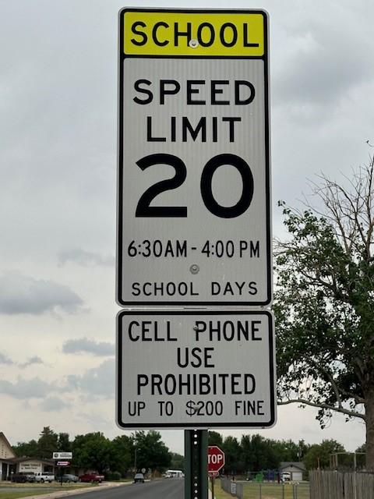
FY 2025 Key Deliverables
Midland Police Department
Enhance Public Safety Through Targeted Enforcement Campaigns
  Campaigns in development:
    Safe Intersection Initiative
    Red For a Reason
    School Zone Initiative
    Lock it or Lose It
    Speeders Beware
18

Slide 19
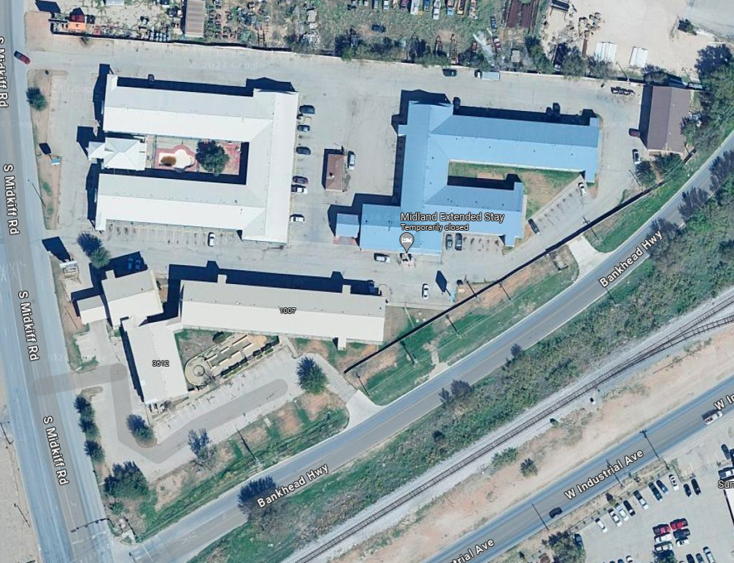
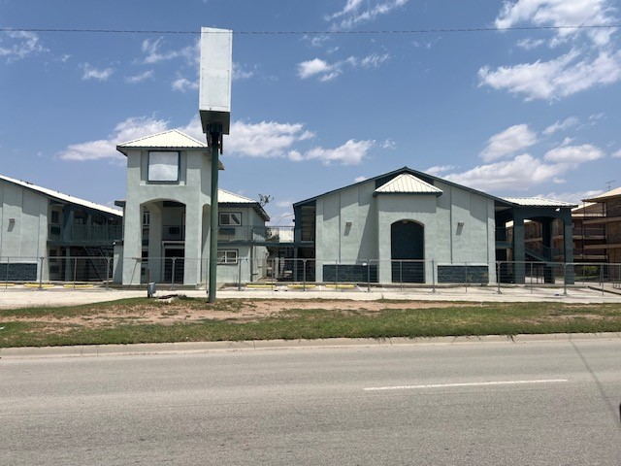
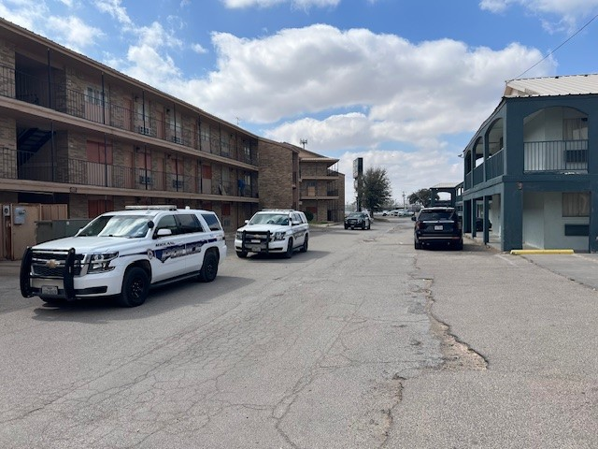
FY 2025 Key Deliverables
Midland Police Department
Collaboration between Water, Code Enforcement, and the PD to address the Triangle: America's Best Value Inn, Midland Extended Stay, and OYO
  Conducted inspections to identify a number of residents, living conditions, and safety hazards.
  Collaborated with Isaac Garnett to provide displaced residents with shelter options.
  Criminally Trespassed non-compliant squatters
  Property owner provided the opportunity to restore to a safe and habitable condition.
19

Slide 20



FY 2025 Key Deliverables
Midland Police Department
As the City of Midland and the Permian Basin Grows, We Grow Together
We Will Strengthen Ties Within the Community Through Collaboration with other Law Enforcement Agencies
  The Midland Police Department spearheaded and continues to support the Permian Basin Violent Crime Task Force (PBVCTF), a multi-agency collaboration that includes MPD, OPD, ECSO, DEA, and FBI.
  The Midland Police Department spearheaded and continues to support the High Intensity Drug Trafficking Areas (HIDTA) in our region, a multi-agency collaboration that includes MPD, OPD, ECSO, and DEA.
  The Midland Police Department maintains Task Force Officers (TFOs) with many Federal Agencies including the FBI, DEA, and HSI.
20

Slide 21
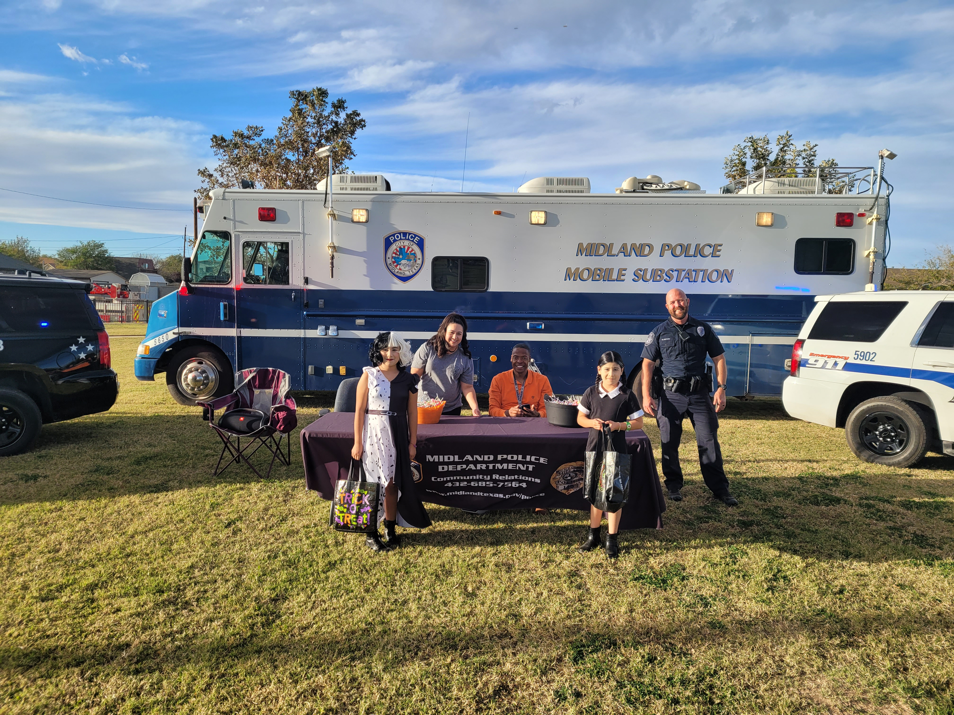
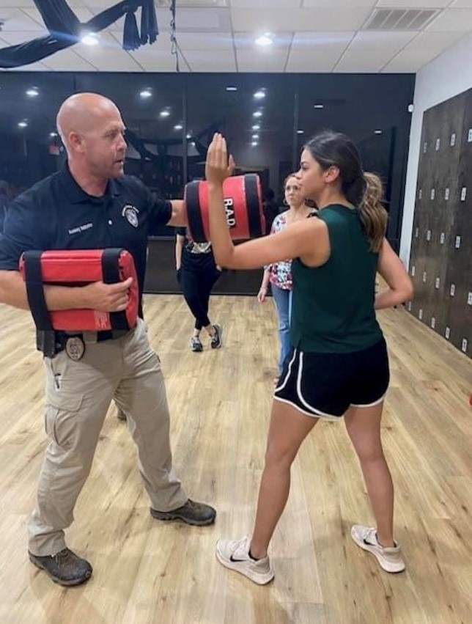
FY 2025 Key Deliverables
Midland Police Department
As the City of Midland and the Permian Basin Grows, We Grow Together
We Will Strengthen Ties Within the Community Through Collaboration and Community Outreach
  The Midland Police Department Provides Several Successful Community Outreach Programs:
    Texas National Night Out
    Trunk-or-Treat
    Blue Santa
    Coffee with a Cop/Donuts with A Cop
    Rape Aggression Defense (RAD) System
21

Slide 22
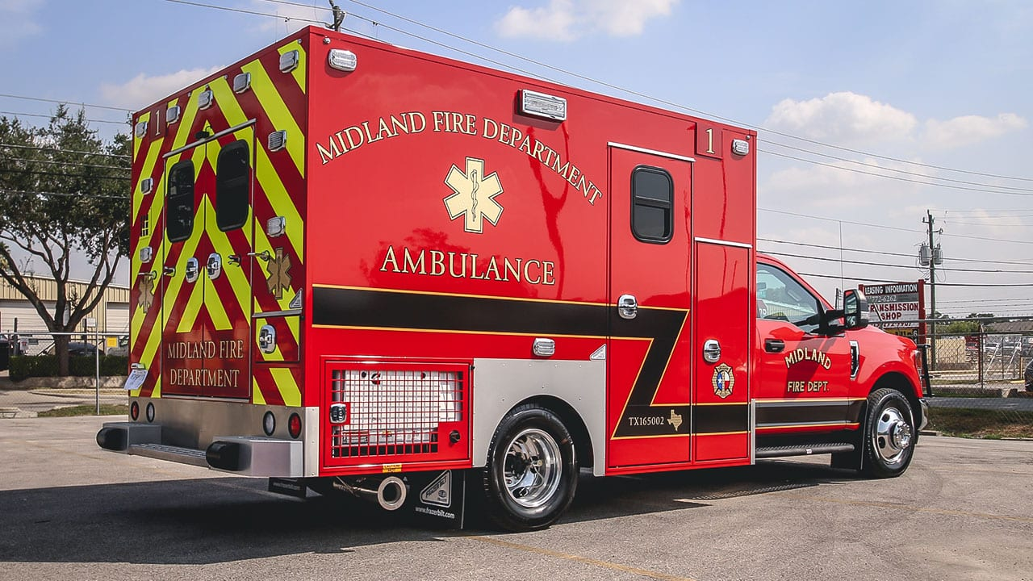
Key Accomplishments
Midland Fire Department
FY 2024
Addition of 8th front line ambulance
  In service 1/2/24
  EMS4 – 785 responses thru 7/1/24
  8.33% of all EMS response
22

Slide 23
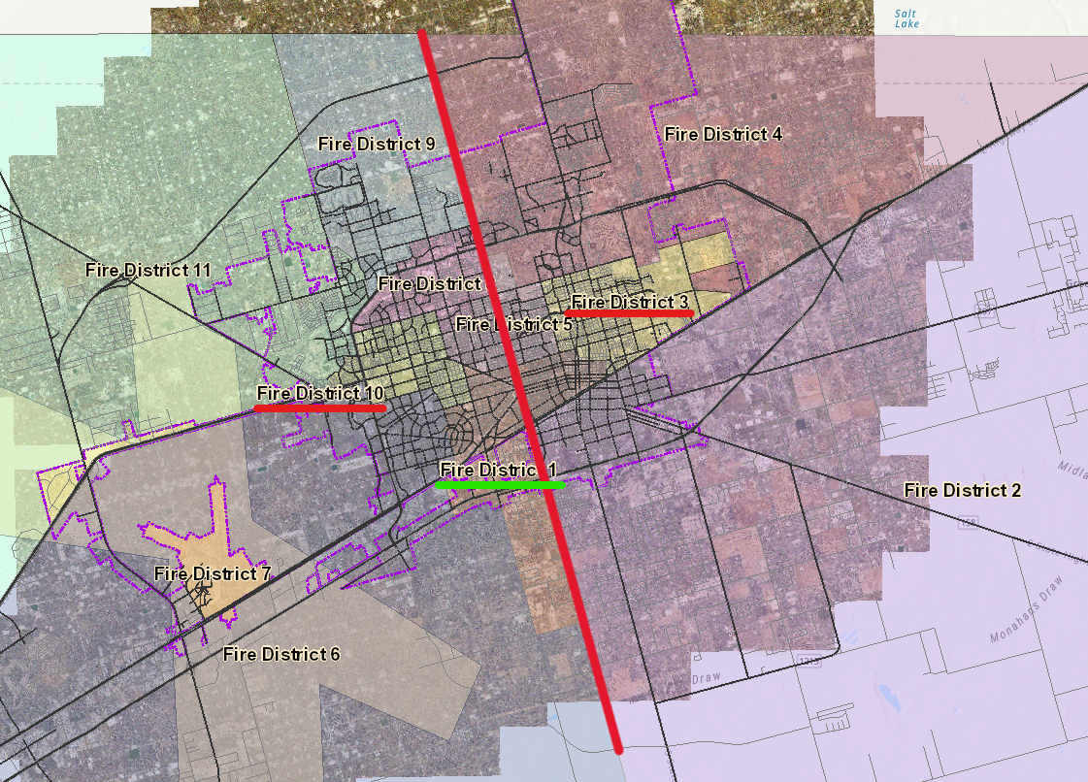
Key Accomplishments
Midland Fire Department
FY 2024
Third aerial apparatus added to response model
  Meets ISO standard of two aerials at all structure fires within City limits.
23

Slide 24
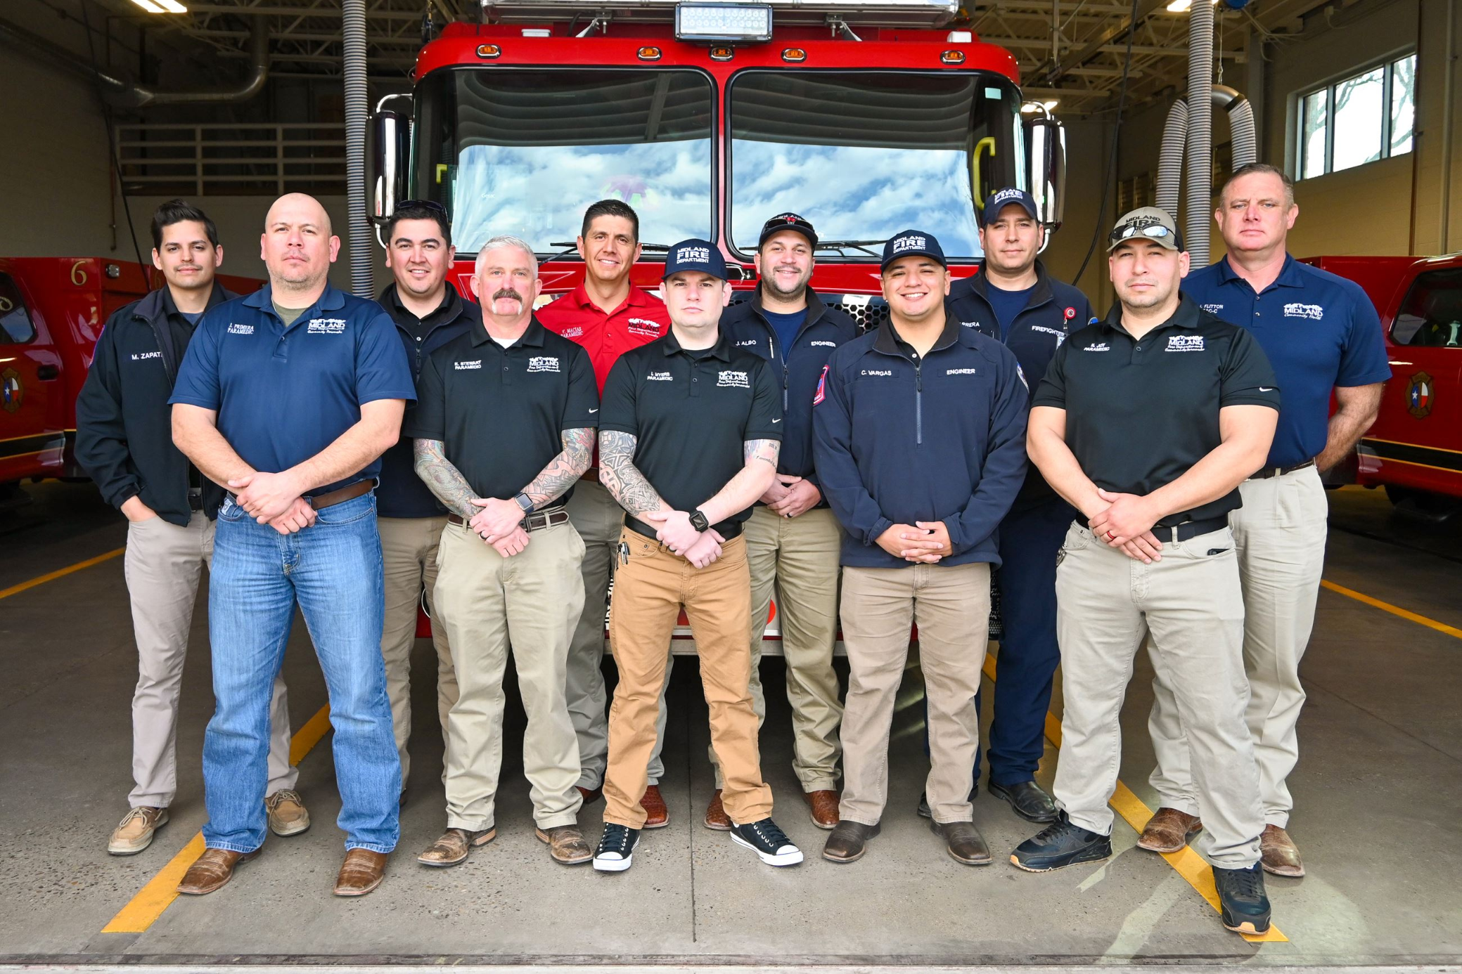
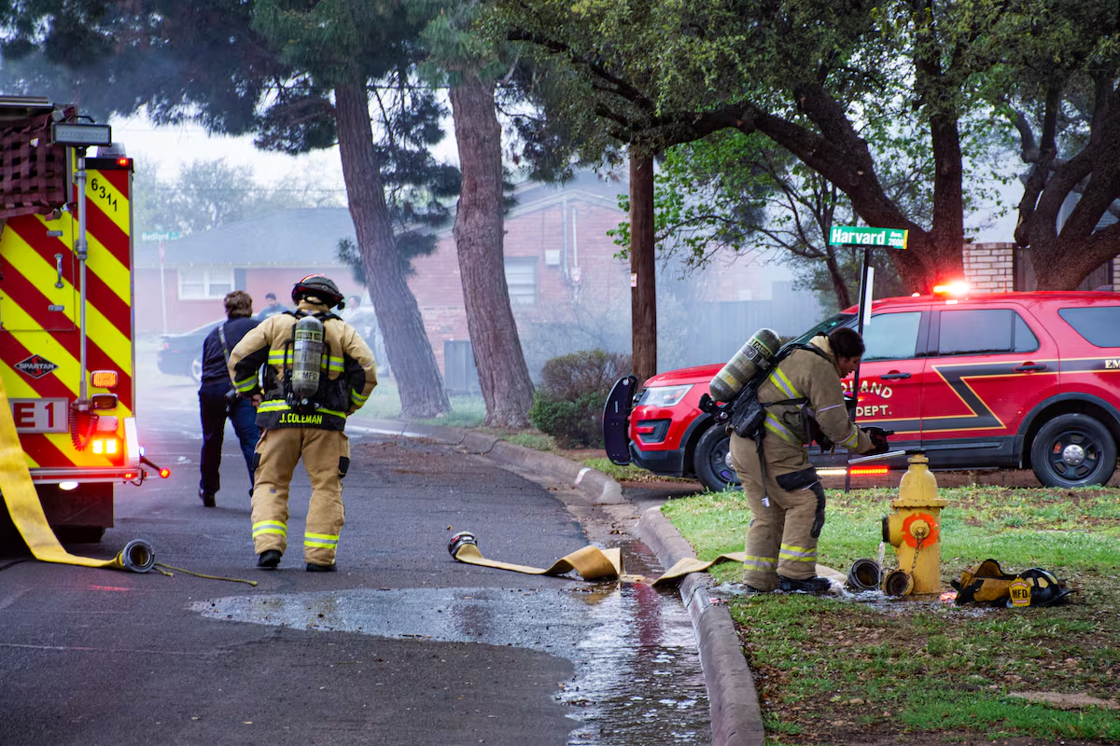
Key Accomplishments
Midland Fire Department
FY 2024
Two City-wide CPR classes
  40+ Employees Trained
  20+ CPR Certified
PPE risk assessment and wear test
  National Fire Protection Association (NFPA) Standard 1851 requirement
24

Slide 25
FY 2025 Key Deliverables
Strategy: Be the Safest City in West Texas
Fire Department
Health and Wellness initiative
  Launch wellness programs focused on physical and mental health.
  Provide access to support services and resources.
Community outreach
  Expand public education programs.
  Increase community engagement with all stakeholders including local, state, and federal agencies.
Emergency Preparedness
  Enhance response capabilities through training.
  Increase community awareness through education.
Improve EMS collection and billing
  Create RFP for third-party EMS specific services.
25

Slide 26
Key Accomplishments
Animal Services
FY 2024
Increased the number of animals released to rescue partners from 697 in 2022 to 804 in 2023.
Achieved an annual live release rate of 72.78%
Facilitated the adoption of 1,479 animals
Responded to 6,410 requests for assistance
Participated in numerous community events such as "Bark in the Park," "Fire Truck or Treat," and "KWEL Pawlidays," fostering community involvement and promoting responsible pet ownership.
26

Slide 27
FY 2025 Key Deliverables
Animal Services
Enhanced Community Outreach and Pet Identification:
  Implementing new initiatives to strengthen community engagement, utilizing our partnership with Petco Love Lost, and offering free microchipping services to improve pet identification and recovery.
Targeted Adoption Campaigns:
  Developing and executing targeted adoption campaigns during historically lower adoption months to boost adoption rates for both dogs and cats.
Increased Community Education:
  Expanding public education efforts on responsible pet ownership, wildlife cohabitation, and prevention of animal bites through outreach.
27

Slide 28
Key Accomplishments
Health Department
FY 2024
7,481 patients seen for immunization
973 Health Inspections completed
16 vaccine clinics held at the Midland Health Department and off-site
956 patients seen for STI services
389 Texas notifiable condition investigations
*Many of these activities are State Mandated
28

Slide 29
FY 2025 Key Deliverables
Health Department
Be proactive instead of reactive in response to emerging diseases.
  Established arbovirus surveillance with two identified locations; working on third.
Identify gaps in health services and connect residents with resources.
  Introduced Wellness Wednesday at the Health Department where community partners can speak to patients about various services provided.
  Started community services referral process to make sure patients have various needs met, even those we may not provide services for.
Strengthen relationships with community partners.
  Collaboration with NewsWest9 to highlight public health and nutrition.
  Annual Spring Health Fair and Annual Fall Festival and Resource Fair that allows for the diverse partnerships to flourish and new ones to form.
29

Slide 30
Data Analysis: Identified drop in code enforcement activity
Industry Standards: Recommend 1 code officer per 10k population
Staff Increase: Added 3 FTEs in Q1 CY2024 (from 6 to 9 FTEs)
Results: 60% increase in average monthly activity, exceeding CY2023, aligning with CY2022 levels
Future Focus (FY25): Shift to measure effectiveness + efficiency
Key Accomplishments
Code Enforcement FY 2024
3 New FTEs Added
655 Cases (2022)
687 Cases (2024)
570 Cases (2021)
425 Cases (2023)
30

Slide 31
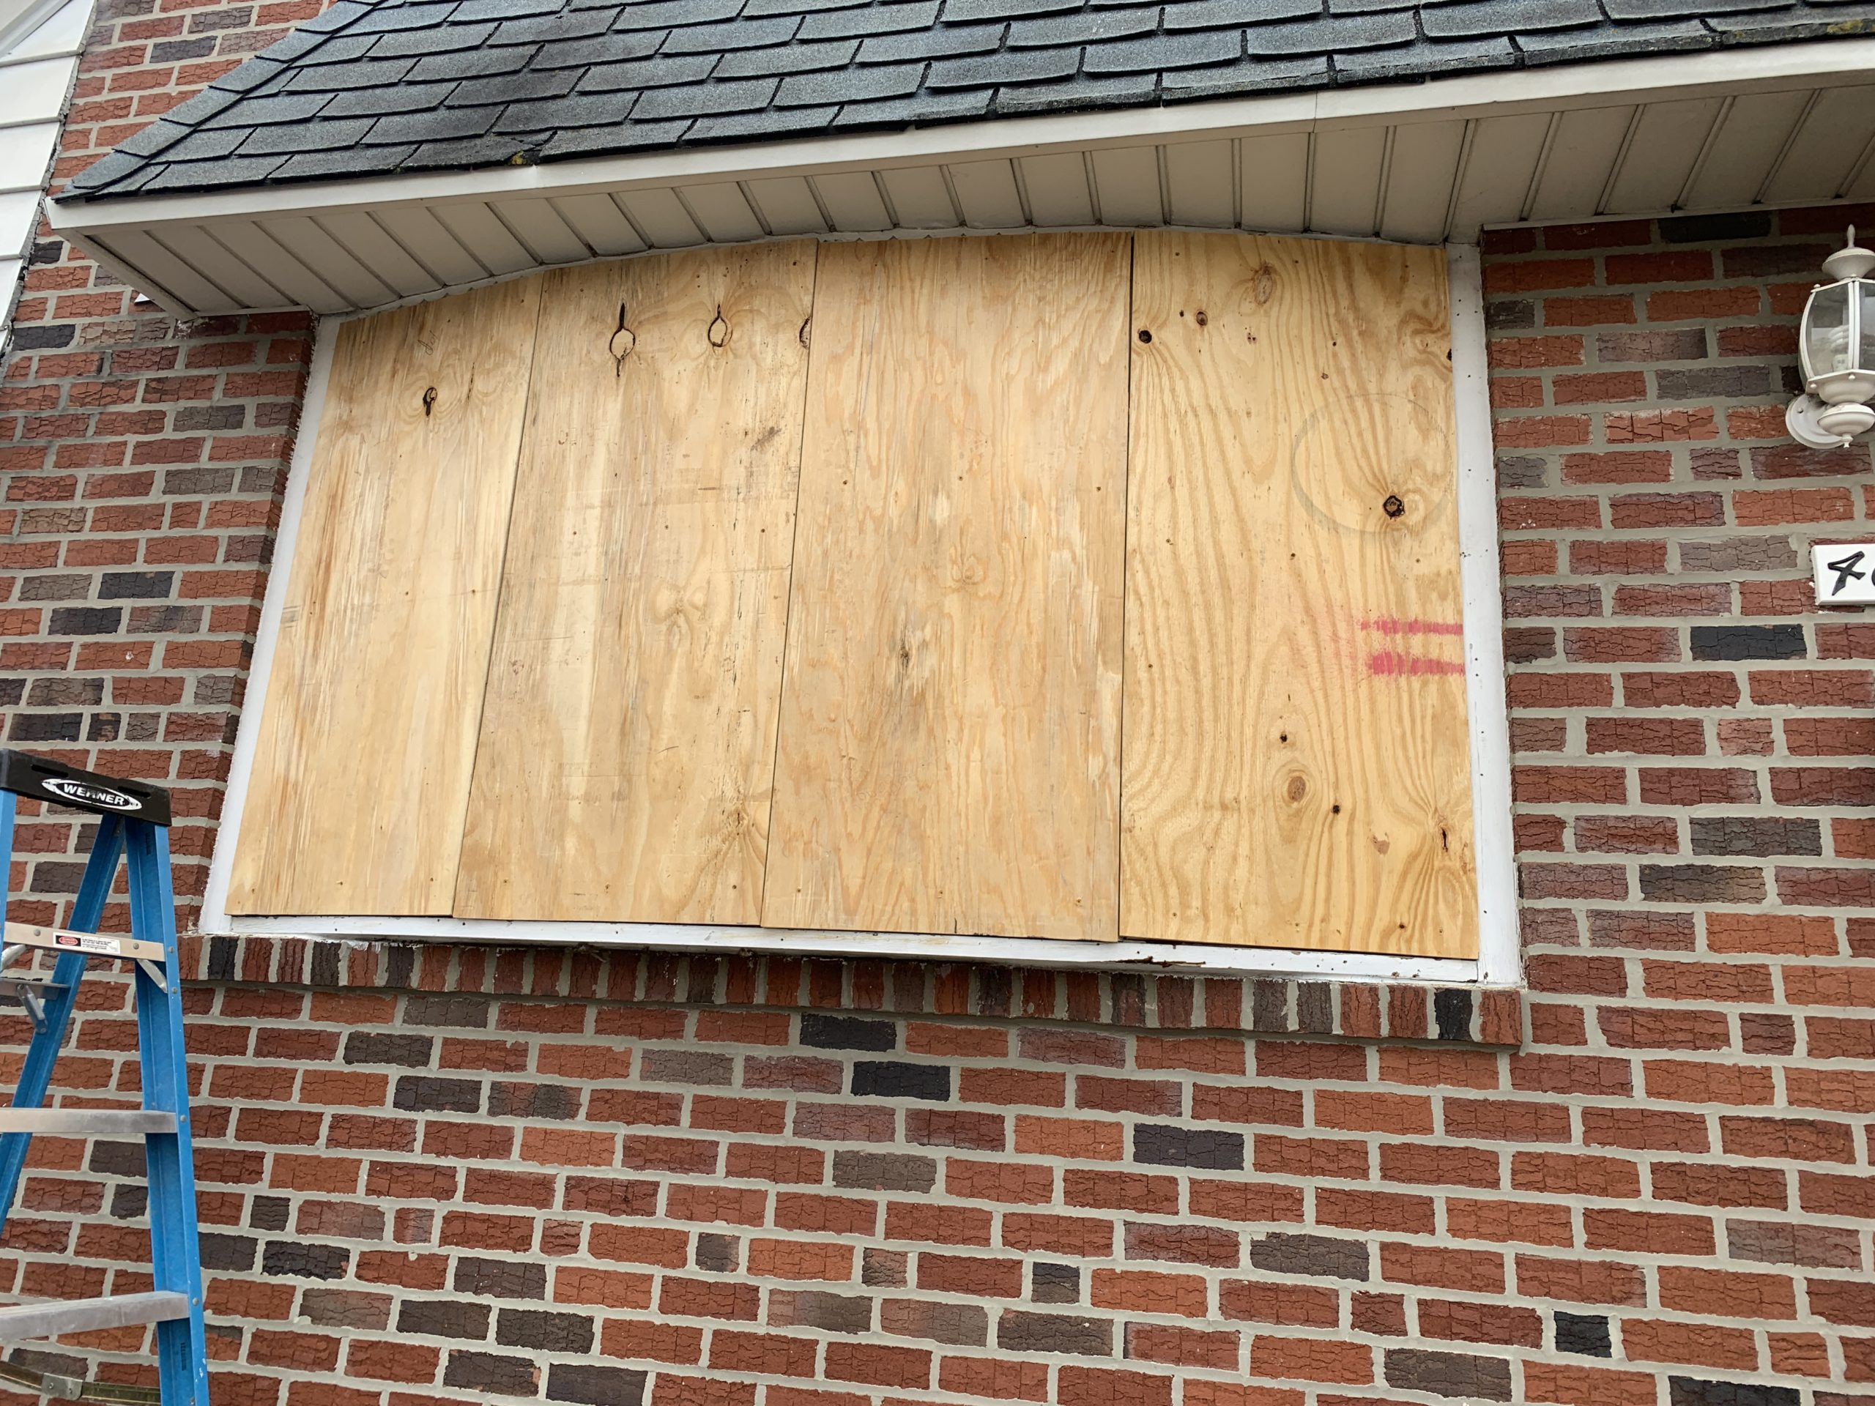
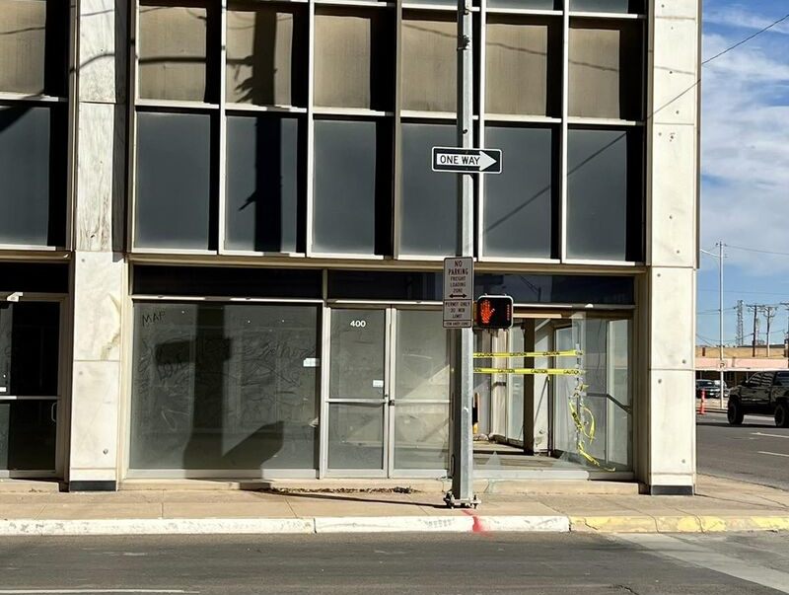
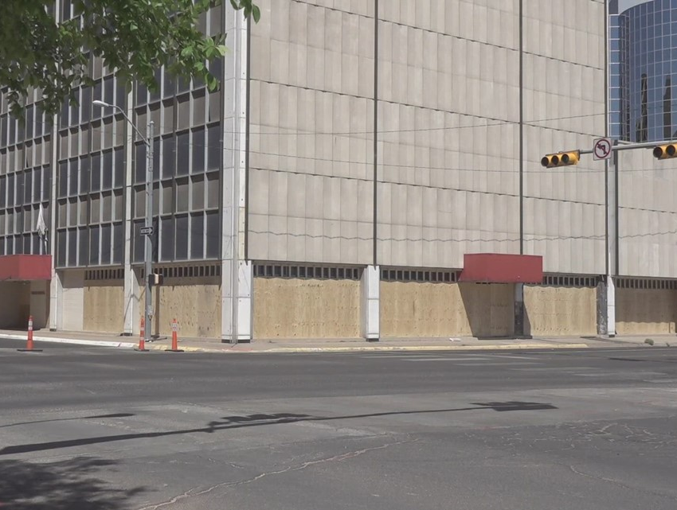
Key Accomplishments
Code Enforcement FY 2024
Before 03/24
After 04/24
Process Improvement: Secure process for vacant, dangerous buildings streamlined via ordinance
Case Application: Prominent unsecured + vacant Vaughn Building in downtown Midland
Result: Vaughn Building successfully + efficiently secured; cost recovered from owner
31

Slide 32
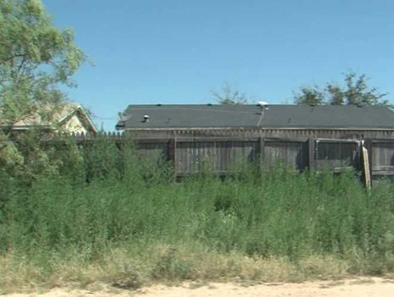
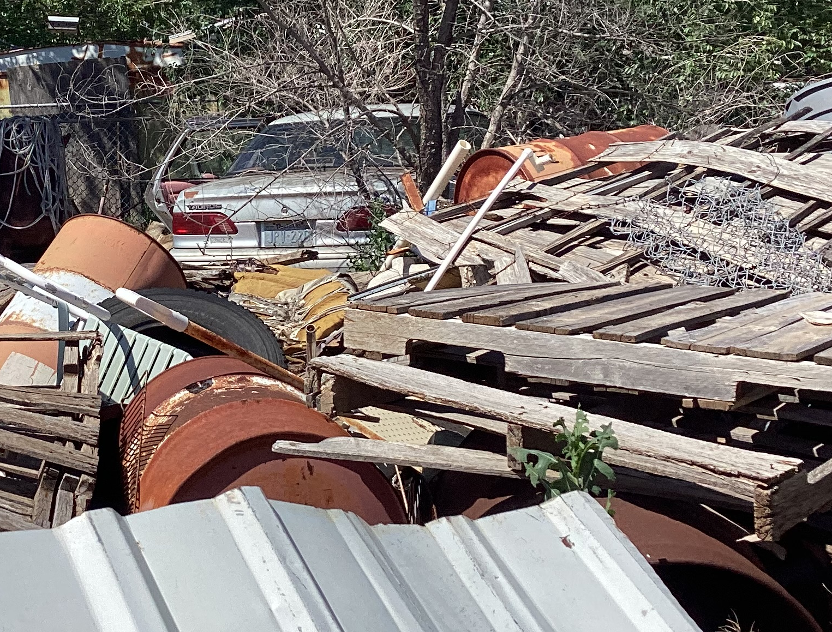
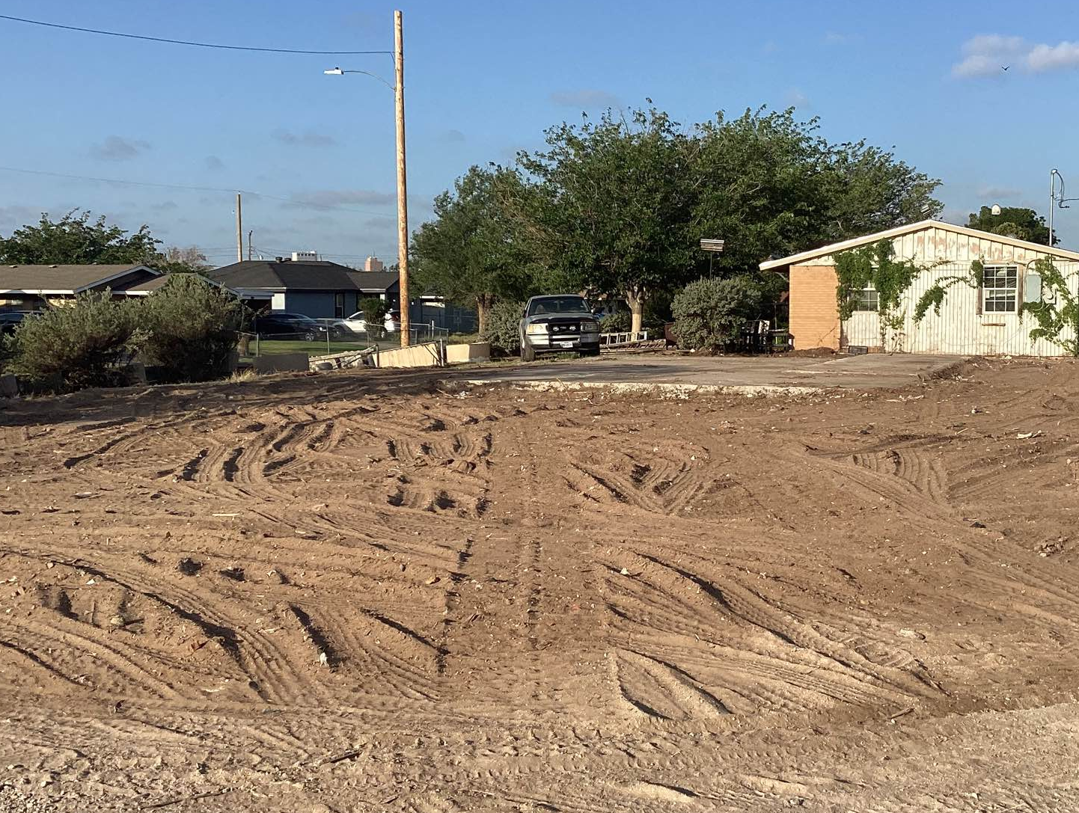
Key Accomplishments
Code Enforcement FY 2024
Before 06/24
After 07/24
Process Improvement: Abatement process for weeds + junked lots streamlined via administrative change
Case Application: Severely junked vacant single-family residence causing public health + safety issue
Result: Lot cleared within 30-days of notice of violation
32

Slide 33
FY 2025 Key Deliverables
Code Enforcement*
2.1 Be the Safest City in West Texas
Develop and implement strategies to address dangerous buildings (substandard, vacant, and/or abandoned)
2.3 Implement Effective Code Enforcement Strategies
Achieve 50% proactivity rate and 70% compliance within 30 days
Adopt property maintenance standards for efficient nuisance resolution
2.4 Revitalize Neighborhoods
Expand CDBG-funded home repair program through partnerships + grants
Develop a commercial infill incentive program for key corridors
33
*Other divisions of Development Services may lead some initiatives

Slide 34
MISSION
Deliver exceptional services and promote a high quality of life and place for ALL our citizens.
34

